Slide 1
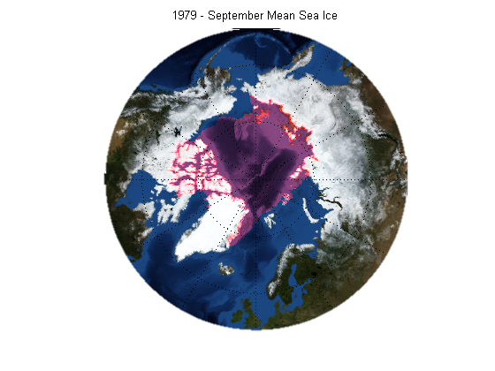
Working with Scientific Data in MATLAB
Nick Haddad
Software Engineering Manager
MathWorks
Notes:
We’re Hiring!!!

Slide 2

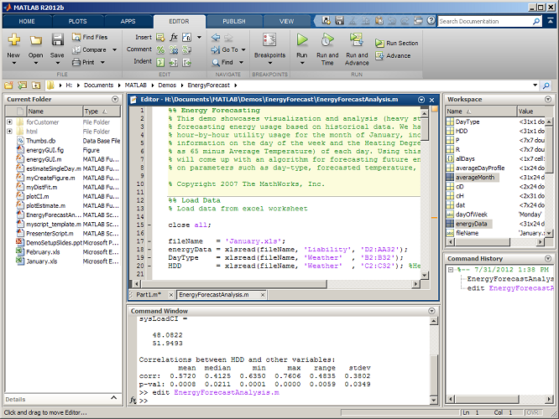
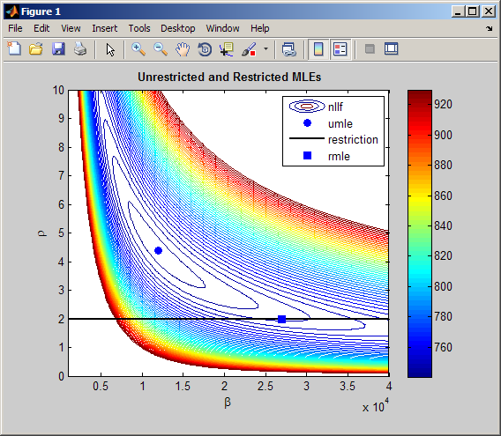
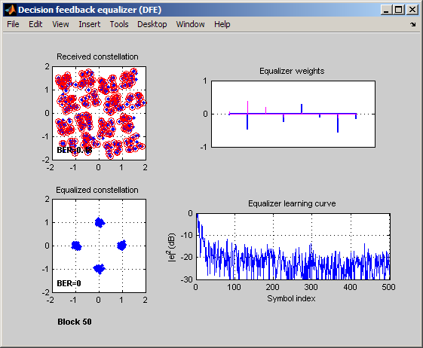
The leading environment for technical computing
The industry-standard, high-level
programming language
for algorithm development
Numeric computation
Parallel computing, with multicore and
multiprocessor support
Data analysis and visualization
Toolboxes for signal and image
processing, statistics, optimization,
symbolic math, and other areas
Tools for application development
and deployment
Foundation of MathWorks products
Notes:
MATLAB, our first core product, is the leading environment for technical computing. It is also the foundation of MathWorks products.
People apply MATLAB to a broad range of applications, including signal processing, control system analysis, image processing, and general data analysis. That’s one reason why MATLAB (is/can be) used so widely throughout (your organization/organizations like yours/your industry).
MATLAB addresses this range of applications by offering a core set of technical computing capabilities. These include:
* Fast and robust numeric computation, with over 1000 algorithms geared to engineering and science
* Engineering graphics and visualization tools
* A high-level programming language that has become an industry standard for developing and sharing algorithms
* Add-on toolboxes, providing additional functions for specific areas, such as signal and image processing, control system design, statistics, symbolic math, and other areas
Optional elaboration:
When people describe MATLAB, they generally talk about it as one of two things:
* An interactive, exploratory analysis and visualization environment
* A programming environment
In fact, it’s both. The math, graphics, and language can be applied in either way, and these two modes can be mixed. You can use MATLAB as an exploratory environment, iteratively trying out math functions and plotting results until you’re satisfied with the resulting analysis. And you can use that same MATLAB language to develop functions and applications that you can reuse and share with others. The mode you use really depends on your style and your end goal. The benefit of this is that you can do your thinking and your programming in a single environment.

Slide 3
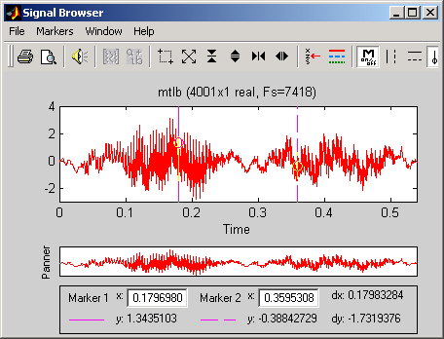
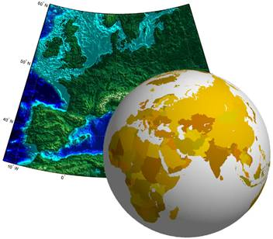
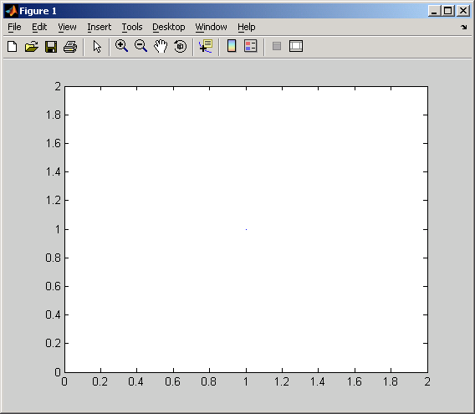
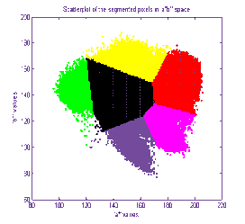
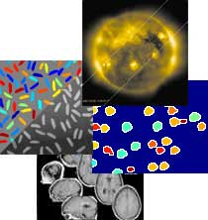


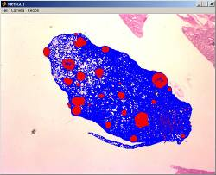

Go Farther with MATLAB and Toolboxes
_{Signal Processing Toolbox}
_{Mapping Toolbox}
_{Statistics Toolbox}
_{Image Processing Toolbox}
_{Database Toolbox}
_{Image Acquisition Toolbox}
_{MATLAB Compiler}
Notes:
Note to presenter: Use this slide to show that we have a number of toolboxes that extend the capabilities of MATLAB and a number of them are useful for Image Processing applications. You do not need to describe all of these toolboxes.
Image Acquisition Toolbox
Capture images and video from hardware, control devices within MATLAB
Database Toolbox
Exchange data with ODBC or JDBC-compliant relational databases
Statistics Toolbox
Perform statistical analysis, like Principle Components Analysis and K-means clustering
Signal Processing Toolbox
Tools for filtering, spectral analysis, and classical signal processing
Mapping Toolbox
Access, visualize, and analyze geospatial data
MATLAB Compiler
Deploy components for larger C/C++ projects or deploy stand-alone desktop applications. (Also available are Builders for JAVA and .NET)

Slide 4
Mapping Toolbox
Access, visualize, and analyze geographic data
Geospatial data access
Map projections
2-D and 3-D map displays
Manipulation of map display
Geospatial data analysis
Notes:
Note: “Geospatial” is a term that refers to any type of data that is referenced to the Earth. Examples are maps, satellite images, altimetry, topographic maps, and sea surface temperature data.
With the Mapping Toolbox and MATLAB, you have an ideal environment in which to perform original research and develop innovative analysis techniques. The Mapping Toolbox provides key functionality to access geospatial data, create 2-D and 3-D map displays, and perform geographic analysis. These capabilities enable you to use geospatial data in MATLAB and take advantage of its well-known capabilities for numerical computation, analysis, visualization, algorithm development and deployment.
The toolbox now supports a broader range of data types, including vector maps, georeferenced imagery and gridded data. In particular, many of you will find it useful that we now support ESRI shapefiles. In the area of visualization, we have completely revamped our map display functionality to incorporate the broader support of data types as well as a brand new interactive mapviewer.
Why this is important:
Within the past few years, there have been an increasing number of sources for such data. Numerous satellites and airborne systems have come online to generate terrabytes of data. This enormous base of geospatial data is used in a wide range of applications that are not considered “remote sensing” or “mapping.” For example, radar systems engineers are using terrain data to develop better ways of handling ground clutter. Reinsurance companies are using it to model tropical storm risk for asset loss. Earth Scientists are using it to model ocean circulation in the Gulf of Mexico. The toolbox can support a wide range of applications for geospatial data in fields such as defense, intelligence, and homeland security applications, as well as in oceanography, geophysics, and other earth and planetary sciences.
Pitch: You may not have thought of using geospatial data to help solve your problem, but if it is related to a specific place on Earth, it could probably help you. The Mapping Toolbox enables you to access this data and use it in the analysis and visualization environment of MATLAB to which you are accustomed.

Slide 5
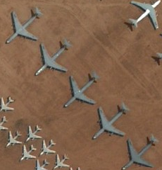
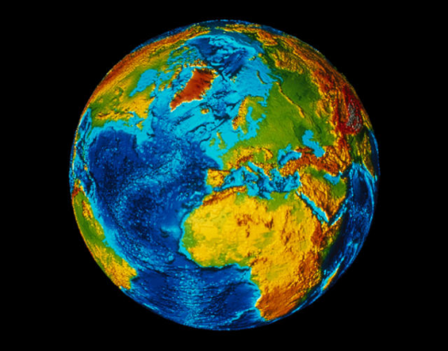
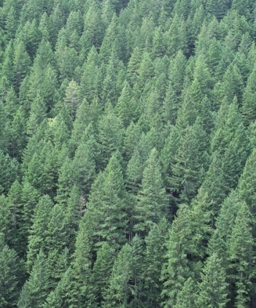
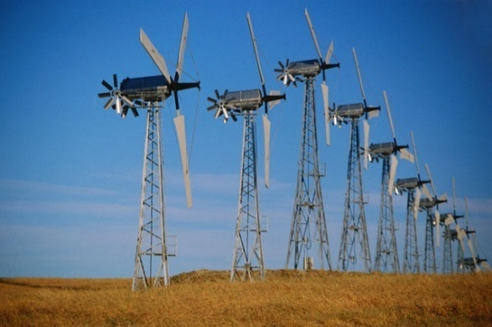
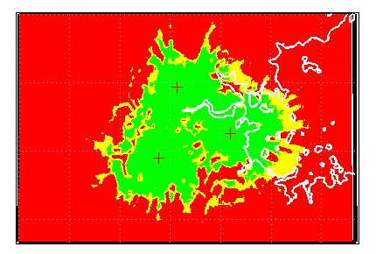
Geospatial Applications
Aerospace and Defense
Earth and Ocean Science
Natural Resources
Energy
Communications
Other Applications:
Finance
Transportation
Government
Agriculture
Notes:
(For Presenter) Mapping Toolbox is used in virtually every industry. Please highlight a couple of these example topics with the following examples.
Aerospace & Defense: Aerospace and defense is the biggest user of Mapping Toolbox. In this industry, maps are used in a variety of applications such as reconnaissance, mission planning, facility placement, navigation, and optimization. One can perform tasks including: calculate buffer zones around perimeters, calculate distances along waypoints, display satellite and aerial photography, and analyze terrain.
Earth & Ocean Science: The toolbox can be used in many ways in the study of Earth and Ocean dynamics. Weather prediction is an important area of research; since sea temperature largely influences the formation of hurricanes, geographic sea temperature data from satellites play an important part in hurricane modeling. Another example is the study of arctic ice caps and their seasonal variations.
Natural Resources/Agriculture: Analyze seasonal growth trends and anomalies from georeferenced vegetative health image products, superimpose vector roads and other contextual information
Energy: In industries such as oil and gas exploration and wind power, users need to analyze geographic data to select optimal sites. While the optimization of where to place wind turbines is often performed with MATLAB and products such as Statistics and Optimization, the display of geographic information such as proximity to roads, infrastructure, zoning, and other considerations must be taken into account.
Communication: In the placement of communication towers such as cell phone towers, one wants to maximize visibility to the tower as this will improve service to customers. Mapping Toolbox can be used to analyze and visualize terrain models and calculate line of sight or viewsheds from proposed antenna locations.
Finance: Geographic information can be used to predict crop futures, predict losses from potential natural disasters (Swiss Reinsurance), and optimize the locations of ATMs. The weather itself can change the value of a number of commodities.
Transportation: Analyze terrain of a proposed route or corridor.

Slide 6
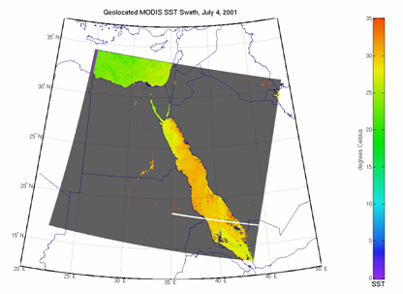
MATLAB and Scientific Data
Scientific data formats:
  HDF5, HDF4, HDF-EOS
  NetCDF (with OPeNDAP!)
  FITS, CDF, BIL, BIP, BSQ
Image file formats:
  TIFF, JPEG, HDR, PNG, JPEG2000, and more
Vector data file formats:
  ESRI Shapefiles, KML, GPS
  and more
Raster data file formats:
  GeoTIFF, NITF, USGS and SDTS DEM, NIMA DTED, and more
Web Map Service (WMS)
Notes:
Mapping Toolbox supports a wide range of file formats and these file formats come in generally two classes: vector and raster data. Note, many customers will buy Mapping Toolbox solely for file I/O so this is will be an important section.
Vector: Vector data is a collection of (x,y) or (latitude, longitude) points that makes up points, lines, or polygons on a map. Some file types are ESRI Shapefiles, VMAP0. Some vector data products include GSHHS, which is essentially coastline vector data.
Raster: Raster data or images are matrices of data points. This includes file types such as GeoTIFF and TIFF, JPEG2000, PNG. There is also a set referred to as gridded data or bathymetry products; this is often elevation data.
MATLAB supports a number of file types that are useful in geographic applications. These include several image formats and scientific data formats. For example, HDF5, HDF4, HDF-EOS, and multiband files (BIP, BIL, BSQ). BIP (Band Interleaved by Pixel) BIL (Band Interleaved by Line) BSQ (Band Sequential)
Image Processing Toolbox supports important file formats including NITF.

Slide 7
HDF5
High Level Interfaces (h5read, h5write, h5disp, h5info)
  h5disp('example.h5','/g4/lat');
  data = h5read('example.h5','/g4/lat');
Low Level Interfaces (Wraps HDF5 C APIs)
  fid = H5F.open('example.h5');
  dset_id = H5D.open(fid,'/g4/lat');
  data = H5D.read(dset_id);
  H5D.close(dset_id);
  H5F.close(fid);
Notes:
h5disp maps to h5dump
try, catch
don’t have to recompile your code to play with the lower level interfaces
Run code as you type it

Slide 8
NetCDF
High Level Interface (ncdisp, ncread, ncwrite, ncinfo)
  url = 'http://oceanwatch.pifsc.noaa.gov/thredds/ dodsC/goes-poes/2day’;
  ncdisp(url);
  data = ncread(url,'sst');
Low Level Interface (Wraps C APIs)
  ncid = netcdf.open(url);
  varid = netcdf.inqVarID(ncid,'sst');
  netcdf.getVar(ncid,varid,'double');
  netcdf.close(ncid);
Notes:
ncdisp maps to ncdump

Slide 9
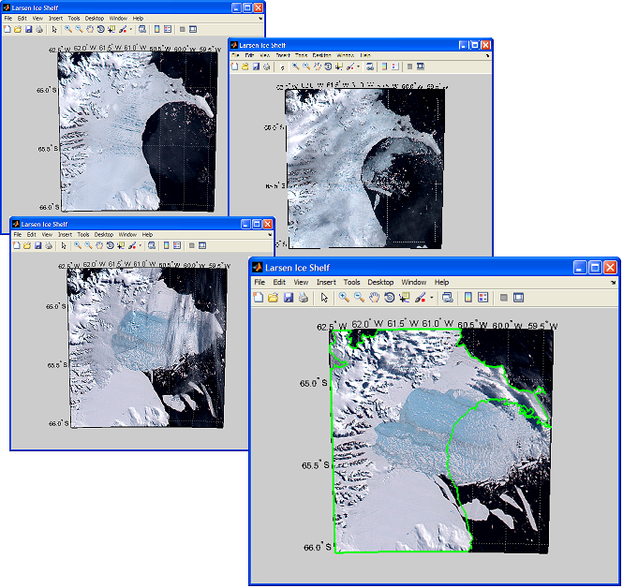
Mapping Toolbox and
Web Map Service (WMS)
Find and download data
  Custom queries by layer name, server name, location, and other terms
Prequalified database of WMS servers and data layers
WMS servers available from:
  NASA, ESA, USGS, NOAA, ESRI,
  Microsoft® and more
Notes:
(For Presenter) WMS capabilities were introduced in R2009b. The functionality enables a user to get customized data directly into MATLAB from WMS servers. This resolves significant pains in obtaining data, interacting with a server, resampling data, and removing seams.
Protocol
WMS was developed by the Open Geospatial Consortium for serving georeferenced images over the Internet. This involves rendering and repojecting. With Mapping Toolbox, a user is able to access elevation, oceanography, weather, satellite imagery, and many other raster data sets in MATLAB.
Custom Queries
To request and retrieve a map with appropriate characteristics, such as spatial resolution and geographic limits, the toolbox provides functions and classes that enable you to define a custom map request, submit it to the server, and retrieve a map into a file or directly into MATLAB for processing. So you can use functions like WMSFIND(‘weather’) to pull up servers with related weather data from the database below.
Prequalified Database
To assist with identifying WMS data layers that are appropriate to your application, the toolbox provides a prequalified database of WMS servers and layers that enables you to search for an appropriate data set by layer name, server name, location, and other terms. You can search through the database for terms such as “weather” or “earthquake” and servers with related data will be returned.
Image: Imagery of the Larsen Ice Shelf, Antarctica, spaced over months, is downloaded via WMS. The original coastline is segmented using Image Processing Toolbox and overlaid on the final image. Many datasets on WMS servers are animations of data.

Slide 10
Web Map Service Example
% Find layers that may contain global temperature data
% and return a WMSLayer array.
layers = wmsfind('global*temperature');
% Display the first layer
layers(1)
WMSLayer
Properties:
Index: 1
ServerTitle: 'WMS for GHRSST Global 1-km Sea Surface Temperature (G1SST),
Global, 0.01 Degree, Daily'
ServerURL: 'http://coastwatch.pfeg.noaa.gov/erddap/wms/jplG1SST/request?'
LayerTitle: 'GHRSST Global 1-km Sea Surface Temperature (G1SST), Global,0.01
Degree, Daily - SST'
LayerName: 'jplG1SST:SST'
Latlim: [-79.9950 79.9950]
Lonlim: [-179.9950 179.9950]

Slide 11
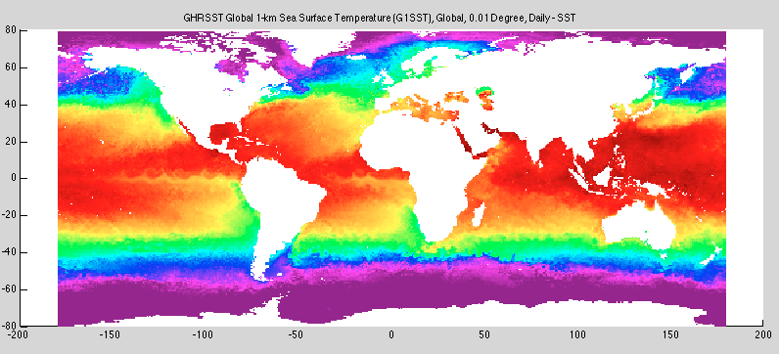
Web Map Service Example
% Show a map from the first layer
[A,R] = wmsread(layers(1));
geoshow(A,R);
title(layers(1).LayerTitle);

Slide 12
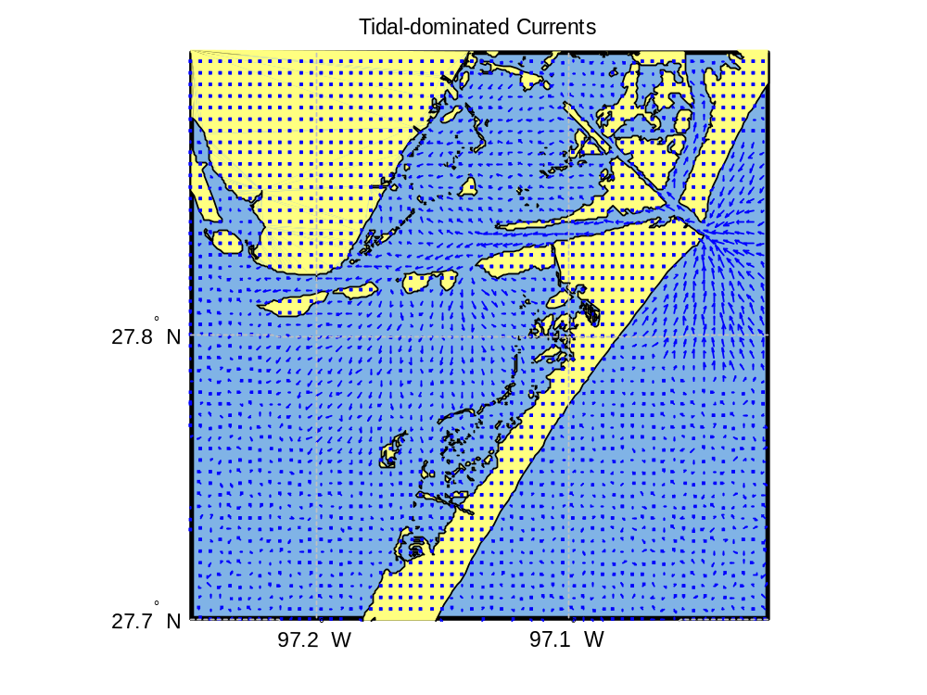
Example Application: Oil Spill Simulation
Notes:
Estimated time: ~ 10 minutes
In this demo, we demonstrate how Mapping Toolbox and MATLAB can be used to simulate an oil spill and display it on a map. Often many users will want to perform some numerical simulations and see the results on a map. If this is the first demo in the presentation it’s also useful for just showing how to create maps.
Load shapefile data
Create a map with inset
Overlay bathymetry
Create vector fields for currents
Simulate oil spill using Euler’s method and patch particles
Find which polygons are touched by oil
Calculate and draw a small circle with a particular radius
Industry: Earth and Ocean Science, Aerospace, Defense
Application: Geodesy, Numerical Simulation
Functionality Highlighted:
SHAPEREAD
USAMAP
SCALERULER
NORTHARROW
GEOLOC2GRID
MAPTRIMS
INPOLYGON
QUIVERM
Please see CRE for demos and recordings
Just search for ‘mapping’

Slide 13
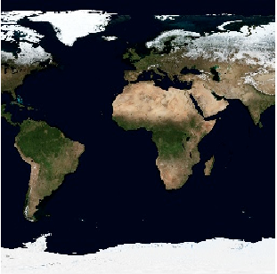
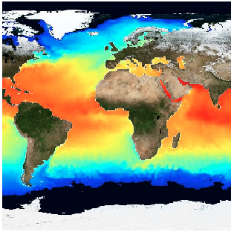
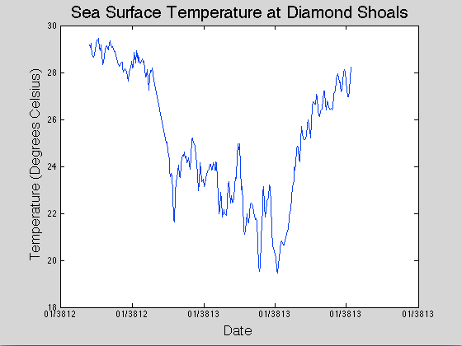
Example
Exploring Sea Surface Temperature with WMS and NetCDF data.

Slide 14
MATLAB’s MAT File Format
Version 7.3 of MAT file format is HDF5 based
  save('bigFile.mat',bigMatrix,'-v7.3');
Support for partial saving and loading of MAT files
  % Create a MAT-file
  matObj = matfile('myfile.mat’)
  % Find the size of a variable in the file
  [nrows, ncols]=size(matObj,'bigMatrix');
  % Load data from a variable in the file
  loadVar = matObj.bigMatrix(nrows-19:nrows, 86:95);

Slide 15
Questions??
www.mathworks.com
  Examples:
    Using the high-level HDF5 functions to Import Data
    Importing NetCDF Files and OPeNDAP Data
    Compositing and Animating Web Map Service (WMS) Meteorological Layers
    Performing a Numerical Simulation of an Oil Spill
  Product documentation
Feel free to ask questions afterwards

