Slide 1
HDF
Town Hall
ESIP Summer Meeting
July 9, 2013

Slide 2

Welcome
Aboard,
Ted

Slide 3
Changes in The HDF Group
New Staff
  Earth Science program Director (Habermann)
  Earth Science Project Manager (Plutchak)
  Project Management Office Coordinator
  Quality Engineer

Slide 4
Earth Science Program Director (Ted)
ESDIS HDF
JPSS HDF
Maintenance, QA
Tools and applications
Studies, Analyses
JPSS Tools
Outreach
Operations Support
High Level Libraries
IDPS support
Project manager
(Joel)
NASA Metadata
Earth Science Team
Ted Habermann
Larry Knox
Joe Lee
Joel Plutchak
Elena Pourmal
Kent Yang
Albert Cheng

Slide 5
  Mailing lists and archives
news@lists.hdfgroup.org
  http://hdfgroup.org/news/
hdf-forum@lists.hdfgroup.org
  http://mail.hdfgroup.org/pipermail/hdf-forum_hdfgroup.org/
New mailing for NASA DAACs
  hdf-nasa-daac@lists.hdfgroup.org
Notes:
Joe will take care of it.

Slide 6
HDF Releases

Slide 7
Maintenance Releases 2012–2013
2012 | Jan | Feb | Mar | Apr | May | Jun | Jul | Aug | Sep | Oct | Nov | Dec
HDF4 |  | 4.2.7 |  |  |  |  |  | 4.2.8
HDF5 |  |  |  |  | 1.8.9 |  |  |  |  |  | 1.8.10
HDF-Java |  |  |  |  |  |  |  |  |  |  |  | 2.9
h4h5 tools |  | 2.2.1
2013 | Jan | Feb | Mar | Apr | May | Jun | Jul | Aug | Sep | Oct | Nov | Dec
HDF4 |  | 4.2.9
HDF5 |  |  |  |  | 1.8.11 |  |  |  |  |  | 1.8.12
HDF-Java |  |  |  |  |  |  |  |  |  |  |  | 2.10
h4CF |  |  |  |  |  | 1.0 beta
Notes:
HDF5 1.8.7 – 1.8.9 Fortran 2003 support, support for Fortran dimension scales
HDF4 releases in support of the H4 mapping project
Support for Powerpc64 platform (big-endian)
Java – addressed all ESDIS requests
Based on the latest available HDF4 and HDF5
H4h5tools – updated to 18 APIs, no 18 features were added

Slide 8
HDF4 maintenance releases
HDF 4.2.9 (February 2013)
  Support for Mac 10.8 with Intel and Clang compilers
  Support for Cygwin version 1.7.7 and higher

Slide 9
HDF5 maintenance releases
HDF5 1.8.10 (Nov 2012) and patch1 (Jan 2013)
  Interoperability between h5dump and h5import
  Performance improvements in h5diff for the files with many attributes
  Support for I/O bigger than 2GB on Mac OS X
Notes:
Up to here elena fixes. Add QA person.

Slide 10
HDF5 maintenance releases
Future releases
    Request to support wide character filenames (MathWorks)
    Request to support UTF-32 encoding (H5Py)
    Request to support parallel compression

Slide 11
New OSs and Compilers
HDF software is now supported on
  SunOS 5.11 (Sparc) with Studio 12 compilers
  CentOS 6 with GCC and Intel compilers
  Mac OS X 10.8.* with Clang and Fortran, Java 1.7 Cygwin 1.7.7
  Windows 7 with VS 12 and Intel 13
  Windows 8 with VS 12 and Intel 13
Notes:
Joe moved this slide after maintenance plan.

Slide 12
Java maintenance releases
2.9 release (December 2012)
  Show groups/attributes in creation order
  Export data to a binary/ASCII file without having to open the object in the TableView
  Reload feature to close/open file
  Improvements for installation
Notes:
Java HDF4.

Slide 13
Java maintenance releases
2.10 release (December 2013)
  0 or 1-based indexing when displaying arrays
  Displaying long names of files (“…” in names)
  Ability to modify HDF4 compressed dataset
  Support netCDF-4 files with VL attributes
Notes:
Java HDF4.

Slide 14


HDF5/JSON
JavaScript Object Notation
Text encoding of JavaScript object and array literals
Use cases similar to DDL and XML
  Text representation
  Diagnostic
  HDF5 “blueprints”
  Catalog records
  Exchange format
  Web services (REST)
  NoSQL document stores
Advantages:
  Less noise (XML tags)
  Multi-dimensional arrays
  Binary encoding (BSON)
  Programmable (JavaScript)
  Browser support
  NoSQL document stores
Tools:
  BNF grammar
  h5json HDF5 → JSON
  jsonh5 JSON → HDF5
  Release date TBD
Notes:
Does this belong to Goal #5?

Slide 15
Tools

Slide 16
HDF and netCDF interoperability tools
HDF4/HDF-EOS2 to CF conversion toolkit - June
HDF-EOS5 augmentation tool (maint) - Dec 2013
HDF-EOS2 dumper tool (maint) - every other year
HDF-EOS5 to netCDF-4 conversion tool (retired)
HDF4 & HDF5 Handlers – May, to synchronize w/ Hyrax release

Slide 17
HDF Visualization tool assessment
To evaluate the HDF Group’s data viewing tools and user needs, and to explore, recommend, and prioritize improvements.
Notes:
HDFView more than 10 years old.
Since first implemented, new technologies and techniques have emerged that could help improve HDFView.
We surveyed HDFView users last year. A lot of good ideas came out of that.
We will not just look at Java, but other alternatives such as QT.
This is an internally funded project led by Cao, Heber, Readey (Amazon).
This group will:
Review our vision for vis tools and how they are aligned with our mission.
Review and company goals as regards support for vis tools.
Identify needs and opportunities based on current and potential customers and their needs and desires.
Review technologies and tools currently available that can help us develop new tools if needed, how the new tools compare with current HDF tools, and what they might offer in terms of improvements.
Develop of a set of guiding principles for going forward.
Recommend activities, perhaps leading to a roadmap to long-term goals for the visualization tool(s).

Slide 18
Other activities

Slide 19
Prototype Studies
Apache Open Source Incubator Pilot Project
Digital Object Identifier (DOI) support in HDF5

Slide 20
HPC R&D
HDF5 Virtual Object Layer
  Allows apps to store and access HDF5 objects in arbitrary storage methods and formats
  Allows HDF5 apps to migrate to future storage systems with no source code modifications
HDF5: Asynchronous I/O
  Application doesn’t wait for I/O
Fault Tolerance:
  Prevent crash from corrupting HDF5 file
End-to-End Data Integrity:
  Verify integrity of data from birth to death of file
I/O Autotuning
  Runtime framework that dynamically determines optimal application I/O strategy

Slide 21
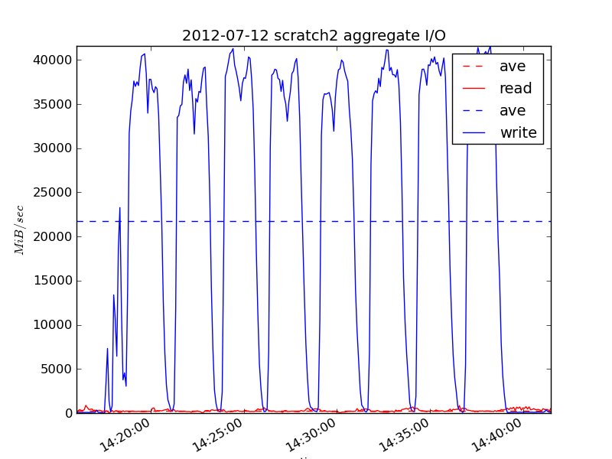


Parallel I/O and Analysis of a Trillion Particle VPIC Simulation
Problem: Support I/O and analysis needs for state-of-the-art plasma physics code
Novel Accomplishments:
  Ran Trillion particle VPIC simulation on 120,000 hopper cores and generated 350 TB dataset
  Parallel HDF5 obtained peak 35GB/s I/O rate and 80% sustained bandwidth
  Developed hybrid parallel FastQuery using FastBit to utilize multicore hardware
  FastQuery took 10 minutes to index and 3 seconds to query energetic particles
  SC12 paper, XLDB 2012 poster
CS Impact
  Demonstrated software scalability for writing and analyzing ~40TB HDF5 files
  Enabled novel discoveries in plasma physics (next slide)
I/O bandwidth utilization for parallel writes (blue) with HDF5 on 120,000 cores
A comparison of indexing (top table) and query times (bottom) for hybrid and MPI-FastQuery
Notes:
The slide highlights recent accomplishments from the ExaHDF5 project funded by DOE/ASCR Exascale Scientific Data Management award.
1) Parallel I/O with HDF5
We ran a Trillion particle simulation on 120K cores on hopper. The code produced 30 TB of particle data per timestep, and produced over 350TB of data total
- To the best of our knowledge, this is the first time that anyone has demonstrated writes to a single, shared 30 TB HDF5 file
We hit peak I/O rates on hopper (~35GB/s) during the run, we sustained an average ~23GB/s, which is a new record for parallel HDF5 performance
2) FastBit based analysis-
We developed a novel hybrid parallel version of FastBit to do the indexing/querying on the dataset
This was the first time that we used FastBit and FastQuery to index and query a dataset with Trillion entries
We were able to index the dataset in 10 minutes and query the dataset in 3 seconds
DOE researchers: Prabhat (PI), Suren Byna, Oliver Rubel and John Wu (LBNL)
Scientific collaborators: Homa Karimabadi (UCSD), Vadim Roytershteyn (UCSD) and Bill Daughton (LANL)
Simulation code used in the study is VPIC, developed at LANL.
Please address any questions to Prabhat (prabhat@lbl.gov).

Slide 22
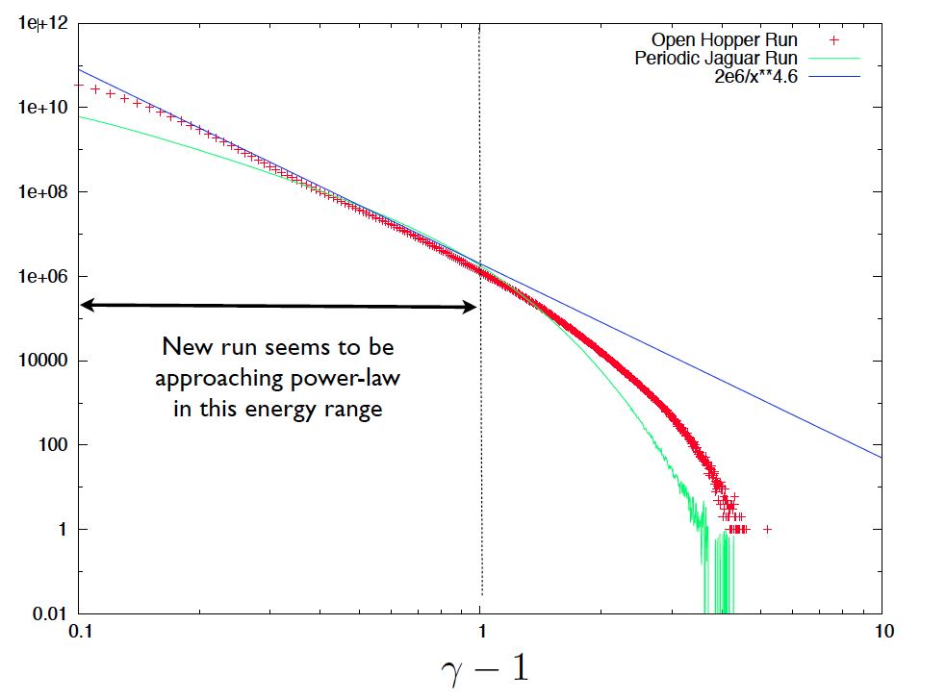
Science Impact: Multiple Scientific Discoveries in Plasma Physics
Preferential acceleration along magnetic field
Energetic particles are correlated with flux ropes
Discovered power-law in energy spectrum
Discovered agyrotropy near the reconnection hot-spot
Notes:
3) Scientific insights
This is the first time that our science collaborators have been able to examine the trillion particle dataset. They had largely ignored the particle data, or looked at a coarse grained version earlier
- Our collaborators discovered a power-law distribution in the energy spectrum of the particles. This is the first kinetic plasma physics to demonstrate a power-law distribution; our analysis capabilities directly facilitated this discovery
Our collaborators had made a number of conjectures and hypothesis regarding the interplay between particles and the magnetic fields and multi-dimensional phase-space distribution of particles. Using these new tools, they were able to confirm these hypothesis quantitatively. More specifically the scientists found:
- a preferential acceleration of particles in a direction parallel to the magnetic field
- predominant distribution of energetic particles in the current sheet, suggesting that flux ropes can confine these particles
agyrotropic (asymmetric) distribution of particles near the magnetic reconnection event

Slide 23
Other projects of interest
ITER – International fusion research project
  Architecture for HDF5 for ITER data life cycle
Particle accelerators and instrument vendors
  Faster I/O for compressed data
    Let apps send pre-compressed chunks directly to file.
  Dynamic filter loading in HDF5
    Let apps read data compressed with non-standard filter.
  SWMR
    Single Writer/Multiple Readers

Slide 24
Other projects of interest
Digital Twin
  “Digital Twin integrates ultra-high fidelity simulation with the vehicle’s on-board integrated vehicle health management system, maintenance history and all available historical and fleet data to mirror the life of its flying twin and enable unprecedented levels of safety and reliability.”

Slide 25
thanks

Slide 27
EOS Support
EOS2 and EOS5 are tested daily with HDF4 and HDF5 development code.
HDF-EOS website now has:
  MEaSUREs VIP and NPP VIIRS IDL/MATLAB/NCL examples.
  descriptions and a search box to help users access the website easily.
Notes:
Kent needs to update this.

