Slide 1

New Elements and Lessons Learned for New Mission HDF5 Products
Observations from developing JPSS nagg and h5augjpss tools
Larry Knox
The HDF Group
lrknox@hdfgroup.org

Slide 2
Basis for observations
Three developers at The HDF Group have been working with JPSS/NPP data files for the last 2 years.
  1/2 year developing h5augjpss
  1 1/2 years developing nagg
The purpose of this talk is to call to your attention some potentially useful HDF5 elements that are used in the JPSS data files and some that have presented obstacles to broader data access and interoperability with netCDF-4, netCDF Java and netCDF based tools.

Slide 3
h5augjpss
h5augjpss is a tool to make NPP files
  netCDF-4 readable (by hiding references)
  more meaningful (by adding dimensional and other metadata from product_profiles)
  accessible to Panoply and IDV by copying associated geolocation data into the file. Addition of attributes for CF compliance may be required and is recommended
  accessible to netCDF based tools that don’t support groups by flattening the file
  These options are independent.
  Note that h5augjpss modifies input files

Slide 4
nagg
nagg, the NPP aggregation and packaging tool is a tool for creating a new copy of NPP product files with a particular aggregation number and packaging arrangement.
nagg copies and rearranges data from the input files into new output files. Data is the same but may be divided differently among files. Aggregation attributes are updated to match new arrangement, and number in granule name matches position in new file.
nagg matches IDPS produced files

Slide 5
Overview of NPP file structure
Documented in JPSS Common Data Format Control Books: 15 volumes available at http://npp.gsfc.nasa.gov/science/documents.html
My opinion: the required reading is http://npp.gsfc.nasa.gov/science/sciencedocuments/2013-01/474-00001-01_JPSS-CDFCB-X-Vol-I_0123A.pdf, pp 1 – 140. The rest is reference material for specific products.
Key new HDF5 elements are object and region references

Slide 6
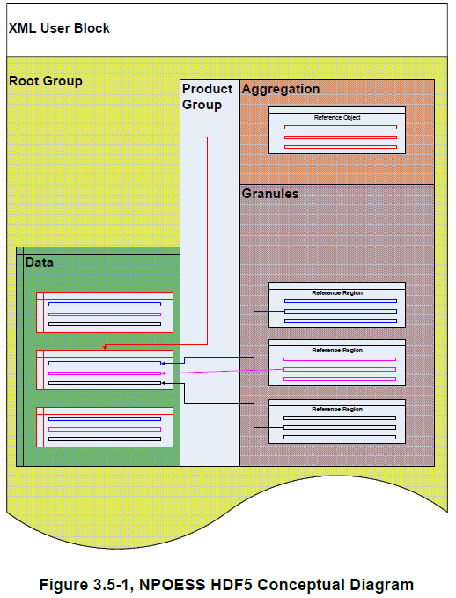
Overview of NPP file structure
Figure 3.5-1 from JPSS Common Data Format Control Book - X Vol. I, p 78 shows the contents of a JPSS or NPP file with
One product
Three granules
Three datasets
This structure is common for the 123 SDR, EDR and IP products and 20 geolocation products for which nagg is supported.
Each file has
XML User Block
Datasets for each product in /All_Data/<Collection Short Name>_All group (green rectangle in left column)
Datasets with references to aggregation and granules in /Data_Products/<Collection Short Name> group (brown and purple rectangles in right column)

Slide 7
JPSS XML User Block Example
From file ICSTT_npp_d20130126_t0155219_e0155517_b06465_c20130126035052218071_noaa_ops.h5
The user block can be read with text editors such as vi or notepad. HDF5 is not required to read the user block, and h5dump does not display it, because it the user block is not required to be text.
For NPP files the user block is a series of xml tags that describe the aggregation in the file.
<HDF_UserBlock>
<Mission_Name>NPP</Mission_Name>
<Platform_Short_Name>NPP</Platform_Short_Name>
<N_GEO_Ref>GCRIO_npp_d20130126_t0154179_e0154477_b06465_c…_noaa_ops.h5</N_GEO_Ref>
<Number_of_Data_Products>1</Number_of_Data_Products>
<Data_Product>
<Instrument_Short_Name>CrIMSS</Instrument_Short_Name>
<N_Collection_Short_Name>CrIMSS-CrIS-SKIN-TEMP-IP</N_Collection_Short_Name>
<N_Processing_Domain>ops</N_Processing_Domain>
<N_Dataset_Type_Tag>IP</N_Dataset_Type_Tag>
<AggregateBeginningDate>20130126</AggregateBeginningDate>
<AggregateBeginningOrbitNumber>6465</AggregateBeginningOrbitNumber>
<AggregateBeginningTime>015417.984111Z</AggregateBeginningTime>
<AggregateEndingDate>20130126</AggregateEndingDate>
<AggregateEndingOrbitNumber>6465</AggregateEndingOrbitNumber>
<AggregateEndingTime>015447.784180Z</AggregateEndingTime>
<AggregateBeginningGranuleID>NPP000398372569</AggregateBeginningGranuleID>
<AggregateEndingGranuleID>NPP000398372569</AggregateEndingGranuleID>
</Data_Product>
</HDF_UserBlock>

Slide 8
References in NPP files
The white rectangles represent datasets.
The Aggregation dataset has
Object references to whole datasets in /All_Data/<Collection Short Name>_All group
Aggregation attributes
Each Granule dataset has
A region reference which identifies a hyperslab in each dataset in All_Data/<Collection Short Name>_All group. In this example, each hyperslab is 1/3 of each dataset in the /All_Data group.
Granule attributes
JPSS CDFCB-X Vol. I Block 1.2.3 474-00001-01-B0123 Effective Date: November 30, 2012 Block/Revision 0123A

Slide 9
References in NPP files
The Aggregation dataset has one object reference entry for each dataset in the /All_Data group
Each Granule dataset has a region reference entry for its hyperslab in each of the Datasets in the /All_Data group.
Figure 3.5-1 represents a file with one product. The path to the datasets in “Data” in the HDF5 file would be /All_Data/<Collection Short Name>_All. The path to the Aggregation and Granule datasets in the HDF5 file would be /Data_Products/<Collection Short Name>.
JPSS CDFCB-X Vol. I Block 1.2.3 474-00001-01-B0123 Effective Date: November 30, 2012 Block/Revision 0123A

Slide 10
Overview of NPP file structure
For packaged files, the rectangles shown would be duplicated completely for each product included in the file. There will be groups named /All_Data with <Collection Short Name>_All subgroups for each product, and /Data_Products with <Collection Short Name>_All subgroups for each product.
JPSS CDFCB-X Vol. I Block 1.2.3 474-00001-01-B0123 Effective Date: November 30, 2012 Block/Revision 0123A

Slide 11
Helpful characteristics of NPP files
Development of the nagg tool was made easier because all of the supported products conform to the IDPS file structure.
nagg uses the region reference APIs in the HL_NPOESS library to read data hyperslabs to be written to output files.

Slide 12
Helpful characteristics of NPP files
Tools that do not understand object or region references but can use the aggregated data can use the datasets in the /All_Data group, ignoring the datasets in /Data_Products. If these tools are unable to ignore the references they can be hidden.

Slide 13
Helpful characteristics of IDPS files
References are a convenient way to identify and access hyperslabs

Slide 14
Lessons learned
References, while they are useful, were an obstacle to interoperability with netCDF based tools that are also useful. These factors should weighed when designing file structures and objects for new missions.

Slide 15
Lessons learned
Adding a compression option to nagg is currently being considered. Initial trials with random files appear to cut file size by about 50%, depending on the data values in the file. In addition it would probably have allowed a representation of quality flags other than the packed bits representaion that was implemented, which required changes to h5dump to recognize and display the data in a way that accurately represents the meaning.

Slide 16
Advice to designers of New Missions
Consider users and users tools.
Contact development teams as soon as possible regarding possible problems with other software.
When possible, match what other products and missions are doing, especially if they are closely related or likely to be used in conjunction with yours.
Check with The HDF Group for available options that may already be implemented and available.

Slide 17
Thank you!

Slide 18
<text>

