Slide 1
Conventions Overview
Joel Plutchak
The HDF Group

Slide 2
Beginning a Conversation
My involvement with data and metadata
Use / Discovery / Preservation
Eighties: SSEC, Brown University Planetary Group
  Monolithic systems, proprietary formats → use
Nineties: U of I Atmospheric Sciences, NCSA / SDG
  Formats as standards + web → use, discovery
Aughties: NCSA / Digital Library Technologies
  Metadata standards and semantics → discovery, preservation
Today: The HDF Group
  Conventions + interoperability + web → enable knowledge
  Emerging technologies enable evolving needs.
Notes:
This overview is about beginning a conversation on conventions and where we are today in the Earth Sciences.
A good place to begin a conversation is with an introduction… my journey to being here today
(add formats, conventions, systems as pop-up terms?)
McIDAS, VICAR | HTML/WWW, Z39.50 | Dublin core, semantic web, library/provenance | CF, et al.

Slide 3
Conventions: What’s in a Word?
The boundaries between concepts are fuzzy:
What is a format?
What is a convention?
What is a profile, or a standard; do they differ only in formality of agreement or definition?
I like to think of the word conventions in a very broad, general way, at least until I figure this all out.

Slide 4
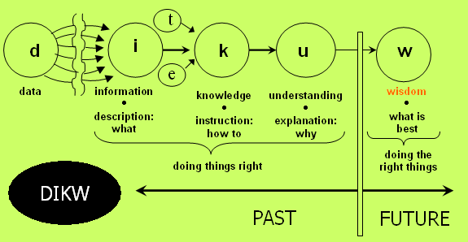
Why Conventions?
Formats add metadata to data to yield Information
Conventions allow combining information to yield Knowledge
Notes:
DIKW: Well-known part of the language of information science
Data: gathering of parts
Information: connection of parts
Knowledge: formation of a whole
Wisdom: joining of wholes
Shared conventions allow joining of the wholes

Slide 5
A Few Conventions
HDF-EOS2 / HDF-EOS5: HDF4/HDF5 format with use metadata conventions
Climate & Forecast (CF): metadata convention for use of data (netCDF origin)
Attributes for Data Discovery: metadata convention for data discovery (Unidata, ESIP)
Others: ISO 19115 (standard), DIF, ECHO, GeoTIFF
Notes:
Keeping in mind the line between formats, conventions, and standards can be fuzzy…
HDF-EOS2: added specific attributes to HDF4
HDF-EOS5: added specific attributes to HDF5
CF: added attributes to netCDF specifically for USE
A for D D: added attributes to netCDF specifically for DISCOVERY

Slide 6
Interoperability / Translation
Conventions enable interoperability & translation
Services: OPeNDAP, taiga, OGC
Middleware*: THREDDS, ArcGIS server, ENVI services engine
Libraries & tools: NCO, GDAL, aughdf5, OGC GeoTools, h4mapwriter, ncISO, etc.
* Connecting services to data
Notes:
The HDF Group maintains hyrax handlers for HDF4 and HDF5
GDAL: Geospatial Data Abstraction Library

Slide 7
Earth Science Group
Ted Habermann
Kent Yang
H. Joe Lee
Joel Plutchak
Notes:
We’ve formed a subgroup within The HDF Group to concentrate on issues like these. We’re excited by the opportunity to join in the conversation and help form the emerging landscape in Earth Sciences data and metadata conventions and their uses in current ad upcoming missions.

