Slide 1
ICESat-2 H5-ES Product Development Strategy
ESIP Summer 2013
July 9, 2013
SGT/Jeffrey Lee
NASA GSFC/Wallops Flight Facility
Jeffrey.e.lee@nasa.gov

Slide 2
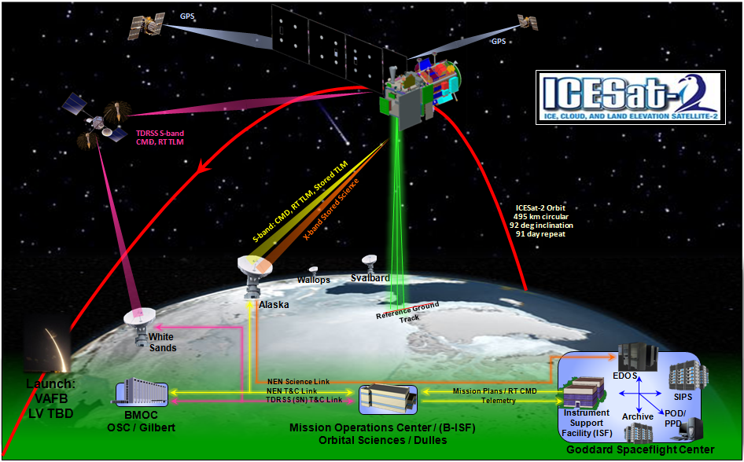
From 495km into the Weeds

Slide 3
Introduction : ICESat-2
Research-Class NASA Decadal Survey Mission.
ICESat follow-on; but uses different measurement technique.
Launches In July 2016.
Science Objectives :
  Determine polar ice sheet mass balance; understand controlling mechanisms; examine how ice sheets will impact global sea level and ocean circulation in a changing climate.
  Measure sea-ice thickness to understand ice/ocean/atmosphere exchanges of energy, mass and moisture.
Mission Characteristics :
  Advanced Topographic Laser Altimeter System (ATLAS)- New Micro Pulse Altimeter, High PRF, low pulse energy, Multi-beam photon counting system.
  Repeat ICESat ground-track.
  Orbit: 495 km, 94° inclination, 91-day repeat.
  Pointing accuracy ± 10 arcseconds (± 30 m on ground)
  10,000 shots/sec; 3 photons/shot.

Slide 4
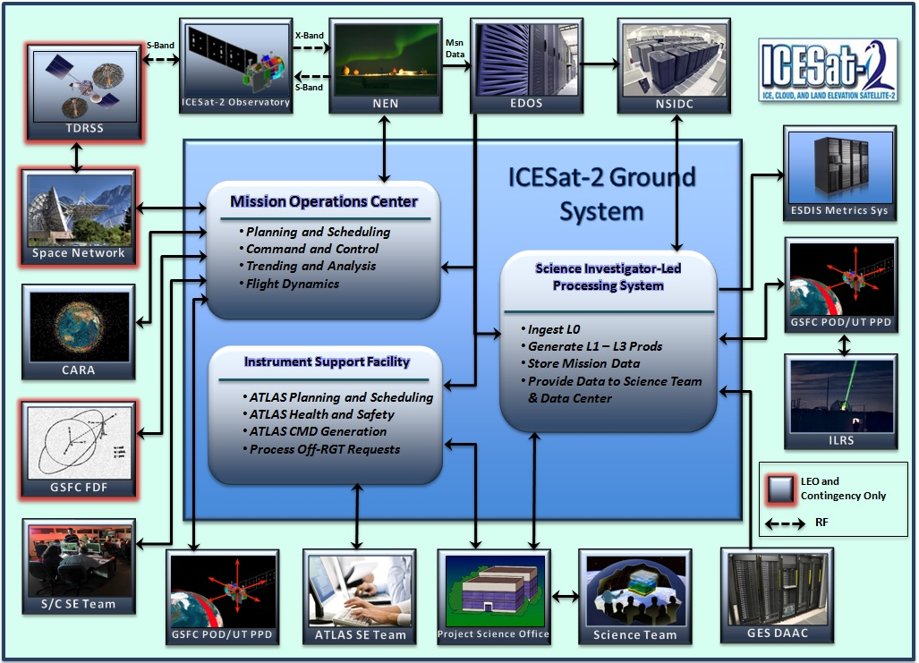
Introduction : Ground System

Slide 5
Introduction : SIPS
The ICESat-2 Science Investigator-led Processing System (SIPS)
  Ingests ATLAS and required spacecraft L0 data
  Ingests ancillary data from external sources
  Creates all ICESat-2 standard data products
  Performs verification of the standard data products via automated QA
  Archives all ingested and created data
  Distributes the standard data products under the guidance of the Project Science Office to the Science Team for validation
  Distributes all Project Science Office approved standard data products to the data center (NSIDC) for public dissemination

Slide 6
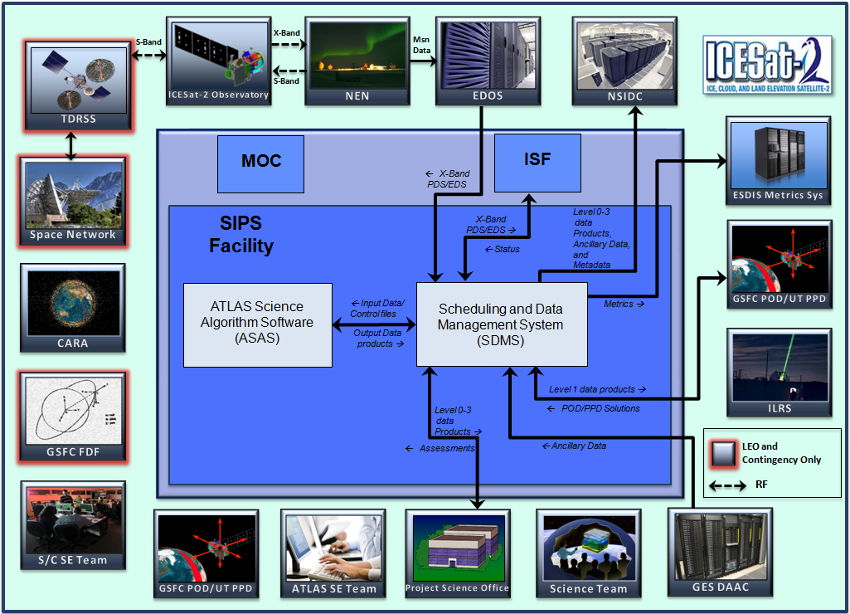
Introduction : SIPS

Slide 7
Introduction : ASAS
“ASAS is the ATLAS Science Algorithm Software that will be used to produce Level 1 through Level 3 standard data products as well as the associated product quality assessments and metadata information.”
Transforms L0 satellite measurements into calibrated science parameters.
Several independent processing engines (PGEs) used within SIPS to create standard data products. (PGE=product generation executable)
Class C (non-safety) compliant software effort.
Responsible for implementation of 10 ATLAS ATBDs.
Responsible for delivering software to produce 20 Standard Data Products.

Slide 8
Introduction : Requirements
Satellite Mission Data Systems Requirements
  c) Science algorithms used to generate the standard science data products listed in Table 1 shall be documented in Algorithm Theoretical Basis Documents (ATBDs).
  ----------
  a) <<project/instrument name(s)>> science data product formats shall conform to the <<standard selected from the published list of ESD-approved Data System Standards>>.
  b) The <<mission/instrument name(s)>> science data products metadata shall conform to ISO 19115 Geographic Information - Metadata standards and adhere to the Metadata Requirements – Base Reference for NASA Earth Science Data Products document published at http://earthdata.nasa.gov/about-eosdis/requirements , and the <<project name>> shall baseline to a specific initial version before launch.

Slide 9
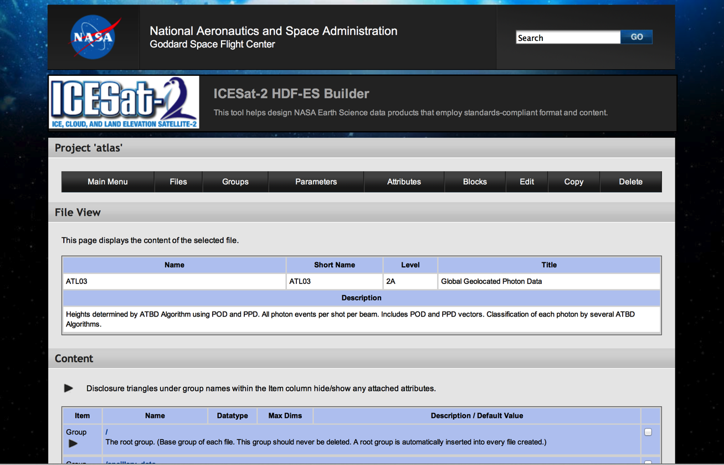
ASAS Product Design Strategy

Slide 10
The Challenge
ICESat-2 is a research-class mission.
SIPS will create 20 Standard Data Products.
  L1A through L3B.
  Both along-track and gridded.
Over 3,200 science parameters.
80 GB L0 data daily.
2.9 TB of L1A-L3B data daily.
3.5 PB over 3 years.

Slide 11
Some Considerations
Lots of experience producing HDF5 products for GLAS_HDF, MABEL & SIMPL.
Number of products & parameters = large SLOC count.
Experience with GLAS says we need a database (data dictionary) to maintain product and parameter descriptions, units, etc.
With past projects, we used a “template” solution for Metadata.

Slide 12
A Solution
A web-based product data dictionary (database) to store and maintain relationships between files/groups/attributes/parameters (mySQL/PHP : h5es_builder).
Software to read output from the product data dictionary and create an HDF5 template file (Fortran : h5es_creator).
A strategy to integrate this toolset into the ASAS product-development workflow.
…H5-ES

Slide 13
What is H5-ES ?
H5-ES = HDF5 Earth Science.
ICESat-2 “flavor” of HDF5.
  Nearly identical to GLAS_HDF, MABEL & SIMPL.
  Fairly consistent with Aura & SMAP.
ICESat-2 product development toolkit and associated Fortran H5_LT-like software library.
ICESat-2 product development strategy.
The result of a 6 week whirlwind development effort.

Slide 14
H5-ES File Characteristics
HDF5 file format.
HDF5 logical grouping.
Science data stored as HDF5 chunked datasets with CF attributes and internal gzip compression.
Ancillary Data stored as HDF5 compact datasets with CF attributes.
CF-style global metadata as HDF5 attributes.
Structured metadata (HDF5 Groups/Attributes) sufficient to generate an ISO 19115 representation.
Best-effort netCDF-extended compatibility.

Slide 15


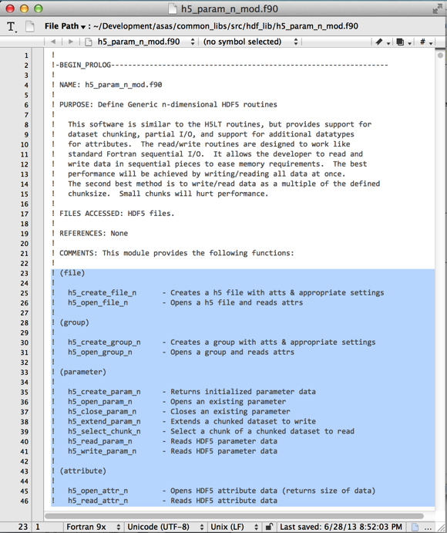



Pieces of the Puzzle

Slide 16
H5-ES : Library
Implemented in a standalone Fortran 2003 module.
Uses HDF5 Fortran 2003 C-based I/O.
Extends H5_LT-like functionality to:
  Chunked/compressed datasets.
  Partial I/O.
  Multiple dimensions.
Supports CF parameter attributes.
Currently 3,722 CLOC.

Slide 17
H5-ES Library : Functions
File
  h5_create_file_n - Creates a h5 file with attributes & appropriate settings
  h5_open_file_n - Opens a h5 file and reads attributes
Group
  h5_create_group_n - Creates a group with attributes & appropriate settings
  h5_open_group_n - Opens a group and reads attributes
Parameter
  h5_create_param_n - Returns initialized parameter data
  h5_open_param_n - Opens an existing parameter
  h5_close_param_n - Closes an existing parameter
  h5_extend_param_n - Extends a chunked dataset to write
  h5_select_chunk_n - Select a chunk of a chunked dataset to read
  h5_read_param_n - Reads HDF5 parameter data
  h5_write_param_n - Reads HDF5 parameter data
Attribute
  h5_open_attr_n - Opens HDF5 attribute data (returns size of data)
  h5_read_attr_n - Reads HDF5 attribute data
  h5_close_attr_n - Closes HDF5 attribute
  h5_write_attr_n - Writes HDF5 attribute data
  h5_read_cf_n - Reads cf parameter data
  h5_write_cf_n - Writes cf parameter data
  h5_set_cf_n - Sets cf parameter data
  h5_str2att_n - Writes string attribute as correct datatype
Utility
  h5_get_hdf_type - Gets supported datatype
  h5_get_h5es_type - Gets index of datatype in h5es typearray

Slide 18
H5-ES : Data Dictionary
Web-based interface written in PHP.
MySQL backend.
Stores Information about :
  Files (A science product implemented in HDF5)
  Groups (HDF5 groups)
  Attributes (HDF5 attributes)
  Parameters (all with CF parameter attributes)
    Datasets (chunked/zipped HDF5 datasets)
    Dimension_Scales: (HDF5 dimension scales)
    Ancillary_Data: (HDF5 compact datasets)
Maintains relationships between components.

Slide 19
Data Dictionary : Relationships
Files contain groups.
File/group combinations contain parameters.
Attributes may be attached to file/group combinations.
All these relationships are maintained in a single table of linked ids (base, parent, child).
Since relationships are maintained by links, change a file/group/parameter/attribute in one place, and it is essentially updated in all places it is used.

Slide 20
Data Dictionary : Functions
Supports multiple projects/databases. (ie: metadata is big enough to need its own database)
Imports/Exports HDF Description Files (Excel).
Generates Template Files (HDF5)
Generates comprehensive HTML-based Data Dictionary.
Generates IDL & Fortran example code to fill HDF Template File with random numbers.

Slide 21
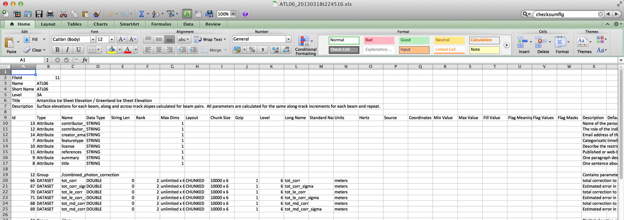
H5-ES Description File
Created from h5es_builder database.
Excel-friendly TAB-delimited text file that describes an H5-ES file.
Import/Export Capability.

Slide 22
H5-ES Template
A‘HDF5 template’ is a valid HDF5 file with all groups, attributes and datasets created, but no (or little) data values filled-in.
Chunked datasets can be created with a dimensions of “0” and then filled later.
Attributes can be created with initial values, but later overwritten.
H5_copy allows the developer to copy content between one or more HDF5 files.

Slide 23
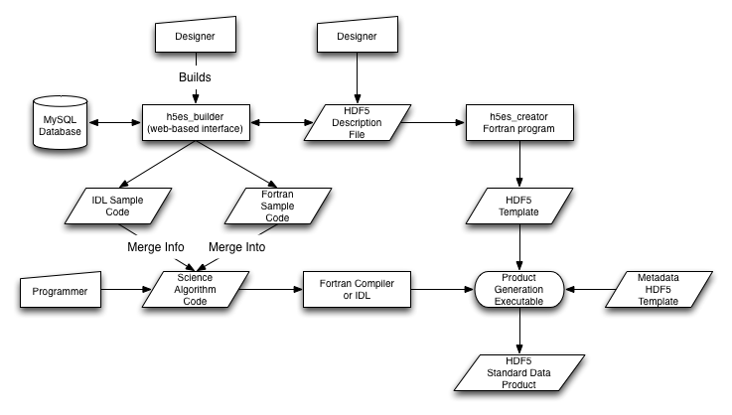
H5-ES Product Development Strategy

Slide 24
H5-ES Product Development Strategy (in Text)
Product designers work with database interface and/or HDF5 Description Files.
Once satisfied, they generate a HDF5 Template and example code.
A programmer takes the example code and merges it with science algorithms to create a PGE.
The PGE “fills-in” the template with science data values to create a Standard Data Product.
The PGE adds metadata from a metadata template (that has been created/maintained with the same process as above.)

Slide 25
Metadata Review
H5-ES is structured-metadata-neutral.
  GLAS_HDF/MABEL uses ECHO-style metadata.
  ICESat-2 uses (TBD) ISO 19115-style metadata.
Metadata is just “lightweight” data.
H5-ES includes parameter-level CF metadata.
H5-ES supports global CF metadata (attributes)
H5-ES supports structured metadata using groups/attributes.

Slide 26
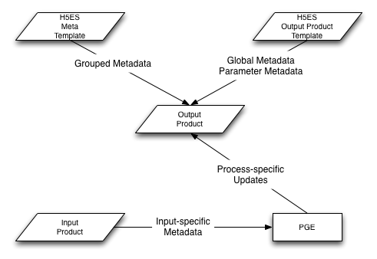
ICESat-2 Metadata Strategy
Separate H5-ES database.
Create separate H5-ES templates.
Static values are filled within H5-ES templates; PGE fills dynamic values.
Can change static metadata without changing PGE code.

Slide 27
Overall Benefits
Traceability of parameters from one product to another.
Improved consistency between data products.
Allows for rapid, relatively inexpensive modification of data products.
Significant reduction in amount of code written.
  Creates an unfilled HDF5 template file with NO coding.
  Provides code fragments from the generated example programs that can be incorporated within science algorithms (or a data conversion program).

Slide 28
Status
Designed for a very specific “flavor” of HDF5 (ICESat-2, GLAS_HDF, MABEL, SIMPL ).
Intending to develop/maintain to level necessary for use with ICESat-2.
Used successfully with refactor of MABEL code.
Used successfully to develop HDF5 products for IceBridge.
In use now generating products for ASAS V0 delivery.
Would be really, really good project for someone to develop further...

Slide 29
Areas for Improvement
Security for web interface.
C/C++ code generation.
Matlab code generation.
Replace spreadsheet model with XML.
  …maybe. Science people LOVE spreadsheets.
Rewrite into single app (like H5View).

Slide 30
Hardware/Software Requirements
Running on my MacBook Pro.
Requires MAMP/LAMP stack (or equivalent)
http://bitnami.com/stack/mamp
Requires gfortran compiler & HDF5 library. IDL is optional.
h5es_creator requires several library routines from ICESat-2 codebase.
All code necessary to fill-in HDF5 template is provided.
No security implemented (yet). Don’t allow public access.

Slide 31
Can This Help Me Now ?
ICESat-2 is prepping for ground system CDR so time is limited. Code needs work before release-quality.
Presented to HDFGroup. (Well received and very supportive).
Presented to ESDIS.
  Funded us to quickly create HDF5 products for 2 IceBridge projects (ATM & ILSSP).
Talking with ESDIS about what to do next.
Take-home message:
  Template files and workflow are biggest logical leap.
  You can create template files now with H5View.

Slide 32
Want to Work on This?
If you (or know someone you know) is looking for an entry-level position, send me a resume.
Job location is NASA Wallops Island.
(Near the ponies & beaches on Chincoteague Island VA).

Slide 33
A Visual Tour…
Decision Tree:
Attempt to perform live demo of H5-ES.
If successful, end presentation;
otherwise, continue slides.

Slide 34
Rats!
So, if we got here, the live demo “gods” struck again….

Slide 35
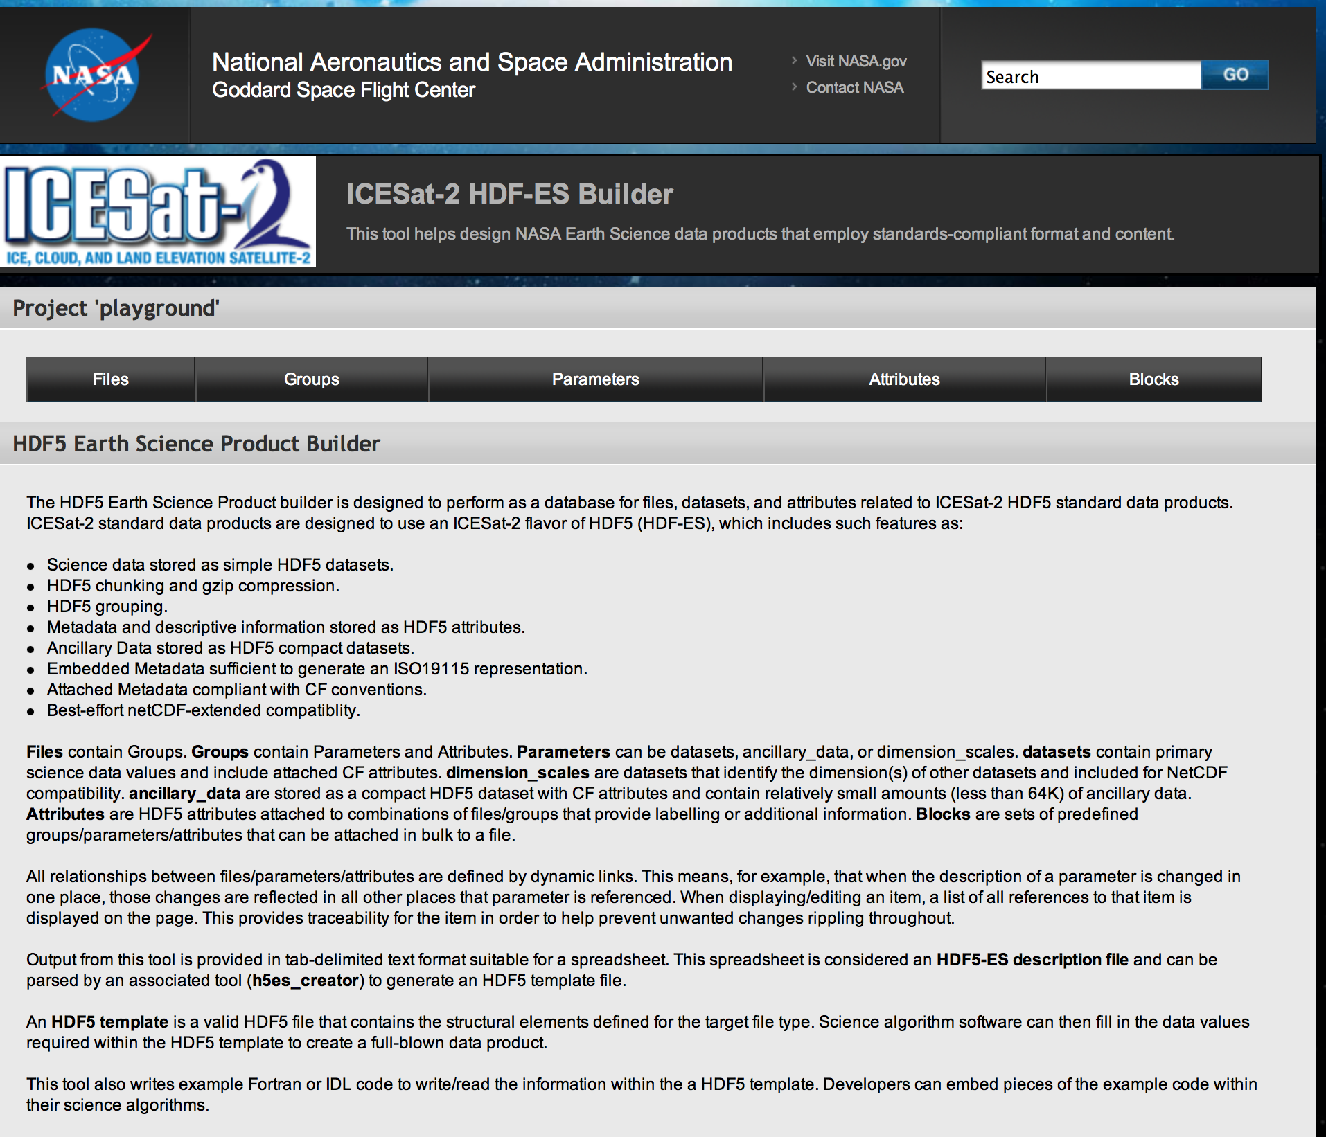
Main Page (top)
The Main Menu

Slide 36
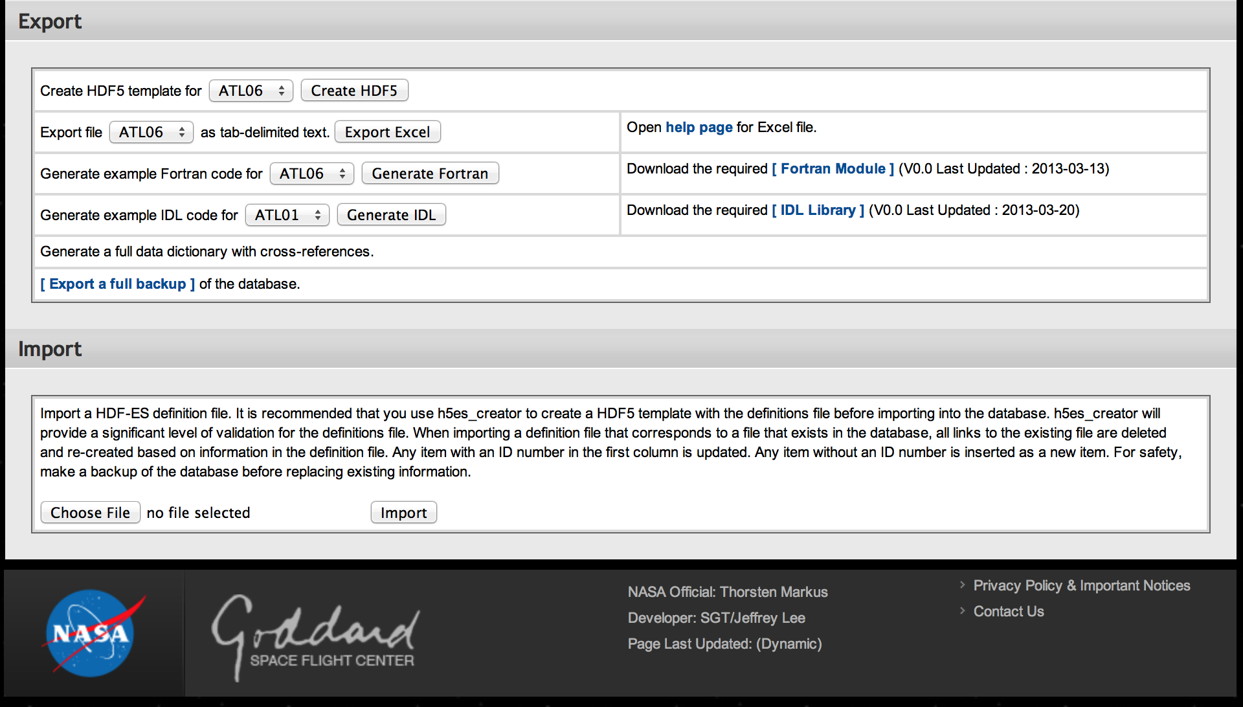
Main Page (bottom)
Main Menu:
Export Options
Import
Options

Slide 37
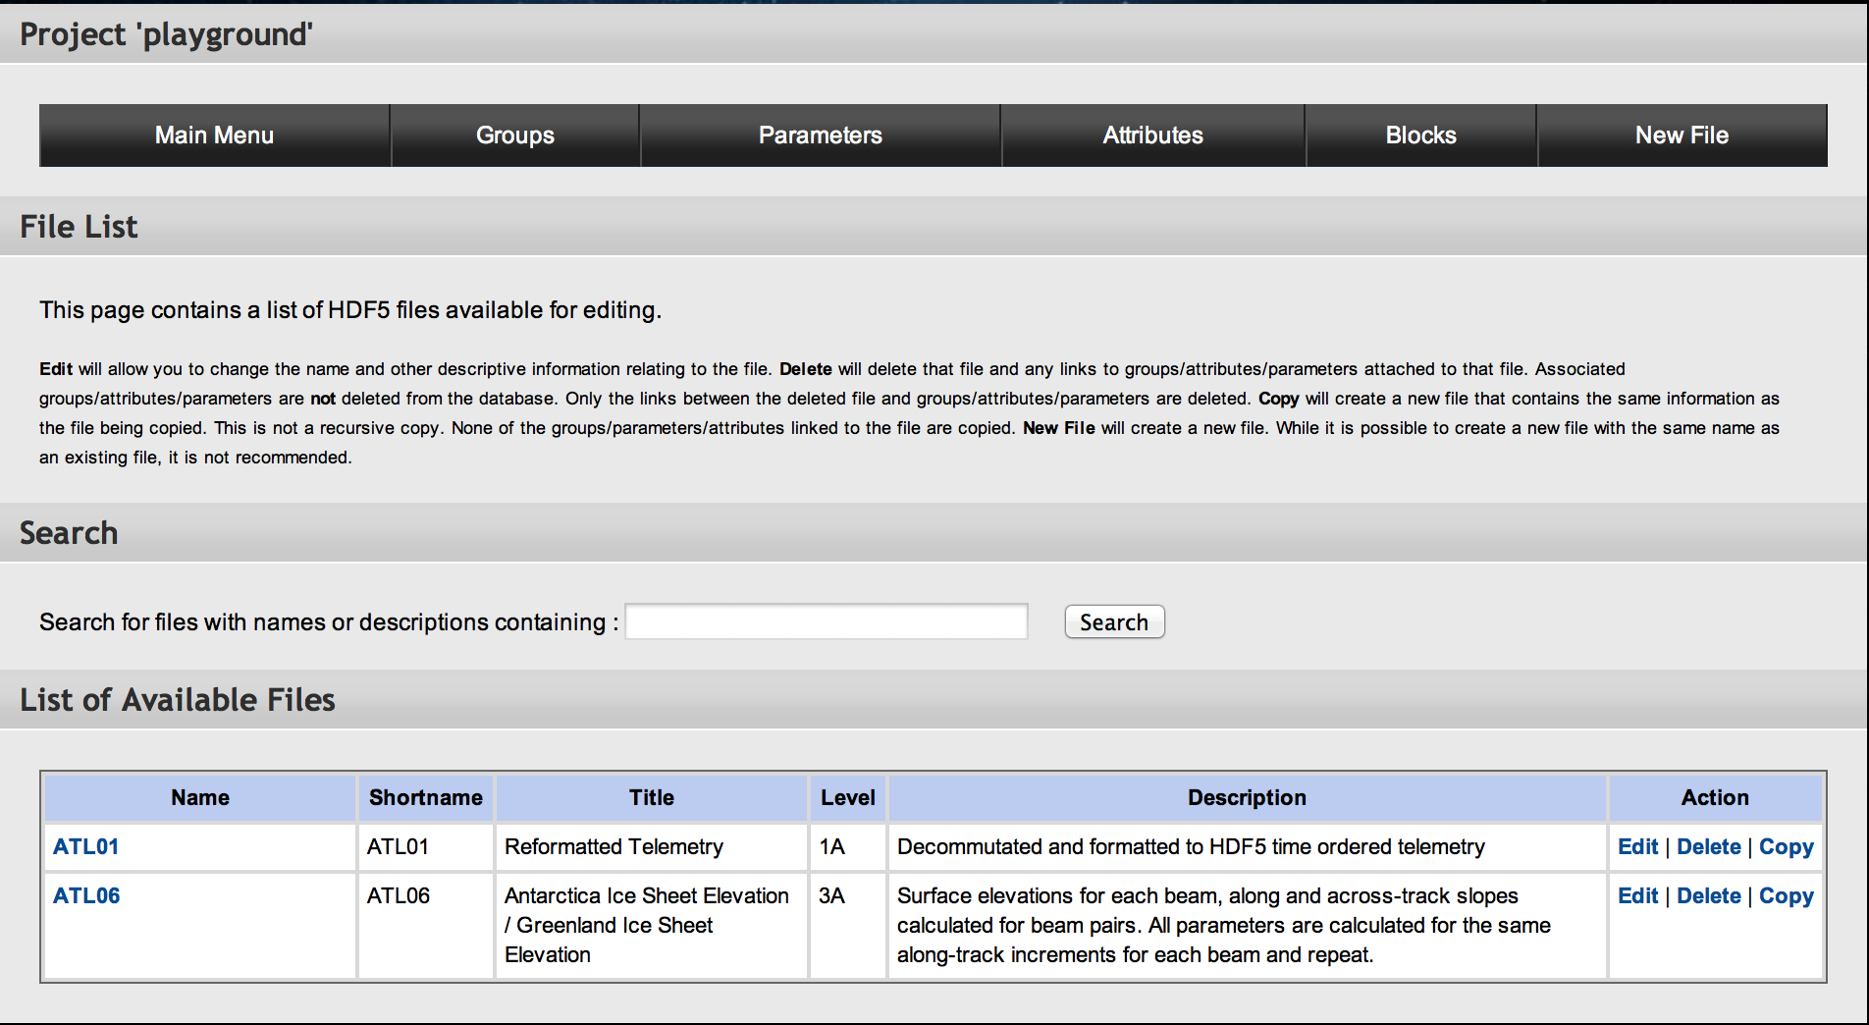
List of Files
Files: Listing

Slide 38
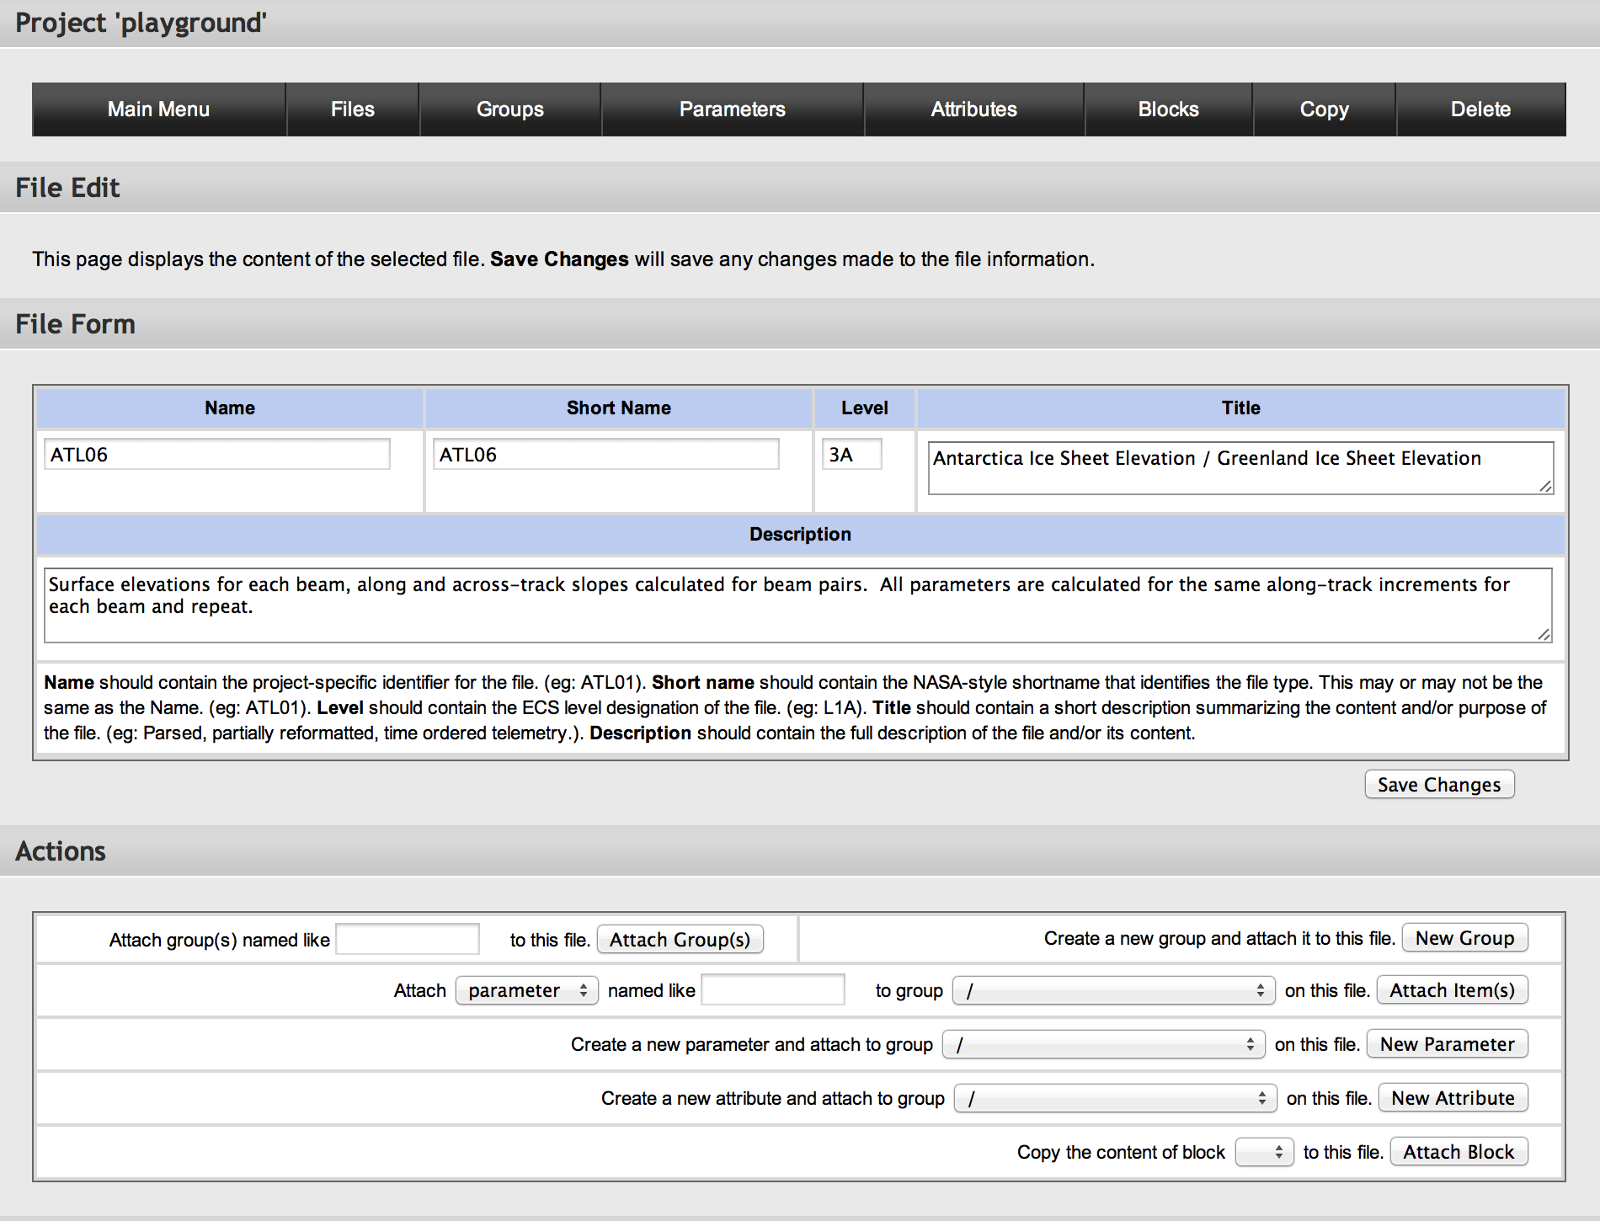
File Form
Files:
Fields
Files:
Attachment Options

Slide 39
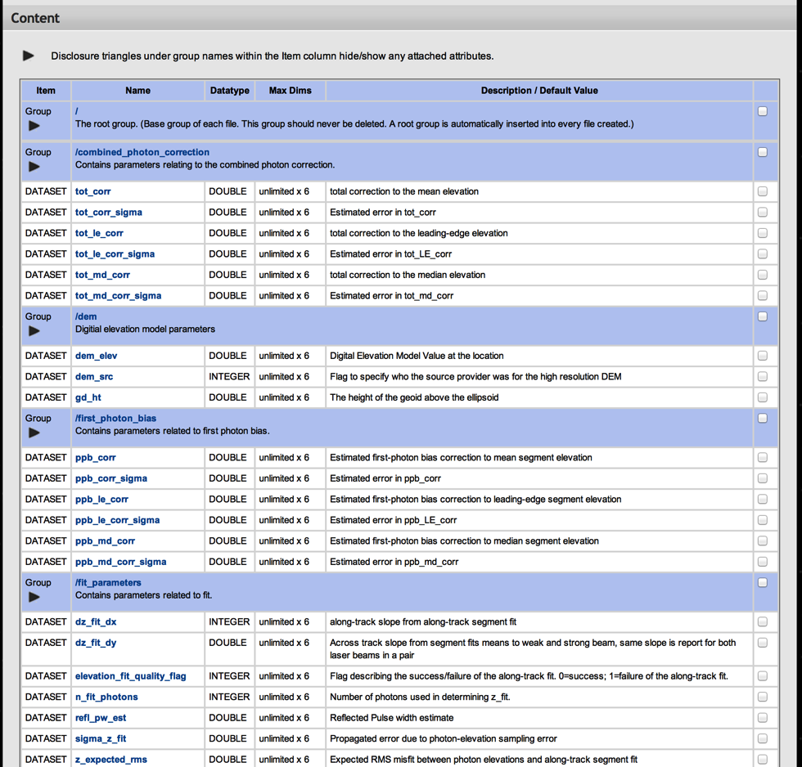
File Content
Files:
Content Listing

Slide 40
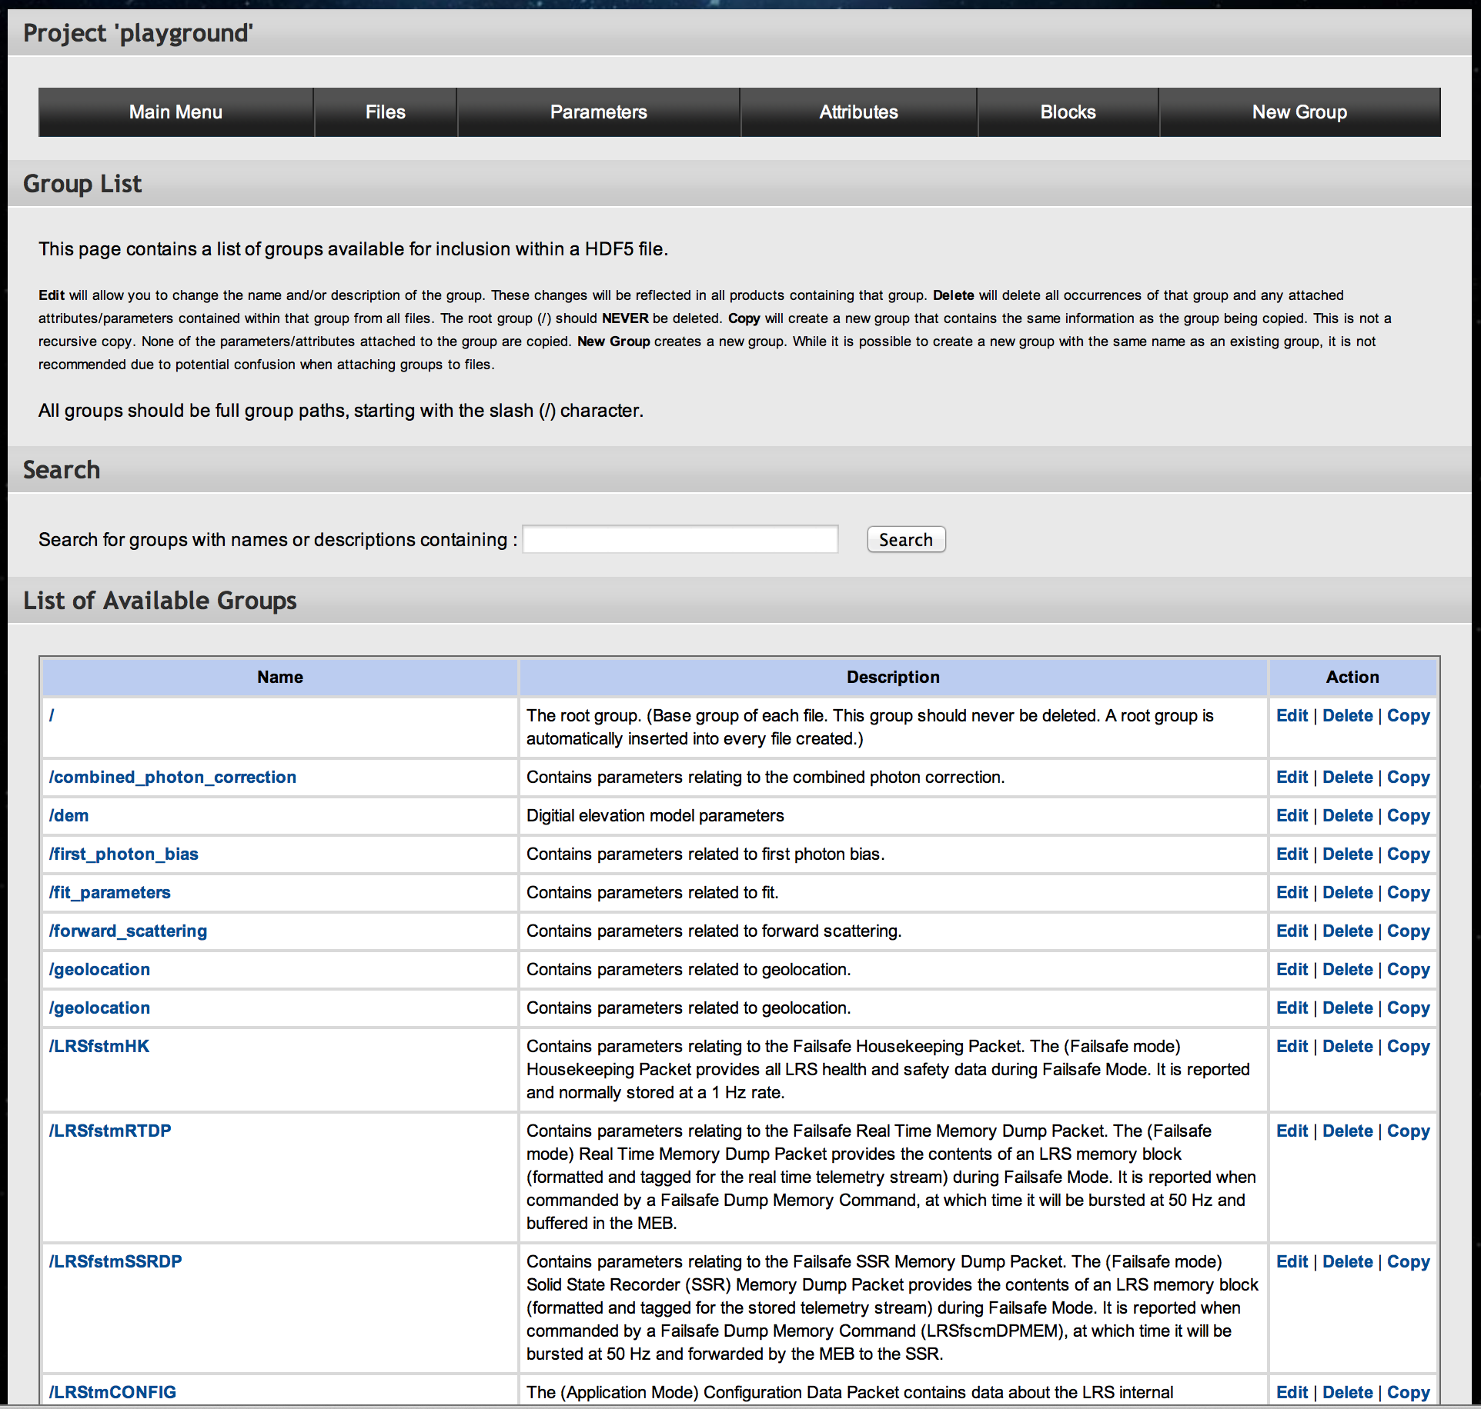
List of Groups
Groups :
List

Slide 41
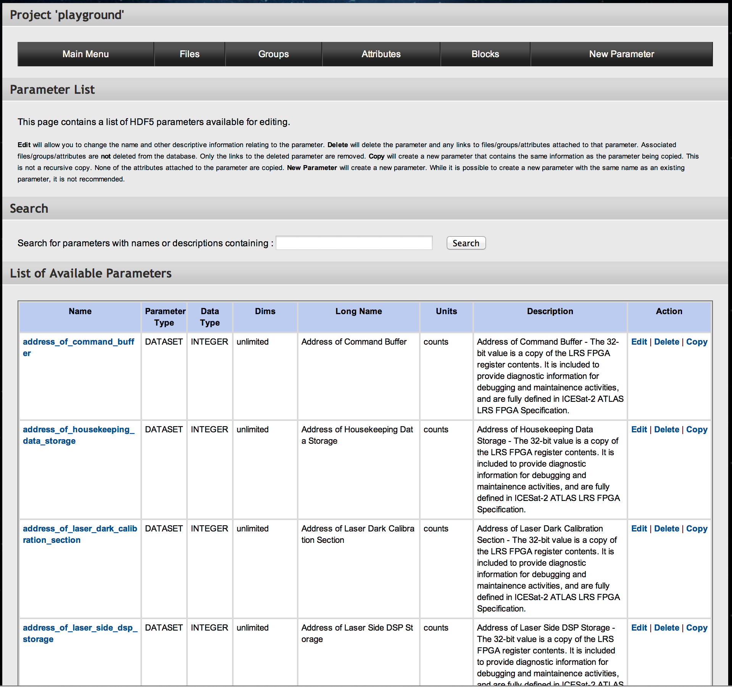
List of Parameters
Parameters:
List

Slide 42
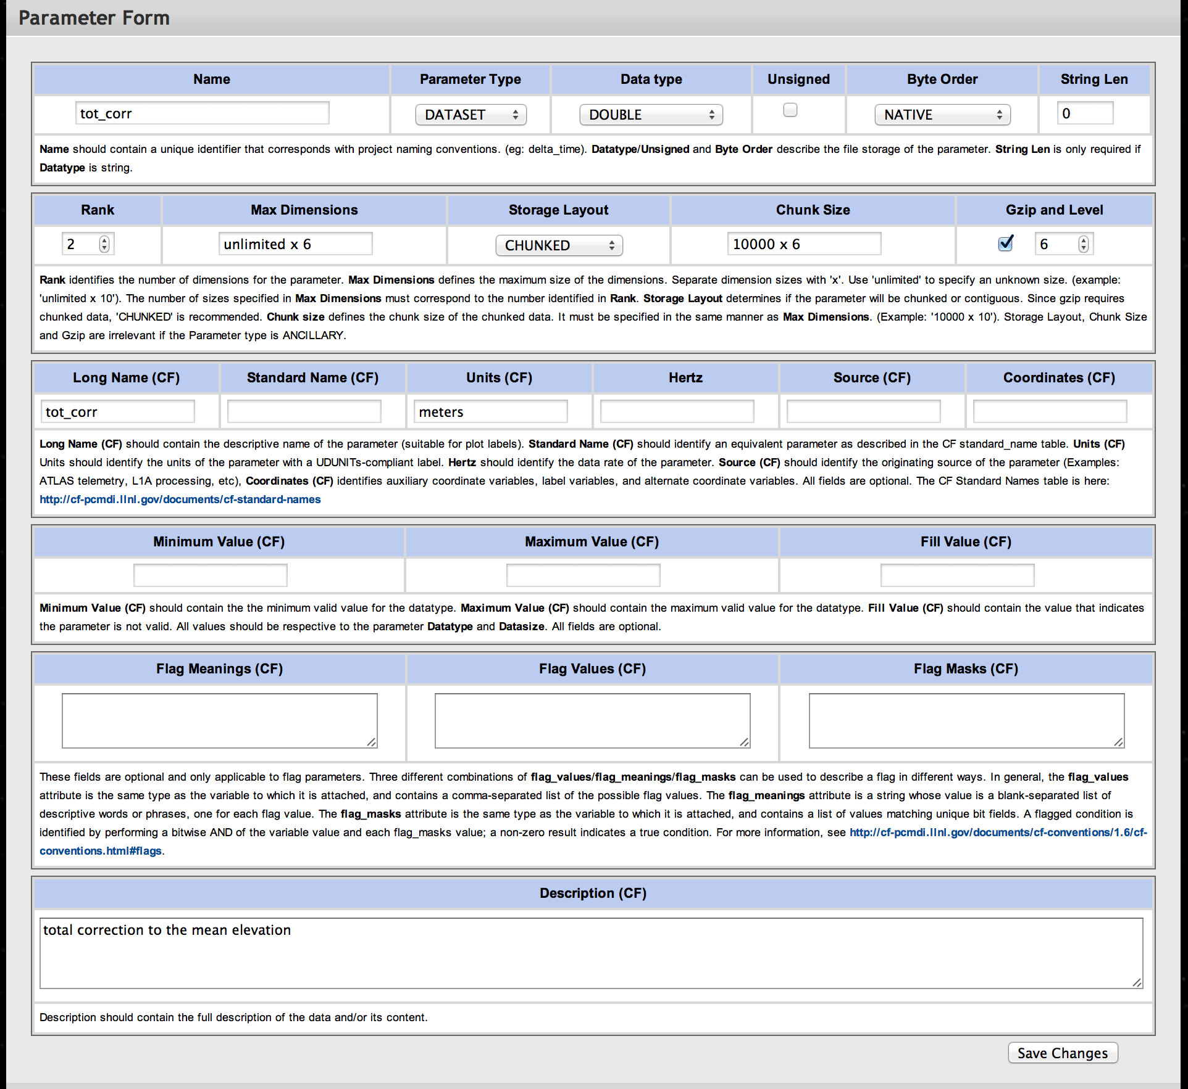
Parameter Contents
Parameters:
Fields

Slide 43
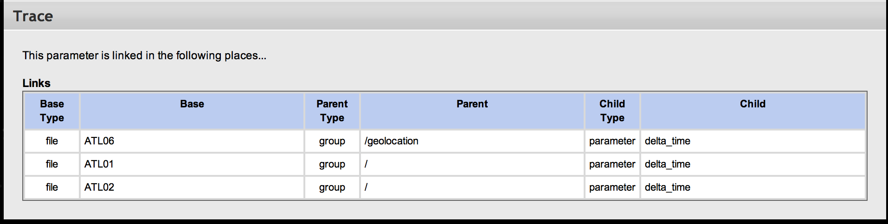
Parameter Trace
Parameters:
Trace

Slide 44
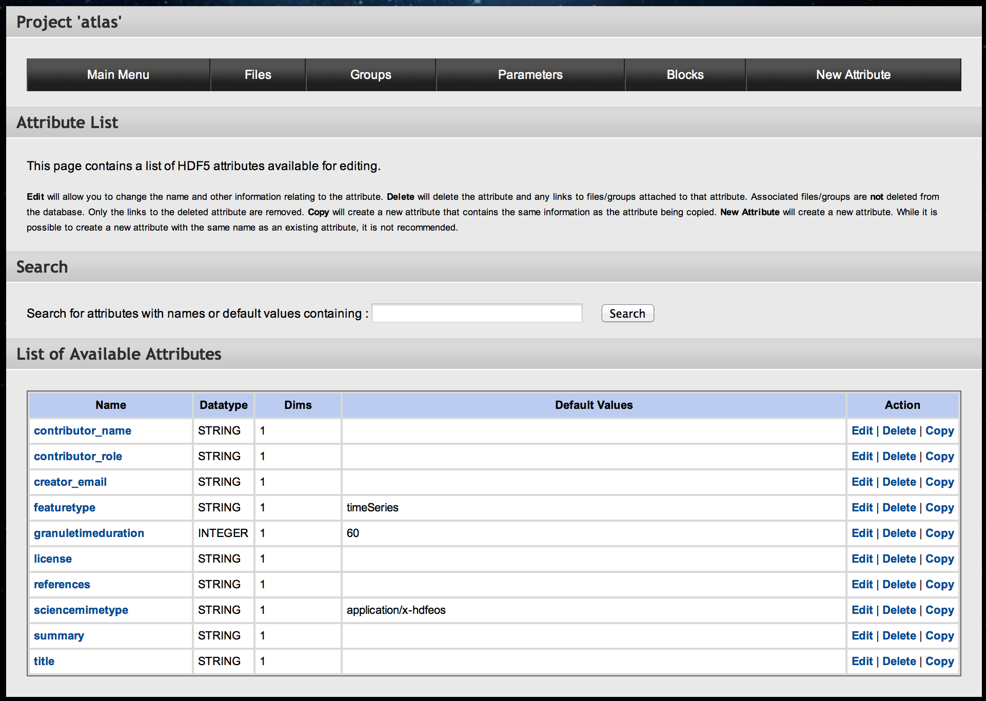
List of Attributes
Attributes:
List

Slide 45
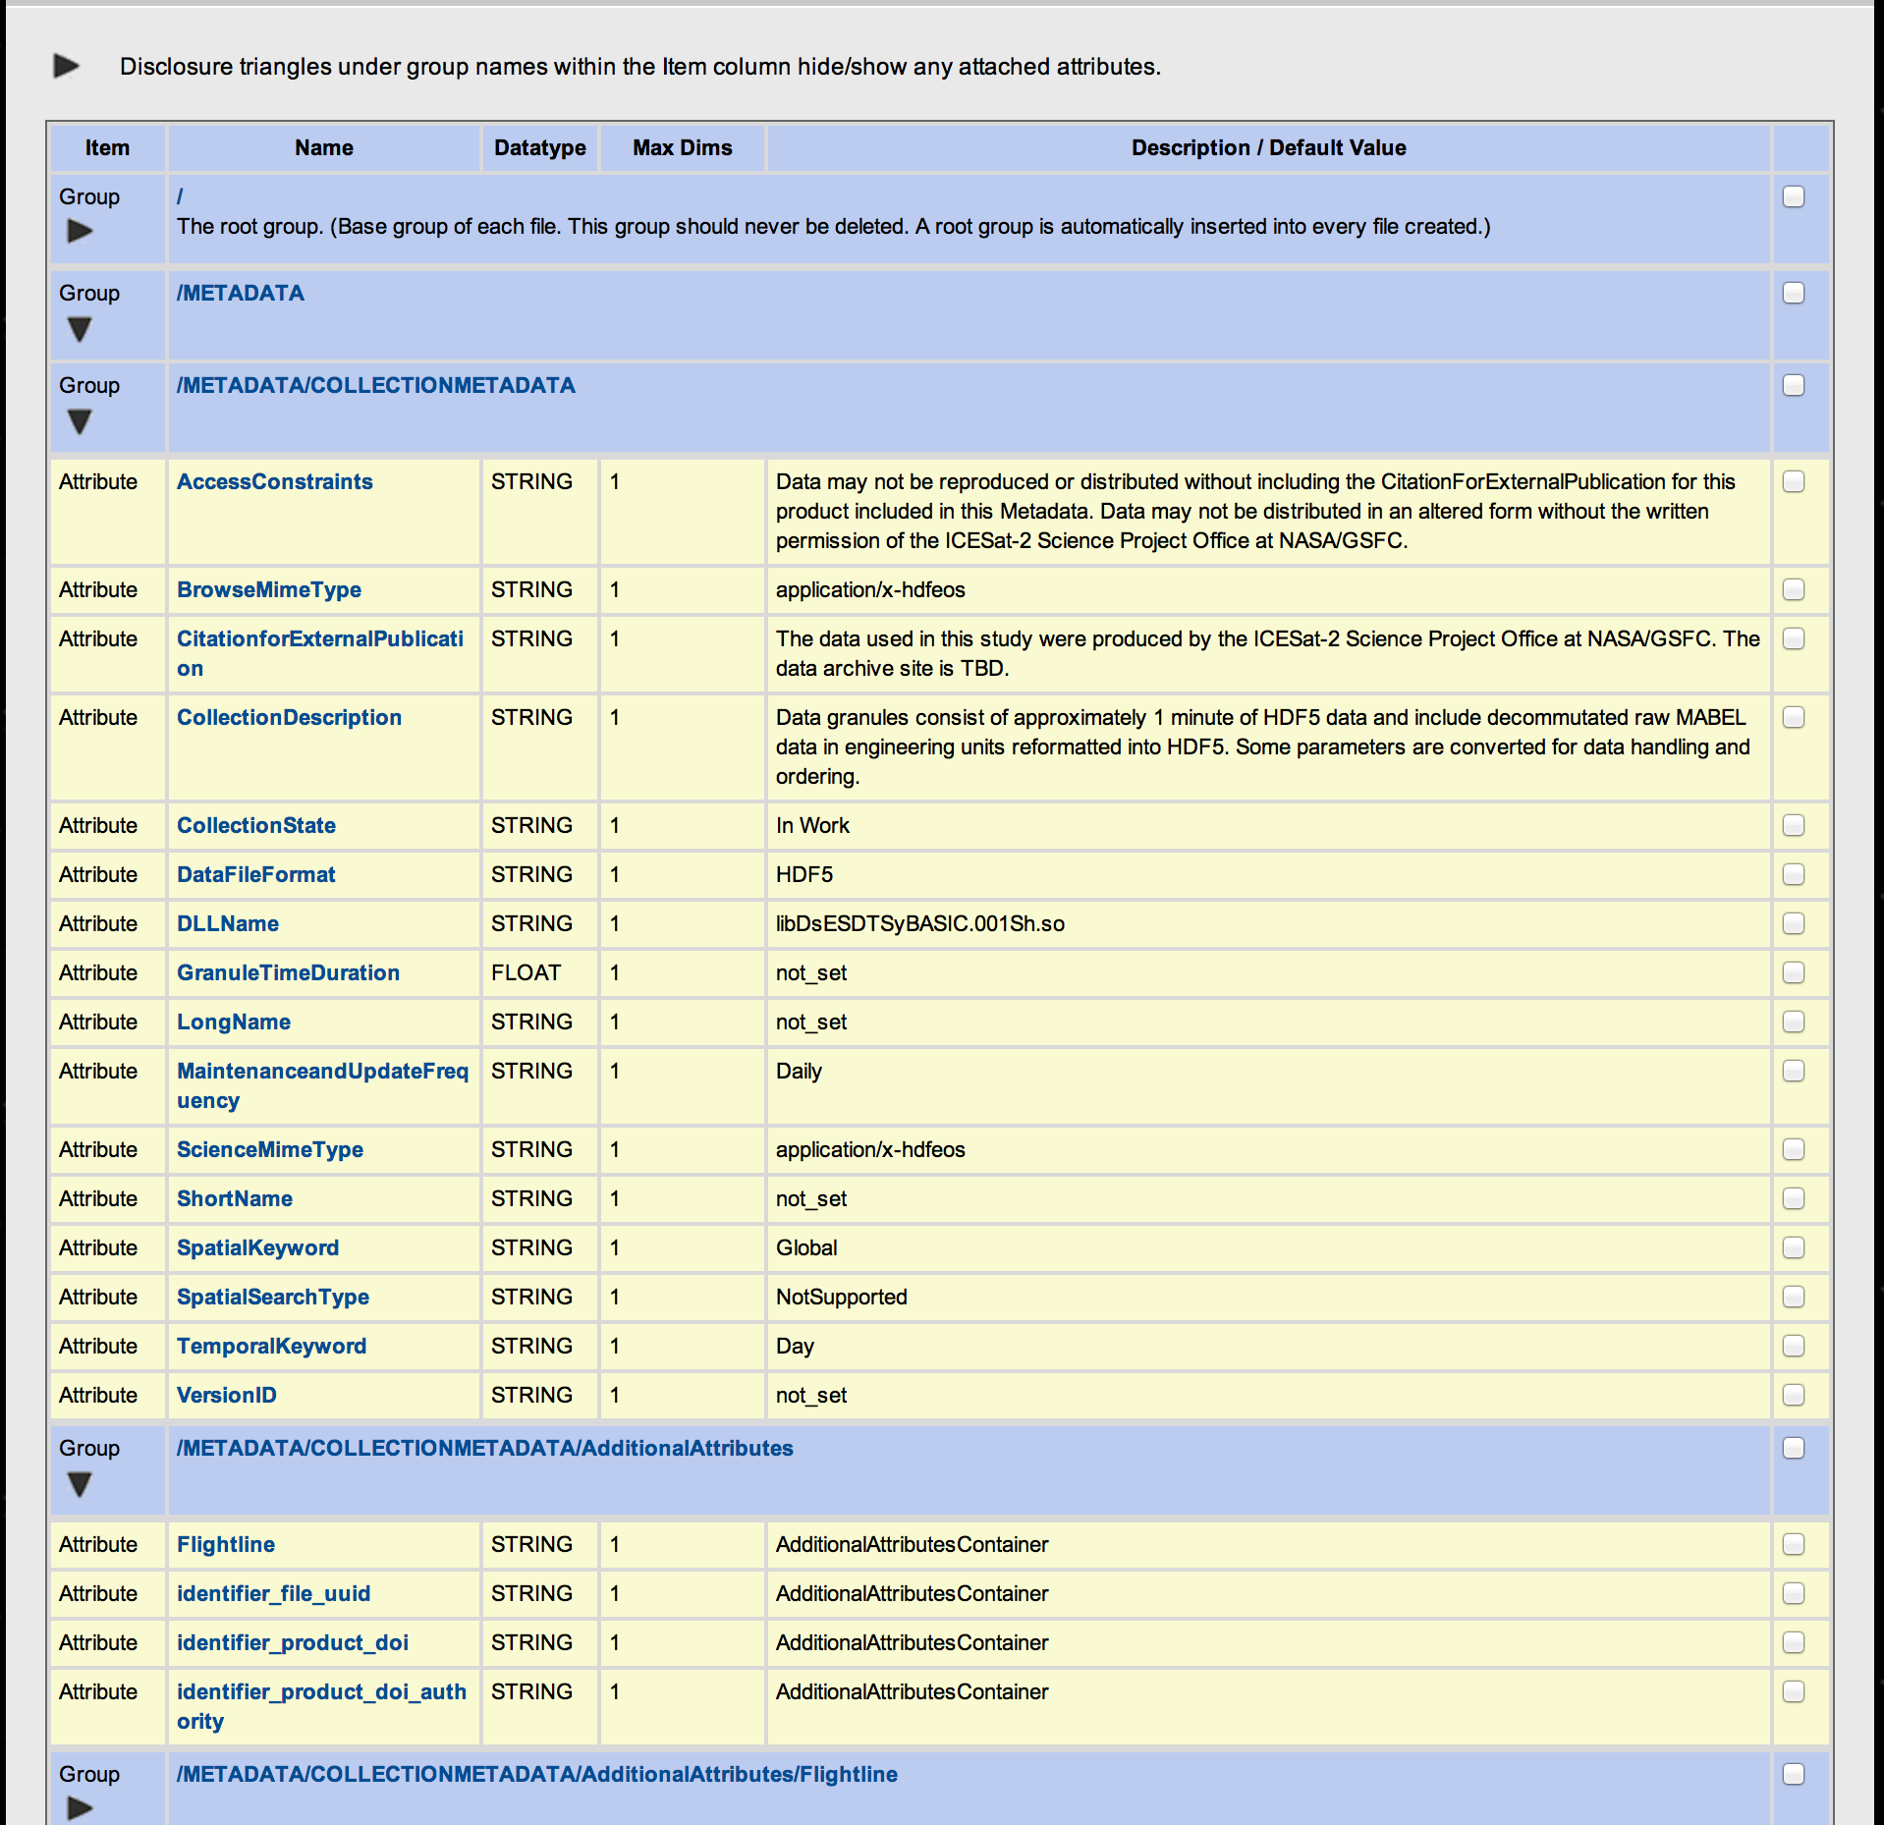
Attributes Attached to Group/File
Attributes:
Attached to a Group

Slide 46
Does It Work?
Well, so far so good.

Slide 47
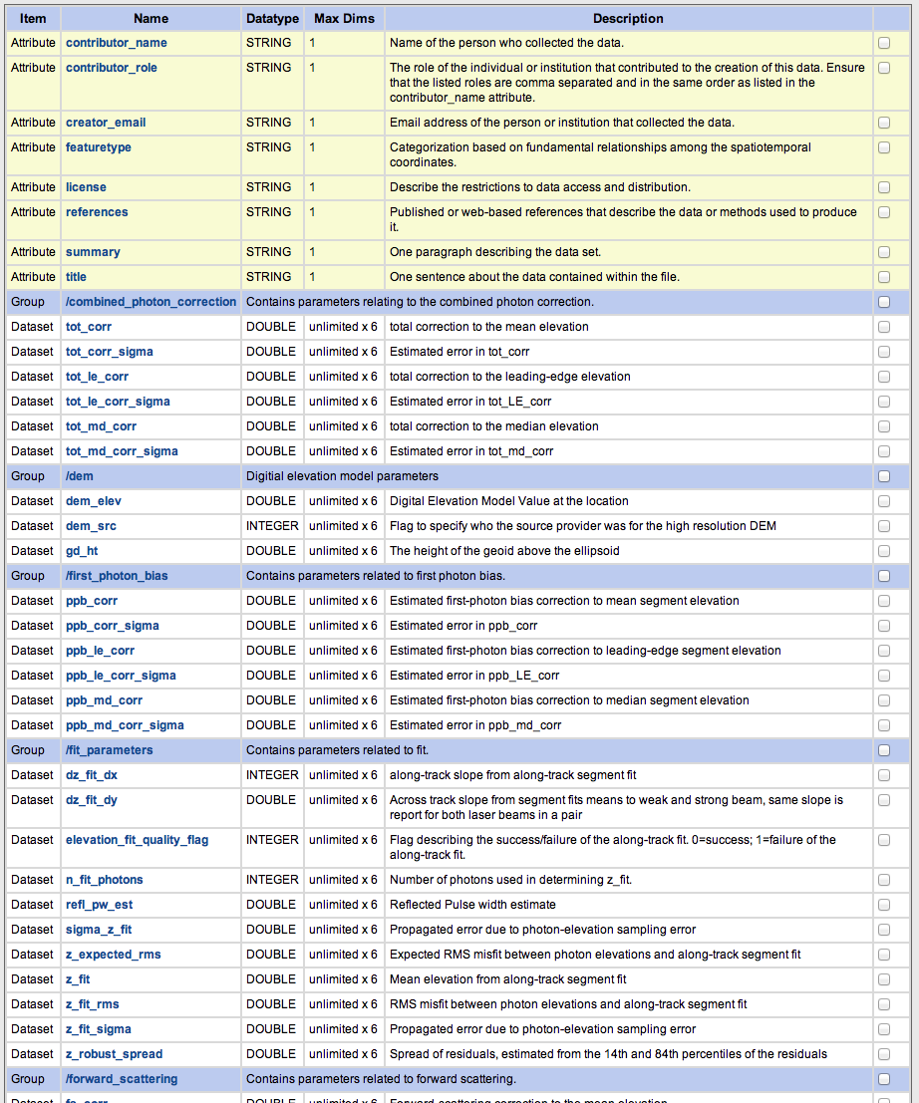
H5-ES Database Content
➔

Slide 48
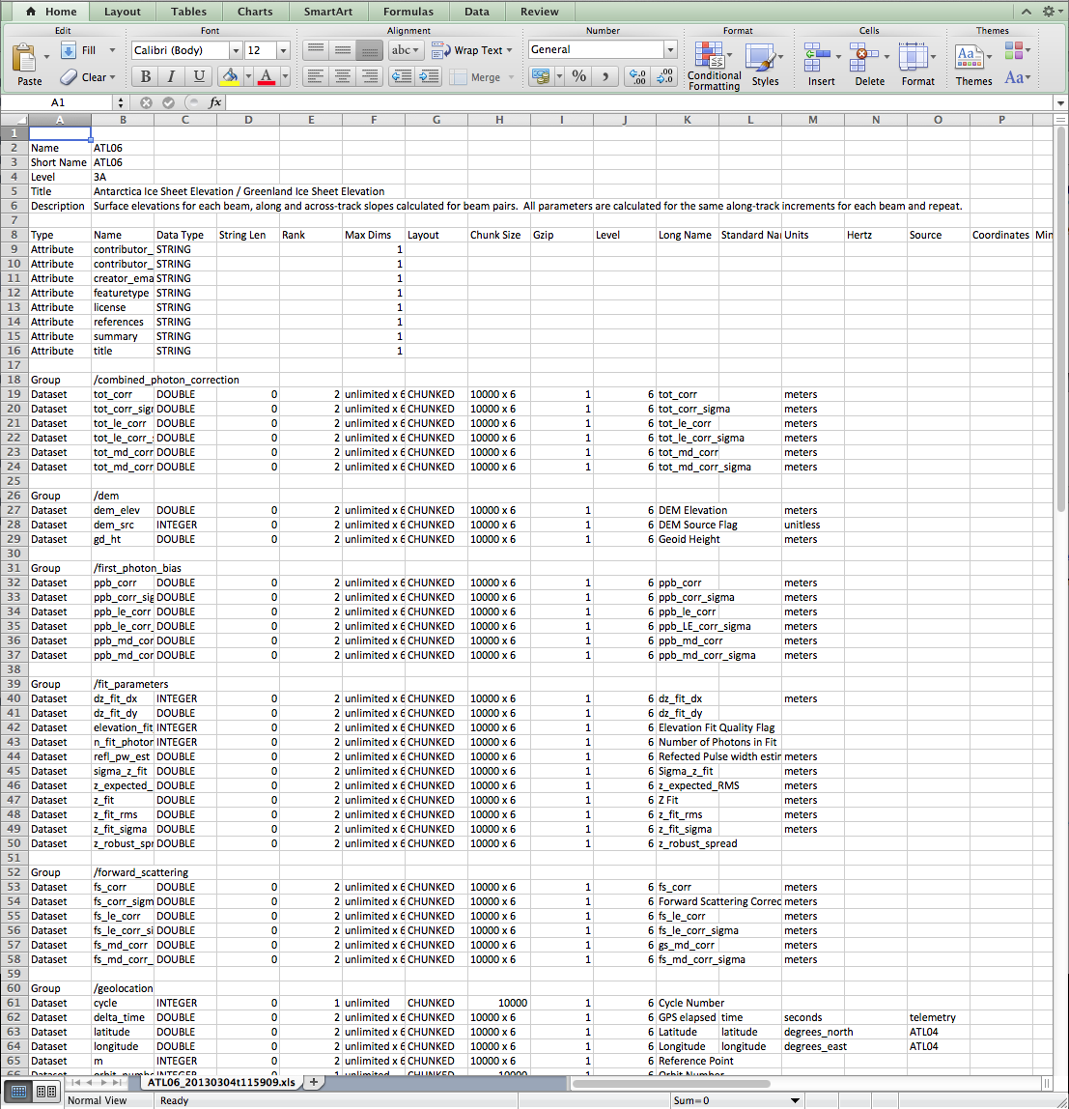
Exported into Excel
➔

Slide 49
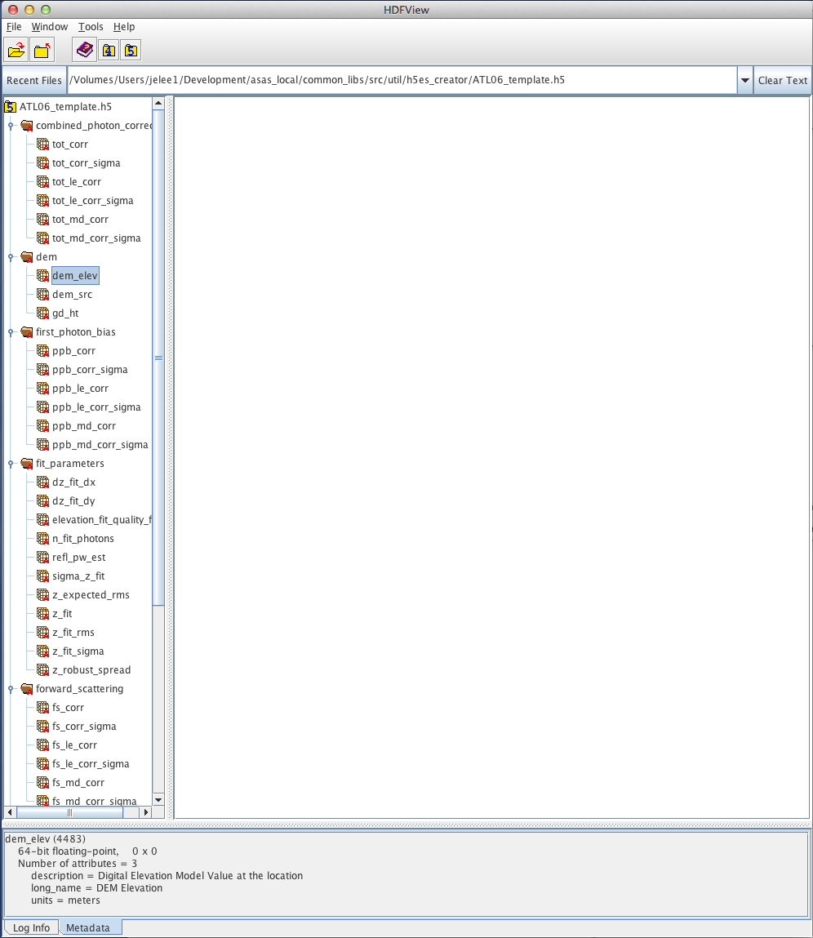
Template Generated & Displayed in H5View
Lines of Code Written=0

