Slide 1
SMAP
ISO Metadata in HDF5
ESIP – Summer 2013
Chapel Hill, NC
Barry Weiss
Jet Propulsion Laboratory
California Institute of Technology
Pasadena, CA
July 9, 2013

Slide 2
Presentation Outline
Metadata Coverage and Guidelines
SMAP ISO Requirement
Metadata Accessibility – HDF5 Group/Attribute
Multiple Instantiation of the Same Class
Simplification of Structure
Tool Chain Flow for Autogeneration
Steps Going Forward

Slide 3
Metadata Coverage
Product metadata – applies to the entire content of a data granule
  Mission specific information
  Spatial and time boundary information
  Data version information – algorithm, Science Processing Software (SPS), Science Data System (SDS) release, HDF5 version
  Granule lineage or pedigree
    Lists of the input that were used to generate a data granule
  Technical parameters that apply to the entire data granule
    Orbit mechanical data
    Instrument specific information
    Small tables of calibration and/or algorithmic coefficients
    Algorithmic parameters and options
  Data quality and completeness
  References to related documentation
Local metadata – applies to particular arrays in the product.
  Maxima, minima, units, dimension definitions, identification of statistical methods

Slide 4
Metadata Guidelines
The metadata shall provide users with adequate self descriptive information to enable an assessment of the content, the quality and the algorithmic conditions associated with any SMAP data product.
The metadata shall enable users to locate specific and appropriate sets of data that they need for their investigation.
The metadata shall enable users to correlate, interoperate and integrate SMAP data products with those generated by disparate sources, within and outside of NASA.

Slide 5
SMAP Requirement for Product Metadata
SMAP Level 1 Requirement: SMAP Science Data Product formats shall conform to ISO 19115 “Geographic Information – Metadata”.
ISO metadata must conform to these standards:
  Provide metadata that conforms to the family of ISO 19115 models
  Metadata represented using ISO 19139 compliant serialization
  Ultimate ISO goal – a global standard model in a global standard format
Major Goal: Generate SMAP products conform to the ISO requirement, while at the same time:
  Ensure that the products that are easy to use
  Ensure that the products have consistent design
  Provide metadata that are easy to locate

Slide 6
ISO 19139 Serialization
SMAP divides the ISO serialized metadata into two discrete packages:
  Dataset metadata
    XML is auto-generated with each executable instance
    SMAP software inserts auto-generated metadata into a single attribute in the HDF5 /Metadata Group named “iso_19139_dataset_xml
    SMAP SDS delivers auto-generated metadata along with each in a separate file to the Data Center
  Series metadata
    XML is curated
      Update the XML with each delivery
    SMAP software inserts curated series metadata into a single attribute in the HDF5 /Metadata Group named “iso_19139_series_xml”
    SMAP SDS delivers curated series metadata to the Data Center in a separate file before the SDS begins product delivery with each new release

Slide 7
Metadata Accessibility
ISO structure and serialization are ideal for machine access
  The ISO 19115 model has a well defined structure
  The ISO 19139 serialization adheres to that structure
    Combined standards provide data and relationships among the data elements in a very clear and regular form
ISO is not as accessible for product users
  The model instantiates the same class multiple times
    Attribute within the class indicates the specifics of each instantiation
    Attribute is not easily accessible
  The rich and complete ISO model is complex to the uninitiated
    Metadata includes algorithm parameters and run time parameters
    Locating specific metadata elements can be difficult
SMAP chose to start simple
  All product level metadata appear in the /Metadata Group
  Metadata also appear in clearly named elements and structure

Slide 8
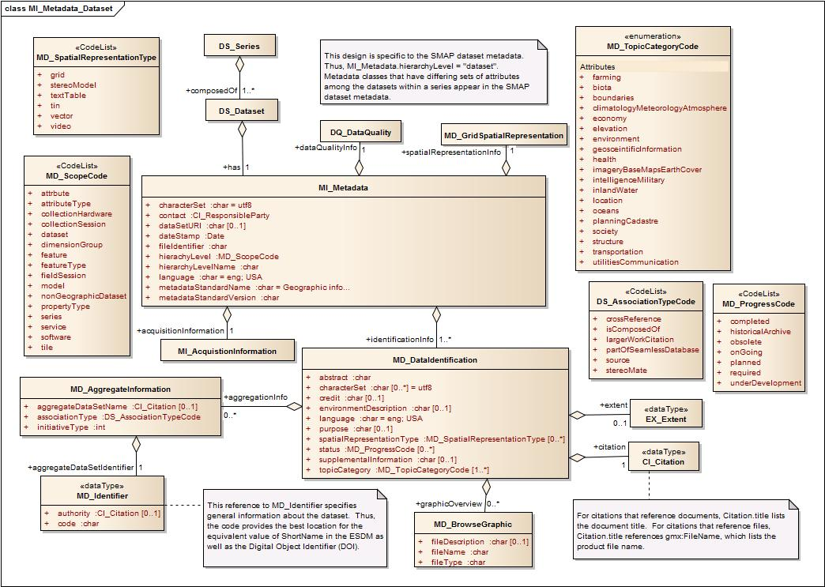
MI_Metadata Class

Slide 9
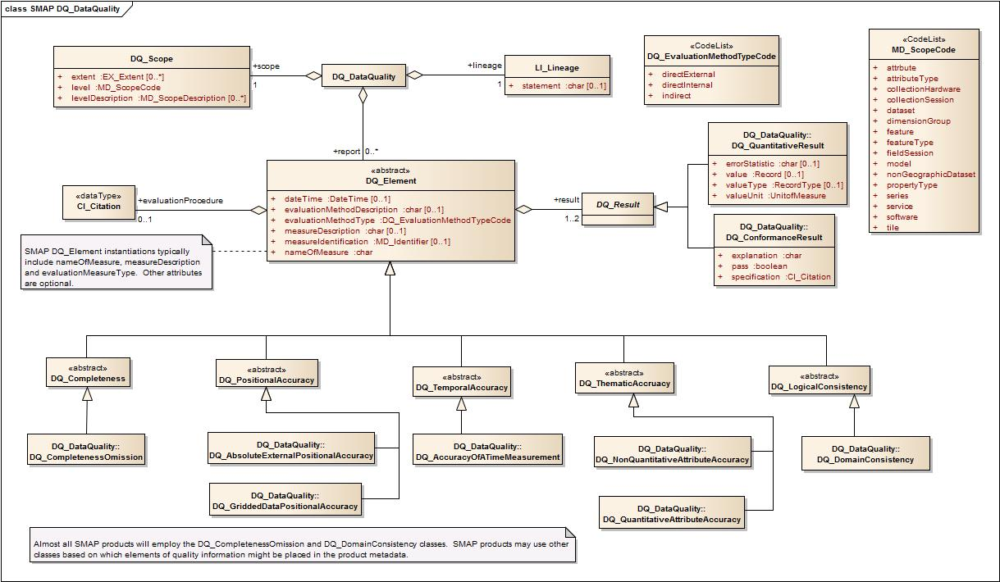
DQ_Quality Class

Slide 10
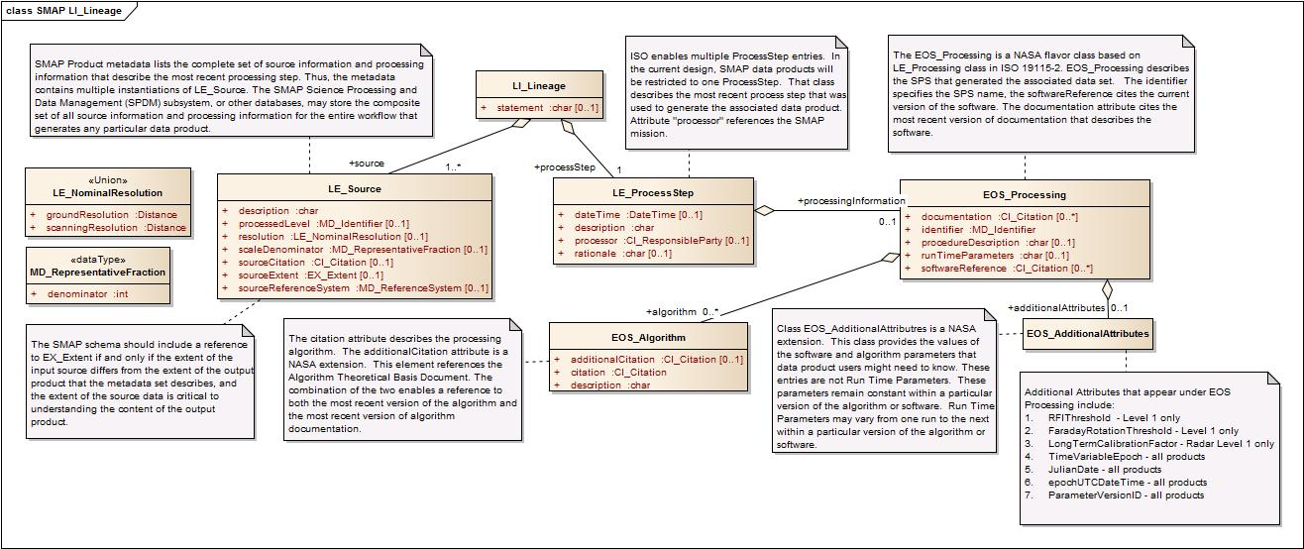
SMAP LI_Lineage

Slide 11
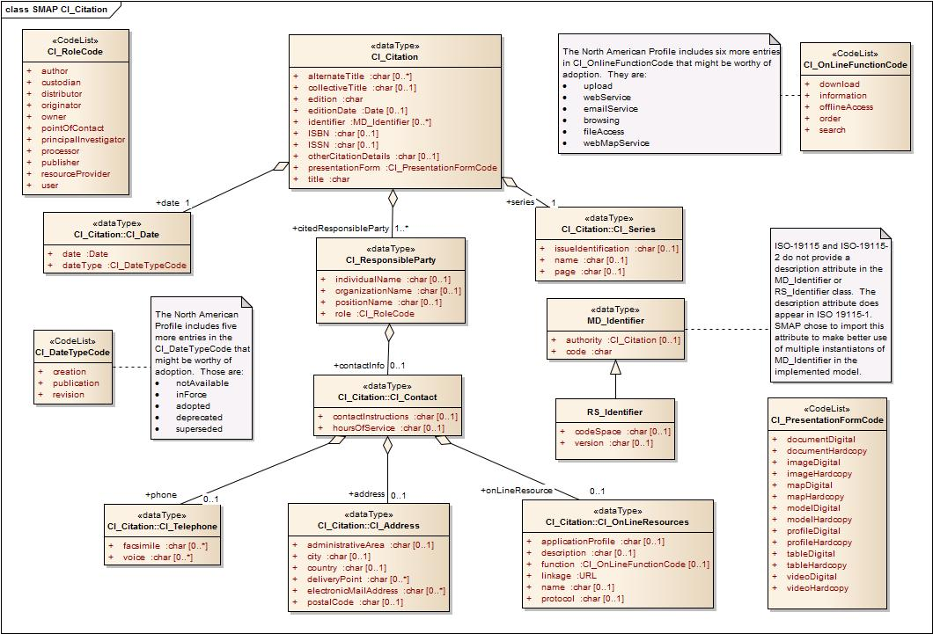
CI_Citation Class and Subclasses

Slide 12
Multiple Instantiations –
Lineage in SMAP Products
SMAP products employ a large number of input data sets. The Level 1C Radar Product employs the following input data sets:
  SMAP Level 1A Radar Product
  Spacecraft Ephemeris
  Spacecraft Attitude
  Spacecraft Antenna Azimuth
  Spacecraft Clock to UTC Correlation
  Short Term Calibration Data
  Long Term Calibration Data
  Total Electron Content in the Ionosphere
  Digital Elevation Map
  Antenna Pattern
  Block Floating Point Quantization Decoder
Each source requires an instantiation of the LI_Lineage/LE_Source class
  In Group/Attribute structure, these elements fall in the /Metadata/Lineage HDF5 Group
  Subgroups names reflect the input product described in the group

Slide 13
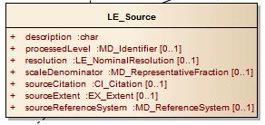
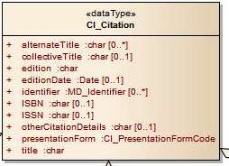
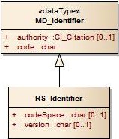
Lineage Example
Radar Level 1A metadata contain 11 instances of LE_Source
Identifier that specifies the Lineage element for each instantiation is in: LE_Source/sourceCitation/CI_Citation/identifier/MD_Identifier/code

Slide 14
Group/Attribute Metadata Structure
Employ HDF5 groups and attributes to represent ISO metadata
Multiple sub-groups under the HDF5 Metadata group
  Groups represent major ISO classes
Attributes map directly to attributes in the ISO classes
  Reduces deeply nested layers within the HDF5 representation
    No more than four nested layers
  In some instances, the design employs modified names of HDF5 groups or attributes to ease user comprehension of the model.
  The HDF group/attribute structure provides a representation layer that is more user friendly

Slide 15
SMAP Rationale
Both the ISO 19139 XML and the HDF Group/Attribute structure must reflect the ISO model.
  Exclusive use of the model layer would require the development of tools that enable users to find the metadata they seek
  The Group/Attribute structure is, in effect, a tool to ease access
Over time, the continued use of ISO model will engender the development of tools and interfaces that ease direct access with ISO serialization

Slide 16
ISO Metadata Structure Example
ISO 19115 Group/Attribute Model for Lineage in the SMAP L1C Radar Product
/Metadata/Lineage/
  L1A_Radar
    DOI = http://dx.doi.org/10.5067/smap/radar/data100
    creationDate = 2015-05-30
    description = Parsed and reformatted SMAP radar telemetry. The Level 1A Product contains both synthetic aperture radar data and real aperture radar data. The product also includes loopback data as well as health and status data.
    fileName = SMAP_L1A_Radar_00016_A_20150530T160100_R04001_001.h5
    identifier = L1A_Radar
    version = R04001
  Ephemeris
    creationDate = 2015-05-29
    description = One or more data products that list the spacecraft trajectory over the same time period as the input Level 1A radar data.
    fileName = traj_SPK_1505291400_1512291400_1505311200_sci_OD0945_v01.bsp
    version = 01
  AntennaAzimuth
    creationDate = 2015-05-30
    description = One or more data products that specify the azimuth angle of the antenna on the SMAP spacecraft over the same time period as the input Level 1A radar data.
    fileName = smap_ar_150530153500_150530172515_v01.bc
    version = 01
  Attitude
  ……….

Slide 17
Model Complexity –
Locating Algorithm Parameters

Slide 18
Locating Algorithm Parameters
ISO 19115 Group/Attribute Model for Process Step in the SMAP L1C Radar Product
Process Step
RFI_Threshold = 2.0
FaradayRotationThreshold = 1.4 degrees
waterBodyThreshold = 30 percent
timeVariableEpoch = J2000
epochJulianDate = 2451545.00
epochUTCDateTime = 2000-01-01T11:58:55.816Z
parameterVersionID = 004
algorithmTitle = Soil Moisture Active Passive Synthetic Aperture Radar processing algorithm
algorithmVersionID = 007
algorithmDate = 2015-05-31
……….
……….
Provides Direct Access to Critical Metadata Elements within the HDF5 Structure
Items in Red are Additional Attributes.
Represented in XML as Record/Record Types

Slide 19
Major Groups in
HDF5 Group/Attribute Structure
The following are HDF5 groups in the SMAP Group/Attribute Structure. Each maps to an instantiation of an ISO class:
AcquisitionInformation
DataQuality
DatasetIdentification
Extent
GridSpatialRepresentation
Lineage
OrbitMeasuredLocation
ProcessStep
ProductSpecificationDocument
QADatasetIdentification
SeriesIdentification

Slide 20
SMAP Tool Chain Flow
Metadata Configuration File
SMAP Specific XML
SMAP Science Processing Software
SMAP Product in HDF5 with Metadata in Group/Attribute Structure
Output Configuration File
SMAP Specific XML
h5dump
Complete Group/Attribute Structure in HDF5 XML
saxon
Automated Metadata in ISO 19139 Compliant Serialization
Curated Series Metadata in ISO 19139 Compliant Serialization
merge
XSL that maps transform form HDF5 XML to ISO 19139 XML
SMAP Product in HDF5
with Metadata in Group/Attribute Structure and in ISO 19139 Compliant XML

Slide 21
Steps Going Forward
ISO offers huge promise
  Common metadata model for all Earth Science Data Products
  Common metadata representation for all Earth Science Data Products
ISO is in early stages of real implementation
  Experience will dictate best methods for user access
  Tools for ISO extraction are not commonly available
SMAP employed a modified representation
  Provides access to metadata in HDF5 environment in an ISO-like model
NASA/SMAP will collaborate with theh HDF Group, other teams that generate Science Data Software
  Effort to incorporate methods that extract metadata directly and seamlessly for science data users

Slide 22
Backup

Slide 23
Global Metadata – ISO 19115
“Geographic Information - Metadata” from the International Organization for Standardization
    Provides a standardized means to describe Earth data
    Provides a means to make products “self descriptive and independently understandable”
    Incorporates all of the major categories required for a complete set of global metadata for each product granule
    Incorporates all of the major categories required to generate a complete set of collection metadata.
    Enables fulfillment of the requirement “to correlate, interoperate and integrate SMAP data products with those generated by disparate sources”.
    Uses standardized XML serialization to ease portability to the wider user community. Standard specified in ISO 19139.

Slide 24
CF Convention – Local Metadata
The Climate and Forecast (CF) is a highly descriptive metadata convention with a widespread science user community
  CF designed specifically designed to fit within attributes in netCDF files.
  CF is based upon the Cooperative Ocean/Atmospheric Data Service (COARDS) standard
The CF convention includes:
  A standard to provide descriptive names for each variable in the product
  Standards for the specification of data units for each variable in the product
    UDUNITS provides a list of supported unit names
  Standards for fill values for each variable in the product
  Standards to express the range of data for each variable in the product
  Standards to express bit flag definitions and define flag values
  Standards to specify relationships between spatial and time coordinates for each variable in the product
    Indicates which particular spatial or temporal coordinates correspond with which dimension axes and indices of a data variable.
  Standards to specify statistical methods that were used to calculate each variable in the product
    Clarifies temporal or spatial intervals that were used to provide statistical results.

Slide 25
Dataset Metadata
Developed an XSLT that maps the HDF5 group/attribute metadata in each data product granule into a representation that complies with ISO 19139 XML encoding
  Near the completion of each executable run, the SMAP software:
    Dumps the group/attribute metadata into HDF5 XML.
    Executes the open source Saxon XSLT engine to convert HDF5 XML to ISO 19139 XML.
    Incorporates the ISO 19139 compliant dataset metadata into an HDF5 attribute in the output data product granule
    Incorporates the curated ISO 19139 series metadata into a separate HDF5 attribute
  The SMAP mission delivers the ISO dataset 19139 compliant metadata to the Data Centers in two forms
    Embedded in the data product metadata for the user community
    In a collocated file for Data Center ingestion
      The separate file does not travel with the product

Slide 26
Curated Series Metadata
Systems Engineers curate the series metadata for each data product
  Model is ISO 19115 compliant with a few SMAP extensions
  Encoding is ISO 19139 compliant
  One file represents a specific SMAP data product for each build
The SMAP SDS delivers the curated series metadata to ESDIS with each build.
  This delivery enables ingestion of data products at the Data Centers
SMAP software automatically incorporates the entire series metadata into a single HDF5 attribute in each data product granule

Slide 27
Standard Representation of
Additional Attributes
<eos:additionalAttribute>
<eos:EOS_AdditionalAttribute>
<eos:reference>
<eos:EOS_AdditionalAttributeDescription>
<eos:type>
<eos:EOS_AdditionalAttributeTypeCode codeList="http://earthdata.nasa.gov/metadata/resources/"
codeListValue="processingInformation">processingInformation</eos:EOS_AdditionalAttributeTypeCode>
</eos:type>
<eos:identifier>
<gmd:MD_Identifier>
<gmd:code>
<gco:CharacterString>uuid for epochJulianDate</gco:CharacterString>
</gmd:code>
<gmd:codeSpace>
<gco:CharacterString>http://smap.jpl.nasa.gov</gco:CharacterString>
</gmd:codeSpace>
</gmd:MD_Identifier>
</eos:identifier>
<eos:name>
<gco:CharacterString>epochJulianDate</gco:CharacterString>
</eos:name>
<eos:dataType>
<eos:EOS_AdditionalAttributeDataTypeCode codeList= http://earthdata.nasa.gov/metadata/resources/Codelists.xml#EOS_AdditionalAttributeDataTypeCode codeListValue="FLOAT">FLOAT</eos:EOS_AdditionalAttributeDataTypeCode>
</eos:dataType>
</eos:EOS_AdditionalAttributeDescription>
</eos:reference>
<eos:value>
<gco:CharacterString>2451545</gco:CharacterString>
</eos:value>
</eos:EOS_AdditionalAttribute>
</eos:additionalAttribute>

