Slide 1
Cool Tools
Esri ArcGIS
Chapel Hill, NC
July 9-12th, 2013
Brandi Quam &
Emily Northup

Slide 2
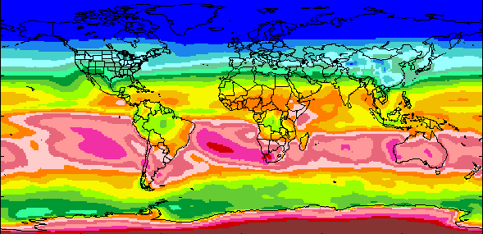
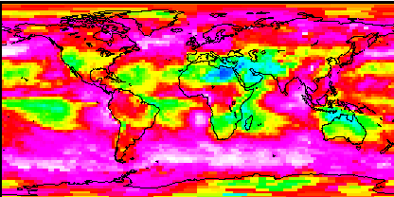
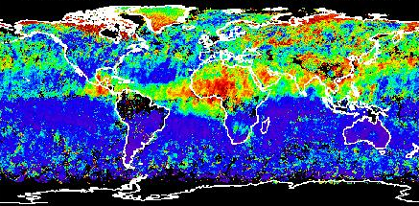
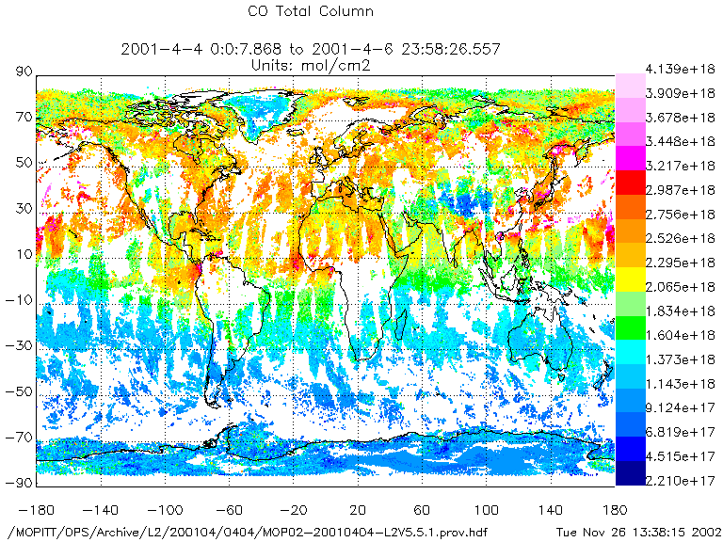
The ASDC at a Glance
Provides data services for over 42 science projects
Primary: CERES, MISR, CALIPSO, ISCCP, SAGE III, MOPITT, TES
Distributes 300+ unique science products
In 2012, 590 Terabytes of data were distributed to over 142,000 customers in 160 countries
2.41 Petabytes of data are in the archive as of Dec 2012
Over 88 million files (1,874 Terabytes) on high-speed disk for quick access
Radiation Budget
Clouds
Aerosols
Tropospheric
Chemistry
Primary Functions
Receive (Ingest) data from numerous data providers to archive and support science driven requirements
Archive data to ensure the long term preservation, provenance, and proper use of the science data
Process data in current and managed environments to create higher level data products for science community
Distribute data to as many scientific communities as possible in as many formats and through as many mechanisms as possible
Provide customer support and outreach to the science community to support science teams and facilitate use of data products and associated technologies by current and emerging users

Slide 3
Esri Pilot
Goal is to utilize Geographic Information System (GIS) technology that can increase discoverability and accessibility of the earth science data holdings of ASDC
Provides data in GIS formats and Open Geospatial Consortium (OGC) compliant services
    Including: WMS, WCS, and WPS
Allows ASDC to reach new user communities and enhance capabilities for current customers
Data can be used in new ways: increased understanding of Earths radiation budget, clouds, aerosols, and tropospheric chemistry

Slide 4











































HIFLD Official Members
Over 5,200 Contributing Partners From
14 Executive Departments, 94 Agencies and 50 States
Homeland Infrastructure Foundation Level Data (HIFLD) Working Group
5

Slide 5
Pilot Objectives
Once Esri pilot moves beyond test phase (operational)
    Overcoming challenges of utilizing HDF and NetCDF files with a GIS
    Solid partnerships across the GIS community
    Easy discovery of ASDC Data Products through ECHO, Geospatial Platform, and Data.gov
    New and greater use of ASDC and inter-DAAC data holdings

Slide 6
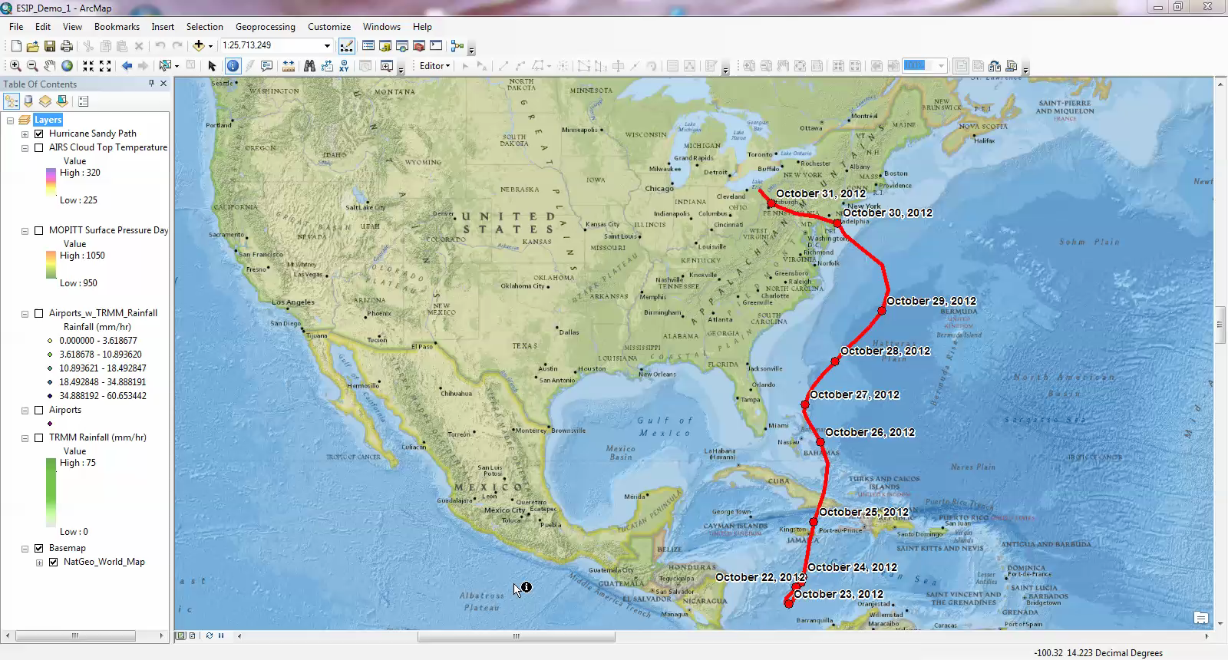
Demo 1

Slide 7
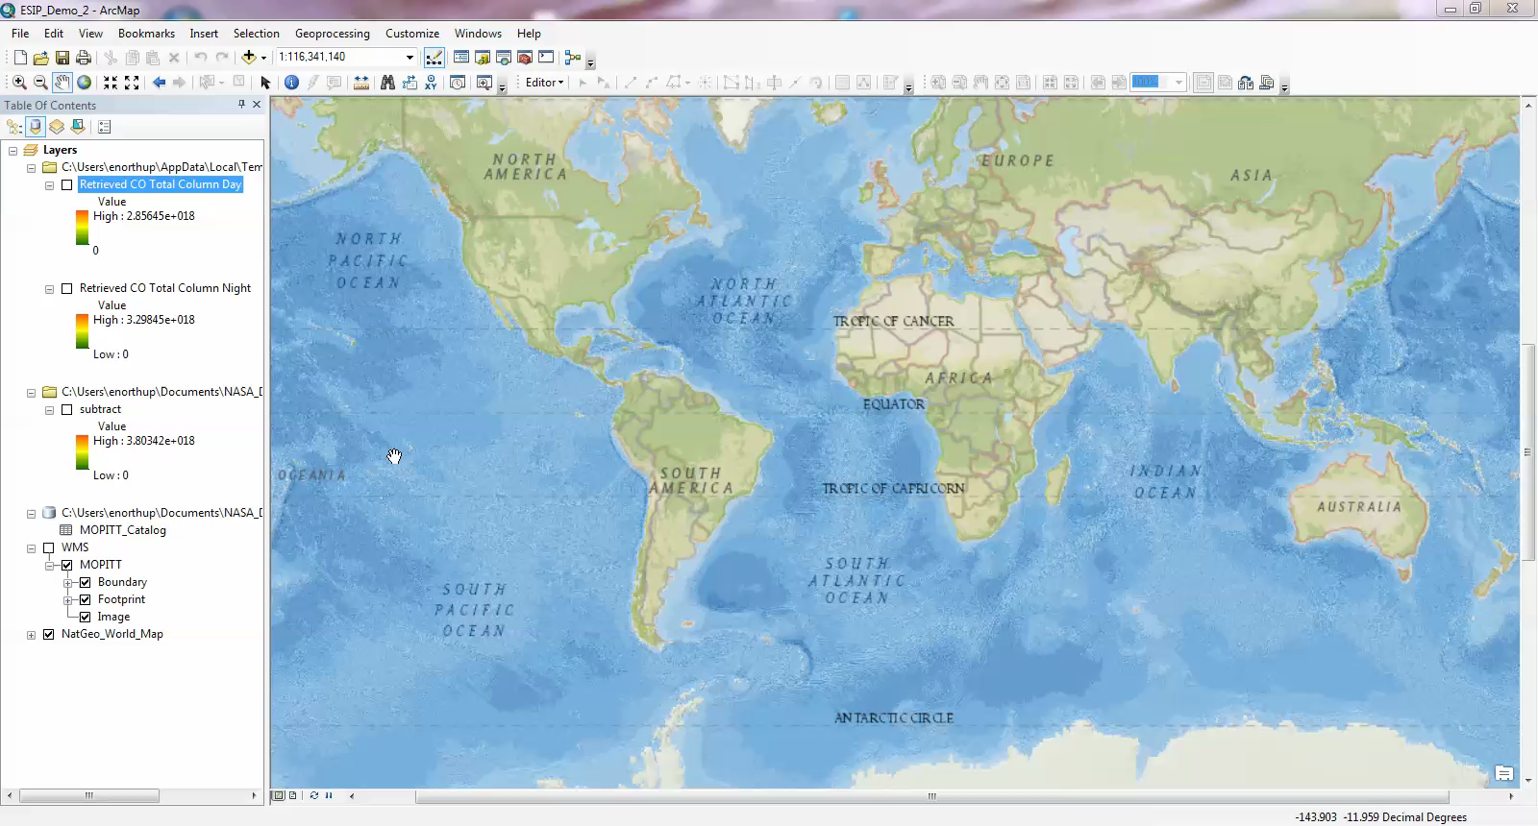
Demo 2

