Slide 1

HDF and netCDF Data Support in ArcGIS
Nawajish Noman
Jeff Donze
HDF and HDF-EOS Workshop XV, April 17-19, 2012, Riverdale, MD

Slide 2

Outline
HDF and netCDF in ArcGIS
Time in ArcGIS
Performing Analysis
Python Tools
Future Directions

Slide 3
HDF and netCDF in ArcGIS

Slide 4
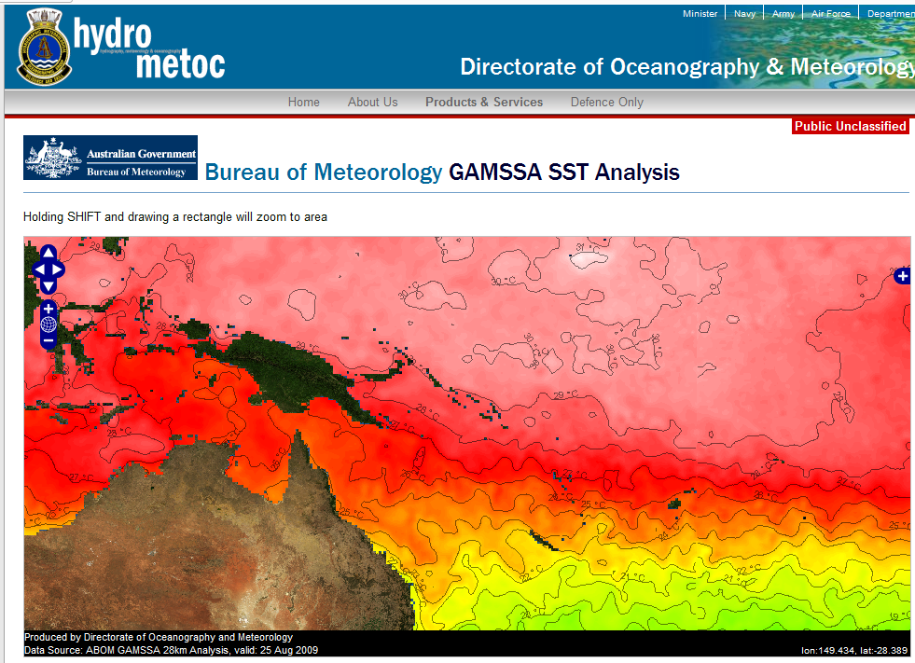
Scientific Data and Esri
Direct support - NetCDF and HDF
THREDDS/OPeNDAP – a framework for scientific data networking, integrated use by our customers
Examples using Esri technology
  National Climate Data Center
  National Weather Service
  National Center for
  Atmospheric Research
  U. S. Navy (NAVO)
  Air Force Weather
  Australian Navy
  Australian Bur.of Met.
  UK Met Office

Slide 5

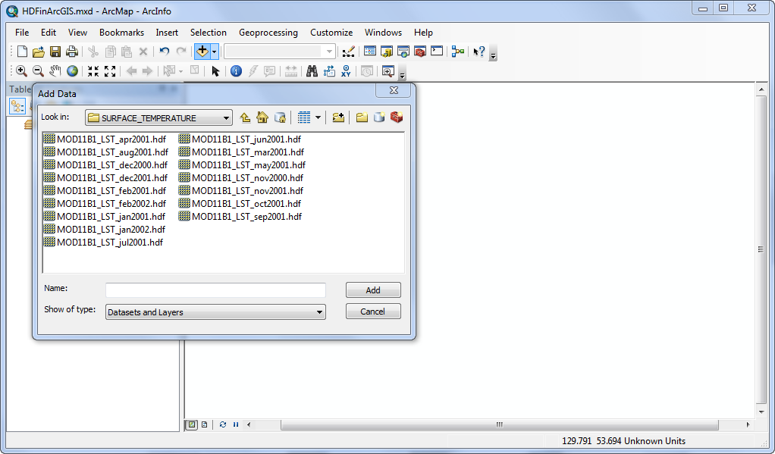
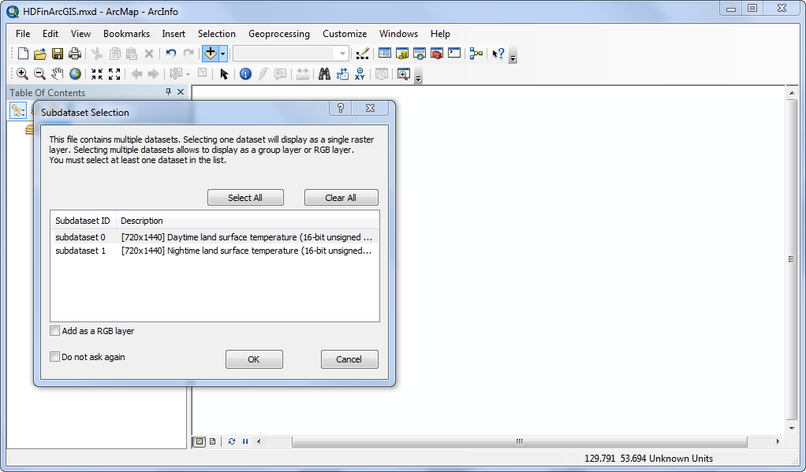
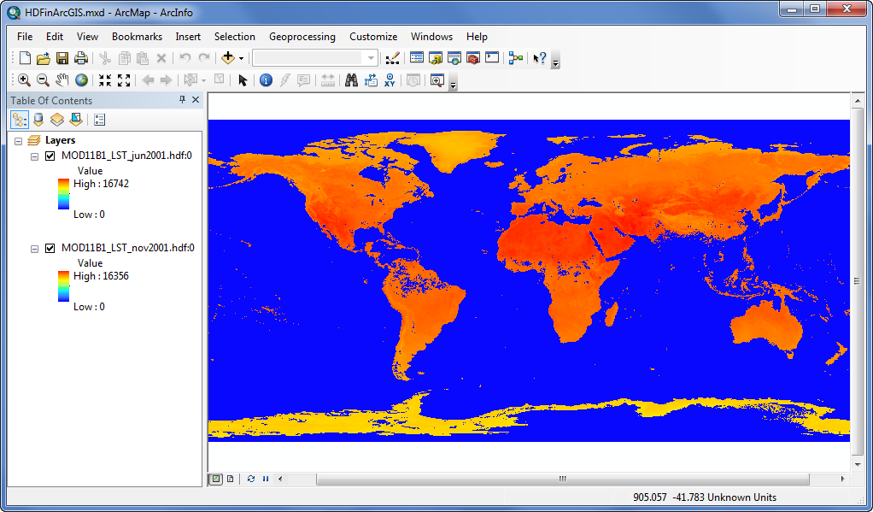
HDF4 and HDF5 Support in ArcGIS
Notes:
- Land Surface Temperature (LST)
- The global monthly composite and average daytime and nighttime land-surface temperatures (LST)
at grids with equal latitude and longitude bin sizes of 0.25 degree.
- The LST data were generated from the daily MODIS LST product (MOD11B1) at5km spatial resolution.
- MODIS (or Moderate Resolution Imaging Spectroradiometer) is a key instrument aboard the Terra (EOS AM) and Aqua (EOS PM) satellites.
- http://modis.gsfc.nasa.gov/about/
Data Source:
Zhengming Wan (wan@icess.ucsb.edu)
Institute for Computational Earth System Science
University of California, Santa Barbara, CA 93106

Slide 6
Raster Concepts
Raster Format (e.g. img, tif, etc.)
  driver level support / storage format and layout / read/write of pixels and metadata
Raster Type (e.g. GeoEye-1)
  implies Raster Format support and are format and sensor specific
  intelligent use of metadata and other sensor specific parameters
  defines georeferencing and well known processing chains
  Raster Product (e.g. Panchromatic, Multispectral, Pansharpened )
  templates which make it easy to work with well defined end user products
  multiple per sensor
  e.g. Panchromatic, Multispectral, Pansharpened
Raster Product Definition (e.g. Natural Color, False Color)
  defines “how you want your Mosaic Dataset to look” regardless of multiple source sensors and band combinations
  uses metadata such as wavelength information to map bands

Slide 7

HDF Raster Support
Raster Concept | ArcGIS 10.1 Support
Raster Format | HDF4 read: open a HDF subdataset as a Raster Dataset write: APIs available but not exposed in UI HDF5 read: open a HDF subdataset as a Raster Dataset write: not supported at this time
Raster Type | HDF4, HDF5 direct ingest of one or many HDF subdatasets into a Mosaic Dataset using the Raster Dataset Raster Type or the Table Raster Type * Esri interested in discussing other Raster Types
Raster Product | * Esri interested in discussing other Raster Products
Raster Product Definition | * Esri interested in discussing other Raster Product Definitions

Slide 8
HDF Raster Support
10.1 Raster Format and Raster Type support implies…
  ArcGIS Desktop
    direct use as a Raster Dataset or Mosaic Dataset
    use via conversion (i.e. convert to another format)
    feature rich use in the applications
      Visualization and Mapping
      Geoprocessing
  ArcGIS Server
    publishing as dynamic image services
    caching and publishing as tile services (i.e. basemaps)
    OGC (WCS, WMS, WMTS)

Slide 9
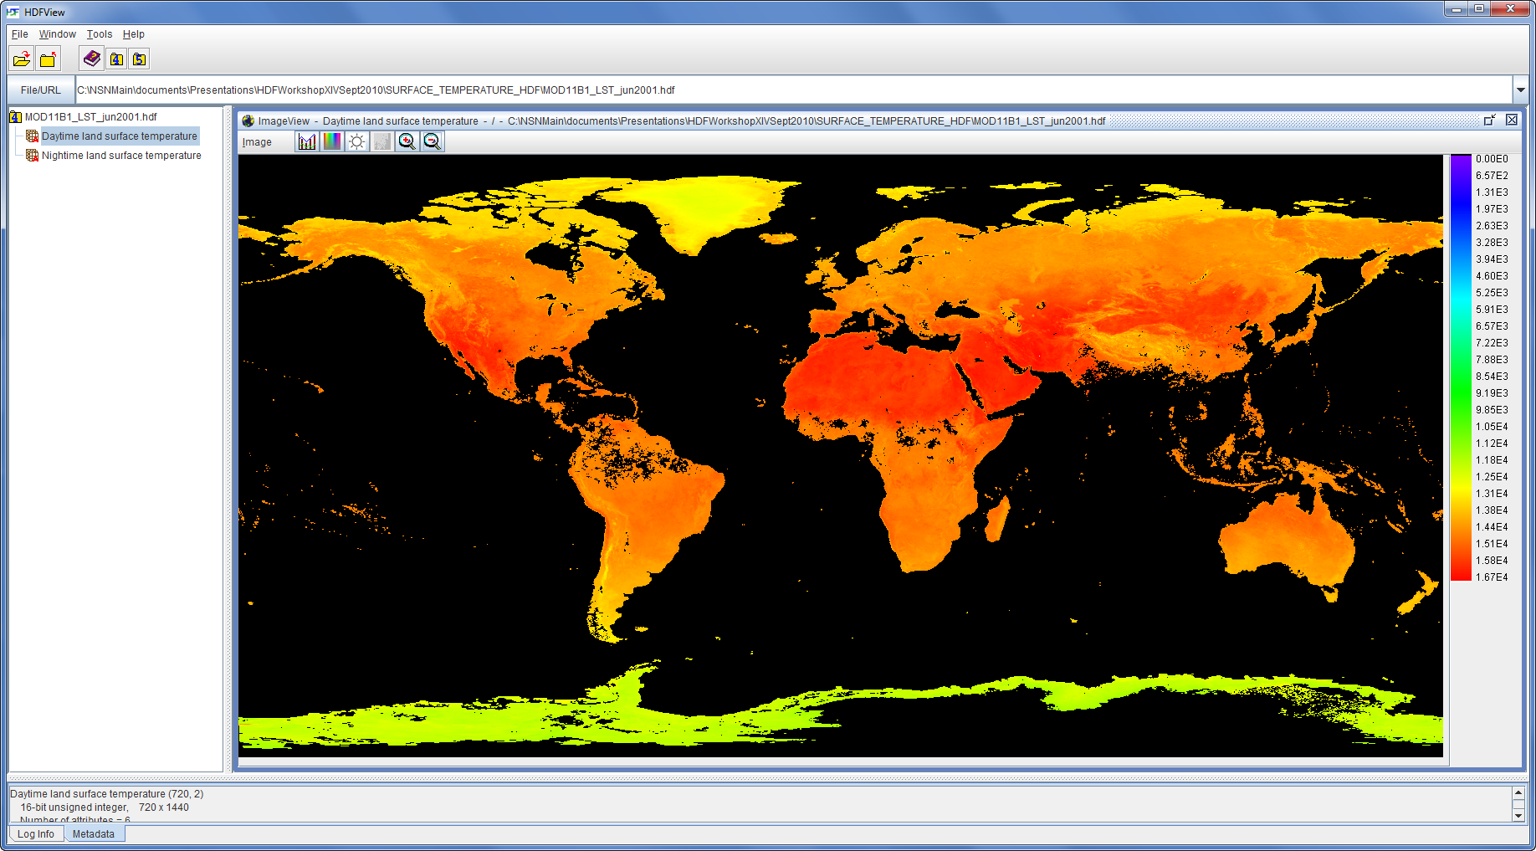
Displaying MODIS LST Data
HDFView
ArcGIS

Slide 10
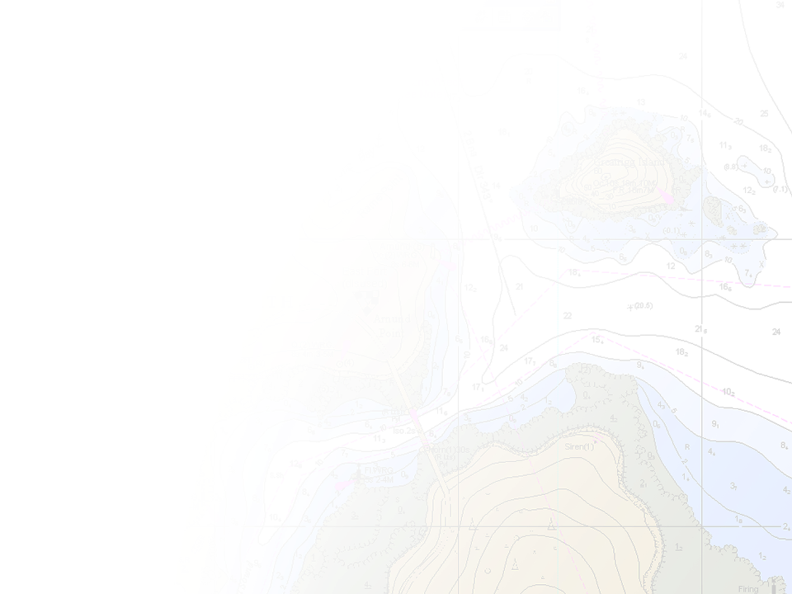
NetCDF Support in ArcGIS
ArcGIS reads/writes netCDF since version 9.2
An array based data structure for storing
multidimensional data.
N-dimensional coordinates systems
  X, Y, Z, time, and other dimensions
Variables – support for multiple variables
  Temperature, humidity, pressure, salinity, etc
Geometry – implicit or explicit
  Regular grid (implicit)
  Irregular grid
  Points
T
Z
Y
X

Slide 11

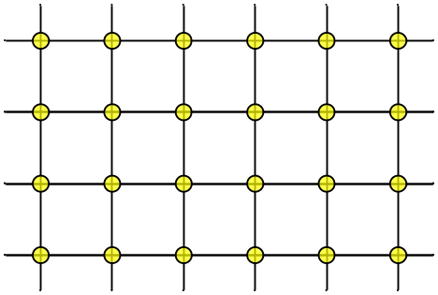

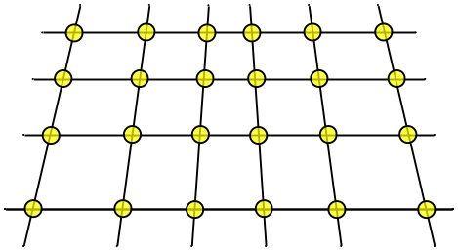
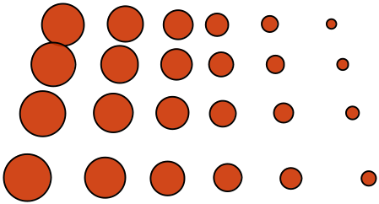
Gridded Data
Regular Grid
Irregular Grid

Slide 12
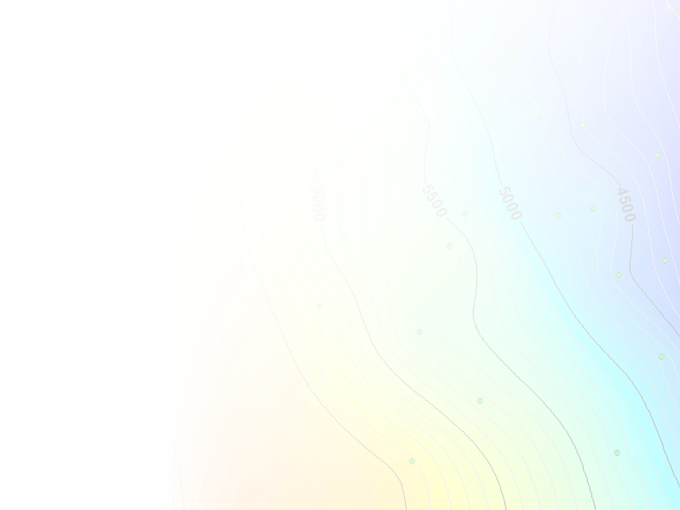
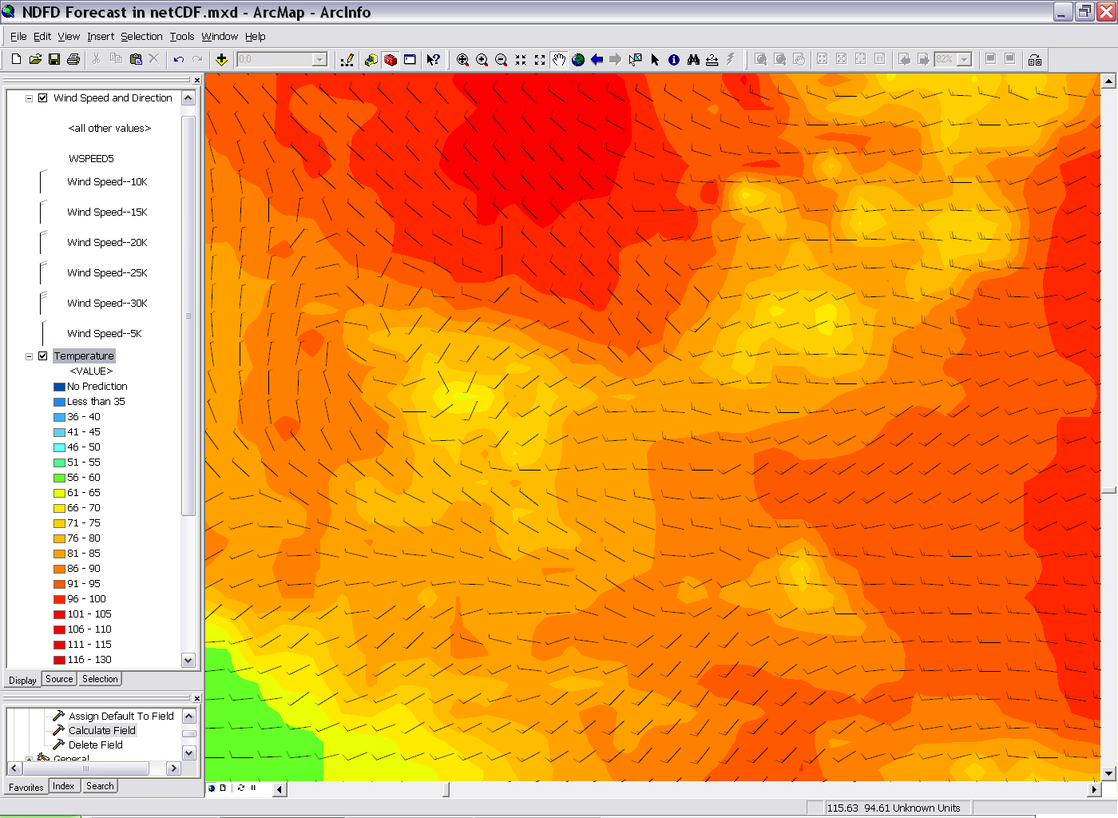
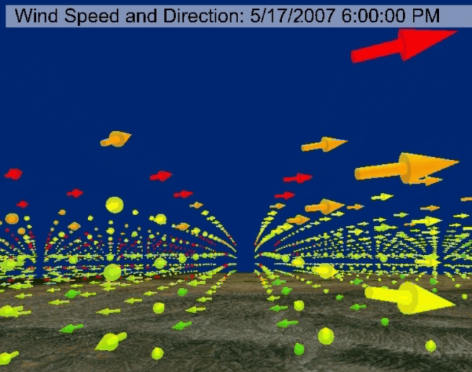
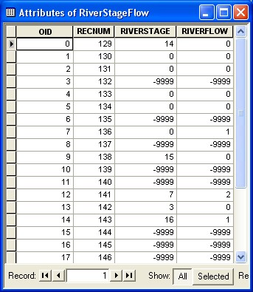
Ingesting netCDF data in ArcGIS
NetCDF data is accessed as
  Raster
  Feature
  Table
Direct read
Exports GIS data to netCDF

Slide 13

CF Convention
Climate and Forecast (CF) Convention
http://cf-pcmdi.llnl.gov/
Initially developed for
Climate and forecast data
Atmosphere, surface and ocean model-generated data
Also for observational datasets
The CF conventions generalize and extend the COARDS (Cooperative Ocean/Atmosphere Research Data Service) convention.
CF is now the most widely used conventions for geospatial netCDF data. It has the best coordinate system handling.

Slide 14
NetCDF and Coordinate Systems
Geographic Coordinate Systems (GCS)
  X dimension units: degrees_east
  Y dimension units: degrees_north
Projected Coordinate Systems (PCS)
  X dimension standard_name: projection_x_coordinate
  Y dimension standard_name: projection_y_coordinate
  Variable has a grid_mapping attribute.
  CF 1.6 conventions currently supports thirteen predefined coordinate systems (Appendix F: Grid Mappings)
Undefined
  If not GCS or PCS
ArcGIS writes (and recognizes) PE String as a variable attribute.

Slide 15
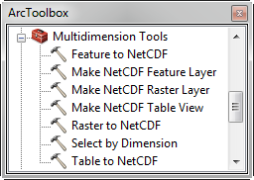
NetCDF Tools
Toolbox: Multidimension Tools
  Make NetCDF Raster Layer
  Make NetCDF Feature Layer
  Make NetCDF Table View
  Raster to NetCDF
  Feature to NetCDF
  Table to NetCDF
  Select by Dimension

Slide 16
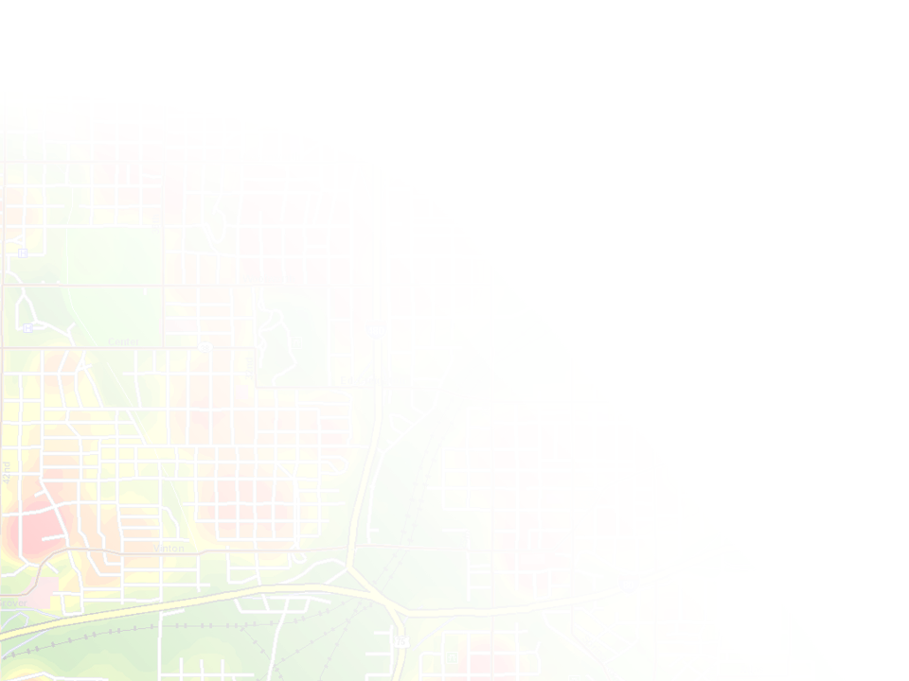
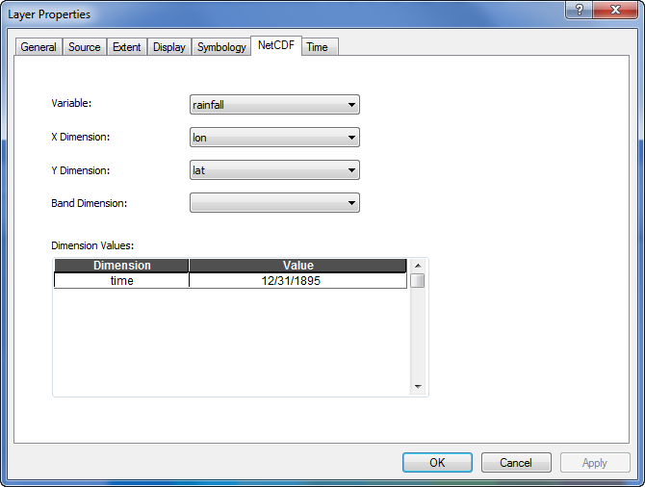
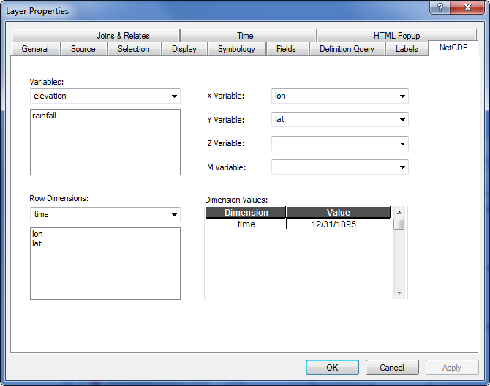
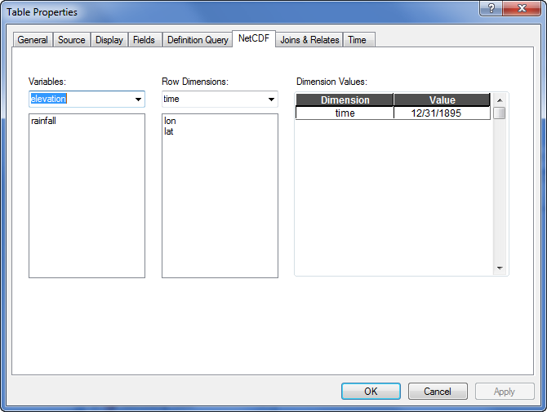
NetCDF Layer/Table Properties
Raster
Feature
Table

Slide 17
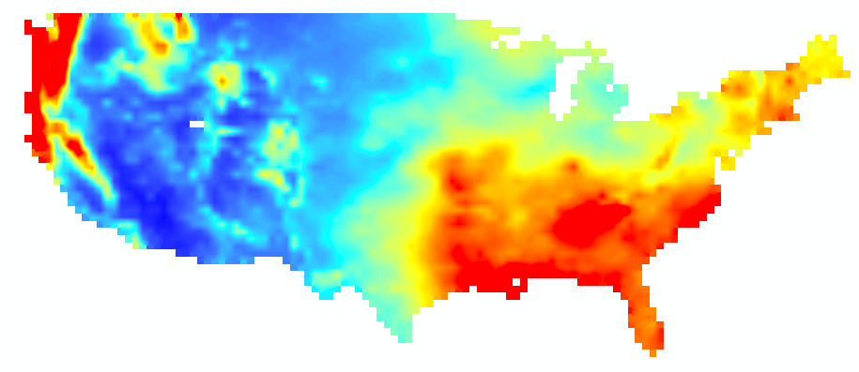
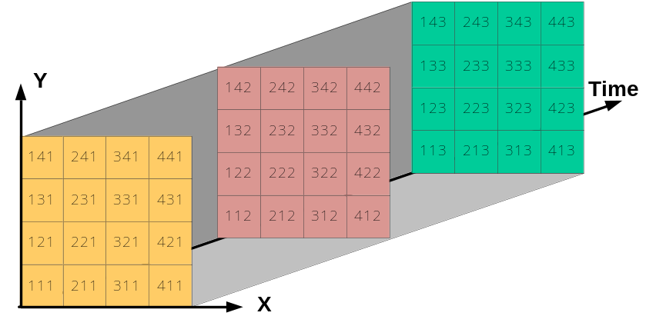
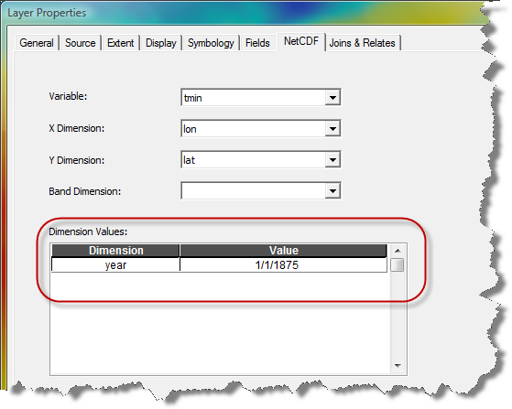
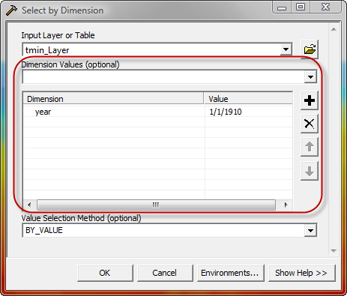
Changing Time Slice
Time = 1

Slide 18

Using NetCDF Data
Behaves the same as any layer or table
Display
  Same display tools for raster and feature layers will work on netCDF raster and netCDF feature layers.
Graphing
  Driven by the table just like any other chart.
Animation
  Multidimensional data can be animated through a dimension (e.g. time, pressure, elevation)
Analysis Tools
  A netCDF layer or table will work just like any other raster layer, feature layer, or table. (e.g. create buffers around netCDF points, reproject rasters, query tables, etc.)

Slide 19
Time in ArcGIS

Slide 20
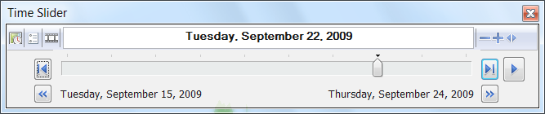
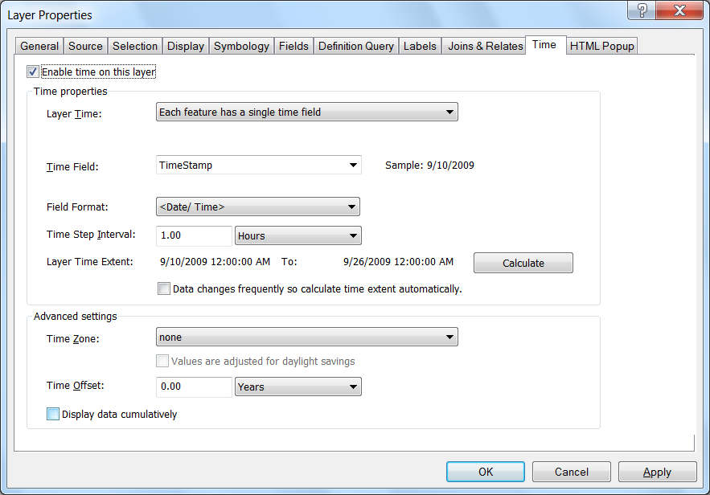
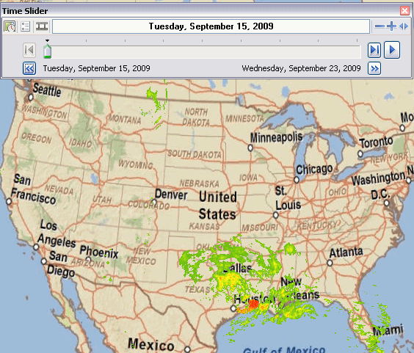
Time is now built-in to ArcGIS
Simple Temporal Mapping
Unified experience for Time
  Configure time properties on the layer
  Use Time Slider to visualize temporal data
Share temporal visualization
  Time-enabled Map Services
  Export videos or images
  Generate temporal map books
  using ArcPy scripting
  Layer and map packages

Slide 21
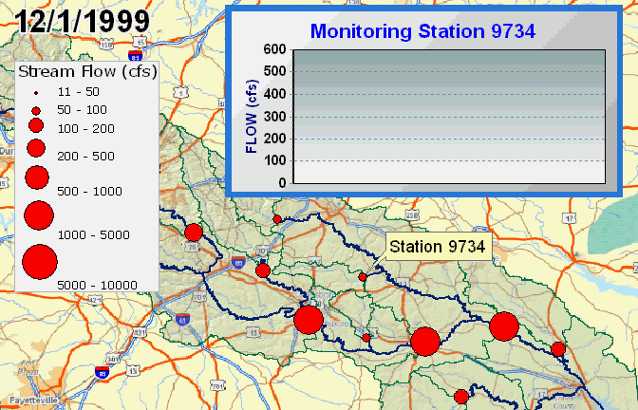
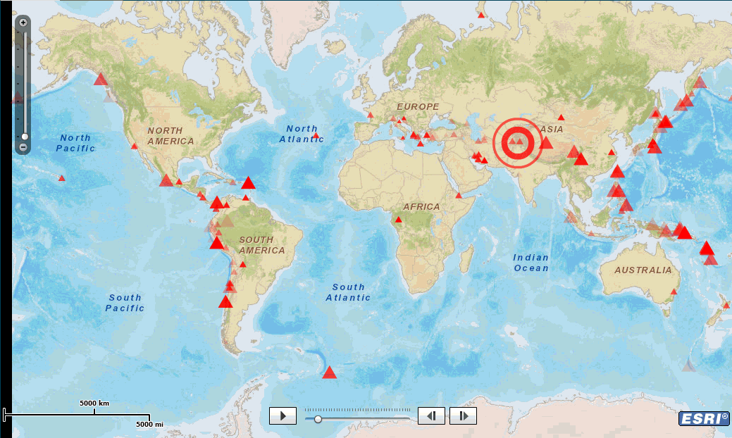
Animation examples
1979

Slide 22
Performing Analysis

Slide 23
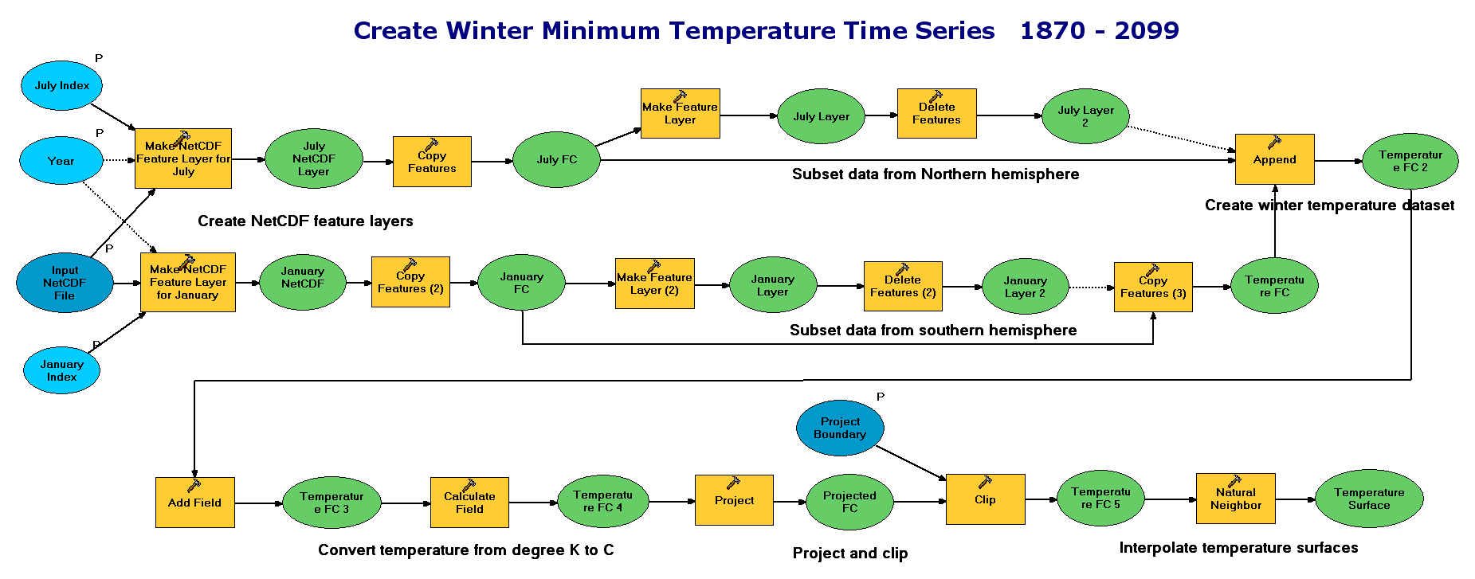
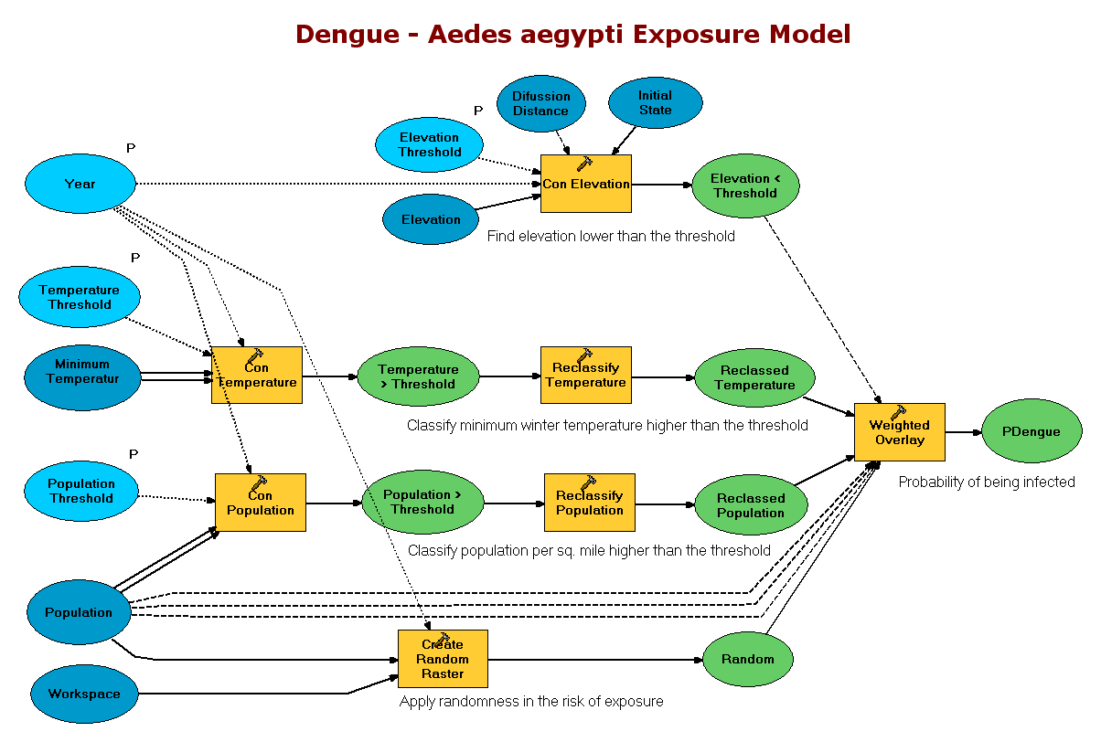
Spatial and Temporal Analysis
Several hundreds analytical tools available for raster, features, and table
Temporal Modeling
  Looping and iteration in ModelBuilder and Python

Slide 24

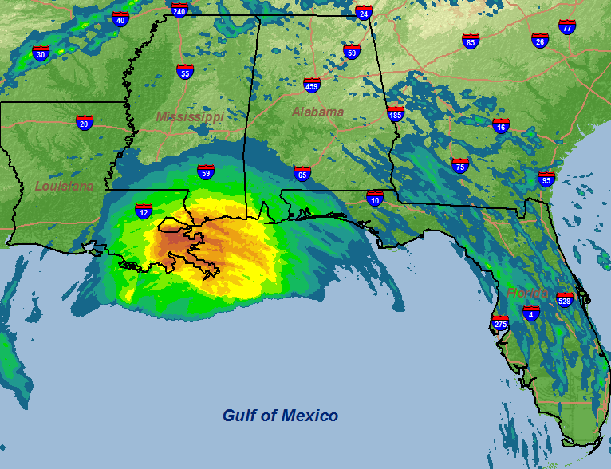
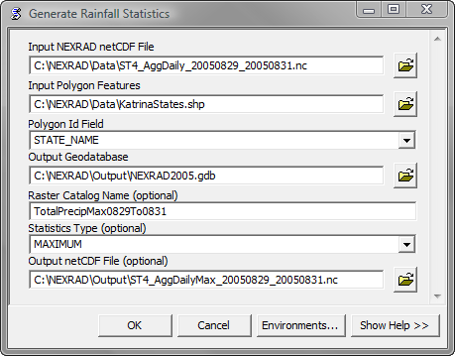
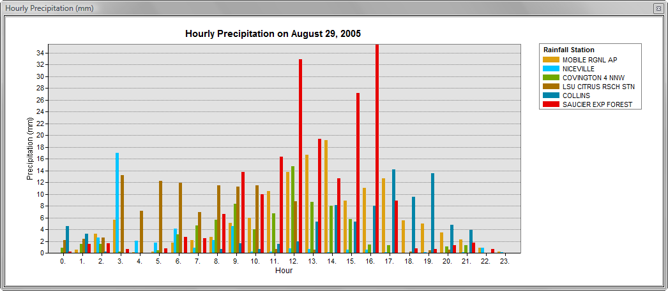
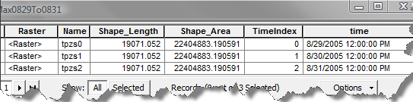
Generate Rainfall Statistics
Calculates specified statistics for all time steps
Outputs a raster catalog
Optionally outputs a netCDF file

Slide 25
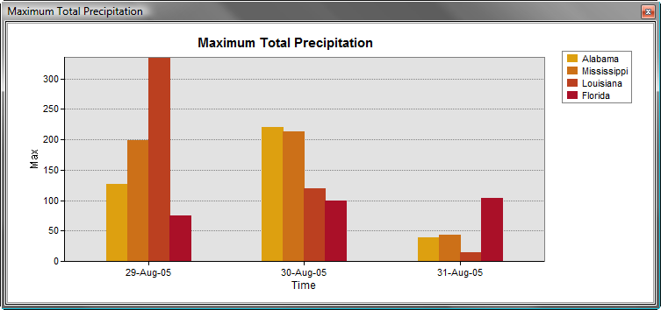
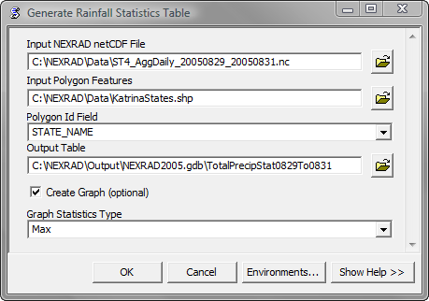
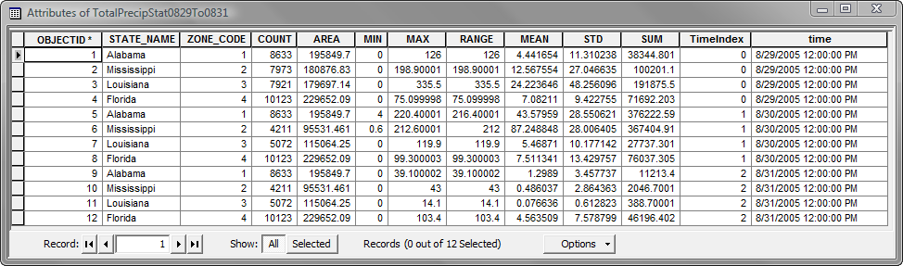
Generate Rainfall Statistics Table
Calculates statistics for all time steps
Outputs a table
Optionally creates a graph

Slide 26
Python Tools

Slide 27
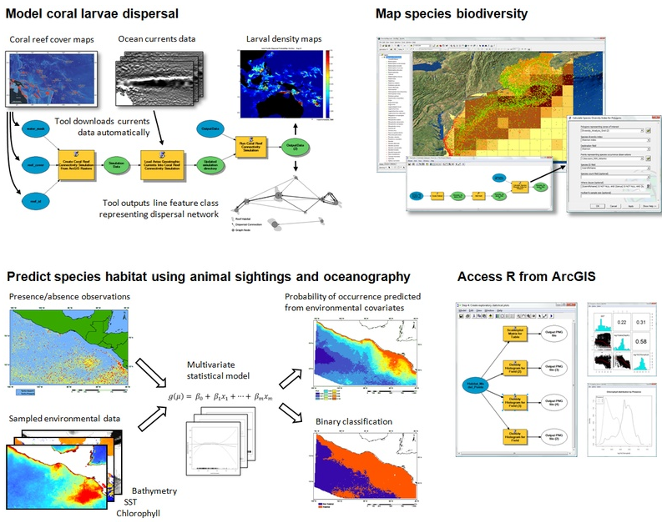
Community Developed Tools
Geoprocessing Resource Center
  http://resources.arcgis.com/geoprocessing/
Marine Geospatial
Ecology Tools (MGET)
  Developed at Duke Univ.
  Over 180 tools for import
  management, and
  analysis of marine data
Australian Navy tools
  (not publicly available)

Slide 28
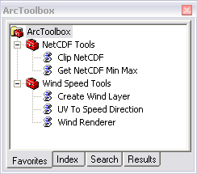
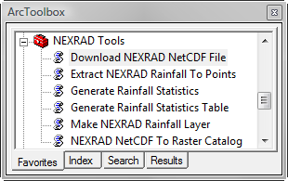
Sample Script Tools
Python is used to build custom tools for specific tasks or datasets

Slide 29
NEXRAD Geoprocessing Tools
Currently 6 geoprocessing script tools
Designed to work with NEXRAD netCDF file
Can be easily modified for other datasets
Customized tools for various workflows
Simplify repetitive work
Automate GIS processes

Slide 30
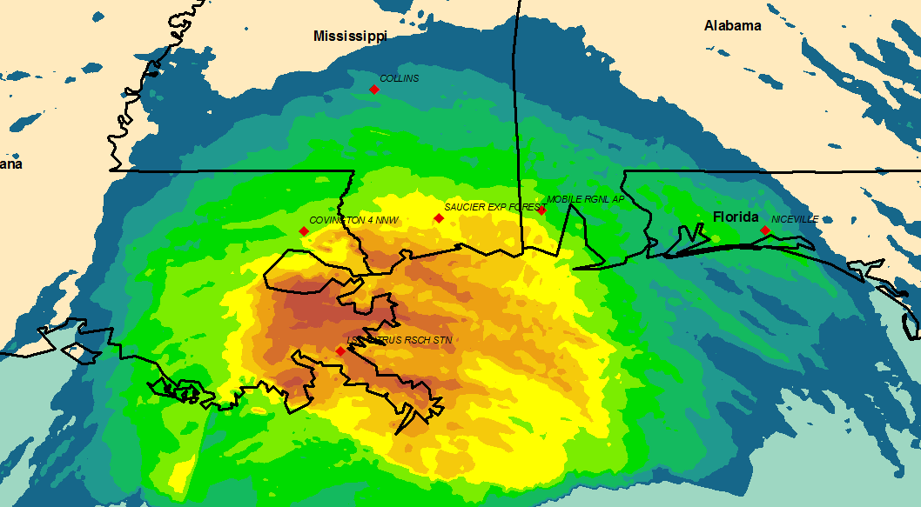
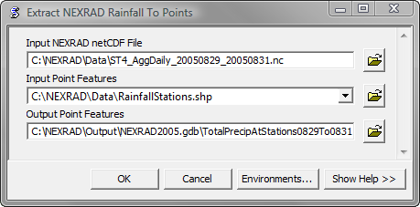
Extract NEXRAD Rainfall To Points
Extracts the cell values for all time steps
Outputs a feature class

Slide 31
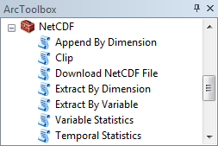
New NetCDF Tools (under development)
Download NetCDF File (OPeNDAP, WCS)
Clip
Extract By Variable
Extract By Dimension
Append By Dimension
Variable Statistics
Temporal Statistics

Slide 32
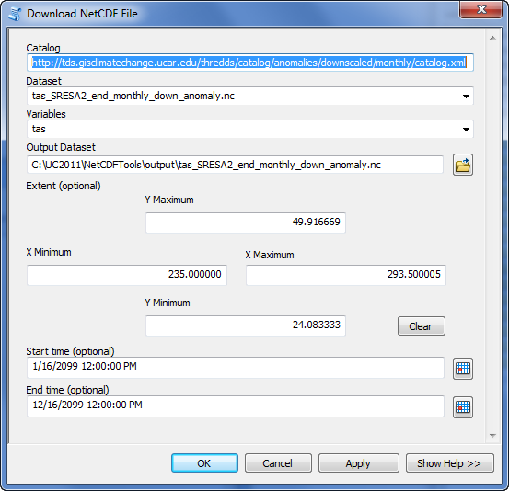
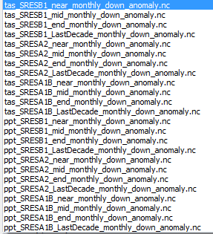
Download NetCDF File (WCS/OPeNDAP)

Slide 33
Dependencies on 3rd Party Utilities
netcdf4-python
  This module can read and write files in both the new netCDF 4 and the old netCDF 3 format, and can create files that are readable by HDF5 clients.
Pydap
  Pydap is a pure Python library implementing the Data Access Protocol, also known as DODS or OPeNDAP. OWSLib
OWSLib (OGC Web Service utility library)
  Package for working with OGC map, feature, and coverage services. OWSLib provides a common API for accessing service metadata and wrappers for GetCapabilities, GetMap, and GetFeature requests.

Slide 34
Future Directions

Slide 35
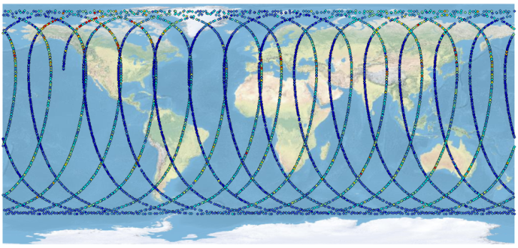
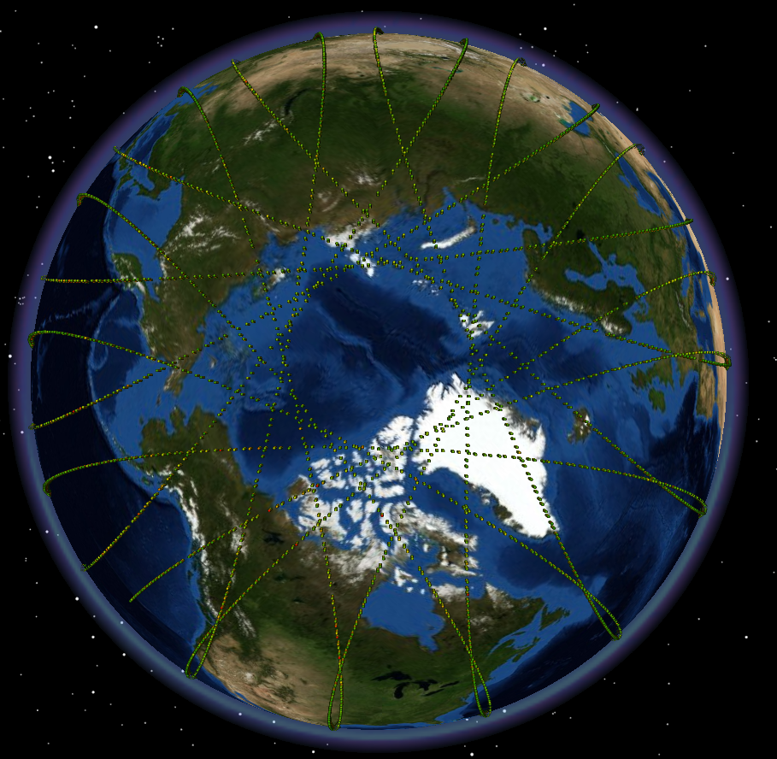
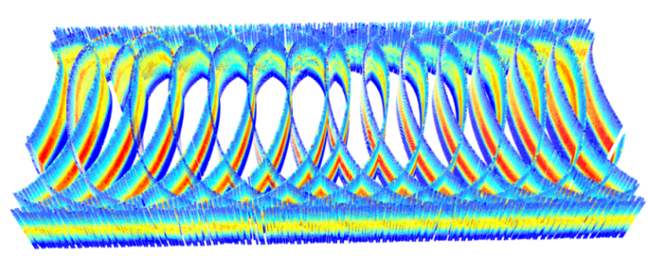
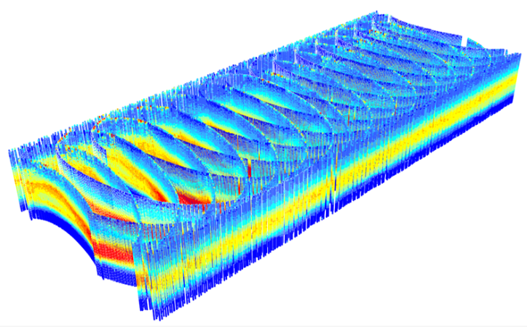
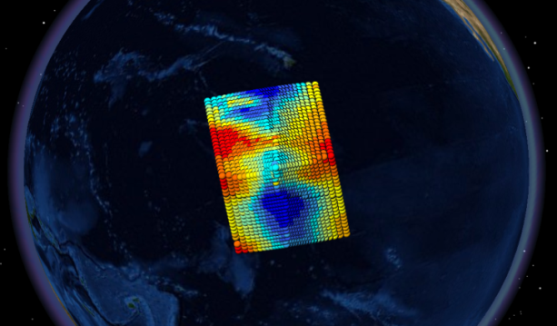
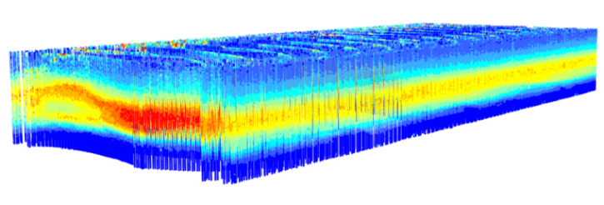
HDF and Swath

Slide 36
Scientific Data Workshop and Future Initiatives…
Esri hosted a workshop in February 2012
To understand the future need for scientific data support in ArcGIS
Ongoing efforts - require close collaboration with all of you
Some of the future initiatives are:
  Continue to support netCDF classic and netCDF4
  Provide better support for HDF5
  Provide tool to consume data served using THREDDS/OPeNDAP
  Continue to support the evolving CF convention
  Support a strong developer experience for netCDF and HDF using Python
  What else?

Slide 37
Things to Consider…
Embrace the Common Data Model (netCDF, HDF etc.)
Use Data and metadata standards (OGC, CF etc)
Provide “mechanism” so that we can access scientific data using a single set of APIs….
and can expect data to be CF complainant
Make your data “spatial” (by specifying geographic or a projected coordinate system)
Clearly define workflow and requirements
Create sample tools where possible

Slide 38
Questions?
Nawajish Noman
Team Lead
nnoman@esri.com
Jeff Donze
Esri Federal Business Development
jdonze@esri.com

