Slide 1
HDF4 Mapping Project Update www.hdfgroup.org/projects/h4map
Ruth Aydt
(aydt@hdfgroup.org)
The HDF Group
The 15th HDF and HDF-EOS Workshop
April 17-19, 2012

Slide 2


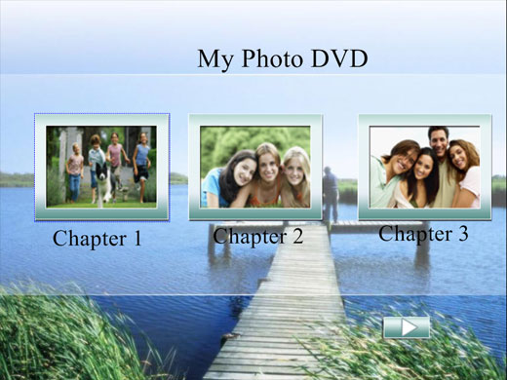
Project Motivation
HDF4 file
DVD
HDFView
HDF4 Library
Notes:
An HDF4 file without the HDF4 library is like a DVD without the player
(hardware and software) to read it.
You can’t tell what the content is (pictures/movies, …) , let alone get at the “data”.
From a preservation perspective, the player and the library are areas of caution.

Slide 3
Project Purpose
Ensure long-term access
to EOS data
stored in HDF4 files.
Notes:
Minimizing risk in this caution area is purpose of the mapping project.

Slide 4
Project Scope
Time
April 2012
HDF4 Library
HDF4 Files with EOS Data produced
HDF4 Files with EOS Data valuable to community
HDF4
Mapping
Project
Scope
Concern
Idea
Proof of Concept Prototype
Develop
Support
Product
Verification Requirements Study
?
Verification Implementation
HDF4 File Content Maps
Notes:
(timeline not to scale)
The HDF4 Library has been around a long time but at some point in the
future, support may be phased out if it becomes cost prohibitive.
That will (we hope) be after HDF EOS files are no longer being written.
But the data in the HDF EOS files will be valuable to the community far into the future.
The Mapping Project scope is represented in the gray box at the bottom of the slide.

Slide 5
Concern – Workshop VIII (2004)
“HDF and HDF EOS: Implications for Long-Term Archiving and Data Access” - Ruth Duerr, NSIDC
Slide Notes:
“Without human readability you are locked into having to maintain the read software forever!”
Notes:
Ruth Duerr has been involved in the project since before it began –
raising concern about access to the data in 2004.
Keeping all data as text would be time (to rewrite) and space (to store)
prohibitive.

Slide 6
Idea – Workshop X (2006)
“Leveraging HDF Utilities” - Chris Lynnes, GES-DISC
Notes:
Chris Lynnes has also been involved from the start of the project.
He proposed an access program that was not reliant on HDF4 library.
Doesn’t require total rewrite of HDF4 data – bulk of data will stay in HDF4 file.
Saves on time (processing) and space (disk).

Slide 7
HDF4 File Contents – User View
Objects & Relationships
Object Data
User Metadata
Notes:
Look a bit more closely at the types of information that are in an HDF4 file…
all of these are important and need to be accessible far into the future.
The object data typically takes up most of the space in an HDF4 file and
is the most difficult to represent in Text format.

Slide 8

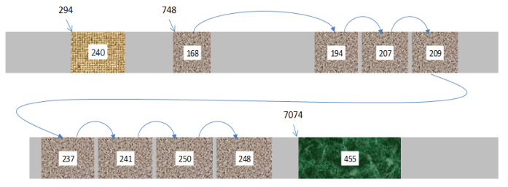
HDF4 File Contents – Format View
Complicated!
?
variable
name = variable_name
rank
type
storagetype
1
1
Vgroup
name = variable_name
class = Var0.0
Object Data
1
1
1
1
1
1
1
0...1
1
NT
SD
SDD
0...1
1
0...1
1
data
byte order,
chunked storage,
compression, …
1
1
1
1
NDG
0…*
0…*
attribute
name = attribute_name
Vdata
name = attribute_name
class = Attr0.0
Notes:
If we look “under the hood” things are more complicated than they appear from
the HDFview display…. The HDF4 library typically hides the complexity.
The car’s engine is kind of like the object data in the HDF4 file…
challenging to represent and explain.
Bits of data for a single object can be spread throughout the file, compressed, etc.
Can we represent this in a way that something other than the HDF4 library
can find the right bits & reconstruct the data?

Slide 9

Proof of Concept (8/07- 7/08)
Categorize HDF4 data held by NASA
Build a prototype
HDF4 File
Map Writer
linked with
HDF4 library
HDF4 File Content
Map (XML)
request
bytestreams
Reader
Objects & Relationships;
User Metadata;
Object Data retrieval &
reconstruction information
2 independent readers
in C and Perl
Success!
Object Data
Notes:
A project was funded to see if this was possible.
Focus was primarily on object data for SDS and Vdata objects.
Results were convincing – 2 independent readers, in different languages,
were able to use the map files to extract the bits from the HDF4 file &
reconstruct the object data in text files.

Slide 10
Develop Product (11/09 - 7/11)
Tasks:
  Investigate integration of mapping schema
  with existing standards
  Determine HDF-EOS 2 requirements
  Redesign and expand the XML schema
  Implement production quality map writer
  Develop demo map reader
  Deploy tools at select NASA data centers
For preservation, we must get it right while the HDF4 library, tools, documentation, and expertise are around.
Notes:
Following the same approach used in the prototype phase,
the next phase of the project supported the development of a
production-quality schema and writer,
as well as a reader that would – to the extent possible – verify that the
content maps met their design requirements.

Slide 11

Develop Product (Tasks C & D)
C: HDF4 File Content Maps
  Have enough information to stand alone
  Described by schema
D: Production Quality Map Writer
  Read HDF4 file and create Map
    Command-line options fine-tune behavior
HDF4 Library
  New functions added to facilitate map creation

Slide 12
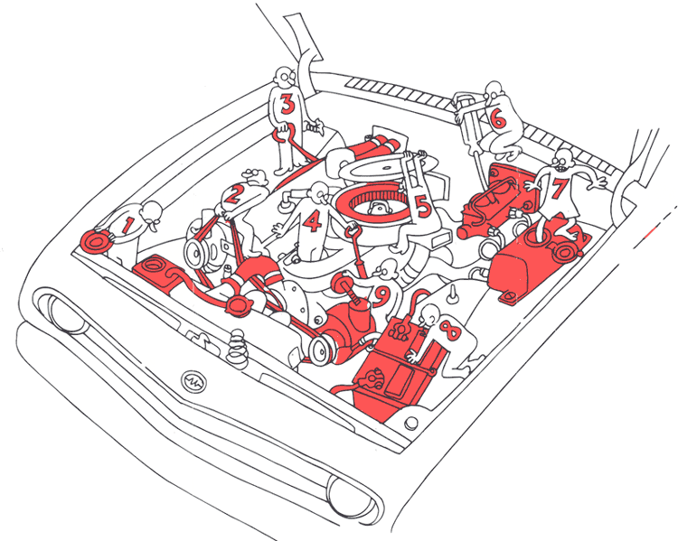
Surprise!
Expected hardest part to be support for retrieval and reconstruction of object data.
In fact, making sure all user-created HDF4 objects were found and represented correctly was a bigger challenge.
  Existing tools didn’t always
  report same user-level
  information.
  “Correctness” can be subject
  to interpretation – not always
  able to know intent of file
  creator.
Image from publications.usa.gov
Notes:
Why wasn’t object data harder?
This information is well-defined by the HDF4 format and is not exposed to
users of the HDF library so isn’t “tinkered with”.
Why is finding all objects and representing them correctly so hard?
Library uses some of the same objects at the HDF4 format level for its
“housekeeping” information as it uses to keep user data… for example Vgroups and Vdata.
- Library has special conventions about object name or class to say “this is special” but
those can be written by a user as well and that confuses things.
Not a one-to-one correspondence between User-level objects (like an attribute)
and low-level objects (Attributes are stored as Vdata with a special class)
– Instead, conventions (like class name or inclusion in a (hidden) group) determine
how the low-level object is treated.
HDF4 API lets users “tinker” with objects at this level… they can write a Vdata
and set the class to indicate it’s an Attribute. But, what if they don’t increment the
number of attributes counter in the object the attribute is associated with?
Is it an attribute or a Vdata?
Furthermore, multiple versions exist for some object types due to evolution of library and format.
Do two low-level objects that “look the same” represent 2 separate objects or a single object
represented using 2 different versions? Usually clear – but not always.
Users have almost unlimited flexibility due to low-level interfaces of HDF4 (“assembly language”).
Current tools (hdp, HDFview) not always consistent in their output, so no authoritative source.
Library “filled in” some information that was not explicitly in the HDF4 file,
for example – fill values if none were set by user.

Slide 13

Project Actions in Response
User View
Map from top down and bottom up
  Watch for extra parts
“Over include” in map if any doubt (e.g., 2 palettes for 1 raster)
Improve HDF4 library, tools, and documentation to address ambiguities
Format View
Notes:
We took a number of actions throughout the product development phase of the project
(and in the support phase as well) to deal with the unexpected challenges
Watch for extra parts –
things in the format view that don’t show up in the user view (and perhaps should)

Slide 14
HDF4 File Content Map
Select object data values included to help reader program verify binary data handled properly
Information needed to access and interpret object data in HDF4 file
Represents HDF4 Objects and Relationships
Notes:
Here’s a snippet from an HDF4 File Content Map with some annotations that show
how the various types of information are represented.
The verification comment blocks that were included so that someone in the
future without access to the HDF4 library could make sure their reader
is getting the correct values with all the offsets / nBytes / etc.

Slide 15
E: Develop Demo Reader
Developed by student at NSIDC
  Only given Content Maps
  Written in Python
  Reader extracts object data from HDF4 file
    Output in ASCII (csv) or binary (numpy)
    Compares extracted data to values for verification in Content Map
Notes:
The demo reader was written by a student with no knowledge of HDF4
(and instructed not to read the manuals!).
Provided with content map files but not the schema or any documentation
beyond the instructions contained in the map files.
Focus was on extracting object data, not on checking that all user data was
completely mapped.

Slide 16
Demo Reader Example
$ python hdfmr.py -f MOD29.A2012001.1310.005.2012001194528.hdf.map.xml -e ALL
Directory created :MOD29.A2012001.1310.005.2012001194528.hdf.map.xml
Processing : MOD29.A2012001.1310.005.2012001194528.hdf.map.xml
----Array: Latitude
Valid values: True
----Array: Longitude
Valid values: True
----Array: Sea_Ice_by_Reflectance
Valid values: True
...
Dumping complete
$ ls -s MOD29.A2012001.1310.005.2012001194528.hdf.map.xml_dump
total 72144
29696 Root-- G-ID_G1 G-ID_G2 G-ID_G3 Ice_Surface_Temperature-ID_A5
10856 Root-- G-ID_G1 G-ID_G2 G-ID_G3 Ice_Surface_Temperature_Pixel_QA-ID_A6
16216 Root-- G-ID_G1 G-ID_G2 G-ID_G3 Sea_Ice_by_Reflectance-ID_A3
10856 Root-- G-ID_G1 G-ID_G2 G-ID_G3 Sea_Ice_by_Reflectance_Pixel_QA-ID_A4
2152 Root-- G-ID_G1 G-ID_G2 Latitude-ID_A1
2368 Root-- G-ID_G1 G-ID_G2 Longitude-ID_A2
$ cat *dump/*Latitude*
# Array shape: (406, 271) Datum: >f4
42.808445,42.801300,42.793739,42.785816,42.777580,42.769073,42.760330,42.751381,
42.742256,42.732983,42.723576,42.714054,42.704441,42.694748,42.684990,42.675175,
...
Notes:
Here I’m running the demo reader on a map file and extracting all the objects.
The reader creates a subdirectory and writes files to that subdirectory
for each of the objects with data.
You see in the first yellow box , for example, the “Latitude” Array (SDS) and
the Valid values: True statement – that means values extracted match those in the
map comment block for that object.
Next yellow block shows the directory that was created & the files in it.
File names built from element IDs in map file (which are unique), and also
data object name.
If you cat a file you’ll see the comma-separated values for the object
along with the object dimensions.

Slide 17
Releases & Support
Date | Version | Comments
July 2011 | 1.0.0 schema 1.0.0 writer | First official release http://www.hdfgroup.org/projects/h4map
Sept 2011 | 1.0.1 writer | Minor bug fixes
Nov 2011 | 1.0.1 schema 1.0.2 writer | Robustly handle empty SDS
March 2012 |  | ECS Release 8.1
May 2012 (planned) | 1.0.3 writer | Minor bug fixes
? |  | Support 2 palettes with same reference number
Notes:
Here’s a table with the releases of writer & schema to date.
For 1.0.1 the changes were (1) fix Group indentation; (2) add byteStreamSet if > 1 block;
(3) Fix bug for unsigned integer type.
For 1.0.3 the changes were (1) handle reserved characters in Vdata Field names;
(2) Handle uchar8 correctly, (3) use byteStreamSet for Dimensions.
Note in particular that the writer was included with ECS release 8.1 last month –
more on this later
The circled items on this slide relate back to the “surprise!” talked
about earlier.
Some things were not handled consistently by existing tools… had to sort
out what is correct.
In case of palettes, still not sure of intent of file creator, so will include 2 palettes.
Need update to HDF4 Library first so that all palettes are reported.

Slide 18
HDF4 File Content Maps
Content Map generation at GES-DISC
Datasets mapped
  TOVS Pathfinder
    For example: ftp://disc1.gsfc.nasa.gov/data/s4pa/tovs/TOVSADNG/1986/330/
  MERRA Model Output
In progress
  TRMM
  AIRS
Notes:
TOVS Pathfinder: http://mirador.gsfc.nasa.gov/cgi-bin/mirador/presentNavigation.pl?tree=project&project=TOVS
MERRA Model Output: mirador.gsfc.nasa.gov/cgi-bin/mirador/presentNavigation.pl?tree=project&project=MERRA
To find the map files, you go down all the way to the granule level, then copy the FTP link and take off the file part, e.g.,:ftp://disc1.gsfc.nasa.gov/data/s4pa/tovs/TOVSADNG/1986/330/
Thanks to Chris Lynnes for the info & links.

Slide 19
ECS Release 8.1 – March 2012
“Raytheon EED deployed the HDF4 File Content Maps capability as part of ECS Release 8.1. This capability wraps the Content Map Writer in the ECS Map Generation Server. ECS DAACs can choose whether or not to enable map generation in operations.
With workload spec testing, seeing 2-3 maps/second under load and 10-15 on unloaded system”
-- Evelyn Nakamura, Raytheon
“We installed our new big ECS software release which included the code for creating maps. The installers set it up to create maps (not in operations mode) for MOD10A1 and it produced 20 or 30 thousand. We haven't had a chance to look at them yet.”
-- Doug Fowler, NSIDC
Notes:
Maps can be generated. Because of concerns that they can’t be verified in an automatic, scalable way, don’t have to be turned on. Verification Study.

Slide 20
Verification* Study (1/12 - 4/12)
“Work with DAAC personnel to identify requirements that would produce appropriate and efficient methods of verifying, concurrent with operation activities, correctness of the HDF4 maps that are produced with the ECS 8.1 capability.”
* The terms Verification and Validation are used interchangeably.
Notes:
With the ability to generate content maps, DAACs wanted to know how they
should verify that dataset files are adequately described…
In many cases they were not responsible for creating the files or for understanding
the content in them… they typically just look at checksums, filesizes, before distributing.
In part because of our surprise in the product phase, we felt it would be best to
discuss some of the uncertainties related to verification – why just comparing
the values in the object data isn’t enough and how the uncertainty regarding
creator intent (in some cases) could be addressed.

Slide 21
Verification Study Activities
Webinars with ASDC, LPDAAC, NSIDC, Raytheon
  Provide background on Mapping Project
  Gather input on requirements and concerns
  Collect sample datasets and generate Content Maps
    →Exposed 3 bugs: 1 in HDF4 library & 2 in Map Writer; Fixed.
  Discuss possible approaches
  Seek guidance from NASA on expectations regarding Map creation timeline and verification responsibilities
Prototype possible approaches
  Demonstrate functionality and assess feasibility
Notes:
Here’s a high-level rundown of the activities that have gone on during the project.
DAAC personnel have been very responsive to questions and made room in their
schedules to meet on fairly short notice.

Slide 22
Verification Study Findings (1)
Automate verification as much as possible.
Focus verification at the ESDT version level.
No definitive specification for user-level objects expected in a given HDF4 file.
Scientists look at visualizations, not directly at data.

Slide 23
Verification Study Findings (2)
Every DAAC is different
  Flexibility in deciding when to generate Maps
  May need involvement of science teams to confirm correctness
Content Maps should be produced near end of mission, or sooner if users want them.
  AMSR-E identified
  NSIDC involved with Mapping project from the start and comfortable with verification using demo reader
Notes:
A summary of the findings. Details are in meeting minutes.

Slide 24
Verification Study Findings (3)
Interest in web-based tools is growing.
  XSLT stylesheets
DAAC representatives are very concerned about long-term access to data.
  This is beyond the scope of the study
  But, something to keep in mind when considering different approaches
Notes:
Will a “Map Reader” replace the HDF4 library as the way to
access data at some point in the future?
How will a “Map Reader” or other utilities be supported?

Slide 25
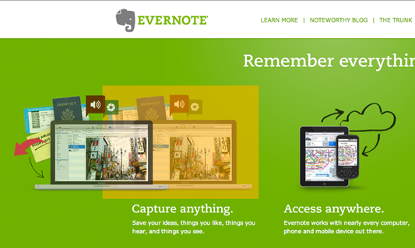

Verification Dilemma
Translator to
DVD
?
Reader
Notes:
Let’s go back to our DVD that we talked about earlier.
Say we are concerned about preservation and decide to translate the
contents of the DVD into a different representation so that we aren’t
solely reliant on the DVD player hardware and software.
Let’s say we choose Evernote. And, that we also provide a way to view the photos –
the object data on the DVD so to speak – by printing them.
The verification question is, does the combination of the Evernote view and the
printed pictures convince us that we are correctly preserving the DVD?
What about the background / labels / etc?
One approach would be to regenerate all of those from the new Evernote format,
but that could take a very long time, as everyone may have set different options
on their DVD player for menu appearance, etc. -- that isn’t really part of the DVD,
but is part of a user’s experience of the DVD. And, there are movies, photos, data
backups… all kind of potential content.
How to give the user the experience they are used to so they can feel
confident that the Evernote representation is accurate?

Slide 26
Possible Approach
DVD
?
DVD
Creator
DVD
Notes:
Maybe we should just generate a new DVD from the evernote content, then use
the familiar tools to look at it and compare to the original.

Slide 27
Applied to Content Maps
HDF4 File
HDF4 File Content
Map (XML)
request
Reader
HDF4
Retranslator
bytestreams
Objects & Relationships;
User Metadata;
Object Data retrieval &
reconstruction information
Objects & Relationships;
User Metadata;
Object Data retrieval &
reconstruction information
HDF4 File
Object Data
Replace this…
with this…
Notes:
Although we know at the low-level the new HDF4 file will not be the
same as the original, they should be the same (or very close) from the user perspective.
Tools like HDFView IDL and GrADS should work with the new HDF4 file –
tools developers and scientists are familiar with.
Can use “hdp” to dump object data from two files and compare the differences. Or “hdiff”

Slide 28
Verification Recommendations (1)
Check h4mapwriter errors
Run xmllint
  Check for well-formed XML
  Validate Map conforms to schema
These checks are possible now

Slide 29
Verification Recommendations (2)
Develop content map checker to check
  Filesize and checksum
  Object data values
  Values for verification
  Attribute values in Map
What people expect to be enough

Slide 30
Verification Recommendations (3)
Develop retranslator to create new HDF4 file
  Allows use of familiar tools (GrADS, IDL, HDFview, hdiff, …)
  If new file is not equivalent to original (from user perspective), investigate ASAP.
Needed since no definitive source of correctness for original HDF4 files.

Slide 31
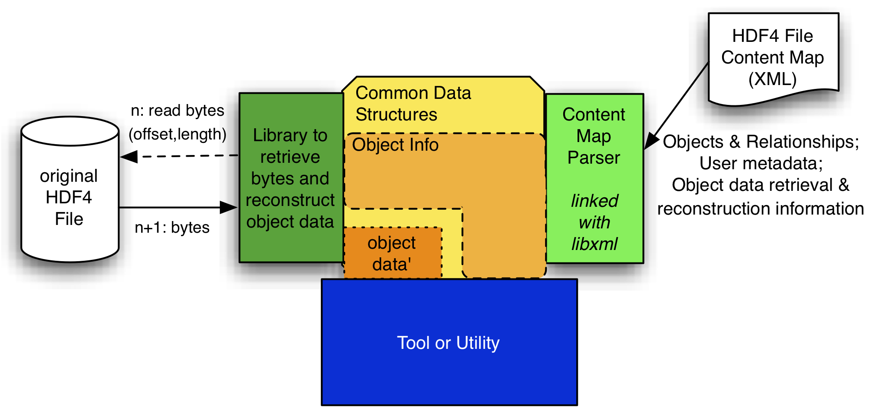
Verification Recommendations (4)
Build content map checker and retranslator on common modular infrastructure.

Slide 32
Not just for Preservation!
“I find the HDF Map writer and reader very useful when I am in the discovery phase of new projects using HDF4 datasets.
  They enable me to analyze the full structure of CERES hdf4 datasets and ensure HDF Attributes from the archived HDF4 files are preserved in subsetted files.
  I am building a capability to subset MOPITT HDF4 data and am using them to help validate SDS data arrays over 4 dimensions.
  A team of consultants is working with ASDC on an experimental semantic database implemented on a 'grand challenge' scale. They are interested in using CERES datasets, but are unfamiliar with HDF. They are using the HDF4 map application to analyze the structure of proposed CERES datasets and to help extract metadata and data from target files.”
--- Walt Baskin, ASDC

Slide 33

Presentation “Take Away”
HDF4 Content Maps are the best thing since
sliced bread!
More seriously …
  Content Maps can be created now and you may find them useful
  Ask questions and report problems
    We want to know about issues ASAP
  Feedback regarding proposed Verification approach very welcome
      Project report / recommendations due next week

Slide 34
Project Contributors
The HDF Group
  Ruth Aydt, Peter Cao, Jo Eads, Mike Folk, Joe Lee, Elena Pourmal, Binh-Minh Ribler, Kent Yang, and others
NASA / DAACs
  Jeanne Behnke, Dan Marinelli, H. K. "Rama" Ramapriyan
  ASDC: Walt Baskin, Greg Cates, Gerald Lemay, Lindsay Parker, Steve Protack
  GES-DISC: Guang-Dih Lei, Chris Lynnes
  LP DAAC: Matt Martens, Bhaskar Ramachandran, Jody Rundell, Jim Vermeer
  NSIDC: Jonathan Crider, Ruth Duerr, Doug Fowler, Luis Lopez
Raytheon
  Evelyn Nakamura, Lou Swentek, Abe Taaheri

Slide 35
Acknowledgements
This work was supported by Subcontract number 114820 under Raytheon Contract number NNG10HP02C, funded by the National Aeronautics and Space Administration (NASA) and by cooperative agreement number NNX08AO77A from the NASA. Any opinions, findings, conclusions, or
recommendations expressed in this material are those of the authors and do not necessarily reflect the views of Raytheon or the National Aeronautics and Space Administration.

Slide 36
Questions/comments?

