Slide 1
Connecting HDF And ISO Metadata
Ted Habermann, NASA/ESDIS
Hook Hua, Barry Weiss, NASA/Jet Propulsion Lab
Mike Folk, Gerd Heber, Elena Pourmal, The HDF Group
Notes:
CONNECTING HDF WITH ISO METADATA STANDARDS
The HDF community understands the benefits of hierarchical structure in datasets, and uses that structure effectively to organize data in files. Modern international metadata standards begin with highly structured conceptual models and are implemented in standard hierarchical XML representations. We are exploring ways to exploit this similarity and developing candidate conventions for connecting metadata from HDF files to standard ISO metadata representations. These will be used to connect NASA Earth observations in HDF to emerging data discovery, use, and understanding frameworks based on the ISO Standards.

Slide 2
Layers of Access
HDF/netCDF
GIS
MatLab, IDL,
IDV, Ferret, GMT
ArcMap, ArcIMS,
WMS, WFS, WCS
OPeNDAP
GML, KML,
SimpleFeatures
Climate Forecast
Conventions
Community Data Models,
Open GIS Specifications
HDF & NetCDF Library
SQL
HDF5 Data
Geospatial Database

Slide 3
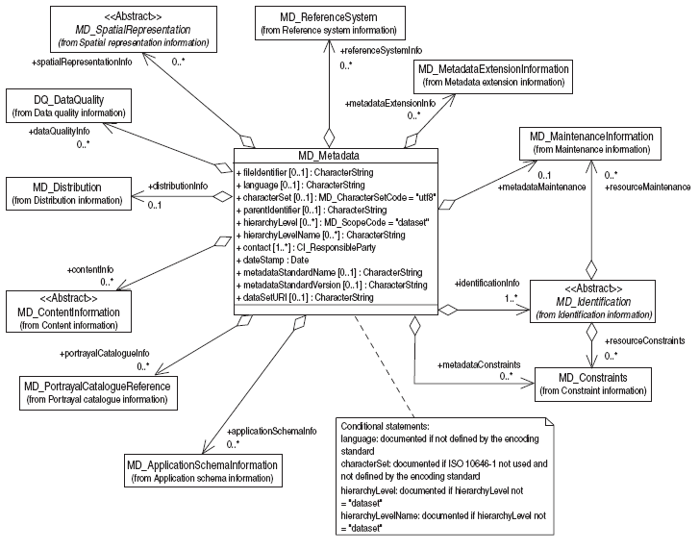
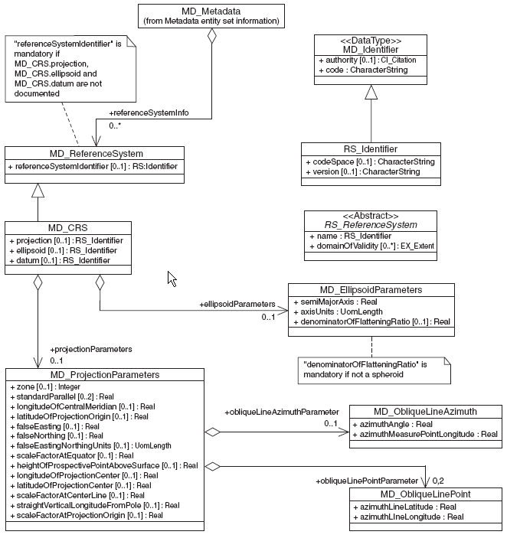
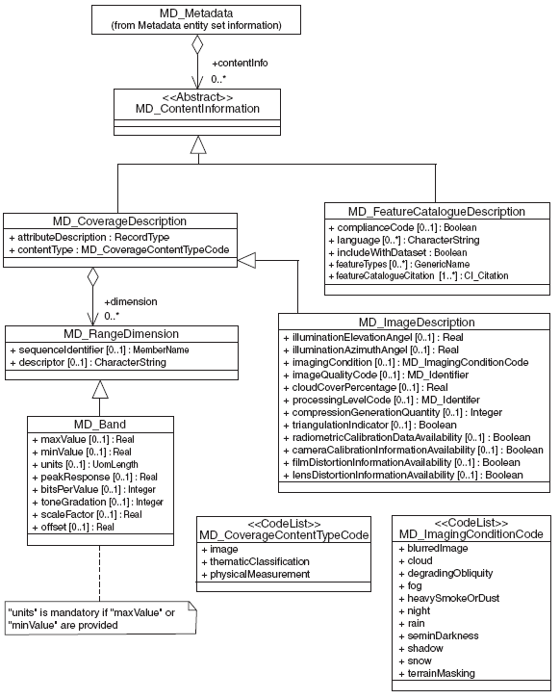
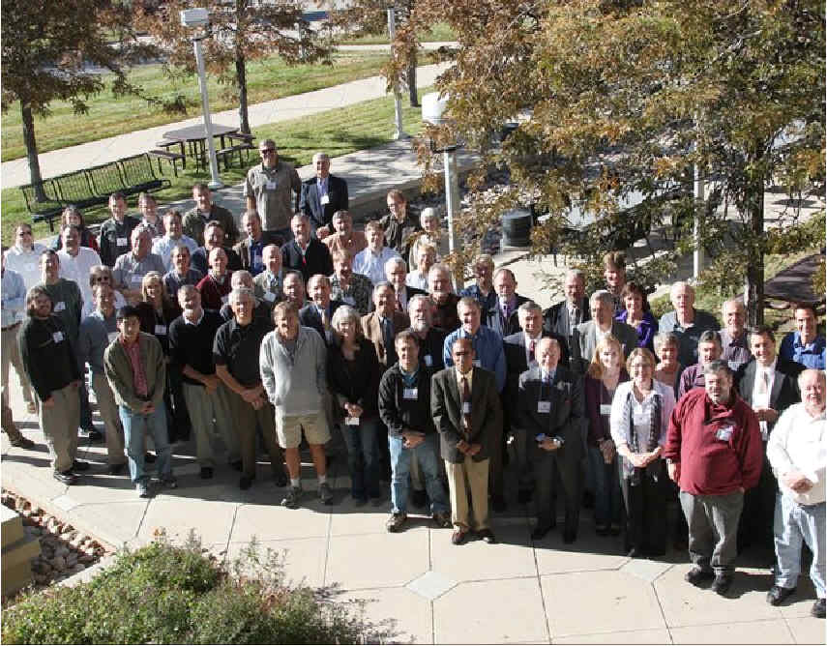
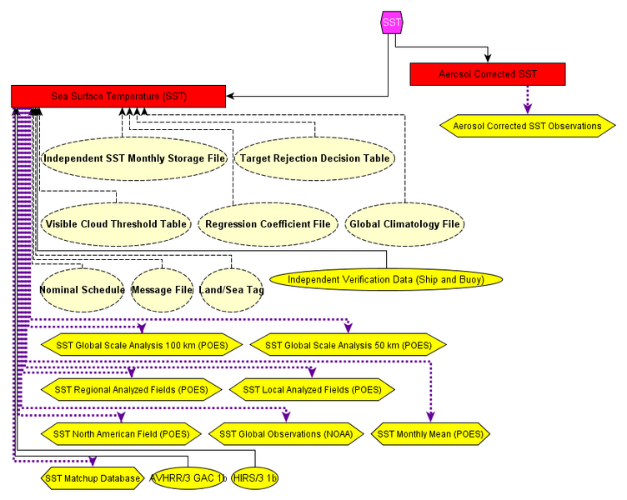
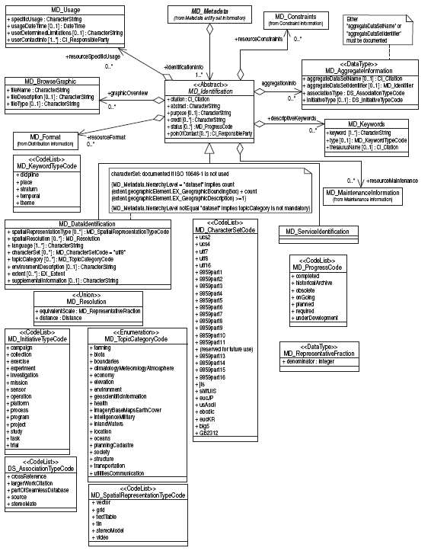
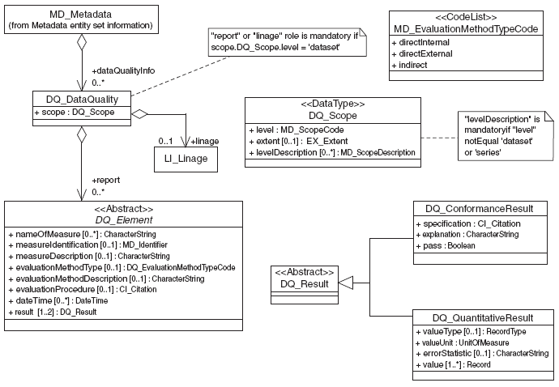
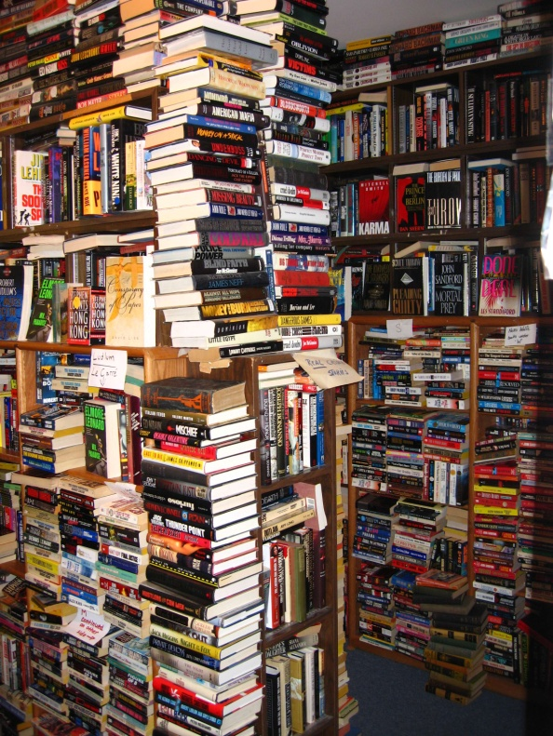
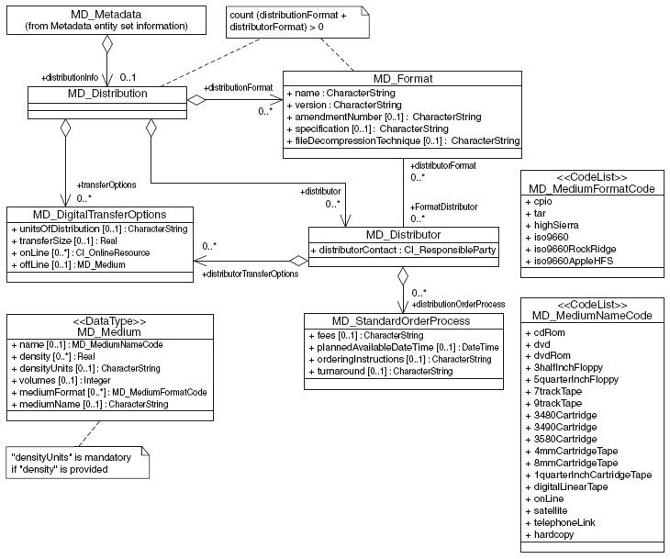
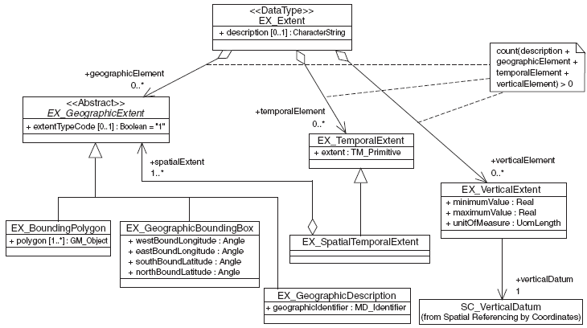

The ISO Metadata Standard (19115)

Slide 4
The ISO Metadata Standard (19115)
<<DataType>>
CI_ResponsibleParty
+ individualName [0..1]: CharacterString
+ organisationName [0..1]: CharacterString
+ positionName [0..1]: CharacterString
+ contactInfo [0..1]: CI_Contact
+ role: CI_RoleCode
LI_Lineage
+ statement [0..1] : CharacterString
+ source [0..*]: LI_Source
+ processStep [0..*]: LE_ProcessStep
<<DataType>>
CI_Citation
+ title : CharacterString
+ alternateTitle [0..*] : CharacterString
+ date [1..*] : CI_Date
+ edition [0..1] : CharacterString
+ editionDate [0..1] : Date
+ identifier [0..*] : MD_Identifier
+ citedResponsibleParty [0..*] : CI_ResponsibleParty
+ presentationForm [0..*] : CI_PresentationFormCode
+ series [0..1] : CI_Series
+ otherCitationDetails [0..1] : CharacterString
+ collectiveTitle [0..1] : CharacterString
+ ISBN [0..1] : CharacterString
+ ISSN [0..1] : CharacterString
<<DataType>>
CI_OnlineResource
+ linkage : URL
+ protocol [0..1] : CharacterString
+ applicationProfile [0..1] : CharacterString
+ name [0..1] : CharacterString
+ description [0..1] : CharacterString
+ function [0..1] : CI_OnLineFunctionCode

Slide 5
Documentation Objects
<<DataType>>
CI_ResponsibleParty
+ individualName [0..1]: CharacterString
+ organisationName [0..1]: CharacterString
+ positionName [0..1]: CharacterString
+ contactInfo [0..1]: CI_Contact
+ role: CI_RoleCode
LI_Lineage
+ statement [0..1] : CharacterString
+ source [0..*]: LI_Source
+ processStep [0..*]: LE_ProcessStep
<<DataType>>
CI_Citation
+ title : CharacterString
+ alternateTitle [0..*] : CharacterString
+ date [1..*] : CI_Date
+ edition [0..1] : CharacterString
+ editionDate [0..1] : Date
+ identifier [0..*] : MD_Identifier
+ citedResponsibleParty [0..*] : CI_ResponsibleParty
+ presentationForm [0..*] : CI_PresentationFormCode
+ series [0..1] : CI_Series
+ otherCitationDetails [0..1] : CharacterString
+ collectiveTitle [0..1] : CharacterString
+ ISBN [0..1] : CharacterString
+ ISSN [0..1] : CharacterString
<<DataType>>
CI_OnlineResource
+ linkage : URL
+ protocol [0..1] : CharacterString
+ applicationProfile [0..1] : CharacterString
+ name [0..1] : CharacterString
+ description [0..1] : CharacterString
+ function [0..1] : CI_OnLineFunctionCode

Slide 6
People/Organizations
<<DataType>>
CI_ResponsibleParty
+ individualName [0..1]: CharacterString
+ organisationName [0..1]: CharacterString
+ positionName [0..1]: CharacterString
+ contactInfo [0..1]: CI_Contact
+ role: CI_RoleCode
<group name="contact_1">
<attribute name="uuid" value="UUID"/>
<attribute name="role" value="pointOfContact"/>
<attribute name="individualName" value="Ted Habermann"/>
<attribute name="organisationName" value="NOAA National Geophysical Data Center"/>
<attribute name="electronicMailAddress" value="ted.habermann@noaa.gov"/>
<group name="onlineResource_1">
<attribute name="uuid" value="UUID"/>
<attribute name="linkage" value="http://www.ngdc.noaa.gov/"/>
<attribute name="function" value="information"/>
</group>
</group>
<<DataType>>
CI_OnlineResource
+ linkage : URL
+ protocol [0..1] : CharacterString
+ applicationProfile [0..1] : CharacterString
+ name [0..1] : CharacterString
+ description [0..1] : CharacterString
+ function [0..1] : CI_OnLineFunctionCode

Slide 7
Citations
<<DataType>>
CI_Citation
+ title : CharacterString
+ alternateTitle [0..*] : CharacterString
+ date [1..*] : CI_Date
+ edition [0..1] : CharacterString
+ editionDate [0..1] : Date
+ identifier [0..*] : MD_Identifier
+ citedResponsibleParty [0..*] : CI_ResponsibleParty
+ presentationForm [0..*] : CI_PresentationFormCode
+ series [0..1] : CI_Series
+ otherCitationDetails [0..1] : CharacterString
+ collectiveTitle [0..1] : CharacterString
+ ISBN [0..1] : CharacterString
+ ISSN [0..1] : CharacterString
<group name="citation_1">
<attribute name="uuid" value="UUID"/>
<attribute name="title" value="Insightful Metadata Ideas"/>
<attribute name="identifier" value="ShortName DOI"/>
<attribute name="edition" value="VersionID"/>
<group name="date_1">
<attribute name="date" value=""/>
<attribute name="dateType" value="publication"/>
</group>
<group name="citedResponsibleParty_1">
<attribute name="uuid" value="UUID"/>
<attribute name="role" value="originator"/>
<attribute name="individualName" value="Ted Habermann"/>
<attribute name="organisationName" value="NOAA National Geophysical Data Center"/>
<attribute name="electronicMailAddress" value="ted.habermann@noaa.gov"/>
<group name="onlineResource_1">
<attribute name="uuid" value="UUID"/>
<attribute name="linkage" value="http://www.ngdc.noaa.gov/"/>
<attribute name="function" value="information"/>
</group>
</group>
</group>

Slide 8

ISO Lineage Model
Source
Source
Source
Source
Source
Step
Step
Step
Product
Processing and Algorithm Descriptions

Slide 9
Lineage
<group name="lineage">
<group name="processStep_1">
<attribute name="uuid" value="UUID"/>
<attribute name="dateTime" value="ProductionDateTime"/>
<group name="processor_1">
<attribute name="uuid" value="UUID"/>
<attribute name="role" value="processor"/>
<attribute name="organisationName" value="ProductionLocationCode"/>
</group>
<attribute name="source" value="UUID,UUID,UUID"/>
<group name="processingInformation_1">
<attribute name="identifier" value="SPSIdentifier"/>
<group name="algorithm_1">
<attribute name="description" value="AlgorithmDescriptor"/>
<group name="citation_1">
<attribute name="uuid" value="UUID"/>
<attribute name="title" value="AlgorithmTitle"/>
<attribute name="identifier" value="AlgorithmPackageMaturityCode"/>
<attribute name="edition" value="AlgorithmPackageVersionID"/>
<group name="date_1">
<attribute name="dateType" value="publication"/>
</group>
</group>
</group>
</group>
<attribute name="output" value="UUID,UUID,UUID"/>
</group>
<group name="source_1">
<attribute name="uuid" value="UUID"/>
<attribute name="description" value="Radar Level 1A Product Description"/>
<group name="sourceCitation_1">
<attribute name="uuid" value="UUID"/>
<attribute name="title" value="http://smap.jpl.nasa.gov/RadarLevel1AProduct.h5"/>
<attribute name="edition" value="Radar Level 1A Product Edition"/>
<group name="date_1">
<attribute name="dateType" value="creation"/>
</group>
</group>
</group>
</group>
LI_Lineage
+ statement [0..1] : CharacterString
+ source [0..*]: LI_Source
+ processStep [0..*]: LE_ProcessStep
LE_Source
+ description [0..1] : CharacterString
+ scaleDenominator [0..1] : MD_RepresentativeFraction
+ sourceReferenceSystem [0..1] : MD_ReferenceSystem
+ sourceCitation [0..1] : CI_Citation
+ sourceExtent [0..*] : EX_Extent
+ processedLevel[0..1] : MD_Identifier
+ resolution[0..1] : LE_NominalResolution
+ sourcemetadata [0..*] : MD_Reference
LE_ProcessStep
+ description : CharacterString
+ rationale [0..1] : CharacterString
+ dateTime [0..1] : DateTime
+ processor [0..*] : CI_ResponsibleParty
+ extent [0..*] : EX_Extent
+ reference [0.*] : CI_Citation
LE_Processing
+ identifier : MD_Identifier
+ softwareReference[0..*] : CI_Citation
+ procedureDescription[0..1] : CharacterString
+ documentation[0..*] : CI_Citation
+ runTimeParameters[0..1] : CharacterString

Slide 10
Multiple Dialects:
THREDDS Metadata Server
THREDDS Data Server
OPeNDAP
WMS
WCS
NcML
ISO
Rubric
Extract Data
Extract Metadata (NcISO)
THREDDS
Catalog
THREDDS
Catalog
THREDDS
Catalog
file1.nc
file2.nc
file3.nc
file4.nc
file1.nc
file2.nc
file.nc
file.nc
file.nc
file.nc

Slide 11
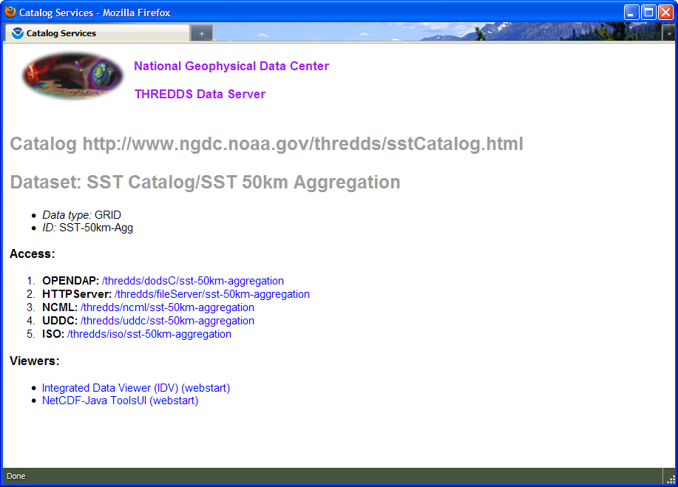
THREDDS Metadata Server

Slide 12
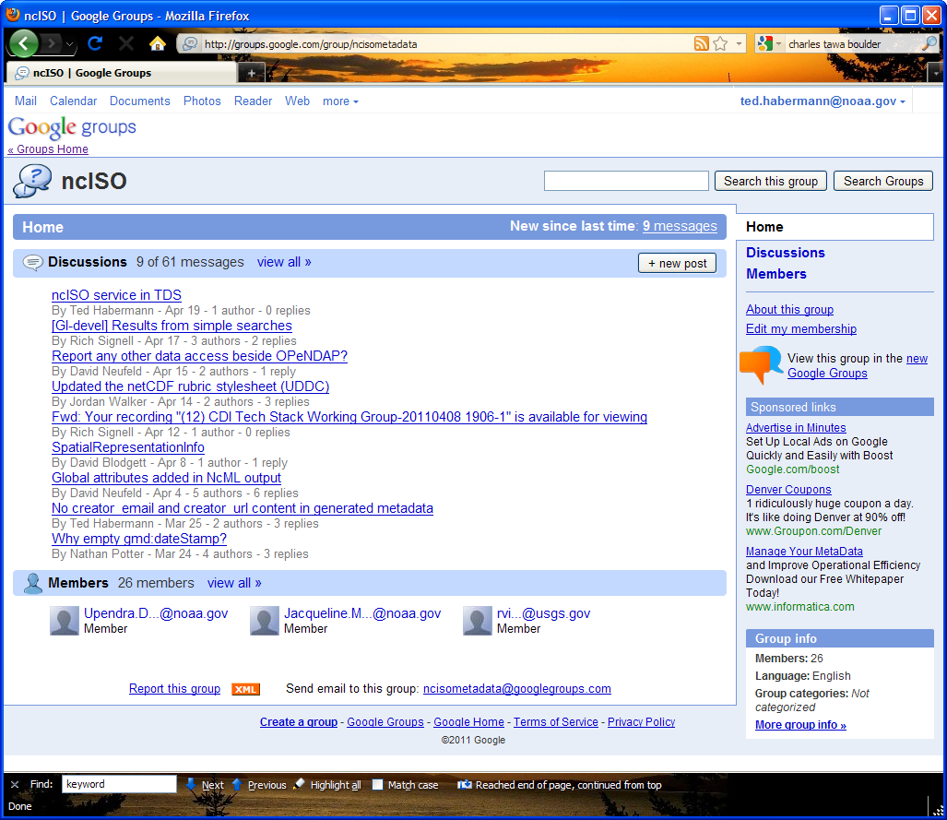
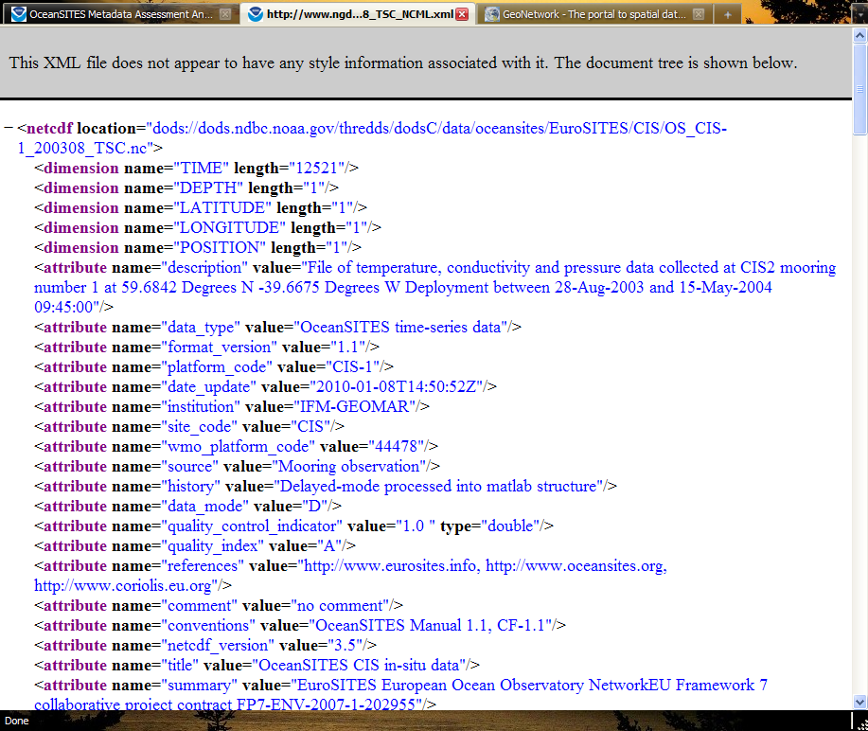
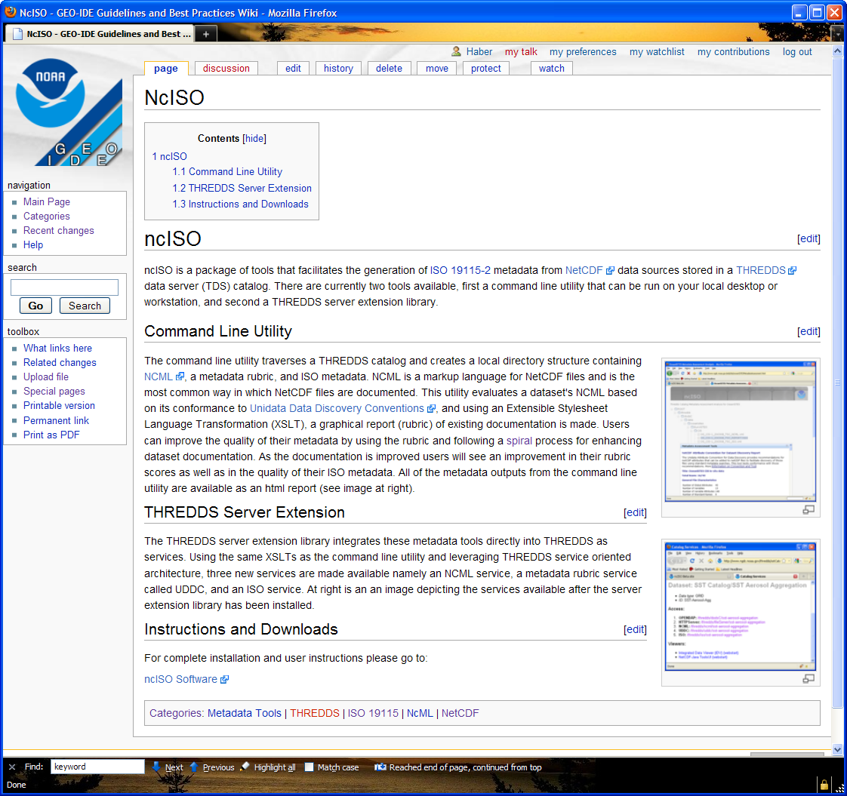
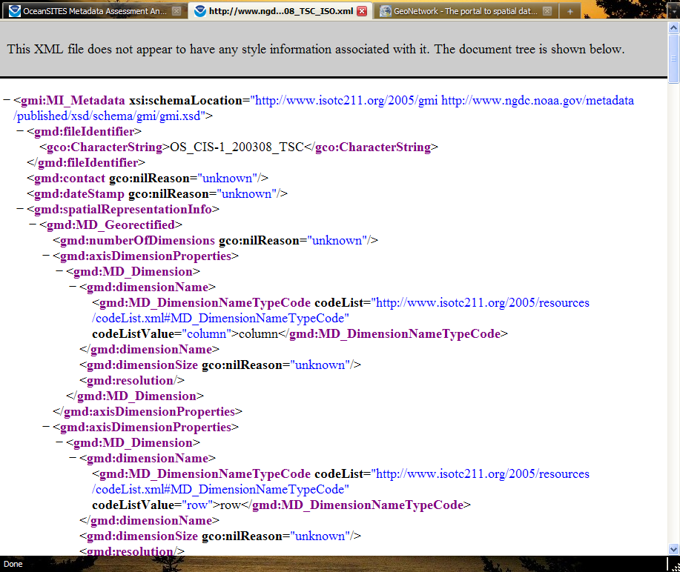
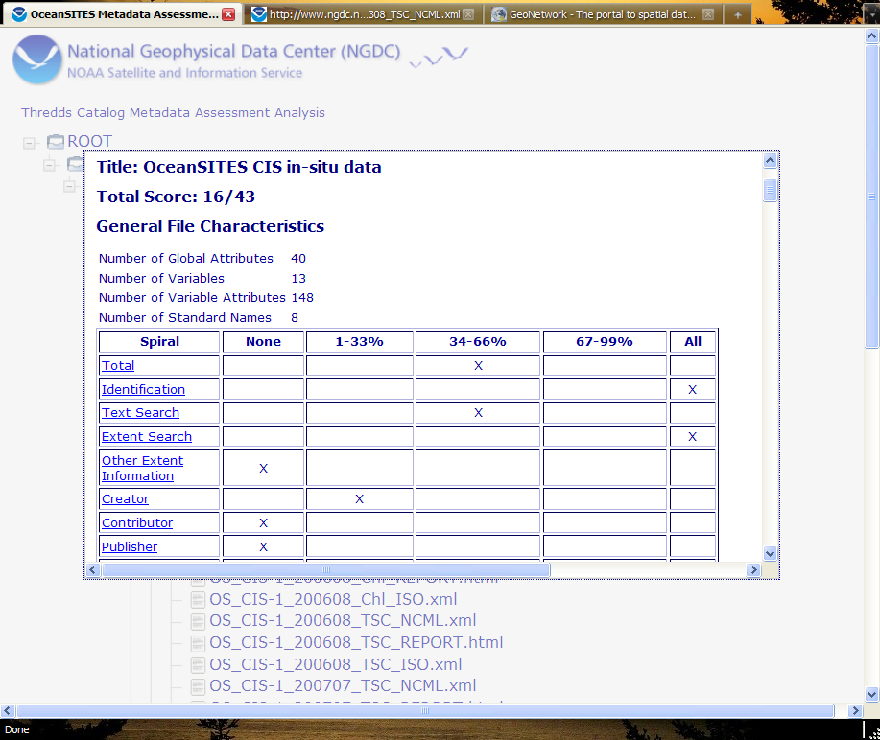
Documentation in Three Dialects
https://geo-ide.noaa.gov/
wiki/index.php?title=NcISO
http://groups.google.com/
group/ncisometadata
NcML
ISO
ACDD

Slide 13

Documentation in Multiple Dialects
Open Provenance
Model, PROV
DIF, FGDC,
Data.Gov
1010101010101010101111100100101101001001001001000100100010010101001001010010010101000100100010100100100101010101010101010101010100010010101000010100
Documentation
Repository
ISO 19115, 19115-2, 19119 and extensions
netCDF
(NcML)
SensorML
THREDDS
WCS, WMS, WFS, SOS
KML

Slide 14
Conventions
Unidata Attribute Convention for Data Discovery
Discovery
ISO Conventions
Climate-Forecast (CF) Conventions
Standard variable names and data organizations
Use / Mashup
Understanding
ISO Conventions

Slide 15
Where Are Citations?
Documentation
dataset /
resource
source
application
schema
keyword
thesaurus
& ontology
algorithm
feature
catalog
Metadata
standard
specification
XML
evaluation
procedure
format
specification
feature
catalog
constraints
reference
additional
documentation
metadata
& service
standard
source
metadata
process
reference &
documentation
software
reference
alternate
metadata
associated
resource
name/metadata

Slide 16
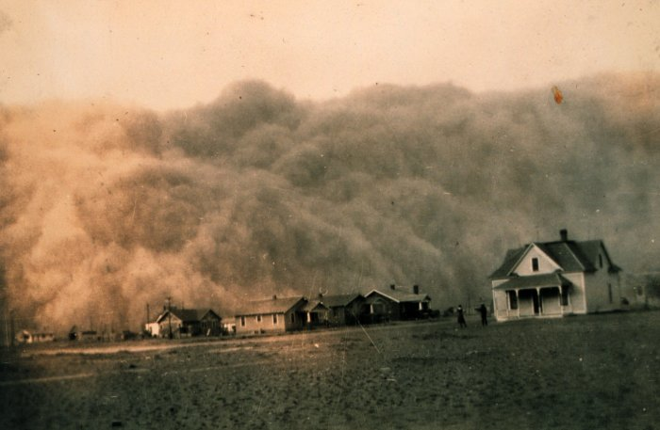
Questions?
ted.habermann@noaa.gov

Slide 17
The Design Process
SMAP.xml
The content of these two files must match
SMAP.xml: an ISO compliant XML file that contains the metadata elements identified in the SMAP metadata model. This is the content that must traverse the system into and out of the HDF5 file.
ISO2NCML.xsl: an xsl file that transforms ISO metadata into a candidate NcML representation. This representation is used because it is intuative and easy to read. It also provides a connection to the netCDF/CF community.
ISO2NCML.xml: an NcML file that contains an extract of the SMAP content in netCDF4 compliant NcML.
NCML2h5py.xsl: an xsl that transforms NCML into python that is compliant with the python HDF5 library (h5py). The python that comes out of this transform instantiates the group structure from ISO2NCML.xml in HDF5
NCML2h5py.py: The python program that, when executed, instantiates the structure from ISO2NCML.xml into HDF5.
SMAP.h5: the HDF5 file created using NCML2h5py.py
SMAPHDF.xml: the XML representation of the content of SMAP.h5
HDF2ISO.xsl: an xsl that transforms the HDF/XML into ISO 19139
SMAP2.xml: the output of the process that should match the original (SMAP.xml).
ISO2NCML.xsl
ISO2NCML.xml
NCML2h5py.xsl
NCML2h5py.py
SMAP.h5
SMAPHDF.xml
SMAP2.xml
h5dump
HDF2ISO.xsl

