Slide 1
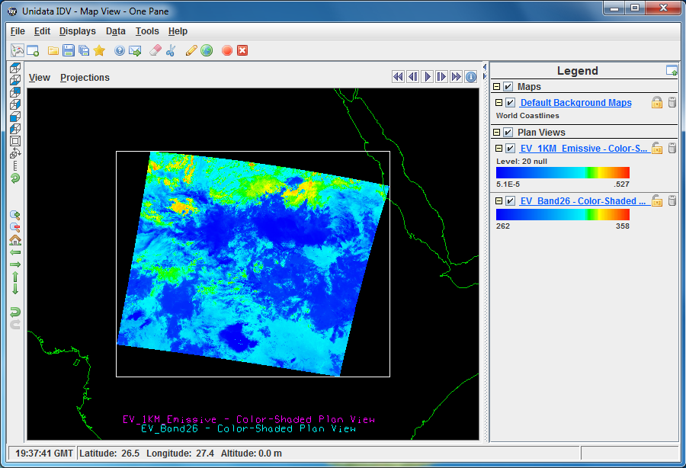
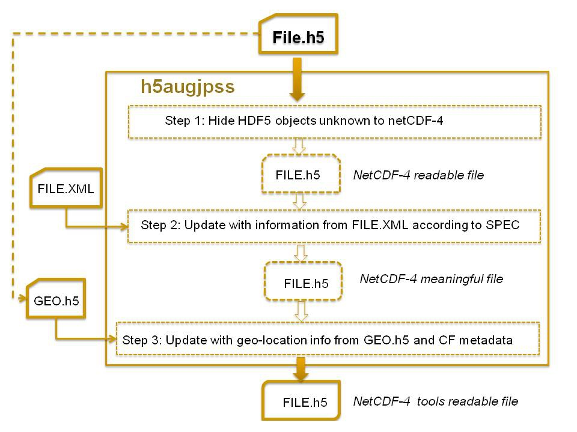
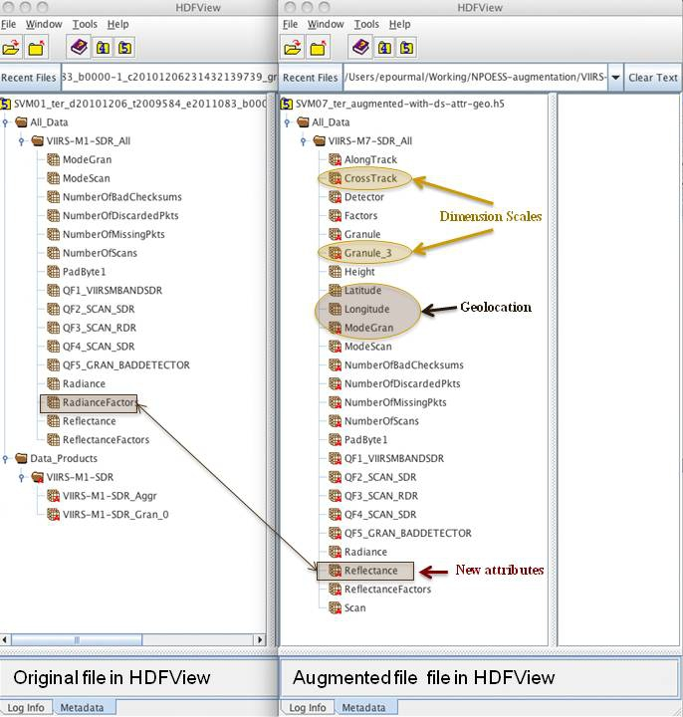
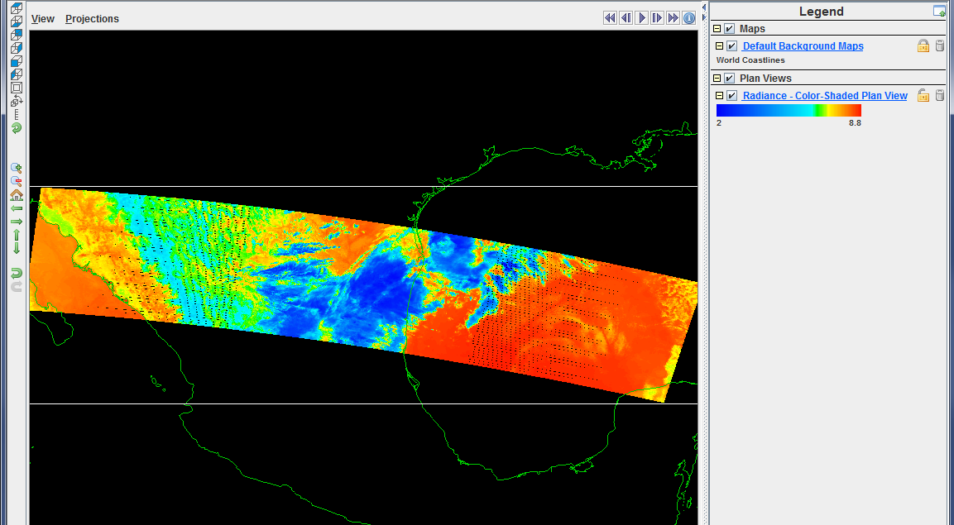
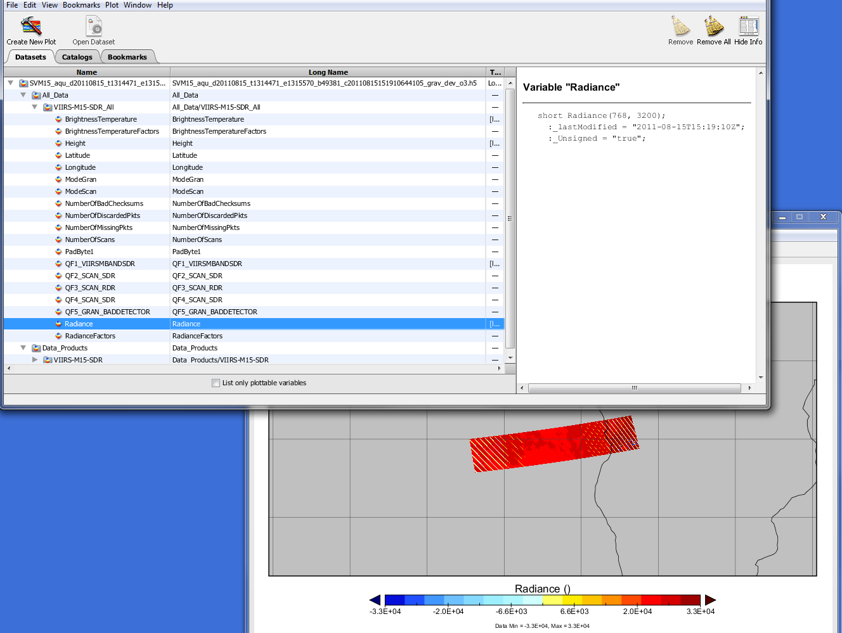
Tools for Interoperability between HDF and NetCDF
http://hdfeos.org
Mike Folk and MuQun Yang
The HDF Group
The HDF Group provides the following tools for the NASA HDF and JPSS data.
Use h4toncccf tool to convert HDF4/HDF-EOS2 to NetCDF-3
Tools that use H4CF Library
h4tonccf Tool Example
CDL dumper
NetCDF converter
…
H4CF Library
The H4CF Library provides a unified way of accessing different types of HDF4 and HDF-EOS2 files.
Provides access all coordinate and data variables and attributes.
Adds CF-metadata to data variables for meaningful access.
HDF-EOS2
HDF4
…
EOS2 file
Type 1
EOS2 file
Type 2
EOS2 file
Type …
HDF4 file
Type 1
HDF4 file
Type 2
HDF4 file
Type …
IDV displays the NetCDF3 file that is converted from NASA MODIS HDF-EOS2 file.
Use aug_eos5 augmentation tool to access HDF-EOS5 data with NetCDF tools
Augmentation
HDF-EOS5
HDF-EOS5
file
Augmented
HDF-EOS5
file
NetCDF-4
file
NetCDF4
HDF5
HDF5
The following NASA data products can be augmented by the aug_eos5 tool: HIRDLS, MLS, OMI, TES, and GSSTF.
Use h5augjpss augmentation tool to access JPSS data with NetCDF tools
IDV with augmented JPSS file
Panoply with augmented JPSS file
This work was supported by Subcontract number 114820 under Raytheon Contract number NNG10HP02C, funded by the National Aeronautics and Space Administration (NASA) and by Subcontract number HDF-1000 under Riverside Technology Inc. Contract number DG133E-07-CQ-0055. Any opinions, findings, conclusions, or recommendations expressed in this material are those of the authors and do not necessarily reflect the views of Raytheon or the National Aeronautics and Space Administration.

Slide 2

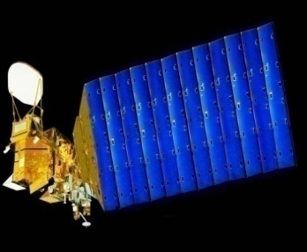
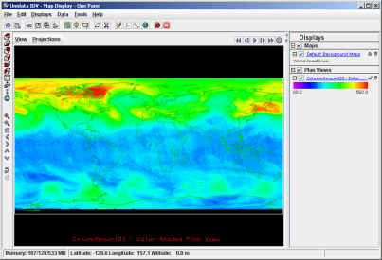


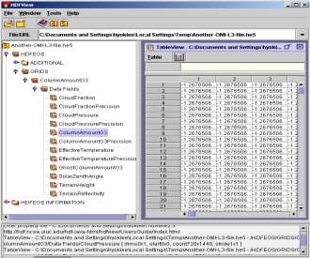
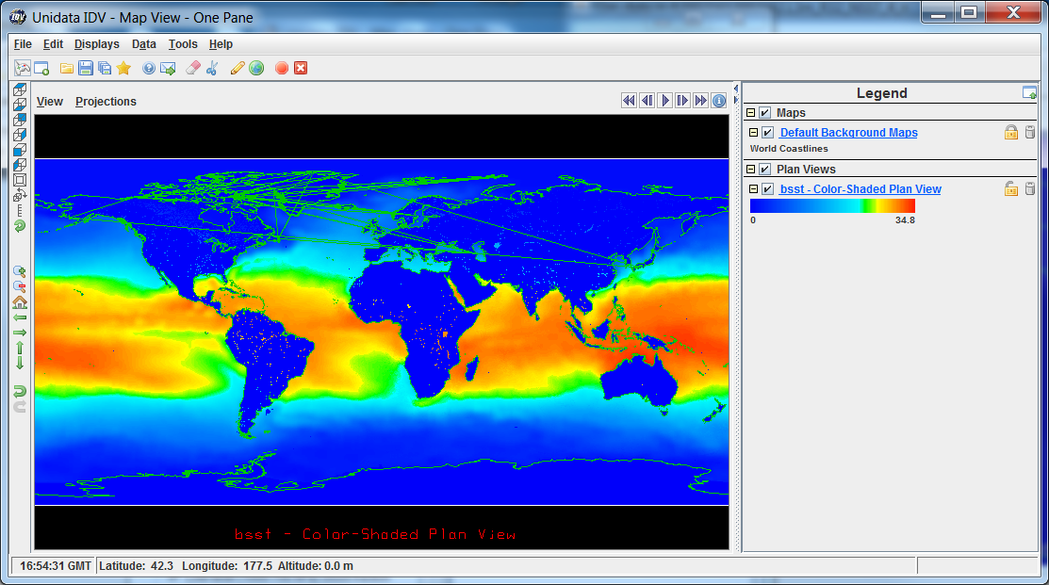
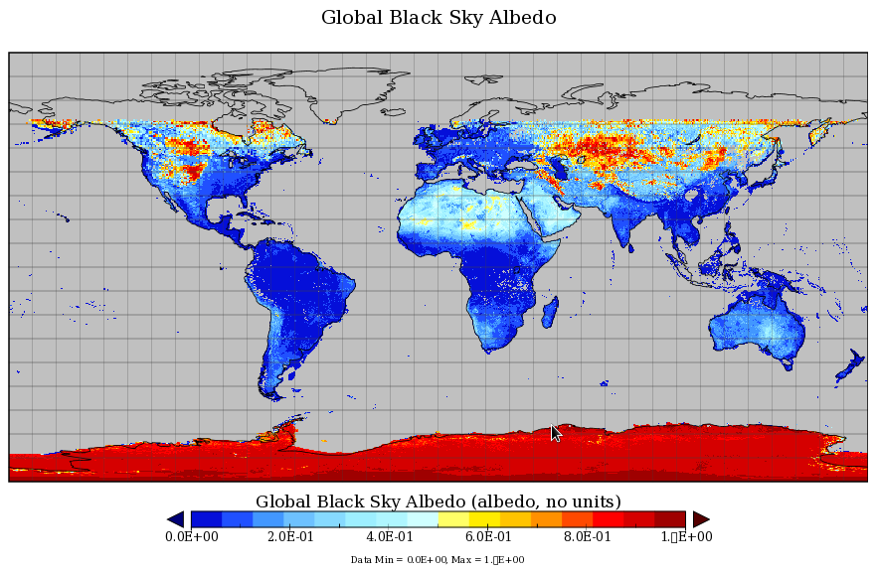
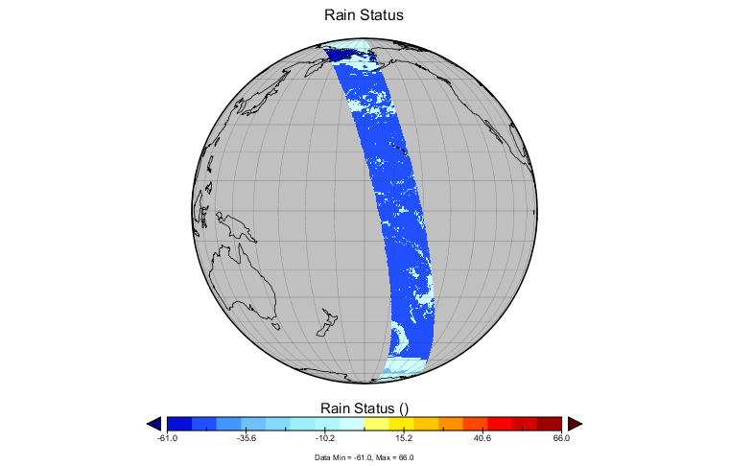
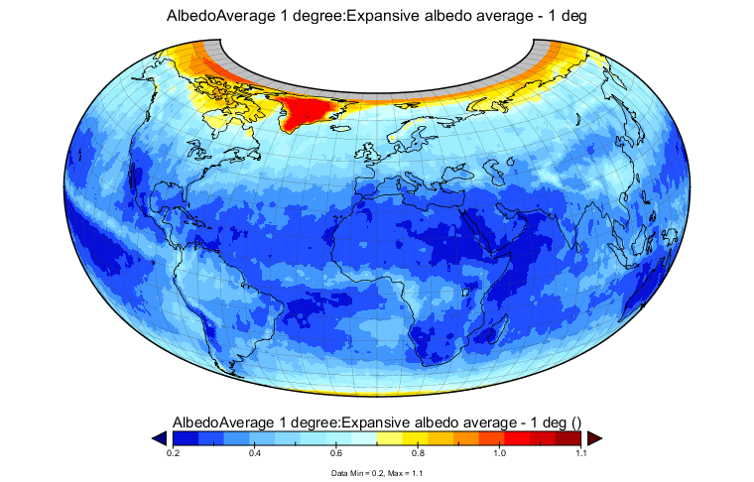
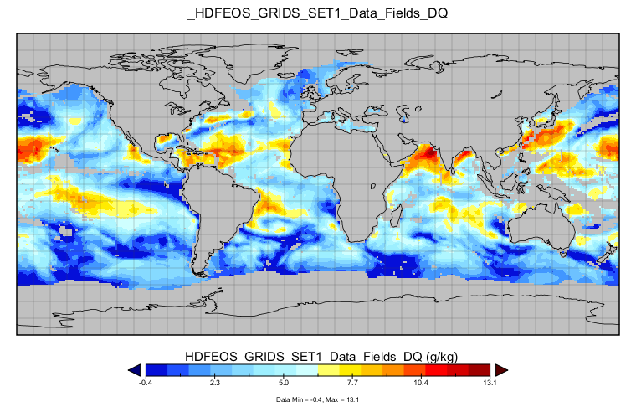
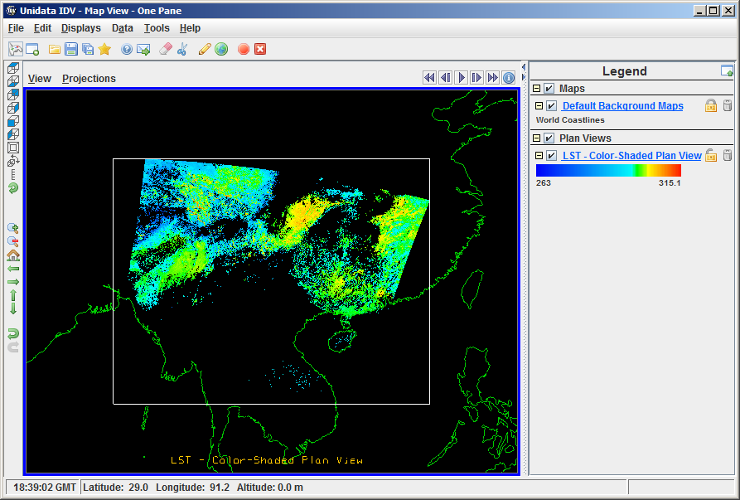
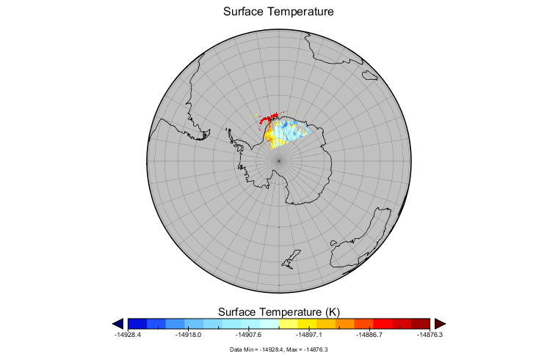
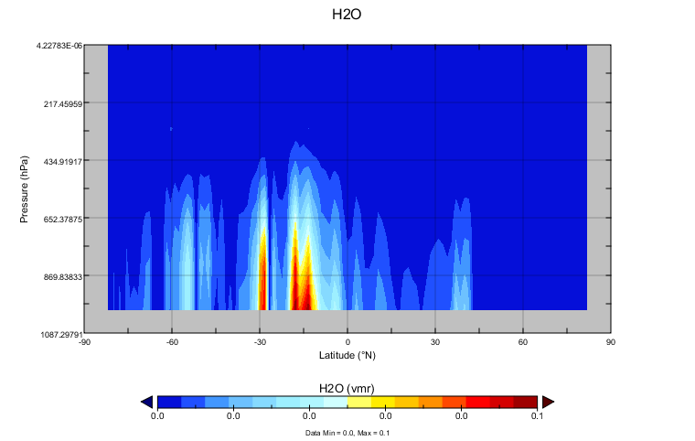
Accessing HDF-EOS Data
via OPeNDAP
http://hdfeos.org
MuQun Yang and Hyo-Kyung Lee
The HDF Group
The HDF Group provides the following servers for the easy access of remote NASA HDF data via OPeNDAP.
Use netCDF tools to access remote HDF-EOS via OPeNDAP
Users
Terra/Aqua/Aura
Translation Layers
libnc-dap
HDF4/5 Handlers
DAP
netCDF Visualization
Tools
OPeNDAP
Clients
OPeNDAP
Servers
HDF4/5 Files
Examples of Accessing NASA HDF via OPeNDAP
PO.DAAC AVHRR IDV
HDF4
LAADS MODIS Panoply
HDF4
NSIDC AMSR_E Panoply
HDF4
LaRC MISR Panoply
HDF4
GES DISC GSSTF Panoply
HDF5
LP DAAC MODIS IDV
HDF4
LAADS MODIS Panoply
HDF4
GES DISC MLS Panoply
HDF5
The HDF4 OPeNDAP handler software can be used to access HDF4 data via OPeNDAP's Data Access Protocol. The original version of the handler was implemented in 1998. The HDF Group enhanced the HDF4 OPeNDAP handler in 2010 to support the access of NASA HDF-EOS2 and some HDF4 products via OPeNDAP's visualization client tools.
The HDF5 OPeNDAP handler software that can be used to access HDF5 data via OPeNDAP's Data Access Protocol. The handler can support OPeNDAP's visualization client tools to access NASA HDF-EOS5(OMI, HIRDLS, MLS, and TES) products.
The handlers have some limitations. Not all NASA HDF data products can be accessed and visualized by OPeNDAP’s visualization client tools.
Acknowledgements: We thank Dan Marinelli, Carol Boquist and Rama Ramapriyan of the NASA ESDIS project; Christopher Lynnes, James Johnson and Fan Fang from NASA GES DISC; Ruth Duerr from NSIDC; James Gallagher from OPeNDAP, Inc.; UCAR's NCL User Group and John Evans from MathWorks for their valuable suggestions and help.
This work was supported by Subcontract number 114820 under Raytheon Contract number NNG10HP02C, funded by the National Aeronautics and Space Administration (NASA) and by cooperative agreement number NNX08AO77A from the NASA. Any opinions, findings, conclusions, or recommendations expressed in this material are those of the authors and do not necessarily reflect the views of Raytheon or the National Aeronautics and Space Administration.

Slide 3
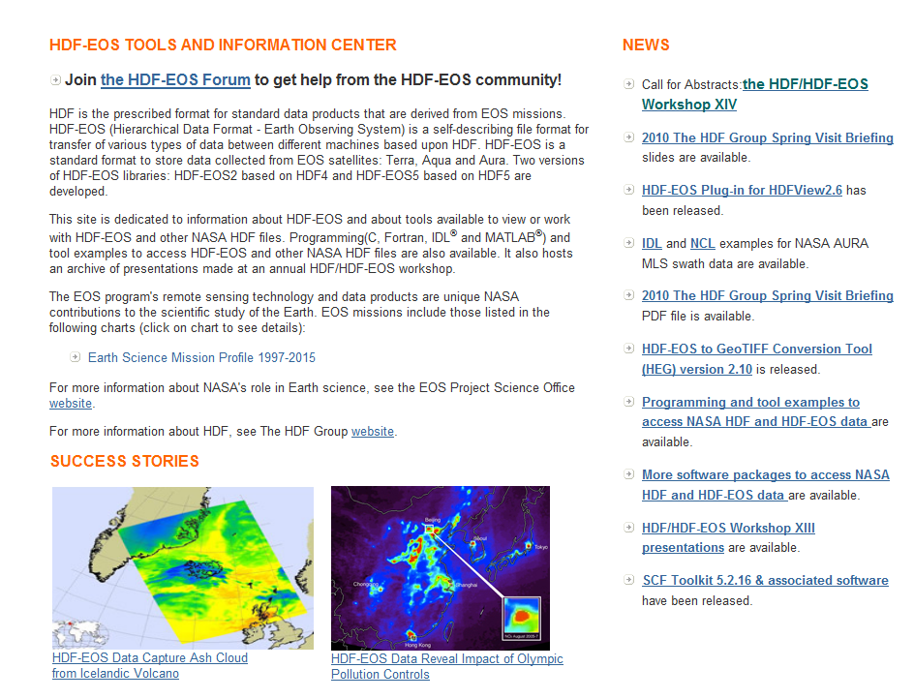
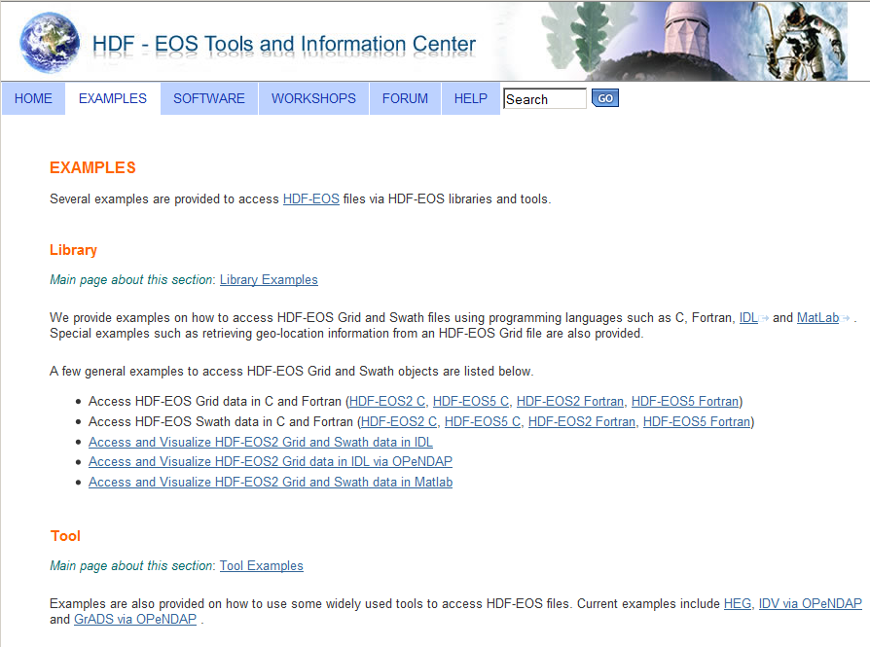
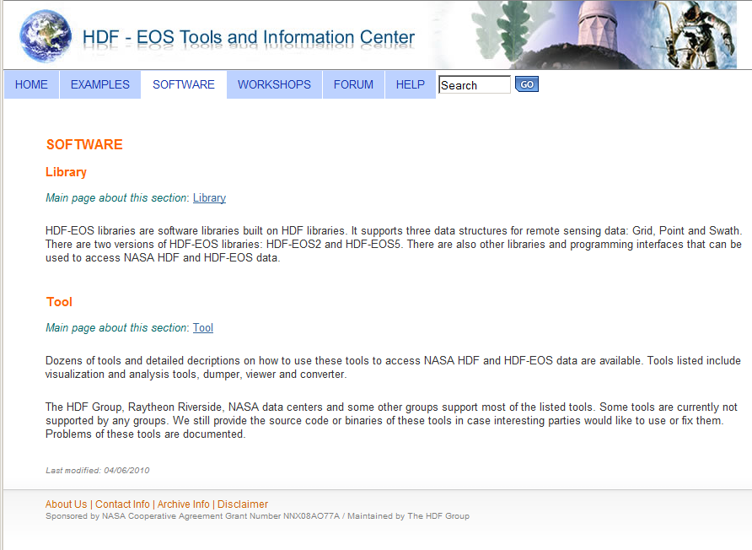
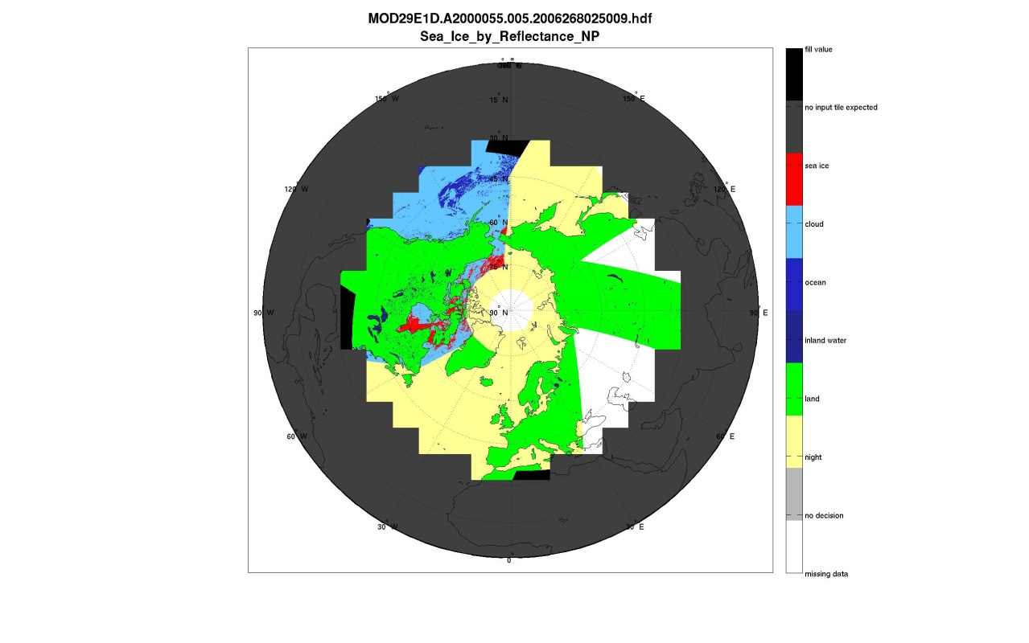
Enhancement to the HDF-EOS Tools and Information Website
http://hdfeos.org
MuQun Yang and Hyo-Kyung Lee
The HDF Group
The HDF Group enhanced the hdfeos.org website so that users can access NASA HDF data easily by following comprehensive examples.
Overview – hdfeos.org
Comprehensive Programming Guides
Latest Software Development & Update
The new website has not only a new look
but also a lot more contents than before…
Covers many NASA HDF/HDF-EOS data products.
Covers different programming languages and tools.
Has a collection of 40+ up-to-date libraries and tools.
Has the latest software development information.
Improved Comprehensive Examples of Accessing NASA HDF with MATLAB, IDL, and NCL
Full HDF file name
Discrete color bar
Data set name form
long_name attribute
if available
Key Improvements:
Corrected the title with HDF file name.
Added descriptive data set name using attributes.
Corrected color bar with right unit and scale formula.
Added more projections.
Added more data products.
More Projection Support
NSIDC MODIS MATLAB
The HDF Group maintains a webpage that includes comprehensive NCL/MATLAB/IDL example codes, and plots of NASA HDF-EOS2, HDF-EOS5, and HDF4 files collected from NASA data centers: GES DISC, MODAPS(LAADS),NSIDC,LP-DAAC, GHRC, OBPG(Ocean Color) and LaRC. More than 80 files and 600 plots and codes of NCL/IDL/MATLAB can be found from this page. More examples will be added soon. We hope this can significantly reduce the time for end users to visualize the NASA HDF4 and HDF-EOS2 data. The URL is http://hdfeos.org/zoo.
Use the updated eos2dump to access HDF-EOS2 using NCL, IDL, and MATLAB
HDF-EOS2 File
eos2dump
Extract geo-location
information
Latitude
Longitude
in ASCII file
HDF SDS Interface
NCL
MATLAB
IDL
Text file Interface
This work was supported by Subcontract number 114820 under Raytheon Contract number NNG10HP02C, funded by the National Aeronautics and Space Administration (NASA). Any opinions, findings, conclusions, or recommendations expressed in this material are those of the authors and do not necessarily reflect the views of Raytheon or the National Aeronautics and Space Administration.

Slide 4
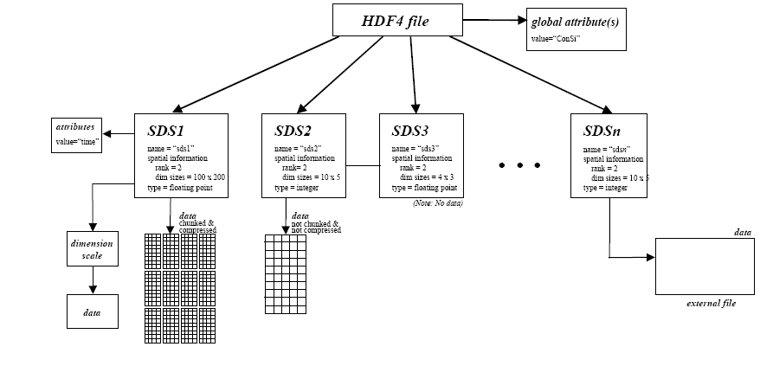
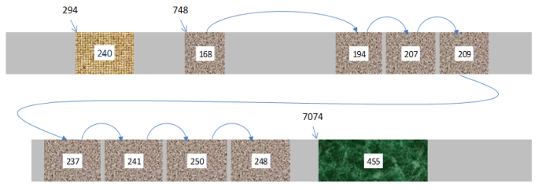
Assuring Long Term Access
with HDF4 File Content Maps
http://hdfgroup.org/projects/h4map
Mike Folk, Hyo-Kyung Lee and MuQun Yang
The HDF Group
The HDF Group provides the following tool for the long term access of NASA HDF data.
Long Term Archive Tool for HDF4 Files
h4mapwriter
linked with
HDF4 library
HDF4 File Content
Map in XML
The normal way to access HDF-formatted data is through the HDF software libraries, either by using the HDF Application Programming Interface (API) directly or by using HDF tools that depend on the HDF libraries.
However, there is a risk in depending solely on the HDF libraries to access HDF-formatted data over the long term. It is possible, especially in the distant future, that the software may not be as readily available as it is today. To address this risk, it is desirable to have a way to retrieve the data independently.
Object Data
Reader
program
Groups, Data Objects,
Structural and Application
Metadata;
Locations of Object Data
HDF4 file layout
HDF4 Mapping Project Team
The HDF Group: Ruth Aydt, Mike Folk, Hyo-Kyung Lee, Binh-Minh Ribler, MuQun Yang
Goddard Earth Sciences Data and Information Services Center: Christopher Lynnes
National Snow and Ice Data Center: Ruth E. Duerr, Luis Lopez
What’s New: The HDF group has released the version 1.0.1 of the h4mapwriter.
Access HDF4 Files without the HDF4 Library
/* Open the hdf file for reading. */
infile = fopen(hdfname, "rb");
if(infile == NULL) {
printf("Error opening file: %s\n", hdfname);
exit(EXIT_FAILURE);
}
/* Read the dataset into the buffer. */
buffer = malloc(nBytes);
fseek(infile, offset, 0);
fread(buffer, 1, nBytes, infile);
def __init__(self,hdf_fileName):
try: #it opens the HDF creating a file object
file_path=path.normpath(hdf_fileName)
self.file_handler=file(file_path,"rb")
…
self.file_handler.seek(int(chunk.attrib["offset"]),0)
#if chunk.attrib["compression"] in ("zlib","szip","DEFLATE"):
tmp_buffer_object.write(self.file_handler.read(int(chunk.attrib["nBytes"])))
Map provides offset and bytes
of HDF4 objects in XML.
Read binary data
using fseek() and fread() in C.
Read binary data
using seek() and read() in Python.
What’s New: NSIDC released a complete Python reader (version 1.0.0. beta) of HDF4 File Content Map reader.
HDF4 File Content Map Schema
The HDF4 File Content Map Schema defines the elements and attributes in an HDF4 file content map. These elements and attributes are used to describe the data and grouping objects in HDF4 files, as well as the structural and application metadata associated with those objects and with the entire HDF4 file.
<?xml version="1.0" encoding="UTF-8"?>
<xs:schema version="1.0.0" targetNamespace=… >
<xs:complexType name="hdf4FileInformationT">
<xs:sequence>
<xs:element name="fileName" type="xs:string"/>
<xs:element name="fileLocation" type="h4:fileLocationT" minOccurs="0"/>
<xs:element name="fileSize" type="xs:integer"/>
<xs:element name="md5Checksum" type="h4:md5ChecksumT" minOccurs="0"/>
</xs:sequence>
</xs:complexType>
HDF4 File Content
Map Schema
Valid or Invalid
HDF4 File Content
Map in XML
XML
Validation Tool
This schema can be used to validate an HDF4 map file produced by the writer. The W3C XML Schema language was used to express the HDF4 mapping schema.
This work was supported by Subcontract number 114820 under Raytheon Contract number NNG10HP02C, funded by the National Aeronautics and Space Administration (NASA). Any opinions, findings, conclusions, or recommendations expressed in this material are those of the authors and do not necessarily reflect the views of Raytheon or the National Aeronautics and Space Administration.

Slide 5
Recent Activities
Recent Activities by The HDF Group
by The HDF Group

