Slide 1
iRODS: Interoperability in Data Management
Leesa Brieger, RENCI-UNC
Mike Wan, DICE-UCSD

Slide 2
integrated Rule-Oriented Data System (iRODS)
Developed by the Data Intensive Cyber Environments (DICE) group, UNC and UCSD
Follow-on to SRB, the Storage Resource Broker from SDSC
  decade-long development experience, community-driven
Modular, extensible, customizable
Open source (BSD license)
Supported by the Renaissance Computing Institute (RENCI), UNC
  a research unit of UNC Chapel Hill
  state-supported
  governed by the Triangle universities (UNC, NCSU, Duke)

Slide 3
iRODS
Data grid middleware
Data management infrastructure
Framework for implementing policy-driven data management
The extensibility and modularity of iRODS make it a customizable and resource-agnostic infrastructure.

Slide 4
iRODS as Data Grid
iRODS View of Distributed Data
User Client
User sees a single collection
My Data:
disk, filesystem,
WOS storage unit...
My Data:
tape, database, filesystem...
Partner’s Data
remote disk, tape, filesystem...
  iRODS installs over heterogeneous data resources
  Users share & manage distributed data as a single collection
  iCAT metadata catalogue: DB that manages the logical-to-
  physical mappings (data objects, users, resources)

Slide 5
Data Life Cycle
Usage evolves across stages of the data life cycle; management policy evolves along with it.
Creation
Active Use
Publication & Sharing
Local Policy
Reference Collection
Service/Use
Distribution
Archival Collection/Deletion
Discovery and
Re-purposing
Retention/
Preservation
iRODS modularity and extensibility allows support for changing
management requirements over the data life cycle.
s ds

Slide 6
iRODS Design Goals
Data grid abstraction for data, users, resources
Abstract out the data management
  Separate data administration from storage administration
    drivers allow iRODS to talk local storage protocol
    rule engine runs services and data operations
  Policy-based data management
    Data management: specialized modules of microservices (C code) and rules for running data-side services
    Policy-based: event-triggered rule execution
  Policy follows data around the grid
    collection management independent of remote storage locations
Notes:
This is the first mention of microservices… defined in the next slide.

Slide 7
Interoperability
Federation
  Data grids with independent administration can federate and cross-communicate
Clients
  User-supplied or specialty client interfaces
  Many specialized views of the collections
iRODS core extensions for resource agnosticism/fitting in with existing infrastructure
  network transport (RBUDP)
  authentication mechanisms (Kerberos, Shibboleth, GSI, etc)
  external databases (DataBase Resources - DBRs)
  storage drivers (HPSS, WOS, EC2, etc)

Slide 8
Interoperability Through Microservices
iRODS provides a structure for implementing custom services
  Rules and microservice modules
  Can be user-defined
  Data-side services: format conversion, extraction, visualization, accounting & reporting, …
  Archival: replication, curation procedures, long-term archival procedures
  Access: access control policy
  Discoverability: metadata organization and management
  Symbolic links: integrate data from other collections into iRODS repository
    microservice drivers
  Universal mass storage driver – plug in new protocols

Slide 9
Interoperability Through Integration with Existing Infrastructure
Data management integrated with storage management: OSG, DDN
Data management integrated with standard interfaces and services:
  Fedora (librarians)
  DataVerse (social scientists)
  HDF5 (cosmologists)
  NetCDF (NASA climate scientists, NSF earth scientists - hydrologists)

Slide 10
Integration with HDF5
Mike Wan and Peter Cao, 2008
Interactive access to HDF5 files on a remote iRODS server – browsing of metadata and data sharing with services
Clients access to data (subsets) and metadata in HDF5 files stored remotely; transfers only of requested data and metadata, not of full files
iRODS microservices and APIs created to support HDF5 functionality on HDF5 objects
islice – extracts a slice from a FLASH (cosmology) file stored on a remote iRODS server
Remote viewing of HDF5 iRODS data
HDFView
  iRODS HDF5 Java objects were added to the HDF-Java products
  HDFView GUI was improved to support iRODS

Slide 11
Integration with NetCDF
Mike Wan, 2012
Add NETCDF functionalities to iRODS:
  wrap NETCDF APIs into iRODS APIs and micro-services
New iRODS APIs to wrap basic NETCDF APIs (libnetcdf) and a higher-level libcf subsetting function
  Basic: nc_create, nc_open, nc_close
  Inquiry functions: nc_inq_varid, nc_inq_dimid, nc_inq_dim, nc_inq_var
  Subsetting functions: nc_get_vars_text, nc_get_vars_string, nc_get_vars_int, nc_get_vars_float, nc_get_vars_double, …
  Higher-level subsetting function of libcf for CF data: nccf_get_vara
New NETCDF-based iRODS micro-services
  Allow NETCDF workflows to be performed data-side on the iRODS servers
  One for each of the new APIs, for server-side operations
  5 micro-services for accessing data elements in the new data structures

Slide 12
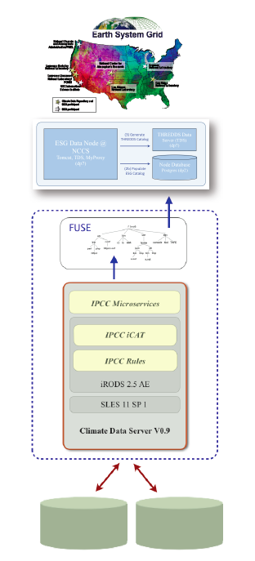
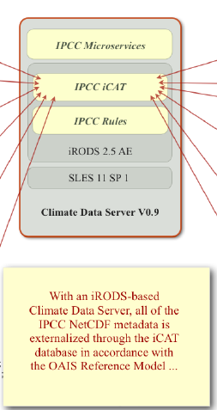
iRODS for Interoperability – NASA (NCCS)
Separating metadata from the data object
(from NetCDF files into the iCAT)
Using an iRODS FUSE client
to expose data to the ESG
Data Node
In support of discovery, long term curation,
and reuse/repurposing of the data

Slide 13
E-iRODS from RENCI – the RedHat Model
Initial release based on iRODS 3.0
  Tracks community code, with a delay
  Download beta release binaries at http://e-irods.com
Hardened binary release of iRODS
  Passes continuous integration with back-ported bug fixes from community trunk
  Packaging and signing: initially RPM and DEB
Certification
Documentation
Subscription Support Contracts – leesa@renci.org for information

