Slide 1



Bridging ICESat and ICESat-2 with Standard Data Products
SGT/Jeffrey Lee
Code 615, NASA GSFC/WFF
HDF & HDF-EOS Workshop XV, April 17-19 2012
jeffrey.e.lee@nasa.gov

Slide 2
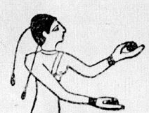
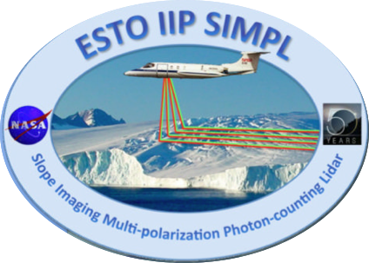
Juggling Three+ Efforts

Slide 3
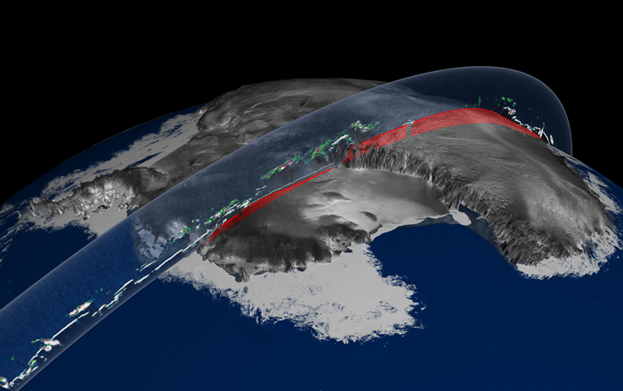
ICESat (GLAS) Rewind
Geoscience Laser Altimeter System (GLAS)
  Traditional Laser Altimeter
  40 shots/sec
15 Data Product Types (GLAxx)
  L1 – L2A
  Fixed-record-length integer-binary
Sparse Multi-rate Point Data
  40/sec, 1/sec, 1/4sec, 1/8sec, 1/16sec
  Lat, Lon, Elev
33 Releases
  Final completed this year
7 years of campaign-mode data collection
Returned to Earth August 30, 2010
http://icesat.gsfc.nasa.gov/icesat/

Slide 4
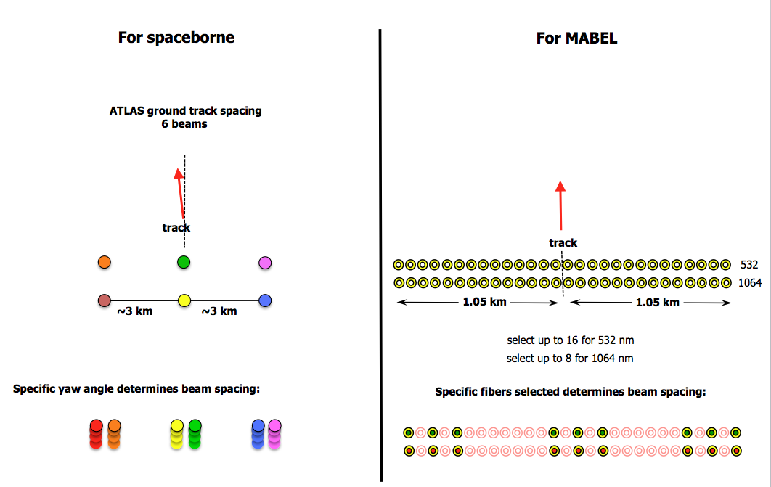
ICESat-2 (ATLAS) Preview
Advanced Topographic Laser Altimeter System (ATLAS)
  Photon Counting Lidar
  6 Beams/Tracks
  10,000 shot/sec; may average
  3 surface photons/shot/beam
21 Suggested Product Types
  L1A-L4
  13 Sparse Multi-Rate Point
  8 Gridded
Big Data!
  L0 : 80GB/Day
  Total Granules : 860GB / Day
Launch 2016
http://icesat.gsfc.nasa.gov/icesat2/

Slide 5

MABEL Review
Multiple Altimeter Beam Experimental Lidar (MABEL).
Demonstrator instrument for ATLAS.
Photon-counting LIDAR.
16 Beams/Tracks for 532nm
8 Beams/Tracks for 1064nm.
Flies aboard ER-2 – Flying from Iceland NOW
Average Size of 30 sec Granules
  L1A = 503 MB
  L1B = 272 MB
  L2A = 234 MB
http://icesat.gsfc.nasa.gov/icesat2/data/mabel/mabel_docs.php

Slide 6
ICESat/ICESat-2 SSDT Goals
Design products and write software for ICESat-2.
Design products and write software for the ICESat-2 demonstrator instrument (MABEL).
Transform GLAS data products into something interoperable and future-friendly. (GLAS_HDF)

Slide 7
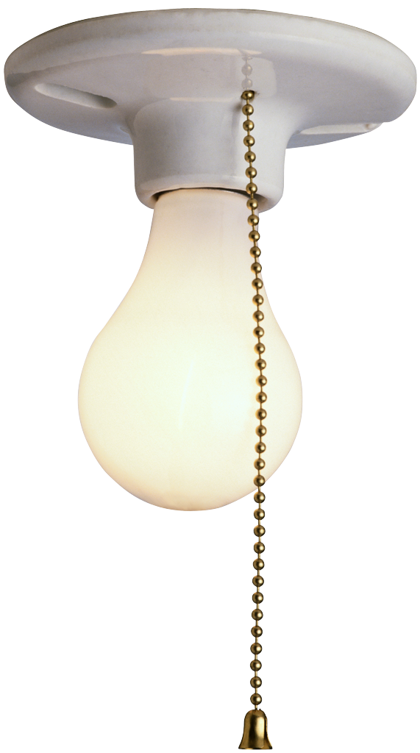
Hmm…
All three datasets are fairly similar in type:
  Sparse, irregular, multi-rate point data.
So, let’s make the products of similar design!
Benefits:
  Promotes interoperability.
  Enables natural progression of development experience.
  Enhances code reuse/enables common codebase.

Slide 8
How Do We Do This?
Used MABEL for initial product development. Designed products in HDF5, wrote software, processed data and created 5 product releases.
Are writing transformation software and designing products for ICESat data (GLAS_HDF) using what learned with MABEL.
Will integrate lessons learned in GLAS_HDF to improve future releases of MABEL products.
Will apply all lessons-learned to ICESat-2.

Slide 9
SDT Desires
SIMPLICITY : a=plot(time,elev)
Embrace Standards (both required and desired).
Self-Describing.
NetCDF4 “Friendly”.
Leverage Existing GLAS Codebase.
Minimize 3rd Party Libraries

Slide 10
Implementation Matrix
Feature | GLAS_HDF | MABEL | ICESat-2
File Format | HDF5 | HDF5 | HDF5
Granule-level Metadata | ECHO+ | ECHO+ (Initial) ISO-19115 (Planned) | ISO 19115
Collection DOIs | YES | YES | YES
CF Conventions | YES | YES | YES
Self-Describing | YES | YES | YES
NetCDF4-friendly | YES | YES | TBD
Granule UUIDs | YES | YES | TBD
Development End Date | May 2012 | TBD | TBD

Slide 11
GLAS_HDF Product Definition
Let’s shift presentation focus to GLAS_HDF but remember there are other drivers in play…

Slide 12
Technical Design
HDF5 (1.8.8)
Each parameter is a SIMPLE dataset.
  Simple & NetCDF4-friendly.
  Allows attached parameter attributes.
  Allows user to easily read parameters they want.
Parameters will be chunked/gzipped.
  This is a –must- given future data sizes.

Slide 13
Product Challenges
Simplicity
Multi-Rate Data
Lots of Parameters
Different Metadata Representations
Provenance

Slide 14
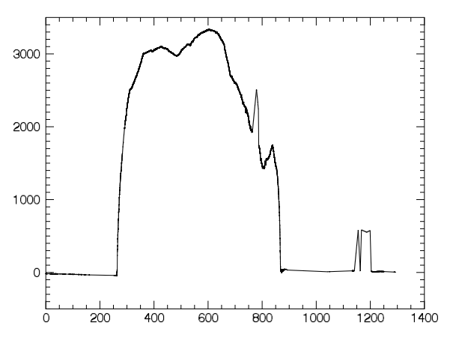
Simplicity=Approachability
Ungridded=No Tool Support
So, make coding easy.
15 lines of code plots elevation (the primary data parameter).
pro plot_elev
;
; Open the file
;
f_id=H5F_OPEN("GLAH06_864_2109_001_1326_3_01_0002.h5")
;
; Read Time
;
time_id=H5D_OPEN(f_id, "/Data_40HZ/Time/d_UTCTime")
time=H5D_READ(time_id)
H5D_CLOSE, time_id
;
; Read Elevation values and the fill value attribute
;
elev_id=H5D_OPEN(f_id, "/Data_40HZ/Elevation_Surfaces/d_elev")
elev=H5D_READ(elev_id)
at_id=H5A_OPEN_NAME(elev_id, "_FillValue")
bad_val=H5A_READ(at_id)
H5A_CLOSE, at_id
H5D_CLOSE, elev_id
;
; Plot the good data
;
good=where(elev ne bad_val[0])
a=plot(time[good]-time[0], elev[good])
H5F_CLOSE, f_id
end

Slide 15
Logical Design
Rate Group – A solution for multi-rate data.
  All Data of a particular rate are bundled into a top-level “rate” group. Each rate group has an associated time parameter with a 1-to-1 array index correspondence.
  Yes, time is repeated, but is simpler than indexing and allows for “a=plot(x,y)”.
Data are further grouped logically per discipline.

Slide 16
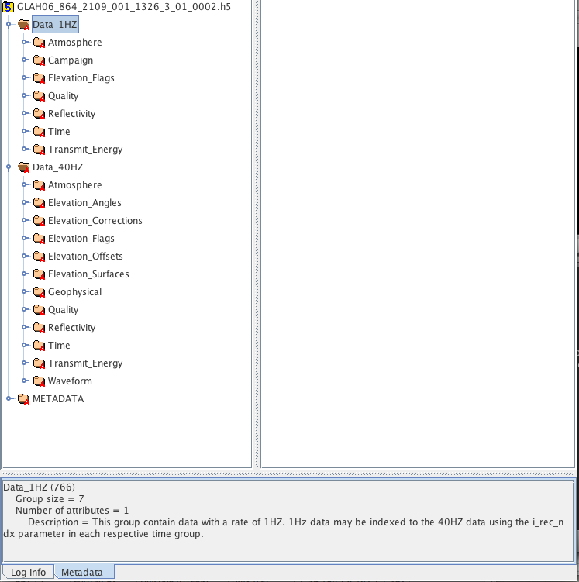
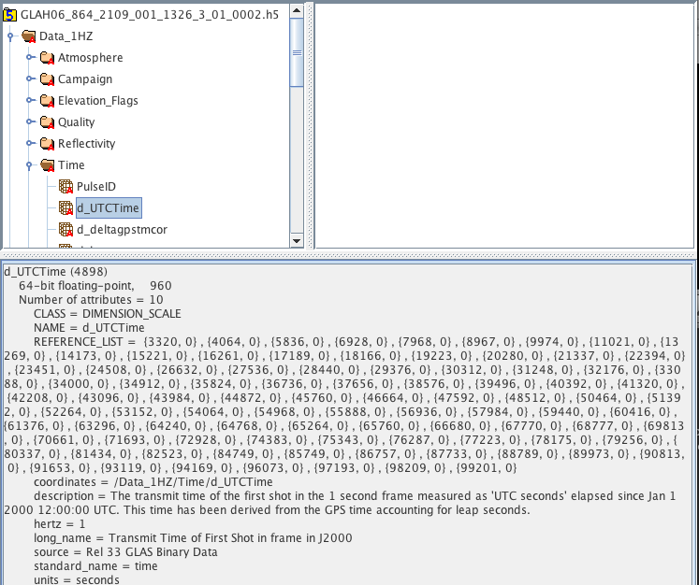
Grouping/CF Attributes

Slide 17
Metadata
Focus Primarily on Content, Not Presentation
  Presentation can be external transformation, but only with identifiable content.
Methods of Storage
  Global Attributes
  Grouped Datasets
  Grouped Attributes

Slide 18
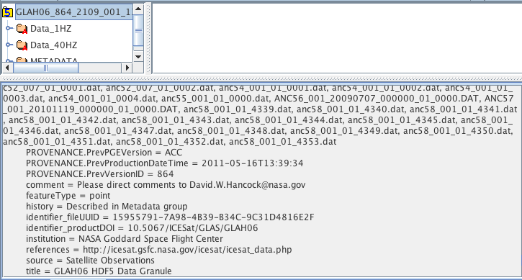
Metadata: Global Attributes

Slide 19
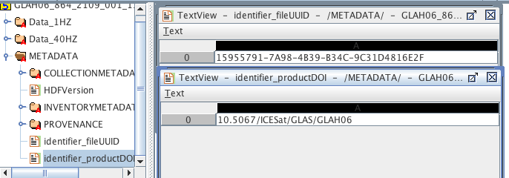
OR… Metadata : Grouped Datasets

Slide 20
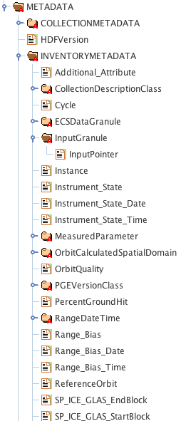
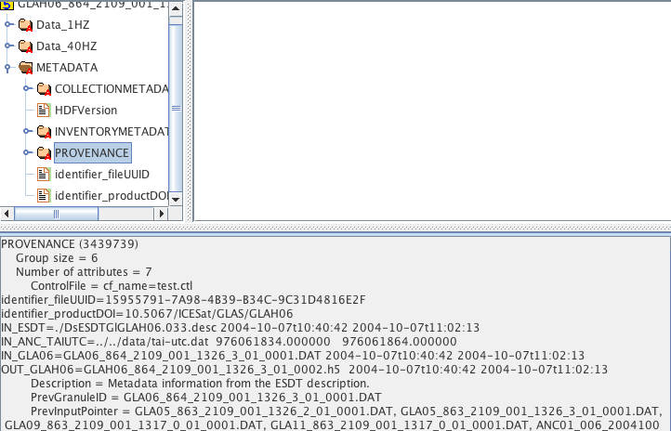
Or… Metadata : Grouped Attributes

Slide 21
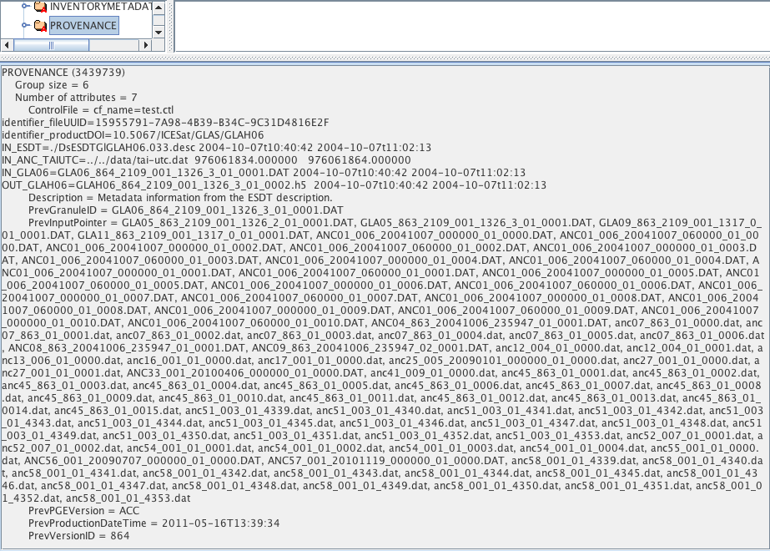
Provenance
GLAS_HDF is a “transformation” process.
We want to preserve processing information from the process that created the original GLAS file.
This is a placeholder
What is the right way?

Slide 22
Development Challenge
GLAS data consists of 15 products with a total of over 2000 parameters.
That’s a lot of code to write!
We can read the integer-binary with existing routines
MABEL development revealed that product development shares a significant amount of coding constructs.

Slide 23
Workflow
Prep Work
  Export cf-style parameter metadata from existing data dictionary into text-based product_spec.
  Massage the product_spec to add rate/logical grouping.
Code Generation
  Feed the product_spec into a code generator to generate Fortran90 product code.

Slide 24
gla_codegen
Internal-quality “evolutionary” code generator.
Written in Fortran90; writes Fortran90 code.
Calls SDT library routines & HDF5 library.
Writes modular API code based on input product_spec.
Is Rate & Logical Group oriented.
Handles:
  Limited datatypes
  Up to rank=2 arrays
  CF attributes
  Basic granule-level metadata
  Chunking, gzip compression
  HTML data dictionary generation

Slide 25
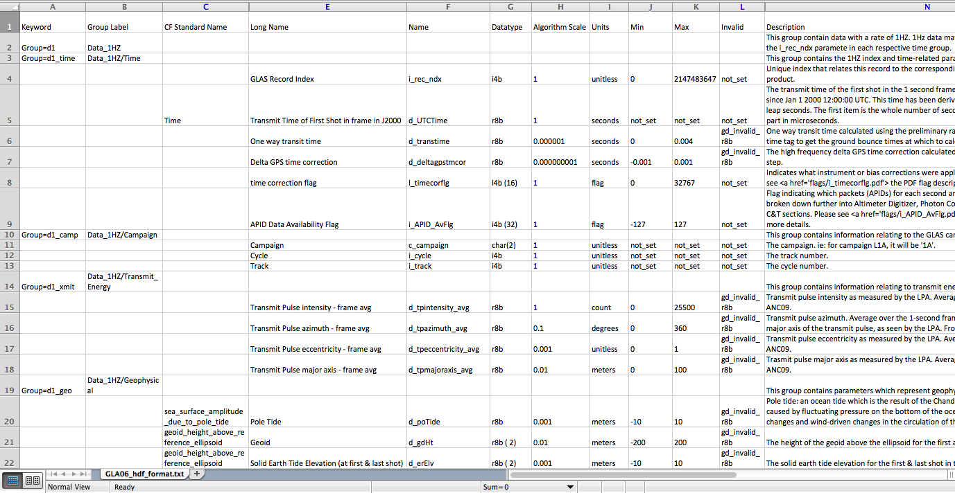
Input Product Spec

Slide 26
Output : Generated Product API
Module | Functionality
init_ | Initializes the data structure for the group
allocate_ | Allocates the data buffer
deallocate_ | Deallocates the data buffer
h5_create_ | Creates group and initializes for writing
h5_init_ | Initializes the HDF5 data structures
h5_open_ | Opens group and reads parameter attributes
h5_close_ | Closes group and any open spaces
h5_read_chunk_ | Reads a chunk of data from file to memory
h5_write_chunk_ | Writes a chunk of data from memory to HDF file
print_attr_ | Prints parameter attributes
print_data_ | Prints parameter data
print_head_ | Prints parameter headings
print_data_dict_ | Prints structure for DD
sync_ | Synchronizes group with time
h5_set_ds_ | Sets parameter dimensional scales

Slide 27
Generated Code
GLAH06 Example:
  Read 193 lines of product description
  Wrote 21K lines of code to instantiate the API.
  Pre-existing code + APID provides over 90% of the code required for the transformation process.

Slide 28
The Poster
Thank You.
Comments, Suggestions, Corrections?
Jeffrey.e.lee@nasa.gov

