Slide 1


HDF-OPeNDAP
Project Update
Joe Lee and Kent Yang
The HDF Group

Slide 2


Outline
Introduction to OPeNDAP
HDF5 Handler Update
HDF4 Handler Update
Live Demo

Slide 3
Introduction to OPeNDAP
Goal: Background on Update
Why OPeNDAP?
What is HDF Handler?
How important CF conventions?
Notes:
The purpose of introduction.

Slide 4

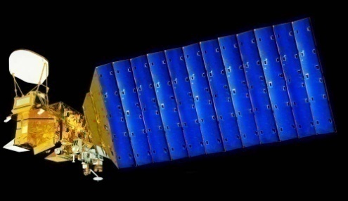
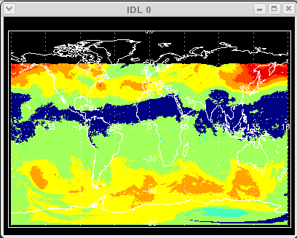


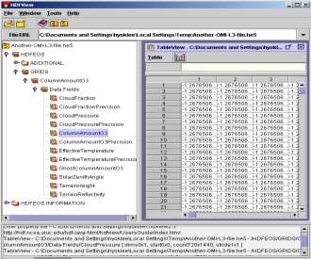
Access HDF via FTP
Aqua/Aura
Users
IDL
AIRS/OMI
FTP
Local HDF Files
FTP
Clients
FTP
Servers
HDF Files
Notes:
When it comes to the network access of data, people think of this manner.
OPeNDAP is an open implementation of easy data access through visualization tools like IDV.
Our work bridges the existing OPeNDAP framework and HDF so that visualization is possible over the Internet.

Slide 5

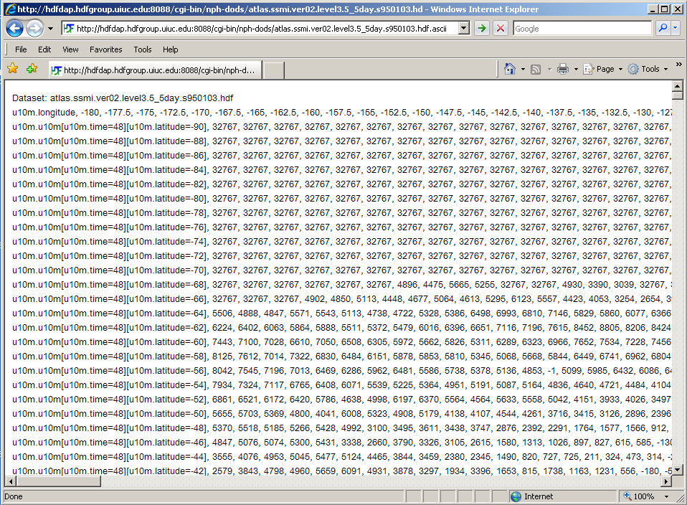
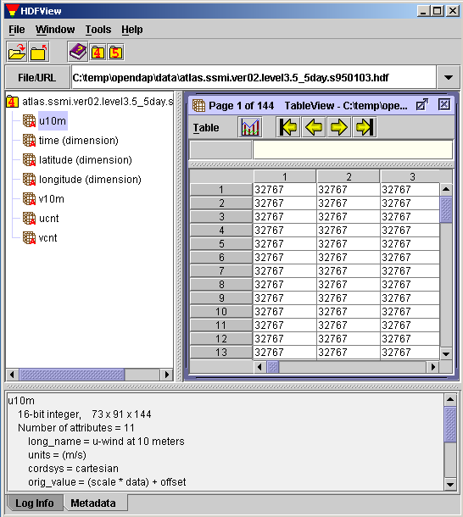
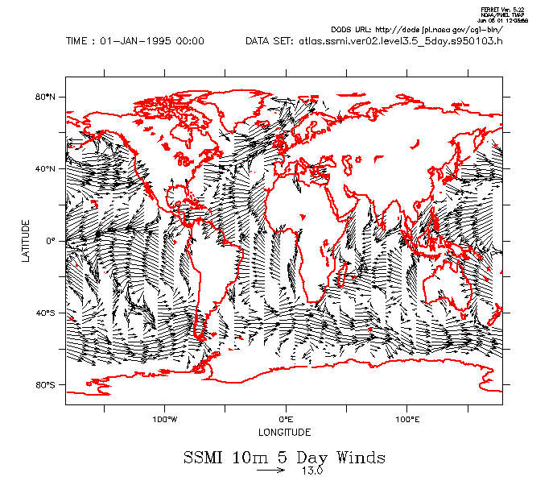
OPeNDAP concept
Typical remote access problem
View Data
(User)
FTP/HTTP
Remote Data
(HDF4/5)
Visualization Tools
(gradsdap)
Visualization tools
(e.g., GrADS)
Handler
(hdf4/5_handler)
Client Library
(libnc_dap)
Server
(Hyrax)
Data Access Protocol (DAP) via Internet
Notes:
This is how remote data can be accessed via OPeNDAP. Normally, users can view local data file using scientific data using visualization tools like GrADS. In DAP, this can be done for remote file. First DAP provides both generic server and client. For different data format like HDF and NetCDF, it needs an additional server that can map such data into a standard DAP format.
Next, by modifying the existing visualization tools to adopt OPeNDAP client library, they can show the remote data on demand.
The benefit of OPeNDAP is clear when you want to view a small dataset; you don’t have to download the entire data from the server.
DAP is a low-level medium that implementers can impose any additional restrictions on top of DAP model.
The bottom line is that web browser can access any HDF data.

Slide 6
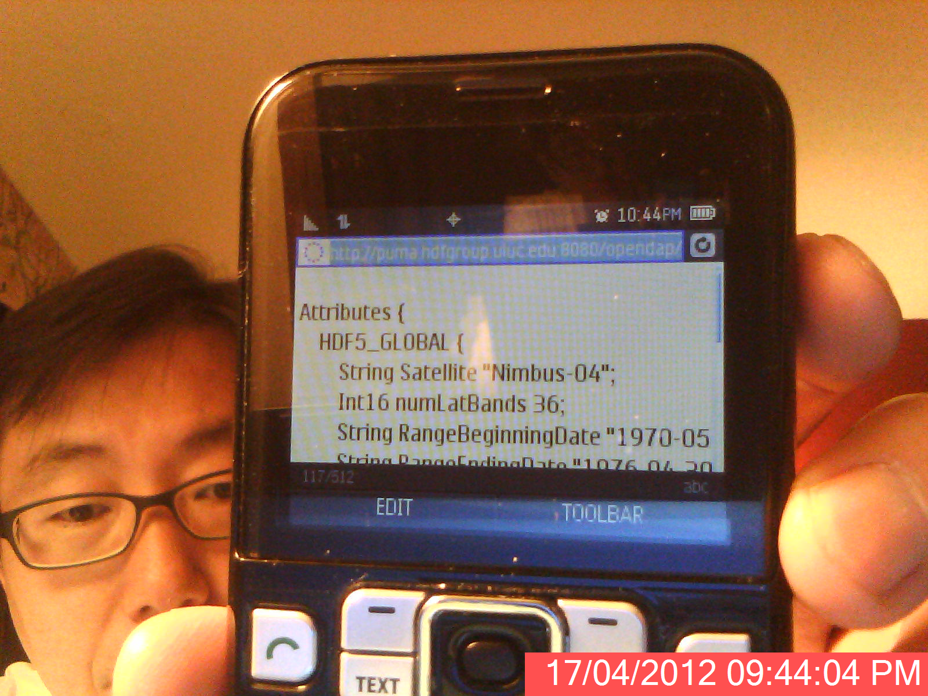
Access remote data easily
Notes:
The purpose of introduction.

Slide 7
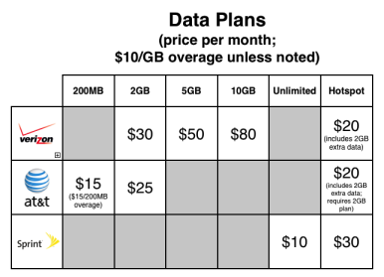
without worrying about data plans.
Notes:
The purpose of introduction.

Slide 8
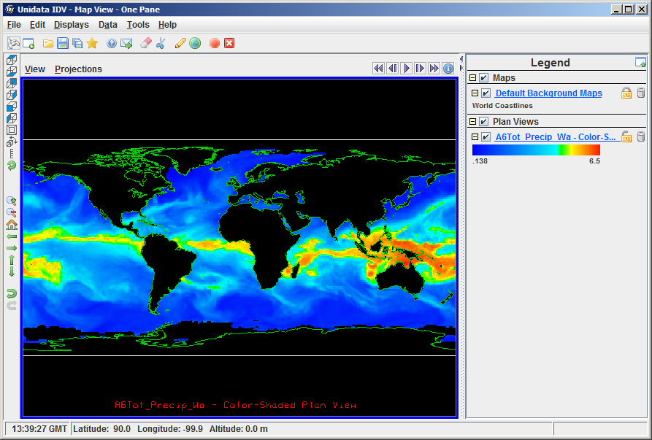

Visualize remote data easily, too.
Notes:
The purpose of introduction.

Slide 9

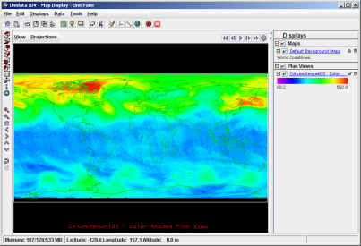
HDF handler is key
Aqua/Aura
HDF HANDLER
Users
IDV
NetCDF Java
Hyrax
AIRS/OMI
DAP
Visualization
Tools
OPeNDAP
Clients
OPeNDAP
Servers
HDF Files
Notes:
For people who are not familiar with OPeNDAP, I’ll explain how OPeNDAP works with HDF.
OPeNDAP is an open implementation of easy data access through visualization tools like IDV.
Our work bridges the existing OPeNDAP framework and HDF so that visualization is possible over the Internet.

Slide 10
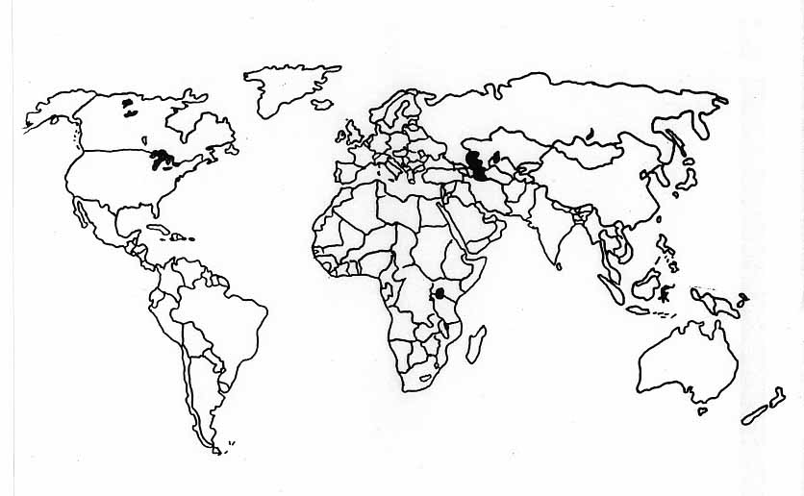
because if handler doesn’t follow CF
No Visualization Bonus!
Notes:
The purpose of introduction.

Slide 11
If handler gives up extra bonus
handler development is easier.
DAP
DAP Server
HDF / HDF-EOS
Notes:
The wider the bottom, it takes longer to reach the top.
Development effort, computationally expensive.
For each layer, they have their own agenda.

Slide 12
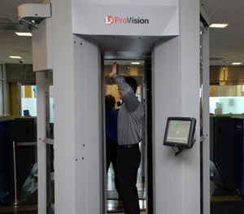
What’s involved in extra bonus
Earth Scientist
Visualization
Check every step.
DAP Client
DAP
DAP Server
CF Conventions
HDF / HDF-EOS
Notes:
The wider the bottom, it takes longer to reach the top.
Development effort, computationally expensive.
For each layer, they have their own agenda.

Slide 13
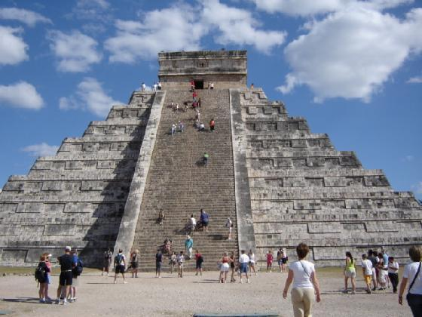

How handler developers feel
Notes:
The wider the bottom, it takes longer to reach the top.
Development effort, computationally expensive.
For each layer, they have their own agenda.

Slide 14

Because we care all NASA products.
AURA
MISR
?
AQUA
TERRA
NPP
Notes:
The wider the bottom, it takes longer to reach the top.
Development effort, computationally expensive.
For each layer, they have their own agenda.

Slide 15
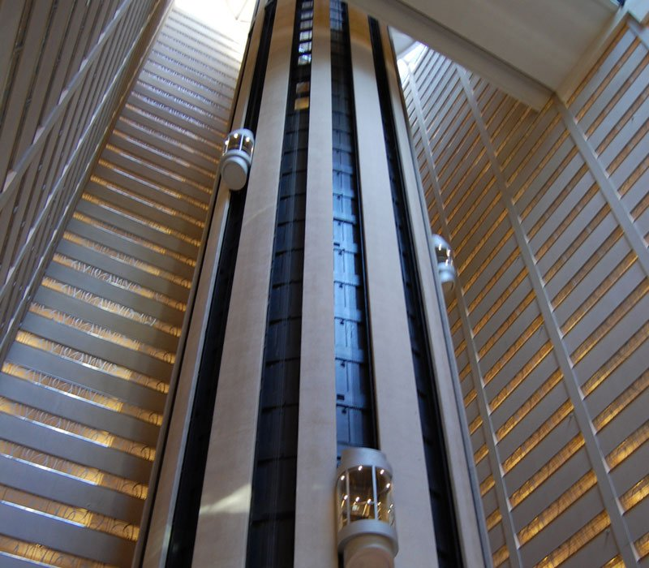
Developers’ Dream
… all data are created equal,
that they shall be visualized
by all client tools easily…
Notes:
The wider the bottom, it takes longer to reach the top.
Elevator model

Slide 16
What if all people agreed…
development might have been much easier.
Earth Scientist
Check every step
Visualization
DAP Client
DAP
DAP Server
UDF (Imaginary)
Check once.
Notes:
The wider the bottom, it takes longer to reach the top.
Elevator model

Slide 17
Lessons from handler development
Communicate and work together among different groups.
Standardize everything from data products to visualization tools.
Follow conventions and standards.
Notes:
If you are going to produce data, in HDF5.
The wider the bottom, it takes longer to reach the top.
Elevator model
The HDF Group may help you with CF issues. Suggestions…

Slide 18
Outline
Introduction to OPeNDAP
HDF5-OPeNDAP Handler Update
HDF4-OPeNDAP Handler Update
Live Demo

Slide 19

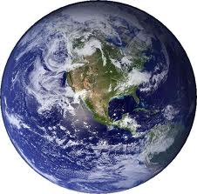
Redesign of HDF5 handler
Goal: Support all NASA HDF5 products.
Modularize for future product support.
Follow CF conventions robustly.
Product

Slide 20
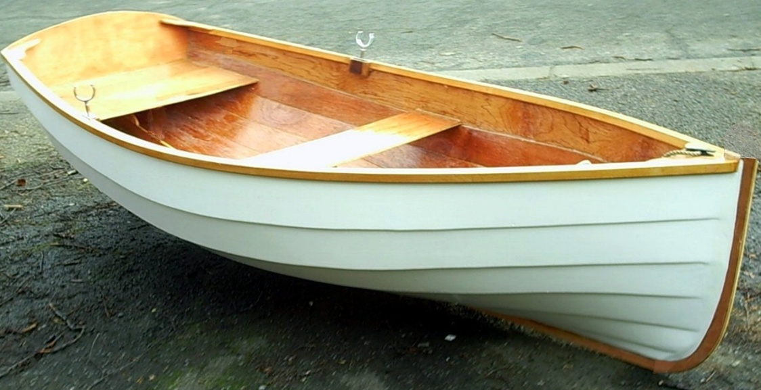

Why did we redesign?
In 2007,
HDF5 handler
was enough for
AURA
Grid

Slide 21


Why did we redesign?
In 2011,
wasn’t enough for
AURA
ZA
AURA
Swath
GSSTF
AURA
Grid

Slide 22
Why did we redesign?
In 2011,
wasn’t enough for
AURA
ZA
AURA
Swath
GSSTF
AURA
Grid

Slide 23
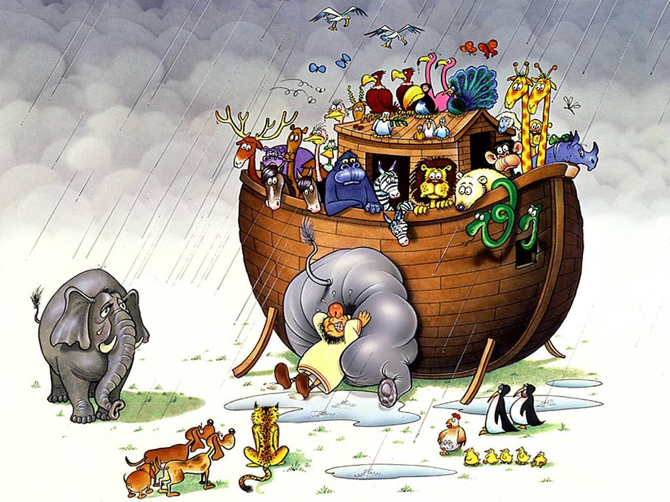
and more… so we gave up!
ICESat-2
Aquarius
GOSAT
SMAP

Slide 24
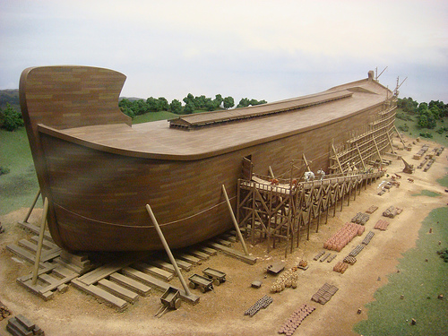
We rebuilt one that can scale up

Slide 25
by modularizing the design
HDF5
GOSAT
Aquarius
HDF-EOS5
GRID
CF
SWATH
ZA
SMAP
HDF5 handler
Generic
with a big room for future products.

Slide 26
Key updates on HDF5 handler
version | 1.5.x | 1.6.x
CF-convention Support | Primitive | Robust
Range of NASA Data Products | Limited | All
Mulitiple Grids/Swath/ZA | No | Yes
Configuration Options | Static Build | Run-time
Support for Future Products | Rigid | Flexible
Notes:
Make CF-convention consistent.

Slide 27

HDF-EOS5 products supported
OMI Swath, Grid
MLS Swath
HIRDLS Swath, ZA
TES Swath, Grid
GSSTF

Slide 28
HDF5 products supported
Aquarius Grid
MEaSUREs SeaWiFS DeepBlue
SBUV2 Ozone (O3) Profile
SMAP (Simulation)
Notes:
Add ICESAT-2 supported.
Data Products Limitation.
Add levels of support – web browser.
General HDF5 – what kind of support is needed. ICESat-2
Not Stable
2) The nature of data products
3) CF convention (still followed)

Slide 29
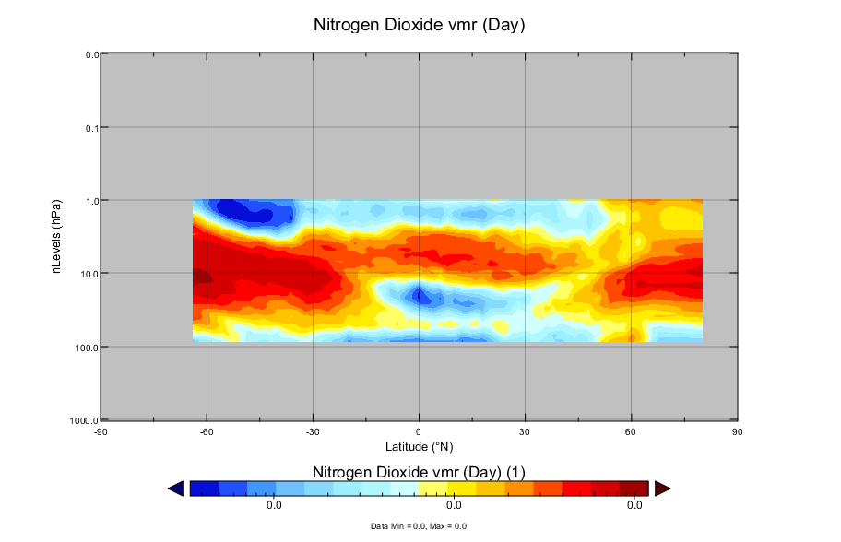
HIRDLS Zonal Average

Slide 30
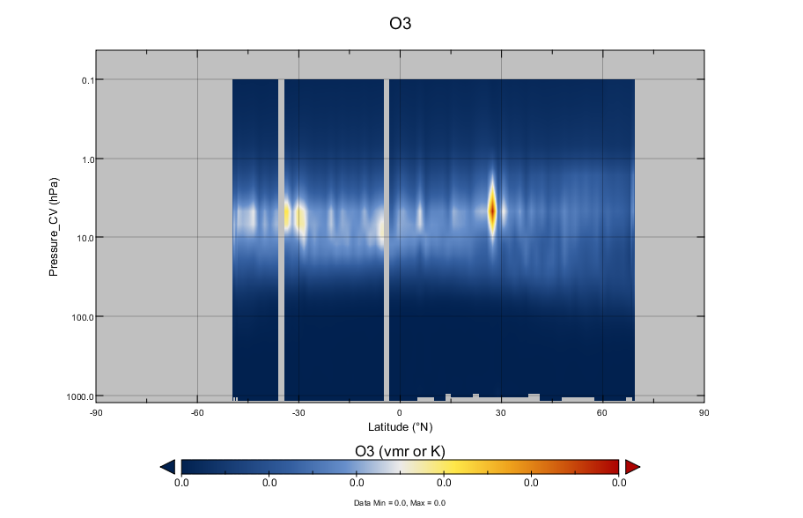
New TES Swath

Slide 31
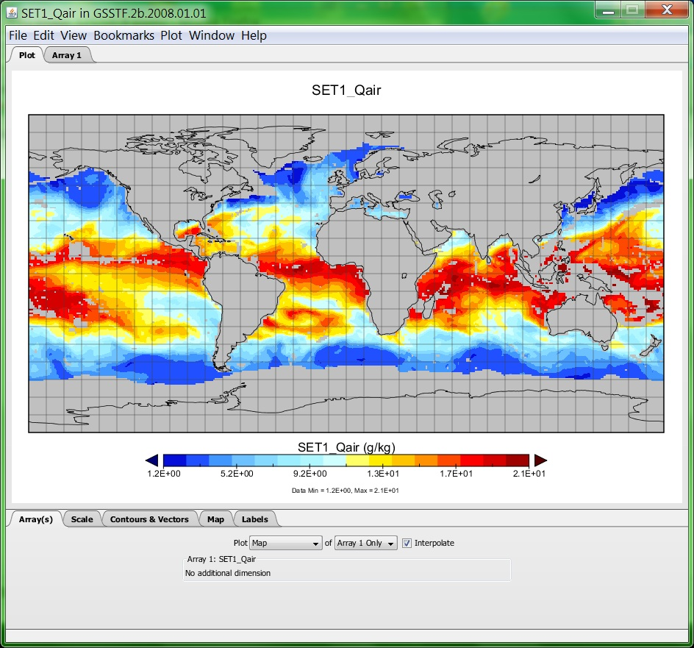
MEaSUREs GSSTF

Slide 32
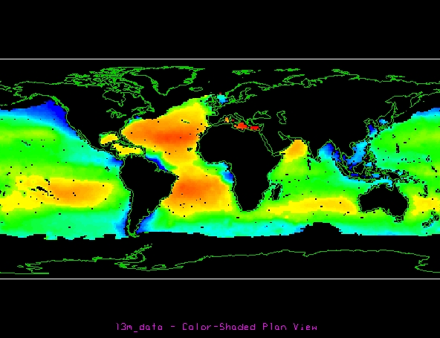
Aquarius Grid (Simulation)

Slide 33
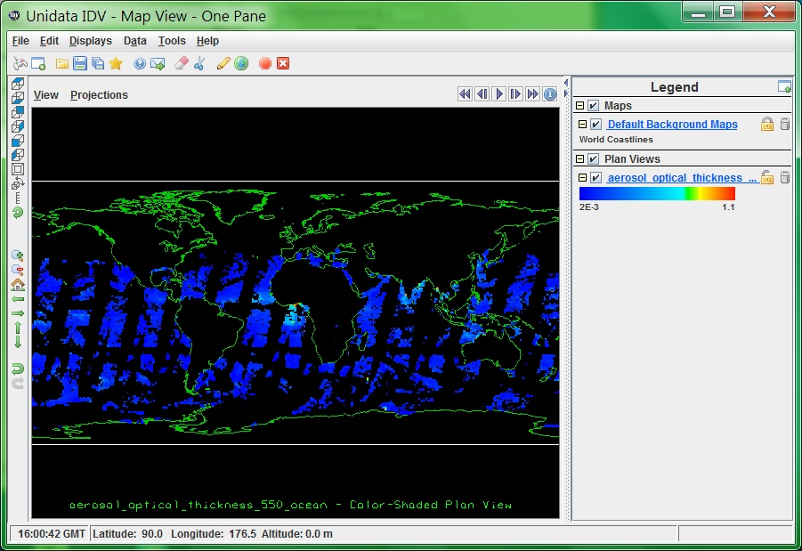
MEaSUREs SeaWiFS DeepBlue

Slide 34
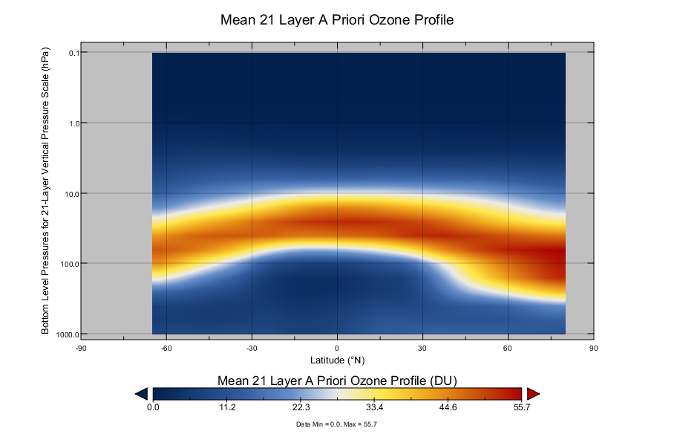
Ozone Profile (BUV)

Slide 35
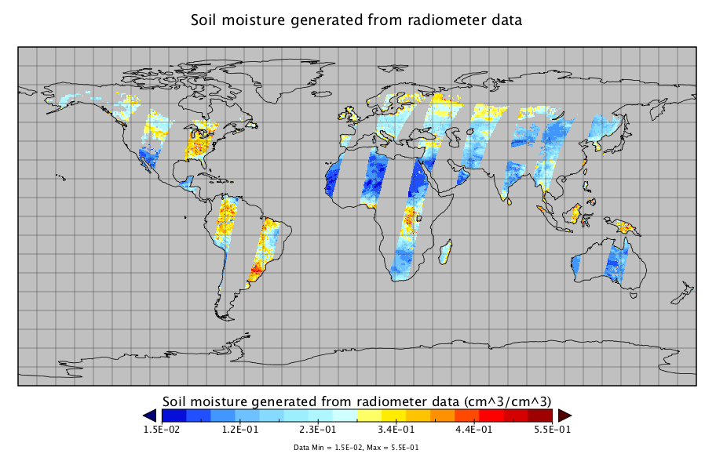
SMAP Swath (Simulation)
Notes:
Correct it to Swath.
Subsetting – Key deom – subsetting with IDV.

Slide 36
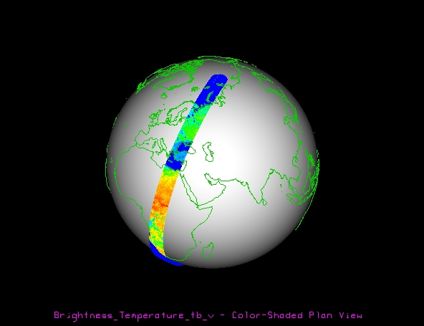
SMAP Swath (Simulation)

Slide 37

No CF magic for some products
Tool / CF Limitation
  GOSAT/acos: 1-D trajectory
  ICESat-2
  OMI L2G: Lat/Lon with 3-D
Java-NetCDF Client Limitation
  Dataset w/ long string
Notes:
Put limitation merge.
Other clients

Slide 38
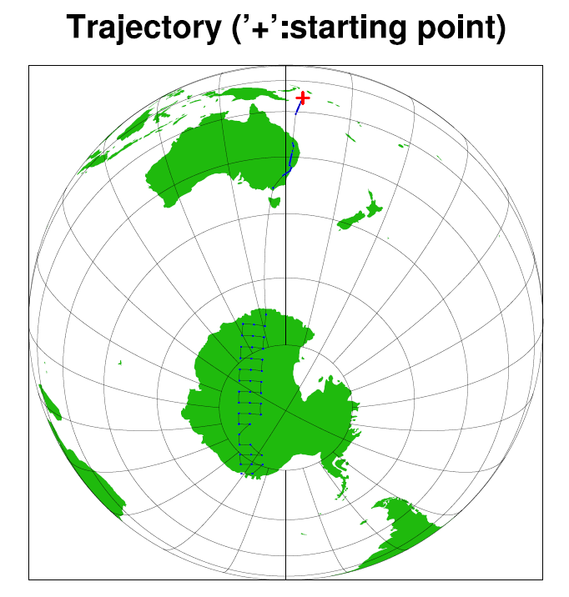

It doesn’t mean handler failure
because
other tools like
can still access and
visualize data.
Notes:
Put limitation merge.
Other clients

Slide 39
MATLAB and IDL will work too.
HDF5 Examples under zoo will work.
  Visit http://hdfeos.org/zoo
  Replace local file access with OPeNDAP URL access.
      MATLAB: Try new OPeNDAP functions.
  The rest will be same.
Notes:
Put limitation merge.
Other clients

Slide 40

Read if you can’t see
http://acdisc.sci.gsfc.nasa.gov/opendap/HDF-EOS5/Aura_OMI_Level3/OMTO3e.003/2012/OMI-Aura_L3-OMTO3e_2012m0416_v003-2012m0418t020608.he5.ascii?lon[1029:1:1029],lat[513:1:513],_HDFEOS_GRIDS_OMI_Column_Amount_O3_Data_Fields_ColumnAmountO3[513:1:513][1029:1:1029]
Dataset: OMI-Aura_L3-OMTO3e_2012m0416_v003-2012m0418t020608.he5 lon, 77.375 lat, 38.375 _HDFEOS_GRIDS_OMI_Column_Amount_O3_Data_Fields_ColumnAmountO3.lon, 77.375 _HDFEOS_GRIDS_OMI_Column_Amount_O3_Data_Fields_ColumnAmountO3._HDFEOS_GRIDS_OMI_Column_Amount_O3_Data_Fields_ColumnAmountO3[_HDFEOS_GRIDS_OMI_Column_Amount_O3_Data_Fields_ColumnAmountO3.lat=38.375], 309.6
Notes:
Put limitation merge.
Other clients

Slide 41
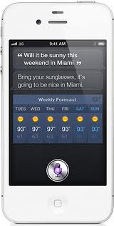
or hear from Siri?
Notes:
Put limitation merge.
Other clients

Slide 42
Outline
Introduction
HDF5-OPeNDAP Handler Update
HDF4-OPeNDAP Handler Update
Live Demo

Slide 43
HDF4 OPeNDAP handler update
Corrected the handling the scale/offset for MODIS products.
Added the support for Lambert azimuthal equal-area (LAMAZ).
Added the support for Space-oblique Mercator projection (SOM).
Other minor bug fixes.
Notes:
Some MODIS data products.

Slide 44
Key updates on HDF4 handler
version | 3.9.3 | 3.9.4
Some MODIS Scale/offset | Wrong | Corrected
LAMAZ projection support | No | Yes
SOM projection support | No | Yes

Slide 45
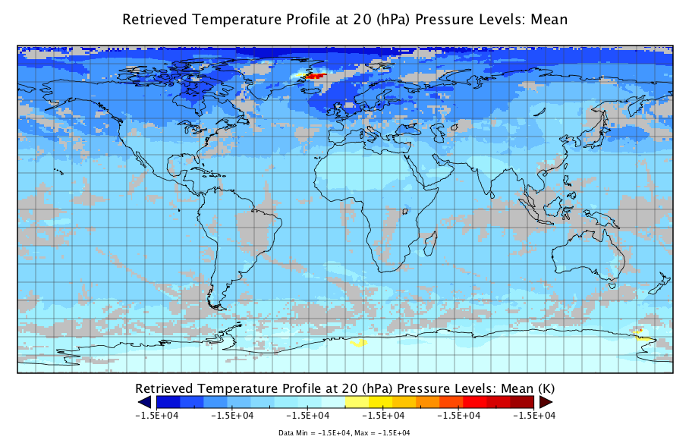
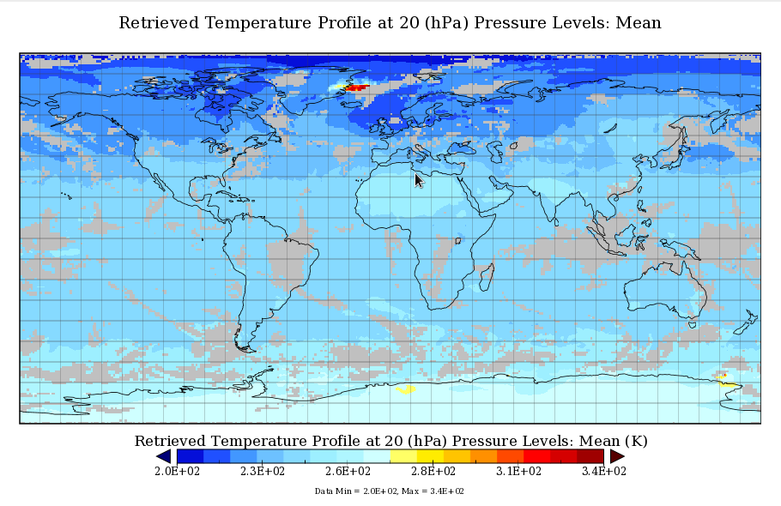
MODIS scale / offset correction

Slide 46
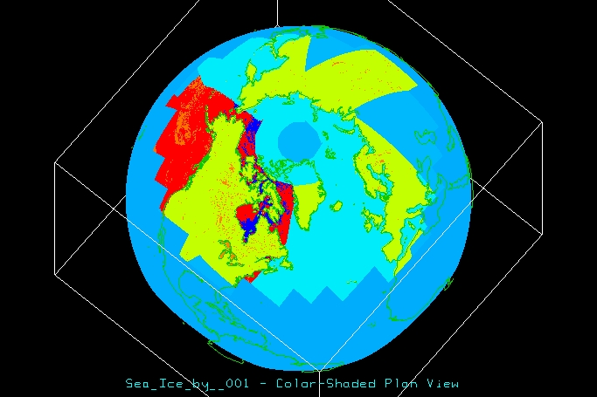
Support for LAMAZ projection

Slide 47
Support for SOM projection
Dataset {
UInt16 Blue_Radiance_RDQIU1[SOMBlockDimD1 = 180][XDimD2 = 128][YDimD3 = 512];
Int32 SOMBlockDimU2[SOMBlockDimD1 = 180];
Float32 LatitudeU3[XDimD2 = 128][YDimD3 = 512];
Float32 LongitudeU4[XDimD2 = 128][YDimD3 = 512];
…
}
Dataset {
UInt16 Blue_Radiance_RDQIU1[SOMBlockDimD1 = 180][XDimD2 = 128][YDimD3 = 512];
Int32 SOMBlockDimU2[SOMBlockDimD1 = 180];
Float32 LatitudeU3[SOMBlockDim = 180][XDimD2 = 128][YDimD3 = 512];
Float32 LongitudeU4[SOMBlockDim = 180][XDimD2 = 128][YDimD3 = 512];
…
}
Notes:
You can sacrifice.

Slide 48
HDF-EOS2 products supported
GES DISC
  AIRS / MERRA / TOMS
LAADS / LP DAAC / NSIDC
  Many MODIS products
NSIDC
  AMSR_E / NISE / MODIS
LaRC
  MISR / MOPITT / some CERES (TRMM)
Notes:
We have summarized the top 7 reasons why some HDF-EOS will fail.
We also listed some sample files that will not work with HDF4 handler.
Here are screenshots of website.
Make animation – screen shots in between texts.

Slide 49
HDF4 products supported
GES DISC
  TRMM L1B, L2B Swath
  TRMM L3 Grid 42B & 43B products
OBPG (Ocean Color)
  SeaWiFS / MODIST / MODISA
  CZCS / OCTS
Notes:
We have summarized the top 7 reasons why some HDF-EOS will fail.
We also listed some sample files that will not work with HDF4 handler.
Here are screenshots of website.
Make animation – screen shots in between texts.

Slide 50
HDF4 products supported
CERES
  CER_AVG
  CER_ES4
  CER_ISCCP-D2like-Day
  CER_ISCCP-D2like-GEO
  CER_SRBAVG
  CER_SYN
  CER_ZAVG
Notes:
Make animation – screen shots in between texts.

Slide 51
HDF4 handler limitations
HDF-EOS2 + additional HDF4 objects
  In some products, some additional HDF4 objects will be ignored.
Other HDF4 products not listed in previous slides are not tested and may not be visualized by Java OPeNDAP clients.
Notes:
Make animation – screen shots in between texts.

Slide 52
Other limitations
CF conventions Limitation
  _FillValue inside latitude and longitude
Java-NetCDF Limitation
  Java Heap Memory
Notes:
Show MATLAB doesn’t have any limit.
Common limiation.
This limiation can be scarificed.
Powerful users of MATLAB / IDL can visualize.
Check name clashing, removed special characters ---- CF-friendly by default.
If data products are good for CF-compliant, things will work immediately.

Slide 53
Outline
Introduction
HDF5-OPeNDAP Handler
HDF4-OPeNDAP Handler
Live Demo
Notes:
Show DDS output on the web browser to indicate NASA’s suggestions.
Multiple grid case… long_name / variable name. IDV name.
Major SeaWiFS.

Slide 54
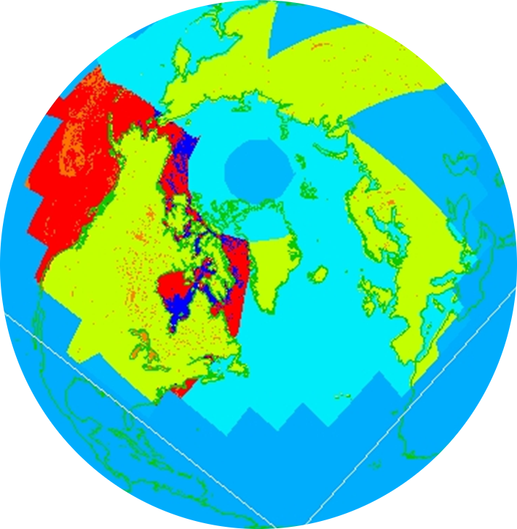
We’ve updated handlers
OPeNDAP
HDF Handlers
HDF-EOS2
HDF5
HDF-EOS5
HDF4
… and will continue.
Notes:
We have summarized the top 7 reasons why some HDF-EOS will fail.
We also listed some sample files that will not work with HDF4 handler.
Here are screenshots of website.
Make animation – screen shots in between texts.

Slide 55
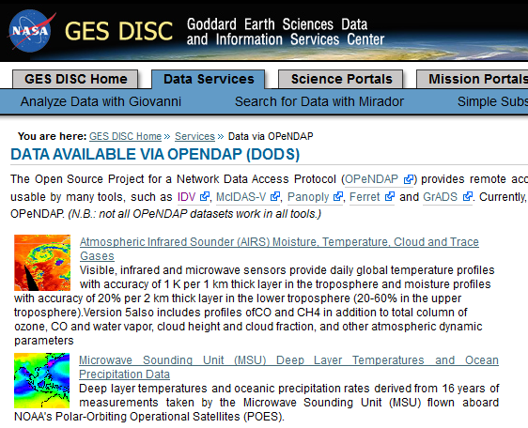

GES DISC Uses Handlers
Notes:
We have summarized the top 7 reasons why some HDF-EOS will fail.
We also listed some sample files that will not work with HDF4 handler.
Here are screenshots of website.
Make animation – screen shots in between texts.

Slide 56
Please try HDF4/HDF5 handlers
New hdf5_handler will be released in July.
Source codes and RPMs:
http://opendap.org
Demo HDF5/HDF4 servers:
http://hdfeos.org/zoo/hdf4_handler/
http://hdfeos.org/zoo/hdf5_handler/
Notes:
We have summarized the top 7 reasons why some HDF-EOS will fail.
We also listed some sample files that will not work with HDF4 handler.
Here are screenshots of website.
Make animation – screen shots in between texts.

Slide 57

and give us feedback.
Notes:
We have summarized the top 7 reasons why some HDF-EOS will fail.
We also listed some sample files that will not work with HDF4 handler.
Here are screenshots of website.
Make animation – screen shots in between texts.

Slide 58
Thank you!

Slide 59
Acknowledgements
This work was supported by Subcontract number 114820 under Raytheon Contract number NNG10HP02C, funded by the National Aeronautics and Space Administration (NASA) and by cooperative agreement number NNX08AO77A from the NASA. Any opinions, findings, conclusions, or
recommendations expressed in this material are those of the authors and do not necessarily reflect the views of Raytheon or the National Aeronautics and Space Administration.

Slide 60
Questions/comments? help@hdfgroup.org

