Slide 1
HDF5 Tools
Updates and Discussions
Peter Cao
The HDF Group
The 15th HDF and HDF-EOS Workshop
April 17-19, 2012

Slide 2
Tools Updates
Keep YOU updated
Report YOUR feedback on the survey
Want to know YOUR needs and thoughts

Slide 3
HDF Java Products Highlights
HDF-Java 2.8 (Dec. 2011)

Slide 4
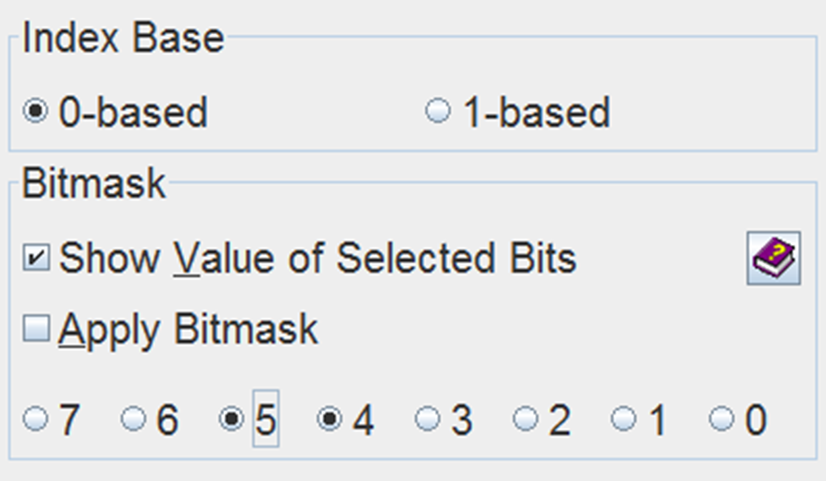
HDF Java Products Highlights
  35 bug fixes/enhancements

Slide 5
HDF Java Products Highlights
  All major HDF5 1.8 API functions
Java
369
462
C functions
V1.8
169

Slide 6
HDF Java Products Highlights
  Unit tests for all major HDF5 JNI functions
Tested
300
Untested
69

Slide 7
Things in the Pipeline
HDF-Java 2.9 (Dec. 2012)
  Build on HDF5 1.8.10
  Add Cmake
  Continue bug fixes/enhancements

Slide 8

Mac Issues

Slide 9

Mac Issues
No Support for MAC OS 10.5

Slide 10

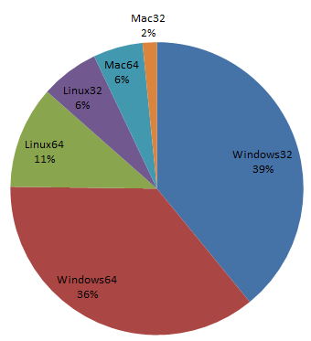
Mac Issues
Drop 32-bit Support ?

Slide 11
Command-line Tools

Slide 12
Major Improvements
h5dump
  Fixed “-a” option to show attributes with name containing “/”
    h5dump -a "/bar_none/high\/low" quux.h5
  Added support for using a wildcard in the filename
    OMI-Aura_L2G-OMAEROG_2004m1001_v003-2009m0112t161650.he5
    OMI-Aura_L2G-OMAEROG_2004m1007_v003-2009m0112t161622.he5
    OMI-Aura_L2G-OMAEROG_2004m1009_v003-2009m0112t161705.he5
    h5dump *7_*.he5
  Completed a major code refactoring

Slide 13
Major Improvements
h5repack
  Selecting data based on chunk layout
  Better performance (hundred times faster for some cases)
Notes:
Consider storage layout, smart

Slide 14
Major Improvements
h5diff
  Added –v1 and –v2 options to show different levels of information
  Added a new flag --exclude-path to exclude objects from comparison

Slide 15
Tools Challenges

Slide 16

Tools Challenges
  Comp of Vlen of Comp of ARRAY of Comp

Slide 17


Tools Challenges
Simple
Design
  External links
  Compact layout

Slide 18

Tools Challenges
CMMI Team

Slide 19
New Development
h5edit
  Command-line tool for editing an HDF5 file
  Create or Delete Attributes

Slide 20
New Development
H5Ocompare API
  A function that compares two HDF5 objects or files
  RFC will be out in April or May 2012
  An independent tool, h5compare, may follow after the API development

Slide 21
New Development
h5augjpss
  a tool for modifying a JPSS product file to make it accessible by netCDF-4 based applications

Slide 22

HDF5-XML Tools
HDF5
h5dump
h5x
xh5
old
xml
XLST
xml
HDF5/ XML

Slide 23
HDFView User Survey

Slide 24

surveymonkey.com
HDFView

Slide 25
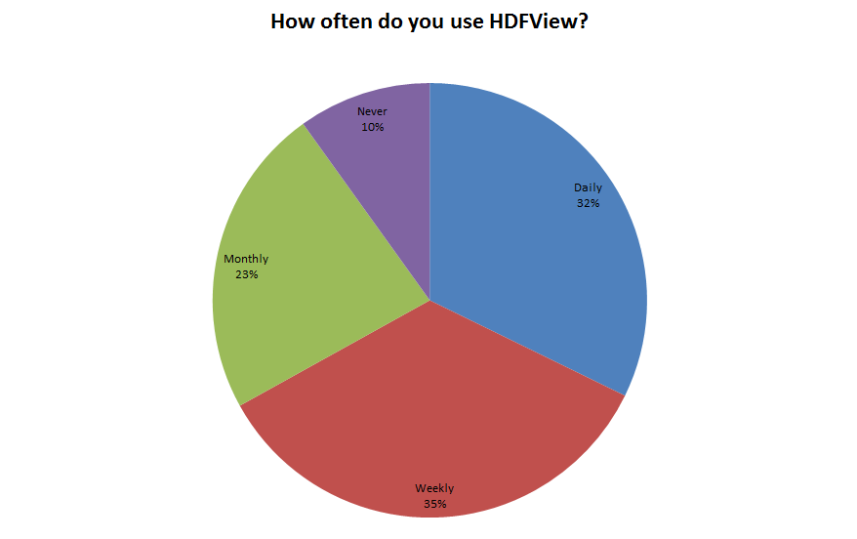
Usage

Slide 26
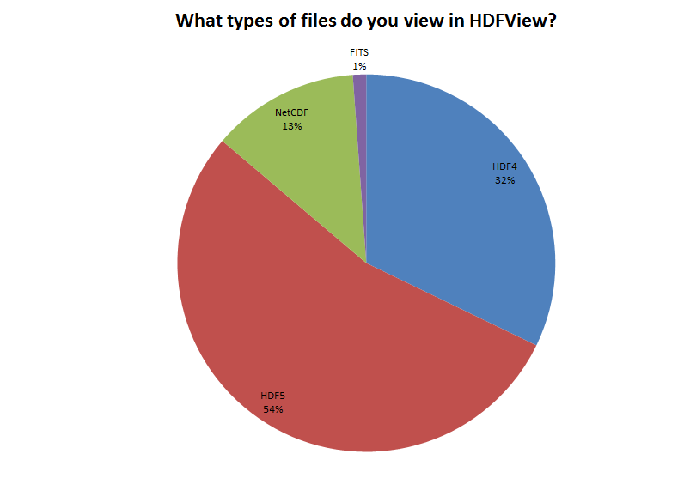
File Types

Slide 27
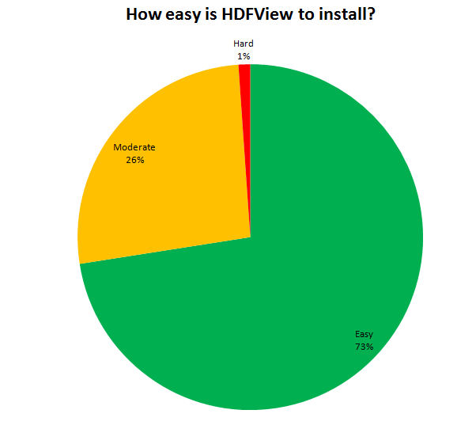
Easy Installation

Slide 28
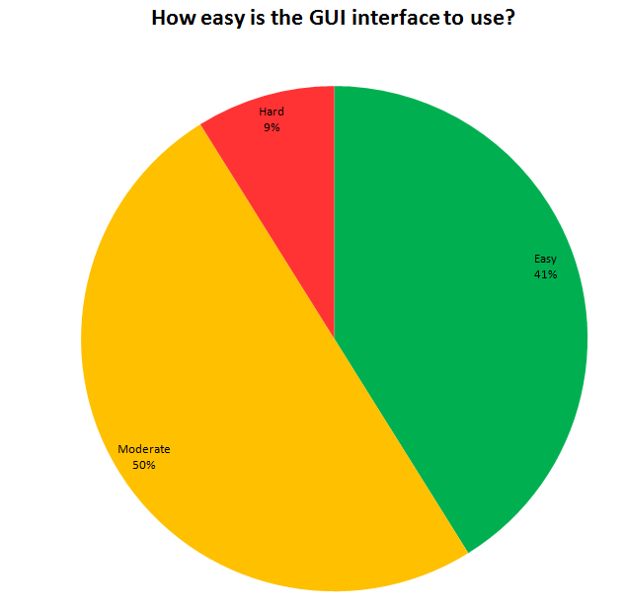
Easy-use GUI

Slide 29
Wishful Things
Over 70% users who responded to the survey think the following are important:
  Improve GUI interface
  Find objects by name
  Search objects by attributes (name or value)
  Search and query data content
  View datasets larger than machine memory

Slide 30

Your Thoughts

Slide 31
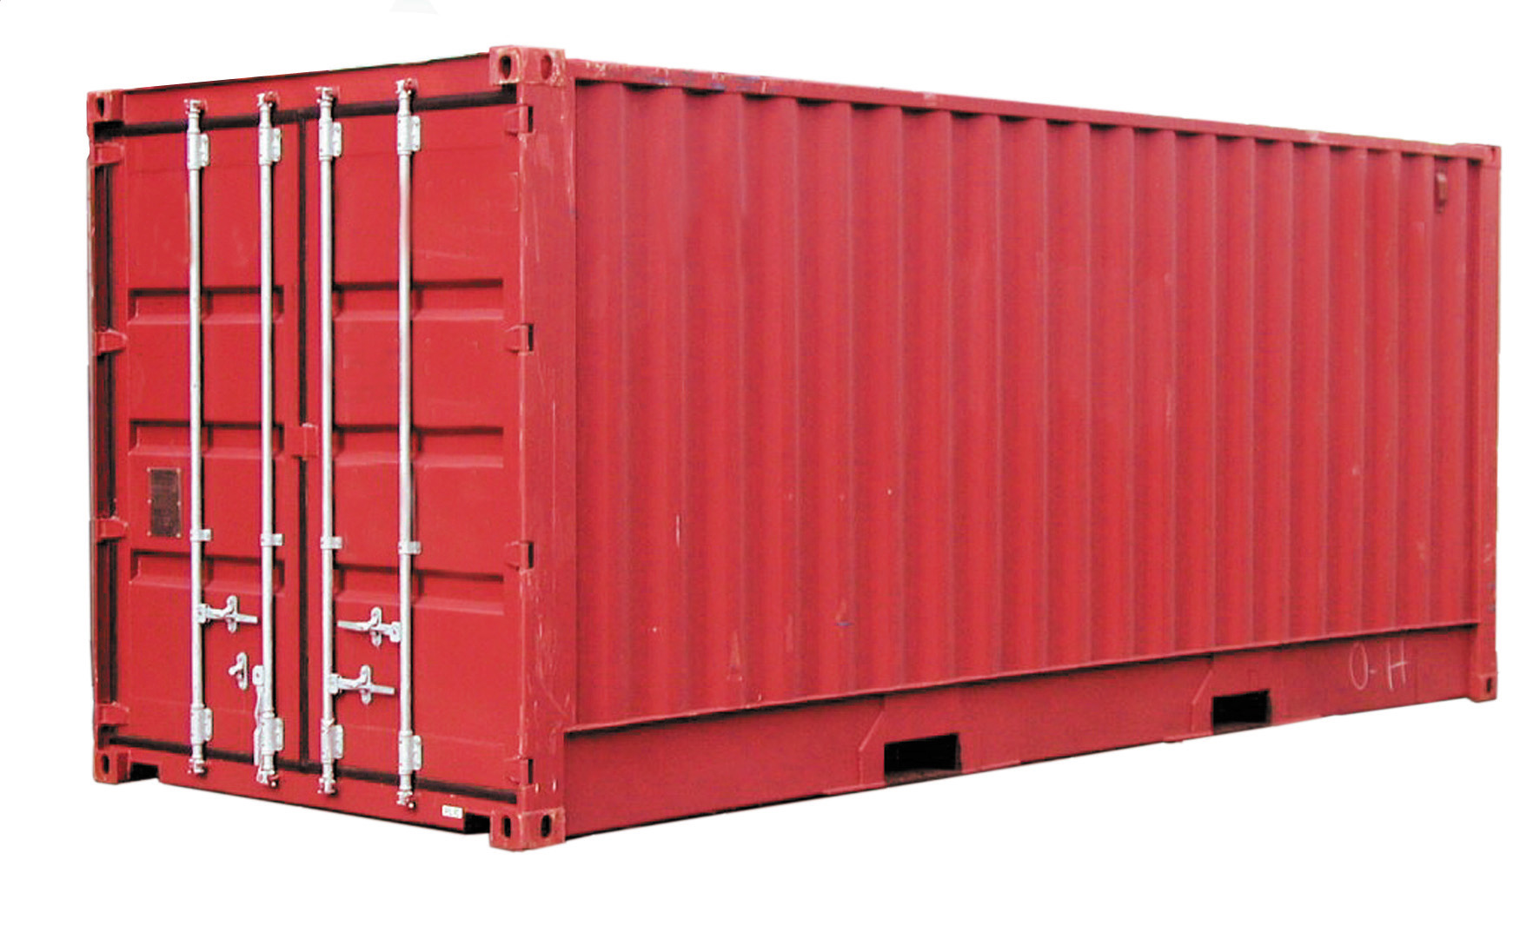
A Wishful Thought
HDF5

Slide 32





A Wishful Thought
My Favorite Things

Slide 33

A Wishful Thought
My Favorite Things

Slide 34
A Wishful Thought
My Favorite Things

Slide 35
Acknowledgements
This work was supported by Subcontract number 114820 under Raytheon Contract number NNG10HP02C, funded by the National Aeronautics and Space Administration (NASA) and by cooperative agreement number NNX08AO77A from the NASA. Any opinions, findings, conclusions, or
recommendations expressed in this material are those of the authors and do not necessarily reflect the views of Raytheon or the National Aeronautics and Space Administration.

