Slide 1





HDF & HDF-EOS Data & Support at NSIDC
SiriJodha Khalsa
Molly McAllister
HDF &HDF-EOS Workshop XV
Riverdale, MD
17-19 April 2012
Notes:
Abstract:
The National Snow and Ice Data Center has been distributing products in HDF since 1997 and thus has a long history of providing support to users in the form of documentation, FAQs, tools and direct responses to user queries. Our presentation will highlight the HDF design features our various data products that are in HDF, specifically the structures, linkages between data fields, metadata, and conformance to conventions and standards. We will discuss the tools and other support that we provide and then offer suggestions for the design of future data products, in particular those coming from the Decadal Survey missions.
1. HDF4 or HDF5
2. HDF or HDF-EOS
3. netCDF4 compliant (uses HDF5)
4. what's coming: SMAP (official), ICESat-2 (anticipated)
5. datasets where HDF (netCDF4) is a distribution format option
6. have associated tools
7. something indicating usage/popularity

Slide 2
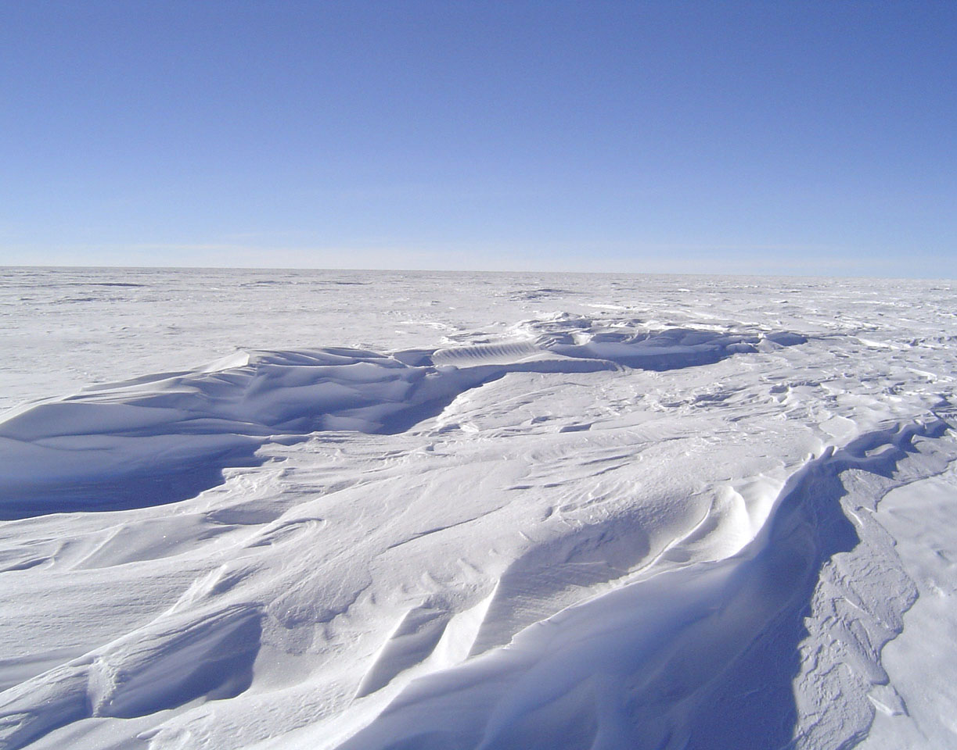
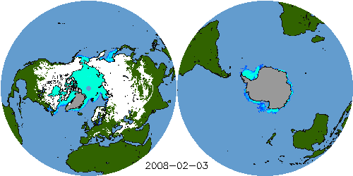
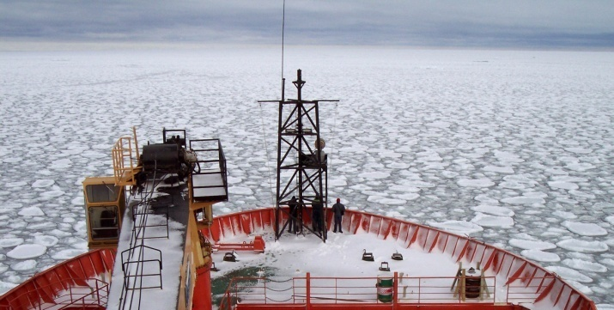
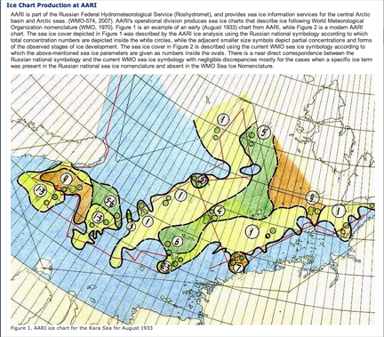
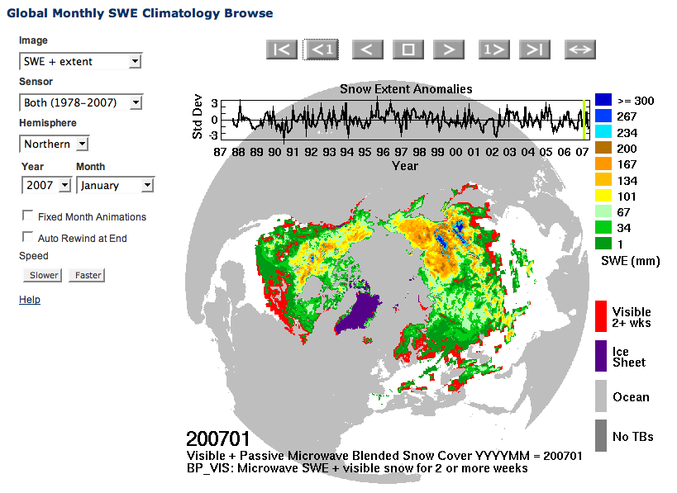
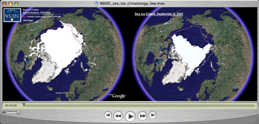
The National Snow and Ice Data Center…
Manages and
distributes
scientific data
Performs scientific
research
Supports data
users
Creates tools for
data access
Educates the public
about the cryosphere
Notes:
Images:
Top left: Near Real-Time SSM/I EASE-Grid Daily Global Ice Concentration and Snow Extent, 3 February 2008
Top right: Pancake ice seen off the bow of the research vessel Aurora Australis, in the Southern Ocean near Antarctica. Photo courtesy Ted Scambos.
Bottom right: Data from the Sea Ice Index, shown on Google Earth and distributed from our Web site in the form of a Quick Time movie. The left image is an animated time series of sea ice extent from 1979 to 2006; the static image on the right compares the extent in 2007.
Bottom left: Global Monthly SWE Climatology Browse, from http://nsidc.org/data/nsidc-0271.html
Center: A section of the online data set documentation from Sea Ice Charts of the Russian Arctic in Gridded Format, 1933-2006 (http://nsidc.org/data/g02176.html).

Slide 3
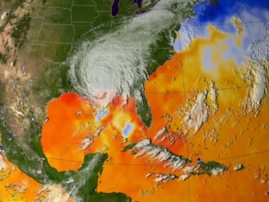
Collections in HDF-EOS2
AMSR-E
3 HDF-EOS Data Types
  Point
  Grid
  Swath
17 Collections
  NSIDC has developed tools in response to data questions from users
Parameters
  precipitation rate
  sea surface temperature
  sea ice concentration
  snow water equivalent
  soil moisture
  surface wetness
  wind speed
  atmospheric cloud water
  water vapor
Hurricane Katrina - Sea Surface Temperature 29 August 2005
Notes:
L1A data is in plain HDF4

Slide 4
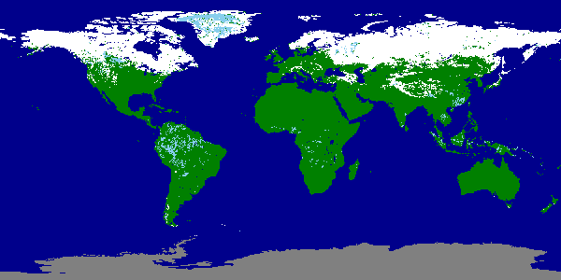
Collections in HDF-EOS2
MODIS
2 Data Types
  Swath
  Grid
    Sinusoidal
    EASE-Grid
    CMG
Parameters
  Snow
  Sea Ice
Image derived from the 8-Day CMG Snow Cover field of the MODIS/Terra Snow Cover 8-Day L3 Global 0.05Deg CMG
20 Version5 Data Sets
  Advise users to utilize HDF-View & other tools developed by the HDF Group
  Developed a UNIX tool kit to reproject MODIS swath data into a grid, MS2GT
Notes:
There are also amsr hdf tools?

Slide 5
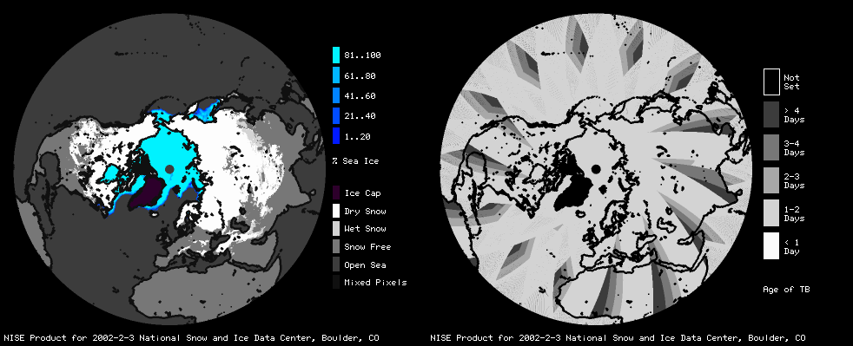
Non-ECS Datasets in HDF
Near-Real-Time SSM/I-SSMIS EASE-Grid Daily Global Ice Concentration and Snow Extent (HDF)
NISE (HDF-EOS2)
  Used in operational EOS processing
  Production began in 1997
  Has been reprocessed in support of MODIS
Snow extent, sea ice concentration, and data age layers for the Northern Hemisphere for 03 February 2002

Slide 6
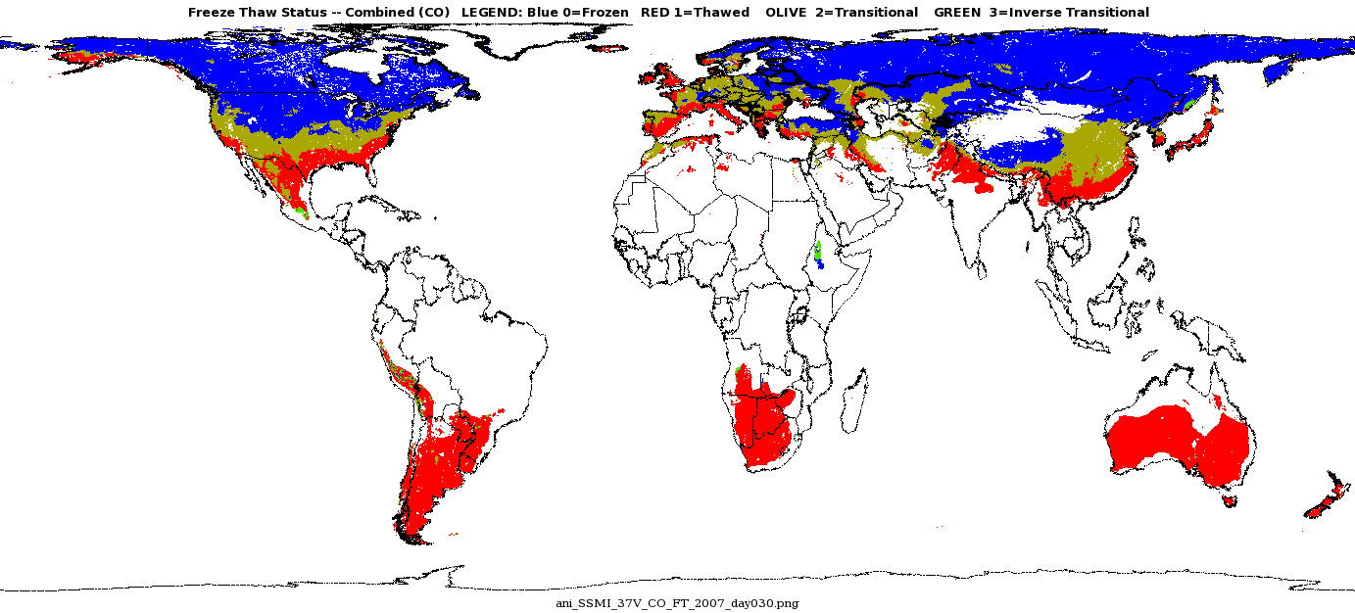
Data in HDF5
Blue = frozen
Red = thawed
Olive = transitional
2007
MEaSUREs Global Record of Daily Landscape Freeze/Thaw Status, Version 01
  Derived from SSM/I
  Is also netCDF4-CF compliant

Slide 7
Other Datasets & Collections in HDF-EOS
TOVS Pathfinder Path-P Daily and Monthly Polar Gridded Atmospheric Parameters
CLPX-Satellite: MODIS Radiances, Reflectances, Snow Cover and Related Grids
SMEX03 AMSR-E Daily Gridded Soil Moisture and Brightness Temperatures
SMEX04 Terra MODIS Data
APR-2 Dual-frequency Airborne Radar Observations, Wakasa Bay

Slide 8
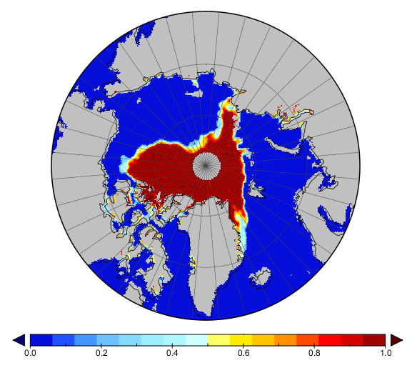
Dataset in netCDF4
Sea Ice Concentration Climate Data Record
  In development for NOAA
  Uses CF conventions

Slide 9
Why HDF? It’s What the Users Want
NASA EOSDIS ACSI Survey
  HDF-EOS 34%
    One of the top two formats preferred by NSIDC users
  ASCII 47%
    The other format in demand
    Not practical for large EOS datasets
Survey information has guided tool development
  Tools available on our Web site

Slide 10
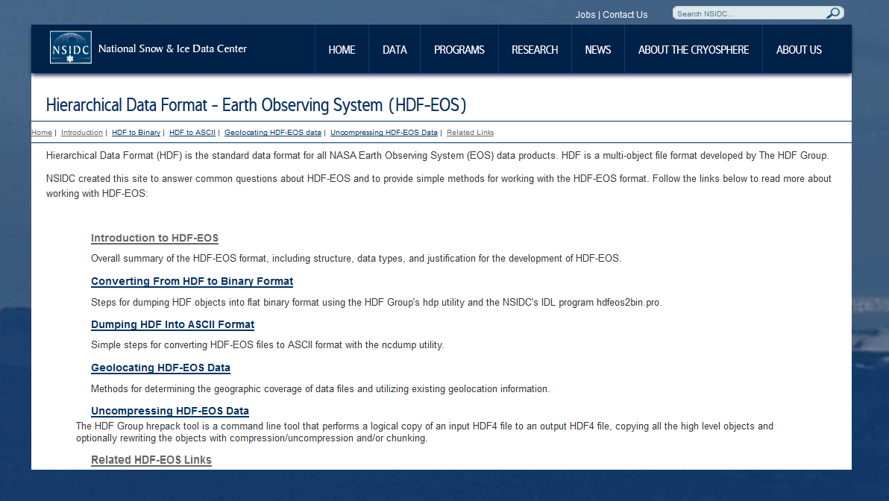
HDF Resources & Tools
HDF to ASCII dump
Notes:
15 non ECS data sets utilize the versatility of HDF data.
Developed tools for users working with multiple types of data

Slide 11
Other Tools & Example Applications
IDL Code to Grid AE_Land Data
  Point datatype to grid
Converting from HDF to Binary Format
  Steps for using the HDF Group's hdp utility, or
  NSIDC-created IDL program hdfeos2bin.pro
Converting from HDF to ASCII Format
  Guidance and examples for using ncdump

Slide 12
What’s Coming?
SMAP
  Soil Moisture Active-Passive (SMAP)
  Will use HDF5 with CF conventions
  Uses a combined radiometer and high-resolution radar to measure surface soil moisture and freeze-thaw state
  All products archived at NSIDC except radar-only products which will be archived at ASF
Notes:
Needs info

Slide 13
What’s Coming?
ICESat-1 is converting final release from binary to HDF5
  See poster!
MABEL ICESat-2 airborne simulator data in HDF5
ICESat-2 will be in HDF5
Seeking to be netCDF-friendly
Notes:
ICESat 2

Slide 14
NASA Conventions for HDF5?
Design of NASA’s HDF5 data products
  NetCDF4 compatibility
  Logical groupings and hierarchies of data arrays
  Metadata: what to include, where to put this information, what conventions to follow (ISO, CF)
  How to utilize dimension mapping to link data arrays with time, position and possibly QA arrays
Attempt to achieve some commonality, perhaps a NASA convention.
  Unlike HDF-EOS, these conventions would not be imposed by a new software library. Rather, it would be up to the discretion of each mission whether and how to implement the guidelines.

Slide 15
Post-Workshop Meeting on NASA HDF5 Conventions
Noon – 2 pm
In the Raytheon Auditorium

Slide 16

Questions

Slide 17
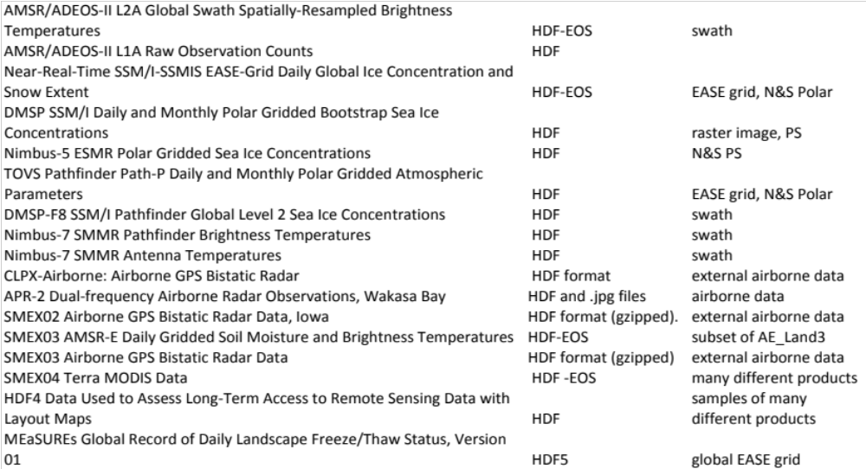
Non-EOS HDF datasets at NSIDC

