Slide 1
The NASA Earthdata Wiki:
A Knowledge Base for ISO Conformance
Benjamin White
04/12/2012
NASA Contract Number:
NNG10HP02C

Slide 2
Overview
NASA and ISO 19115
ISO Implementation at NASA
ISO and HDF
Overview of the Earthdata Wiki
State of the Wiki
Notes:
ISO 19115 is the most widely used geospatial standard. ISO 19115 compliance at NASA greatly increase the potential for interoperability and data access, discovery and exploitation.

Slide 3
NASA and ISO 19115
NASA Mandate
Going forward
L1G
Legacy Data
Notes:
NASA has made the strategic decision to be ISO 19115 compliant. The transition to ISO will be easier for future missions (the Decadal Missions are the priority) with legacy metadata potentially more complex.

Slide 4
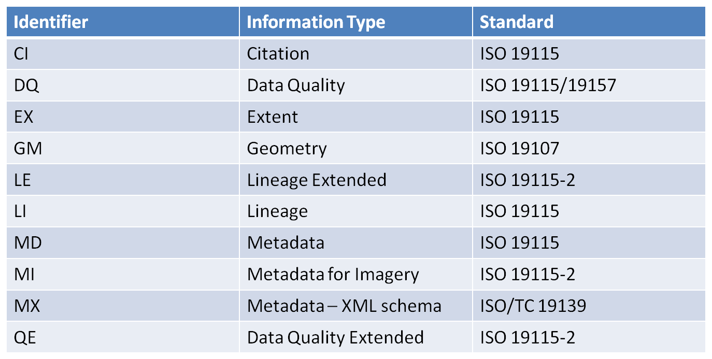
ISO 19*** Family of Metadata at NASA
Notes:
Technical Committee 211 of the International Standards Organization (ISO) has defined a family of standards for geographic metadata and services. ISO 19115 is the primary metadata standard in the ISO TC211 Collection. The objective of ISO 19115 is to provide a structure for describing digital geographic data. It defines metadata elements, provides a schema (ISO 19139) and establishes a common set of metadata terminology, definitions, and extension procedures. It provides information about the identification, the extent, the quality, the spatial and temporal schema, spatial reference, and distribution of digital geographic data.

Slide 5
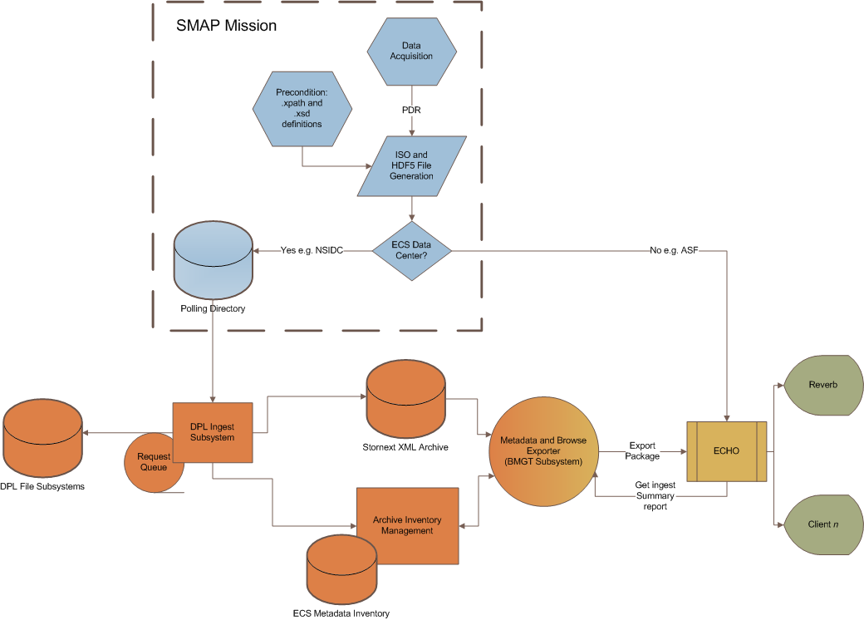
HDF in the Context of the Ingestion Workflow
Notes:
This is an example of the HDF and ISO file generation and ingestion process using NASA JPL’s SMAP mission:
HDF and ISO file generation
Files are passed to NSIDC and ASF
ECS files are ingested and archived
The BMGT subsystem exports the ECS data to the ECHO clearinghouse
ECHO makes data available either directly or through clients such as Reverb

Slide 6
Overview of the Earthdata Wiki
Wiki functionality:
  Knowledge Repository
  Communication of conformance tracking
    Exploitation of NASA conformance
  Implementation of the ISO 19115 standard at NASA
  Evolution of the ISO 19115 family of standards
Wiki Focal Areas:
  The ISO family of metadata
  ECS
  ECHO
  ISO-HDF
  MENDS
  Resources
Notes:
Functionally, the NASA Earthdata provides a place for the exchange of ideas on the ISO standard. It provides both private and public workspaces with a user groups supporting conformance, implementation and evolution. The wiki also provides a repository for knowledge on systems such as ECHO, ECS and their relationship to ISO 19115.

