Slide 1
Granules are forever
Ted Habermann
NOAA

Slide 2
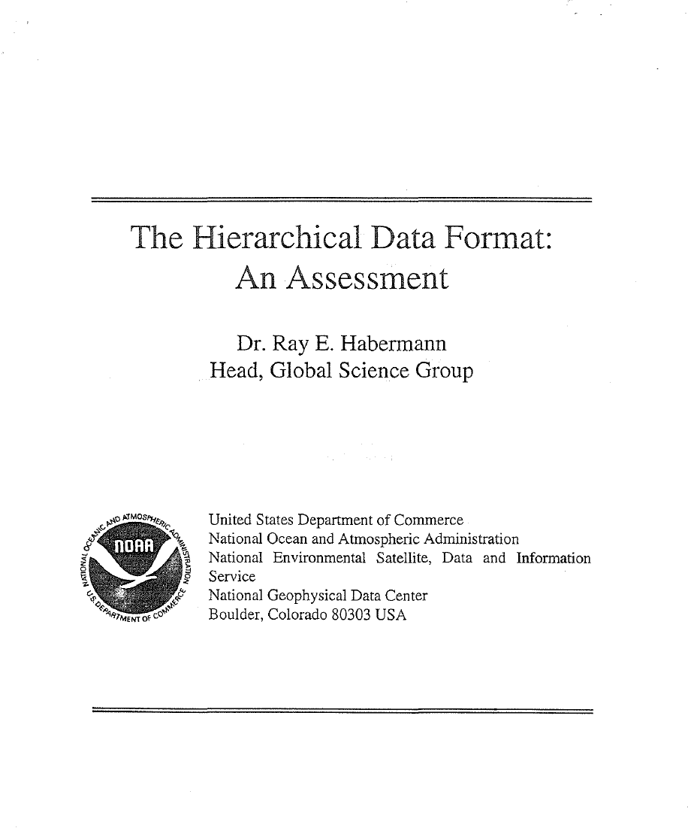
Conclusions
1. HDF is a reasonable choice as a format for data which can be represented as images.
2. Many tools for working with images in HDF are available in the public domain and from the private sector. These tools may provide enough increased capabilities for some groups in NOAA to immediately justify translation of their data into HDF.
3. HDF presently has data structures for describing several types of point data, and is developing others. Development of tools for this type of data has lagged behind the image tools. This lag is presently being addressed by several government, university, and commercial groups, making access to and analysis of point data in HDF a very exciting and active field of research. NOAA will certainly benefit from this work in the near future.
4. The diversity of NOAA data and NOAA data users suggests that, even with the selection of HDF as a standard format, NOAA needs to incorporate format flexibility into the foundation of its data access plans.
5. Recent developments in data access suggest that the importance of standard formats is decreasing as a function of time.
1993
4. The diversity of NOAA data and NOAA data users suggests that, even with the selection of HDF as a standard format, NOAA needs to incorporate format flexibility into the foundation of its data access plans.
5. Recent developments in data access suggest that the importance of standard formats is decreasing as a function of time.

Slide 3
Ferment in the Adoption Cycle
Disruption
Selection
A disruption is an event that destroys existing competence. It could be a new innovation, a new technology or a new standard.
Era of Ferment: high risks, uncertainty, considerable waste
and
no interoperability
The Era of Ferment ends with the agreement on a dominant design.
The rate of progress increases because community energy is focused.
Developments are supportive and cumulative
and a period of (technical) experimentation begins
Every disruption raises a series of questions:
What impact will adoption have on existing resources and processes?
Is adoption consistent with existing culture and values?
If I don't adopt, why not? What are the trade-offs and costs?
What will be the cost to me if a competing technology/emerges?
How many of the organizations that I coordinate with are going to adopt?
How is adoption going to affect my legacy data/applications?
TIME
Notes:
The adoption cycle starts with the occurrence of an event that destroys existing competence. This disruption leads to a number of questions (adopted from NASA Geospatial Interoperability Return on Investment Study, Booz Allen Hamilton, 2005) and a period of experimentation and ferment (see Tushman, M. L., & Anderson, P., Technological discontinuities and organizational environments. Administrative Science Quarterly, 31(3), 439-465, 1986) during which many different approaches to applying the new technology are explored.
The Era of Ferment ends with the selection of a dominant design.

Slide 4
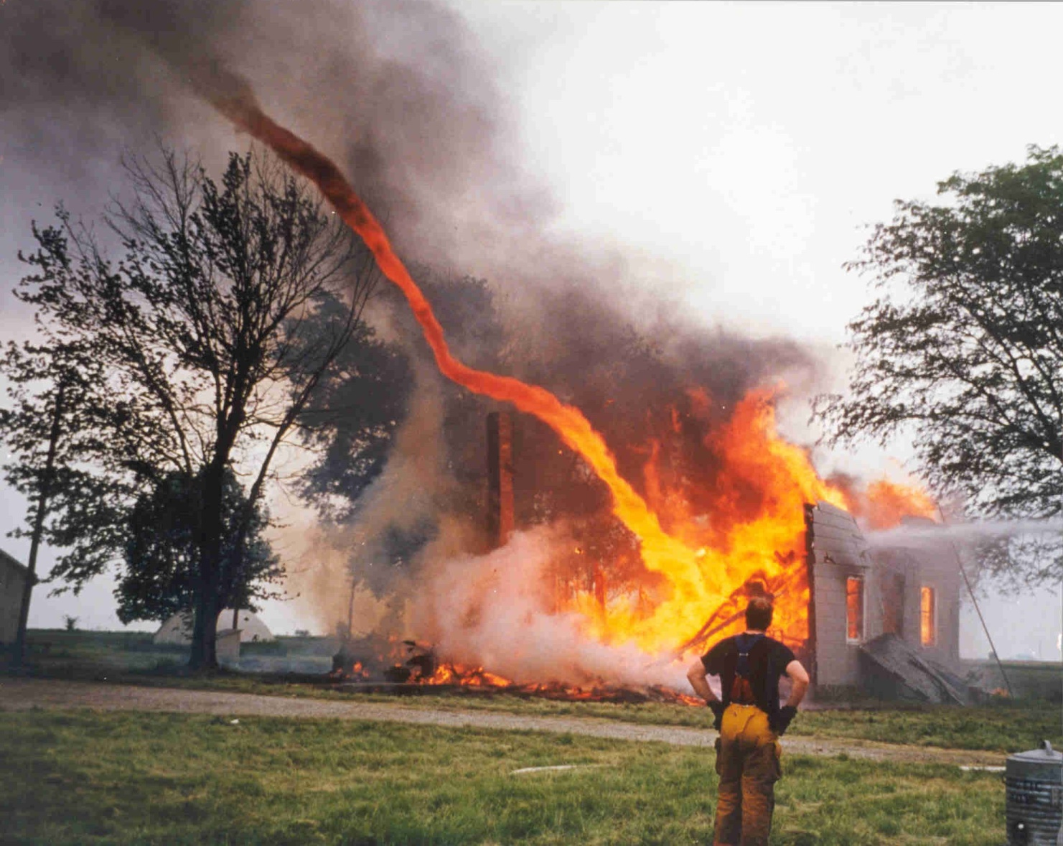
Ferment: A state of agitation, turbulent change or development

Slide 5
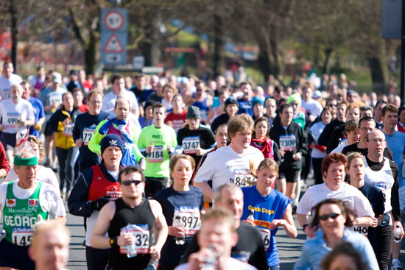

Heroes Don't End the Era of Ferment
Communities Do…

Slide 6
Ferment in the Adoption Cycle
Selection
The rate of progress increases because community energy is focused.
Developments are supportive and cumulative
TIME
Notes:
The adoption cycle starts with the occurrence of an event that destroys existing competence. This disruption leads to a number of questions (adopted from NASA Geospatial Interoperability Return on Investment Study, Booz Allen Hamilton, 2005) and a period of experimentation and ferment (see Tushman, M. L., & Anderson, P., Technological discontinuities and organizational environments. Administrative Science Quarterly, 31(3), 439-465, 1986) during which many different approaches to applying the new technology are explored.
The Era of Ferment ends with the selection of a dominant design.

Slide 7
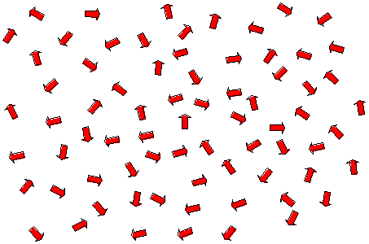
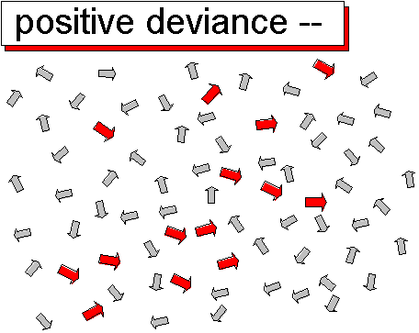
Leadership Model: Positive Deviance
Positive deviance says that if you want to create change, you must scale it down to the lowest level of granularity and look for people within the social system who are already manifesting the desired future state. Take only the arrows that are already pointing toward the way you want to go, and ignore the others. Identify and differentiate those people who are headed in the right direction. Give them visibility and resources. Bring them together. Aggregate them. Barbara Waugh
Notes:
Positive Deviance is a model of organizational change based on the premise that organizations already contain members that are instantiating the desired end state of a change process. These are the secret change agents in the organization. The idea is that these people can lead the change in the broader organization.

Slide 8
Data and Information: End-to-End Process
Producers
Consumers
Community
Data
Information
Knowledge
Wisdom
Data to Information Concept Mapping
Many concepts have been well developed and successfully implemented to achieve (or at least improve) data interoperability.
Can the same concepts facilitate interoperable information?
Variables and Properties
Multiple Dialects
Persistence vs. Transport
Standards and Conventions
Spiral Development
Spatial/Temporal Data Systems
Hierarchical Organizations
Training
Evolution

Slide 9
Hierarchical Organization: Data
File
+has
0..*
+ readme
+ parentDirectory 0..*
Directory
+ subdirectory
0..*
Platform
Sensor
Sensor

Slide 10
Hierarchical Organization: Documentation
MI_Metadata
(from Metadata entity set information)
+has
1..*
+ seriesMetadata
1..*
+ superset 0..*
DS_DataSet
Multiple
Aggregation
DS_Series
+ composedOf
1..*
+ subset 0..*
DS_Platform
DS_Sensor

Slide 11
Hierarchical Organization: InSitu Documentation
Program Documentation
Office of Climate Observations
Other Projects
Other Networks
AggInfo
LWCit
AggInfo
CRef
Project Documentation
AggInfo
LWCit
AggInfo
CRef
<<CodeList>>
MX_ScopeCode
Network Documentation
MI – Network
Extent
Distribution
AggInfo
LWCit
+ attribute + feature
+ attributeType + featureType
+ collectionHardware + propertyType
+ collectionSession + fieldSession
+ dataset + software
+ series + service
+ nonGeographicDataset + model
+ dimensionGroup + tile
+ productionSeries + initiative
+ sensorSeries + sensor
+ platformSeries + otherAggregate
+ transferAggregate + stereoMate
Platform Documentation
DS_Platform
seriesMetadata
MI – Platform
subset
DS_Sensor
DS_DataSet
MI – Deployment 1
MI – Deployment 2
MI – Deployment 3
seriesMetadata
MI - Sensor
Other Deployments
AggInfo
CRef
Granules
THREDDS Data Server
netCDF files
Other formats
Deployment Documentation
MI – Deployment
AggInfo
CRef
NcML
XSLT
ISO
Other Platforms
Notes:
11

Slide 12
Persistence vs. Transport - OPeNDAP
File System
File System
DAP
DAP
Client

Slide 13
Persistence vs. Transport - Documentation
Relational Databases
File System
Rich Inventory
XML
XML
Client

Slide 14
Variables and Properties - Data
<variable name="MHchla" type="float" shape="time altitude lat lon">
<attribute name="_CoordinateAxes" value="time altitude lat lon "/>
<attribute name="_FillValue" value="-9999999.0 " type="float"/>
<attribute name="actual_range" value="0.01 63.997 " type="float"/>
<attribute name="coordsys" value="geographic"/>
<attribute name="fraction_digits" value="2 " type="int"/>
<attribute name="long_name" value="Chlorophyll-a, Aqua MODIS, NPP, 0.05
degrees, Global, Science Quality"/>
<attribute name="missing_value" value="-9999999.0 " type="float"/>
<attribute name="numberOfObservations" value="9664503 " type="int"/>
<attribute name="percentCoverage" value="0.2589298000257202 "
type="double"/>
<attribute name="standard_name"
value="concentration_of_chlorophyll_in_sea_water"/>
<attribute name="units" value="mg m-3"/>
</variable>

Slide 15
Variables and Properties - Documentation
MD_Metadata
+contentInfo 0..*
MD_CoverageDescription
+ attributeDescription : RecordType
+ contentType [1.*]: MD_CoverageContentTypeCode
+ processingLevelCode [0..1]: MD_Identifier
+attribute 0..*
MD_RangeDimension
+ sequenceIdentifier [0..1] : MemberName
+ name[0..*]: MD_Identifier
+ description [0..1] : CharacterString
+rangeElementDescription 0..*
MD_SampleDimension
MI_RangeElementDescription
+ minValue [0..1] : Real
+ maxValue [0..1] : Real
+ units [0..1] : UnitOfMeasure
+ scaleFactor [0..1] : Real
+ offset [0..1] : Real
+ numberOfValues [0..1] : Integer
+ meanValue [0..1] : Real
+ standardDeviation [0..1] : Real
+ otherAttributeType [0..1] : RecordType
+ otherAttribute [0..1] : Record
+rangeElementDescription
0..*
+ name : CharacterString
+ definition : CharacterString
+ rangeElement[1..*] : Record
<<CodeList>>
MD_CoverageContentTypeCode
+ image
+ thematicClassification
+ physicalMeasurement
+ referenceInformation
+ qualityInformation
+ auxilliaryData
+ modelResult
minValue, maxValue and units must have units of length.
RangeElement, otherAttributeType, and other Attribute have cardinality [0..0]
MD_Band
+ peakResponse [0..1] : Real
+ bitsPerValue [0..1] : Integer
+ toneGradation [0..1] : Integer
Community Input to Revisions

Slide 16
Convergence: Data
O&M 1.0
O&M 1.0
O&M 2.0
WXXM 1.0
WXXM 1.1
WXXM 2.X
Aligned with
WXXM Builds
on CSML 3.X
(XML encoding)
O&M 2.0
CSML 1.0
CSML 2.X
CSML 3.X
Aligned with
Aligned with
Unidata CDM
Unidata CDM
Unidata CDM
(Binary encoding)

Slide 17
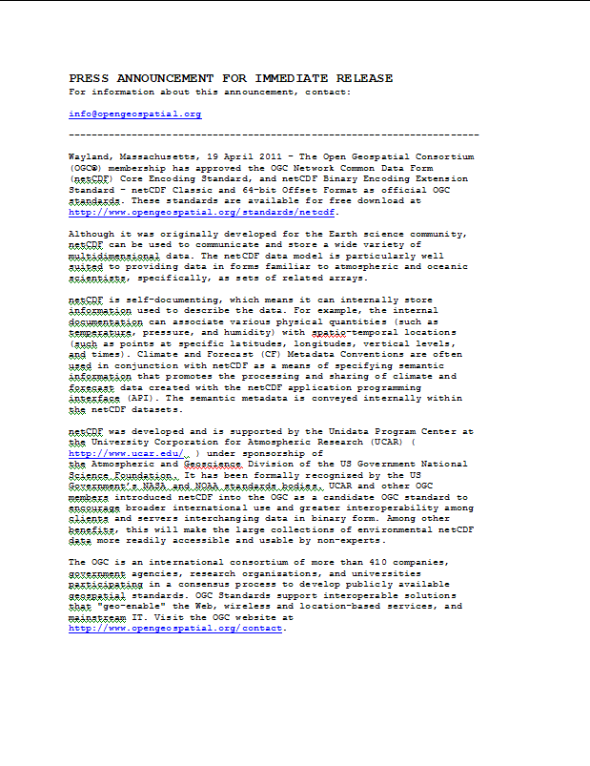
Convergence: Data
The Open Geospatial Consortium (OGC®) membership has approved the OGC Network Common Data Form(netCDF) Core Encoding Standard, and netCDF Binary Encoding Extension Standard - netCDF Classic and 64-bit Offset Format as official OGC standards.

Slide 18
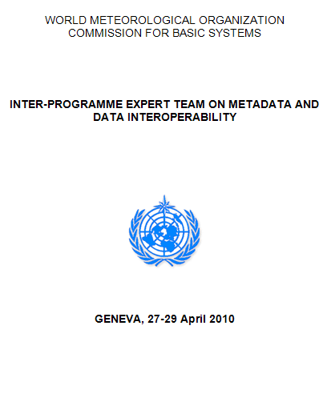
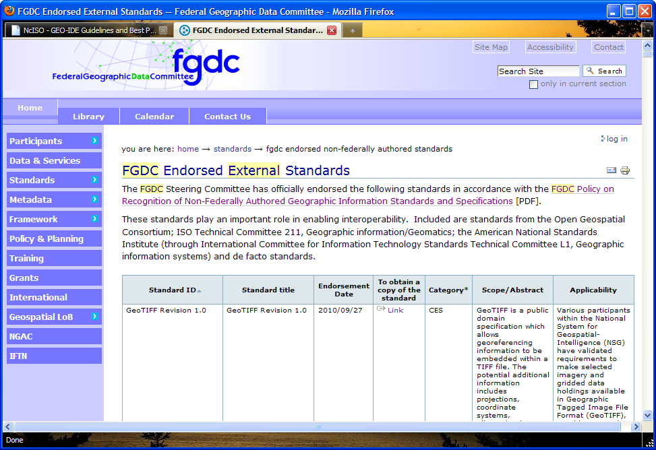
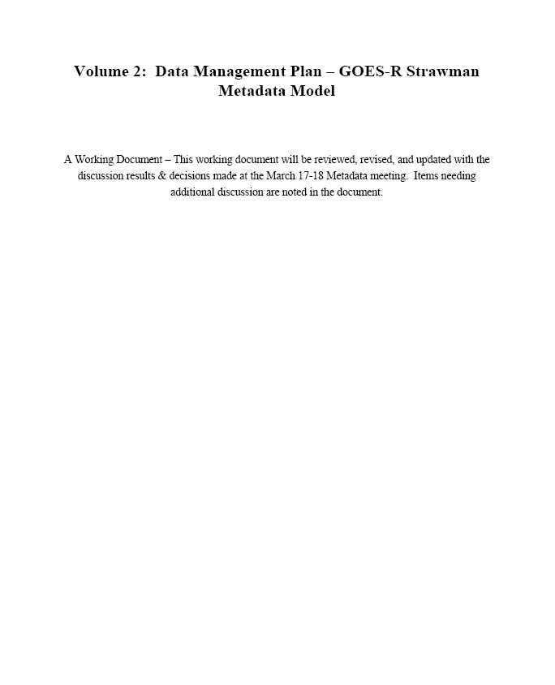
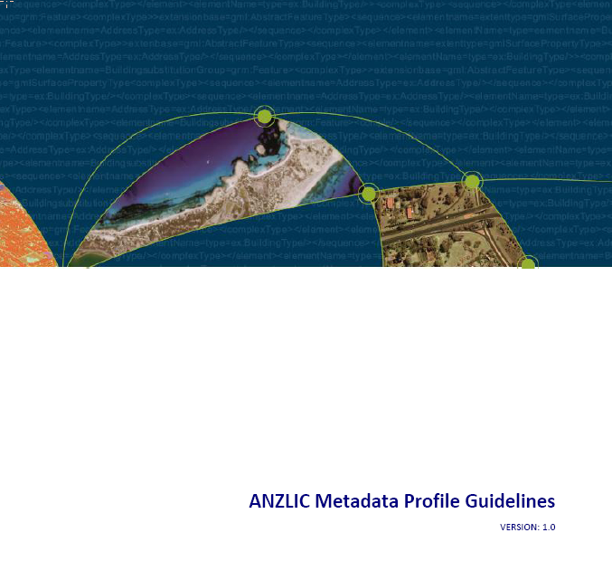
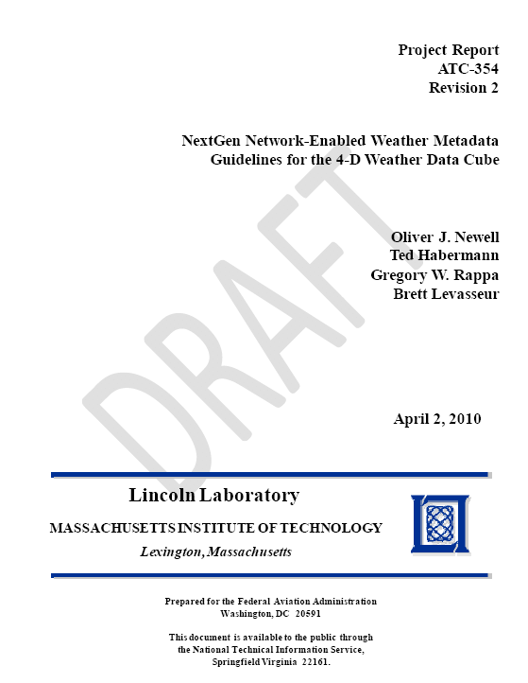
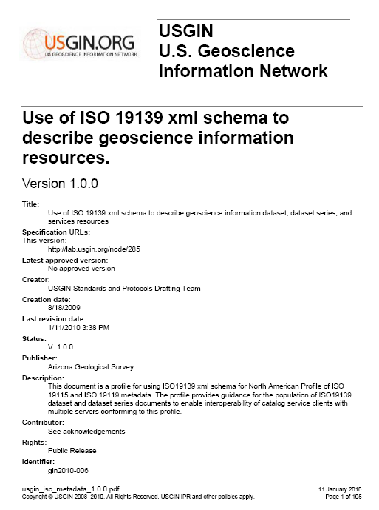
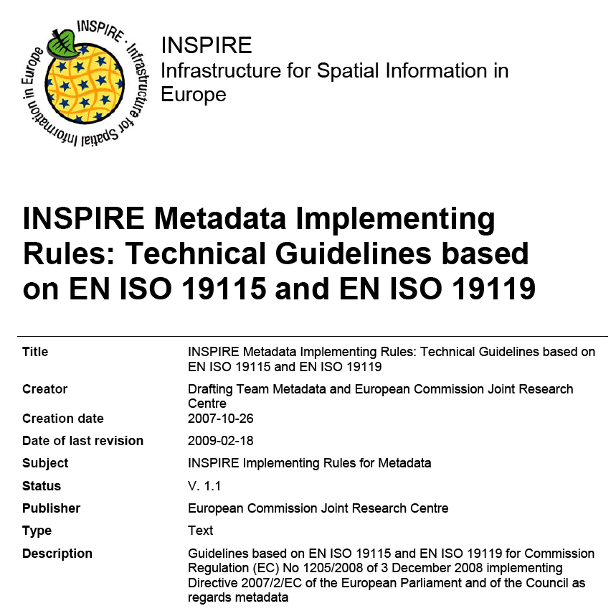
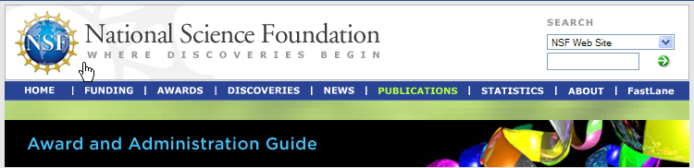
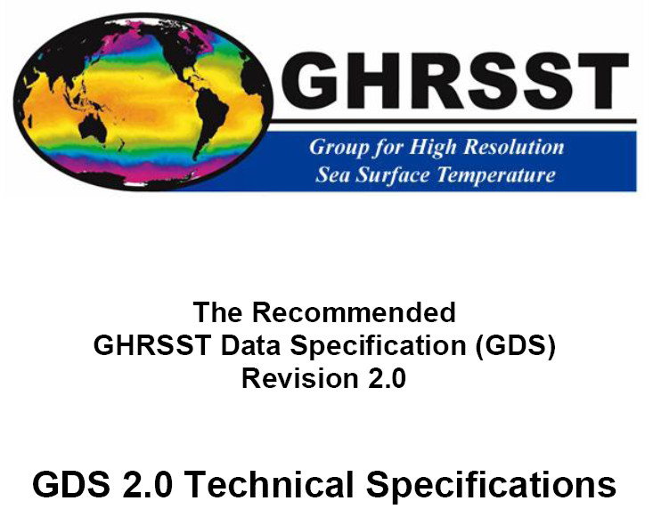
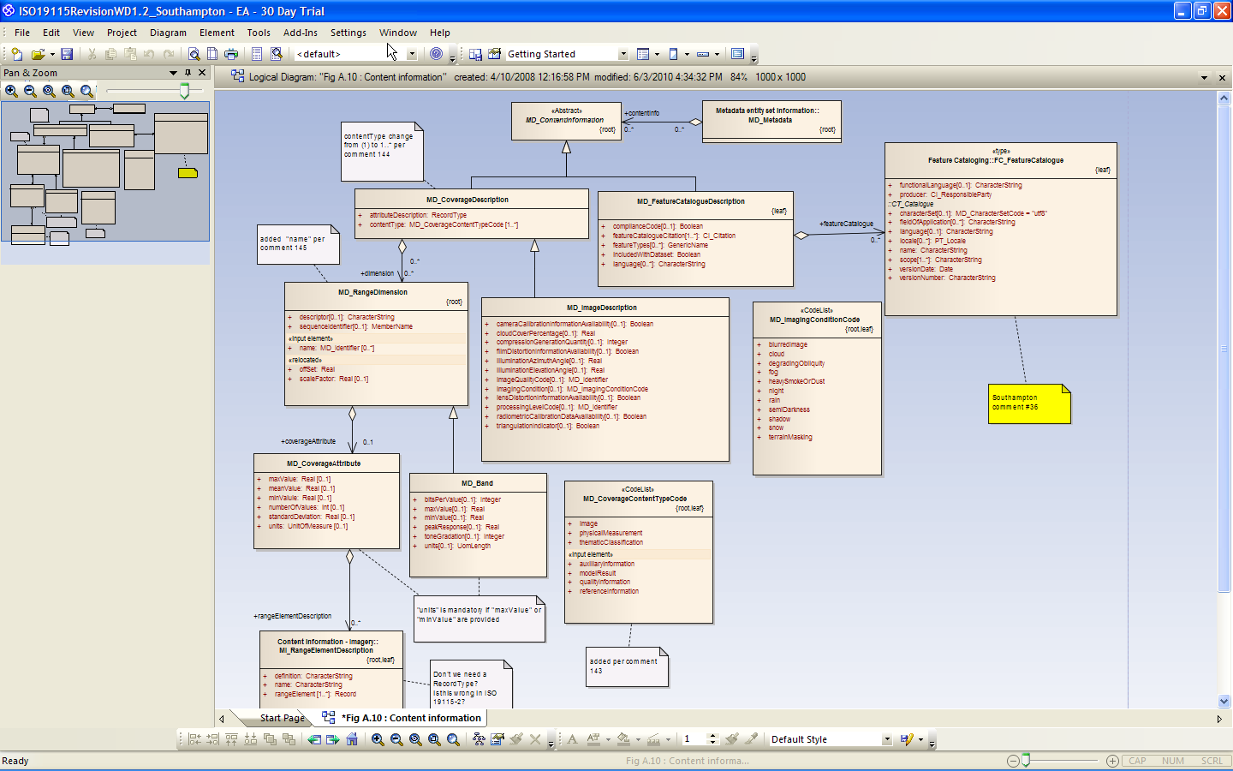
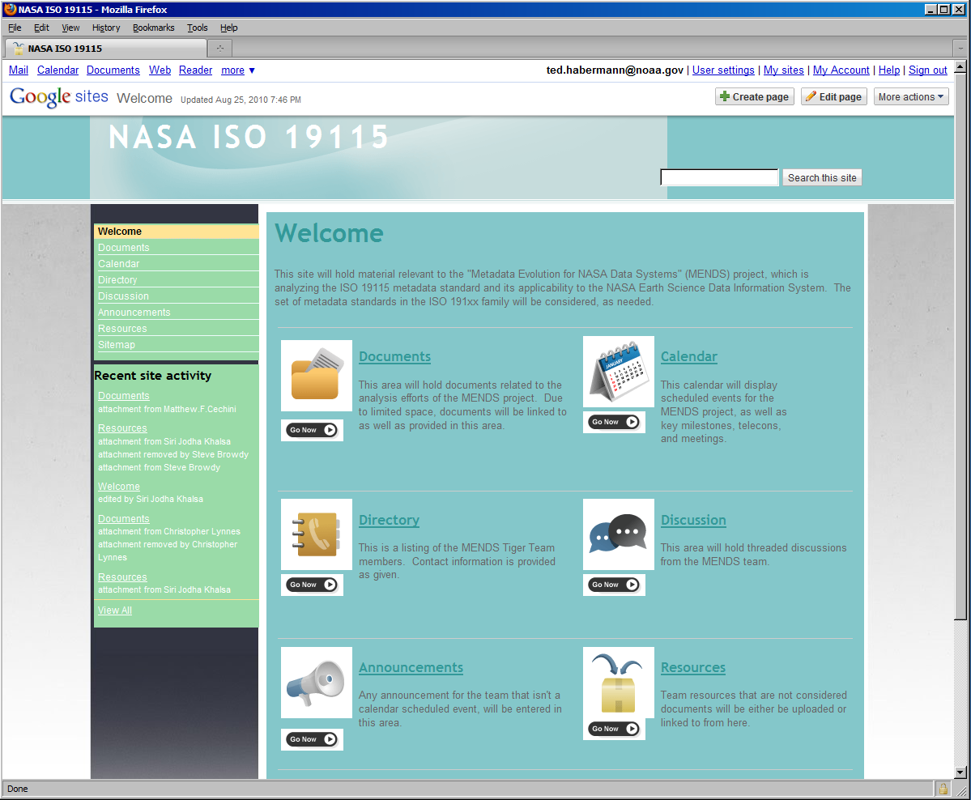
Convergence: Documentation
AMS Metadata Policy Working Group Recommendations:
The AMS should adopt ISO 19115-2 and SensorML as the metadata standards for the Nationwide Network of Networks.
In coordination with other organizations within the broader atmospheric and oceanic sciences community, the AMS should provide opportunities for its members to become better educated on the nomenclature, structure, and implementation of metadata and the standards recommended above.
The AMS should establish a permanent committee to serve as a body of experts … to provide advice to organizations working to implement a Nationwide Network of Networks and to coordinate with the Federal Committee for Integrated Observing Systems (CIOS).
Federal Coordinator for Meteorology Metadata Joint Action Committee
The Joint Action Group recommends that the Federal departments and agencies adopt ISO 19115-2 and SensorML as weather observation metadata standards and participate in the process of implementing those standards across the national weather enterprise.
Chapter VI - Other Post Award Requirements and Considerations
4. Dissemination and Sharing of Research Results
b. Investigators are expected to share with other researchers, at no more than incremental cost and within a reasonable time, the primary data, samples, physical collections and other supporting materials created or gathered in the course of work under NSF grants. Grantees are expected to encourage and facilitate such sharing.
GOES-R: NOAA and NASA
Notes:
Many groups around the world have decided to adopt the ISO Metadata Standards. The World Meteorological Organization, the NextGen Project (FAA and NOAA/NWS), the GOES-R Project (NASA, NOAA/NESDIS, NOAA/NWS), the FGDC, the American Meteorology Society, the Federal Coordinator for Meteorology, ESDIS (NASA), the Group for High Resolution Sea Surface Temperature, the EU (INSPIRE), Australia and New Zealand have all adopted, or are considering adoption, of ISO documentation standards. All of these groups are beginning to work on guidance for application of these standards in their communities. This community effort is reflected in the revision process for the ISO documentation standards. The final picture in this set shows a segment of the model for the revisions to the ISO 19115 Standard that will coalesce into a new version of the standard during 2012. These revisions have benefitted significantly from input from the community of early adopters.
18

Slide 20
Metadata Types and Sharing
User
Discovery Portal
More documentation is required for understanding data than discovering or using it.
Discovery
Use / Mashup
Understanding

Slide 21

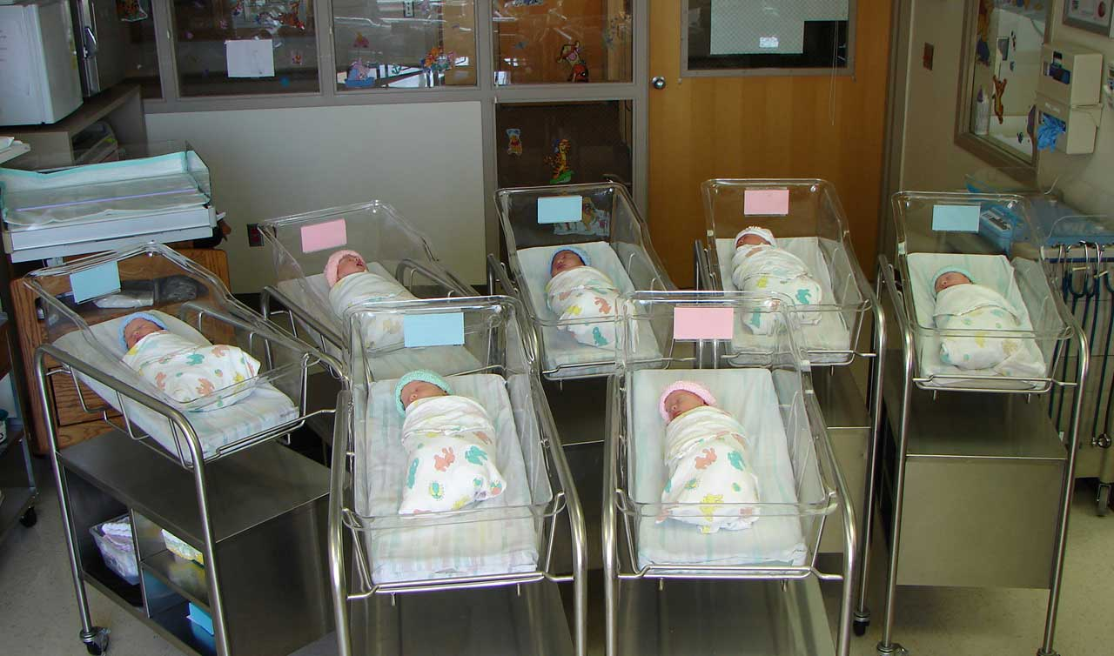
Granules Are Forever
1010101010101010101111100100101101001001001001000100100010010101001001010010010101000100100010100100100101010101010101010101010100010010101000010100
01011011001001001001001000110100101
01011011001001001001001000110100101
01011011001001001001001000110100101
01011011001001001001001000110100101
01011011001001001001001000110100101
01011011001001001001001000110100101
01011011001001001001001000110100101
01011011001001001001001000110100101
01011011001001001001001000110100101
01011011001001001001001000110100101
01011011001001001001001000110100101
01011011001001001001001000110100101
01011011001001001001001000110100101
01011011001001001001001000110100101
01011011001001001001001000110100101
01011011001001001001001000110100101
01011011001001001001001000110100101
01011011001001001001001000110100101
01011011001001001001001000110100101
01011011001001001001001000110100101
01011011001001001001001000110100101
01011011001001001001001000110100101
01011011001001001001001000110100101
01011011001001001001001000110100101
01011011001001001001001000110100101
01011011001001001001001000110100101
01011011001001001001001000110100101
01011011001001001001001000110100101
01011011001001001001001000110100101
01011011001001001001001000110100101
01011011001001001001001000110100101
01011011001001001001001000110100101
01011011001001001001001000110100101
01011011001001001001001000110100101
01011011001001001001001000110100101
01011011001001001001001000110100101
01011011001001001001001000110100101
01011011001001001001001000110100101
01011011001001001001001000110100101

Slide 22

Andy Grove: Communication Overcomes Computing
The framework is changing now. The Internet is redefining software. The Internet is redefining the role of computing and communication and their interaction with each other. I still don’t understand the framework. I don’t think any of us really do. But some aspects of it are pretty clear. It’s proven not to be computing based but communications based. In it computing is going to be subordinated to the communications task.
“Decisions Don’t Wait”, Harvard Management Update.
Notes:
Andy Grove, the ex-chairman of Intel, proposes that the future of technology will be more about communications than computing. The evolution of computing from number crunching to word processing to the web clearly supports this hypothesis.

Slide 23
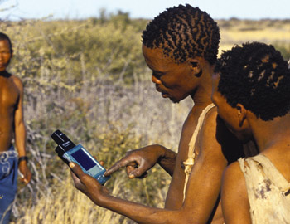
Questions?
ted.habermann@noaa.gov

