Slide 1

Earth Science Data and Information System (ESDIS) Project Update
April 18, 2012
HDF and HDF-EOS Workshop XV
Dan Marinelli (with much thanks to Drew Kittel)
ESDIS Project, Code 423
NASA GSFC
301.614.5357
Notes:
As a Whole - ESDIS supports:
Science Data Processing for 10 Missions
Archiving and Distribution for 38 Missions
Instruments Supported: 87 Instruments
GSFC / Flights Projects Directorate (400) / Earth Science Projects (420) / ESDIS (423) / Science Operations (JB Deputy PM)
Manages the science systems of EOSDIS - which provides science data to a wide community of users for NASA's Science Mission Directorate
Manages and monitors performance of Distributed Active Archive Centers
Data Preservation - planning for data and information beyond the mission EOL and recovering some historic NASA ES datasets
Data preservation, quality and provenance practices; metadata standards
Network access and monitoring, e.g. EOSDIS Backbone Network
ESDIS Project.
ESDIS Project is responsible for:
Processing, archiving, and distributing Earth science satellite data (e.g., land, ocean and atmosphere data products)
Providing tools to facilitate the processing, archiving, and distribution of Earth science data
Collecting metrics and user satisfaction data to learn how to continue improving services provided to users
Ensuring scientists and the public have access to data to enable the study of Earth from space to advance scientific understanding and meet societal needs.
Supporting Earth Science Division at NASA HQ:
Development of standards for science info exchange
Develop interoperability functions with other Data Centers
Represent NASA in interagency and international working groups
Data center oversight (PM, Sys Engineering and technical direction)

Slide 2
ECS SDPS Recent Progress
  ECS 8.1 has been delivered and is undergoing testing at the sites which host ECS (Land Processes DAAC, Souix Falls, SD, Atmospheric Sciences Data Center, Langley, VA, and National Snow and Ice Data Center, Boulder, CO)
    Database consolidation – reduces code complexity/lines of code and presumably sustaining costs in the future
    HDF4 Map Generation Utility
    Data access enhancements
      Web service with an API for accessing EOSDIS on-line archive data
      API provides users the new capabilities for subsetting, reformatting, re-projection, and re-sampling
      API is integrated with ECHO/Reverb so Reverb users can access the processing capabilities on-line on-demand and download the results.
      Also provides an internal API that a DAAC can use to offer the processing capabilities of their preferred tools via the SDPS web API.

Slide 3
ECHO Recent Progress
Reverb client completely replaces WIST client as of 3/28/12
Data Access Enhancements
  Ability to expose processing services, e.g., HEG into the search and order workflow using ECHO/Reverb or other clients
ECHO Multi-format support dramatically reduced query times (26 to 3.5 seconds average)
New REST API for ECHO which makes client development easier – allowed us to build two visualization features for LPDAAC and will enable us to build faceted search

Slide 4
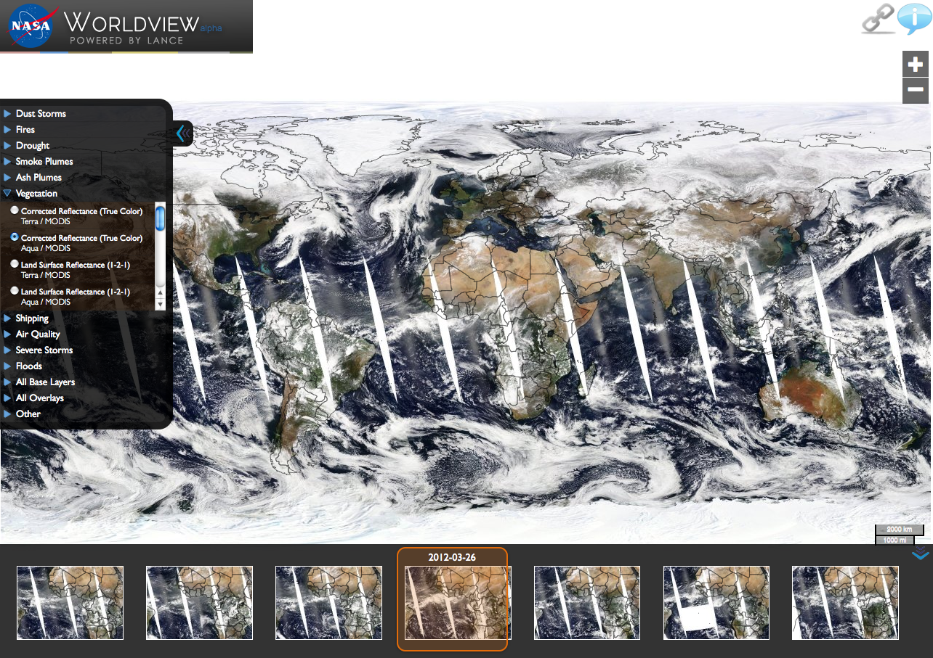
WORLDVIEW

Slide 5
WORLDVIEW
Interactively browse full-resolution, global, near real-time satellite imagery.
Data is generally available within three hours of observation.
Allows comparison to observations of past week.
Currently supports 50+ imagery products supplied by LANCE data providers:
  AMSR-E SIPS
  GES DISC
  MODAPS
  OMI SIPS
  SEDAC (socioeconomic data)
Developed using OGC WMS and Tiled WMS
  Future plans include providing standardized, public access to Worldview's imagery servers to allow external users to build their own interfaces or ingest the imagery directly.
http://earthdata.nasa.gov/labs/worldview/ (currently in alpha)
Arctic and Antarctic views also under development:
  http://earthdata.nasa.gov/labs/worldview_arctic/
  http://earthdata.nasa.gov/labs/worldview_antarctic/
LANCE– Land Atmosphere Near Real-time Capability for EOS (http://lance.nasa.gov/)
Notes:
Visual search, full fidelity/resolution. Will eventually allow you to get to full data sets underlying selection. For now you can still use Reverb/echo.
For more functionality, please use the LANCE WMS client or, for a more hazards-and-disasters-specific experience, this introduction to the LANCE WMS client. Arctic and Antarctic instances of Worldview are also available and will eventually be merged into this version. We also plan to provide standardized, public access to Worldview's imagery servers to allow external users to build their own interfaces or ingest the imagery directly; until then, direct access to those servers is unsupported and subject to change.
Acknowledgements
Near-real time data is courtesy of LANCE data providers: AMSR-E SIPS, GES DISC, MODAPS, and OMI SIPS. Socioeconomic data supplied by SEDAC. Credit for development of the data ingest and serving system belongs to the Tiled WMS development team at NASA/JPL's Physical Oceanography Distributed Active Archive Center (PO.DAAC). Special thanks to the NASA/GSFC Scientific Visualization Studio, Steve Romalewski and Dave Burgoon/CUNY CUR, Bruce Campbell/RISD, and Ben Fry/Fathom Information Design for their invaluable feedback, much of which is still to be implemented. Additional thanks to Katie Lewis, NASA/GSFC, for graphic design and nomenclature support.

Slide 6
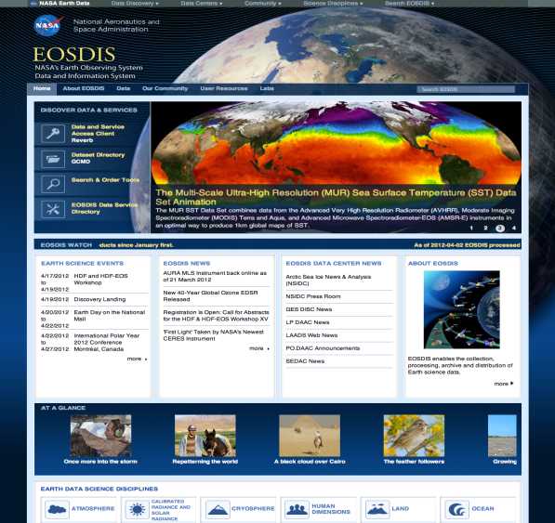
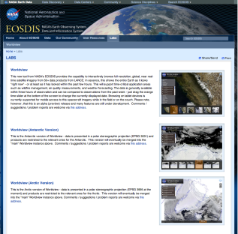
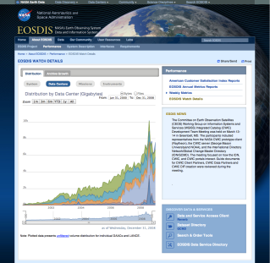
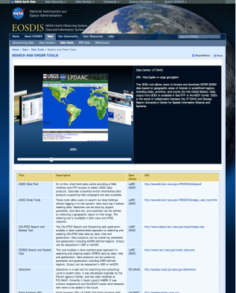
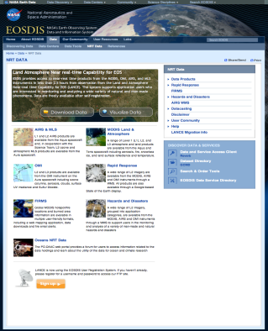
Coherent Web - earthdata.nasa.gov
Major development activities for phase 2 of the Coherent Web project were completed at the end of March. Accomplishments during this phase include:
  Finalized consolidation of 14 separate websites into earthdata.nasa.gov (well over 2000 pages of content)
  Added labs section with visualization tools
  Cross-DAAC/EOSDIS content and news sharing
  Selection and initial configuration of EOSDIS-wide user support tool - Kayako
  Implemented an EOSDIS service registry viewer in collaboration with ECHO
  Dynamic EOSDIS metrics viewer powered by the ESDIS Metrics System
  Mobile device support and usability enhancements
  EOSDIS wide content and web search with a Google Search Appliance
Notes:
Websites included a lot of ESDIS sites, ESDSWG sites, DAAC Alliance, LANCE, Rapid Response etc…
Currently cross DAAC content in manual, still waiting for the firewall rules to do the rss feeds. Ross is working on this and all DAACs should have been contacted by him in preparation for the eventual opening of firewalls.
Services are mostly tools at this point. We will be expanding to web services in the next phase.

Slide 7
Coherent Web - earthdata.nasa.gov
The next phase of development will concentrate on:
  Developing collaborative capabilities
  Improving the design and information architecture to increase usability
  Add support for customization of web services by end users
  Implement an EOSDIS-wide software sharing infrastructure to foster reuse of capabilities created at DAACs
  Continue to provide technical and design assistance to DAACs and other EOSDIS projects
Notes:
Collaborative capabilities: wiki, document management, forum, voting, user registration and that type of thing. The overall requirements are still being developed but one of the things that we want to do is 'enable' the ESDSWG meetings and the like.

Slide 8
URS Overview
The URS will enable improved collection of metrics on users and usage of resources to help evaluate system enhancements and the impact of new tools and services.
URS is defined as providing:
    User Registration
    User Authentication
    Profile and Password expiration and Renewal
    Profile Maintenance
    Profile Access

Slide 9
Benefits of the URS system
EOSDIS Benefits
  Provide consolidated registration and authentication services
  Improve metrics collection on usage of EOSDIS Data and Services
  Ensure consistent policy enforcement
  Standards based API and Tools reduce integration costs
  Validation of email during registration reduces errors
  Metrics collected reduce efforts required for ACSI surveys
User Benefits
  Offer customized views
  Dataset suggestions based previous search and order
  Order/Search Management - order history, recent queries
  Opportunity to access tools that cannot fully operate without user identification
  Access to active participation in exchange of information through sanctioned forums
Notes:
Policy enforcement: e.g. password size/strength/composition/aging & renewal
Email validation – e.g. part of reg. process is email with instructions to complete registration. Addresses input/bad email issues.
Consistent access to other tools using same login/auth. mechanism (e.g. LANCE, DAR, etc.)

Slide 10
URS Phase I
  Phased Approach (minimizes impact on existing users)
Phased Approach (minimizes impact on existing users)
Phase I will include the transition of
  EOS Clearinghouse (ECHO) (Ops. Tentatively 4/25/12)
    Land Processes Data Center (LP DAAC) DAR Tool user authentication
  Land Atmosphere Near real-time Capability for EOS (LANCE) User Registration system (Ops. Tentatively 4/18/12)
  Integration of URS and ESDIS Metric System (EMS)
  An on-line browser based GUI will be provided on the Earthdata website to allow users to perform self registration
Phase I transition is scheduled to conclude by May 2012.
Phase II will include the transition of additional data centers and applications. It also includes enhancements to allow the addition of data center/application specific fields.
Notes:
DAR tool utilizes ECHO authentication
Some dupe emails reg’d in DAR tool
New URS is more strict (single email) -> clean up of user emails underway. Users to get email re: conflicts and assistance in resolution.
remind Janice Wilson that the DAR Tool users who have conflicting accounts will be getting emails to reconcile their accounts? Leon Maldonado hasn't gotten back to ECHO on this issue.
ECHO/Reverb notes from Matt C.
We have provided the AST_L1A metadata for the entire dataset. I know there has been a lot of interest in this for a while.
WIST is retired, Reverb has taken over
We have made a number of visualization enhancements in coordination with LPDAAC. They are available in our partner test environment and we have an Operations Concept outlining the new features.
The items that were requested by the ASTER Science team for Reverb were turned into NCRs (e.g. Change Request) that are on the LPDAAC wish list. We worked the must-have issues and will schedule the rest.

Slide 11
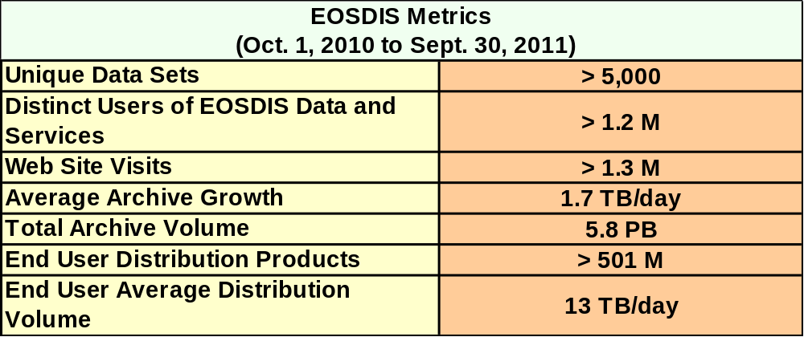
EOSDIS Performance
>1.2 M Distinct Users
>1.3 M Web Site Visits (> 1 min.)
>501 M Products
Avg. 13 TB/day
Avg. 1.7 TB/day
Distributed Active Archives
5.8 PB
> 5,000 Datasets
Notes:
ESDIS measures EOSDIS performance through metrics and a survey of customer satisfaction.
Each data center provides metrics to a central system.
Once a year all users are asked to comment on satisfaction using an OMB approved survey
Metrics
collected on a daily basis from each data center
ESDIS collects these metrics in a tool called the ESDIS Metrics System (EMS) – data and web metrics
combines all DAAC metrics for system level view of EOSDIS performance
Presented by FY not CY
Unique Data Sets: Total number of unique data sets distributed in the fiscal year.
Distinct Users of EOSDIS Data and Services: Total unique users across EOSDIS Data Users and Web Visitors, per data center and summed
Web Site Visits: Sum of web visits for data centers where a visit represents a user session not broken by more than 30 minutes and a duration of at least one minute
Average Archive Growth: Sum across reporting data centers of the data volume added to the individual archives divided by the days in the year
Total Archive Volume: Sum across reporting data centers of the data volumes in the archive as of end of the fiscal year
End User Distribution Products: Total number of products distributed from all reporting data centers
End User Average Distribution Volume: Sum across reporting data centers of the data volume distributed for the fiscal year divided by the days in the year

Slide 12
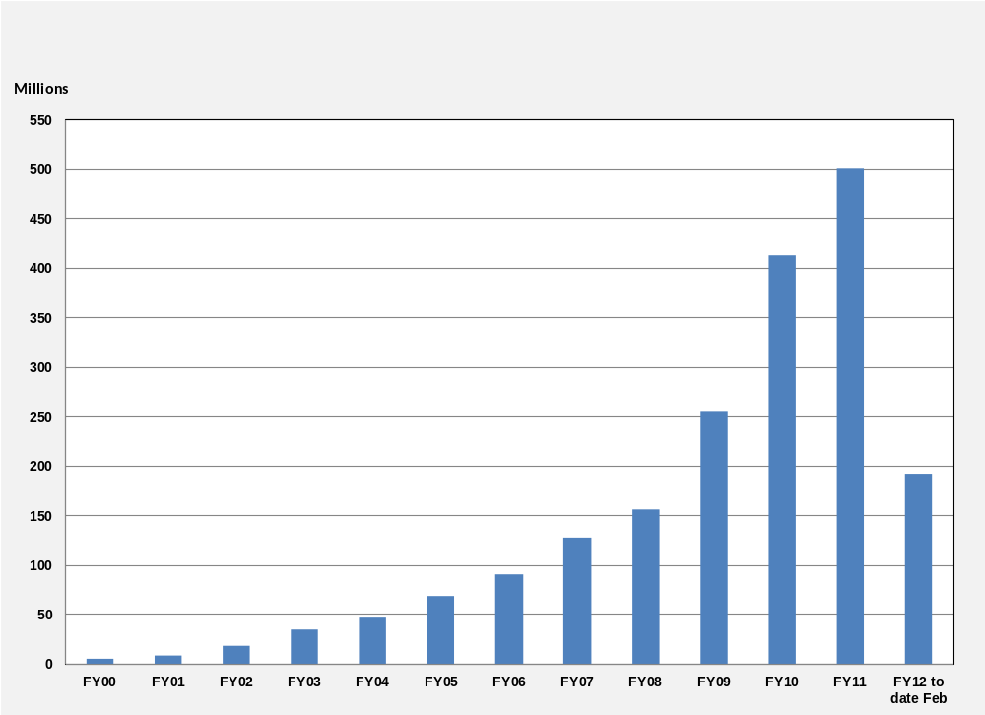
EOSDIS Products Delivered: FY00 thru Feb 2012
Notes:
As of Feb 2009, all historical data comes from EMS (no EDGRS annual report data for pre-2000) and OBPG data is added from the Ocean Color website statistics for FY04 through FY11.
Prior years (FY00-FY2008) products distribution data sources cover the following data centers:
ASF, EDC, GSFC, GHRC, PO.DAAC, ASDC, NSIDC, ORNL, SEDAC, including OBPG since FY2004, MODAPS since FY2006, and CDDIS since FY2009. All data are on FY boundaries.
FY2011 data is cumulated per month for the following 11 data centers:
ASF, EDC, GSFC, GHRC, PO.DAAC, ASDC, NSIDC, ORNL, MODAPS, SEDAC, and CDDIS, with OBPG to be added at end of the fiscal year.
FY2012 data is cumulated per month for the following data providers:
ASF, EDC, GSFC, GHRC, PO.DAAC, ASDC, NSIDC, ORNL, MODAPS, SEDAC, CDDIS and LANCE; OBPG to be added at end of the fiscal year.
As of FY12 CALIPSO distribution is included in ASDC totals
Roughly 37,586 K products delivered through Feb 2012.

Slide 13
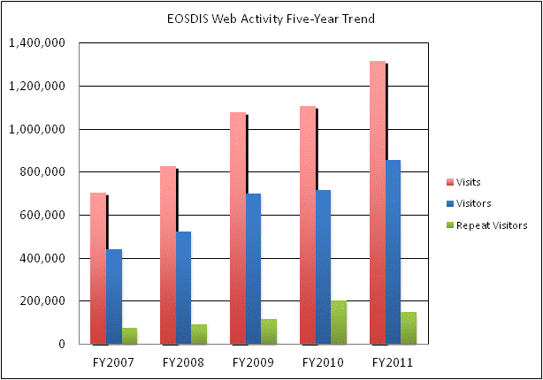
Web Trends
~1.318 M
~856 K
~150 K
Notes:
Web metrics data for EOSDIS became available as of FY2007
Data for FY2007 is complete for 7 centers
FY2008 is complete for 8 centers
FY 2011 for all 11 centers

Slide 14
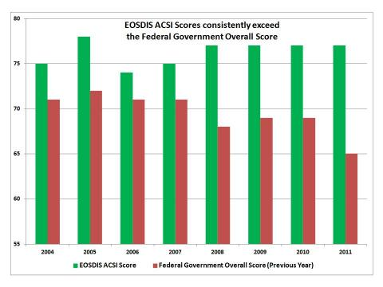
EOSDIS Annual Customer Satisfaction Survey
The American Customer Satisfaction Index (ACSI) has been the standard metric for measuring citizen satisfaction
Ratings in the mid to upper 70s are considered “very good”
Overall 2011 Survey results based on 3,996 responses (8% vs. 7% last year)
77
77
77
77
- EOSDIS
76
75
76
76
- LP
Notes:
1999, the federal government selected ACSI to be a standard metric for measuring citizen satisfaction.
The Index was founded at the University of Michigan and is now produced by ACSI, LLC. ForeSee Results sponsors the e-government index. The Federal Consulting Group (FCG) operates as a fee-for-service franchise in the National Business Center (Dept of the Interior) and serves as the executive agent in the government for the American Customer Satisfaction Index (ACSI). The Federal Consulting Group uses a generic clearance from the Office of Management and Budget to obtain expedited approval of ACSI surveys as required by the Paperwork Reduction Act. This enables agencies to conduct ACSI surveys without obtaining a separate clearance.
Agencies can assess and improve programs, call centers and websites using the ACSI methodology through an Interagency Agreement with the Federal Consulting Group
How can we utilize ACS Data to drive improvements (aside from reporting out to congress, customers, employees)?
Test results against current assumptions.
Identify strategic benchmarking partners.
Reexamine improvement plans and strategy.
EOSDIS consistently exceeds the Federal Government average
Ratings in the mid to upper 70s are considered “very good” by the rating organization, the ACSI LLC, and Federal Consulting Group
Overall survey: ~58K email invitations staged over multiple days. The invitation asked customers to participate in the online survey during September 12 – October 18th, 2011
3996 responses. 8% rate
LP invites/response constituted nearly half the survey:
LP had ~25.5K invite recipients. 1849 responded. 8% response rate was average of all DAACs this year
LP DAAC score was 76 based on 1,849 responses (8%) – consistent with overall response rate.
Any suggestions for improving overall customer satisfaction?
(Customer consistently scores 83-85; search low-mid 70’s; select/order mid 70’s; delivery hi 70’s-80; product do mid 70’s)
Seeking feedback on
other data sets used (or would like to use),
the ease of find, search, order data,
tools used (or would like to see used)
pain points
suggestions

Slide 15
Additional EOSDIS Performance Info
EOSDIS Annual Reports
  http://earthdata.nasa.gov/about-eosdis/performance/eosdis-annual-metrics-reports
System Performance (key FY metrics)
  http://earthdata.nasa.gov/about-eosdis/performance
Weekly Metrics
  http://earthdata.nasa.gov/about-eosdis/performance/weekly-metrics
EOSDIS Watch Detail (interactive charts)
  http://earthdata.nasa.gov/about-eosdis/performance/eosdis-watch-details
American Customer Satisfaction Index (ACSI) Reports
  http://earthdata.nasa.gov/about-eosdis/performance/american-customer-satisfaction-index-reports

Slide 16
Questions?

Slide 17
Context backup

Slide 18
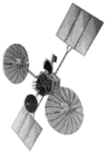
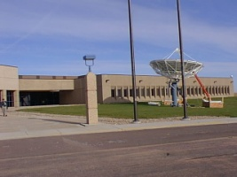
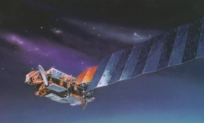
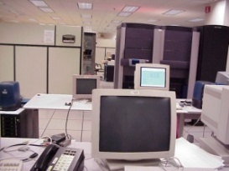
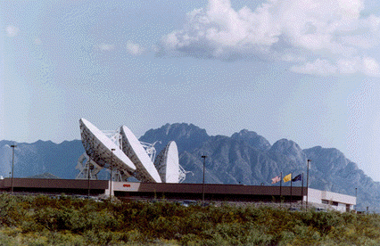
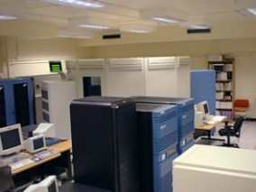
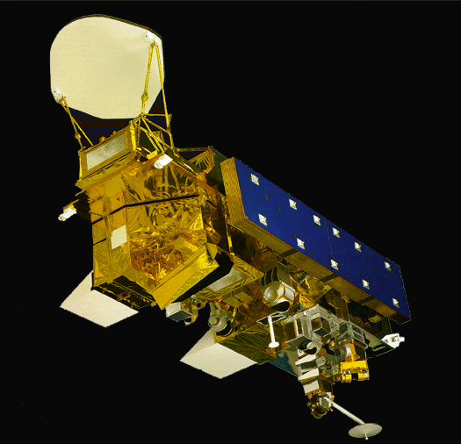
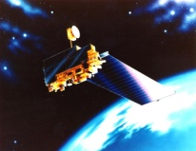
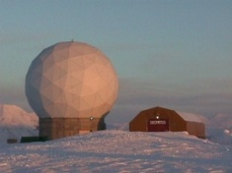
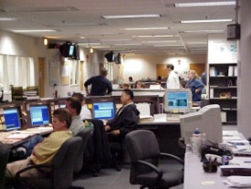
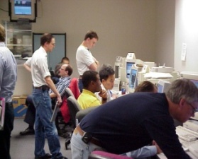
EOSDIS Context
Mission Operations
Science Operations
Data Transport
to Data Centers/
SIPSs
Data Acquisition
Flight Operations,
Data Capture,
Initial Processing,
Backup Archive
Science Data Processing,
Data Mgmt, Interoperable Data Archive, & Distribution
Distribution and Data
Access
EOS
Tracking & Data Relay Satellite (TDRS)
Spacecraft
Research
Education
White Sands
Complex
(WSC)
EOS Data and Operations System (EDOS)
Data Processing
EOSDIS Data
Centers
Internet
Value-Added
Providers
(Search, order,
distribution)
EOS Operations Center (EOC) Mission Control
Interagency
Data Centers
Earth
System Models
EOS Polar
Ground Stations
NASA Integrated Services Network (NISN) Mission Services
International
Partners
Instrument Teams
and Science
Investigator-led
Processing System
(SIPS)
Decision Support
Systems
ESMO
ESDIS
Notes:
History of working as a whole system
ESDIS now separated into ESMO and ESDIS
Currently operating 12 Earth-observing spacecraft (Terra, Aqua, Aura, TRMM, SORCE, EO1, ACRIMSAT, CAPISO, Cloudsat, GRACE, Jason-1, OSTM)
Launching NPOESS Preparatory Project and Aquarius in FY 2011.
Proceeding towards launch of the Landsat Data Continuity Mission (June 2013) and the Global Precipitation Measurement mission (July 2013).

Slide 19
EOSDIS Facilities
ASF DAAC
SAR Products
Sea Ice, Polar
Processes
Discipline Data Centers archive and distribute near real time and standard data products.
CDDIS
Crustal Dynamics
Solid Earth
SEDAC
Human Interactions
in Global Change
NCAR, U of Col.
HIRDLS, MOPITT, SORCE
LP DAAC
Land Processes
& Features
GSFC
GLAS, MODIS, OMI, OBPG
GES DISC
Atmos Composition &
Dynamics, Global
Modeling, Hydrology,
Radiance
Key
NSIDC DAAC
Cryosphere, Polar
Processes
OBPG
Ocean Biology &
Biogeochemistry
Data
Center
JPL
MLS, TES
ORNL DAAC
Biogeochemical
Dynamics, EOS Land
Validation
LAADS/
MODAPS
Atmosphere
SIPSs
LaRC
CERES, SAGE III
San Diego
ACRIM
PO.DAAC
Ocean Circulation
Air-Sea Interactions
GHRC
Hydrological Cycle &
Severe Weather
ASDC
Radiation Budget,
Clouds, Aerosols,
Tropo Chemistry
GHRC
AMSR-E, LIS
Science Data Processing: 10 Missions
Archiving and Distribution: 38 Missions
Instrument Product Support: 87 Instruments
Notes:
EOSIDS/DAACs (14)
Designed as a distributed system, with major facilities at data centers located throughout the United States
Discipline data centers are collocated with centers of science expertise (e.g. atmospheric chemistry, polar processes, ocean topography, SAR)
SIPS (12) – Science Investigator Led Processing Systems
Most of the EOS standard products are produced at facilities under the direct control of the instrument Principal Investigators/Team Leaders (PIs/TLs) or their designees. These facilities are referred to as Science Investigator-led Processing Systems (SIPSs)
Science System Elements
Specialized Data Centers: 12
Science Investigator Processing Systems: 14
Interfaces/Interface Control Documents: 32
As a Whole - ESDIS supports:
Science Data Processing for 10 Missions
Archiving and Distribution for 38 Missions
Instruments Supported: 87 Instruments

Slide 20
Metrics backup

Slide 21
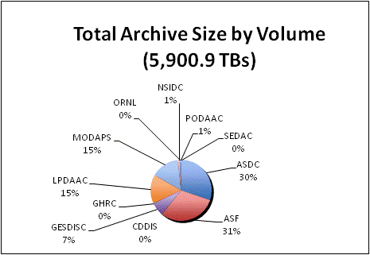
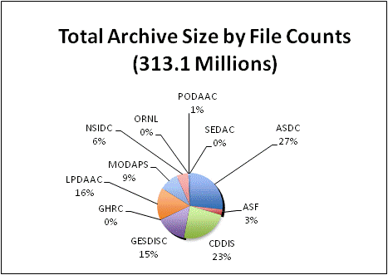
Total Archive Size
Notes:
The Total Archive Size describes the EOSDIS archive at the end of FY2011. This includes all data (including ancillary) but not data marked for deletion.

Slide 22
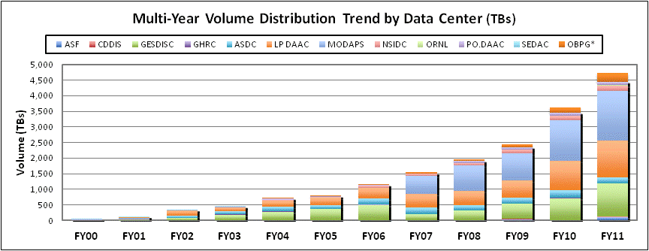
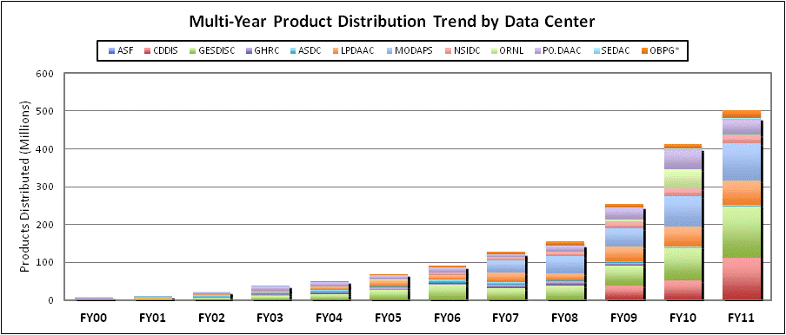
Data Distribution Trends
4729 TB
501 M
Notes:
Volume Distribution Trend presents distributed volume counts from EMS by data center.
OBPG distribution metrics from the Ocean Color web site are included beginning in FY2004. CDDIS data became available in FY2009.
Product Distribution Trend presents distributed product counts from EMS by data center.
OBPG distribution metrics from the Ocean Color web site are included beginning in FY2004. CDDIS data became available in FY2009.

Slide 23
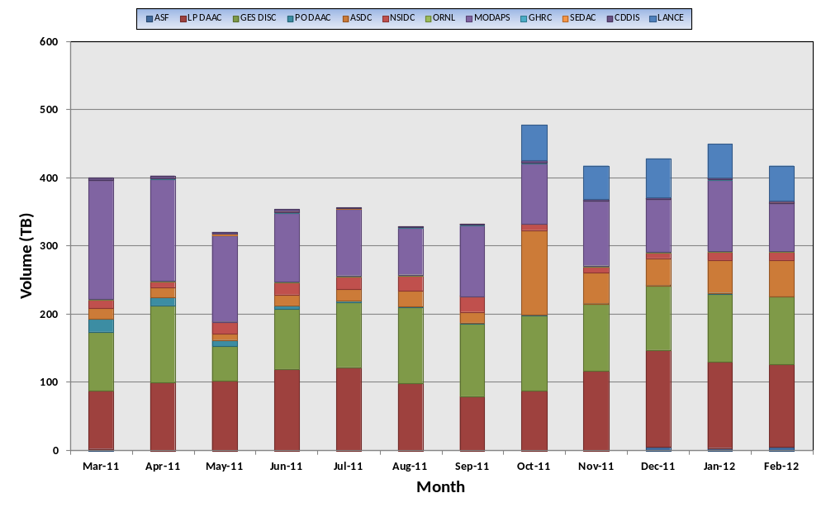
Monthly Distribution Volume (Mar 2011 – Feb 2012)
Notes:
The February 2012 distribution shows decrease in both volume (-32.7 TB) and file counts (-8.7 M files) when compared with January 2012. The decrease is partially due to the fact that there were only 29 days in February. Major contributing data centers responsible for the monthly changes are:
MODAPS (34.1 TB decrease, 4.0 M files decrease) – Distribution of L1B products (MOD021KM, MYD021KM, MOD03, MYD03) dropped significantly in February
LP DAAC (5.6 TB decrease, 2.1 M files decrease) – Distribution of MODIS surface reflectance products (MOD09A1, MYD09GA) decreased.
GESDISC (0.8 TB decrease, 2.2 M files decrease) – Distribution of AIRS L1B products (AIRIBRAD) and MERRA product (MAI6NPANA: MERRA 3D Analyzed State, Meteorology Instantaneous 6-hourly) decreased. There were four (3 US and 1 foreign) power users who retrieved almost 15 TB of AIRIBRAD in January.

Slide 24
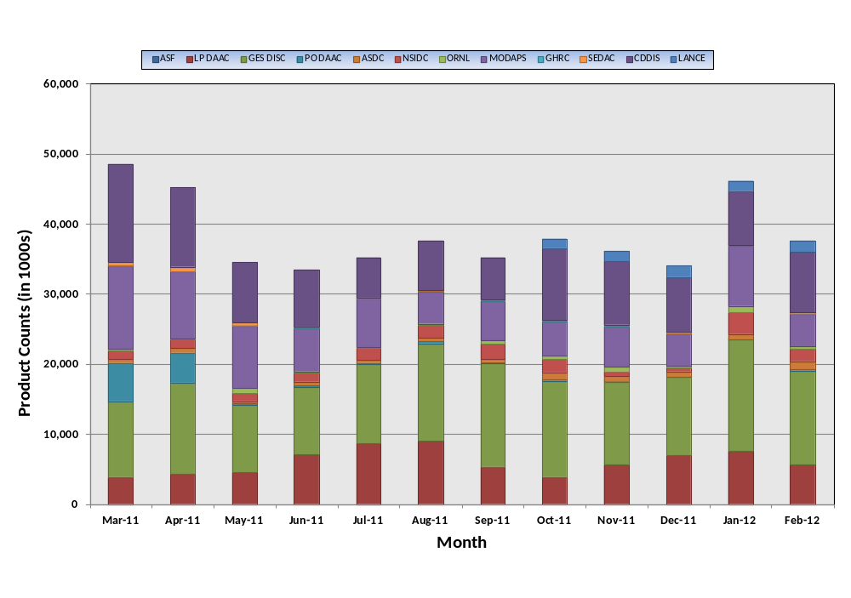
Monthly Distribution by Products (Mar 2011 – Feb 2012)
Notes:
The February 2012 distribution shows decrease in both volume (-32.7 TB) and file counts (-8.7 M files) when compared with January 2012. The decrease is partially due to the fact that there were only 29 days in February. Major contributing data centers responsible for the monthly changes are:
MODAPS (34.1 TB decrease, 4.0 M files decrease) – Distribution of L1B products (MOD021KM, MYD021KM, MOD03, MYD03) dropped significantly in February
LP DAAC (5.6 TB decrease, 2.1 M files decrease) – Distribution of MODIS surface reflectance products (MOD09A1, MYD09GA) decreased.
GESDISC (0.8 TB decrease, 2.2 M files decrease) – Distribution of AIRS L1B products (AIRIBRAD) and MERRA product (MAI6NPANA: MERRA 3D Analyzed State, Meteorology Instantaneous 6-hourly) decreased. There were four (3 US and 1 foreign) power users who retrieved almost 15 TB of AIRIBRAD in January.

Slide 25
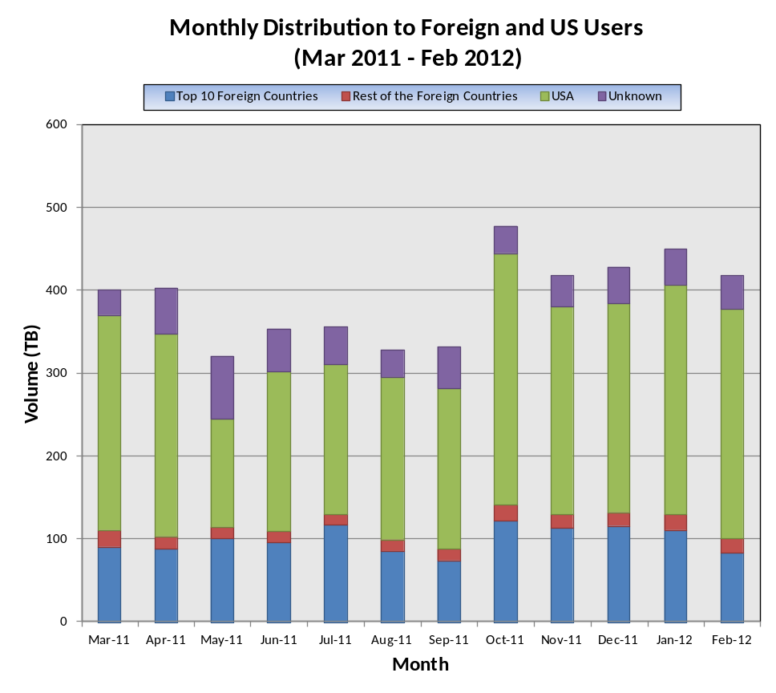
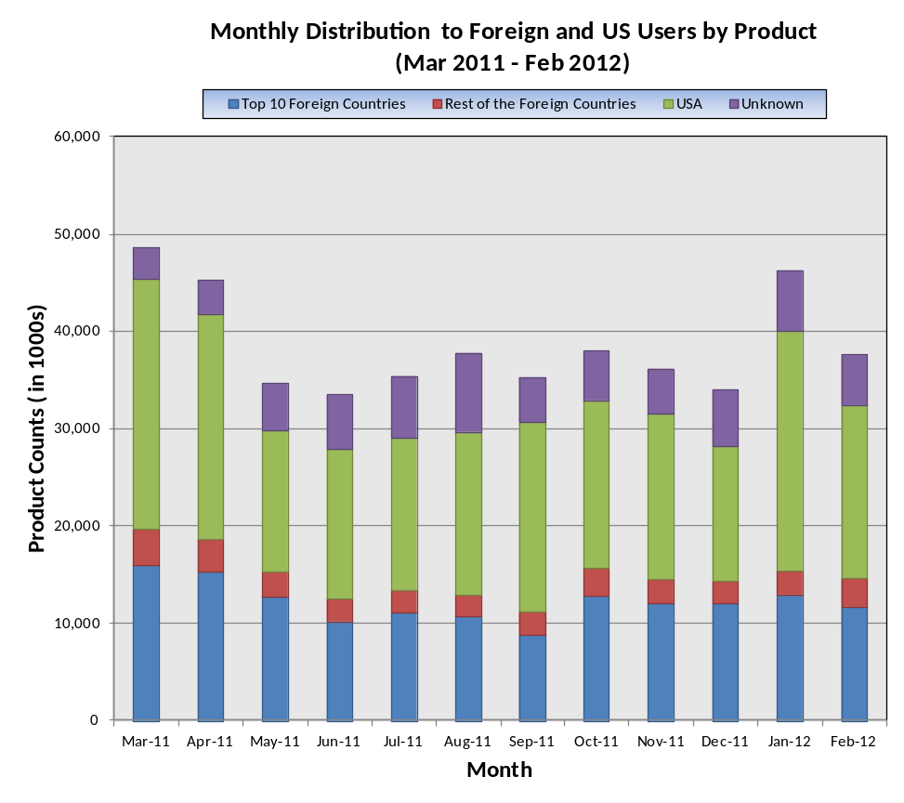
Monthly Distribution to Users (Mar 2011 – Feb 2012)
Beginning in October 2011,
1. CALIPSO is included in the ASDC metrics
2. LANCE metrics for the NRT products are included

Slide 26
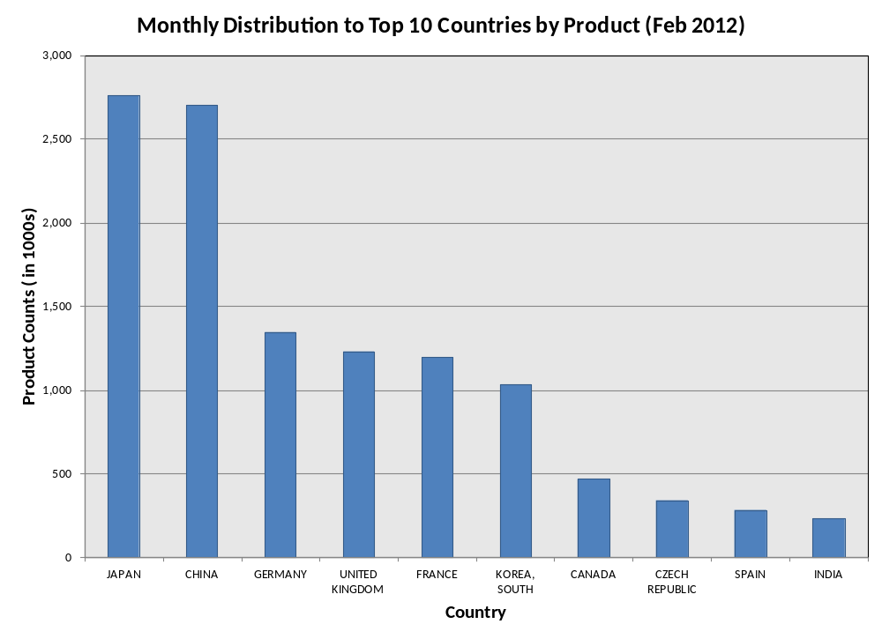
Monthly Products/Volume Distribution (Feb 2012)
 | Monthly Volume: Feb 2012
 | Country | Vol (TB)
 | CHINA | 15.13
 | JAPAN | 13.10
 | FRANCE | 12.92
 | UNITED KINGDOM | 9.97
 | SPAIN | 7.47
 | GERMANY | 6.45
 | BELGIUM | 5.90
 | KOREA, SOUTH | 5.89
 | DENMARK | 3.66
 | CANADA | 2.83

Slide 27
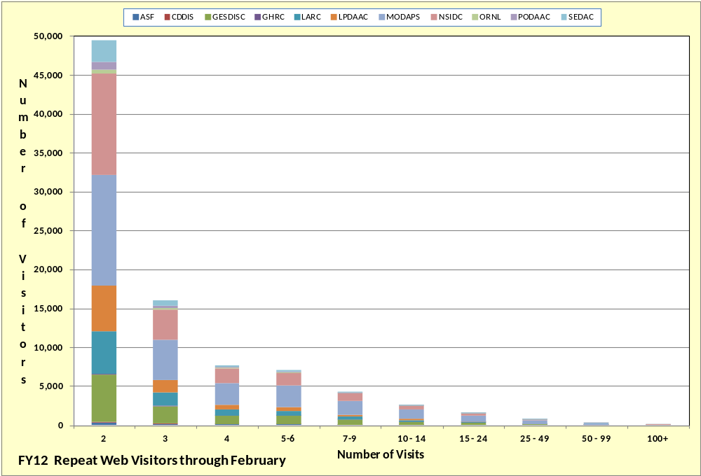
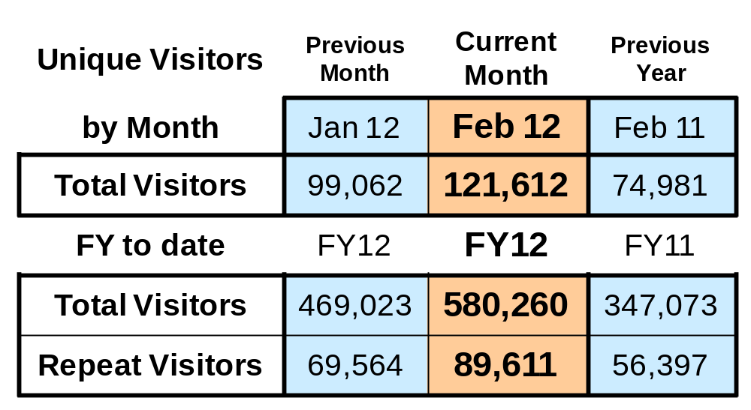
FY2012 Data Center Web Activity – Feb 2012
Notes:
Provides a table of current and past month web visitor totals to the EOSDIS data center web sites, plus a histogram of repeat visitors. Visits with a time duration of “Didn’t stay” (i.e., <1 sec) and “Less than 1 minute” are not counted.
Unique Visitors Table: presents counts of unique visitors for the previous month, current month and previous year of the current month, across all data center web sites. Eleven data centers are included: OBPG web metrics are not yet available; and GHRC does not have metrics data for FY08, CDDIS does not have metrics data before Sept. FY2009
Visitors by Month is a count of the unique visitors for that month.
FY Total Visitors counts unique visitors since the beginning of FY2010. FY Repeat Visitors counts the unique visitors who have returned at least once during the FY – the current months value is broken out in the histogram plot.
Histogram: shows number of repeat unique web visitors since the start of the FY by the number of visits made, metrics for each data center
A “visit” is an interaction, by an individual, with a website consisting of one or more pages. If an individual has not taken another action (typically additional page views) on the site within a specified time period (typically 30 minutes) the visit session will terminate.
11/04/2011: Visitor counts for October 2011 were very high due to many visitors at LP DAAC (received over 85K visitors in Oct. compared with the 5k-7k per month received during FY2011). A content analysis of the LP DAAC site shows the visitors were looking for information or data about the mid October released Version 2 ASTER Global DEM data

