Slide 1
HDF Tools Tutorial
Peter Cao
The HDF Group
The 15th HDF and HDF-EOS Workshop
April 17-19, 2012

Slide 2


Tools Tutorial
HDFView | HDF5 Command-line tools
GUI | Text
Built in Java | Built in C
Separate release | Part of the lib release
HDF4, HDF5, NetCDF, etc. | HDF5 only
Notes:
Hdf4, netcdf, etc.

Slide 3

HDFView

Slide 4
HDFView
The best way to get help
  Call Peter
  Email to Barbara
  Stop by Mike’s office
  All of above
  None of above

Slide 5

HDFView
HDFView

Slide 6
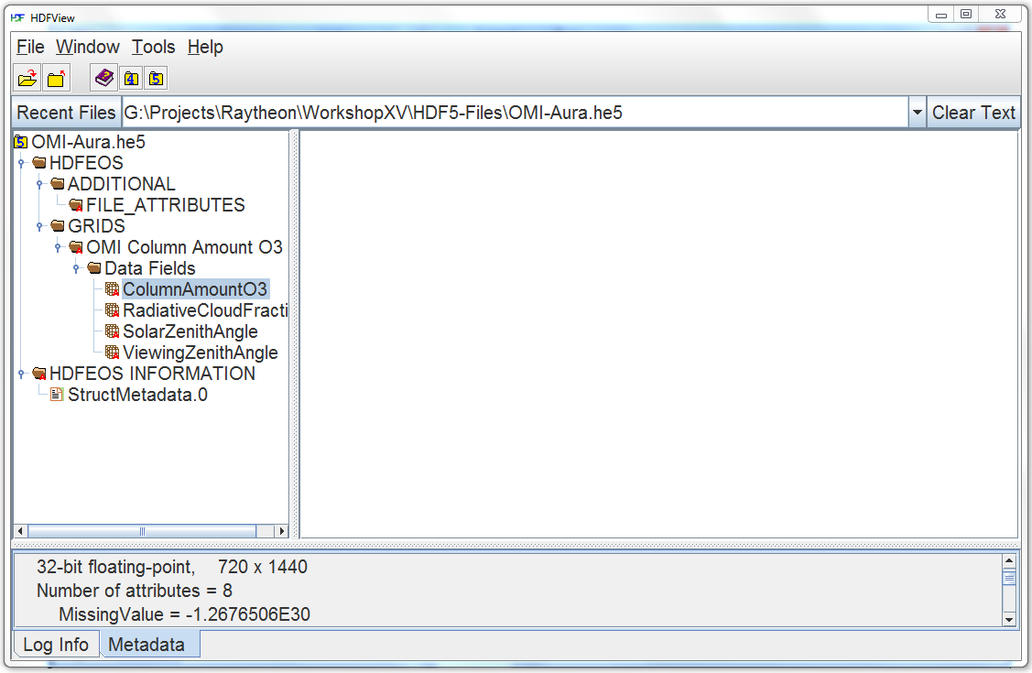
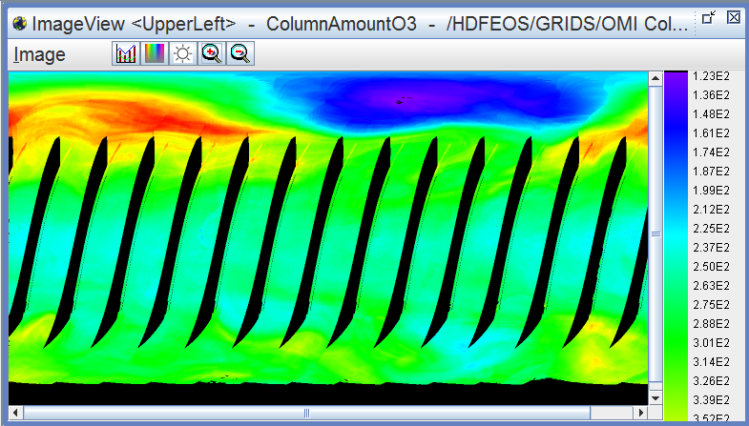
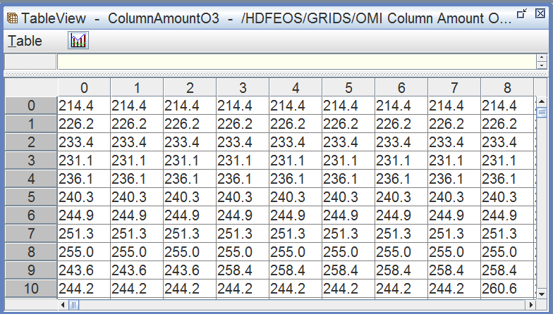
View File Content
File structure
File Content
Metadata and log info.

Slide 7

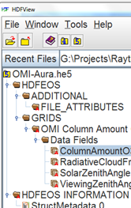
Add/delete, Copy/paste Objects

Slide 8

Add/delete, Copy/paste Objects

Slide 9
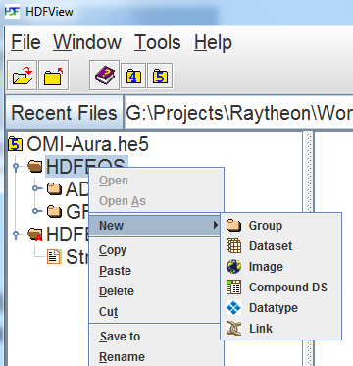
Add/Delete, Copy/Paste Objects

Slide 10
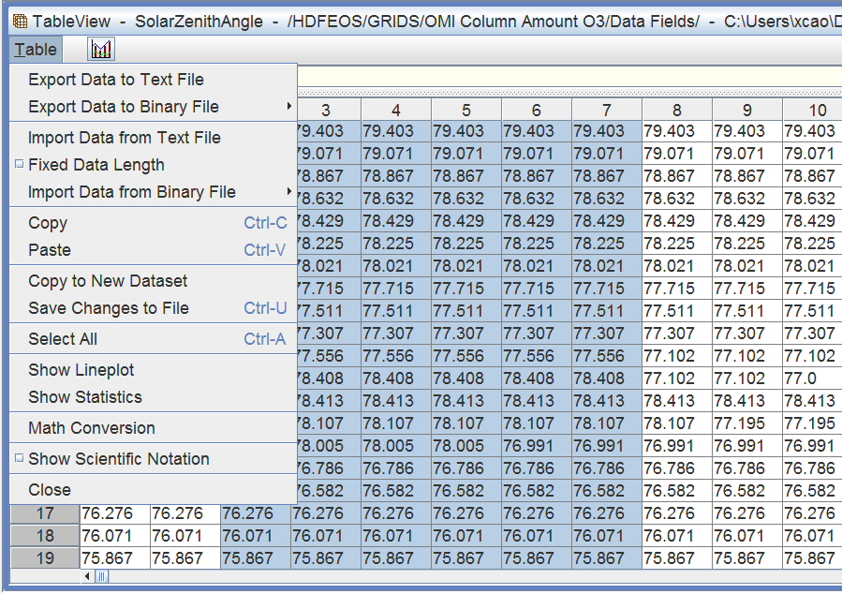
Modify, Copy/Paste Data Values
Notes:
Copy and paste

Slide 11

Modify, Add, Delete Attributes
Notes:
Add general view

Slide 12

Modify, Add, Delete Attributes
Notes:
Add general view

Slide 13
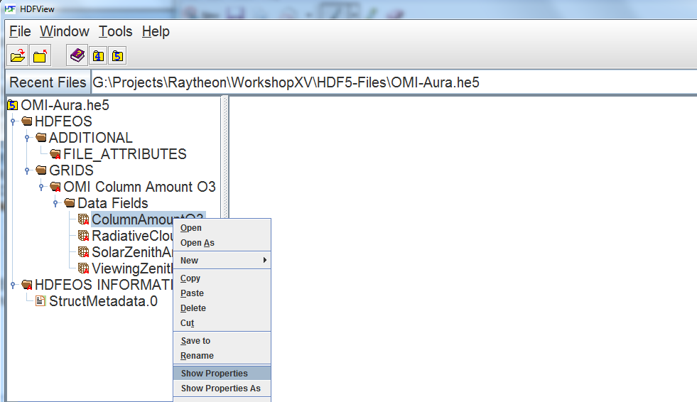
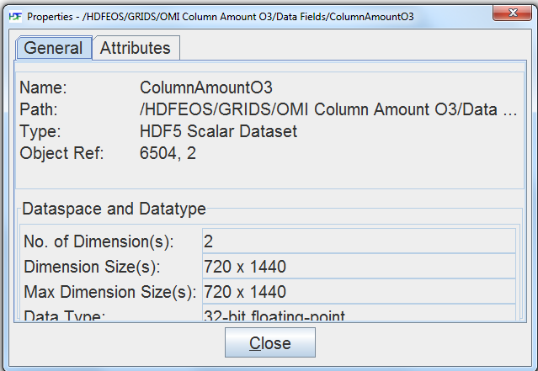
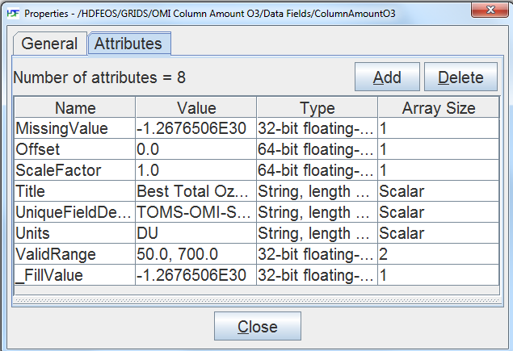
Modify, Add, Delete Attributes
Notes:
Add general view

Slide 14
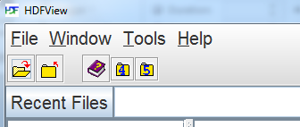
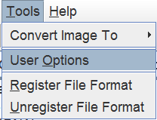
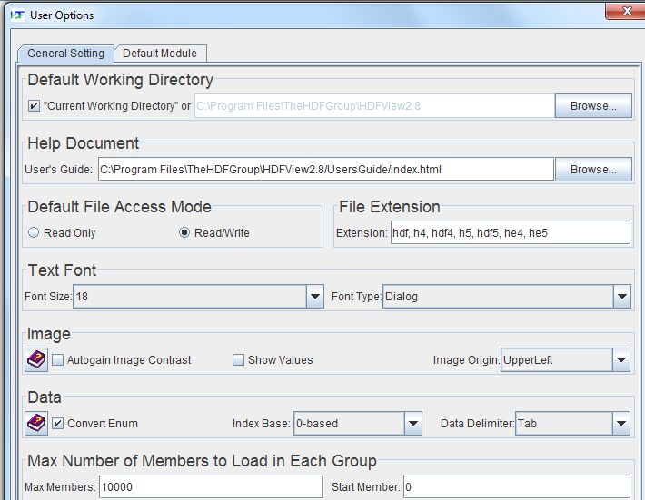

Slide 15
HDFView
View file content
  File structure/metadata
  Data values or Images
Change file content
  Add/delete objects/attributes
  Modify values of datasets or attribute
Import/export
  Image files
  Text files

Slide 16
HDF5 Command-line tools

Slide 17
HDF5 Command-line tools
View or check file content
  h5dump, h5diff, h5ls, h5check, etc.
Change file content or create a new file
  h5repack, h5import, h5jam, h5copy, etc.
Convert between HDF5 and another format
  h4toh5, h5toh4, gif2h5, h52gif, etc.
Notes:
Introduce 4 tools, mention Gerd’s powershell, Dan’s python, and other tools

Slide 18
HDF5 Command-line tools
H5dump
H5repack
H5diff
h5copy
Notes:
Find these are the most useful/used tools

Slide 19
HDF5 Command-line tools
“-h” or “-help”
h5dump -h
HDF5 tools

Slide 20
h5dump
h5dump -H ami.h5
HDF5 "ami.h5" {
GROUP "/" {
GROUP "EnSight_model" {
ATTRIBUTE "description_1" {
DATATYPE H5T_STRING {
STRSIZE 256;
STRPAD H5T_STR_NULLPAD;
CSET H5T_CSET_ASCII;
CTYPE H5T_C_S1;
}
DATASPACE SIMPLE { ( 1 ) / ( 1 ) }
}
….
Notes:
Does not show content of a dataset

Slide 21
h5dump: Dataset Information
H5dump –H -d /EnSight_model/geometry/parts/part_2/quad4 ami.h5
HDF5 "ami.h5" {
DATASET "/EnSight_model/geometry/parts/part_2/quad4" {
DATATYPE H5T_STD_I32LE
DATASPACE SIMPLE { ( 768, 4 ) / ( 768, 4 ) }
}
}

Slide 22
h5dump: Dataset Content
h5dump -d /EnSight_model/geometry/parts/part_2/quad4 ami.h5
HDF5 "ami.h5" {
DATASET "/EnSight_model/geometry/parts/part_2/quad4" {
DATATYPE H5T_STD_I32LE
DATASPACE SIMPLE { ( 768, 4 ) / ( 768, 4 ) }
DATA {
(0,0): 5, 6, 431, 430,
(1,0): 6, 7, 432, 431,
(2,0): 7, 8, 433, 432,
(3,0): 8, 9, 434, 433,
(4,0): 9, 10, 435, 434,
(5,0): 10, 11, 436, 435,
…

Slide 23
h5dump: Data Subset
h5dump -d /EnSight_model/geometry/parts/part_2/quad4 -s 10,0 -c 10,2 ami.h5
HDF5 "ami.h5" {
DATASET "/EnSight_model/geometry/parts/part_2/quad4" {
DATATYPE H5T_STD_I32LE
DATASPACE SIMPLE { ( 768, 4 ) / ( 768, 4 ) }
SUBSET {
START ( 10, 0 );
STRIDE ( 1, 1 );
COUNT ( 10, 2 );
BLOCK ( 1, 1 );
DATA {
(10,0): 15, 16,
(11,0): 16, 17,
(12,0): 17, 18,
(13,0): 18, 19,
(14,0): 19, 20,
}

Slide 24

h5repack
Copies a whole file to a new file
Notes:
A little too many details.

Slide 25
H5repack: Remove Junk Space

Slide 26


H5repack: change the storage layout
2x2 chunks
  h5repack -l CHUNK=16x16 tools_bad_layout.h5 tmp.h5
162x16 chunks

Slide 27
H5repack:Apply compression filter
10 GB
  h5repack -f GZIP=6 tmp.h5 tmp2.h5
1 GB

Slide 28

h5diff
Show differences
between
two files or two objects

Slide 29
H5diff: Two files
  h5diff tools_diff1.h5 tools_diff2.h5

Slide 30
H5diff: Two datasets
  h5diff tools_diff1.h5 tools_diff2.h5 /dset
  h5diff tools_diff1.h5 tools_diff2.h5 /g1/uint8 /dset

Slide 31

h5copy
Copy one or more objects to another file
h5copy -i tools_input.h5 -o tmp.h5 -s /g1/g2/f -d /float
-h
Notes:
One or more objects to another file

Slide 32
Acknowledgements
This work was supported by Subcontract number 114820 under Raytheon Contract number NNG10HP02C, funded by the National Aeronautics and Space Administration (NASA) and by cooperative agreement number NNX08AO77A from the NASA. Any opinions, findings, conclusions, or
recommendations expressed in this material are those of the authors and do not necessarily reflect the views of Raytheon or the National Aeronautics and Space Administration.
Notes:
Mention the updates and other things

