Slide 1
Introduction to HDF5
Barbara Jones
The HDF Group
The 15th HDF and HDF-EOS Workshop
April 17-19, 2012

Slide 2
Foreword
We will be using H5Py – Python interface to HDF5
  Easy to learn
  Saves a lot of time fro prototyping and getting data and metadata out of HDF5 files
  Hides HDF5 complexity
Resources
  http://code.google.com/p/h5py/wiki/HowTo
  http://alfven.org/wp/hdf5-for-python/
Installation requires Python 2.7, NumPy 1.6.1, and HDF5 1.8.3 (or later)

Slide 3
Topics Covered
What HDF5 is
HDF5 Data Model
HDF5 Software and Tools
Introduction to HDF5 APIs
Examples

Slide 4

What is HDF5?
Open file format
  Designed for high volume or complex data
Open source software
  Works with data in the format
A data model
  Structures for data organization and specification

Slide 5
HDF = Hierarchical Data Format
HDF4 is the first HDF
  Originally called HDF; last major release was version 4
HDF5 benefits from lessons learned with HDF4
  Changes to file format, software, and data model
  HDF5 and HDF4 are different
No plans for an HDF6!

Slide 6
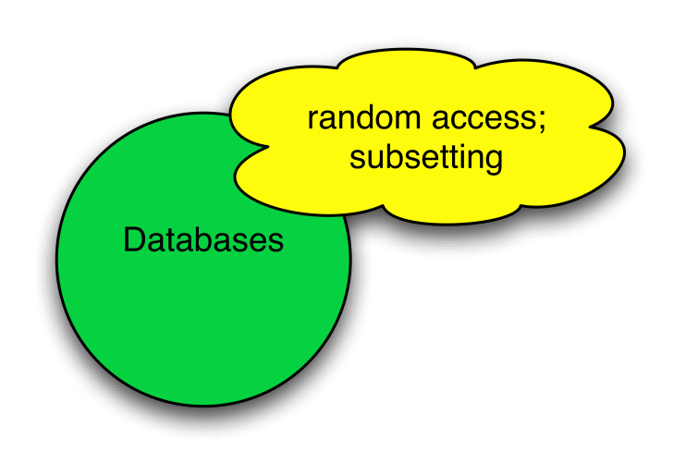
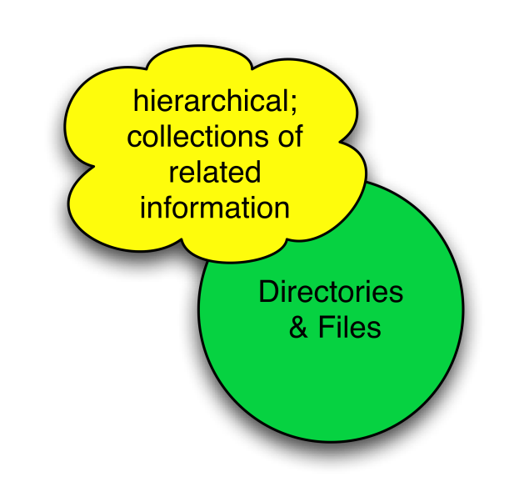
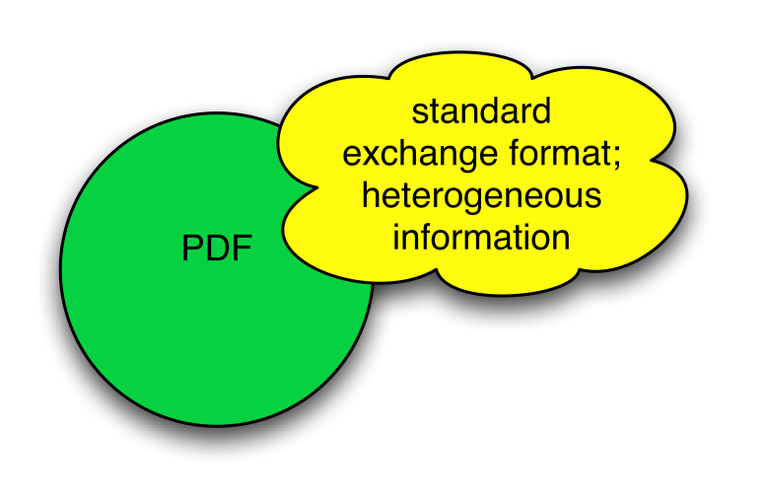
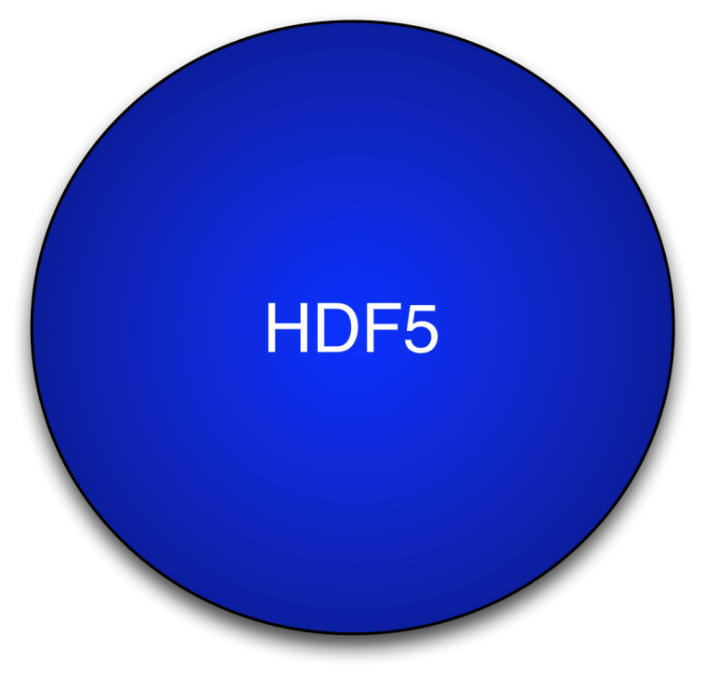
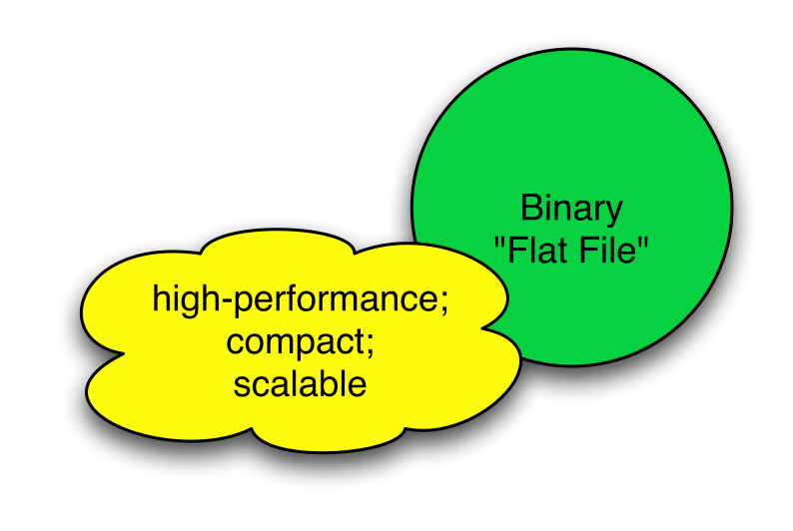
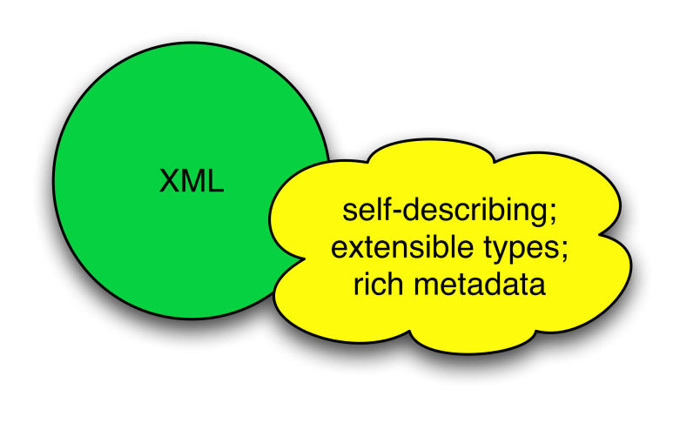
HDF5 has characteristics of …
Notes:
HDF5 has the characteristics of other formats that are out there.
It’s hard to store metadata in a binary flat file and it is not scalable

Slide 7
HDF5 is designed …
for small or high volume and/or complex data
for every size and type of system (portable)
for flexible, efficient storage and I/O
to enable applications to evolve in their use of HDF5 and to accommodate new models
to support long-term data preservation
Use it as a file format tool kit

Slide 8

HDF5 Technology Platform
HDF5 data model
  The “building blocks” for data organization and specification
HDF5 software
  Library, language interfaces, tools
HDF5 file format
  Bit-level organization of HDF5 file
Let’s look at ….

Slide 9

HDF5 Data Model
HDF5
Objects
Dataset
Link
Datatype
Group
Dataspace
Attribute
Property List
File
a.k.a. HDF5 Abstract Data Model
a.k.a. HDF5 Logical Data Model

Slide 10
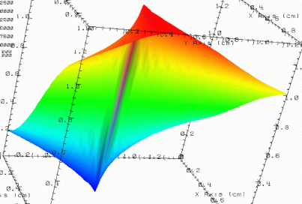



HDF5 File
lat | lon | temp
----|-----|-----
12 | 23 | 3.1
15 | 24 | 4.2
17 | 21 | 3.6
An HDF5 file is a container that holds data objects.
Experiment Notes:
Serial Number: 99378920
Date: 3/13/09
Configuration: Standard 3

Slide 11
HDF5 Dataset
Metadata
Data
Dataspace
Rank
Dimensions
3
Dim_1 = 4
Dim_2 = 5
Dim_3 = 7
Datatype
Integer
(optional)
Attributes
Properties
Time = 32.4
Chunked
Multi-dimensional array of
identically typed data elements
Pressure = 987
Compressed
HDF5 datasets organize and contain “raw data values”.
  HDF5 datatypes describe individual data elements.
  HDF5 dataspaces describe the logical layout of the data elements.
Notes:
11
Data Array is an ordered collection of identically typed data items distinguished by their indices
Metadata:
Dataspace – Rank, dimensions; spatial info about dataset
Datatype – Information on how to interpret your data
Storage Properties – How array is organized
Attributes – User-defined metadata (optional)

Slide 12

HDF5 Dataset & Dataspace
Dim_2 = 5
Dim_3 = 7
Dim_1 = 4
HDF5 Dataspace
Rank
Dimensions
3
Dim_1 = 4
Dim_2 = 5
Dim_3 = 7
Specifications for array dimensions
Multi-dimensional array of
identically typed data elements
HDF5 datasets organize and contain “raw data values”.
  HDF5 dataspaces describe the logical layout of the data elements
Notes:
Dataspace describes “logical” layout and nothing about how it is actually stored on disk. For our purposes we describe dimension 1 as the
Vertical dimension, dimension 2 as the horizontal dimension, and dimension 3 as the depth or number of planes in the dataset.

Slide 13
HDF5 Dataspaces
Describe the logical layout of the elements in an HDF5 dataset
  NULL
    - no elements
  Scalar
    - single element
  Simple array (most common)
  - Multiple elements organized in a rectilinear array:
  Rank = number of dimensions
    Dimension size = number of elements in each dimension
    Maximum number of elements in each dimension can be fixed or unlimited

Slide 14
HDF5 Dataspaces
Two roles:
  Dataspace contains spatial information (logical layout) about a dataset
  stored in a file
    Rank and dimensions
    Permanent part of dataset
    definition
  Partial I/0: Dataspaces describe applications’ data buffers and data elements participating in I/O
Rank = 2
Dimensions = 4x6
Rank = 1
Dimension = 10

Slide 15
HDF5 Dataset & Datatype
HDF5 Datatype
Integer 32bit LE
Specifications for single data
element
Multi-dimensional array of
identically typed data elements
HDF5 datasets organize and contain “raw data values”.
  HDF5 datatypes describe individual data elements.

Slide 16

HDF5 Datatypes
Describe individual data elements in an HDF5 dataset
Wide range of datatypes supported
  Integer (signed and unsigned, 32 and 64-bit, etc.)
  Float
  Variable-length sequence types (e.g., strings)
  Compound (similar to C structs)
  User-defined (e.g., 13-bit integer)
  Nested types
  Pretty much any type!

Slide 17
HDF5 Dataset
3
5
12
Datatype: 32-bit Integer
Dataspace: Rank = 2
Dimensions = 5 x 3

Slide 18
HDF5 Dataset with Compound Datatype
3
5
V
V
V
V V V
V V V
int16
char
int32
2x3x2 array of float32
Compound
Datatype:
Dataspace: Rank = 2, Dimensions = 5 x 3
Notes:
Allows you to store a record of any structure

Slide 19
HDF5 Dataset
Metadata
Data
Dataspace
Rank
Dimensions
3
Dim_1 = 4
Dim_2 = 5
Dim_3 = 7
Datatype
Attributes
(optional)
Integer
Properties
Time = 32.4
Chunked
Multi-dimensional array of
identically typed data elements
Pressure = 987
Compressed
Notes:
19
Data Array is an ordered collection of identically typed data items distinguished by their indices
Metadata:
Dataspace – Rank, dimensions; spatial info about dataset
Datatype – Information on how to interpret your data
Storage Properties – How array is organized
Attributes – User-defined metadata (optional)

Slide 20
HDF5 Property Lists
Property lists allow you to configure or control the behavior of the library.
They provide fine grain control when creating or accessing objects. For example how datasets are stored, performance tuning…
There are default values associated with property lists.

Slide 21
Special Storage Options
Better subsetting access time; extendable
chunked
Improves storage efficiency, transmission speed
compressed
Arrays can be extended in any direction
extendable
File B
Dataset “Fred”
Metadata in one file, raw data in another.
External file
File A
Metadata for Fred
Data for Fred

Slide 22
Dataset Storage Properties
Data elements stored physically adjacent to each other
Contiguous
(default)
Better access time for subsets; extendible
Chunked
Chunked & Compressed
Improves storage efficiency, transmission speed

Slide 23
HDF5 Attributes
Typically contain user metadata
Have a name and a value
Attributes “decorate” HDF5 objects
Value is described by a datatype and a dataspace
  Analogous to a dataset, but do not support partial IO operations; nor can they be compressed or extended

Slide 24

HDF5 Data Model: Are we there yet?
HDF5
Objects
Group
and Link
✓
Attribute
Property List
✓
Dataspace
✓
Datatype
✓
Dataset
✓
File
✓

Slide 25



HDF5 Groups and Links
HDF5 groups
and links
organize
data objects.
Every HDF5 file
has a root group
/
Parameters
10;100;1000
Viz
SimOut
lat | lon | temp
----|-----|-----
12 | 23 | 3.1
15 | 24 | 4.2
17 | 21 | 3.6
Timestep
36,000
Similar to UNIX directories
Notes:
Arrows symbolize the links between objects.

Slide 26
HDF5 Groups
The path to an object defines it
Objects can be shared:
/A/k and /B/m are the same
“/”
C
A
B
temp
m
k
temp
= Group
= Dataset

Slide 27
HDF5 Technology Platform
HDF5 data model
  The “building blocks” for data organization and specification
Let’s look at ….
HDF5 software
  Library, language interfaces, tools

Slide 28
HDF5 Home Page
HDF5 home page: http://hdfgroup.org/HDF5/
  Latest release: HDF5 1.8.8 (1.8.9 coming in May)
HDF5 source code:
  Written in C, and includes optional C++, Fortran 90 APIs, and High Level APIs.
  Contains command-line utilities (h5dump, h5repack, h5diff, ..) and compile scripts
HDF5 pre-built binaries:
  When possible, include C, C++, F90, and High Level libraries. Check ./lib/libhdf5.settings file.
  Built with and require the SZIP and ZLIB external libraries, which are included.

Slide 29
HDF5 API and Applications
Applications
EOS
Application
MATLAB
Domain Data
Objects
EOS
library
…
HDF5 Library
Storage

Slide 30
HDF5 Software Layers & Storage
Tools
…
High Level
APIs
API
h5dump
tool
h5repack
tool
HDFview
tool
Java Interface
HDF5 Library
Language
Interfaces
HDF5 Data Model Objects
Groups, Datasets, Attributes, …
Tunable Properties
Chunk Size, I/O Driver, …
C, Fortran, C++
Internals
Memory Mgmt
Datatype Conversion
Filters
Chunked Storage
Version Compatibility
and so on…
Virtual File Layer
Split Files
Posix I/O
MPI I/O
Custom
I/O Drivers
Storage
HDF5 File Format
File on Parallel Filesystem
?
File
Split
Files
Other

Slide 31
HDF5 File Format
Defined by the HDF5 File Format Specification.
http://www.hdfgroup.org/HDF5/doc/H5.format.html
Specifies the bit-level organization of an HDF5 file on storage media.
HDF5 library adheres to the File Format, so for the most part basic users do not need to know the guts of this information.

Slide 32
Useful Tools For New Users
h5dump:
Tool to “dump” or display contents of HDF5 files
h5cc, h5c++, h5fc:
Scripts to compile applications
HDFView:
Java browser to view HDF4 and HDF5 files
http://www.hdfgroup.org/hdf-java-html/hdfview/

Slide 33
h5dump utility
h5dump [options] [file]
-H, --header Display header only – no data
-d <names> Display specified pathname/dataset(s)
-g <names> Display the specified group(s) and all members
-p Display properties
<names> is one or more appropriate object names.

Slide 34
Example of h5dump Output
HDF5 “my.h5" {
GROUP "/" {
DATASET “mydata" {
DATATYPE { H5T_STD_I32BE }
DATASPACE { SIMPLE ( 4, 6 ) / ( 4, 6 ) }
DATA {
1, 2, 3, 4, 5, 6,
7, 8, 9, 10, 11, 12,
13, 14, 15, 16, 17, 18,
19, 20, 21, 22, 23, 24
}
}
}
}
“/”
mydata
my.h5
Notes:
H5T_STD_I32BE is a pre-defined datatype with encoding to fully interpret the data.

Slide 35
Introduction to
HDF5 Programming Model and APIs

Slide 36
General Programming Paradigm
Object is opened or created
Object is written to or read from, possibly many times
Object is closed
Properties of object are optionally defined
  Creation properties
  Access properties

Slide 37
Order of Operations
An order is imposed on operations by argument dependencies
For Example:
A file must be opened before a dataset
-because-
the dataset open call requires a file handle
as an argument.
Objects can be closed in any order.

Slide 38

The HDF5 API
The API is extensive
  300+ functions
This can be daunting… but there is hope
  A few functions can do a lot
  Start simple
  Build up knowledge as more features are needed
Swiss Army Cybertool 34

Slide 39
HDF5 APIs
Currently C, Fortran 90, C++ and Java bindings supported by The HDF Group
Others:
HDF5DotNet (C#, VB.NET, IronPython,..)
http://hdf5.net/
h5py (Python)
http://code.google.com/p/h5py/
(developed by Andrew Collette)
Notes:
HDF5DotNet does not include all functionality that is in the C library

Slide 40
Language Specific Requirements
For portability, the HDF5 library has its own defined types. For example, hid_t is used for object handles.
Must include language specific files in your application:
C – Add “#include hdf5.h”
F90 - Add “USE HDF5”
Call h5open_f/h5close_f to initialize/close
Fortran interface
C++ - Add “#include H5Cpp.h”
Python - Add “import h5py” / “import numpy”

Slide 41
Example HDF5 Code

Slide 42
Steps to Create a File
1. Specify property lists (or use defaults)
2. Create the file
3. Close the file (and properties if necessary)

Slide 43
Creating an HDF5 File in Python
File Access Flag (create new file)
1. import h5py
2. file = h5py.File ('file.h5', 'w')
3. file.close ()
file.h5
“/” (root)

Slide 44
Creating an HDF5 File In C
1. Specify Include File
#include “hdf5.h”
int main() {
hid_t file_id;
herr_t status;
file_id = H5Fcreate ("file.h5", H5F_ACC_TRUNC,
H5P_DEFAULT, H5P_DEFAULT);
status = H5Fclose (file_id);
}
2. Example of Defined Types
3. File Access Flag
(create new file)
4. To specify default property lists

Slide 45
Creating an HDF5 File in F90
PROGRAM FILEEXAMPLE
USE HDF5
IMPLICIT NONE
CHARACTER(LEN=8), PARAMETER :: filename = "filef.h5" ! File name
INTEGER(HID_T) :: file_id ! File identifier
INTEGER :: error
CALL h5open_f (error)
CALL h5fcreate_f (filename, H5F_ACC_TRUNC_F, file_id, error)
CALL h5fclose_f (file_id, error)
CALL h5close_f (error)
END PROGRAM FILEEXAMPLE
1. Specify HDF5 Module
2. Example of Defined Types
3. Initialize Fortran interface
4. Close Fortran interface

Slide 46
Steps to Create a Dataset
1. Define dataset characteristics
  a) Datatype
  b) Dataspace
  c) Properties (or use default)
Decide where to put it
    Group or root group
3. Create dataset in file
4. Close dataset handle from step 3.

Slide 47
Example: Create a Dataset
dset.h5
“/” (root)
dset
Integer, 4x6

Slide 48
Create a Dataset: h5_crtdat.py
1. import h5py
2. file = h5py.File ('dset.h5', 'w')
3. dataset = file.create_dataset ('dset', (4, 6), 'i')
4. file.close()
Name
Dataspace
(shape)
Datatype
Create Dataset in Root Group
h5py closes the dataset for you

Slide 49
Write To/Read From a Dataset: h5_rdwt.py
1. import h5py
2. import numpy as np
3. file = h5py.File('dset.h5','r+')
4. dataset = file['dset']
5. data = np.zeros((4,6))
6. for i in range(4):
7. for j in range(6):
8. data[i][j]= i*6+j+1
dataset[...] = data
10. data_read = dataset[...]
11. file.close()
Open ‘dset’ in root group
Write buffer to ‘dset’
Read data in ‘dset’ into buffer

Slide 50
How To Write to a Subset of the dataset?
dim2
 |  | 5 | 5 | 5 | 5
 |  | 5 | 5 | 5 | 5
 |  | 5 | 5 | 5 | 5
dim1
dataset[1:4, 2:6] = 5
(instead of using “dataset[…]”)

Slide 51
Read integer into float buffer: h5_readtofloat.py
1. import h5py
2. import numpy as np
3. file = h5py.File('dset.h5','r+')
4. dataset = file['dset']
5. data = np.zeros((4,6))
6. for i in range(4):
7. for j in range(6):
8. data[i][j]= i*6+j+1
9. dataset[...] = data
10. data_read32 = np.zeros((4,6,), dtype=np.float32)
11. dataset.id.read (h5py.h5s.ALL, h5py.h5s.ALL, data_read32, mtype=h5py.h5t.NATIVE_FLOAT)
12. file.close()
Write buffer to integer ‘dset’
Read data in ‘dset’ into
float buffer

Slide 52
Steps to Create a Group
Decide where to put it – “root group” or other group
Define properties or use default
Create the group in file
4. Close the group

Slide 53
Example: Create a Group
“/” (root)
dset
MyGroup
4x6 array of integers
dset.h5

Slide 54
Create a Group: h5_crtgrp.py
1. import h5py
2. file = h5py.File('dset.h5', 'r+')
3. group = file.create_group ('MyGroup')
4. file.close()
Create group ‘MyGroup’ under root group
h5py closes the group for you

Slide 55
Example: Create Attributes
“/” (root)
dset
Attributes:
Units=“Meters per second”
Speed=[100,200]
4x6 array of integers
dset.h5

Slide 56
Create Attributes: h5_crtatt.py
1. import h5py
2. import numpy as np
3. file = h5py.File('dset.h5','r+')
4. dataset = file['/dset']
5. dataset.attrs["Units"] = “Meters per second”
6. attr_data = np.zeros((2,))
7. attr_data[0] = 100
8. attr_data[1] = 200
9. dataset.attrs.create("Speed", attr_data, (2,), “i”)
10. file.close()
Create string attribute
Create integer attribute
Notes:
In step 9, the attr_data in effect is your dataspace

Slide 57
High Level APIs
HDF5 Lite
HDF5 Image
HDF5 Table
HDF5 Dimension Scales
HDF5 Packet Table

Slide 58
HDF5 Tutorial and Examples
HDF5 Tutorial:
  http://www.hdfgroup.org/HDF5/Tutor/
HDF5 Examples:
  http://www.hdfgroup.org/ftp/HDF5/examples/
HDF5 Documentation:
http://www.hdfgroup.org/HDF5/doc/

Slide 59
HDF5 Technology Platform
HDF5 data model
  The “building blocks” for data organization and specification
HDF5 software
  Library, language interfaces, tools
HDF5 file format
  Bit-level organization of HDF5 file
Recall …

Slide 60
Thank You!

Slide 61
Questions/comments?

