Slide 1
Interoperability with netCDF-4
Kent Yang, Larry Knox, Elena Pourmal
The HDF Group
The 15th HDF and HDF-EOS Workshop
April 17-19, 2012
Notes:
Good afternoon. We switch to another topic.. I am Kent Yang. Larry Knox
And me will present this tutorial together. . Both of us come from the HDF group.
In the past 2-3 years, we’ve gained some experience and knowledge in
Making HDF5 interoperable with netCDF, OPeNDAP.
Today we will only share our knowledge and experience regarding the
interoperability with netCDF-4. We will also mention how CF conventions
can affect the final visualization output when using netCDF tools to access
HDF5 data.

Slide 2
Outline
Background
  netCDF-4
  CF
Use cases
Experience with HDF-EOS5 products
Experience with JPSS products
Current Status and future directions

Slide 3
Clarification –netCDF format
netCDF-3 format
  Simple self-describing data format based on netCDF classic data model
netCDF-4 format
  Uses HDF5 as a storage layer
  Exploits
    Compression, chunking, parallel-IO
    Group hierarchy, user-defined data types, etc.
  Supports both netCDF enhanced and netCDF classic data models
Interoperability with netCDF-4 format in this talk

Slide 4
Clarification – netCDF packages
netCDF software packages
  netCDF-C
    Support both netCDF-3 and netCDF-4 formats
    C++/Fortran Wrappers
  netCDF-Java
    Support both netCDF-3 and netCDF-4 formats
    The implementation of the Common Data Model
netCDF version 4
  Generally mean the version 4 package of the netCDF-C library
  (Not only support netCDF-4 format)
Notes:
At the end of the slide, how many people are familiar with netCDF-4?

Slide 5
Why netCDF-4
Big user community
User-friendly data models
Tools
  Home-grown and third-party visualization and analysis tools
  - ncdump, ncgen, IDV, Panoply, Ferret etc.
Notes:
May skip this slide quickly: not mention data model.
Several popular tools that are used widely by Earth Science community.

Slide 6
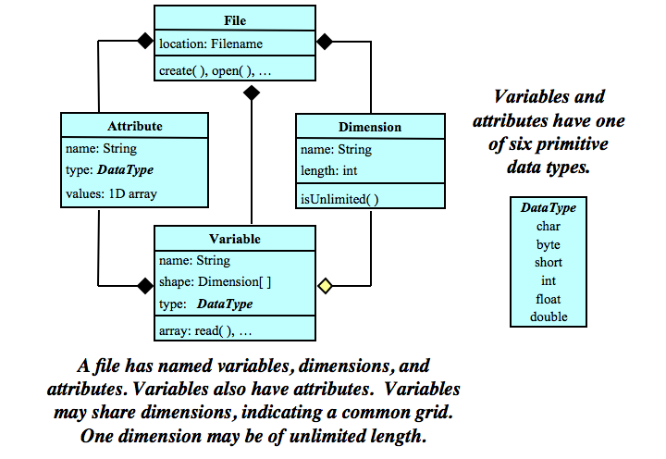
NetCDF Classic Model
Notes:
The shared dimensions can be easily used by Earth Science applications
to specify the coordinate variables.

Slide 7
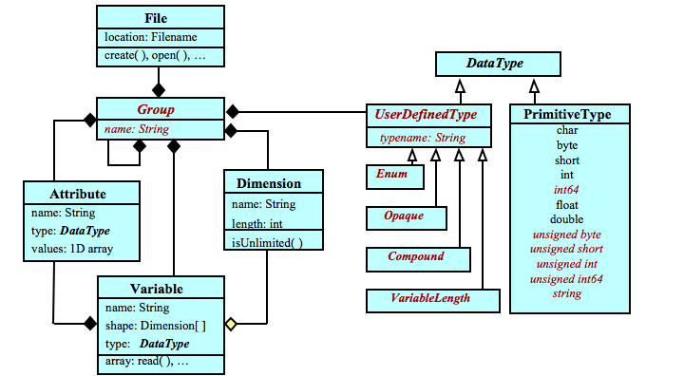
NetCDF enhanced model
Notes:
Group hierarchy and User-defined datatypes are key concepts to add
To the enhanced model.
After this slide, ask the audiences how many people heard of CF conventions,
how many people would like to know how CF attributes can affect
the visualization results.

Slide 8
CF conventions
Metadata conventions for earth science data.
Sharing of files created with the NetCDF APIs, but not specifically to netCDF.
The CF conventions are now increasingly gaining acceptance.
URL: http://cf-pcmdi.llnl.gov/

Slide 9
In this tutorial, we only review the key CF attributes that affect the access of NASA and other Earth Science HDF and HDF-EOS data via popular visualization tools.

Slide 10
Key CF data description attributes
Attribute | Description
Units | A string that represents the quantity of measurement. A variable with no units attribute is assumed to be dimensionless.
long_name | A descriptive name that indicates a variable’s content.
standard_name | A standard name that references a description of a variable’s content in the standard name table of CF conventions.
_FillValue | A value used to represent missing or undefined data.
valid_min | Smallest valid value of a variable.
valid_max | Largest valid value of a variable.
valid_range | Smallest and largest valid values of a variable.
Use these attributes if possible, especially use
_FillValue, valid_min,valid_max if you have missing value(s).
Notes:
May quickly go through this slide if audiences know CF attributes.
_FillVaule only specifies one distinct missing or undefined value.
Using valid_min, valid_max or valid_range multiple distinct missing or
undefined values can be filtered out

Slide 11
Reduction of dataset size
Attribute | Description
scale_factor | If present for a variable, the data are to be multiplied by this factor after the data are read by an application.
add_offset | If present for a variable, this number is to be added to the data after it is read by an application. If both scale_factor and add_offset attributes are present, the data are first scaled before the offset is added.
The equation that describes the usage of scale_factor and add_offset is:
Final_data_value = “scale_factor” * Raw_data_value + “add_offset”;
Notes:
Be careful when using these two attributes. Joe will share with you
MODIS examples.

Slide 12
“Units” for coordinate variables
Horizontal
  Latitude – “degrees_north”
  Longitude – “degrees_east”
Vertical
  Pressure – “hPa”
  Height(depth) – “Meter” (m) or “kilometer”(km)
Time
  seconds(minutes etc.) since a time point
  An example
    “seconds since 1992-10-8 15:15:42.5 -6:00”
Use these attributes with the CF values if possible,
without following CF conventions for these attributes, some
tools cannot properly visualize the data.
Notes:
Also make sure to use the exact format. Some tools are picky.

Slide 13
“coordinates” attribute
List the associated coordinate variable names of the variable
  An example
    Variable: Temperature
      Associated Coordinate variables: “latitude”,“longitude”,”pressure”
      coordinates = “latitude longitude pressure”
Include this attribute if possible. For some data
products, this is the key attribute to specific the
coordinates of a variable.
Notes:
At the end of slides, just mention other CF requirement:
The variable and attribute names can only have number, letter
and underscore. No other characters are allowed.

Slide 14
Interoperability of HDF5 with netCDF-4
General Information

Slide 15
Review Concepts
netCDF classic model
  Shared dimension
netCDF enhanced model
  Group hierarchy

Slide 16
Use cases to access HDF5 via netCDF-4
1. General HDF5
  Follow neither netCDF data models nor CF conventions
2. netCDF-4 HDF5
  Follow netCDF enhanced data model
3. netCDF-4 CF HDF5
  Follow netCDF enhanced model and CF conventions
4. netCDF (classic) HDF5
  Follow netCDF classic model
5. netCDF (classic) CF HDF5
  Follow netCDF classic model and CF conventions

Slide 17
How to demonstrate
Simple HDF5 files
netCDF tools
  netCDF C
    ncdump
  netCDF Java
    IDV

Slide 18
There are some limitations for netCDF4 to access HDF5 files

Slide 19
General HDF5
Add phony dimension names to variables
Generally cannot be opened by IDV
Notes:
HDFView: t_int.h5 ncdump –h t_int.h5 Not working
Tdset.h5 ncdump –h tdset.h5 working

Slide 20
netCDF-4 HDF5
HDF5 that follows netCDF enhanced model
  ncdump can pick up the dimension information
  cannot be opened by IDV

Slide 21
netCDF-4 CF HDF5
HDF5 that follows netCDF enhanced model and CF conventions
  cannot be opened by IDV

Slide 22
We will use several demos to show the differences for the last two cases
  netCDF(classic) HDF5
  netCDF(classic) CF HDF5
ncdump can dump all demo files

Slide 23
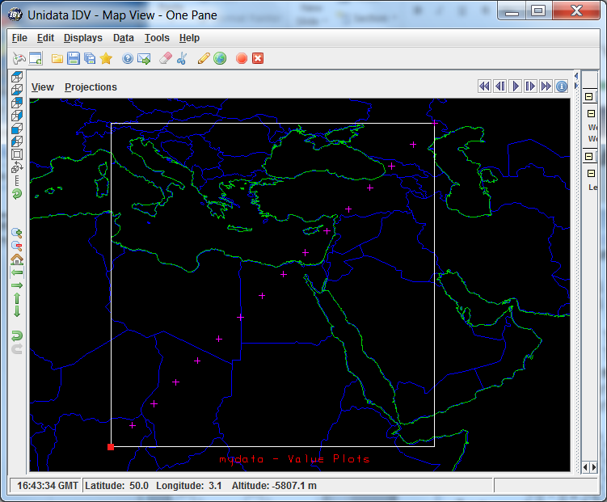
Demo dataset
Latitude/Longitude
10,12.5,15,17.5,20,22.5,
……
42.5, 45.0, 47.5
Data:
1,2,3,4,5,6,7,8,9,10,
11,12,13,14,15,16

Slide 24
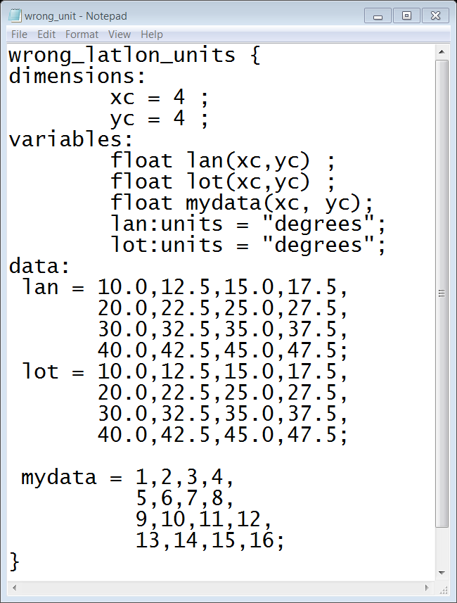
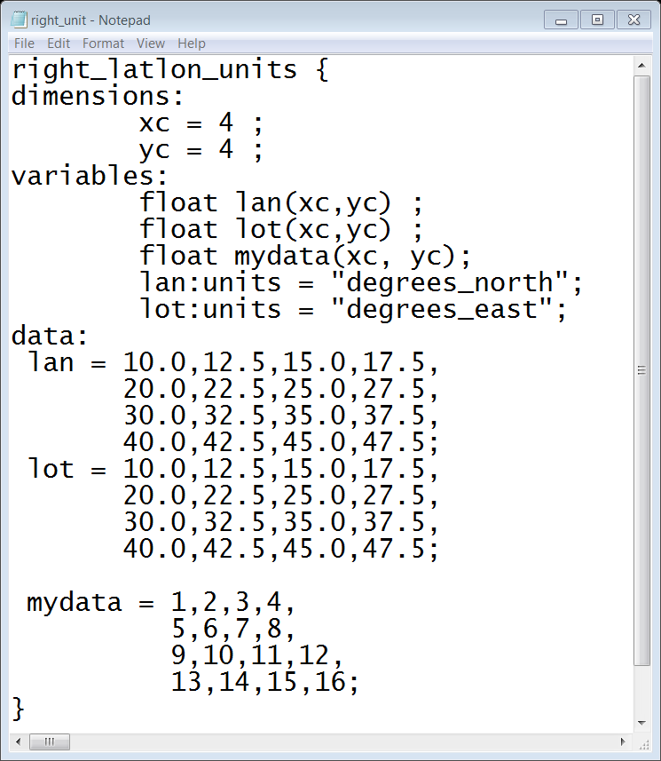

Use case 4 and 5 IDV demo 1
CF category | netCDF classic ( Case 4) | netCDF classic CF (Case 5)
Units for latitude and longitude | Units is “degrees” | Latitude: “degrees_north” Longitude: “degrees_east”
Notes:
Demos:
Lat/Lon: screenshots and IDV demo
Units that don’t follow CF, IDV cannot open the file.
Units that follow CF, IDV can.

Slide 25
Use case 4 and 5 IDV demo 1
CF category | netCDF classic ( Case 4) | netCDF classic CF (Case 5)
Units for latitude and longitude | Cannot open the file | Correctly display the data
Notes:
Demos:
Lat/Lon: screenshots and IDV demo
Units that don’t follow CF, IDV cannot open the file.
Units that follow CF, IDV can.

Slide 26
Use case 4 and 5 IDV demo 2
CF category | netCDF classic (Case 4) | netCDF classic CF (Case 5)
_FillValue | No _FillValue attribute | Have _FillValue
Notes:
Demos:
_FillValue:
1) Use HDFView to show the data,
2) IDV first shows the data without the fillvalue attribute
3) Add _FillValue attribute at HDFView.
Change the HDF5 dataset name to another name.
4) Save the file(not to another HDF5 file)
5) Open with the IDV again, this time the _FillValue is not printed.

Slide 27
Use case 4 and 5 IDV demo 2
CF category | netCDF classic (Case 4) | netCDF classic CF (Case 5)
_FillValue | Treat _FillValue as the real data | Correctly filter out the _FillValue
Notes:
Demos:
_FillValue:
1) Use HDFView to show the data,
2) IDV first shows the data without the fillvalue attribute
3) Add _FillValue attribute at HDFView.
Change the HDF5 dataset name to another name.
4) Save the file(not to another HDF5 file)
5) Open with the IDV again, this time the _FillValue is not printed.

Slide 28

Use case 4 and 5 IDV demo 3
CF category | netCDF classic(Case 4) | netCDF classic CF(Case 5)
scale_factor and add_offset | Attribute names for scale_factor and add_offset don’t follow CF conventions | Have correct scale_factor and add_offset attribute names
scale_factor = 10.0
add_offset = 1000.0
Attributes:
wrong_scale_name = 10.0
Wrong_offset_name = 1000.0
Attributes:
scale_factor = 10.0
add_offset = 1000.0
1,2,3,4,5,6,7,8,9,10,
11,12,13,14,15,16
Scale Offset
1010,1020,1030,
……
Notes:
Demos:
Show the scale factor and add_offset. The initial value and the final
value.
2. Show the wrong attribute name and the right attribute name
3.. Demo:
file with the wrong attribute names(1,2,3…)
file with the right attribute names(1010,1020, etc.)

Slide 29
Use case 4 and 5 IDV demo 3
CF category | netCDF classic(Case 4) | netCDF classic CF(Case 5)
scale_factor and add_offset | Doesn’t apply the scale_factor and add_offset | Correctly apply scale_factor and add_offset
Notes:
Demos:
Show the scale factor and add_offset. The initial value and the final
value.
2. Show the wrong attribute name and the right attribute name
3.. Demo:
file with the wrong attribute names(1,2,3…)
file with the right attribute names(1010,1020, etc.)

Slide 30
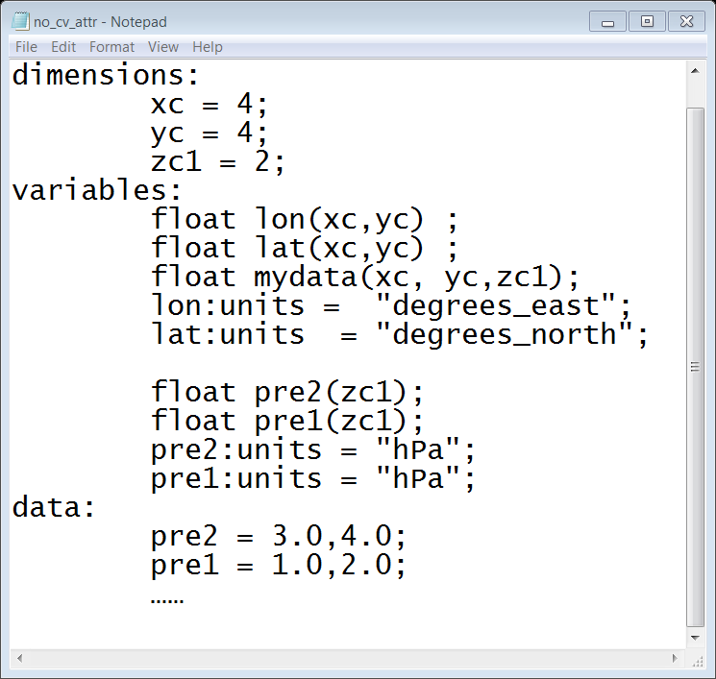
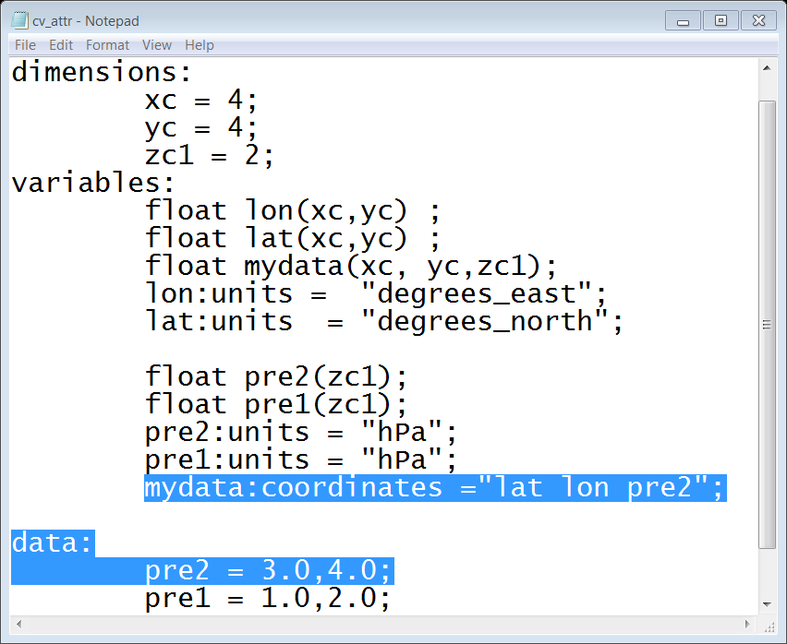
Use case 4 and 5 IDV demo 4
CF category | netCDF classic(Case 4) | netCDF classic CF(Case 5)
coordinates | No ‘coordinates’ attribute | Have ‘coordinates’
Notes:
Demos:
Screenshots:
Let the audience note the “coordinates” attribute.
4. Show IDV, don’t display the value plot(IDV has a bug), just show the
vertical coordinate

Slide 31
Use case 4 and 5 IDV demo 4
CF category | netCDF classic(Case 4) | netCDF classic CF(Case 5)
Coordinates | May not pick up the correct coordinate | Correctly pick up the right coordinate
Notes:
Demos:
Screenshots:
Let the audience note the “coordinates” attribute.
4. Show IDV, don’t display the value plot(IDV has a bug), just show the
vertical coordinate

Slide 32
netCDF HDF5 vs netCDF CF HDF5
CF attributes are key to make IDV
correctly display the data

Slide 33
Summary of use cases
There are some limitations for netCDF4 to access HDF5 files
Use Cases | ncdump | IDV
General HDF5 | Can view (with phony dimensions) | Generally cannot view
netCDF-4 HDF5 | Can view | Generally cannot view
netCDF-4 CF HDF5 | Can view | Generally cannot view
netCDF Classic HDF5 | Can view | Can view some files but the visualization may not be right
netCDF Classic CF HDF5 | Can view | Can view

Slide 34
Interoperability of HDF5 with netCDF-4
Experience with HDF-EOS5

Slide 35
netCDF4 to access HDF-EOS5 files
Augmentation
  One file can be accessed by both EOS5 and netCDF-4
  Accessed by netCDF4
    netCDF data model should be followed
HDF-EOS5
netCDF4
Augmentation
HDF5
HDF5
HDF-EOS5 file

Slide 36
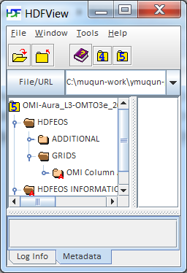


An HDF-EOS5 file structure
HDFEOS
GRIDS
CloudFractionAndPressure
Data Fields
CloudFraction
CloudPressure
Because of the group hierarchy, we can only augment the HDF-EOS5 file by following the netCDF enhanced model
Notes:
The netCDF-4 requires the association of dimensions with coordinate variables.

Slide 37

An example: Augment an HDF-EOS5 Grid
The HDF-EOS5 saves the coordinate information XDim and YDim in an equation
The tool retrieves the values of XDim and YDim
It creates coordinate variables XDim and YDim with the raw values
Then it associates the coordinate variables with the data variables
Then netCDF-4 can follow the netCDF enhanced model to access the HDF-EOS5 data
HDFEOS
GRIDS
CloudFractionAndPressure
Data Fields
CloudFraction[XDim][YDim]
CloudPressure[XDim][YDim]
XDim
YDim

Slide 38
How does the augmented HDF-EOS5 file follow CF conventions?
  The Aura teams(HIRDLS etc.) add key CF attributes when creating the original HDF-EOS5 file.

Slide 39
Use cases to access HDF5 via netCDF-4
1. General HDF5
  Follow neither netCDF data models nor CF conventions
2. netCDF-4 HDF5
  Follow netCDF enhanced data model
3. netCDF-4 CF HDF5
  Follow netCDF enhanced model and CF conventions
4. netCDF (classic) HDF5
  Follow netCDF classic model
5. netCDF (classic) CF HDF5
  Follow netCDF classic model and CF conventions

Slide 40
Interoperability of HDF5 with netCDF-4
Experience with JPSS

Slide 41
Applications for JPSS files
Many potentially useful applications are netCDF based
Structure of JPSS files allows for effective modification – data is separated from objects that are unknown to netCDF-4

Slide 42
JPSS obstacles to using netCDF-4 tools
Limitations of netCDF-4 – HDF5 may have objects unknown to netCDF-4 (Use case 1)
    References
    Multi-dimensional attributes
    Chunked datasets (variables) with unlimited maximum size

Slide 43
JPSS obstacles to using netCDF-4 tools
Limitations of netCDF-4 - objects unknown to netCDF-4
Files are not netCDF Classic Model conformant (Use case 4)
  Group structure
  Important information including dimensions in separate xml file
  Geolocation data in separate file or group

Slide 44
JPSS obstacles to using netCDF-4 tools
Limitations of netCDF-4 - objects unknown to netCDF-4
Not netCDF Classic Model conformant
Key CF Attributes (Use Case 5)
  Latitude Longitude
  Measurement units
  Valid_min valid_max (determined by data type and fill values)
  Scale factors

Slide 45
Modification of JPSS files to overcome obstacles

Slide 46
JPSS file structure
/
/All_Data
VIIRS-M3-SDR_All
Raw data
/Data_Products
VIIRS-M3-SDR
References to raw data
  Groups Datasets

Slide 47
JPSS file structure
  1. Hide problem objects
/
/All_Data
VIIRS-M3-SDR_All
Raw data
/Data_Products
VIIRS-M3-SDR
References to raw data
  Groups Datasets

Slide 48
JPSS file structure
  2. Hide structure that does not conform to Classic Model
/
/All_Data
VIIRS-M3-SDR_All
Raw data
/Data_Products
VIIRS-M3-SDR
References to raw data
  Groups Datasets

Slide 49
JPSS file structure
  3. Import external information from product profiles
/
/All_Data
VIIRS-M3-SDR_All Group
Raw data datasets
Geolocation datasets
Dimension name and length and other attributes from product profiles
/Data_Products
VIIRS-M3-SDR
Reference datasets
  Groups Datasets attributes

Slide 50
Tool for obstacles 1 – 3: H5augjpss
Hides problem objects
Makes structure conform to Classic Model
Imports external information
Files are modified! Copy to preserve original
Final obstacle: CF compliance
Manual additions with HDFView or h5edit

Slide 51
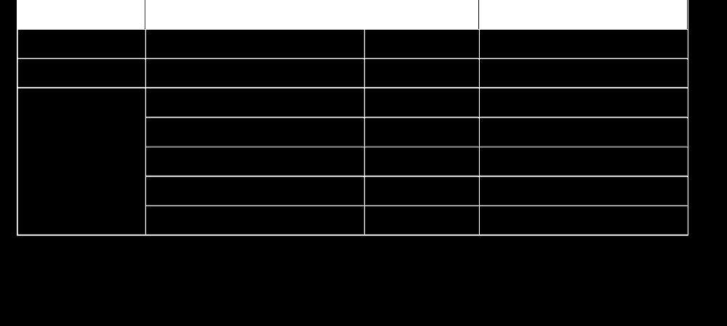
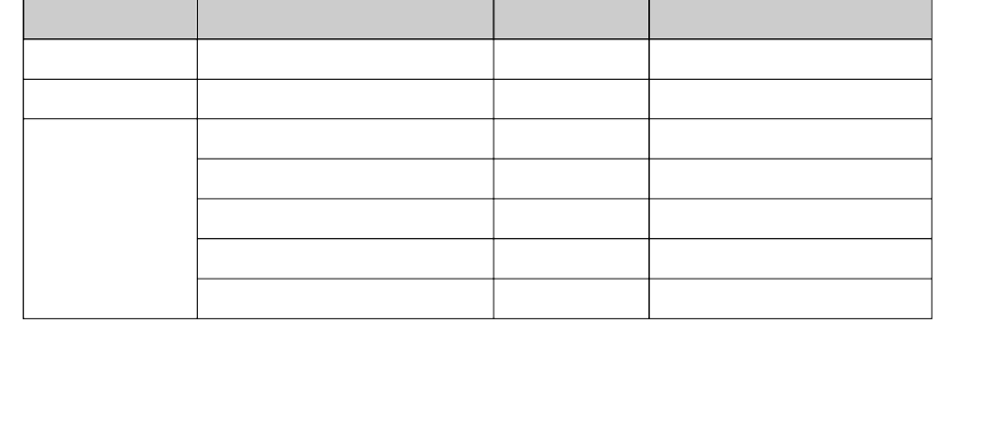
Key CF data description attributes
Variable
Required Attribute
Type
Value
Latitude
Units
string
degrees_north
Longitude
Units
string
degrees_east
Radiance
Coordinates
string
Latitude Longitude
add_offset
float
-
0.08
scale_factor
float
2.8339462E
-
4
valid_min
ushort
0
valid_max
ushort
65527

Slide 52
Summary
Obstacles to making JPSS files readable by netCDF-4 can be addressed by:
hiding file structure and objects unknown to netCDF-4.
importing information to interpret the data from external files.
Product specific information for CF compliance is currently added with HDFView or h5edit.
Unknown objects that are hidden can be unhidden with saved object address. No tool is planned to remove imported data.
.

Slide 53
Interoperability of HDF5 with netCDF-4
Current Status and Future Directions

Slide 54
Current Status
Opportunities for interoperability primarily involve reading HDF5 produced files using netCDF-4 and netCDF-4 based tools.
Issues are periodically identified and some have been solved.

Slide 55
Future Directions
Continue working with Unidata to reduce obstacles to HDF5/netCDF-4 interoperability

Slide 56
Thank You!

Slide 57
Acknowledgements
This work was supported by Subcontract number 114820 under Raytheon Contract number NNG10HP02C, funded by the National Aeronautics and Space Administration (NASA) and by cooperative agreement number NNX08AO77A from the NASA. Any opinions, findings, conclusions, or
recommendations expressed in this material are those of the authors and do not necessarily reflect the views of Raytheon or the National Aeronautics and Space Administration.

Slide 58
Questions/comments?

