Slide 1
HDF5 Advanced Topics
Elena Pourmal
The HDF Group
The 15th HDF and HDF-EOS Workshop
April 17, 2012

Slide 2
Goal
To learn about HDF5 features important for writing portable and efficient applications using H5Py

Slide 3
Outline
Groups and Links
  Types of groups and links
  Discovering objects in an HDF5 file
Datasets
  Datatypes
  Partial I/O
  Other features
    Extensibility
    Compression

Slide 4
Groups and Links

Slide 5
Groups and Links
Groups are containers for links (graph edges)
Links were added in 1.8.0
Warning: Many APIs in H5G interface are obsolete - use H5L interfaces to discover and manipulate file structure

Slide 6





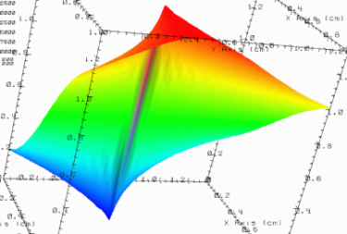
Groups and Links
HDF5 groups
and links
organize
data objects.
Every HDF5 file
has a root group
/
Experiment Notes:
Serial Number: 99378920
Date: 3/13/09
Configuration: Standard 3
Parameters
10;100;1000
Viz
SimOut
lat | lon | temp
----|-----|-----
12 | 23 | 3.1
15 | 24 | 4.2
17 | 21 | 3.6
Timestep
36,000

Slide 7
Example h5_links.py
Different kinds of links
/
links.h5
A
B
dangling
a
soft
a
External
Dataset can be “reached”
using three paths
/A/a
/a
/soft
dset.h5
Dataset is in a different file
Notes:
Example h5_links.py creates a file links.h5 and two groups “A” and “B” in it.
Then it creates a one-dimensional array “a” in group “A”. After the datasets was created a hard link “a” was added to the root group. (It is one dimensional in example and doesn’t have data). Also soft link with the value “/A/a” was added to the root group along with the dangling soft link “dangling”.
External link “External” was added to group B. It points to a dataset “dset” in dset.h5.

Slide 8
Example h5_links.py
Different kinds of links
/
links.h5
A
B
dangling
a
soft
Hard links “A” and “B” were created when groups were created
Hard link “a” was added to the root group and points to an existing dataset
Soft link “soft” points to the existing dataset (cmp. UNIX alias)
Soft link “dangling” doesn’t point to any object

Slide 9
Links
Name
  Example: “A”, “B”, “a”, “dangling”, “soft”
  Unique within a group; “/” are not allowed in names
Type
  Hard Link
    Value is object’s address in a file
    Created automatically when object is created
    Can be added to point to existing object
  Soft Link
    Value is a string , for example, “/A/a”, but can be anything
    Use to create aliases
Notes:
Group A would be created if /A/a path was specified when we created one-dimensional dataset in our example

Slide 10
Links (cont.)
Type
  External Link
    Value is a pair of strings , for example, (“dset.h5”, “dset” )
    Use to access data in other HDF5 files
      Example: For NPP data products geo-location information may be in a separate file

Slide 11
Links Properties
Links Properties
  ASCII or UTF-8 encoding for names
  Create intermediate groups
    Saves programming effort
C example
  lcpl_id = H5Pcreate(H5P_LINK_CREATE);
  H5Gcreate (fid, "A/B", lcpl_id, H5P_DEFAULT, H5P_DEFAULT);
Group “A” will be created if it doesn’t exist
Notes:
Group A would be created if /A/a path was specified when we created one-dimensional dataset in our example

Slide 12
Operations on Links
See H5L interface in Reference Manual
Create
Delete
Copy
Iterate
Check if exists
Notes:
Our example creates hard, soft and external links; it deletes dangling link; it copies hard link to a

Slide 13
Operations on Links
APIs available for C and Fortran
Use dictionary operations in Python
Objects associated with links ARE NOT affected
  Deleting a link removes a path to the object
  Copying a link doesn’t copy an object
Notes:
Our example creates hard, soft and external links; it deletes dangling link; it copies hard link to a

Slide 14
Example h5_links.py
Link a in A is removed
/
links.h5
A
B
dangling
a
soft
External
Dataset can be “reached”
using one paths
/a
dset.h5
Dataset is in a different file
Notes:
When link a in A is removed dataset can be reached using path /a, soft link becomes dangling

Slide 15
Example h5_links.py
Link a in root is removed
/
links.h5
A
B
dangling
soft
External
dset.h5
Dataset is unreachable
Dataset is in a different file
Notes:
When link a in the root group is removed, dataset with graph becomes unreachable; soft link cannot be resolved without a “real” path

Slide 16
Groups Properties
Creation properties
  Type of links storage
    Compact (in 1.8.* versions)
      Used with a few members (default under 8)
    Dense (default behavior)
      Used with many (>16) members (default)
    Tunable size for a local heap
      Save space by providing estimate for size of the storage required for links names
    Can be compressed (in 1.8.5 and later)
      Many links with similar names (XXX-abc, XXX-d, XXX-efgh, etc.)
      Requires more time to compress/uncompress data

Slide 17
Groups Properties
Creation properties
  Links may have creation order tracked and indexed
    Indexing by name (default)
      A, B, a, dangling, soft
    Indexing by creation order (has to be enabled)
      A, B, a, soft, dangling
http://www.hdfgroup.org/ftp/HDF5/examples/examples-by-api/api18-c.html

Slide 18
Discovering HDF5 file’s structure
HDF5 provides C and Fortran 2003 APIs for recursive and non-recursive iterations over the groups and attributes
  H5Ovisit and H5Literate (H5Giterate)
  H5Aiterate
Life is much easier with H5Py (h5_visita.py)
import h5py
def print_info(name, obj):
print name
for name, value in obj.attrs.iteritems():
print name+":", value
f = h5py.File('GATMO-SATMS-npp.h5', 'r+')
f.visititems(print_info)
f.close()
Notes:
Example shows how to print paths to all objects in the NPP file and names and values of attributes for each object.

Slide 19
Checking a path in HDF5
HDF5 1.8.8 provides HL C and Fortran 2003 APIs for checking if paths exists
  H5LTvalid_path (h5ltvalid_path_f)
  Example: Is there an object with a path /A/B/C/d ?
  TRUE if there is a path, FALSE otherwise
Notes:
Example shows how to print paths to all objects in the NPP file and names and values of attributes for each object.

Slide 20
Hints
Use latest file format (see H5Pset_libver_bound function in RM)
  Save space when creating a lot of groups in a file
  Save time when accessing many objects (>1000)
Caution: Tools built with the HDF5 versions prirt to 1.8.0 will not work on the files created with this property

Slide 21
Datasets

Slide 22
HDF5 Datatypes

Slide 23
HDF5 Datatypes
Integer and floating point
String
Compound
  Similar to C structures or Fortran Derived Types
Array
References
Variable-length
Enum
Opaque

Slide 24
HDF5 Datatypes
Datatype descriptions
  Are stored in the HDF5 file with the data
  Include encoding (e.g., byte order, size, and floating point representation) and other information to assure portability across platforms
See C, Fortran, MATLAB and Java examples under
  http://www.hdfgroup.org/ftp/HDF5/examples/
Notes:
Portability: insures endianess conversion, size conversion, structures portability, etc.

Slide 25
Data Portability in HDF5
Array of integers on Intel platform
int is little-endian, 4 bytes
Array of long integers on SPARC64 platform
long is big-endian, 8 bytes
int
long
H5Dwrite
conversion
H5Dread
H5T_STD_I32LE

Slide 26
Data Portability in HDF5 (cont.)
We use native integer type to describe data in a file
dset = H5Dcreate(file,NAME,H5T_NATIVE_INT,…
Description of data in a buffer
H5Dwrite(dset,H5T_NATIVE_INT,…,buf);
H5Dread(dset,H5T_NATIVE_LONG,…, buf);
Description of data in a buffer; library will perform
Conversion from 4 byte LE to 8 byte BE integer
Notes:
Failure to describe correctly memory buffer or to provide “unconvertible” type will result in wrong data read/written

Slide 27
Hints
Avoid datatype conversion if possible
Store necessary precision to save space in a file
  Starting with HDF5 1.8.7, Fortran APIs support different kinds of integers and floats (if Fortran 2003 feature is enabled)

Slide 28
HDF5 Strings

Slide 29
HDF5 Strings
Fixed length
  Data elements has to have the same size
  Short strings will use more byte than needed
  Application responsible for providing buffers of the correct size on read
Variable length
  Data elements may not have the same size
  Writing/reading strings is “easy”; library handles memory allocations

Slide 30
HDF5 Strings – Fixed-length
Example h5_string.py(c,f90)
fixed_string = np.dtype('a10')
dataset = file.create_dataset("DSfixed",(4,), dtype=fixed_string)
data = ("Parting", ".is such", ".sweet", ".sorrow...")
dataset[...] = data
Stores fours strings “Parting", ” .is such", ” .sweet", ”.sorrow…” in a dataset.
Strings have length 10
Python uses NULL padded strings (default)

Slide 31
HDF5 Strings
Example h5_vlstring.py(c,f90)
str_type = h5py.new_vlen(str)
dataset = file.create_dataset("DSvariable",(4,), dtype=str_type)
data = ("Parting", " is such", " sweet", " sorrow...")
dataset[...] = data
Stores fours strings “Parting", ” is such", ” sweet", ”sorrow…” in a dataset.
Strings have length 7, 8, 6, 10

Slide 32
Hints
Fixed length strings
  Can be compressed
  Use when need to store a lot of strings
Variable-length strings
  Compression cannot be applied to data
  Use for attributes and a few strings if space is a concern

Slide 33
HDF5 Compound Datatypes

Slide 34
HDF5 Compound Datatypes
Compound types
  Comparable to C structures or Fortran 90 Derived Types
  Members can be of any datatype
  Data elements can written/read by a single field or a set of fields

Slide 35
Creating and Writing Compound Dataset
Example h5_compound.py(c,f90)
Stores four records in the dataset
Orbit integer | Location string | Temperature (F) 64-bit float | Pressure (inHg) 64-bit-float
1153 | Sun | 53.23 | 24.57
1184 | Moon | 55.12 | 22.95
1027 | Venus | 103.55 | 31.33
1313 | Mars | 1252.89 | 84.11

Slide 36
Creating and Writing Compound Dataset
comp_type = np.dtype([('Orbit’,'i'),('Location’,np.str_, 6), ….)
dataset = file.create_dataset("DSC",(4,), comp_type)
dataset[...] = data
Note for C and Fortran2003 users:
You’ll need to construct memory and file datatypes
Use HOFFSET macro instead of calculating offset by hand.
Order of H5Tinsert calls is not important if HOFFSET is used.

Slide 37
Reading Compound Dataset
f = h5py.File('compound.h5', 'r')
dataset = f ["DSC"]
….
orbit = dataset['Orbit']
print "Orbit: ", orbit
data = dataset[...]
print data
….
print dataset[2, 'Location']

Slide 38
Fortran 2003
HDF5 Fortran library 1.8.8 with Fortran 2003 enabled has the same capabilities for writing derived types as C library
  H5OFFSET function
  No need to write/read by fields as before

Slide 39
Hints
When to use compound datatypes?
  Application needs access to the whole record
When not to use compound datatypes?
  Application needs access to specific fields often
    Store the field in a dataset
/
/
Orbit
Pressure
DSC
Location
Temperature

Slide 40
HDF5 Reference Datatypes

Slide 41
References to Objects and Dataset Regions
/
Viz
Test Data
Group
Image 2…..
Image 3…..
.
References to HDF5
Objects
References to dataset regions
.

Slide 42
Reference Datatypes
Object Reference
  Unique identifier of an object in a file
  HDF5 predefined datatype H5T_STD_REG_OBJ
Dataset Region Reference
  Unique identifier to a dataset + dataspace selection
  HDF5 predefined datatype H5T_STD_REF_DSETREG

Slide 43
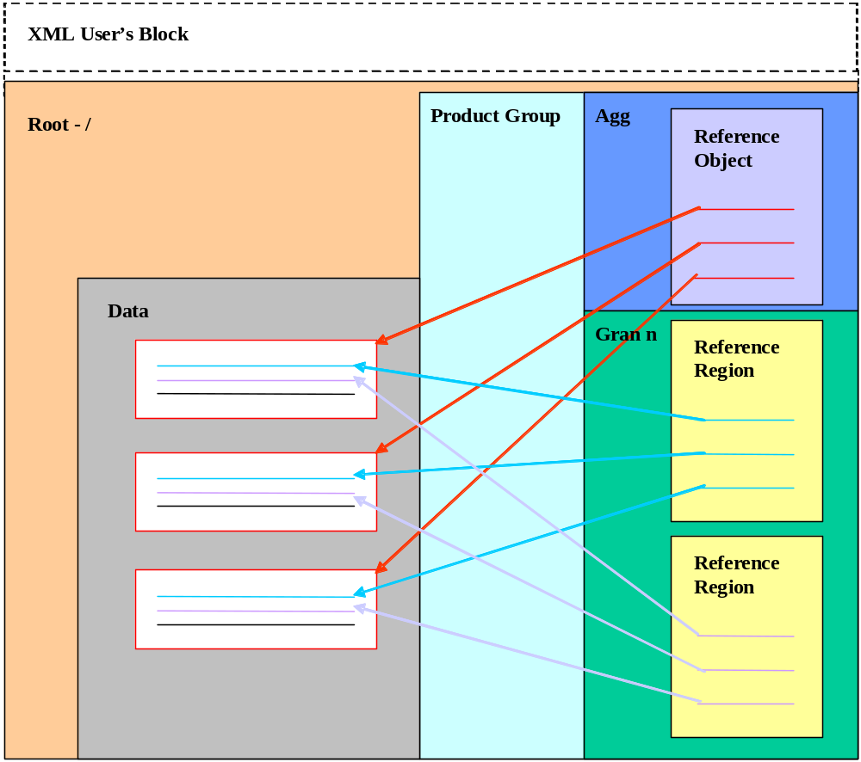
Conceptual view of HDF5 NPP file
Notes:
This slide is from HDFand HDF-EOS Workshop IX, Kim Tomashosky “NPOESS Product Delivery in HDF”

Slide 44
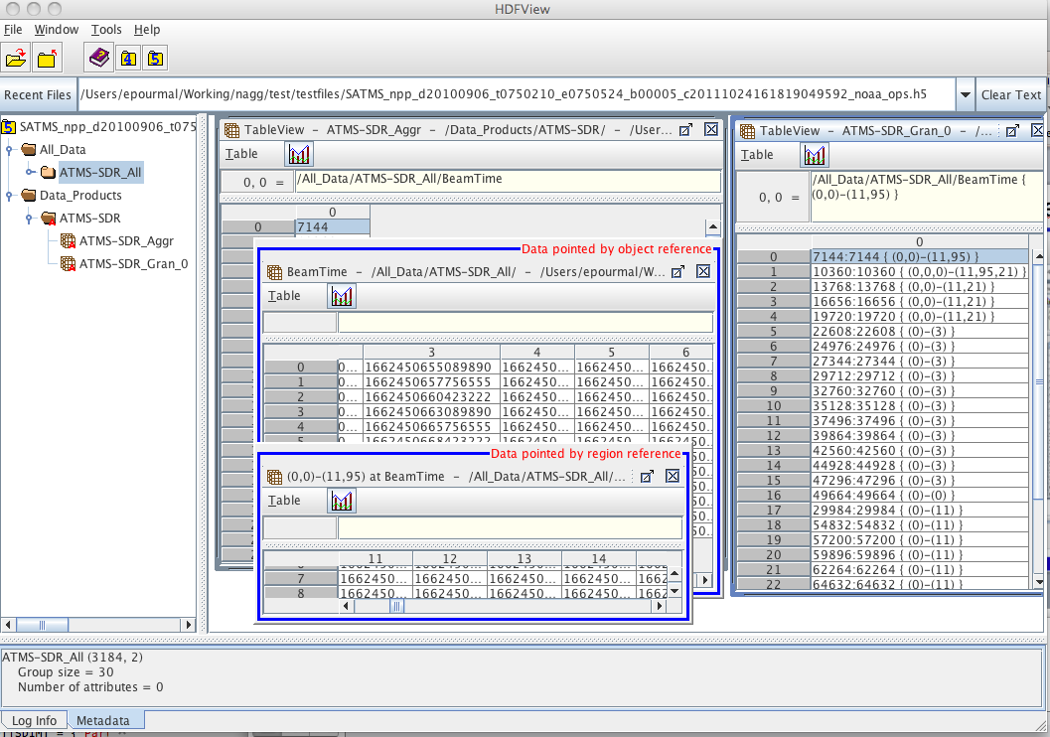
NPP HDF5 file in HDFView

Slide 45
HDF5 Object References
h5_objref.py (c,f90)
Creates a dataset with object references
group = f.create_group("G1") Scalar dataspace
dataset = f.create_dataset("DS2",(), 'i')
# Create object references to a group and a dataset
refs = (group.ref, dataset.ref)
ref_type = h5py.h5t.special_dtype(ref=h5py.Reference)
dataset_ref = file.create_dataset("DS1", (2,),ref_type)
dataset_ref[...] = refs

Slide 46
HDF5 Object References (cont.)
h5_objref.py (c,f90)
Finding the object a reference points to:
f = h5py.File('objref.h5','r')
dataset_ref = f["DS1"]
print h5py.h5t.check_dtype(ref=dataset_ref.dtype)
refs = dataset_ref[...]
refs_list = list(refs)
for obj in refs_list:
  print f[obj]

Slide 47
HDF5 Dataset Region References
h5_regref.py (c,f90)
Creates a dataset with region references to each
row in a dataset
refs = (dataset.regionref[0,:],…,dataset.regionref[2,:])
ref_type = h5py.h5t.special_dtype(ref=h5py.RegionReference)
dataset_ref = file.create_dataset("DS1", (3,),ref_type)
dataset_ref[...] = refs

Slide 48
HDF5 Dataset Region References (cont.)
h5_regref.py (c,f90)
Finding a dataset and a data region pointed by a
region reference
path_name = f[regref].name
print path_name
# Open the dataset using the pathname we just found
data = file[path_name]
# Region reference can be used as a slicing argument!
print data[regref]

Slide 49
Hints
When to use HDF5 object references?
  Instead of an attribute with a lot of data
    Create an attribute of the object reference type and point to a dataset with the data
  In a dataset to point to related objects in HDF5 file
When to use HDF5 region references?
  In datasets and attributes to point to a region of interest
  When accessing the same region many times to avoid hyperslab selection process

Slide 50
Partial I/O
Working with subsets

Slide 51




Collect data one way ….
Array of images (3D)

Slide 52
Display data another way …
Stitched image (2D array)

Slide 53

Data is too big to read….

Slide 54
How to Describe a Subset in HDF5?
Before writing and reading a subset of data one has to describe it to the HDF5 Library.
HDF5 APIs and documentation refer to a subset as a “selection” or “hyperslab selection”.
If specified, HDF5 Library will perform I/O on a selection only and not on all elements of a dataset.

Slide 55
Types of Selections in HDF5
Two types of selections
  Hyperslab selection
    Regular hyperslab
    Simple hyperslab
    Result of set operations on hyperslabs (union, difference, …)
  Point selection
Hyperslab selection is especially important for doing parallel I/O in HDF5 (See Parallel HDF5 Tutorial)

Slide 56
Regular Hyperslab
Collection of regularly spaced equal size blocks

Slide 57
Simple Hyperslab
Contiguous subset or sub-array

Slide 58
Hyperslab Selection
Result of union operation on three simple hyperslabs

Slide 59
Hyperslab Description
Start - starting location of a hyperslab (1,1)
Stride - number of elements that separate each block (3,2)
Count - number of blocks (2,6)
Block - block size (2,1)
Everything is “measured” in number of elements

Slide 60
Simple Hyperslab Description
Two ways to describe a simple hyperslab
As several blocks
  Stride – (1,1)
  Count – (3,4)
  Block – (1,1)
As one block
  Stride – (1,1)
  Count – (1,1)
  Block – (3,4)
No performance penalty for
one way or another

Slide 61
Writing and Reading a Hyperslab
Example h5_hype.py(c, f90)
  Creates 8x10 integer dataset and populates with data; writes a simple hyperslab (3x4) starting at offset (1,2)
  H5Py uses NumPy indexing to specify a hyperslab
    Numpy indexing array[i : j : k]
    i – the starting index; j – the stopping index; k – is the step (≠ 0)
  dataset[1:4, 2:6]
  offset count+offset

Slide 62
Writing and Reading Simple Hyperslab
dataset[1:4, 2:6] = 5
print "Data after selection is written:"
print dataset[...]
[[1 1 1 1 1 2 2 2 2 2]
[1 1 5 5 5 5 2 2 2 2]
[1 1 5 5 5 5 2 2 2 2]
[1 1 5 5 5 5 2 2 2 2]
[1 1 1 1 1 2 2 2 2 2]
[1 1 1 1 1 2 2 2 2 2]
[1 1 1 1 1 2 2 2 2 2]
[1 1 1 1 1 2 2 2 2 2]]

Slide 63
Writing and Reading Regular Hyperslab
space_id = dataset.id.get_space()
space_id.select_hyperslab((1,1), (2,2), stride=(4,4), block=(2,2))
dataset.id.read(space_id, space_id, data_selected)
print data_selected
Selected data read from file....
[[0 0 0 0 0 0 0 0 0 0]
[0 1 5 0 0 5 2 0 0 0]
[0 1 5 0 0 5 2 0 0 0]
[0 0 0 0 0 0 0 0 0 0]
[0 0 0 0 0 0 0 0 0 0]
[0 1 1 0 0 2 2 0 0 0]
[0 1 1 0 0 2 2 0 0 0]
[0 0 0 0 0 0 0 0 0 0]]

Slide 64
Writing and Reading Point Selection
Example h5_selecelem.py(c, f90)
  Creates 2 integer datasets and populates with data; writes a point selection at locations (0,1) and (0, 3)
  H5Py uses NumPy indexing to specify points in array
val = (55,59)
dataset2[0, [1,3]] = val
[[ 1 55 1 59]
[ 1 1 1 1]
[ 1 1 1 1]]

Slide 65
Hints
C and Fortran
  Applications’ memory grows with the number of open handles.
  Don’t keep dataspace handles open if unnecessary, e.g., when reading hyperslab in a loop.
  Make sure that selection in a file has the same number of elements as selection in memory when doing partial I/O.

Slide 66
Other Features
Storage, Extendibility, Compression

Slide 67
Dataset Storage Options
Compact
  Used for storing small (a few Ks) data
Contiguous (default)
  Used for accessing contiguous subsets of data
Chunked
  Data is store in chunks of predefined size
  Used when:
    Appending data
    Compressing data
    Accessing non-contiguous data (e.g., columns)

Slide 68
HDF5 Dataset
Metadata
Dataset data
Dataspace
Rank
Dimensions
3
Dim_1 = 4
Dim_2 = 5
Dim_3 = 7
Datatype
IEEE 32-bit float
Attributes
Storage info
Time = 32.4
Chunked
Pressure = 987
Compressed
Temp = 56

Slide 69
Examples of Data Storage
Compact
Metadata
Raw data
Chunked
Contiguous

Slide 70
Extending HDF5 dataset
Example h5_unlim.py(c,f90)
Creates a dataset and appends rows and columns
  Dataset has to be chunked
  Chunk sizes do not need to be factors of the dimension sizes
dataset = f.create_dataset('DS1',(4,7),'i',chunks=(3,3), maxshape=(None, None))
0 0 0 0 0 0 0 0 0
0 0 0 0 0 0 0 0 0
0 0 0 0 0 0 0 0 0
0 0 0 0 0 0 0 0 0
0 0 0 0 0 0 0 0 0
0 0 0 0 0 0 0 0 0

Slide 71
Extending HDF5 dataset
Example h5_unlim.py(c,f90)
dataset.resize((6,7))
dataset[4:6] = 1
dataset.resize((6,10))
dataset[:,7:10] = 2
0 0 0 0 0 0 0 2 2 2
0 0 0 0 0 0 0 2 2 2
0 0 0 0 0 0 0 2 2 2
0 0 0 0 0 0 0 2 2 2
1 1 1 1 1 1 1 2 2 2
1 1 1 1 1 1 1 2 2 2

Slide 72
HDF5 compression
Chunking is required for compression and other filters
HDF5 filters modify data during I/O operations
Compression filters in HDF5
  Scale + offset (H5Pset_scaleoffset)
  N-bit (H5Pset_nbit)
  GZIP (deflate) (H5Pset_deflate)
  SZIP (H5Pset_szip)

Slide 73
HDF5 Third-Party Filters
Compression methods supported by HDF5 User’s community
  http://www.hdfgroup.org/services/contributions.html
  LZF lossless compression (H5Py)
  BZIP2 lossless compression (PyTables)
  BLOSC lossless compression (PyTables)
  LZO lossless compression (PyTables)
  MAFISC - Modified LZMA compression filter, (Multidimensional Adaptive Filtering Improved Scientific data Compression)

Slide 74
Compressing HDF5 dataset
Example h5_gzip.py(c,f90)
Creates compressed dataset using GZIP compression with effort level 9
  Dataset has to be chunked
  Write/read/subset as for contiguous (no special steps are needed)
dataset = f.create_dataset('DS1',(32,64),'i',chunks=(4,8),compression='gzip',compression_opts=9)
dataset[…] = data

Slide 75
Hints
Do not make chunk sizes too small (e.g., 1x1)!
  Metadata overhead for each chunk (file space)
  Each chunk is read at once
    Many small reads are inefficient
Some software (H5Py, netCDF-4) may pick up chunk size for you; may not be what you need
  Example: Modify h5_gzip.py to use
  dataset = file.create_dataset('DS1',(32,64),'i',compression='gzip',compression_opts=9)
  Run h5dump –p –H gzip.h5 to check chunk size

Slide 76
More Information
More detailed information on chunking can be found in the “Chunking in HDF5” document at:
http://www.hdfgroup.org/HDF5/doc/Advanced/Chunking/index.html

Slide 77
Thank You!

Slide 78
Acknowledgements
This work was supported by cooperative agreement number NNX08AO77A from the National Aeronautics and Space Administration (NASA).
Any opinions, findings, conclusions, or recommendations expressed in this material are those of the author[s] and do not necessarily reflect the views of the National Aeronautics and Space Administration.

Slide 79
Questions/comments?

