Slide 1
Improving long-term preservation of EOS data by independently mapping HDF4 data objects
Mike Folk, Ruth Aydt, Joe Lee, Binh-Minh Ribler, Kent Yang
Ruth Duerr, Christopher Lynnes
The 14th HDF and HDF-EOS Workshop
September 28-30, 2010

Slide 2
Mapping project team members
The HDF Group
NASA
Ruth Aydt
Peter Cao
Mike Folk
Joe Lee
Elena Pourmal
Tong Qi
Binh-Minh Ribler
Eunsoo Seo
Veer Singh
Muqun {Kent} Yang
Ruth Duerr (NSIDC)
Chris Lynnes (GES-DISC)

Slide 3
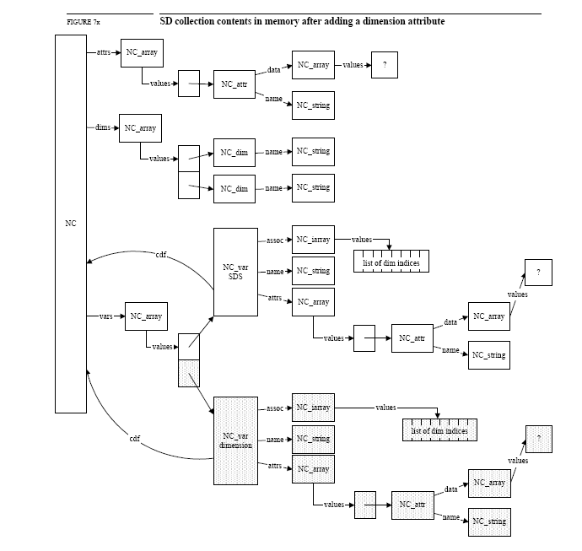
HDF4 files are complex

Slide 4
How do HDF users avoid having to deal with all of that complexity?

Slide 5
Through the HDF software libraries,
either by using HDF APIs directly,
or by using HDF tools that depend on the HDF libraries.
But what about the future…
Notes:
Full quote, from proposal:
Through the HDF software libraries, either by using the HDF APIs directly or by using HDF tools that depend on the HDF libraries.
However there is a risk in depending solely on the HDF libraries to access HDF-formatted data over the long term.
It is possible, especially in the distant future, that the libraries may not be as readily available as they are today. To address this risk, it is desirable to have a way to retrieve the data independently.
At the 10th HDF workshop, Christopher Lynnes of the Goddard Earth Sciences Data and Information Services Center(GES DISC) addressed this need: “If only we could read HDF data with an independent program that does not rely on the HDF API… A possible approach [would be to] extend” hdfls to print a hierarchical map of a data file, [and] write ncdump/hdp-like utilities to find, assemble and write out SDSes and vdatas.”
“Leveraging HDF Utilities,” Christopher Lynnes, 10th HDF Workshop. http://www.hdfeos.org/workshops/ws10/presentations/day3/Leveraging_HDF_Utilities.ppt.

Slide 6
Over the long term, there is a risk in depending solely on HDF software to access HDF-formatted data.
It is possible
in the distant future, that the software may not be available.

Slide 7
“If only we could read HDF data with an independent program that does not rely on the HDF API…
A possible approach [would be to create] a map of a data file, [and] utilities to find, assemble and write out SDSes and vdatas.”
“Leveraging HDF Utilities”
Christopher Lynnes
HDF Workshop X.

Slide 8
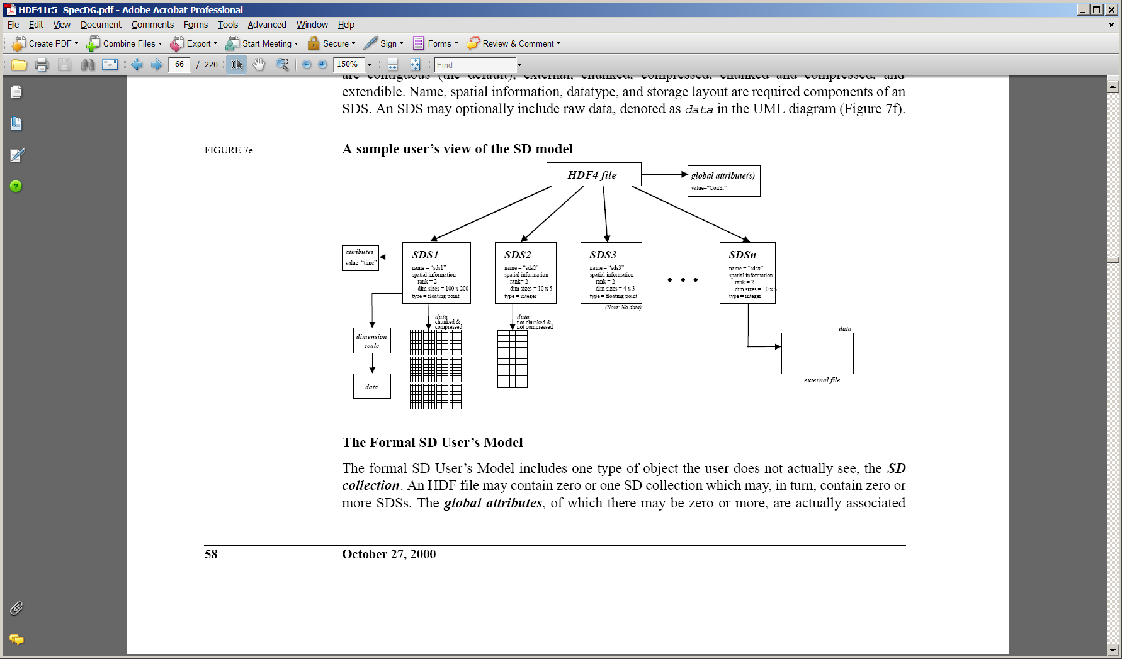
User’s view of the HDF4 SD model

Slide 9

Mapping SDS to file offset/length
HDF4 file layout

Slide 10
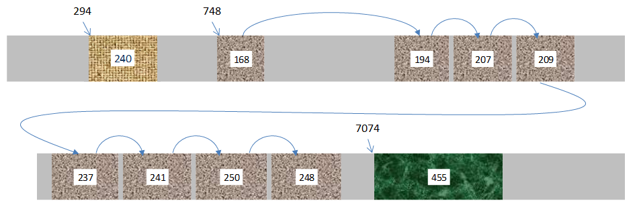
Mapping with compressed chunks
HDF4 file layout

Slide 11
Recap
Problem
  The complex byte layout of HDF files makes long-term readability of HDF data dependent on long-term availability of HDF software.
Solution
  Create a map of the layout of data objects in an HDF file, allowing a simple reader to be written to access the data.

Slide 12
HDF4 mapping workflow
HDF4 File
HDF4 Mapping File
(XML document)
hmap
linked with
HDF4 library
Object Data
Groups, Data Objects,
Structural and Application
Metadata;
Locations of Object Data
Reader
program

Slide 13

Target User
Person 20+ years in the future
Interested in data stored in HDF4 file
Has HDF4 file and companion map file
Can “write a program”
May not have:
  HDF4 data model, format, documentation, or software
  Mapping schema, documentation, or software
Will have knowledge of:
  Basic XML
  Data representations used today
  Compression used by HDF4 (JPEG, Szip, etc.)
Notes:
The HDF4 Mapping Schema describes an XML Document that provides access to content originally stored in a binary HDF4 file.
The HDF4 Mapping Schema is defined by one or more XML schema documents written in the XML Schema Definition Language, XSDL.
An HDF4 Mapping File is an XML Document that conforms to the HDF4 Mapping Schema.
Data representations used today: twos-complement, IEEE floating point, big/little endian

Slide 14
Project Phases
Phase 1
  Categorize HDF4 data held by NASA.
  Build a prototype
    XML layout representation
    Tool to create XML map file for given HDF4 file
    Tools to read HDF4 data based solely on map files
Phase 2
  Build a robust version
  Deploy

Slide 15
How many HDF4 products?
Data Center | HDF4 Products
ASF | 0
GES-DISC | 236
GHRC | 54
ASDC | 63
LP-DAAC | 67
NSIDC | 47
ORNL-DAAC | 2
PO.DAAC | 22
SDAC | 0
MrDC | 95
Total | 586

Slide 16
Data characteristics
Product Characteristics Examined
Product Identification
  Product Name
  Data Level
  Archive Location
For HDF-EOS products
  HDF-EOS version
  For swath data
    Number of swaths
    Maximum number of dimensions
    Organized by time, space, both, or other
  Etc.
For SDS data
  Number of SDSs
  Max number of dimensions
  Did any SDS have attributes
  Was any SDS annotated
  Were dimension scales used
  Was compression used and if so what kind
  Was chunking used
For Vdata
  Number of Vdata structures
  Did any have attributes
  Did any fields have attributes
Etc.

Slide 17
Phase 2 tasks
Investigate integration of mapping schema with existing standards
Determine HDF-EOS 2 requirements
Redesign and expand the XML schema
Implement production quality map writer
Develop demo map reader
Deploy tools at select NASA data centers

Slide 18
Task A
Investigate integration of mapping schema with existing standards

Slide 19

Investigate existing standards
Investigated:
  METS, PREMIS, ESML, NcML, and CSML
Concluded:
  Existing standards have different purposes than mapping schema
    None meet all needs of mapping project
  Develop new schema tailored to project goals
    Harmonize with PREMIS
    Leverage terminology and approaches from all
Notes:
METS = Metadata Encoding and Transmission Standard; a standard for encoding descriptive, administrative, and structural metadata regarding objects within a digital library
PREMIS = PREservation Metadata: Implementation Standard; The PREMIS Data Dictionary defines a core set of semantic units that repositories should know in order to perform their preservation functions. Format-specific metadata is excluded as out of scope.
ESML = Earth Science Markup Language
NcML = NetCDF Markup Language [Schema used with Common Data Model (CDM) datasets]
CSML = Climate Science Modelling Language

Slide 20
Task B
Determine HDF-EOS2 requirements

Slide 21
Categorize HDF-EOS2 data products
Created a data pool from NASA data centers
  GES DISC, NSIDC, LAADS, LP DAAC
  LaRC, PO.DAAC, GHRC, OBPG, LAADS
Detailed description of sample data
Reported options for adding HDF-EOS2 contents to the mapping file
Documents and reports at wiki:
  http://wiki.hdfgroup.org/MappingPhase2_TaskB

Slide 22
Task C
Redesign Schema

Slide 23
Design priorities
Mapping files
  Provide complete access to user-supplied content in NASA’s EOS binary HDF4 files
  Have enough information to stand on their own
  Be as simple as possible
Mapping schema
  Describe the Mapping files
  Used for validation and documentation
  May not be available to target user

Slide 24
Representation of HDF4 Objects
HDF4 User-Level Object | Mapping File XML Element
Attribute, Annotation | Attribute
Vgroup | Group
Vdata | Table
SDS | Array
Dimension | Dimension
Raster Image | Not yet done
Palette | Not yet done

Slide 25
Mapping File – Group & Table (fragment)
Select raw data values included to help user verify binary data handled properly
Information needed to access and interpret raw data in HDF4 file
Represents HDF4 Objects and Relationships
AMSR_E_L2_Land_V09_200501180027_D
Notes:
AMSR_E_L2_Land_V09_200501180027_D

Slide 26
Status and Plans
Status
  Map file design stabilizing for most HDF4 objects
Plans
  Complete design for Raster Images and Palettes
  Continue to refine instructions and contents
  Finalize schema

Slide 27
Task D
Implement Writer

Slide 28
Map Writer Requirements
Retrieve information needed from HDF4 file
Write out corresponding XML file
Quality requirements
  Completeness – don’t miss any objects in file.
  Accuracy – don’t give wrong information.

Slide 29
Writer Status and Plan
Status
  Covers most Vgroup/Vdata/SDS objects.
  Covers some GR/Annotation objects.
  Being tested with NASA data.
Plans:
  Increase coverage / accuracy / reliability.

Slide 30
Task E
Implement demo reader

Slide 31
Demo Reader Requirements
Multiplatform command line tool
Easy to use clear arguments and output
Must validate that objects in the mapping file are actually in the HDF4 file
Developed in a well-supported high level language (python)
Well documented
Available as open source

Slide 32
Demo Reader Status
Status
  Only Vdata support provided so far
  Current source code available at https://sourceforge.net/projects/pyhdf
  Documentation at http://pyhdf.sourceforge.net/
Plans
  SDS and RIS support

Slide 33
Task G
Deploy

Slide 34
Deploy
Begin in Jan 2011, complete in April
Activities:
  GES DISC
    Incorporate into the existing archive ingest system
    Manage the retrofit into existing metadata files
  NSIDC
    Support implementation in NSIDC’s ECS system
  Other ESDCs
    Encouraged to join in
    But deployment to other centers expected subsequent to the project.

Slide 35
Thank You!

Slide 36
Acknowledgements
This work was supported by cooperative agreement number NNX08AO77A from the National Aeronautics and Space Administration (NASA).
Any opinions, findings, conclusions, or recommendations expressed in this material are those of the author[s] and do not necessarily reflect the views of the National Aeronautics and Space Administration.

Slide 37
Questions/comments?

Slide 39
Extra slides

Slide 40
Mapping File – Array with Attribute (fragment)
Select raw data values included to help user verify binary data handled properly;
“corners” + 5 random
Information needed to access and interpret raw data in HDF4 file
Represents HDF4 Objects and Relationships
AIRS.2002.08.31.L3.RetStd_H001.v5.0.14.0.G07178195754
Notes:
AIRS.2002.08.31.L3.RetStd_H001.v5.0.14.0.G07178195754

Slide 41
Mapping of Array with complex storage
Raw data in HDF4 file;
First chunk’s data is not contiguous
Select values included in map file for verification
Chunks with Ghost Cells
Compression
Test file created for project
Notes:
Test file created for project

