Slide 1
Support for NPP/NPOESS by The HDF Group
Mike Folk, Elena Pourmal
The HDF Group
HDF/HDF-EOS Workshop XIV
September 30, 2010

Slide 2
HDF-NPOESS Team members
Frank Baker
Scot Breitenfeld
Allen Byrne
Peter Cao
Albert Cheng
Michael Folk
Nidhi Gupta
Barbara Jones
Jonathan Kim
Larry Knox
Mike McGreevy
Herbert Morgan
Elena Pourmal
Muqun {Kent} Yang

Slide 3
Goal
Provide HDF5 risk-reduction support for the distribution of NPOESS VIIRS, OMPS, and other sensor and environmental data products

Slide 4
Areas of primary need
Easy and intuitive data access and use by diverse communities
Allow producers and consumers to view content, manage metadata, and convert data to other formats.
High-quality, rapid-response HDF5 support for NPOESS/NPP users at all levels.

Slide 5
2009-2010 Priorities
Implement tools and library functions to simplify working with NPOESS data
Begin work on an h5edit tool
Implement testing on NASA mini-IDPS
Meet with NPOESS community regularly
Provide high priority helpdesk support

Slide 6
NPP/NPOESS Project Information
Project Web site
  http://www.hdfgroup.org/projects/npoess/
    Project description
    Released software
    Documentation

Slide 7
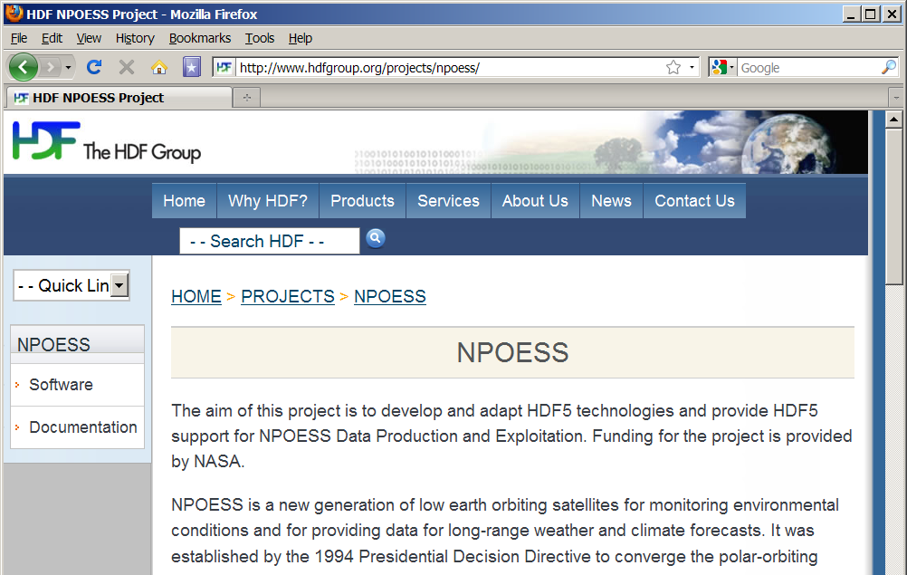
NPOESS Web site

Slide 8
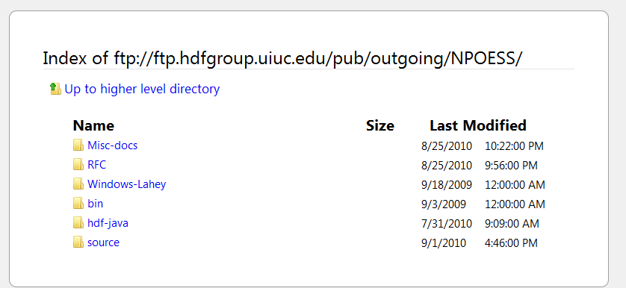
NPOESS Software FTP Site

Slide 9
NPOESS Project Information
Project Wiki site
  http://wiki.hdfgroup.org/NPOESS-Project
  Monthly progress reports, links to software under development, presentations, etc.
    Requires a password
    Contact epourmal@hdfgroup.org

Slide 10
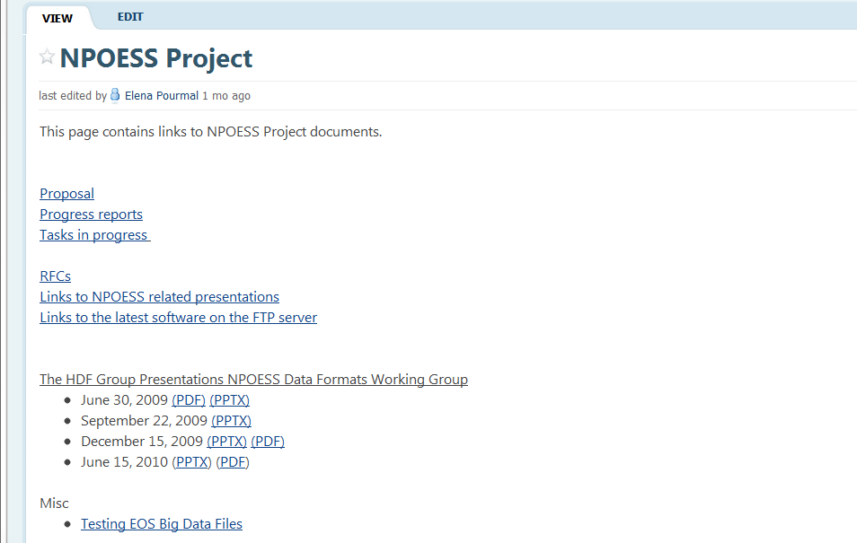
HDF NPOESS Wiki

Slide 11
Library of High-Level APIs to support NPOESS data

Slide 12
NPOESS High-Level Library
Library to support HDF5 region references and packed bits in support of NPOESS quality flags
  C and Fortran APIs
  Documentation
  Tests
  C and Fortran Examples
Source available from
  ftp://ftp.hdfgroup.uiuc.edu/pub/outgoing/NPOESS/source/
Documentation is available from
  http://www.hdfgroup.org/projects/npoess/
Notes:
A file format for managing

Slide 13
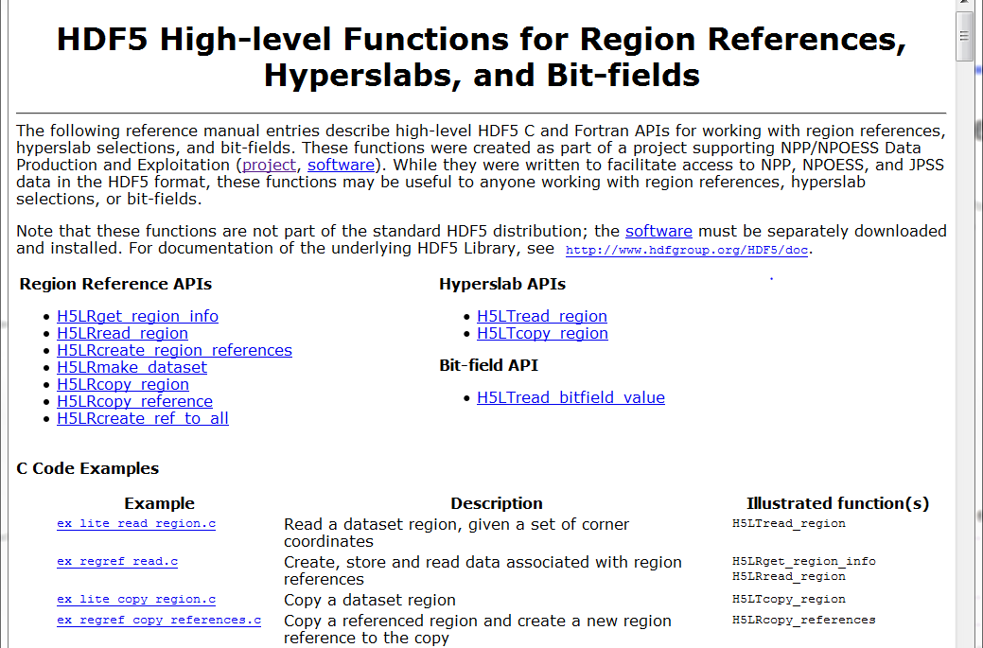
Documentation

Slide 14
HDF5 Testing on NASA mini-IDPS

Slide 15
HDF5 Testing on NASA mini-IDPS
HDF5 development versions are tested in a NPP SDS I&TSE Mini-IDPS machine, running AIX 5.3
Goal is to do test runs on a weekly basis
Included as a pre-release test machine
Notes:
Current plan:
The plan is that once a week, THG team will send the latest version from the
release (v1.8) and development (v1.9) branches to NASA team. They will run tests with those two versions and send the results back to HDF5 team.
(Some detail background: The NASA team, at least for now, will not grant
account access to THG staff yet, and do not want the test suite to do any
network access such as SVN source code update, or email results out. So,
for now, lots of manual hand-shack involved. Hopefully, once they are more
comfortable with our tests, some parts will be automized but I don't expect
it can ever be totally automized as our regular daily tests.)
2. Third sub-bullet:
The NASA machine is included as one of test machines for our release-candidate.
We will fix all errors flagged by the test machines before the official release.

Slide 16
HDF5 Command Line Tools
New Features to Support Object and Region References and Packed Bits

Slide 17
h5dump
New features to support NPP/NPOESS data
  Display region reference target data
  Export region reference target to binary file
  Improve syntax for displaying certain data
  Display data packed into integer (quality flag)

Slide 18
h5repack and h5copy
Fixed several problems discovered while testing with NPP/NPOESS data
Fixed in 1.8.5 release
Send us your sample files to test!!

Slide 19
HDFView
Support for Bit-Field Data

Slide 20
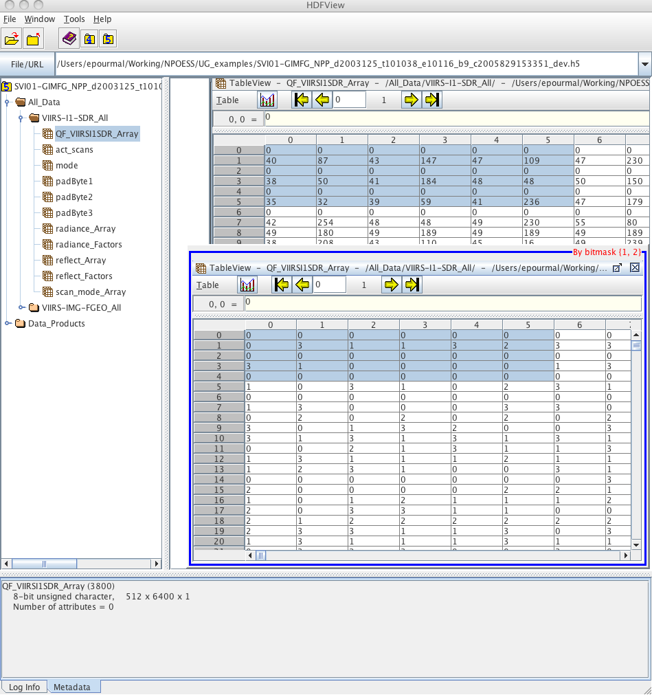
HDFView
Support for bit-field data added to HDFView 2.7 (coming soon)

Slide 21
h5edit
Creating a new tool to add/delete/edit objects in HDF5 files

Slide 22
h5edit
Motivation
  Add attributes to many NPOESS datasets
  Add new region reference to at dataset
Requirements
  A single tool to edit objects in an HDF5 file
  Familiar syntax (similar to h5import)
  Scriptable (in shell script to run on set of files)
  Extendable (more objects, complex data types)
  Input specifiable in a file or on command line

Slide 23
h5edit
New tool for editing an HDF5 file
  RFC: http://www.hdfgroup.org/pubs/rfcs/
Initial implementation will support attributes
  Create, delete
  rename, modify, copy, move, exists
Command language similar to h5dump
Please send us your comments!

Slide 24
Future Work

Slide 25
Future work - Overview
Finish h5edit
Deploy/maintain software
Streamline testing on mini-IDPS
Achieving netCDF compatibility for JPSS
User support

Slide 26
Deploy/maintain software
Deploy and maintain new features
Includes APIs, command line tools, HDFView.
Improve based on feedback from NPP/NPOESS customers and users.
Perform testing, documentation, bug fixes, source and binary releases.

Slide 27
Streamline testing
Frequent testing on the platforms critical to NPOESS/JPSS
  AIX 5.3 & 6.1 and Red Hat Enterprise Linux 5
  Test special features, such as thread safe and shared libraries on AIX
Test backward/forward compatibility with NPP/NPOESS files
Send us your sample files to test!!

Slide 28
Achieving netCDF compatibility for JPSS
Background
  NetCDF-4 is built on HDF5.
  NOAA communities use NetCDF-4 heavily.
  NOAA communities are potentially the biggest JPSS data users.
  CF conventions have gained acceptance by Earth Science communities.
Goals
  To make HDF5 JPSS data be accessible by netCDF-4 classic APIs
  Follow CF conventions.

Slide 29
Achieving compatibility: possible solutions
Collaborate with Unidata (Ed) to address the issue at the level of the netCDF library.
Implement a tool to augment JPSS HDF5 files to make them accessible by netCDF-4 interfaces.
If augmentation done, make JPSS attributes follow CF conventions.
Could tools be adapted similarly?

Slide 30
Other interoperability issues
Timeline
  The JPSS satellite is scheduled to launch Summer 2011.
  Ideally have initial solutions Nov. 2011.
NASA community will also want it to look like HDF-EOS.

Slide 31
NPOESS/JPSS User Support
Priority support to NPOESS/NPP users
  Send email to help@hdfgroup.org
  Add NPOESS, or NPP, or JPSS to the subject field
    Subject: [NPOESS] Where is the plug-in?
    Subject: [NPP] Why my program doesn’t work?
    Subject: [JPSS] Need a tool to edit files with references
  Response in less than 4 hours
Special tasks, such as
  Porting to requested compilers and systems
  Performance tuning for applications
We want to hear from you!

Slide 32
Other R&D Projects in the Queue
Investigate efficiency improvements for products in the data management portion of the Raytheon Algorithm Development Library (ADL).
Investigate implementation of an OPeNDAP server for HDF5 NPOESS/JPSS SDR and EDR products.
Develop a specialized version of h5check for NPOESS/JPSS products.
Recommend performance tuning of the HDF5-NPOESS/JPSS product profile.

Slide 33
Thank You!

Slide 34

Questions?

Slide 35
Acknowledgements
This work was supported by cooperative agreement number NNX08AO77A from the National Aeronautics and Space Administration (NASA).
Any opinions, findings, conclusions, or recommendations expressed in this material are those of the author[s] and do not necessarily reflect the views of the National Aeronautics and Space Administration.

Slide 37
Example: h5edit
h5edit --command \
“delete ATTRIBUTE Percentage_per_Volume /m1;” \ file1.h5
h5edit --command \
“create ATTRIBUTE Percentage_per_Volume 40 /m1;” \
file1.h5
h5edit --command-file change-cmds file1.h5
Content of the change-cmds file
delete ATTRIBUTE “Temp Scale” /m1 /m2 /m3 /m4;
create ATTRIBUTE “Temp Scale” {
DATATYPE H5T_C_S1
DATA {“Celsius”}
}
/m1 /m2 /m3 /m4;

