Slide 1
Parallel HDF5 Developments
Quincey Koziol
The HDF Group
koziol@hdfgroup.org

Slide 2
Parallel I/O in HDF5
Goal is to be invisible: get same performance with HDF5 as with MPI I/O
Project with LBNL/NERSC to improve HDF5 performance on parallel applications:
  6-12x performance improvements on various applications (so far)

Slide 3
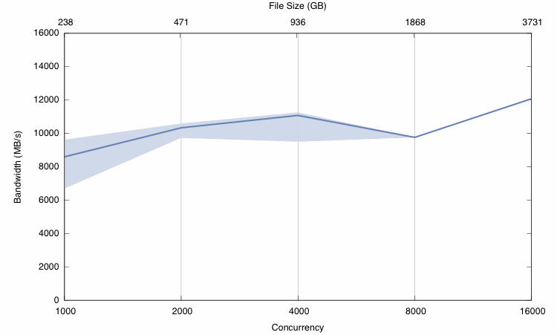
Parallel I/O In HDF5
Up to 12GB/s to shared file (out of 15GB/s) on NERSC’s franklin system:

Slide 4
Recent Improvements to Parallel HDF5

Slide 5
Recent Parallel I/O Improvements
Reduce number of file truncation operations
Distribute metadata I/O over all processes
Detect same “shape” of selection in more cases, allowing optimized I/O path to be taken more often
Many other, smaller, improvements to library algorithms for faster/better use of MPI

Slide 6
Reduced File Truncations
HDF5 library was very conservative about truncating file when H5Fflush called.
However, file truncation very expensive in parallel.
Library modified to defer truncation until file closed.

Slide 7
Distributed Metadata Writes
HDF5 caches metadata internally, to improve both read and write performance
Historically, process 0 writes all dirtied metadata to HDF5 file, while other processes wait
Changed to distribute ranges of metadata within the file across all processes
Results in ~10x improvement in I/O for Vorpal (see next slide)

Slide 8
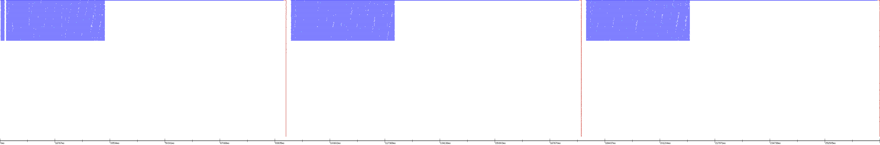
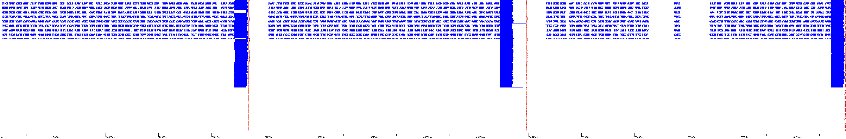
Dsitributed Metadata Writes
I/O Trace Before Changes
  Note long sequence of I/O from process 0
I/O Trace After Changes
  Note distribution of I/O across all processes, taking much less time

Slide 9
Improved Selection Matching
When HDF5 performs I/O between regions in memory and the file, it compares the regions to see if the application’s buffer can be directly used for I/O
Historically, this algorithm couldn’t detect that a region with the same shape, but embedded in arrays of different dimensionality were the same
  For example, a 10x10 region in a 2-D array should compare equal to the equivalent 1x10x10 region in a 3-D array
Changed to detect same shaped region in arbitrary source and destination buffer array dimensions, allowing I/O from application’s buffer in more circumstances.

Slide 10
Improved Selection Matching
Change resulted in ~20x I/O performance improvement when reading 1-D buffer from 2-D file dataset
    From ~5-7 seconds (or worse) to ~0.25-0.5 seconds, on a variety of machine architectures (Linux: amani, hdfdap, jam; Solaris: linew)

Slide 11
Upcoming Improvements to Parallel HDF5

Slide 12
High-Level “HPC” API for HDF5
HPC environments typically have unusual, possibly even unique, computing, network and storage configurations.
The HDF5 distribution should provide easy to use interfaces that ease scientists and developers’ use of these platforms:
  Tune and adapt to the underlying parallel file system.
  New high-­‐level API routines that wrap existing HDF5 functionality in a way that is easier for HPC application developers to use and help them move applications from one HPC environment to another.
  RFC: http://www.hdfgroup.uiuc.edu/RFC/HDF5/HPC-High-Level-API/H5HPC_RFC-2010-09-28.pdf

Slide 13
High-Level “HPC” API for HDF5 – API Overview
File System Tuning:
  Automatic file system tuning
  Pass file system tuning info to HDF5 library
Convenience Routines:
  “Macro” routines
    Encapsulate common parallel I/O operations
    E.g. - create a dataset and write a different hyperslab from each process, etc.
  “Extended” routines
    Provide special parallel I/O operations not available in main HDF5 API
    Examples:
      “Group” collective I/O operations
      Collective raw data I/O on multiple datasets
      Collective multiple object manipulation
      Optimized collective object operations

Slide 14
Parallel HDF5 in the Future

Slide 15
HPC Funding in 2010 and Beyond
DOE Exascale FOA w/LBNL & PNNL Proposal Funded
  Exascale-focused enhancements to HDF5
LLNL Support & Development Contract
  Performance, support and medium-term focused development
DOE Exascale FOA w/ANL and ORNL Proposal Funded
  Research on alternate file formats for Exascale I/O
LBNL Development Contract
  Performance and short-term focus

Slide 16
Future Parallel I/O Improvements
Library Enhancements Proposed:
  Remove collective metadata modification restriction
  Append-only mode, targeting restart files
  Embarrassingly parallel mode, for decoupled applications
  Overlapping compute & I/O, with asynchronous I/O
  Auto-tuning to underlying parallel file system
  Improve resiliency of changes to HDF5 files
  Bring FastBit indexing of HDF5 files into mainstream use for queries during data analysis and visualization
  Virtual file driver enhancements
Improved Support:
  Parallel I/O performance tracking, testing and tuning

Slide 17
Future Parallel I/O Improvements
Contract w/LLNL to do:
  Scalable I/O performance tracking, testing and tuning
  Virtual file driver enhancements
  HPC Specific fast­tracking
  Parallel interface enhancements
  Exploratory design development
  User support and routine maintenance

Slide 18
Performance Hints for Using Parallel HDF5

Slide 19
Hints for Using Parallel HDF5
Pass along MPI Info hints to file open: H5Pset_fapl_mpio
Use MPI-POSIX file driver to access file: H5Pset_fapl_mpiposix
Align objects in HDF5 file: H5Pset_alignment
Use collective mode when performing I/O on datasets: H5Pset_dxpl_mpio before H5Dwrite/H5Dread
Avoid datatype conversions: make memory and file datatypes the same
Advanced: explicitly manage metadata flush operations with H5Fset_mdc_config

