Slide 1
HDF5 Tools Updates
Peter Cao, The HDF Group

Slide 2

Tools Updates
HDF5 Command-line tools
HDF-Java Products
Changes and updates

Slide 3
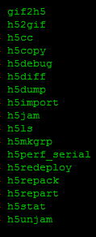
HDF5 Command-line tools
Look or check file content
  h5dump, h5diff, h5ls, h5check, etc.
Change file content or create a new file
  h5repack, h5import, h5jam, h5copy, etc.
Convert an HDF5 file to a different file
  h4toh5, h5toh4, gif2h5, h52gif, etc.

Slide 4

h5ls
Prints information about one or more HDF5 files or objects

Slide 5
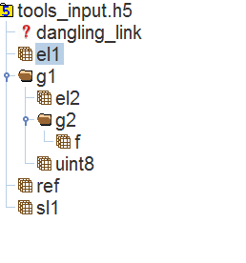
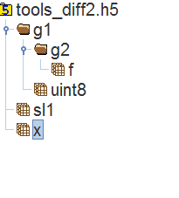
h5ls
New features
  ‘--follow-symlinks’ option to follow soft and external link.

Slide 6
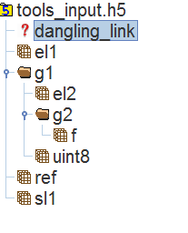

h5ls
New features
  ‘--no-dangling-links’ option to check dangling links

Slide 7

h5dump
Dumps contents of HDF5 file to stdout
  ASCII text
  XML
  Binary
Examine file contents and dump file contents in an ASCII or binary file

Slide 8
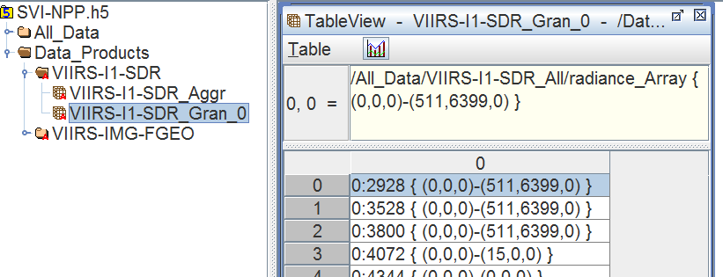
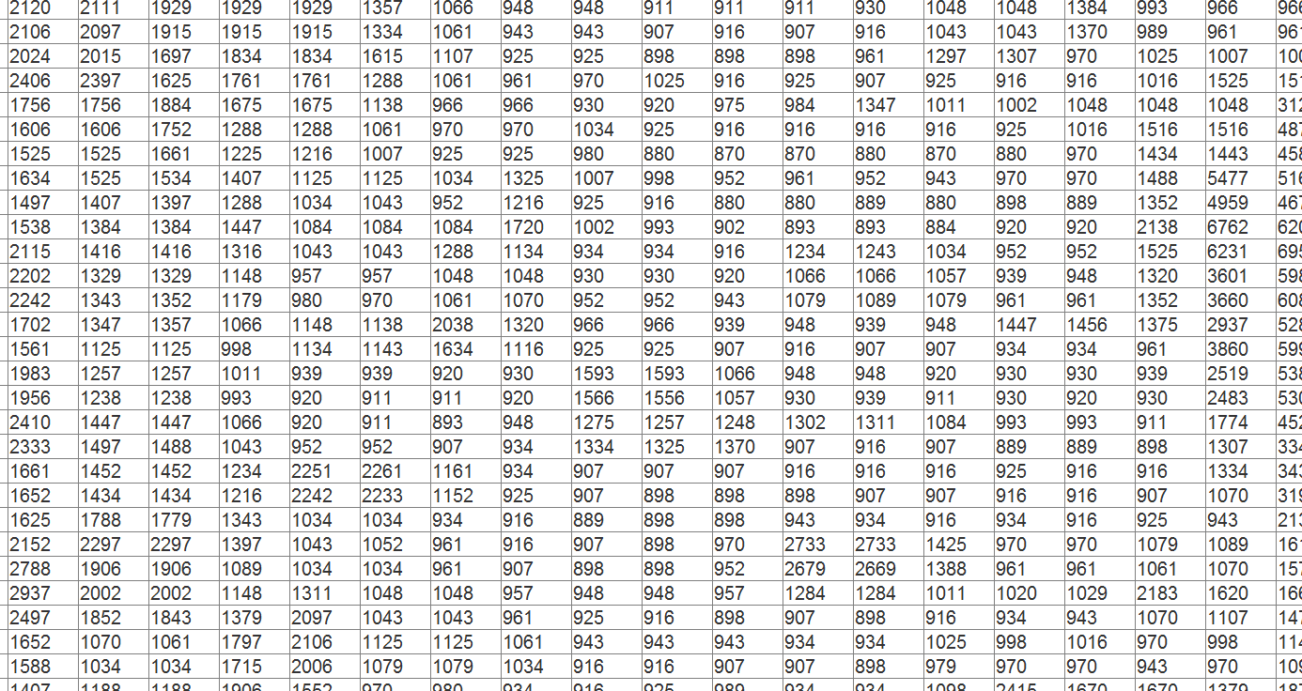
h5dump
New features
  Show data pointed by region references

Slide 9




h5dump
New features
  Bit(s) values packed in a byte/short integer
  E.g. Quality flags
    Land/Water Background -- 1-bit
    SST Skin Quality -- 2-bits
    SST Bulk Quality -- 2-bits
    Aerosol Correction -- 3-bits

Slide 10
h5dump
Bug fixes
  Datatype of object references was displayed as the datatype of region references.
  Does not export data pointed by a region reference as a binary file.
  Ignore –m <set the floating point output format> option when generating XML with –u.
  Subsetting does not check dimension bounds.

Slide 11

h5diff
Show
differences
between…
two objects
or
two files

Slide 12
h5diff
New features
  ‘--follow-symlinks’ option to follow soft and external link.

Slide 13
h5diff
New features
  ‘--no-dangling-links’ option to check dangling links

Slide 14
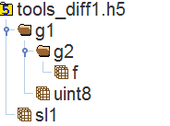
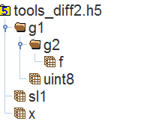
h5diff
New features
  ‘--exclude-path’ option to exclude specified object pointed by a given path for comparison.
  Will apply to attributes in the future.
E.g. h5diff --exclude-path /g1/g2/f tools_diff1.h5 tools_diff2.h5

Slide 15

h5diff
Bug fixes
  Improved to traverse groups recursively for comparing child objects when the groups are specified to be compared via command line.

Slide 16


h5repack
Copies
an entire file to
a new file…
Changes storage layouts and apply compression filters

Slide 17
h5repack
Bug fixes
  Attributes on the datasets with H5T_REFERENCE type were not present in the repacked file
  A data element which was a reference to a group became NULL in the repacked file
  Display compression information incorrectly.

Slide 18

h5copy
Copies
objects
to a different file
/
/
integers
floats
i1
i2
f32
64-bit
64-bit
f1
f1
f2
f2

Slide 19
h5copy
Bug fixes
  Failed to copy dangling links when it’s specified directly as the source object.
  Couldn’t deal with NULL elements of object references
  Copying references was not tested and properly documented

Slide 20

New Tools in development
h5watch
h5edit
HDF/HDF-EOS Workshop XIII

Slide 21


h5watch
Allows the user to monitor the growth of a dataset
Prints out the new elements appended to a dataset
Includes options on what to be monitored.

Slide 22

h5edit
Motivation
  Create an attribute
  Change the value of an attribute in a dataset
  Edit other objects in an HDF5 file
Requirements
  Familiar syntax for the input data (DDL or h5import)
  Scriptable (can be used in a shell script )
  Extendible to support other HDF5 object

Slide 23
h5edit
New tool for editing an HDF5 file
  RFC: http://www.hdfgroup.org/pubs/rfcs/
Initial implementation will include creating and deleting attributes
Prototype will be released soon
Please send us your comments!

Slide 24
Example: h5edit
  H5edit --command
  “delete ATTRIBUTE Percentage_per_Volume /m1;” file1.h5
  h5edit --command
  “create ATTRIBUTE Percentage_per_Volume 40 /m1;” file1.h5

Slide 25

HDF-Java Products
Support for HDF5 1.8
HDF-Java 2.7 release

Slide 26


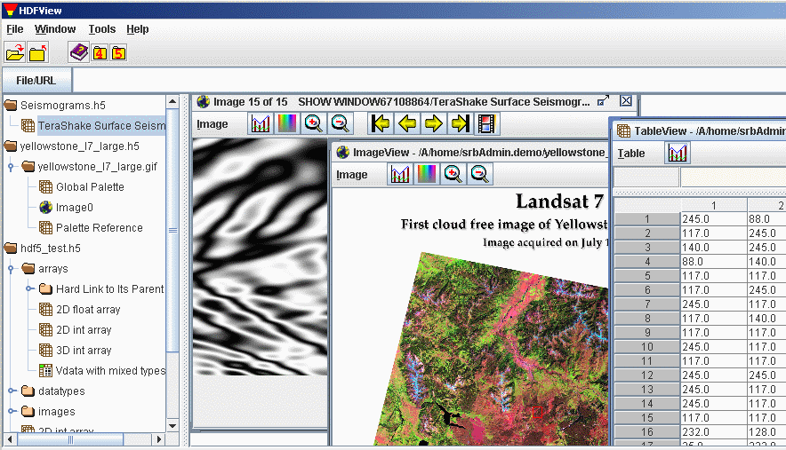
HDF-Java Products
HDF-Java
HDF
Java
Wrapper
Object
Package
Viewer
Editor

Slide 27


Java Wrapper
HDF
A programming framework that allows Java code to call and be called by applications and libraries written in other languages
JNI
HDF

Slide 28

Object Package: basic objects
File
Group
Dataset
Datatype
Attribute
http://www.hdfgroup.org/hdf-java-html/hdf-object/

Slide 29
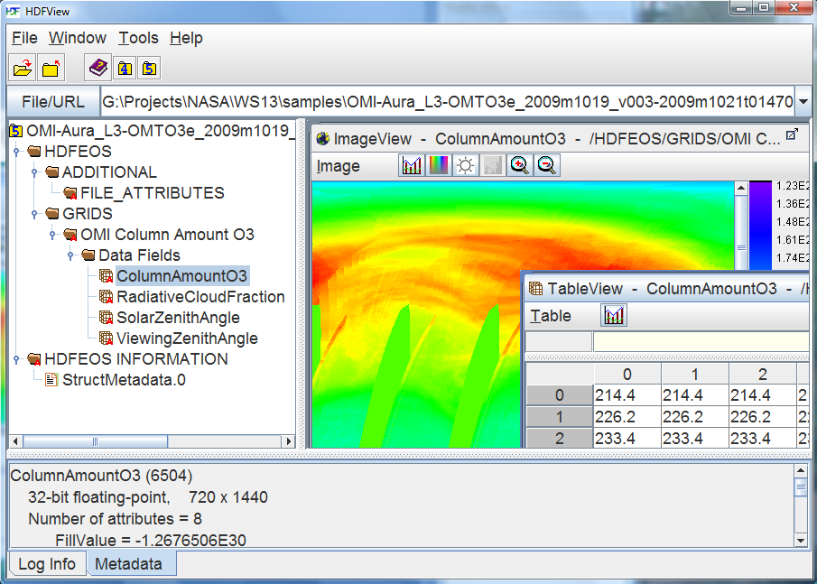
HDFView

Slide 30
Support for HDF 1.8 in HDF-Java
HDF5 JNI (funded by Sandia National Lab)
  Added about 118 (out of 169) new functions
  Added unit tests for theJNI functions
Package | No. of new APIs
H5S | 3
H5T | 7
H5D | 5
H5O | 17
H5L | 18
H5A | 14
H5R | 1
H5I | 2
H5P | 34
1.6 compatable APIs | 17
Total | 118

Slide 31
Support for HDF 1.8 in HDF-Java
Added HDF5 1.8 related features to the Object Layer and HDFView
  Set the bounds of library versions
  Set link creation order
  Set link storage type
  Show groups and attributes in creation order (not in HDFView)
  Create soft and external links
  Retrieve link information

Slide 32
HDF-Java 2.7
New features (17), e.g.
  Show bit(s) values in byte or short integers
  Move objects within the same file
  Import/export binary data
  Use H5Ocopy() API (important for copying large datasets)
  Rename Attributes
  Support for 64-bit Windows

Slide 33
HDF-Java 2.7
Bug fixes (29), e.g.
  Java binary jar files are not the same for 32-bit and 64-bit
  Datasets displayed incorrectly if you swap dimensions
  H5Sset_extent_simple in Java does not seem to take effect
  Possible useful information for HDF-EOS2 files are not displayed by HDFView

Slide 34
HDF-Java 2.7
Support for HDF5 1.8
Bug fixes/other new features
Beta is out for you to try
Official release – Nov. 2010

Slide 35

HDF-Java Features/Roadmap
Nov. 2010
Support for HDF5 1.8
Unit tests for JNI
Bug fixes
Other new features
N-dimension Array
Creation Order *
Import/Export GeoTiff *
GUI Widgets *
Automatic GUI tests *
Buffered Array
Buffered Array
Import/export XML *
Drag/drop (in & ex) *
Function pointers
Edit complex data
3D Graphic view *
* For HDFView only
Please give us your feedback

Slide 36
Thank You!
Questions/comments?

