Slide 1
Easy Remote Access via OPeNDAP
Kent Yang and Joe Lee
The HDF Group
The 14th HDF/HDF-EOS Workshop
September 28, 2010
Notes:
Clarification of HDF-EOS website
The Earth Observing System Project Science Office -> eospso.gsfc.nasa.gov (Information about Earth Observing System)
SDP Toolkit/HDF-EOS: http://newsroom.gsfc.nasa.gov/sdptoolkit/toolkit.html
HDF Group website: http://hdfgroup.org
But HDF-EOS Tools and Information Center http://hdfeos.org or http://hdfeos.net
Don’t forget MLS. Highlight HDF4 handler.
Say problem: Java / CERES
Add Zhang Fan
Explain two reasons for this work:
We’ve done this work in the past few months.
Some information of tools are out of date. Need to be updated.
Requests for more information such as examples.

Slide 2

Easy
Notes:
The Earth Observing System Project Science Office -> eospso.gsfc.nasa.gov (Information about Earth Observing System)
SDP Toolkit/HDF-EOS: http://newsroom.gsfc.nasa.gov/sdptoolkit/toolkit.html
HDF Group website: http://hdfgroup.org
But HDF-EOS Tools and Information Center http://hdfeos.org or http://hdfeos.net Screenshot of http://hdfeos.org
Explain two reasons for this work:
We’ve done this work in the past few months.
Some information of tools are out of date. Need to be updated.
Requests for more information such as examples.

Slide 3
Outline
Introduction to OPeNDAP
What’s New?
  HDF4-OPeNDAP Handler (major)
  HDF5-OPeNDAP Handler (minor)
Notes:
For those who missed the OPeNDAP tutorial on the first day workshop, I’ll give a brief introduction to OPeNDAP again.
I’ll give a short update for HDF5 OPeNDAP handler work first and then HDF4 OPeNDAP handler wok, which was the major work of the last year.
At the end, I’ll go over the future work necessary for HDF4 handler.

Slide 4

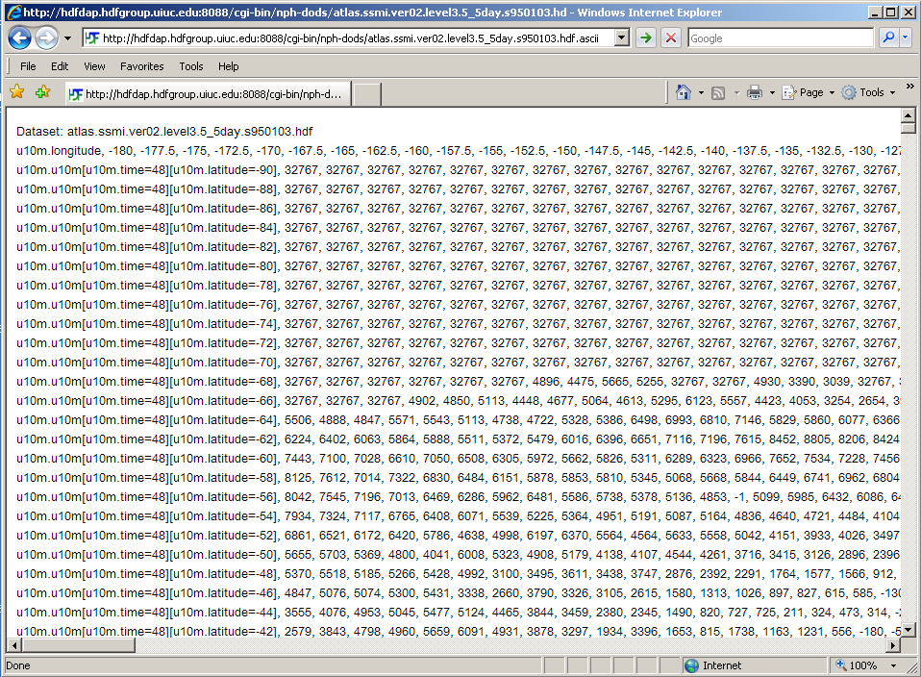
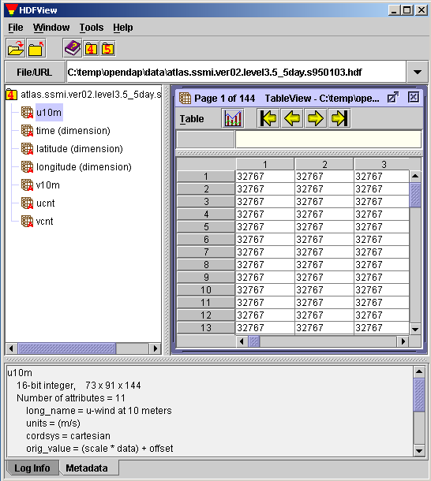
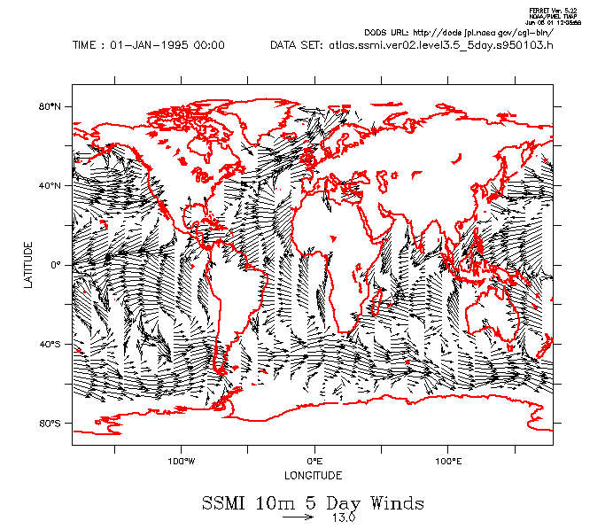
OPeNDAP Concept
Typical Remote Access
View Data
(User)
FTP/HTTP
Remote Data
(HDF4/5)
Visualization Tools
(gradsdap)
Visualization tools
(e.g., grads)
Handler
(hdf4/5_handler)
Client Library
(libnc_dap)
Server
(Hyrax)
Data Access Protocol (DAP) via Internet
Notes:
This is how remote data can be accessed via OPeNDAP. Normally, users can view local data file using scientific data using visualization tools like GrADS. In DAP, this can be done for remote file. First DAP provides both generic server and client. For different data format like HDF and NetCDF, it needs an additional server that can map such data into a standard DAP format.
Next, by modifying the existing visualization tools to adopt OPeNDAP client library, they can show the remote data on demand.
The benefit of OPeNDAP is clear when you want to view a small dataset; you don’t have to download the entire data from the server.
DAP is a low-level medium that implementers can impose any additional restrictions on top of DAP model.
The bottom line is that web browser can access any HDF data.

Slide 5

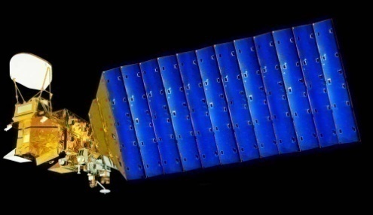

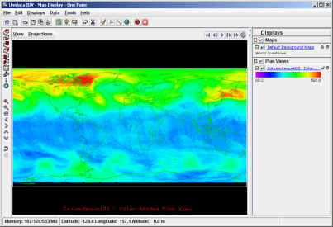


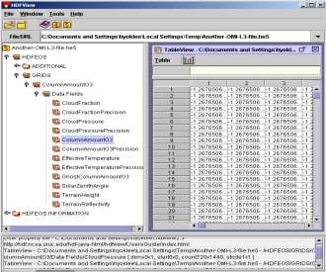
Access HDF via OPeNDAP
Aqua/Aura
Users
Hyrax
IDV
libnc-dap
HDF HANDLER
AIRS/OMI
DAP
Visualization
Tools
OPeNDAP
Clients
OPeNDAP
Servers
HDF Files
Notes:
For people who are not familiar with OPeNDAP, I’ll explain how OPeNDAP works with HDF.
OPeNDAP is an open implementation of easy data access through visualization tools like IDV.
Our work bridges the existing OPeNDAP framework and HDF so that visualization is possible over the Internet.

Slide 6
Outline
Introduction to OPeNDAP
What’s New?
  HDF4-OPeNDAP Handler (major)
  HDF5-OPeNDAP Handler (minor)
Notes:
For those who missed the OPeNDAP tutorial on the first day workshop, I’ll give a brief introduction to OPeNDAP again.
I’ll give a short update for HDF5 OPeNDAP handler work first and then HDF4 OPeNDAP handler wok, which was the major work of the last year.
At the end, I’ll go over the future work necessary for HDF4 handler.

Slide 7
What’s New?
HDF4-OPeNDAP Handler Work
Notes:
From now on, I will mainly focus on hdf4 handler since we made a lot of efforts on this projection.
First, I’ll describe the problems of the old handlers and then what we did, limitations of our solution and future work.

Slide 8
HDF4-OPeNDAP Handler Work
Problems
Our Work
Limitations
Notes:
From now on, I will mainly focus on hdf4 handler since we made a lot of efforts on this projection.
First, I’ll describe the problems of the old handlers and then what we did, limitations of our solution and future work.

Slide 9
Existing HDF4 Handler Problem
Some OPeNDAP Visualization Tools CAN NOT display most NASA HDF-EOS2 and HDF4 data
Notes:
Yes, the HDF4 handler is more than 10 years old
and it was part of the OPeNDAP ever since.
The biggest problem is that we can’t see anything with visualization clients for HDF-EOS2 and HDF4 data.

Slide 10

Existing HDF4 Handler Problem
Aqua
Users
Existing HDF4 HANDLER
IDV
libnc-dap
Hyrax
AIRS Grid
DAP
Visualization
Tools
OPeNDAP
Clients
OPeNDAP
Servers
HDF4 Files
Notes:
Here’s the illustration of problem.

Slide 11
HDF4-OPeNDAP Handler Work
Problems
Our Work
Limitations
Notes:
From now on, I will mainly focus on hdf4 handler since we made a lot of efforts on this projection.
First, I’ll describe the problems of the old handlers and then what we did, limitations of our solution and future work.

Slide 12
Our Work
Let Visualization Clients Access HDF-EOS2 and HDF4 files
Notes:
Therefore, our primary goal is to enhance it so that it can visualize data instantly.

Slide 13
Why Visualization Fail?
My house costs 1.
My house in Hawaii costs $1M.
  Information – Earth Science - Content
  Geo-Location, Geo-Location, Geo-Location
  Unit, Scale factor
Notes:
We asked ourselves. Why didn’t the clients work?

Slide 14
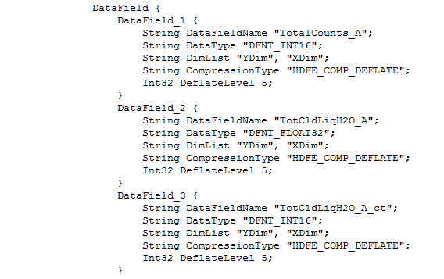
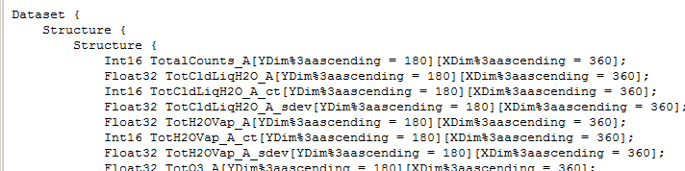
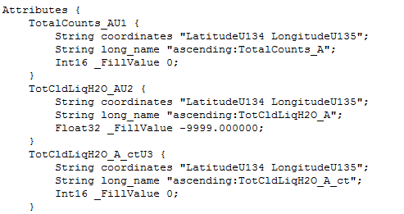
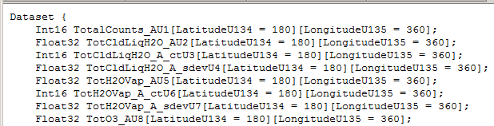
Why Visualization Fails?
Clients expect certain data structures
  Shared & named dimensions
Clients expect some key attributes
  CF conventions
    coordinates attribute
    unit attribute
Notes:
We asked ourselves. Why didn’t the clients work?
Many clients are built around the NetCDF-style data structures.
Also, they expected some key attributes that follow CF conventions
CF stands for Climate and Forecast.
It’s because there are some missing information that clients expect and it’s the handler’s job to provide them.
It’s not easy

Slide 15
Extreme Makeover
My house in HI costs 1M.
My house in Hawaii costs $1M.
  Enhanced HDF4 Hander
  Interoperability!
Notes:
We asked ourselves. Why didn’t the clients work?

Slide 16
Challenges
Hundreds of HDF-EOS2 and HDF4 products
  Grid Projections
  Swath Dimension Map
  Product Specific: TRMM / TOMS / MERRA / CERES / Etc.
Notes:
The key challenge originates from the diversity of HDF4 and HDF-EOS2 products. For example, these are the new hurdles for meeting the convention.

Slide 17
Solution
Step 1: Retrieve Key Information
Step 2: Transform Output File Structure following CF conventions and DAP 2.0
Notes:
In order to support more files, we tried to use HDF-EOS2 library since it can handle different Grid projections and swath dimension maps.
Again, this was done efficiently because we’ve accumulated knowledge through the previous h4toh5 tool work.

Slide 18
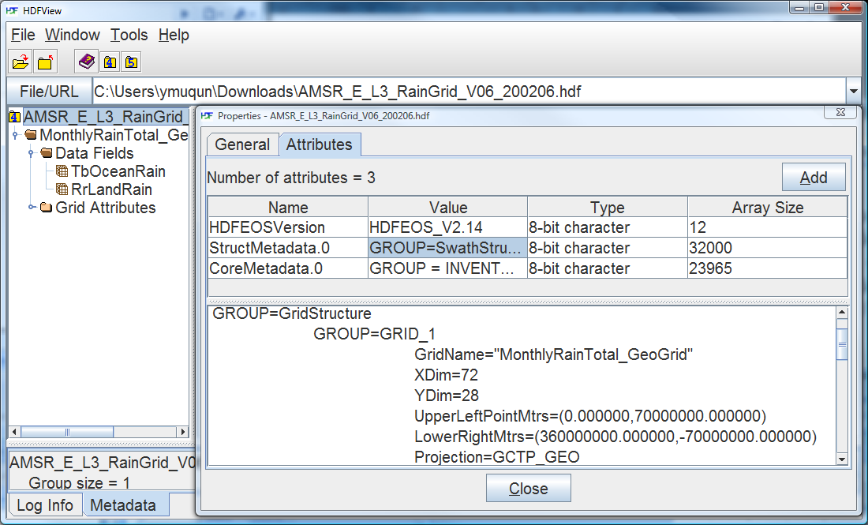
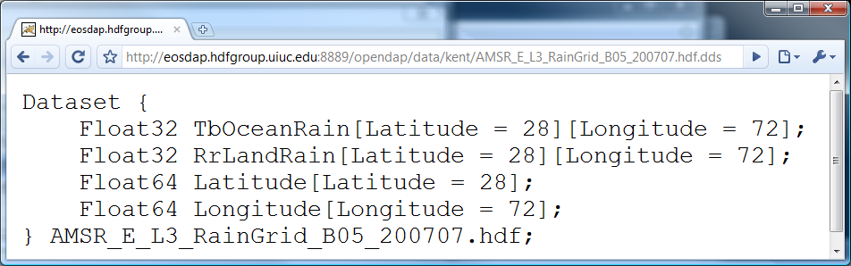
Step1: Retrieve Key Information
Coordinate variable values in an HDF-EOS2 file
Calculate Lat/Lon
Notes:
In order to support more files, we tried to use HDF-EOS2 library since it can handle different Grid projections and swath dimension maps.
Again, this was done efficiently because we’ve accumulated knowledge through the previous h4toh5 tool work.

Slide 19
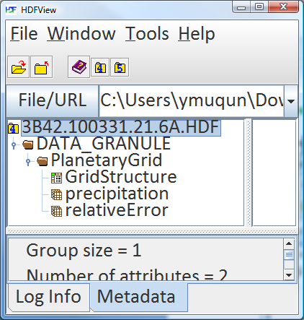
Step1: Retrieve Key Information(continued)
Coordinate variable values in an HDF4 file
Latitude and Longitude are
Provided outside the file.
Notes:
In order to support more files, we tried to use HDF-EOS2 library since it can handle different Grid projections and swath dimension maps.
Again, this was done efficiently because we’ve accumulated knowledge through the previous h4toh5 tool work.

Slide 20
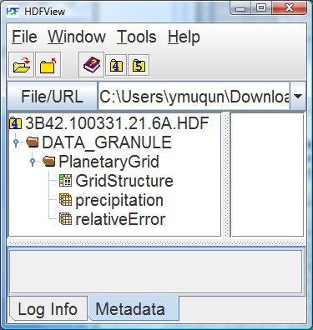
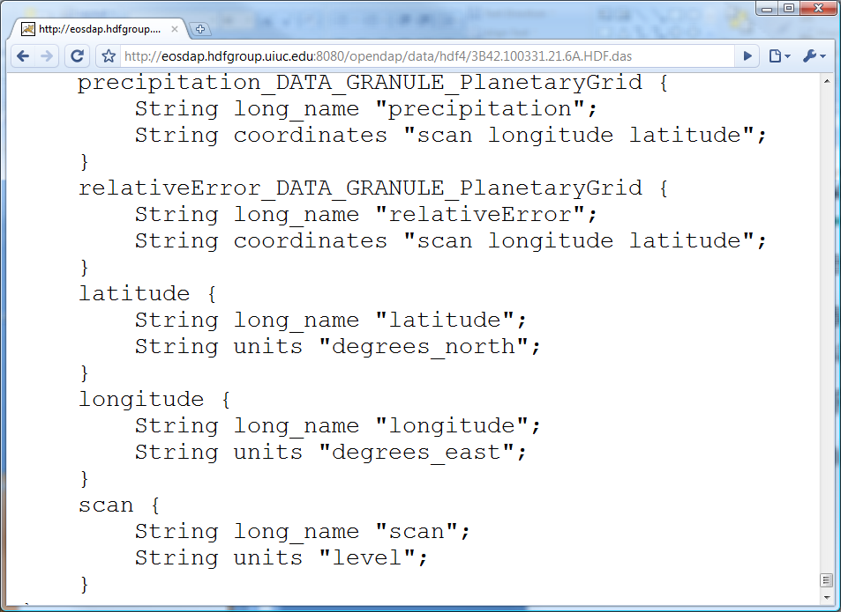
Step2: Transform Output
Flatten Structure and handle special characters
An HDF file
DAP DAS Output following CF
Flatten
CF attributes
Notes:
In order to support more files, we tried to use HDF-EOS2 library since it can handle different Grid projections and swath dimension maps.
Again, this was done efficiently because we’ve accumulated knowledge through the previous h4toh5 tool work.

Slide 21
Shift of Burden
From Users to Handler Developers
Client processing to Server processing
Notes:
In order to support more files, we tried to use HDF-EOS2 library since it can handle different Grid projections and swath dimension maps.
Again, this was done efficiently because we’ve accumulated knowledge through the previous h4toh5 tool work.

Slide 22
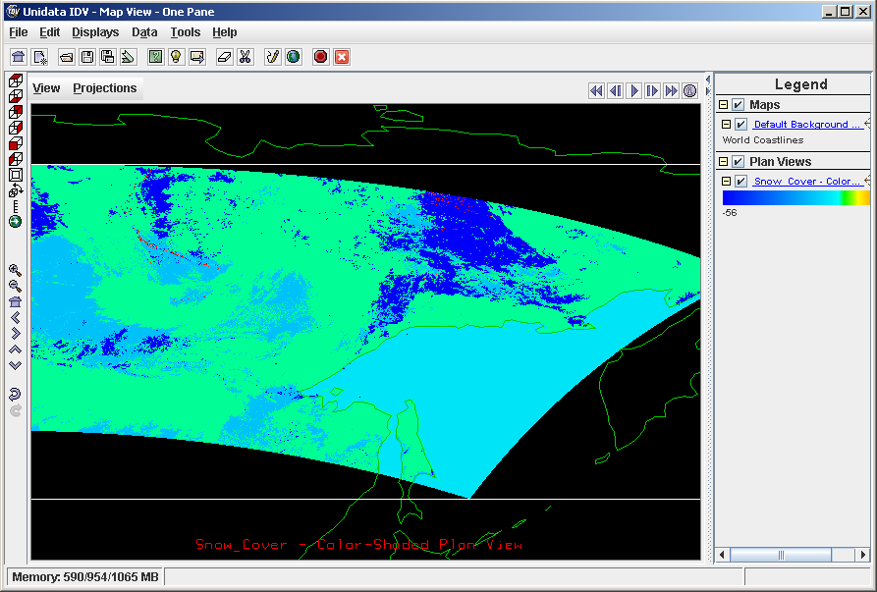
Enhanced HDF4 Handler
Enhanced HDF4 HANDLER
Aura
Users
MODIS Swath
w/ Dim. Map
IDV
libnc-dap
Hyrax
DAP
Visualization
Tools
OPeNDAP
Clients
OPeNDAP
Servers
HDF4 Files
Notes:
I will quickly go over hdf5 handler update.
First, I’ll describe the problems of the old handlers and then what we did, limitations of our solution and future work.
HE2 to EOS2.

Slide 23
Demo: HDF-EOS2 Library Solution
Swath with Dimension Map
Notes:
Here’s one proof that using HDF-EOS2 library really helps to visualize something that wasn’t possible with a parser-based solution.

Slide 24
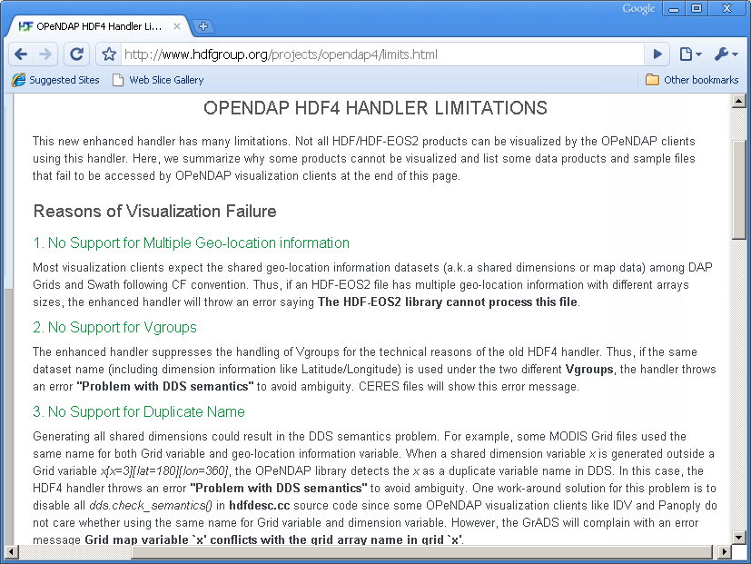
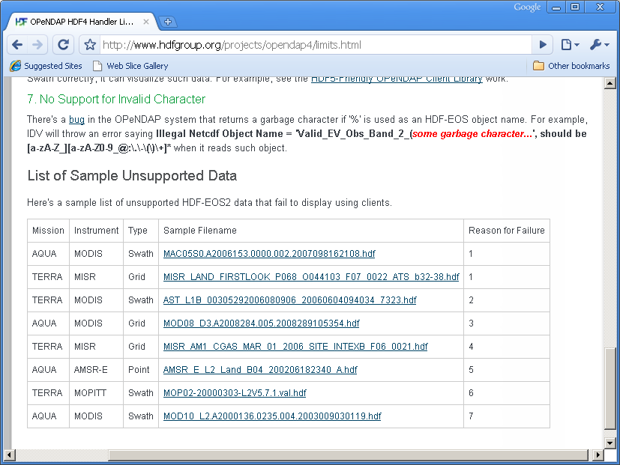
HDF-EOS2 Products Supported
GES DISC
  AIRS / MERRA / TOMS
LAADS / LP DAAC / NSIDC
  Many MODIS products
NSIDC
  AMSR_E / NISE
LaRC
  MISR / MOPITT / some CERES(TRMM)
Notes:
We have summarized the top 7 reasons why some HDF-EOS will fail.
We also listed some sample files that will not work with HDF4 handler.
Here are screenshots of website.
Make animation – screen shots in between texts.

Slide 25
Pure HDF4 Products Supported
GES DISC
  TRMM L1B, L2B Swath
  TRMM L3 Grid 42B & 43B products
OBPG (Ocean Color)
  SeaWiFS / MODIST / MODISA
  CZCS / OCTS
Notes:
We have summarized the top 7 reasons why some HDF-EOS will fail.
We also listed some sample files that will not work with HDF4 handler.
Here are screenshots of website.
Make animation – screen shots in between texts.

Slide 26
Pure HDF4 Products Supported
CERES
  CER_AVG
  CER_ES4
  CER_ISCCP-D2like-Day
  CER_ISCCP-D2like-GEO
  CER_SRBAVG
  CER_SYN
  CER_ZAVG
Notes:
We have summarized the top 7 reasons why some HDF-EOS will fail.
We also listed some sample files that will not work with HDF4 handler.
Here are screenshots of website.
Make animation – screen shots in between texts.

Slide 27
HDF4-OPeNDAP Handler Work
Problems
Our Work
Limitations
Notes:
From now on, I will mainly focus on hdf4 handler since we made a lot of efforts on this projection.
First, I’ll describe the problems of the old handlers and then what we did, limitations of our solution and future work.

Slide 28
Their Limitations
Reasons for Visualization Failures
  IDV / Panoply / Java Heap Memory
  Network / DAP (e.g., max HTTP header size)
  Can’t retrieve key information correctly (e.g., LAMAZ projection) from data
  Unable to harmonize with CF-conventions (e.g., FillValue inside latitude and longitude)
Notes:
We have summarized the top 7 reasons why some HDF-EOS will fail.
We also listed some sample files that will not work with HDF4 handler.
Here are screenshots of website.
Make animation – screen shots in between texts.

Slide 29
Our Limitations
HDF-EOS2 + additional HDF4 objects
- Additional HDF4 objects will be ignored.
The rest of pure HDF4 products not listed in previous slides are not tested and may not be visualized by Java OPeNDAP Clients.
Notes:
We have summarized the top 7 reasons why some HDF-EOS will fail.
We also listed some sample files that will not work with HDF4 handler.
Here are screenshots of website.
Make animation – screen shots in between texts.

Slide 30
What’s New?
HDF5-OPeNDAP Handler Work
Notes:
From now on, I will mainly focus on hdf4 handler since we made a lot of efforts on this projection.
First, I’ll describe the problems of the old handlers and then what we did, limitations of our solution and future work.

Slide 31
HDF5-OPeNDAP Handler Update
Aura
Users
HDF5 HANDLER Update
IDV
libnc-dap
Hyrax
OMI Swath
OMI Grid
DAP
Visualization
Tools
OPeNDAP
Clients
OPeNDAP
Servers
HDF5 Files
Notes:
I will quickly go over hdf5 handler update.
First, I’ll describe the problems of the old handlers and then what we did, limitations of our solution and future work.

Slide 32
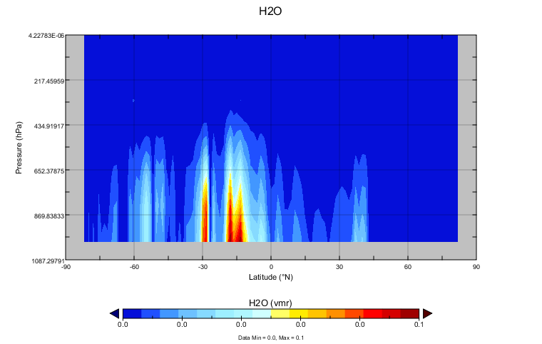
HDF5-OPeNDAP Handler Update
Support Aura HDF-EOS5 OMI Swath
Support Aura HDF-EOS5 MLS
Notes:
For HDF5 handler, we added support for some OMI swath file.
Next, we added a support for some files that follow HDF5 dimension scale models.
Finally, we changed short name option. This helps GrADs users to visualize data more quickly using the simple ‘sdfopen’ command.

Slide 33
OPeNDAP HDF4/HDF5 handlers
Source codes and RPMs can be found under
http://opendap.org
Demo HDF5/HDF4 servers
http://hdfeos.org/zoo/hdf5_handler
http://hdfeos.org/zoo/hdf4_handler

Slide 34
Thank you !

Slide 35
Acknowledgements
This work was supported by cooperative agreement number NNX08AO77A from the National Aeronautics and Space Administration (NASA).
Any opinions, findings, conclusions, or recommendations expressed in this material are those of the author[s] and do not necessarily reflect the views of the National Aeronautics and Space Administration.

Slide 36
Questions/comments?

