Slide 1
A Common Data Model
In the Middle Tier
Enabling Data Access in Workflows …
HDF/HDF-EOS Workshop XIV
September 29, 2010
Doug Lindholm
Laboratory for Atmospheric and Space Physics
University of Colorado, Boulder
doug.lindholm@lasp.colorado.edu

Slide 2
The Problem
Diverse, disparate data formats and conventions abound in scientific datasets.
Not going to get everyone to agree on storing data in a common format.
A common format is not enough. Need higher level semantics. e.g. time series
Data access, not discovery, not storage
Long time series, but not HPC (yet?)

Slide 3
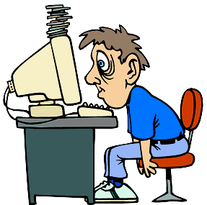
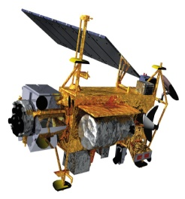
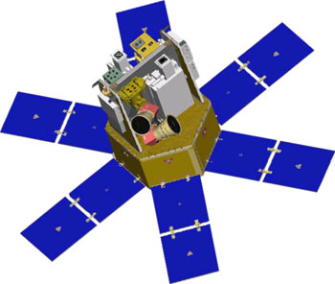
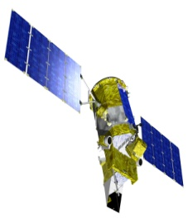

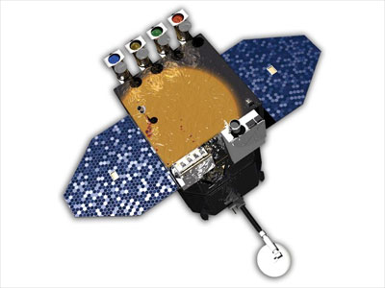
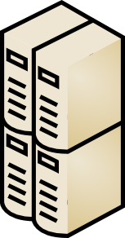
Data Processing Stove Pipes
Telemetry
Storage
Science
Product
Storage
Data
Processing
File
Server
UARS
Database
Server
Telemetry
Storage
Science
Product
Storage
Data
Processing
Web
Server
SORCE
Legacy
Science
Products
Glory
SDO
Notes:
We do provide tools to simplify access, but they often don't work together to overcome the data diversity.
The user may have to login to another machine to access some data files.
Some data reside in a relational database which requires special expertise or tools to access.
Many projects have simplified data access by providing a web interface, but these too are often stove pipe solutions.
Accessing our data can be very time consuming. We aim to relieve the data user of this concern.

Slide 4
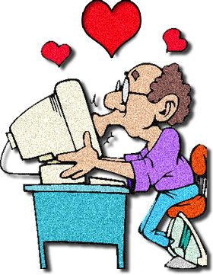
Data Processing Stove Pipes
Telemetry
Storage
Science
Product
Storage
Data
Processing
File
Server
UARS
Database
Server
Telemetry
Storage
Science
Product
Storage
Data
Processing
Web
Server
SORCE
Legacy
Science
Products
LASP Time Series Server
(LaTiS)
Glory
Interoperability via a Common Service
SDO
Notes:
The LASP Time Series Server (LaTiS) is designed to provide a single interface to the data. In lieu of imposing any common software infrastructure on all missions, our approach adapts to existing systems.

Slide 5
Interoperability via a Common Data Model
files
Excel
TSML
ASCII File
Reader
Common
Data
Model
CSV
Writer
Binary File
Reader
Binary
Writer
IDL/Matlab
Program
database
TSML
Database
Reader
OPeNDAP
Writer
Analysis
Tools
Service
Reader
JSON
TSML
Web
Application
(LISIRD)
remote
services
...
...
LASP Time Series Server
Data
Source
Dataset
Descriptor
Data
Application
Notes:
LaTiS operates by providing Readers to input various data sources into a common data model and Writers that can output various formats. Additional Readers and Writers and Filters can be developed and plugged in to support additional data sources and application needs.
Cdm can later be used by reusable data processing framework

Slide 6
Unidata Common Data Model
Merge NetCDF Classic, HDF5, OpeNDAP data models
As implemented by NetCDF-Java
NetCDF Markup Language (NcML) + IOServiceProvider (IOSP)
http://www.unidata.ucar.edu/software/netcdf-java/CDM/

Slide 7
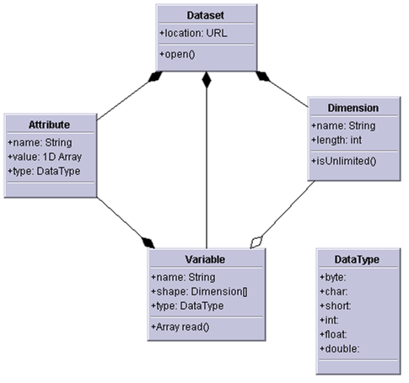
NetCDF Class Data Model

Slide 8
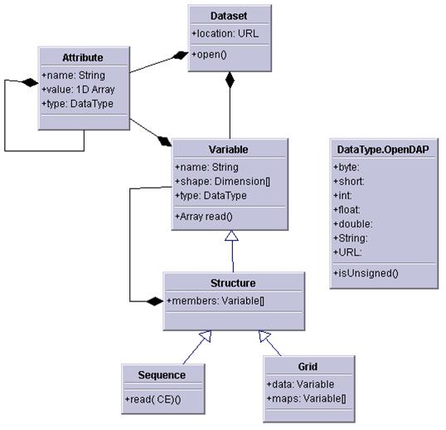
OPeNDAP Data Model

Slide 9
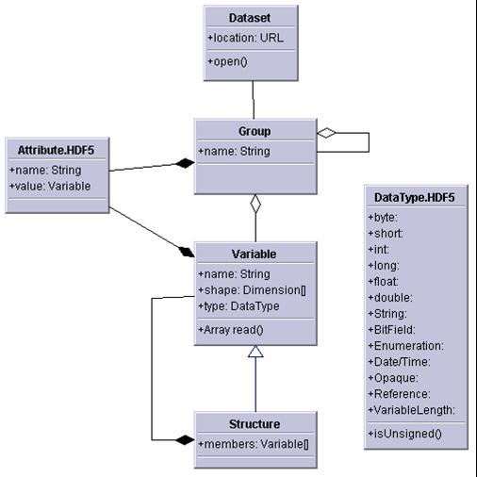
HDF5 Data Model

Slide 10
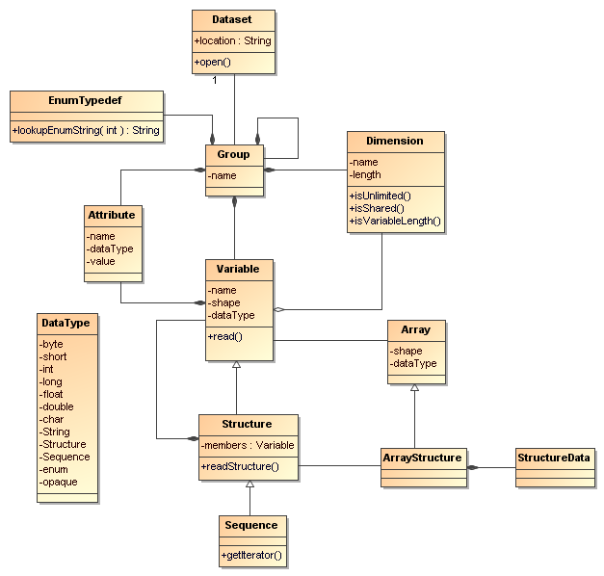
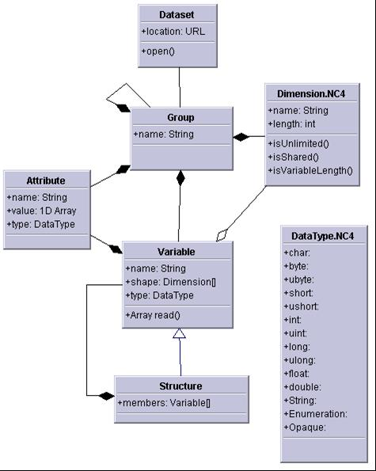
Unidata Common
Data Model

Slide 11
Unidata CDM limitations (for our needs)
Different intent, design goals
  Unidata: enhance existing dataset
  LASP: describe, reshape existing data
Time Series: Sequence, not mature
Aggregation limited
NetCDF-Java API largely influenced by netCDF as a file format.
Specialized scientific feature types (e.g. forecast models) are tightly coupled to the implementation.
Unneeded complexity.

Slide 12
LaTiS Data Model
Inspired by the Unidata CDM
Largely consistent with CDM but different semantics
Object Oriented over Array based
Functional relationships
Dimensions have shape, not each Variable
Structure plays the role of Group, Compound type, or even Dataset. Just a collection of variables.
Data storage agnostic, beyond file and type abstraction
Virtual: subset, filter before reading data
Implementation independent API
Extensible with custom variable types as plugins

Slide 13
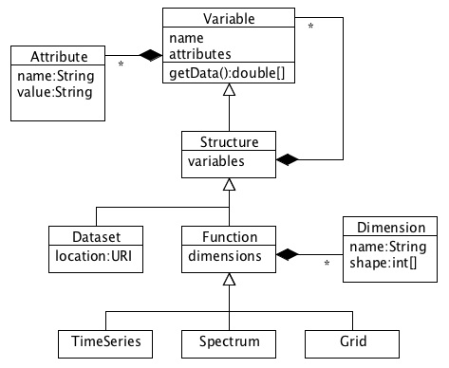
LaTiS Data Model

Slide 14
Example: Time Series of Spectra
NetCDF Classic (CDL):
dimensions:
time = UNLIMITED;
wavelength = 100;
variables:
double time(time);
double wavelength(wavelength);
double a(time,wavelength);

Slide 15
Example: Time Series of Spectra
Unidata CDM (NcML):
<dimension name="time" isUnlimited="true"/>
<dimension name=”wavelength” length=”100”/>
<variable name=”time” shape=”time” type=”double”/>
<variable name=”spectrum” shape=”time” type=”Structure”>
<variable name=”wavelength” shape=”wavelength” type=”double”/>
<variable name=”a” shape=”wavelength” type=”double”/>
</variable>

Slide 16
Example: Time Series of Spectra
LaTiS Data Model (TSML):
<variable name=”TimeSeries”>
<dimension name="time"/>
<variable name=”time”/>
<variable name=”spectrum”>
<dimension name=”wavelength” length=”100”/>
<variable name=”wavelength”/>
<variable name=”a”/>
</variable>
</variable>

Slide 17
LASP Time Series Server (LaTiS)
RESTful web service built around the reference implementation of the data model API
Open Source, Java Servlet, portable, easy to install
Independent implementation of OPeNDAP (DAP2) specification, and more
Time Series Markup Language (TSML) as dataset descriptor. Inspired by NcML.
Adapters (like IOSPs) to read various data sources via common data model interface (note: does not specify data representation), can use the TSML (unlike IOSPs)
Writers to output various formats
Filters to do server side processing
Modular architecture. Plugin functionality.

Slide 18
LaTiS Data Access Interface
Web Service URL (REST):
http://host/latis/dataset.suffix?constraint_expression
host: Name (and port) of the computer running the server
dataset: Name of a dataset that the server is configured to serve
suffix: The requested type/format of the output
constraint_expression: A collection of request parameters such as
time range and filters to limit the results
http://lasp.colorado.edu/lisird/tss/sorce_tsi_24hr.csv?time,tsi_1au
&format_time(yyyy-DDD)&time>2010-01-01
Demos...

Slide 19
LaTiS Roadmap
HDF Adapter and Writer modules
Other formats
More Filters
December 2010 release (AGU)
Go beyond the time series abstraction
Run with distributed data in the cloud.

Slide 20
Bonus slides

Slide 21
See Time Series Data Server poster (AGU 2009): http://sourceforge.net/projects/tsds/files/TSDS_poster_nobg.pdf/download

