Slide 1
HDF
Past, Present, Future
Mike Folk
The HDF Group
The 14th HDF and HDF-EOS Workshop
September 28-30, 2010

Slide 2

The Earlyyears

Slide 3
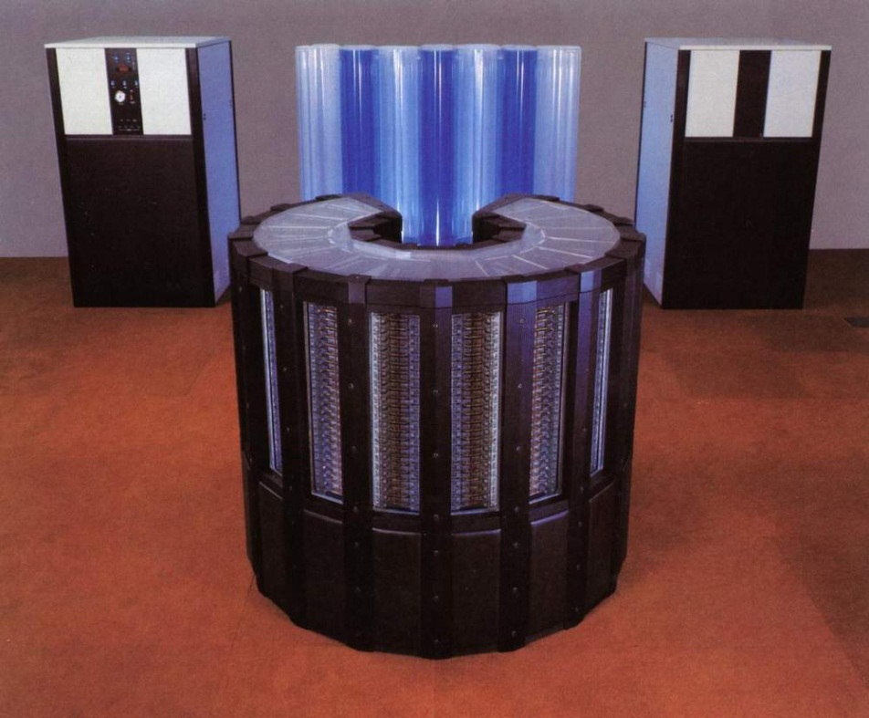
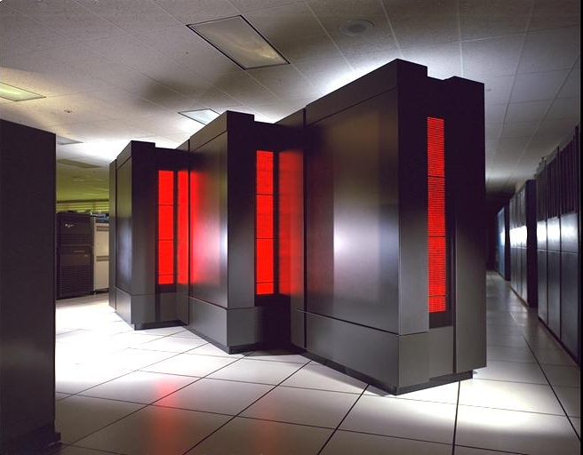
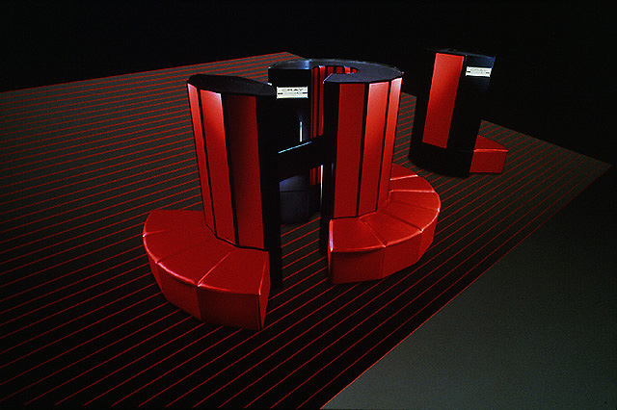
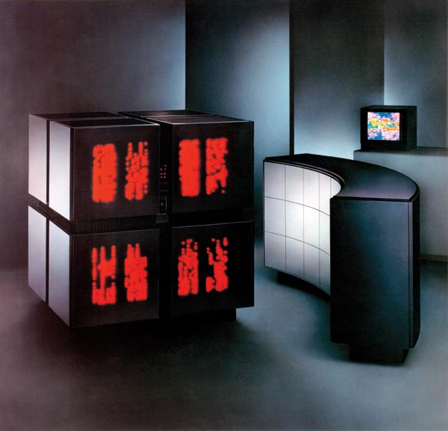

Slide 4
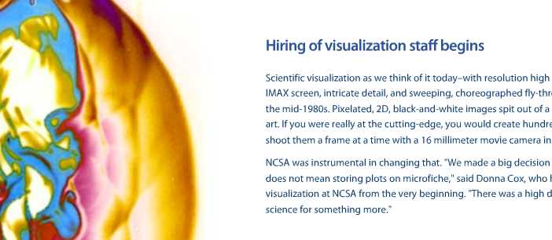
NCSA 1986

Slide 5
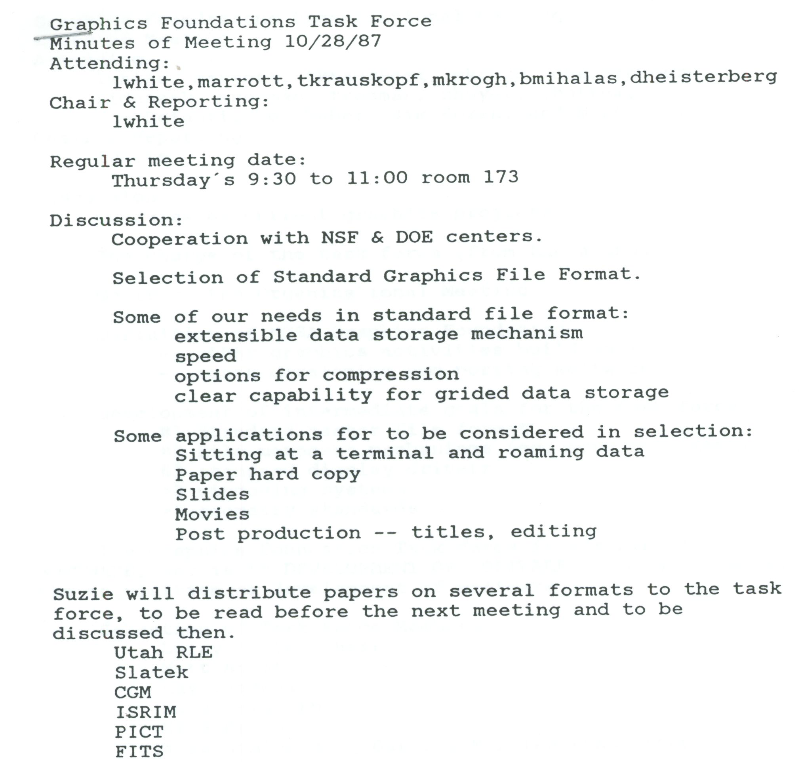
GFTF Oct 28, 1987

Slide 6
GFTF Oct 28, 1987

Slide 7
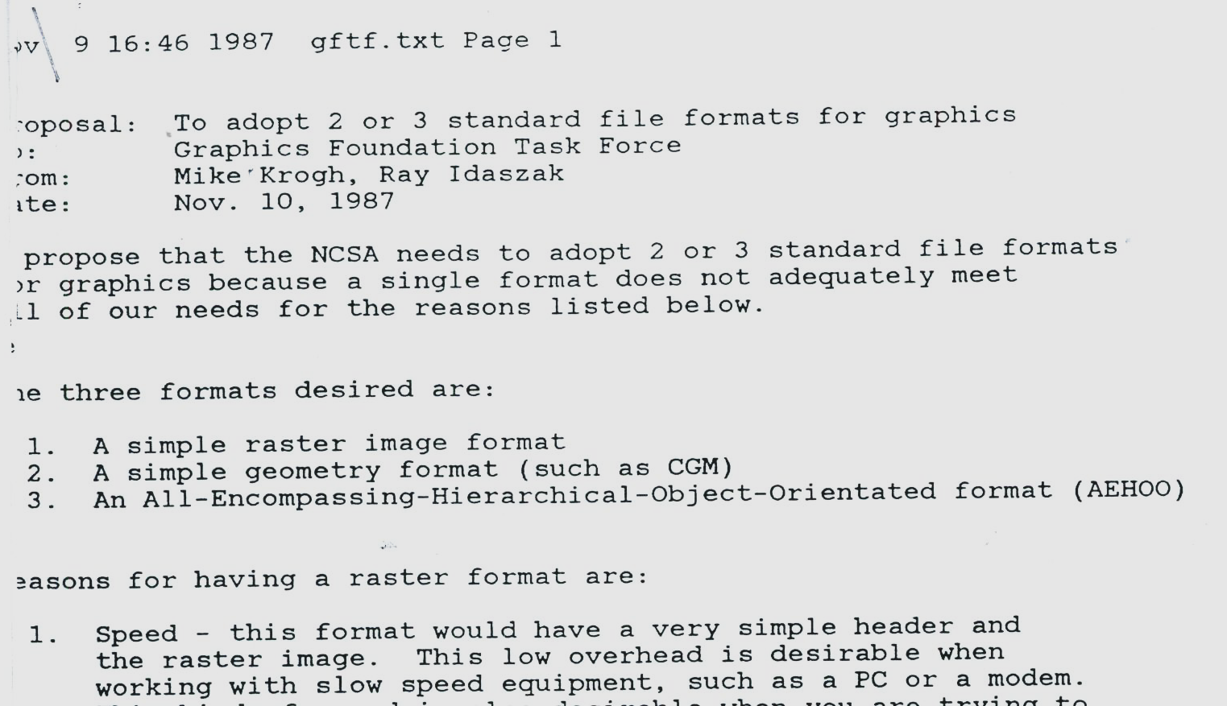
GFTF Nov 9, 1987

Slide 8
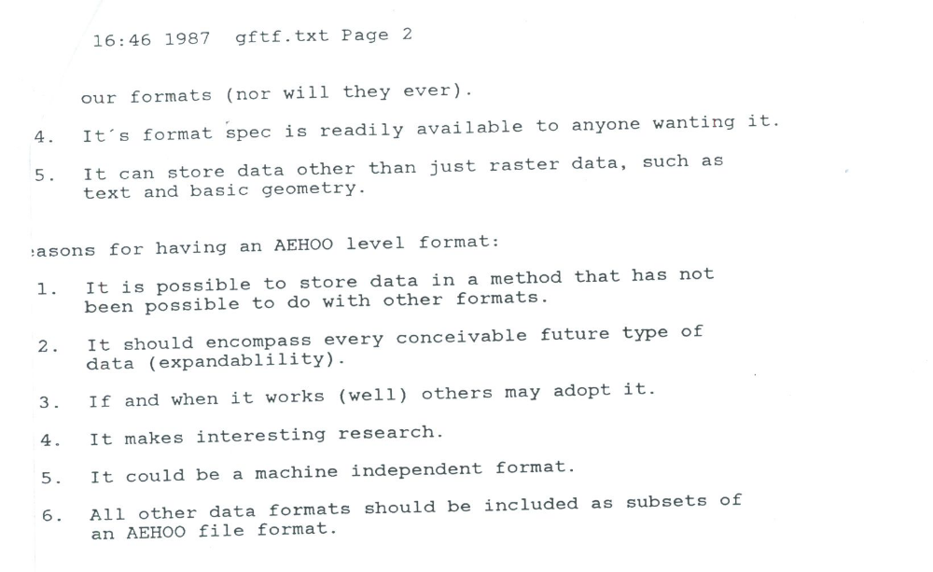
GFTF Nov 9, 1987

Slide 9
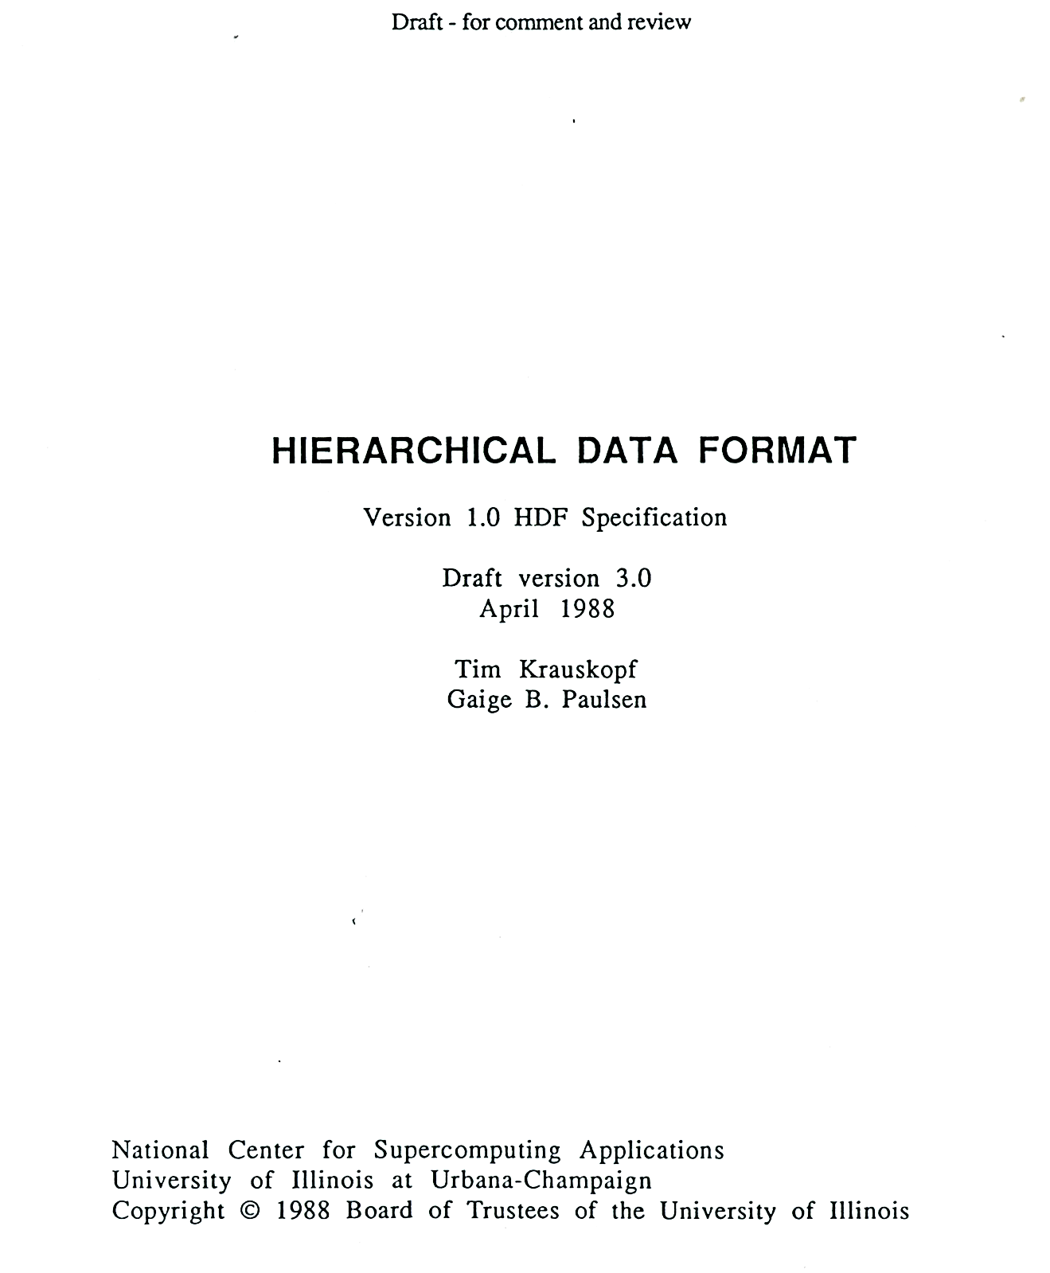

Slide 10
Library
Version 1 – 1988
  Primitive objects
    “raster,” “palette”, “aspect ratio”
  “sets” or groupings to form higher level objects
    “raster image set”
Version 2 – 1989
  Scientific data sets
  24-bit raster

Slide 11
Library
Version 3 – 1990
  Subsetting
  Vertex sets (Vsets)
    Groups (Vgroups), and tables (Vdatas)
Version 4 – 1996
  Full multiple file, multiple object access

Slide 12
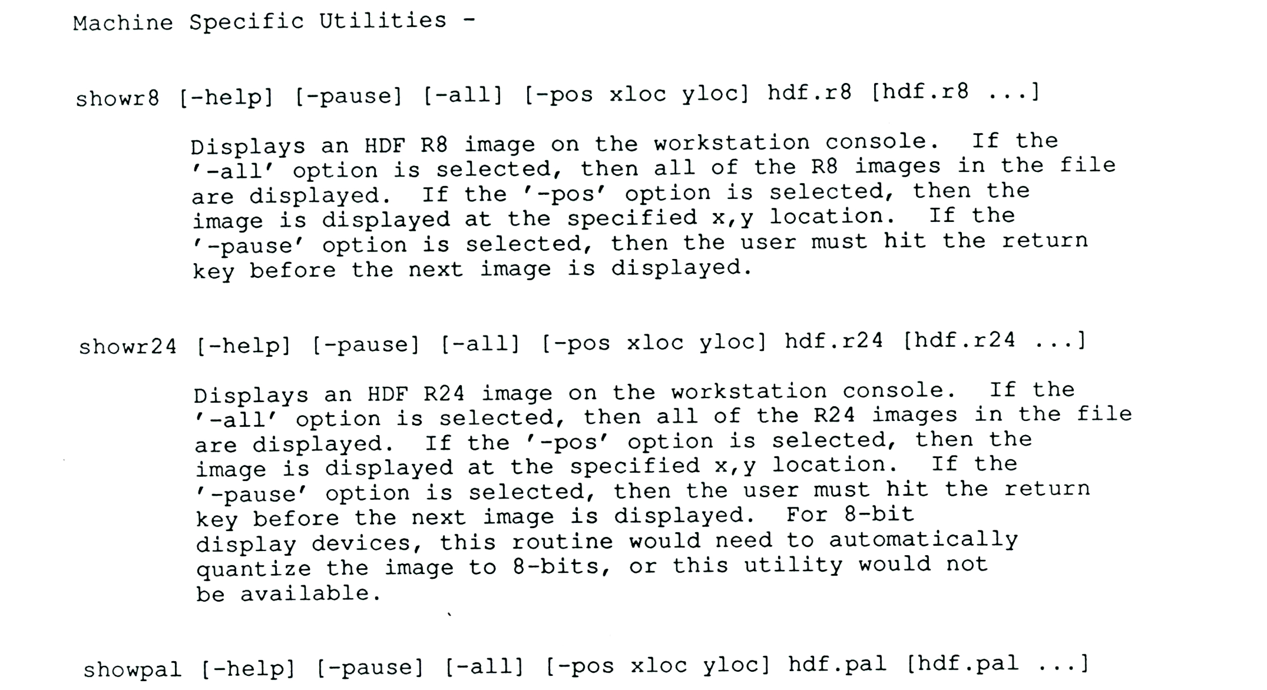
Command line tools

Slide 13
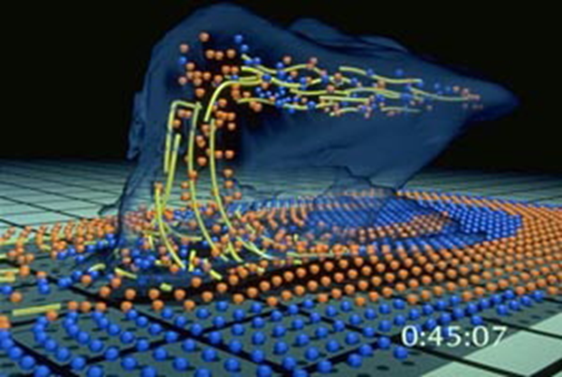
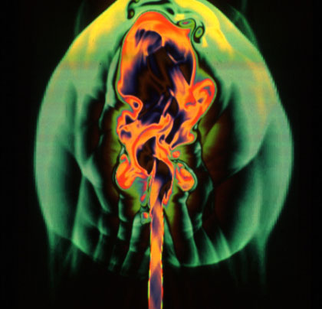
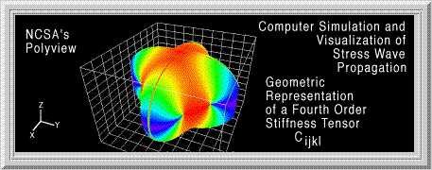
NCSA software
Big simulations with HDF
Desktop visualization with “NCSA Image”
Desktop visualization with PolyView
Notes:
Wilhelmson
Norman
Polyview: Kriz paper: http://www.sv.vt.edu/NCSA_WkShp/kriz/WkShp_kriz.html

Slide 14
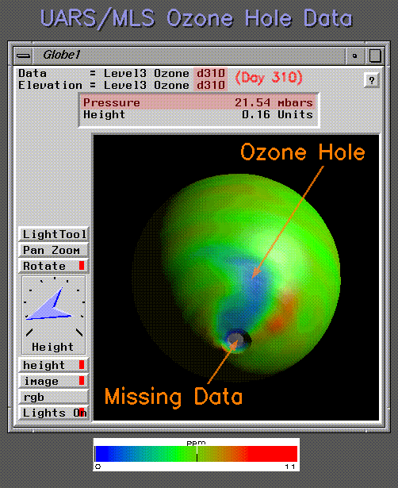


Slide 15
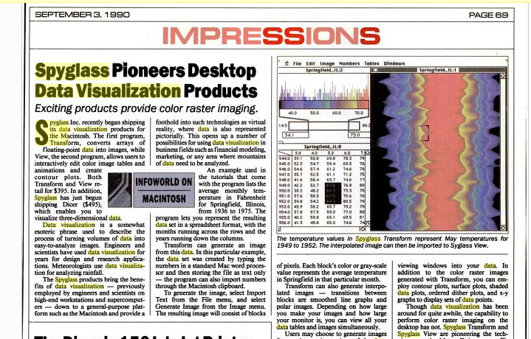

Slide 16
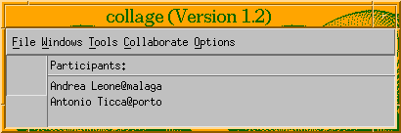
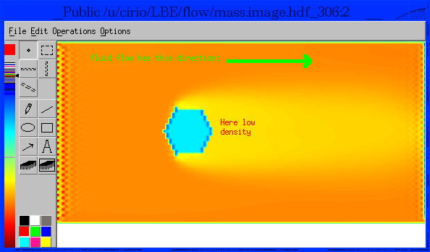

Slide 17
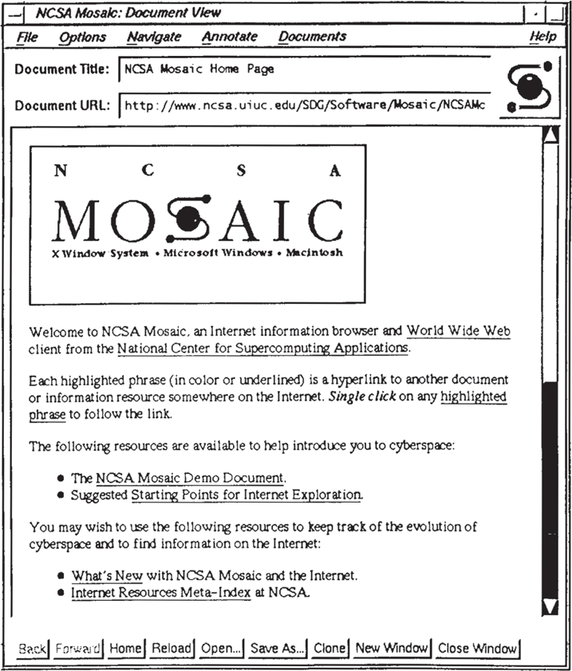
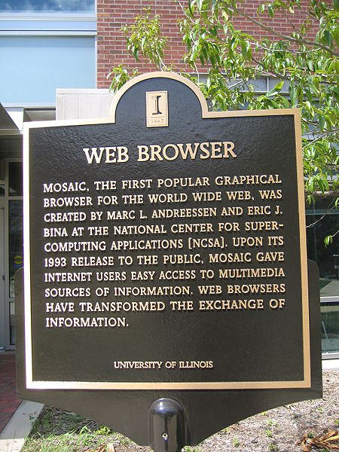

Slide 18
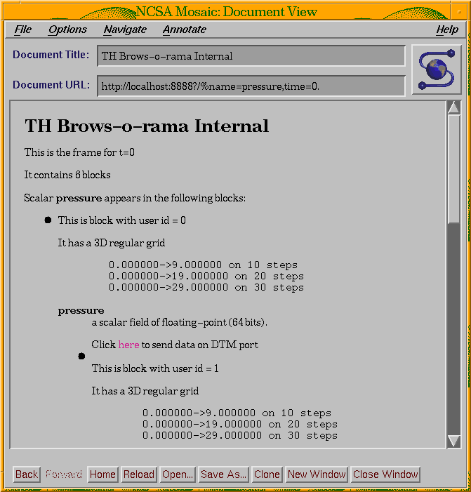
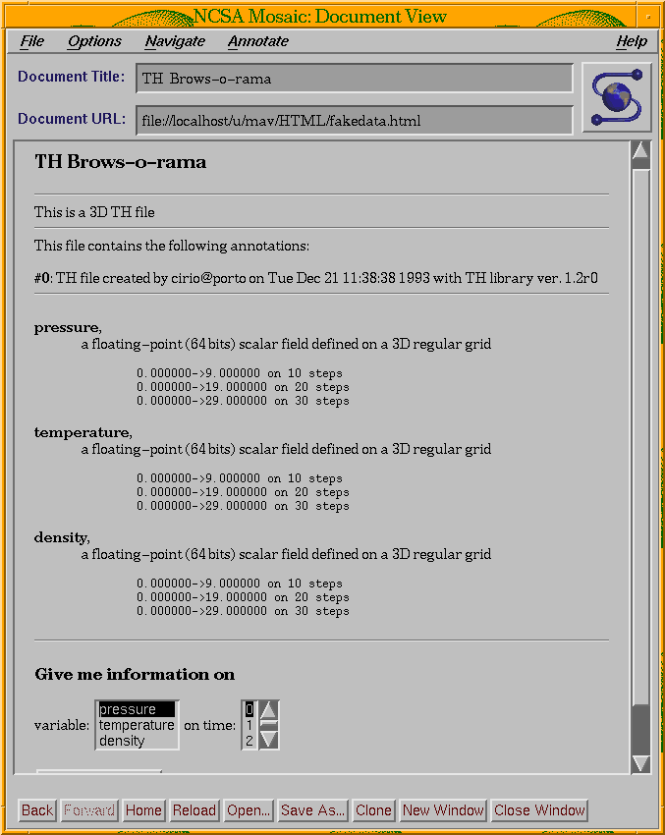

Slide 19


Slide 20


NetCDF Harmonization
NSF $ =
+

Slide 21
“NSF Software Capitalization”
User support
Documentation
testing
NSF $ =

Slide 22
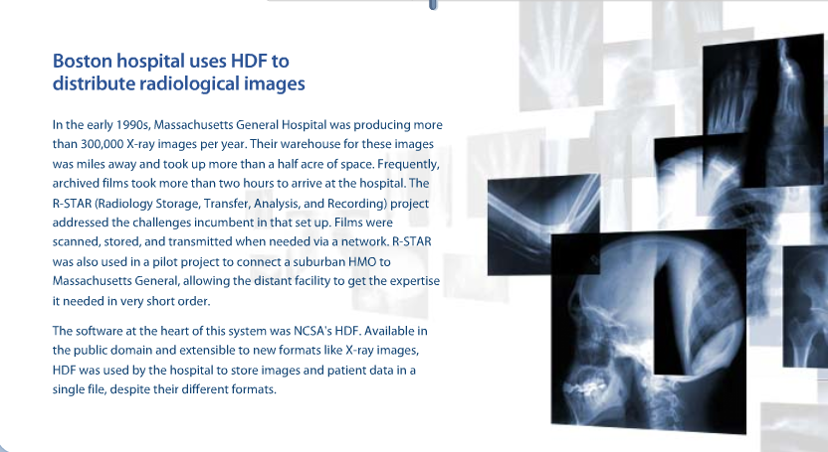
Other adopters of HDF

Slide 23
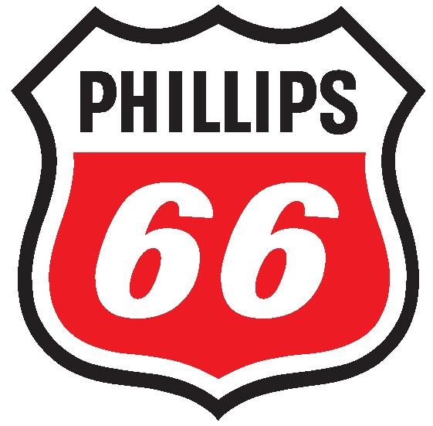
Other adopters of HDF

Slide 24
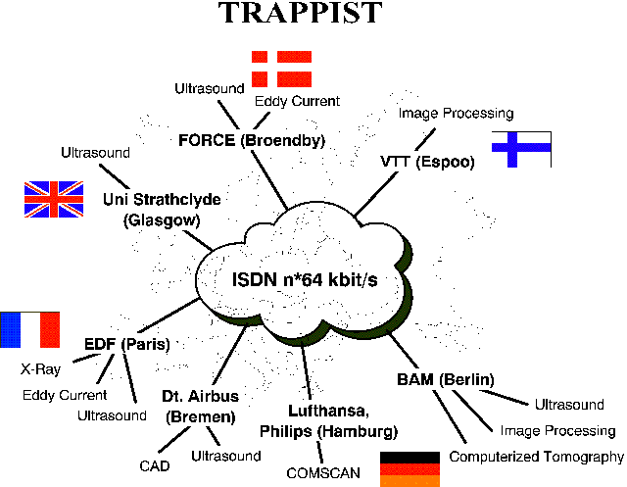
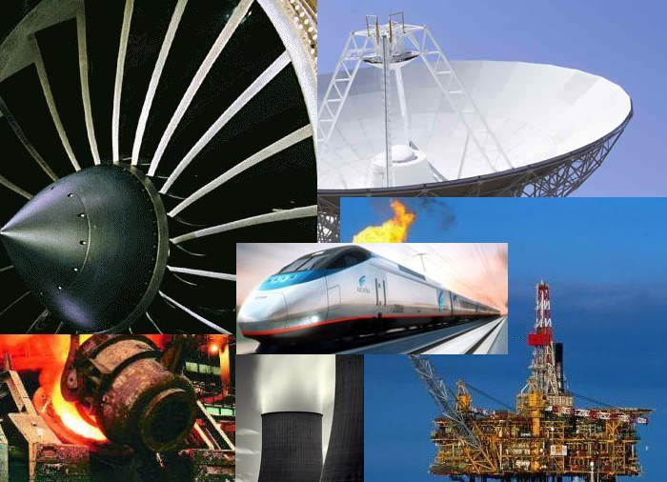
Other adopters of HDF
Non-destructive testing

Slide 25
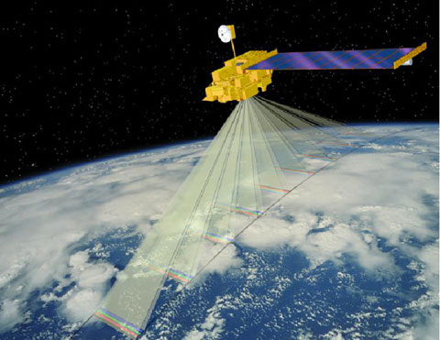
Earth Observing System

Slide 26

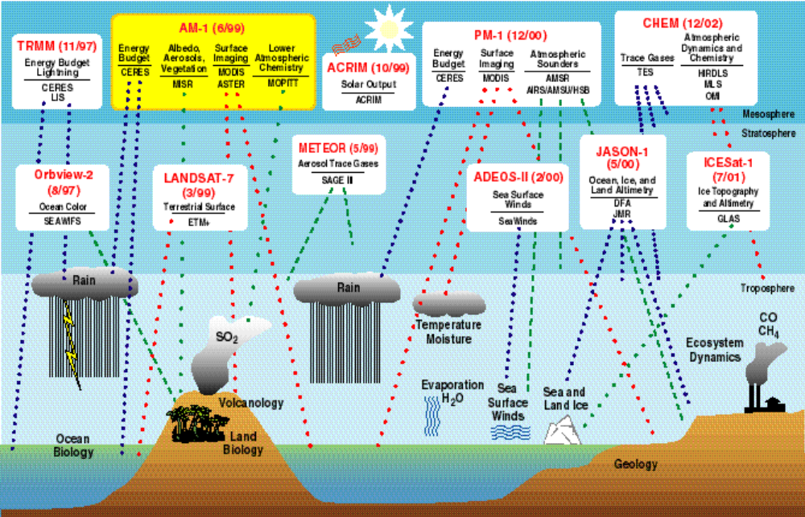
Earth Science (Earth Observing System)
Terra
CERES MISR
MODIS MOPITT
Aqua (6/01)
Aqua
CERES MODIS
AMSR
Aura
TES HRDLS
MLS OMI

Slide 27
Message:
HDF needs to support mission critical applications with high quality and performance standards

Slide 28
A need for change?
Shortcomings of HDF (1996)
Limits on object & file size (<2GB)
Limited number of objects (<20K)
Rigid data models
I/O performance
Code complexity

Slide 29
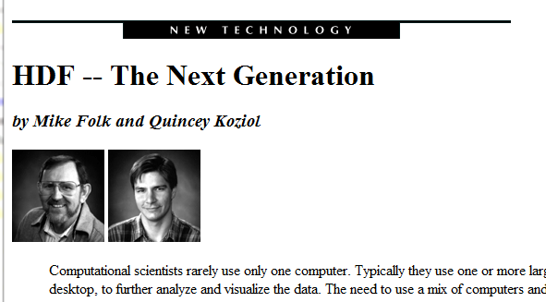
NCSA Access, Spring 1996

Slide 30
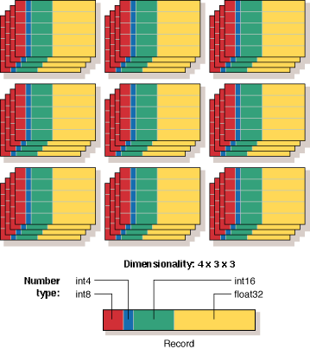

Slide 31
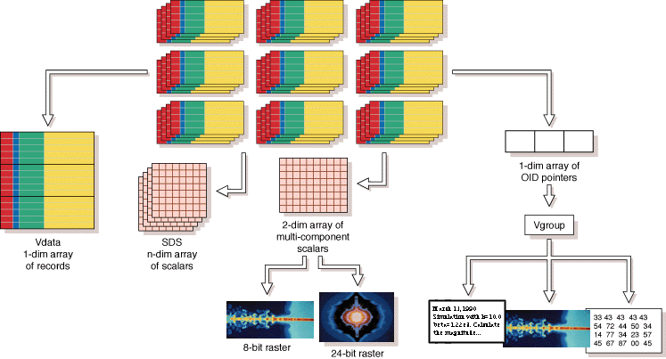

Slide 32
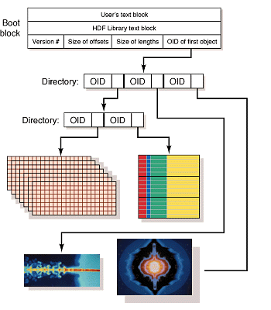

Slide 33
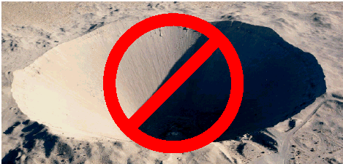
ASCI = Accelerated Strategic Computing Initiative
We Have A Nuclear Test Ban Treaty
How do we maintain a nuclear stockpile in the absence of testing?

Slide 34
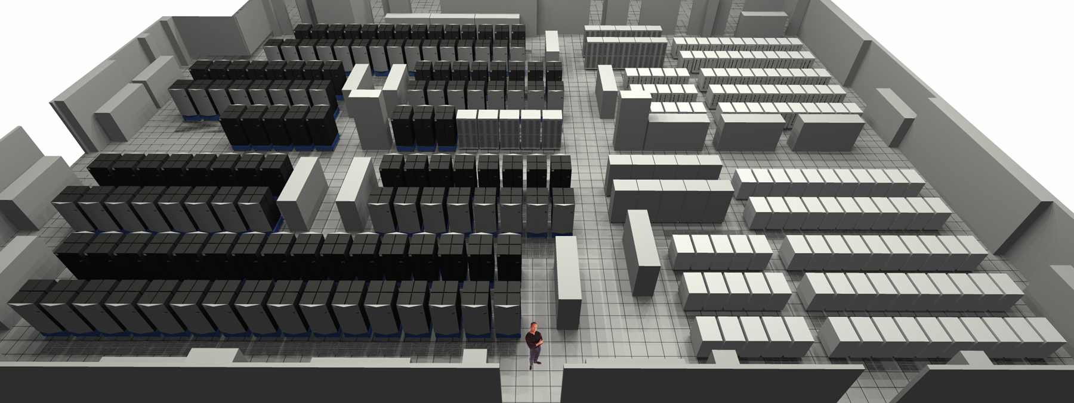

Slide 35
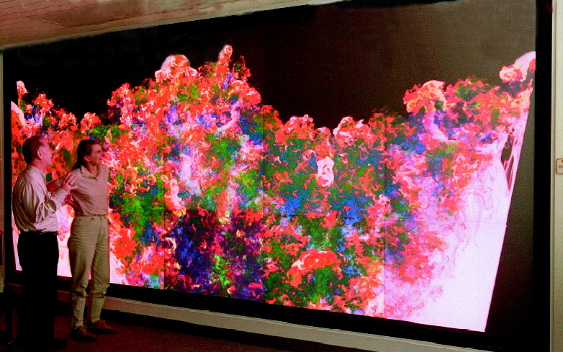
Big simulations
A simulation can have billions of elements
Each element can have dozens of associated values

Slide 36


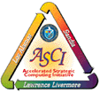


ASCI Data models and Formats Group
Notes:
Terascale computing
DMF
Tri-lab collaboration
Fiber Bundles

Slide 37
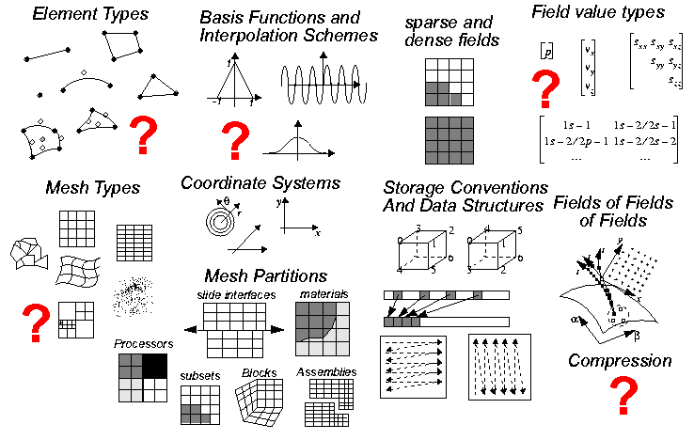
Describing data is challenging

Slide 38
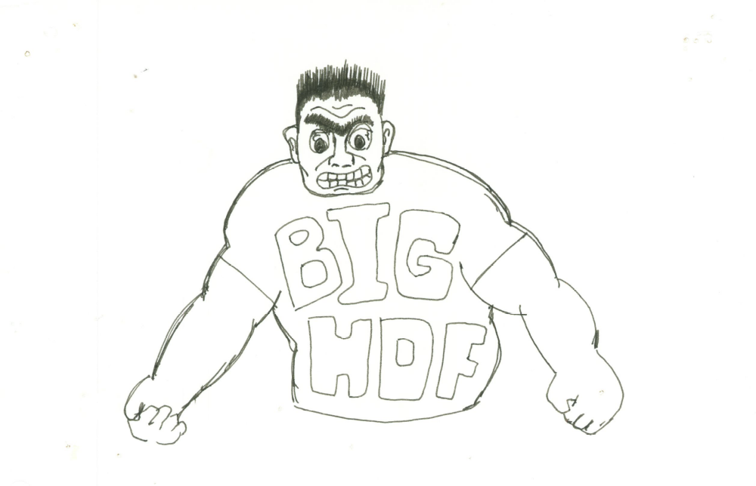

Slide 39
HDF audience (1997)
Applications facing big data challenges
Academia, government, industry
Hundreds of different applications
Users world-wide

Slide 40

Something is missing

Slide 41
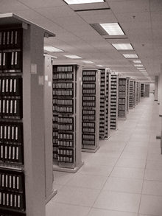

What is on these tapes?
?
Notes:
Al Fleig in 1990 took me to a hallway at NASA where there were racks upon racks of shelves containing old magnetic tapes. Al said to me, “Mike, do you see all of those tapes. Some of them are decades old. They contain priceless data that can help us understand our planet as a system. And Mike, guess what, we don’t have any way to get to the data on most of those tapes because we can’t find the information we need to decipher them. Is there some way with HDF that we can put information at the start of the file – a name, a phone number, anything – that would give us a fighting chance to figure out that information?”
That conversation with Al stuck in my mind from that day forward. When it came time to redesign HDF by creating HDF5, one of the things we did was introduce the use of a user block, so that someone could put their name, or anything else they wanted to, at the beginning of a file, so that the creator or someone else can provide information that will give posterity a fighting chance to figure out what’s in the file.

Slide 42
Message:
Communities are committing critically important data to HDF for the long term, and expect it to last.

Slide 43
The middle years

Slide 44

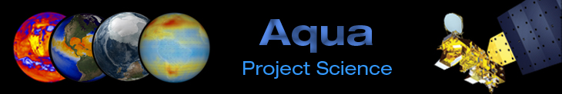


Slide 45
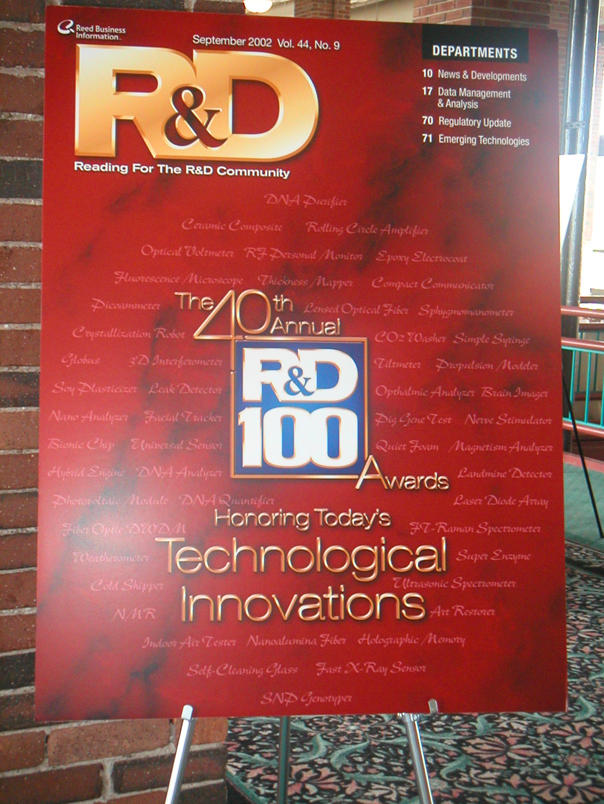
R&D 100

Slide 46
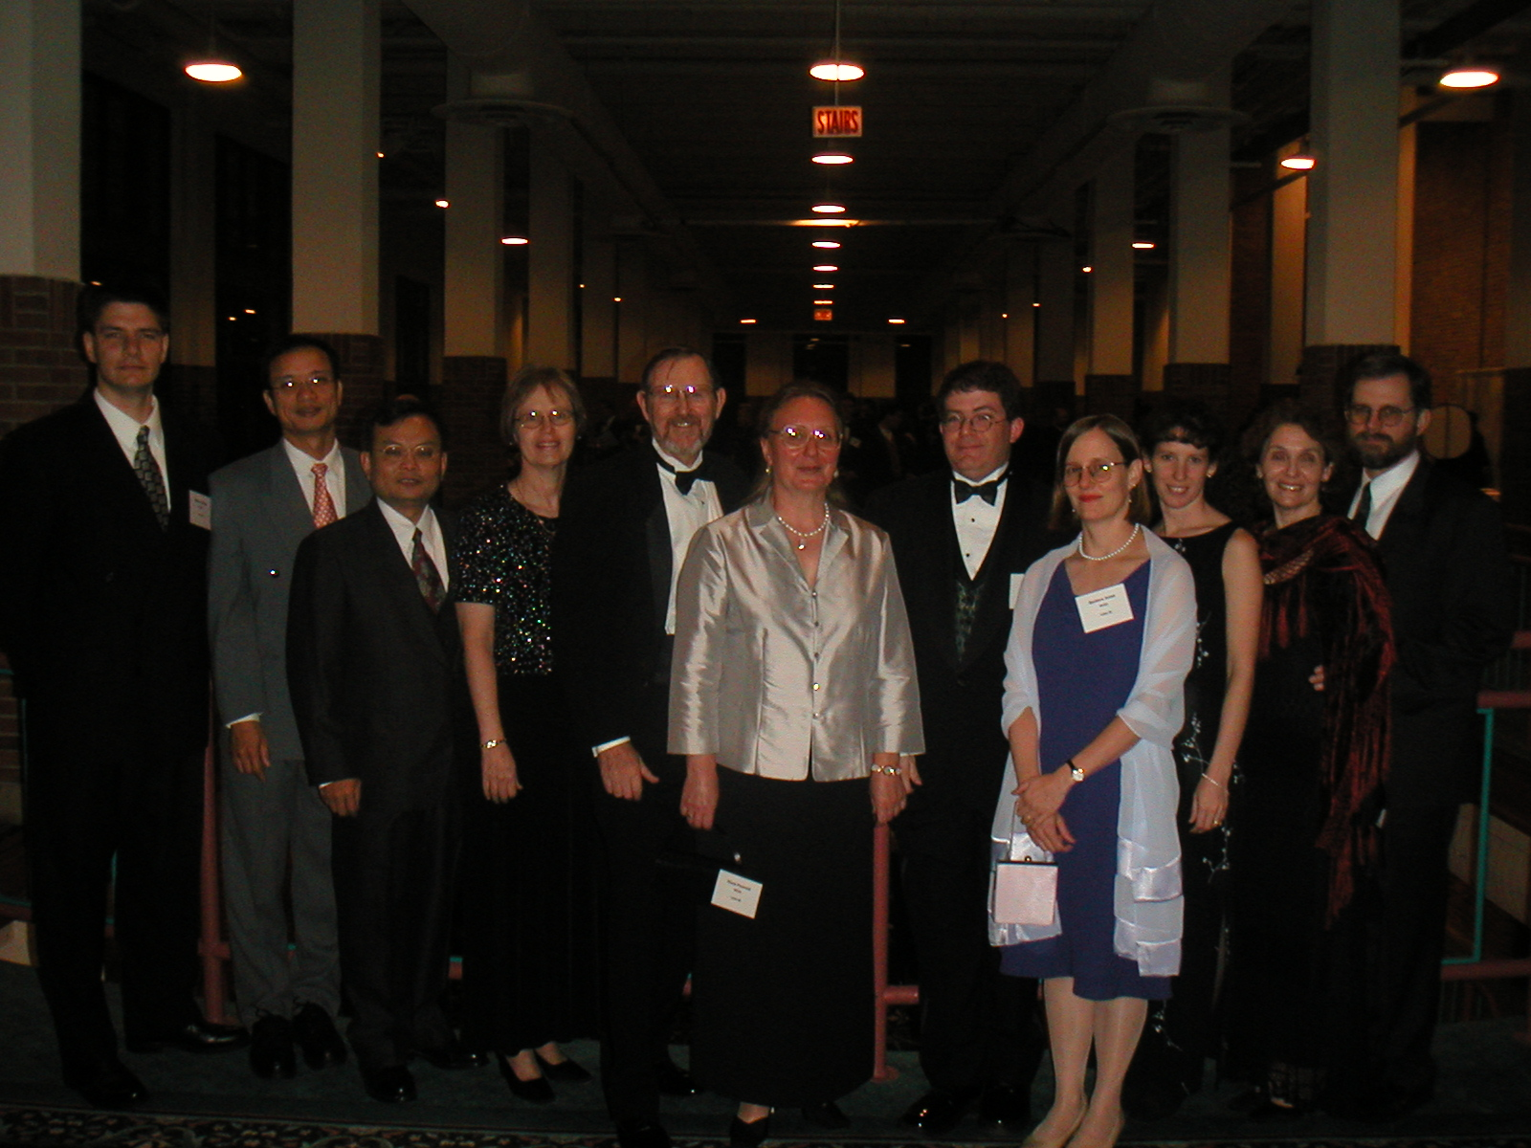

Slide 47
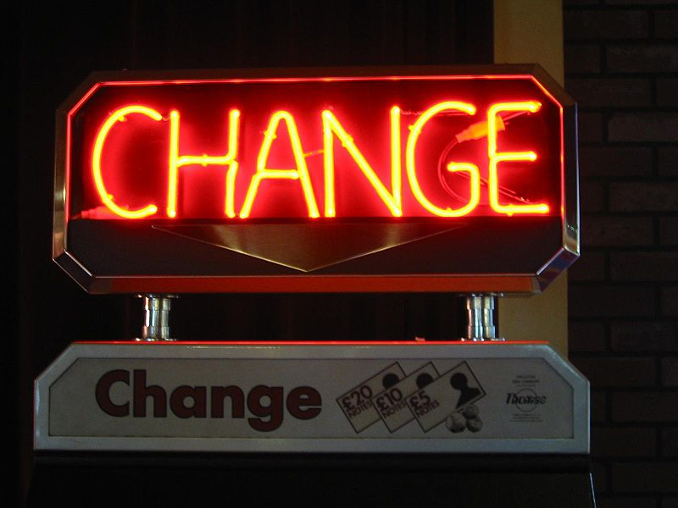
Changing user profile

Slide 48
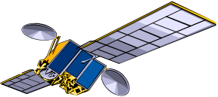
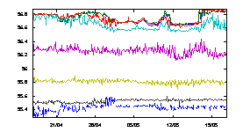
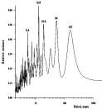
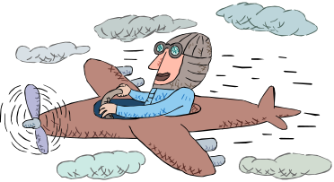




Flight testing
Notes:
New applications and visionaries
Flight testing (Boeing)

Slide 49
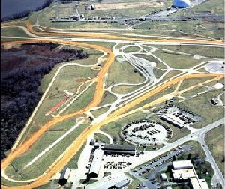
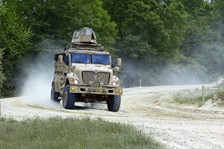
Vehicle testing

Slide 50
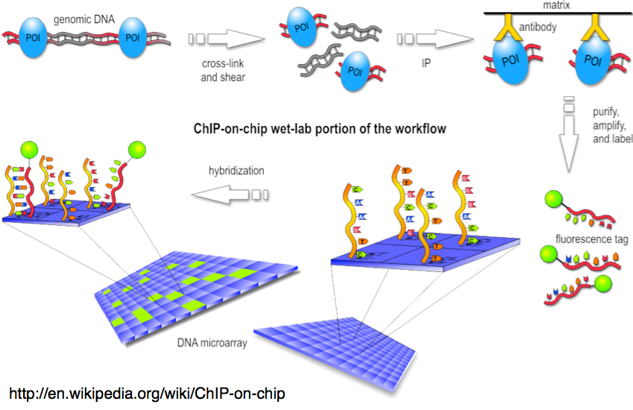
Bioinformatics
Notes:
DNA sequencing (Geospiza)

Slide 51
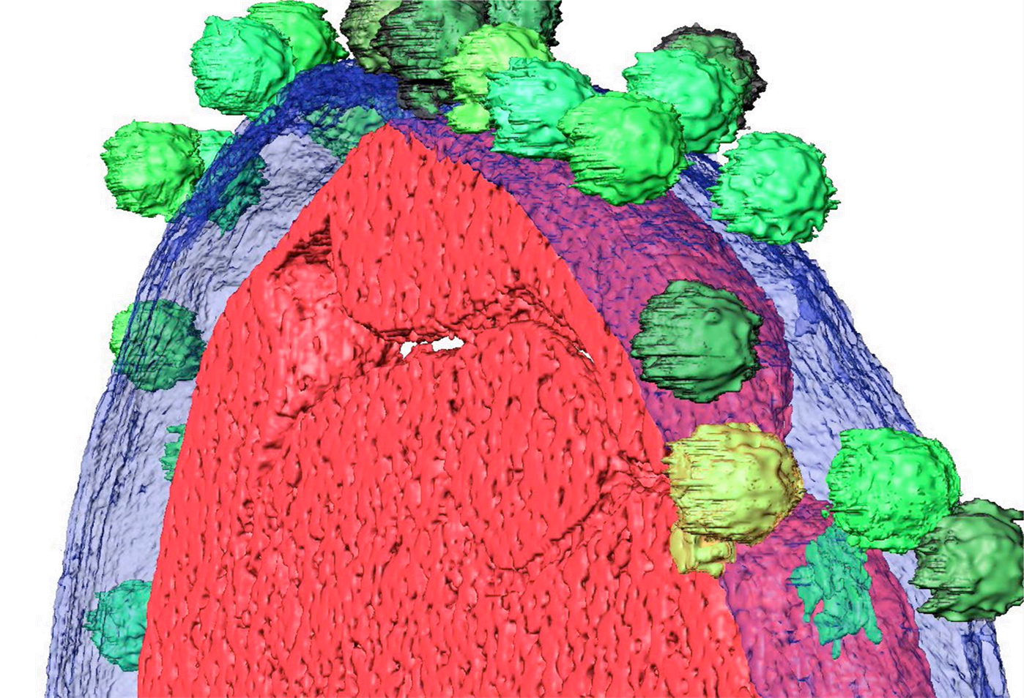
Images
25-80Å resolution electron tomography
8k x 8k x 1k images soon (256 GB)
Notes:
Electron tomography

Slide 52


Making movies
Spiderman 3
The Polar Express
Notes:
Sony Imageworks’ Field3D uses HDF5 as its format.
HDF5 was used in the making of Lord of The Rings

Slide 53
New expectations
“Deliverables”
“What about my data in 2080?”
How soon can you do this for me?
Business opportunities and the academy

Slide 54

Doing business in academia
We deliver papers,
not software.
Data preservation?
Talk to the librarian.
I can do that
for you maybe
by next year.
No profits
allowed here!

Slide 55

Notes:
The Fiddler is a metaphor for survival, through tradition and joyfulness, in a life of uncertainty and imbalance.

Slide 56


Slide 57
Missions and Goals
The five missions
  Public
  Software
  Service
  Human
  Financial/Structural

Slide 58
HDF Group Mission
To ensure long-term accessibility of HDF data through sustainable development and support of HDF technologies.

Slide 59

Spinning off
Business options and questions
  For-Profit or not?
  How to make money?
Intellectual property

Slide 60


Help from an unexpected place

Slide 61
Running our Business:
Challenges and Surprises

Slide 62
Challenges
Managing contracts
Finance
  Keeping overhead under control
  Defining “profit”
  Accounting and budgeting expertise
Business model
Notes:
Cost model includes
Cost of the work
Our salaries and expertise make us competitive
F&A overhead
R&D tax
For non-targeted
Sustainability tax
Other options?
E.g. licensing strategies to provide long-term revenue sources
Cash flow
There’s always a lag b/w when the work’s performed and when it’s rec’d
Build a financial reserve – 3 mos. operational expenses min
This will allow you to operate and preserve cash flow while billables/AR
are flowing in
Your lack of a track record can change your charging options
Get lucky –
Find client with a big need for your product and ready cash
Or go the more traditional route
Know your cost structure and benchmarks
People, overhead, good/services, raw materials, facilities, profit
What do we need now, what can we phase in?
Will costs vary by markets?
Valuable old clients’ expectations and needs may not match
what is best for you, forcing compromise
What impact will this have on bottom line?
Essential to cash flow, esp. early on
Essential to revenue and making sure you have the right resources
to deploy at the right time.
You’ll need to be flexible while working this out
You are learning as you go

Slide 63
Today vs. 2006
 | 2006 | 2010
Staff | 17 | 34
Funded projects | 6 | 13
Budget | $1.6M | $3.4M

Slide 64
The Future

Slide 65


The near future

Slide 66

    Cross the chasm to new users and applications
Time
Notes:
To broaden the base of supporters, thus reaching a threshold support for HDF5 that will guarantee sustainability
And/or to reach a point where the technology is perceived as a public good that must be sustained.
Broaden the base - increase the need for long-term support
Diverse application domains
Diverse institutional types (govt, commercial, academic)
Vendors
More large, stable institutional use and support
Whole product support
Tools
technology interoperability
(iRODS, opendap, XML, RDBMS, MATLAB, ...)
Add enough legs to the stool...
To broaden the base of supporters, thus reaching a threshold support for HDF5 that will guarantee sustainability
And/or to reach a point where the technology is perceived as a public good that must be sustained.

Slide 67
The near future
From technology driven to market driven
Raising the open source quality bar
Expanding our ability to help customers
Expanding the kinds of things we're good at

Slide 68


The future

Slide 69

Technology strategies
Notes:
A simple, durable but evolvable model and implementation
Self-description
Specification documentation
Preservation-based evolution
Providing different ways to view the same information
Integration with preservation frameworks

Slide 70

Lots of data
Notes:
Avogadro’s number – the number of carbon atoms in 12 grams – is
602,200,000,000,000,000,000,000
In 15 years the number of bits in the digital universe will surpass Avogadro’s number.*
* The digital universe.

Slide 71

Big data
Cores | Petaflops
224,162 | 1.759
Image courtesy of the National Center for Computational Sciences, Oak Ridge National Laboratory”.
Notes:
The world's fastest supercomputer today, a Cray XT5 system at Oak Ridge National Laboratory that's known as Jaguar, has a peak performance of 2.3 petaflops. A petaflop is a quadrillion, or 1,000 trillion, sustained floating-point operations per second.
The total capacity of the latest Top500 list of the most powerful supercomputers, released at SC09, was 27.6 petaflops, up from 22.6 petaflops in the previous list, released in June.
One exaflop is 1,000 times faster than a petaflop -- performing 1 quintillion, or 1 million trillion calculations per second. "We think exascale is a 100 million-core kind of enterprise," said Dave Turek, vice president of deep computing at IBM.
In mid-2008, IBM's Roadrunner supercomputer -- a hybrid system that runs both AMD's Opteron processors and Cell chips designed by IBM, Toshiba Corp. and Sony Corp. -- was the first to achieve petaflop speeds. Now the U.S. Department of Energy has started making plans to build an exascale system that's 1,000 times more powerful than Jaguar.
These future systems must use less memory per core and more memory bandwidth. Systems running 100 million cores will face continuous core failures, and the tools for dealing with them will have to be rethought "in a dramatic kind of way," said Turek.

Slide 72




Kinds of data

Slide 73
GFTF Nov 9, 1987

Slide 74

A focus on Preservation
Darwin’s first evolutionary tree - 1837
Notes:
"Evolve with compatibility"
Develop guidelines to keep evolution under control
Develop process to ensure cross-generational compatibility

Slide 75

Preservation-based evolution
Darwin’s first evolutionary tree - 1837
Notes:
"Evolve with compatibility"
Develop guidelines to keep evolution under control
Develop process to ensure cross-generational compatibility

Slide 76

    Promoting standardization and interoperability
Notes:
Emphasis on standards. Organization and with user communities emphasize the importance of developing and adhering to standards.
Make HDF5 itself a national and international standard, and important building block to preservation.
Foster standard uses of HDF5 so that more and more diverse groups can share and integrate data
Promote standard usage within domains
Examples
HDF-EOS
CGNS
HDF Time history (Aerospace)
NeXuS
BioHDF
components
Unified data model
API and implementation (preferably multi-language)
Tools
Lots of data

Slide 77

Institutional strategies
Notes:
Long-term institutional support
One keeper of the format and software
A mission-driven business
Open source
Free as in speech, not as in
Cross the chasm to new users and applications
Promoting standardization

Slide 78

    A mission-driven business

Slide 79

    One keeper of the format and software

Slide 80

Open source
Notes:
Community-based, created for and supported by vast user base who constantly test HDF, demonstrate its countless uses, help improve and promote it.
Open source lowers barriers to basic access
Knowledge : format and source code available
Economic: format, basic library, tools all free
IP: applications built on HDF not encumbered by IP requirements

Slide 81

    Long-term institutional support
The National Archives, Washington, D.C.
Notes:
Become a sustainable institution
Create independent, self-sustaining institutional support
Define the mission and vision
Establish organization that is mission driven
Establish a mindset that values long-term preservation mission

Slide 82



    Human, financial, legal foundations for sustainability
Notes:
Find a business model that builds assets and is sustainable
Find the right IP strategy that balances openness with stewardship
Develop sustainability assets: knowledge, people, finances

Slide 83

Business model

Slide 84

    A virtual organization
Notes:
Emphasis on standards. Organization and with user communities emphasize the importance of developing and adhering to standards.
Make HDF5 itself a national and international standard, and important building block to preservation.
Foster standard uses of HDF5 so that more and more diverse groups can share and integrate data
Promote standard usage within domains
Examples
HDF-EOS
CGNS
HDF Time history (Aerospace)
NeXuS
BioHDF
components
Unified data model
API and implementation (preferably multi-language)
Tools
Lots of data

Slide 85
Thank You

