Slide 1
HDF Update
Mike Folk
The HDF Group
The 14th HDF and HDF-EOS Workshop
September 28-30, 2010

Slide 2
Topics
What's up with The HDF Group?
Library Update
Tools update
HDF Java Products
Other activities
Library development in the works

Slide 3
What’s up with The HDF Group?

Slide 4
What is
The HDF Group
And why does it exist?
Notes:
Why
Increasing need for support, services, quick response
Not a good model for a University R&D project
Who
11 software engineers and several students: develop, maintain HDF software, work on special projects, manage projects
3 tech support staff: helpdesk, doc, sysadmin.
Management team
President
Director of Technical Services and Operations
Director of Software Development
Director of Business Operations
Managers responsible for tools, applications
Other THG staff include seven full-time software engineers who develop and
maintain the HDF software, as well as working on special projects, and three
technical support staff who provide helpdesk support, documentation, and
system administration. The HDF group also generally employs students from
the University Computer Science and Engineering departments.

Slide 5
The HDF Group
A company dedicated to supporting HDF and its users
  18 years at University of Illinois National Center for Supercomputing Applications
  5 years non-profit “The HDF Group”
The HDF Group owns HDF4 and HDF5

Slide 6
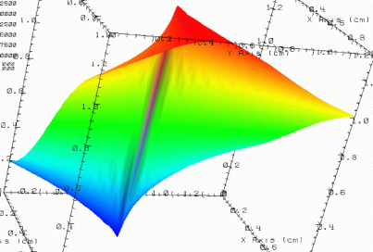

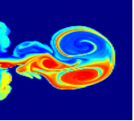

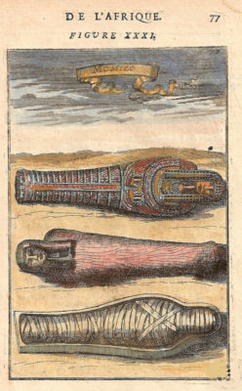
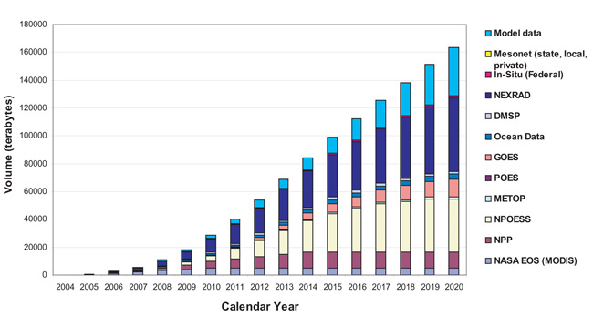
Data challenges addressed by HDF
Need to
organize complex collections of data
lat | lon | temp
----|-----|-----
12 | 23 | 3.1
15 | 24 | 4.2
17 | 21 | 3.6
Experiment Notes:
Serial Number: 99378920
Date: 3/13/09
Configuration: Standard 3
Long term data preservation
Efficient, scalable storage and access

Slide 7
The HDF Group Services
Helpdesk and Mailing Lists
  Available to all users as a first level of support
Standard Support
  Rapid issue resolution and advice
Consulting
  Needs assessment, troubleshooting, design reviews, etc.
Training
  Tutorials and hands-on practical experience
Enterprise Support
  Supporting many HDF activities across organizations
Special Projects
  Adapting customer applications to HDF
  New features and tools
  Research and Development

Slide 8


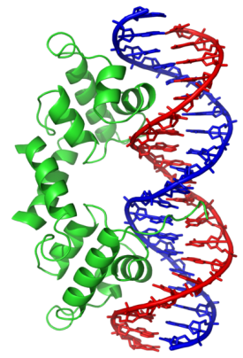






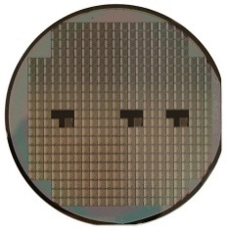







Members of the HDF support community
Army test and evalution command
Notes:
NASA – EOS
NOAA/NASA/Riverside Tech – NPOESS/JPSS
Army Geospatial Center
A leading U.S. aerospace company
NIH/Geospiza (bio software company )
University of Illinois/NCSA
Sandia National Laboratory
Lawrence Berkeley National Lab
Projects in petroleum industry, chip design, finance, others
“In kind” support

Slide 9
Some areas of increased recent interest
Improvements
  Concurrent access
  Remote Access
  Parallel I/O performance
  Real-time write performance
  High level language support
Life sciences
  Sequencing
  Biomedical imaging
Database integration
Microsoft products (HPC, .NET, others)

Slide 10
Topics
What's up with The HDF Group?
Library Update
HDF Java Products
Library development in the works
Other activities
Tools Update

Slide 11

Software Releases
Highlights
HDF5
HDF4
HDF4

Slide 12
Time-line of the HDF software releases
HDF5 1.6
1.8.4
(Nov 2009)
1.8.4-patch1 (Feb 2010)
HDF4
4.2.5
(Feb 2010)
H4toH5 conversion software
1.8.5
(June 2010)
1.8.5-patch1 (Aug 2010)
1.8.6
(Oct 2010)
1.8.7
(May 2011)
4.2.6
(Feb 2011)
2.1.1
(Feb 2010)
2.1.3
(Feb 2011)
H5check
2.0
(Apr 2010)
2.1
( Apr 2011 or earlier)
HDF-Java Products
2.6
(Jan 2010)
2.6.1
(Mar 2010)
2.7
(Oct-Nov 2010)
2.1.2
(Oct 2010)
2.7 beta
(Sep 2010)
Dropped
Notes:
1.8 had two patch releases along with the scheduled ones
1.8.6 will come a month earlier due to the office move
New release of h5check depends on future file format changes and reported bugs in the tool; it doesn’t depend on the HDF5 library at all, only on the file format

Slide 13
HDF5 1.8.4 minor release (Nov 09)
New features
  Embedded library information in executable
    UNIX “strings” command pulls the info
  h5diff: Added system “epsilon” for comparing floating-point datasets
  h5diff: Infinity is treated as a number (vs. NaN); a dataset compared to itself is always “the same” now
Bugs
  Corrected a problem where library will touch the file when file opened with R/W permissions, when no changes were done
  HDF5 configure no longer modifies CFLAGS set by a user
  Corrected a problem with deleting many objects in a heap that caused a file to become unreadable.

Slide 14
HDF5 1.8.4-patch1 (Feb 10)
Bug reported by netCDF-4 users: some files created on big-endian machines could not be read on little-endian systems
  A problem with encoding fractal heap IDs for attributes and shared object header messages in releases 1.8.0-1.8.4
  Only files created according to the scenario described at http://www.hdfgroup.org/HDF5/release/known_problems/ are affected
  Please contact help@hdfgroup.org if you need help with such files

Slide 15
HDF5 1.8.5 minor release (Jun 10)
New features
  CMake support is added for Windows and Linux
  Configure adds appropriate defines for supporting large (64-bit) files on all systems, and instead of only Linux (e.g., Solaris 32-bit)
  h5dump: added display of packed bits (a.k.a quality flags)
  h5diff: better support for symbolic and external links
  Added support for AIX 6.1
Bugs
  Enabled -03 optimization with gcc

Slide 16
HDF5 1.8.5-patch1 (Feb 10)
Potential file corruption problem reported by the SMHI (Swedish Meteorological and Hydrological Institute) developers
  Introduced in 1.8.5
  Occurs when using non-default sizes of addresses and/or lengths for file creation
  Switch to 1.8.5-patch1 immediately if you use such creation properties for the files
  THG is working with SMHI to get access to the files and to include them into backward/forward compatibility testing

Slide 17
Preview: HDF5 1.8.6 minor release (Oct 10)
New features
  Added support for thread safety on Windows using the Windows threads library.
  Improved I/O performance on datasets with the “same shape” but different ranks (e.g., writing from 2D array to a 2D plane in 3D dataset in a file)
  Added support for Sun C and C++ 5.10 and Sun Fortran 95 8.4
  h5ls: added new feature to follow symbolic links
Bugs
  Fixed numerous memory leak problems

Slide 18
HDF 4.2.5 minor release (Feb 10)
  Enhanced the library to handle Vgroup names and Class names
    Many files use name lengths greater than 64 characters (default)
    Added ne functions to find the length Vgetnamelen and Vgetclassnamelen
  Enhanced hdp to display SDSs in a specified order (vs. index order)
  Added support for AIX 6.1, Mac Intel 64-bit with GNU and Intel compilers
  Added all User’s Guide examples to the source code for better support and regression testing
  Cleaned up a lot of obsolete code

Slide 19
Preview: HDF 4.2.6 minor release (Feb 11)
  CMake to build on Windows, Linux and Mac
  New functions added to support H4 mapping project
    Application can find the location of data in the HDF4 files; it can be used to read data without HDF4 library, e.g., using C program to seek to and read data back
      Functions to return location and sizes of metadata for SDSs, Images, Vgroups and Vdatas, Labels and Annotations
      Functions to return location and sizes of raw data for SDSs, Images, Vgroups and Vdatas, Labels and Annotations

Slide 20
H4-H5 Conversion Software 2.1.1 (Feb 10)
Based on HDF 4.2.5 and HDF5-1.8.5
Added support for Windows 64-bit
New release will in Oct 2010 will have a minor bug fix and use HDF5 1.8.6 release
Future work: move to Cmake for better Windows support

Slide 21
H5check Apr 10
Many bug fixes
Added support for Solaris 64-bit
Improved configuration step
Future releases depend on bugs/enhancements requests and possible file format changes in the future HDF5 versions

Slide 22
Lessons learned or what we do
Testing, testing, testing
Regression testing on major platforms
  Linux, Solaris, FreeBSD, Windows, Mac, AIX, SGI Altix
  Little-endian and big-endian platforms
  32 and 64-bit
  Variety of compilers (e.g., gcc 4.3.*, 4.4,*, Intel, PGI, Absoft, IBM, Sun)

Slide 23
Lessons learned or what we do
Backward/forward compatibility testing (file format and APIs)
Third part software testing (netCDF-4 and HDF-EOS2(5)
Performance testing
  Assure that fixes and new features do not harm performance
Software quality analysis with special tools – Coverity sessions
In the process of revising current regression tests
  Adding more tests for the libraries and tools
  Adding different levels of tests (current tests take too much time already)
  Enabling regression tests with valgrind

Slide 24
Lessons learned or how you can help
Need your help
  Participate in the pre-release testing
    Announced on hdf-forum mailing list
    Let us know if you are interested, we will contact you individually
  Give us your files to include in backward/forward compatibility testing
  Tell us about your applications or send us examples of your HDF code (both HDF4 and HDF5)
  Tell us how do you use command line tools, HDFView, documentation, APIs, etc.
    Send email to help@hdfgroup.org
    Post on hdf-forum mailing list

Slide 25

Topics
What's up with The HDF Group?
Library Update
Tools update
HDF Java Products
Library development in the works
Other activities

Slide 26
Command line tools
Peter will cover in detail in tools update.
Improvements to
  h5repack
  h5copy
  h5diff
  h5ls
New tools in development
  h5watch - allows user to monitor growth of a dataset
  H5edit - add/remove/modify data or metadata
Give us feedback!

Slide 27
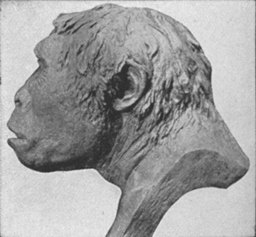
Topics
What's up with The HDF Group?
Library Update
Tools update
HDF Java Products
Library development in the works
Other activities
Java Man

Slide 28
Support HDF5 1.8
HDF5 JNI
  Over 100 new functions added to Java Interface (JHI5)
  Unit tests added for new functions & some HDF5 1.6 functions
Many features added to Object Layer & HDFView, such as:
  Support for external links
  Attribute renaming
Some features removed, including:
  Setting link creation order and link storage type
  Showing groups and attributes in creation order (Object Layer)
  Creating soft and external links
  Retrieve link information
  Rename Attributes

Slide 29

Topics
What's up with The HDF Group?
Library Update
Tools update
HDF Java Products
Library development in the works
Other activities

Slide 30



New capabilities in the works
Single-Writer/Multiple-Reader (SWMR) Access
  Allows simultaneous reading of HDF5 file while the file is being modified by another process
Better Multi-Threaded Concurrency
  Improve ability to have multiple threads performing HDF5 operations simultaneously
Recent parallel I/O improvements
  Changes to reduce redundancy and communication (available in 1.8.6 release)
Notes:
30
- As long as the file system is POSIX compliant
Other processes can be on other systems (as long as shared file system is POSIX compliant)

Slide 31



Other Library Features
Saving space
  Persistent File Free Space tracking/recovery
  Allow a group’s link info to be compressed
Saving time
  New chunk indexing methods
  Aggregate metadata for faster metadata I/O
  Asynchronous metadata I/O operations
Preserving file in case of crash
  Separately journal metadata changes to file
  Re-order updates to metadata
Notes:
Store Partial Edge Chunks More Efficiently
Allow application to control whether partially used chunks at edges of datasets are compressed and/or allocated as full chunks in file.
Persistent File Free Space tracking
No more “forgetting where all the free space in the file is” when the file is closed
Allow a group’s heaps (which store link info) to be compressed

Slide 32
Parallel I/O Improvement - Partnerships
Improve performance on parallel apps
Improve performance on parallel apps
Add features anticipating exascale systems

Slide 33
Future Parallel I/O Improvements
High-level “HPC” API
Fast indexing for HDF5 files (FastBit)
  I/O performance tracking, testing and tuning
  HPC specific “fast-tracking”
Virtual file driver enhancements
Auto-tuning to underlying parallel file system
Notes:
Examples for fast-tracking: (1) you know you will never do partial I/O. (2) You know you will never want to reclaim space in a file.

Slide 34
Recent NSF proposals for new features
New built-in datatypes
  Boolean, complex, C99 types, etc.
Expand coverage of attributes
  Attributes for individual fields of compound type
  Attributes for regions within dataspace
Store compound datatypes in columns (per field)
Allow shared dataspaces in file
Improve HPC performance
Facilitate remote access

Slide 35
Topics
What's up with The HDF Group?
Library Update
Tools update
HDF Java Products
Library development in the works
Other activities

Slide 36

HDF-EOS Support

Slide 37
EOS support
HDF-EOS2 and HDF-EOS5
  Continue testing daily with HDF4 and HDF5 development code
Updated and maintained the HDF-EOS website
Notes:
37

Slide 38
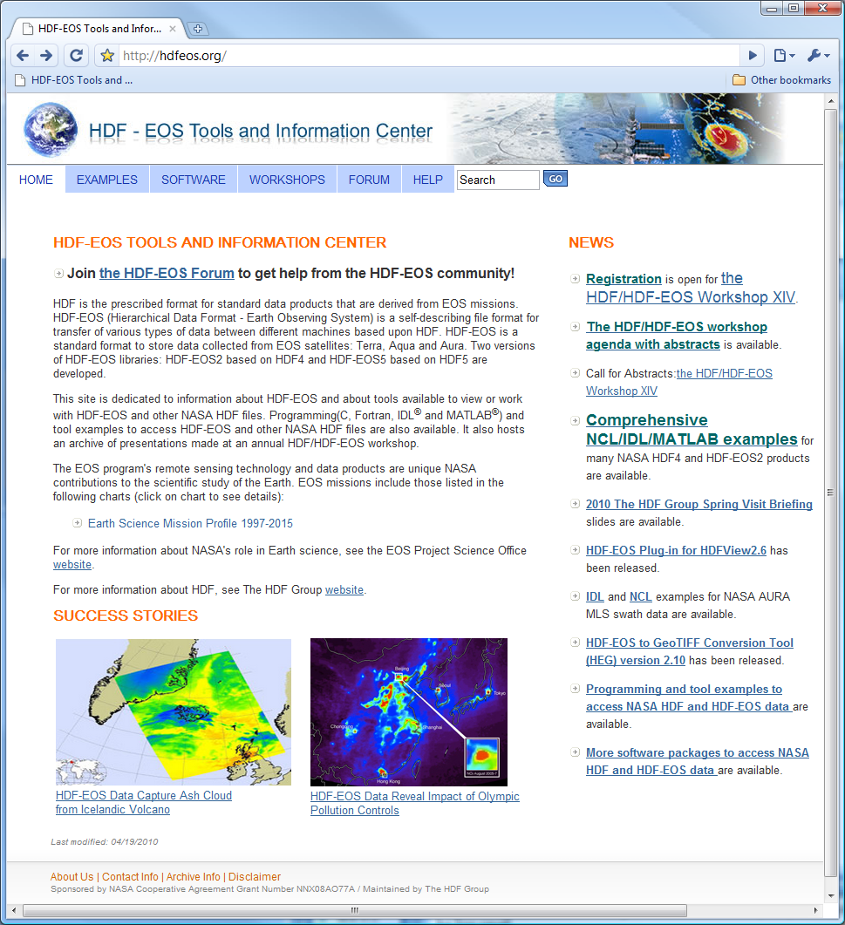
The Updated HDF-EOS website
Software
  Evaluating many packages
Examples
  Adding examples for many
  NASA products
Forums
  Moderating the forum
http://hdfeos.org

Slide 39
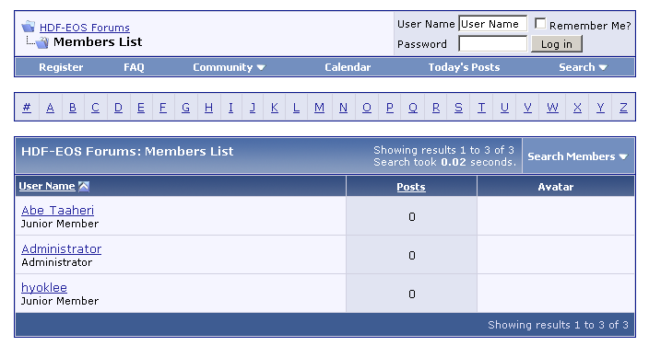
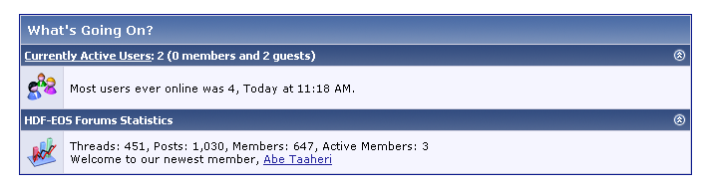
HDF-EOS User Forum

Slide 40
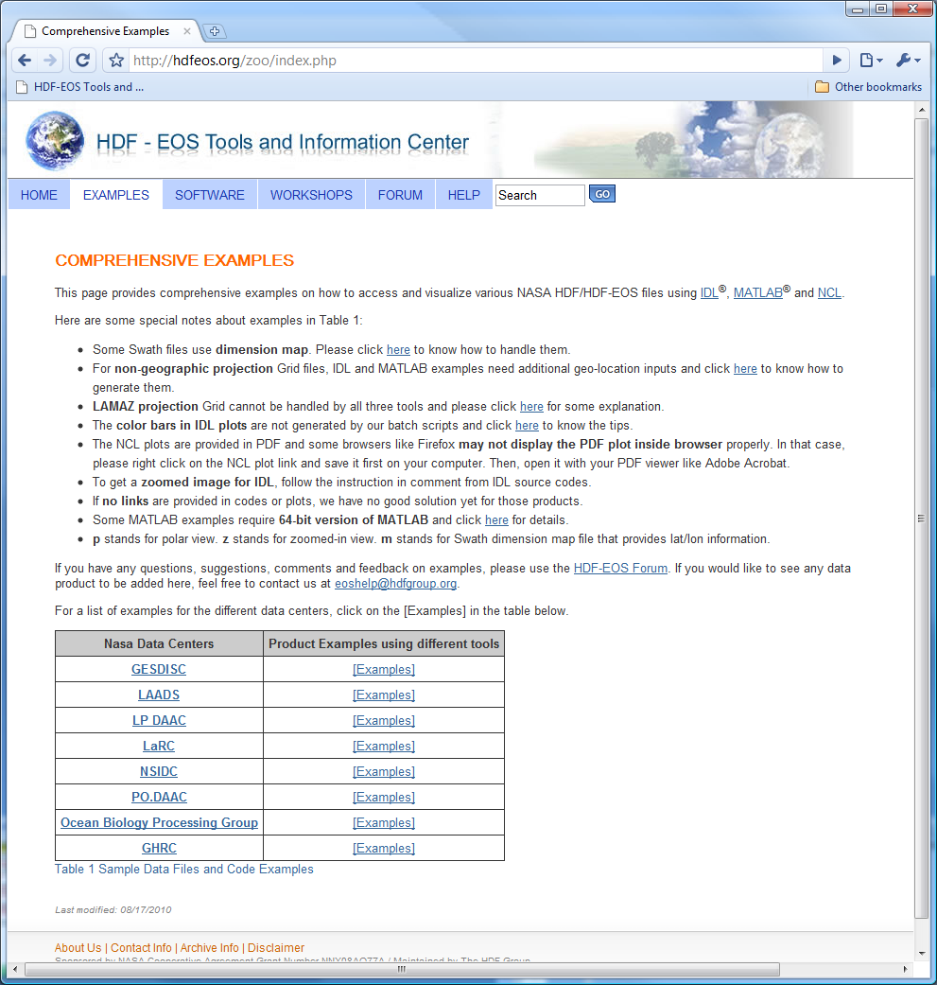
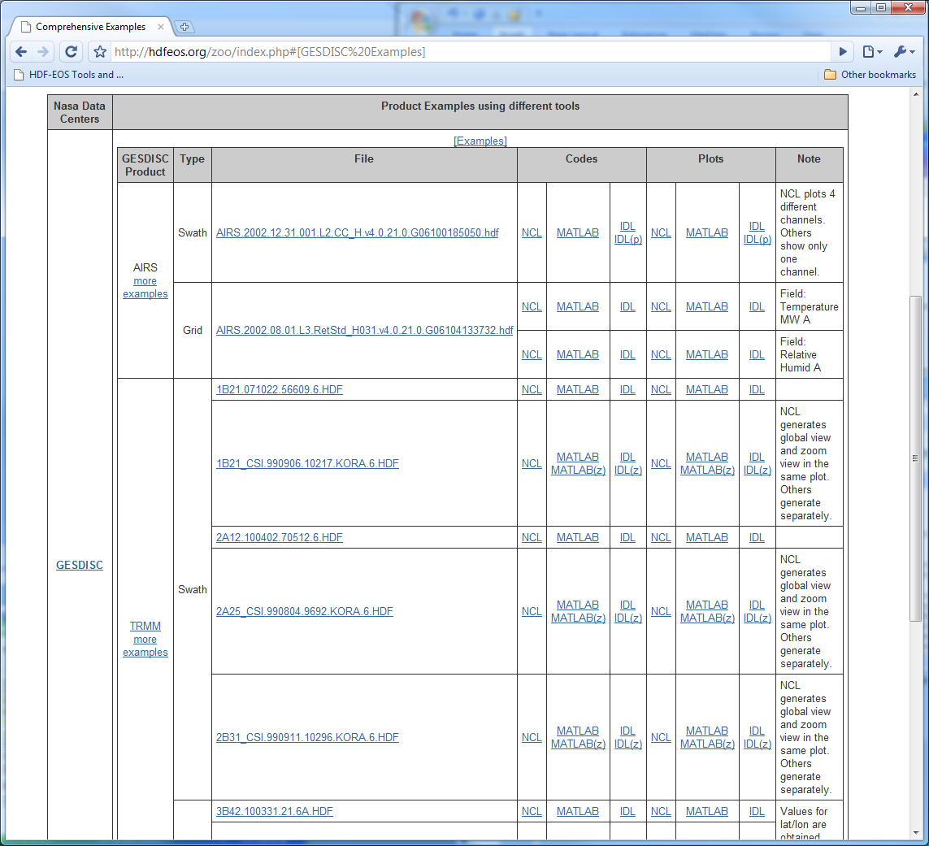
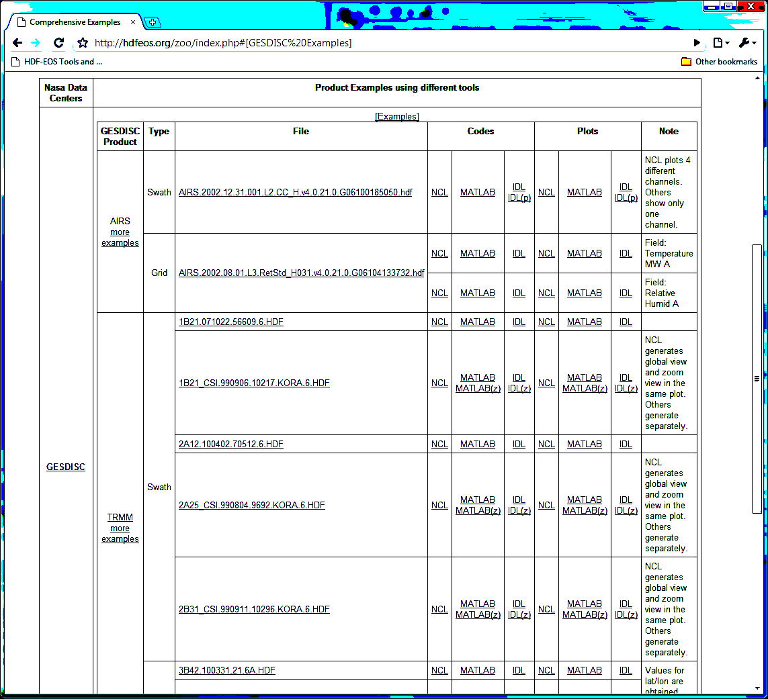
NCL/IDL/MATLAB examples
Many examples from different NASA data centers’
Example codes and plots

Slide 41
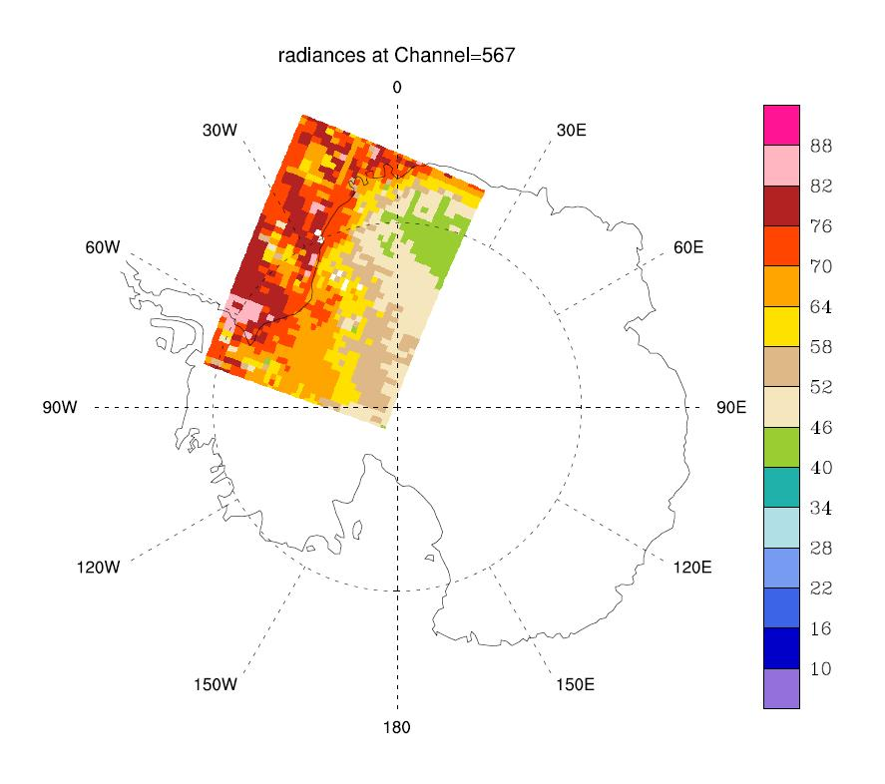
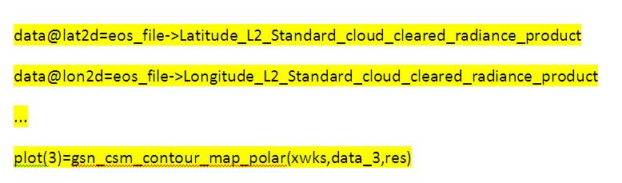
An example to access AIRS Swath
Directly read the lat/lon and use polar view
…
data=eos_file->radiances_L2_Standard_cloud_cleared_radiance_product(:,:,0) ; read specific subset of data field
; In order to read the radiances data field from the HDF-EOS2 file, the group
; under which the data field is placed must be appended to the data field in NCL. For more information,
; visit section 4.3.2 of http://hdfeos.org/software/ncl.php.
data@lat2d=eos_file->Latitude_L2_Standard_cloud_cleared_radiance_product ; associate longitude and latitude
data@lon2d=eos_file->Longitude_L2_Standard_cloud_cleared_radiance_product
data@_FillValue=-9999 ;
…
res@gsnCenterString="radiances at Channel=567"
plot(2)=gsn_csm_contour_map_polar(xwks,data_2,res)
res@gsnCenterString="radiances at Channel=1339"
plot(3)=gsn_csm_contour_map_polar(xwks,data_3,res)
delete(plot) ; cleaning up resources used
delete(data)
NCL
Notes:
In general, for all the following slides: You need to specify the tool name under the plot. The font should not be too small.
Add another code section:
Amplify
data@lat2d=eos_file->Latitude_L2_Standard_cloud_cleared_radiance_product
..
Amplify:
plot(3)=gsn_csm_contour_map_polar(xwks,data_3,res…)
Replace the plot with channel 567

Slide 42
Interoperability

Slide 43
HDF-EOS5/netCDF-4
Augmentation Tool
Accessing HDF-EOS5 files via netCDF-4 API

Slide 44
HDF-EOS5 and NetCDF-4
Enabling NetCDF4 to access HDF-EOS5 data
  One file can be used for both EOS5 and NetCDF-4.
  Note that EOS5 users are not affected at all.
Augmentation
HDF-EOS5
HDF-EOS5
file
Augmented
HDF-EOS5
file
NetCDF-4
file
NetCDF4
HDF5
HDF5

Slide 45


The Main Challenge
  Would like netCDF-4 applications to be able to read and understand HDF-EOS 5 files
  Problem: NetCDF-4 model follows the HDF5 dimension scale model but HDF-EOS5 does not.
HDFEOS
GRIDS
No HDF5 dimension
scales are associated
with this variable
CloudFractionAndPressure
Data Fields
CloudFraction
CloudPressure

Slide 46

Our Solution – Augmentation
Provide dimensions required by netCDF-4
HDFEOS
GRIDS
CloudFractionAndPressure
Data Fields
CloudFraction[XDim][YDim]
CloudPressure[XDim][YDim]
XDim
YDim

Slide 47
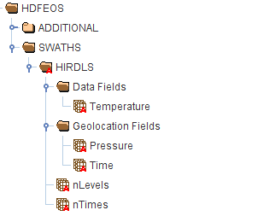

Handling missing metadata information
The following input file is required:
We need similar information for other instruments.
[nLevels][nTimes]

Slide 48
HDF-EOS2 dumper

Slide 49
HDFEOS2 dumper - motivation
HDF-EOS2 Grid
  Latitude and longitude values are not stored inside the file.
  It is not straightforward for users to calculate the latitude and longitude for some projections.
HDF-EOS2 Swath using dimension map
  Latitude/longitude values are provided either in a separate HDF-EOS2 file or need to be interpolated.
Notes:
Basically it’s a tool for getting lat/lon from HDF-EOS 2 files.
Tool created a couple years ago for internal use, by Choonhwan. Kent found it convenient for finding lat/lon. Had a student test and improve it, fix bugs.
Now it’s available.

Slide 50
HDF EOS2 dumper
This EOS2 dumper can be used to quickly obtain the latitude and longitude data
It is a command-line tool only supported on Linux
The output is ASCII format
The dumper is used to generate some HDF-EOS2 plots via IDL,NCL and MATLAB

Slide 51
HDF EOS2 dumper – example usage
For the file only including one HDF-EOS2 grid or swath
./eos2dump –c1 filename
provide all latitude values in this grid.
For the file only including multiple HDF-EOS2 grids
./eos2dump –c1 filename gridname
provide all latitude values in this grid.

Slide 52
More information
Augmentation tool
http://hdfeos.org/software/aug_hdfeos5.php
HDF-EOS2 dumper
http://www.hdfeos.org/software/eosdump.php

Slide 53

OPeNDAP
Notes:
53

Slide 54
OPeNDAP Update
HDF4-OPeNDAP handler
  Access many NASA HDF-EOS and HDF4 products
HDF5-OPeNDAP handler
  Access MLS/HIRDLS Swath data and bug fixes
More information in the afternoon session

Slide 55
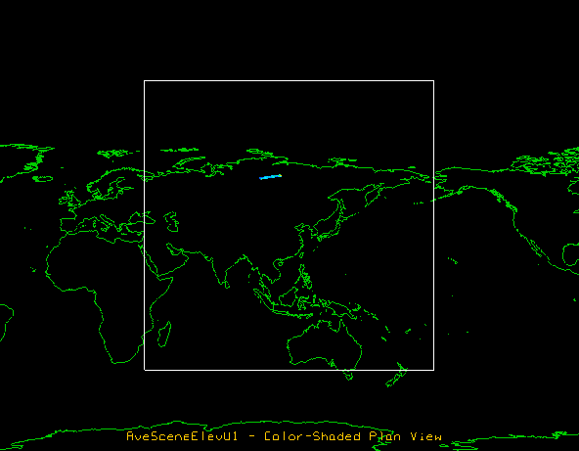
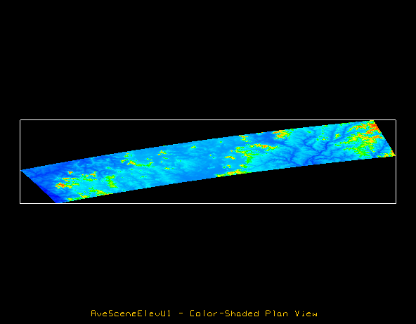
Use IDV to Access MISR data via OPeNDAP

Slide 56
HDF Group Support for NPP/NPOESS/JPSS

Slide 57
2009-2010 Priorities
Implement software to simplify working with NPOESS data
Include changes in mainstream
Begin work on an h5edit tool
Testing on NASA mini-IDPS system
Regular meetings with NPOESS community
High priority helpdesk support

Slide 58
2010-2011 Priorities
Deploy/maintain new software for working with HDF5 objects used by NPOESS
Implement h5edit tool
Help facilitate access to NPOESS data by netCDF applications
Streamline testing on NASA mini-IDPS
User support
See Presentation Thursday

Slide 59


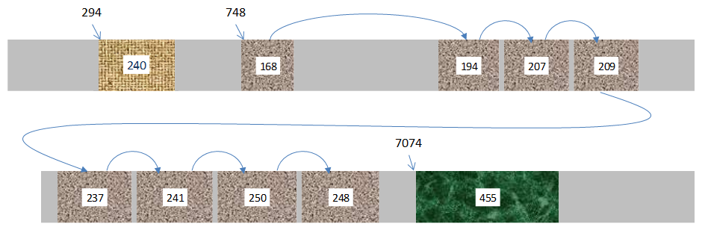
HDF4 Layout Maps

Slide 60
HDF4 Layout Map Project
Problem
  Long-term readability of HDF data depends on long-term availability of software
Proposed solution
  Create a map of the layout of data objects in an HDF file, allowing a simple reader to be written to access the data
See Presentation Thursday

Slide 61
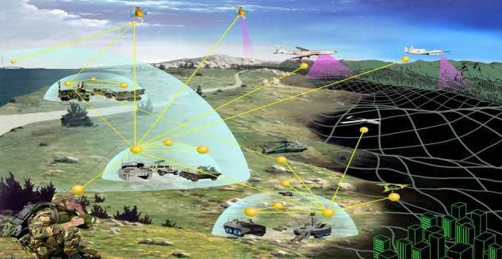
Exploiting HDF5 to represent Geo-Information
An example with complex terrain data

Slide 62
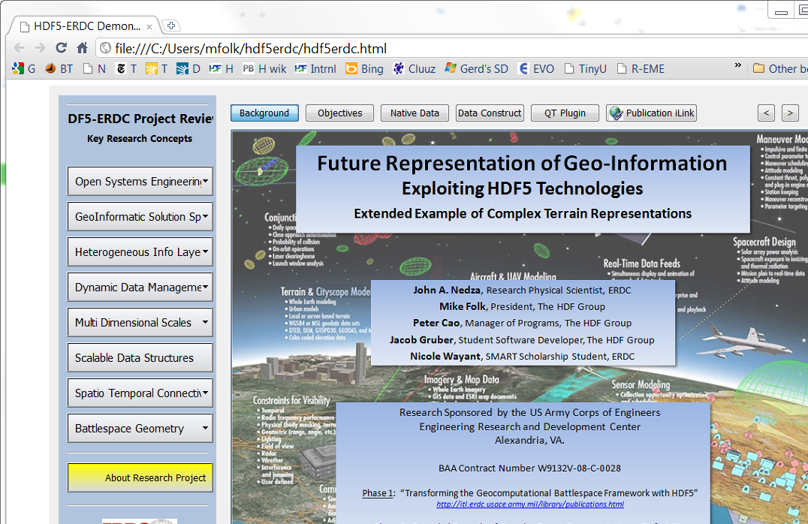
See Presentation Thursday

Slide 63
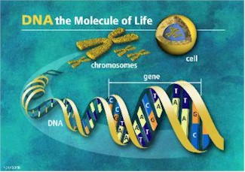

BioHDF : Toward Scalable Bioinformatics Infrastructures
NIH STTR with Geospiza, Seattle WA
TM

Slide 64
BioHDF Project
Goal: Reduce need to organize and structure data, so researchers can focus on asking questions and visualizing data
  Develop data models and tools to work with sequence data in HDF5
  Integrate BioHDF technologies into Geospiza products
  Deliver core BioHDF technologies to the community as open-source software

Slide 65
Thank You All and
Thank You NASA!

Slide 66
Acknowledgements
This report is based on work supported by cooperative agreement number NNX08AO77A from the National Aeronautics and Space Administration (NASA).
Any opinions, findings, conclusions, or recommendations expressed in this material are those of the author[s] and do not necessarily reflect the views of the National Aeronautics and Space Administration.

Slide 67
Questions/comments?

