Slide 1
HDF Tools Tutorial
Peter Cao, The HDF Group
Jonathan Kim, The HDF Group

Slide 2

Tools Tutorial
HDFView
HDF5 Command-line tools

Slide 3

HDFView
View file content
Edit file content
Show NPOESS/JPSS related features

Slide 4

HDFView
Download HDF-Java 2.7 beta from http://www.hdfgroup.org/ftp/HDF5/hdf-java-2.7
Download example files from ftp://ftp.hdfgroup.uiuc.edu/pub/outgoing/WorkshopXIV/HDF5-Files/

Slide 5
HDFView
View file content
  Open OMI-Aura_L3.he5
  Open groups (try expand all)
  Stretch the metadata view for showing metadata
  Double click on “ColumnAmountO3” to show data in table
  Use “Open As” to show “ColumnAmountO3” in image
View a subset
  Open weather.h5
  Select from preview image or selection fields

Slide 6
HDFView
Copy/paste a dataset and a group
  Create a new file: tmp.h5
  Copy/paste “ColumnAmountO3” and show the image from the new file
  Copy the group “GRIDS” to show the whole group is copied

Slide 7
HDFView
Create a dataset and add an attribute
  Create /d1 (32-bit float, 720x1440)
  Copy “ColumnAmountO3” to /d1
  Add attribute “IMAGE_MINMAXRANGE = 123.0,447.0”
  Export /d1 to text file
  Create /d2 and import d1.txt

Slide 8
HDFView
NPOESS/JPSS related features
  Object reference
  Region references
  Quality flags

Slide 9
HDFView
Object reference
  Open file: SVI-NPP.h5
  Open “VIIRS-I1-SDR_Aggr”
  Click on object ID and shows object name
  Right mouse to click to open data as image
  Open data in table
  Select two cells and open them at once

Slide 10
HDFView
Region references
  Open “VIIRS-I1-SDR_Gran”
  Right mouse to click to open data as image
  Open data in table
  Select two cells and open at once

Slide 11
HDFView
Quality flags
  Quality flags
    Land/Water Background -- 1-bit
    SST Skin Quality -- 2-bits
    SST Bulk Quality -- 2-bits
    Aerosol Correction -- 3-bits
  Open QF_VIIRSI1SDR_Array
  Use "Open As" on QF_VIIRSI1SDR_Array
  Select first bit

Slide 12
HDFView
Advanced features
  Import/export images
  Use HDF-EOS plugin

Slide 13
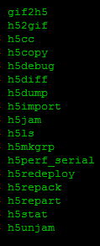

HDF5 Command-line tools
h5ls
h5dump
h5repack
h5diff
h5copy
What these tools can do for you

Slide 14

h5ls
Show file content list
  h5ls ami.h5
  h5ls –r ami.h5

Slide 15

h5dump
Structure
Dataset
Binary
XML
Region references
Examine file contents and dump file contents in an ASCII or binary file

Slide 16
h5dump
Structure
  h5dump -H tools_diff1.h5
  h5dump -H ami.h5

Slide 17
h5dump
Dataset
  Content
    h5dump -d /EnSight_model/geometry/parts/part_2/quad4 ami.h5
  Information
    h5dump –p –H -d /EnSight_model/geometry/parts/part_2/quad4 ami.h5
  Subset
    H5dump -d /EnSight_model/geometry/parts/part_2/quad4 -s 10,0 -c 20,2 ami.h5
    <-s and –c must be used after –d>

Slide 18
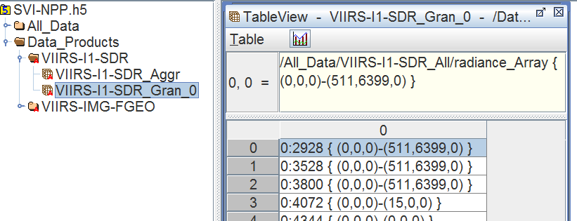
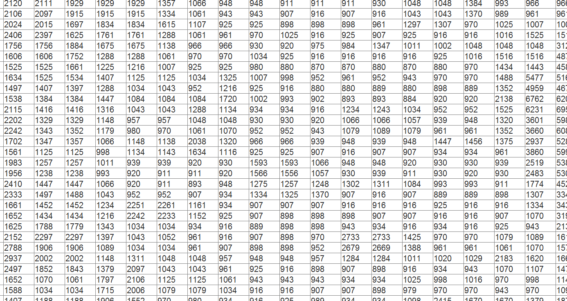
h5dump
Binary
  h5dump -d /EnSight_model/geometry/parts/part_2/quad4 -b LE –o out.bin ami.h5
XML
  h5dump –x ami.h5
Region
  h5dump -d /Data_Products/VIIRS-I1-SDR/VIIRS-I1-SDR_Gran_0 -s 3 -c 1 SVI-NPP.h5
  h5dump –R -d /Data_Products/VIIRS-I1-SDR/VIIRS-I1-SDR_Gran_0 -s 3 -c 1 SVI-NPP.h5
Packed fields <only 1.8.5+>

Slide 19

h5repack
Remove inaccessible objects / junk spaces
Change storage layout
Apply compression filter
Copies a file to a new file
with different storage layouts
and compression filters

Slide 20
h5repack
Remove inaccessible objects
  h5dump tools_junk.h5
  h5repack tools_junk.h5 tmp.h5
Change layout
  h5dump -H tools_bad_layout.h5
  h5repack tools_bad_layout.h5 tmp.h5
  h5repack -l CHUNK=16x16 tools_bad_layout.h5 tmp.h5
Change compression
  h5repack -f GZIP=6 tmp.h5 tmp2.h5
More: use latest version, link storage, shared message, and etc

Slide 21

h5diff
Show differences between
two files or two objects
Dataset
Whole file

Slide 22
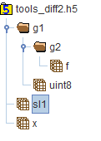
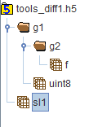
h5diff
Dataset
  h5diff -r tools_diff1.h5 tools_diff2.h5 /g1/uint8 /x
Whole file
  Run “h5ls –r tools_diff1.h5” and “h5ls -r tools_diff2.h5”
  h5diff tools_diff1.h5 tools_diff2.h5
  h5diff –v tools_diff1.h5 tools_diff2.h5
Follow symlinks
  h5diff -r --follow-symlinks tools_diff1.h5 tools_diff2.h5 /sl1

Slide 23

h5copy
Dataset
Group
Copies
objects
to files…

Slide 24
h5copy
Dataset
  h5copy -i tools_input.h5 -o tmp.h5 -s /g1/g2/f -d /float
Group
  Default: h5copy -i tools_input.h5 -o tmp.h5 -s /g1 -d /g1
  Parent groups: h5copy -p -i tools_input.h5 -o tmp.h5 -s /g1/g2/f -d /g1/g2/f

Slide 25
Thank You!
Questions/comments?

