Slide 1
HDF5 Advanced Topics
Neil Fortner
The HDF Group
The 14th HDF and HDF-EOS Workshop
September 28-30, 2010

Slide 2
Outline
Overview of HDF5 datatypes
Partial I/O in HDF5
Chunking and compression

Slide 3
HDF5 Datatypes
Quick overview of the most difficult topics

Slide 4
An HDF5 Datatype is…
A description of dataset element type
Grouped into “classes”:
  Atomic – integers, floating-point values
  Enumerated
  Compound – like C structs
  Array
  Opaque
  References
    Object – similar to soft link
    Region – similar to soft link to dataset + selection
  Variable-length
    Strings – fixed and variable-length
    Sequences – similar to Standard C++ vector class

Slide 5
HDF5 Datatypes
HDF5 has a rich set of pre-defined datatypes and supports the creation of an unlimited variety of complex user-defined datatypes.
Self-describing:
  Datatype definitions are stored in the HDF5 file with the data.
  Datatype definitions include information such as byte order (endianness), size, and floating point representation to fully describe how the data is stored and to insure portability across platforms.

Slide 6
Datatype Conversion
Datatypes that are compatible, but not identical are converted automatically when I/O is performed
Compatible datatypes:
  All atomic datatypes are compatible
  Identically structured array, variable-length and compound datatypes whose base type or fields are compatible
  Enumerated datatype values on a “by name” basis
Make datatypes identical for best performance

Slide 7
Datatype Conversion Example
Array of integers on IA32 platform
Native integer is little-endian, 4 bytes
Array of integers on SPARC64 platform
Native integer is big-endian, 8 bytes
H5T_NATIVE_INT
H5T_NATIVE_INT
H5Dwrite
Little-endian 4 bytes integer
H5Dread
H5Dwrite
H5T_STD_I32LE
VAX G-floating

Slide 8
Datatype Conversion
Datatype of data on disk
dataset = H5Dcreate(file, DATASETNAME, H5T_STD_I64BE,
space, H5P_DEFAULT, H5P_DEFAULT);
Datatype of data in memory buffer
H5Dwrite(dataset, H5T_NATIVE_INT, H5S_ALL, H5S_ALL,
H5P_DEFAULT, buf);
H5Dwrite(dataset, H5T_NATIVE_DOUBLE, H5S_ALL, H5S_ALL,
H5P_DEFAULT, buf);

Slide 9
Storing Records with HDF5

Slide 10
HDF5 Compound Datatypes
Compound types
  Comparable to C structs
  Members can be any datatype
  Can write/read by a single field or a set of fields
  Not all data filters can be applied (shuffling, SZIP)

Slide 11
Creating and Writing Compound Dataset
h5_compound.c example
typedef struct s1_t {
int a;
float b;
double c;
} s1_t;
s1_t s1[LENGTH];

Slide 12
Creating and Writing Compound Dataset
/* Create datatype in memory. */
s1_tid = H5Tcreate(H5T_COMPOUND, sizeof(s1_t));
H5Tinsert(s1_tid, "a_name", HOFFSET(s1_t, a),
H5T_NATIVE_INT);
H5Tinsert(s1_tid, "c_name", HOFFSET(s1_t, c),
H5T_NATIVE_DOUBLE);
H5Tinsert(s1_tid, "b_name", HOFFSET(s1_t, b),
H5T_NATIVE_FLOAT);
Note:
Use HOFFSET macro instead of calculating offset by hand.
Order of H5Tinsert calls is not important if HOFFSET is used.

Slide 13
Creating and Writing Compound Dataset
/* Create dataset and write data */
dataset = H5Dcreate(file, DATASETNAME, s1_tid, space,
H5P_DEFAULT, H5P_DEFAULT);
status = H5Dwrite(dataset, s1_tid, H5S_ALL, H5S_ALL,
H5P_DEFAULT, s1);
Note:
In this example memory and file datatypes are the same.
Type is not packed.
Use H5Tpack to save space in the file.
status = H5Tpack(s1_tid);
status = H5Dcreate(file, DATASETNAME, s1_tid, space,
H5P_DEFAULT, H5P_DEFAULT);

Slide 14
Reading Compound Dataset
/* Create datatype in memory and read data. */
dataset = H5Dopen(file, DATASETNAME, H5P_DEFAULT);
s2_tid = H5Dget_type(dataset);
mem_tid = H5Tget_native_type(s2_tid);
buf = malloc(H5Tget_size(mem_tid)*number_of_elements);
status = H5Dread(dataset, mem_tid, H5S_ALL,
H5S_ALL, H5P_DEFAULT, buf);
Note:
We could construct memory type as we did in writing example.
For general applications we need to discover the type in the file, find out corresponding memory type, allocate space and do read.

Slide 15
Reading Compound Dataset by Fields
typedef struct s2_t {
double c;
int a;
} s2_t;
s2_t s2[LENGTH];
…
s2_tid = H5Tcreate (H5T_COMPOUND, sizeof(s2_t));
H5Tinsert(s2_tid, "c_name", HOFFSET(s2_t, c),
H5T_NATIVE_DOUBLE);
H5Tinsert(s2_tid, “a_name", HOFFSET(s2_t, a),
H5T_NATIVE_INT);
…
status = H5Dread(dataset, s2_tid, H5S_ALL,
H5S_ALL, H5P_DEFAULT, s2);

Slide 16
Table Example
a_name (integer) | b_name (float) | c_name (double)
0 | 0. | 1.0000
1 | 1. | 0.5000
2 | 4. | 0.3333
3 | 9. | 0.2500
4 | 16. | 0.2000
5 | 25. | 0.1667
6 | 36. | 0.1429
7 | 49. | 0.1250
8 | 64. | 0.1111
9 | 81. | 0.1000
Multiple ways to store a table
Dataset for each field
Dataset with compound datatype
If all fields have the same type:
  2-dim array
  1-dim array of array datatype
Continued…
Choose to achieve your goal!
Storage overhead?
Do I always read all fields?
Do I read some fields more often?
Do I want to use compression?
Do I want to access some records?

Slide 17
Storing Variable Length Data with HDF5

Slide 18
HDF5 Fixed and Variable Length Array Storage
Data
Time
Data
Data
Data
Data
Time
Data
Data
Data
Data

Slide 19
Storing Variable Length Data in HDF5
Each element is represented by C structure
  typedef struct {
  size_t length;
  void *p;
  } hvl_t;
Base type can be any HDF5 type
  H5Tvlen_create(base_type)

Slide 20
Example
hvl_t data[LENGTH];
for(i=0; i<LENGTH; i++) {
data[i].p = malloc((i+1)*sizeof(unsigned int));
data[i].len = i+1;
}
tvl = H5Tvlen_create (H5T_NATIVE_UINT);
data[0].p
Data
Data
Data
Data
data[4].len
Data

Slide 21
Reading HDF5 Variable Length Array
HDF5 library allocates memory to read data in
Application only needs to allocate array of hvl_t elements (pointers and lengths)
Application must reclaim memory for data read in
hvl_t rdata[LENGTH];
/* Create the memory vlen type */
tvl = H5Tvlen_create(H5T_NATIVE_INT);
ret = H5Dread(dataset, tvl, H5S_ALL, H5S_ALL,
H5P_DEFAULT, rdata);
/* Reclaim the read VL data */
H5Dvlen_reclaim(tvl, H5S_ALL, H5P_DEFAULT,rdata);

Slide 22
Variable Length vs. Array
Pros of variable length datatypes vs. arrays:
  Uses less space if compression unavailable
  Automatically stores length of data
  No maximum size
    Size of an array is its effective maximum size
Cons of variable length datatypes vs. arrays:
  Substantial performance overhead
    Each element a “pointer” to piece of metadata
  Variable length data cannot be compressed
    Unused space in arrays can be “compressed away”
  Must be 1-dimensional

Slide 23
Storing Strings in HDF5

Slide 24
Storing Strings in HDF5
Array of characters (Array datatype or extra dimension in dataset)
  Quick access to each character
  Extra work to access and interpret each string
Fixed length
  string_id = H5Tcopy(H5T_C_S1);
  H5Tset_size(string_id, size);
    Wasted space in shorter strings
    Can be compressed
Variable length
  string_id = H5Tcopy(H5T_C_S1);
  H5Tset_size(string_id, H5T_VARIABLE);
    Overhead as for all VL datatypes
    Compression will not be applied to actual data

Slide 25
HDF5 Reference Datatypes

Slide 26
Reference Datatypes
Object Reference
  Pointer to an object in a file
  Predefined datatype H5T_STD_REG_OBJ
Dataset Region Reference
  Pointer to a dataset + dataspace selection
  Predefined datatype H5T_STD_REF_DSETREG

Slide 27
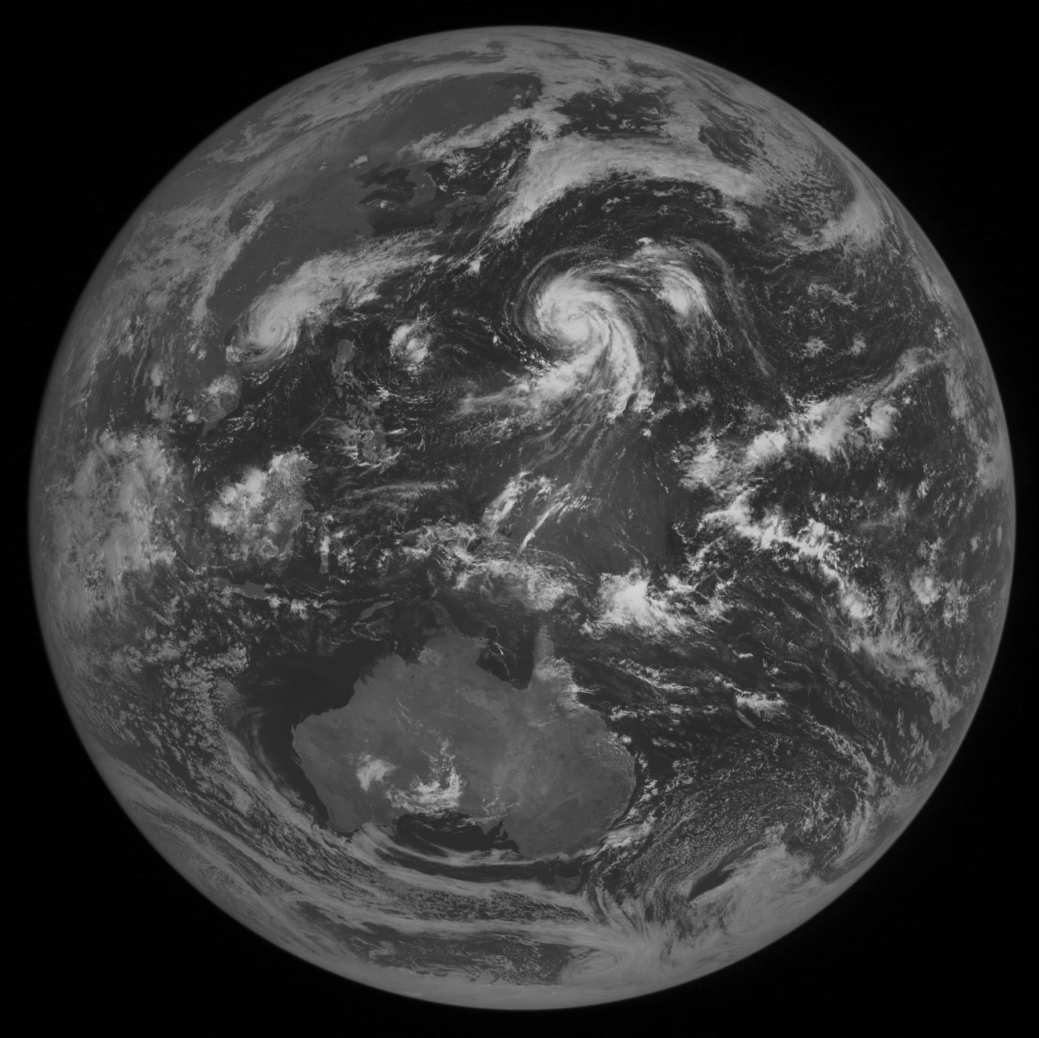
Saving Selected Region in a File
Need to select and access the same
elements of a dataset

Slide 28
Reference to Dataset Region
REF_REG.h5
Root
Matrix
Region References
1 1 2 3 3 4 5 5 6
1 2 2 3 4 4 5 6 6

Slide 29
Reference to Dataset Region
Example
dsetr_id = H5Dcreate(file_id,
“REGION REFERENCES”, H5T_STD_REF_DSETREG, …);
H5Sselect_hyperslab(space_id,
H5S_SELECT_SET, start, NULL, …);
H5Rcreate(&ref[0], file_id, “MATRIX”, H5R_DATASET_REGION, space_id);
H5Dwrite(dsetr_id, H5T_STD_REF_DSETREG, H5S_ALL, H5S_ALL, H5P_DEFAULT, ref);

Slide 30
Working with subsets

Slide 31
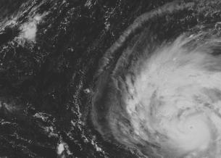


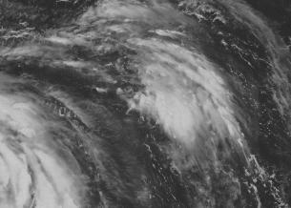
Collect data one way ….
Array of images (3D)

Slide 32
Display data another way …
Stitched image (2D array)

Slide 33

Data is too big to read….

Slide 34
HDF5 Library Features
HDF5 Library provides capabilities to
  Describe subsets of data and perform write/read operations on subsets
    Hyperslab selections and partial I/O
  Store descriptions of the data subsets in a file
    Object references
    Region references
  Use efficient storage mechanism to achieve good performance while writing/reading subsets of data
    Chunking, compression

Slide 35
Partial I/O in HDF5

Slide 36
How to Describe a Subset in HDF5?
Before writing and reading a subset of data one has to describe it to the HDF5 Library.
HDF5 APIs and documentation refer to a subset as a “selection” or “hyperslab selection”.
If specified, HDF5 Library will perform I/O on a selection only and not on all elements of a dataset.

Slide 37
Types of Selections in HDF5
Two types of selections
  Hyperslab selection
    Regular hyperslab
    Simple hyperslab
    Result of set operations on hyperslabs (union, difference, …)
  Point selection
Hyperslab selection is especially important for doing parallel I/O in HDF5 (See Parallel HDF5 Tutorial)

Slide 38
Regular Hyperslab
Collection of regularly spaced equal size blocks

Slide 39
Simple Hyperslab
Contiguous subset or sub-array

Slide 40
Hyperslab Selection
Result of union operation on three simple hyperslabs

Slide 41
Hyperslab Description
Start - starting location of a hyperslab (1,1)
Stride - number of elements that separate each block (3,2)
Count - number of blocks (2,6)
Block - block size (2,1)
Everything is “measured” in number of elements

Slide 42
Simple Hyperslab Description
Two ways to describe a simple hyperslab
As several blocks
  Stride – (1,1)
  Count – (4,6)
  Block – (1,1)
As one block
  Stride – (1,1)
  Count – (1,1)
  Block – (4,6)
No performance penalty for
one way or another

Slide 43
H5Sselect_hyperslab Function
space_id Identifier of dataspace
op Selection operator
    H5S_SELECT_SET or H5S_SELECT_OR
start Array with starting coordinates of hyperslab
stride Array specifying which positions along a dimension
to select
count Array specifying how many blocks to select from the
  dataspace, in each dimension
block Array specifying size of element block
  (NULL indicates a block size of a single element in
a dimension)
Notes:
H5Sselect_hyperslab:
1: dataspace identifier
2: selection operator to determine how the new selection is to be combined with the already existing selection for the dataspace. CUrrenlty on H5S_SELECT_SET operator is
supported, which replaces the existing selection with the parameters from this call. Overlapping blocks are not supported with H5S_SELECT_SET.
3:start - starting coordinates. 0-beginning
4:stride: how many elements to move in each dimension.
Stride of zero not supported: NULL==1
5:count: determines how many spaces to select in each dimension
6: block: determines size of the element block: if NULL then
defaults to single emenet in each dimension.
H5Sselect_elements:
1: dataspace identifier
2: H5S_SELECT_SET: (see above)
3:NUMP: number of elements selected
4:coord: 2-D array of size (dataspace rank0 by
num_elements in szie. The order of the element coordinates in the coord array also specifies the order that the array elements are iterated when I/O is performed.

Slide 44
Reading/Writing Selections
Programming model for reading from a dataset in
a file
Open a dataset.
Get file dataspace handle of the dataset and specify subset to read from.
  H5Dget_space returns file dataspace handle
    File dataspace describes array stored in a file (number of dimensions and their sizes).
  H5Sselect_hyperslab selects elements of the array that participate in I/O operation.
Allocate data buffer of an appropriate shape and size

Slide 45
Reading/Writing Selections
Programming model (continued)
Create a memory dataspace and specify subset to write to.
  Memory dataspace describes data buffer (its rank and dimension sizes).
  Use H5Screate_simple function to create memory dataspace.
  Use H5Sselect_hyperslab to select elements of the data buffer that participate in I/O operation.
Issue H5Dread or H5Dwrite to move the data between file and memory buffer.
Close file dataspace and memory dataspace when done.

Slide 46
Example : Reading Two Rows
Data in a file
4x6 matrix
1 | 2 | 3 | 4 | 5 | 6
7 | 8 | 9 | 10 | 11 | 12
13 | 14 | 15 | 16 | 17 | 18
19 | 20 | 21 | 22 | 23 | 24
Buffer in memory
1-dim array of length 14
-1 | -1 | -1 | -1 | -1 | -1 | -1 | -1 | -1 | -1 | -1 | -1 | -1 | -1

Slide 47
Example: Reading Two Rows
start = {1,0}
count = {2,6}
block = {1,1}
stride = {1,1}
1 | 2 | 3 | 4 | 5 | 6
7 | 8 | 9 | 10 | 11 | 12
13 | 14 | 15 | 16 | 17 | 18
19 | 20 | 21 | 22 | 23 | 24
filespace = H5Dget_space (dataset);
H5Sselect_hyperslab (filespace, H5S_SELECT_SET,
start, NULL, count, NULL)

Slide 48
Example: Reading Two Rows
start[1] = {1}
count[1] = {12}
dim[1] = {14}
-1 | -1 | -1 | -1 | -1 | -1 | -1 | -1 | -1 | -1 | -1 | -1 | -1 | -1
memspace = H5Screate_simple(1, dim, NULL);
H5Sselect_hyperslab (memspace, H5S_SELECT_SET,
start, NULL, count, NULL)

Slide 49
Example: Reading Two Rows
1 | 2 | 3 | 4 | 5 | 6
7 | 8 | 9 | 10 | 11 | 12
13 | 14 | 15 | 16 | 17 | 18
19 | 20 | 21 | 22 | 23 | 24
H5Dread (…, …, memspace, filespace, …, …);
-1 | 7 | 8 | 9 | 10 | 11 | 12 | 13 | 14 | 15 | 16 | 17 | 18 | -1

Slide 50
Things to Remember
Number of elements selected in a file and in a memory buffer must be the same
  H5Sget_select_npoints returns number of selected elements in a hyperslab selection
HDF5 partial I/O is tuned to move data between selections that have the same dimensionality; avoid choosing subsets that have different ranks (as in example above)
Allocate a buffer of an appropriate size when reading data; use H5Tget_native_type and H5Tget_size to get the correct size of the data element in memory.

Slide 51
Chunking in HDF5

Slide 52
HDF5 Dataset
Metadata
Dataset data
Dataspace
Rank
Dimensions
3
Dim_1 = 4
Dim_2 = 5
Dim_3 = 7
Datatype
IEEE 32-bit float
Attributes
Storage info
Time = 32.4
Chunked
Pressure = 987
Compressed
Temp = 56

Slide 53
Contiguous storage layout
Metadata header separate from dataset data
Data stored in one contiguous block in HDF5 file
Application memory
Metadata cache
Dataset header
………….
Dataset data
Datatype
Dataspace
………….
Attributes
…
File
Dataset data

Slide 54
What is HDF5 Chunking?
Data is stored in chunks of predefined size
Two-dimensional instance may be referred to as data tiling
HDF5 library usually writes/reads the whole chunk
Chunked
Contiguous

Slide 55
What is HDF5 Chunking?
Dataset data is divided into equally sized blocks (chunks).
Each chunk is stored separately as a contiguous block in HDF5 file.
Application memory
Metadata cache
Dataset data
Dataset header
A
B
C
D
………….
Datatype
Dataspace
………….
Chunk
index
Attributes
…
File
header
Chunk
index
A
C
D
B

Slide 56
Why HDF5 Chunking?
Chunking is required for several HDF5 features
  Enabling compression and other filters like checksum
  Extendible datasets

Slide 57
Why HDF5 Chunking?
If used appropriately chunking improves partial I/O for big datasets
Only two chunks are involved in I/O

Slide 58
Creating Chunked Dataset
Create a dataset creation property list.
Set property list to use chunked storage layout.
Create dataset with the above property list.
dcpl_id = H5Pcreate(H5P_DATASET_CREATE);
rank = 2;
ch_dims[0] = 100;
ch_dims[1] = 200;
H5Pset_chunk(dcpl_id, rank, ch_dims);
dset_id = H5Dcreate (…, dcpl_id);
H5Pclose(dcpl_id);

Slide 59
Creating Chunked Dataset
Things to remember:
  Chunk always has the same rank as a dataset
  Chunk’s dimensions do not need to be factors of dataset’s dimensions
  Caution: May cause more I/O than desired (see white portions of the chunks below)
Notes:
More data will be written in this case
Ghost zones are filled with fill value unless fill value is disabled

Slide 60
Creating Chunked Dataset
Chunk size cannot be changed after the dataset is created
Do not make chunk sizes too small (e.g. 1x1)!
  Metadata overhead for each chunk (file space)
  Each chunk is read individually
    Many small reads inefficient

Slide 61
Writing or Reading Chunked Dataset
Chunking mechanism is transparent to application.
Use the same set of operation as for contiguous dataset, for example,
H5Dopen(…);
H5Sselect_hyperslab (…);
H5Dread(…);
Selections do not need to coincide precisely with the chunks boundaries.

Slide 62
HDF5 Chunking and compression
Chunking is required for compression and other filters
HDF5 filters modify data during I/O operations
Filters provided by HDF5:
  Checksum (H5Pset_fletcher32)
  Data transformation (in 1.8.*)
  Shuffling filter (H5Pset_shuffle)
Compression (also called filters) in HDF5
  Scale + offset (in 1.8.*) (H5Pset_scaleoffset)
  N-bit (in 1.8.*) (H5Pset_nbit)
  GZIP (deflate) (H5Pset_deflate)
  SZIP (H5Pset_szip)

Slide 63
HDF5 Third-Party Filters
  Compression methods supported by HDF5 User’s community
  http://wiki.hdfgroup.org/Community-Support-for-HDF5
    LZO lossless compression (PyTables)
    BZIP2 lossless compression (PyTables)
    BLOSC lossless compression (PyTables)
    LZF lossless compression H5Py

Slide 64
Creating Compressed Dataset
Create a dataset creation property list
Set property list to use chunked storage layout
Set property list to use filters
Create dataset with the above property list
dcpl_id = H5Pcreate(H5P_DATASET_CREATE);
rank = 2;
ch_dims[0] = 100;
ch_dims[1] = 100;
H5Pset_chunk(dcpl_id, rank, ch_dims);
H5Pset_deflate(dcpl_id, 9);
dset_id = H5Dcreate (…, dcpl_id);
H5Pclose(dcpl_id);

Slide 65
Performance Issues or
What everyone needs to know about chunking and the chunk cache

Slide 66
Accessing a row in contiguous dataset
One seek is needed to find the starting location of row of data. Data is read/written using one disk access.

Slide 67
Accessing a row in chunked dataset
Five seeks is needed to find each chunk. Data is read/written using five disk accesses. Chunking storage is less efficient than contiguous storage.

Slide 68
Quiz time
How might I improve this situation, if it is common to access my data in this way?

Slide 69
Accessing data in contiguous dataset
M rows
M seeks are needed to find the starting location of the element. Data is read/written using M disk accesses. Performance may be very bad.

Slide 70
Motivation for chunking storage
M rows
Two seeks are needed to find two chunks. Data is read/written using two disk accesses. For this pattern chunking helps with I/O performance.

Slide 71
Motivation for chunk cache
A
B
H5Dwrite
H5Dwrite
Selection shown is written by two H5Dwrite calls (one for each row).
Chunks A and B are accessed twice (one time for each row). If both chunks fit into cache, only two I/O accesses needed to write the shown selections.

Slide 72
Motivation for chunk cache
A
B
H5Dwrite
H5Dwrite
Question: What happens if there is a space for only one chunk at a time?

Slide 73
Advanced Exercise
Write data to a dataset
Dataset is 512x2048, 4-byte native integers
Chunks are 256x128: 128KB each, 2MB rows
Write by rows

Slide 74
Advanced Exercise
Very slow performance
What is going wrong?
Chunk cache is only 1MB by default
Read into cache

Slide 75
Advanced Exercise
Very slow performance
What is going wrong?
Chunk cache is only 1MB by default
Write to disk
Read into cache

Slide 76
Advanced Exercise
Very slow performance
What is going wrong?
Chunk cache is only 1MB by default
Write to disk
Read into cache

Slide 77
Advanced Exercise
Very slow performance
What is going wrong?
Chunk cache is only 1MB by default
Write to disk
Read into cache

Slide 78
Advanced Exercise
Very slow performance
What is going wrong?
Chunk cache is only 1MB by default
Write to disk
Read into cache

Slide 79
Advanced Exercise
Very slow performance
What is going wrong?
Chunk cache is only 1MB by default
Write to disk
Read into cache

Slide 80
Advanced Exercise
Very slow performance
What is going wrong?
Chunk cache is only 1MB by default
Read into cache
Write to disk

Slide 81
Advanced Exercise
Very slow performance
What is going wrong?
Chunk cache is only 1MB by default
Read into cache
Write to disk

Slide 82
Exercise 1
Improve performance by changing only chunk size
Access pattern is fixed, limited memory
One solution: 64x2048 chunks
  Row of chunks fits in cache

Slide 83
Exercise 2
Improve performance by changing only access pattern
  File already exists, cannot change chunk size
One solution: Access by chunk
  Each selection fits in cache, contiguous on disk

Slide 84
Exercise 3
Improve performance while not changing chunk size or access pattern
  No memory limitation
One solution: Chunk cache set to size of row of chunks

Slide 85
Exercise 4
Improve performance while not changing chunk size or access pattern
Chunk cache size can be set to max. 1MB
One solution: Disable chunk cache
  Avoids repeatedly reading/writing whole chunks

Slide 86
More Information
More detailed information on chunking and the chunk cache can be found in the draft “Chunking in HDF5” document at:
http://www.hdfgroup.org/HDF5/doc/_topic/Chunking

Slide 87
Thank You!

Slide 88
Acknowledgements
This work was supported by cooperative agreement number NNX08AO77A from the National Aeronautics and Space Administration (NASA).
Any opinions, findings, conclusions, or recommendations expressed in this material are those of the author[s] and do not necessarily reflect the views of the National Aeronautics and Space Administration.

Slide 89
Questions/comments?

