Slide 1
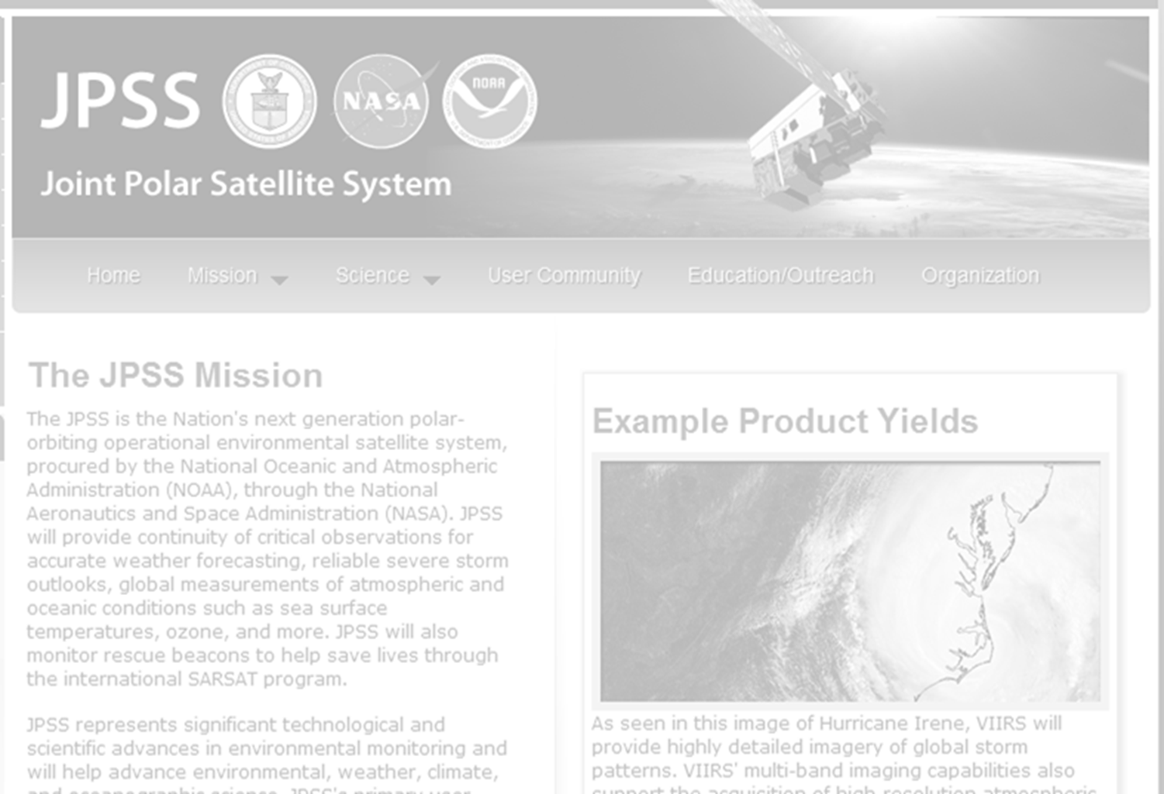
HDF Group Support for NPP/JPSS
Mike Folk, Elena Pourmal, Larry Knox, Albert Cheng
The HDF Group
Briefing to ESDIS
October 16-17, 2012

Slide 2
Goal
Provide HDF5 support for the distribution of VIIRS, OMPS, and other JPSS sensor and environmental data products

Slide 3
2011-2012 Priorities
Test software on platforms critical to NPP/JPSS
Develop software to facilitate access and management of NPP/JPSS products
Provide rapid and high priority support for data producers and users

Slide 4
Project Information
Project Web site
  http://www.hdfgroup.org/projects/npoess/
Project Wiki
  http://confluence.hdfgroup.uiuc.edu/display/indproj/NPOESS+Project

Slide 5
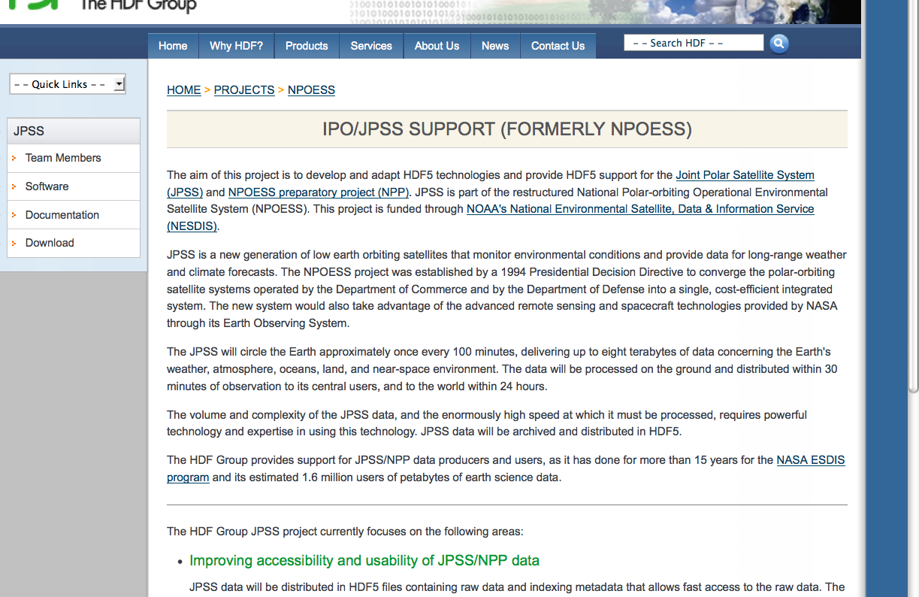
JPSS Released Software
Notes:
The page has links to the JPSS software description, downloads, and documentation

Slide 6
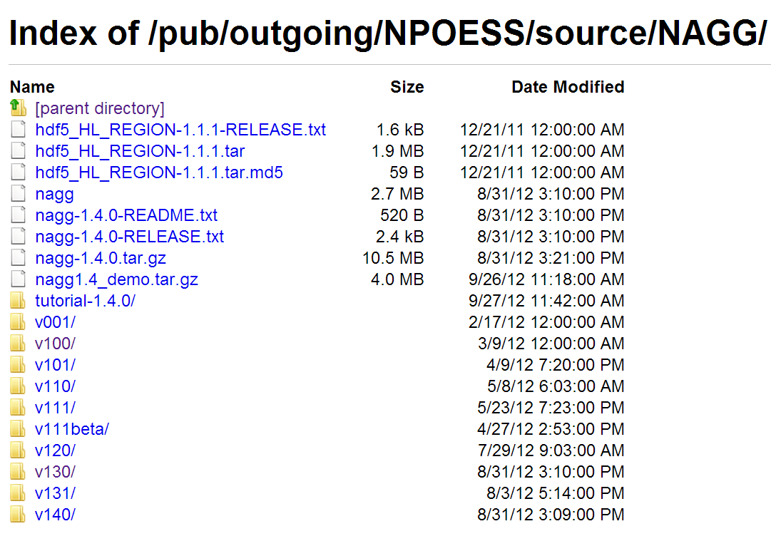
Software under Development

Slide 7
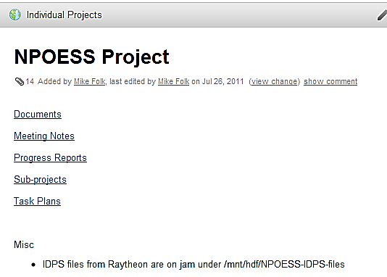
HDF NPOESS Wiki

Slide 8
H4edit and h5augJPSs

Slide 9
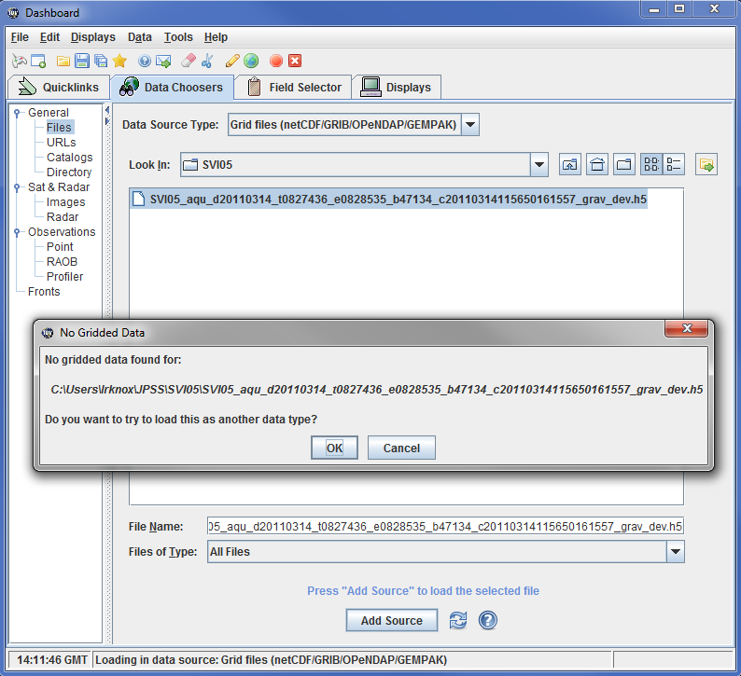
IDV “before”

Slide 10
Two problems
HDF5 file not netCDF-3 conformant
Missing CF metadata

Slide 11
H5edit and h5augjpss
help us address situations
where an application needs
a netCDF file
or
CF metadata
or both

Slide 12

h5augjpss
“Augmentation” - making an HDF5 JPSS file look like a netCDF-4 file
H5augjpss will …
  add metadata or data to the JPSS HDF5 file
  hide HDF5 elements not supported by netCDF
  …making it look like a netCDF-4 file
  or even a netCDF-3 conformant netCDF-4 file

Slide 13
h5edit
H5edit - edit attributes in an HDF5 file
For example, add CF metadata attributes
Example: add scale_factor attribute
    h5edit -c "CREATE /Radiance scale_factor {H5T_IEEE_F32LE SIMPLE(1) DATA{2.8339462E-4}};" file.h5

Slide 14
Two problems (revisited)
HDF5 file not netCDF-3 conformant
  h5augjpss –o4 SVI05.h5
Missing CF metadata
  h5edit -c "CREATE /Radiance scale_factor {H5T_IEEE_F32LE SIMPLE(1) DATA{2.8339462E-4}};" SV105.h5
  h5edit -c "CREATE /Longitude units {H5T_STRING { STRSIZE 12 } DATA {'degrees_east'}};” SV105.h5

Slide 15
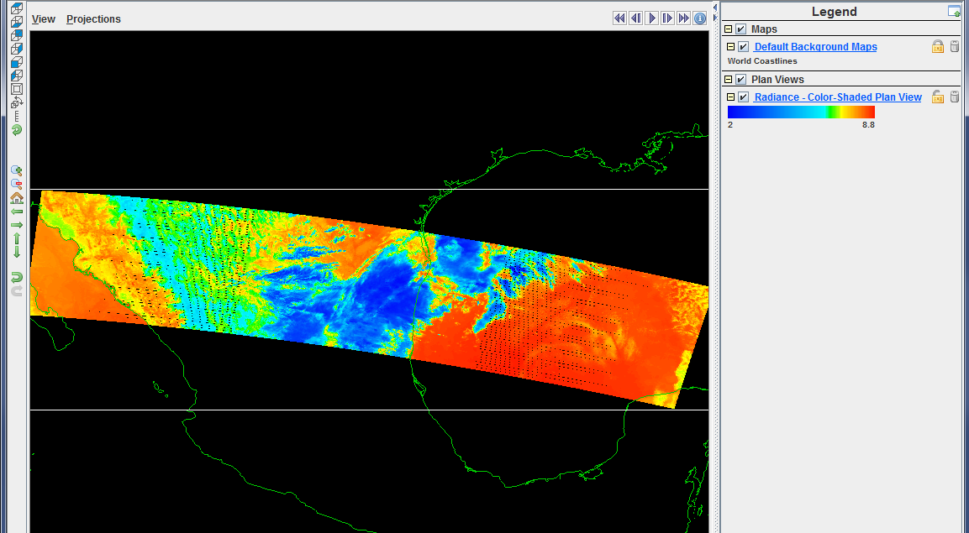
IDV after augmentation
IDV with augmented JPSS file

Slide 16
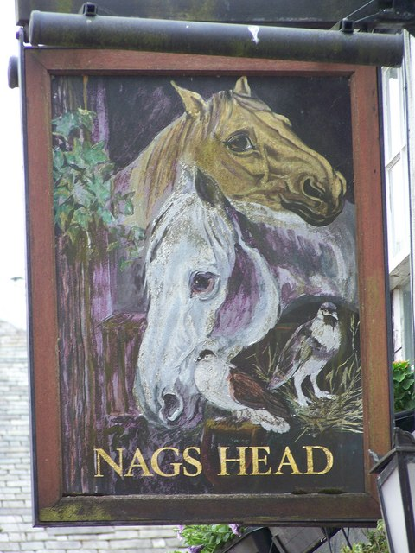
nagg
NPP
aggregation
tool
Notes:
Photo: Sign for the Nags Head Pub, Brampton. Photo by Trish Steel

Slide 17
Why nagg?*
NPP data products organized as “granules.”
Granules are relatively small.
Several granules may be packaged per file.
Several products may be packaged per file.
For convenience of a particular application, we may want to re-package them.
May also want only a subset of them.
(*Thanks to Richard Ullman)
Notes:
Data products are organized as “granules.”
Granules are made relatively small for convenience of handling them.
Several granules may be packaged per file, and usually are.
E.g. 16 granules per file.
For convenience of a particular application, we may want to package them differently.
E.g. 1,000 granules per file instead of 16.
We may also want just a subset of all available granules.
E.g. those measurements taken during a particular time period.
That is what nagg does.
"For NPP, the concept of a granule is independent of the packaging of the granule in a file, so we make granules relatively small in order to conveniently manipulate them, but we can package them into arbitrary numbers of granules for the convenience of the particular application. "
nagg is needed to address the flexibility of NPP products, especially swaths products. A swath is a ribbon of data collected as the satellite orbit sweeps across the Earth. As an orbit is continuous, the swath is continuous, wrapping around the Earth over and over again like a yarn on a ball. In most NASA heritage missions, the ribbon of swath is snipped into equal size pieces which we call granules, and one granule is placed in each file. The size of the snipped piece while usually set for each mission, varies from mission to mission based mostly on the amount of data and therefore the size of the file that can be conveniently manipulated.
For NPP, the concept of a granule is independent of the packaging of the granule in a file, so we make granules relatively small in order to conveniently manipulate them, but we can package them into arbitrary size for the convenience of the particular application. For example, when comparing a MODIS 5 minute data granules to the VIIRS data, if is useful to package four VIIRS 86 second granules together to make the piece of swath similar in size to the MODIS granule. Some data analysis tools analyze by full orbit, so it is convenient to package OMPS data that way. Nagg makes it possible for the analyst to package NPP data into files in the way that best suits them. -Rich (You could think of the NPP relationship of a granule to a product swath to be similar to the HDF relationship between a chunk and a dataset.)

Slide 18
What is nagg?
Nagg is a tool for rearranging NPP data granules from existing files to create new files with a different aggregation number or a different packaging arrangement.

Slide 19
Nagg operations
Aggregation
Aggregate data granules
De-aggregate data granules
Re-aggregate data granules
Packaging
Package granules of multiple compatible products in common files
Un-package products into separate files for each product
-g no or –g <product>
Notes:
Two independent operations which can be combined

Slide 20
Plans for 2012-2013

Slide 21
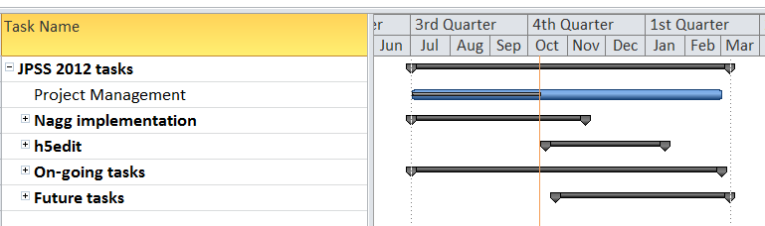

Slide 22
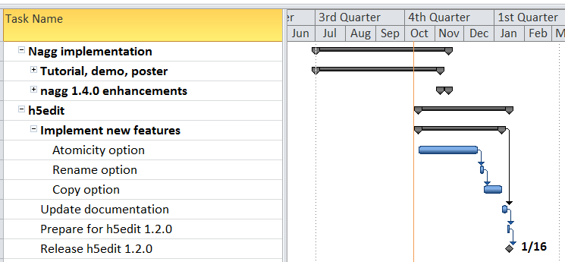

Slide 23
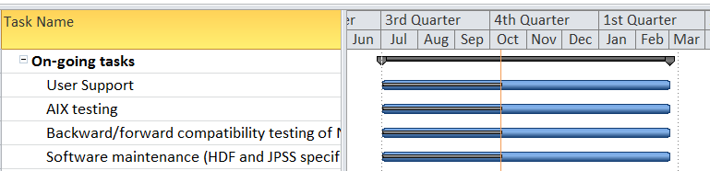

Slide 24
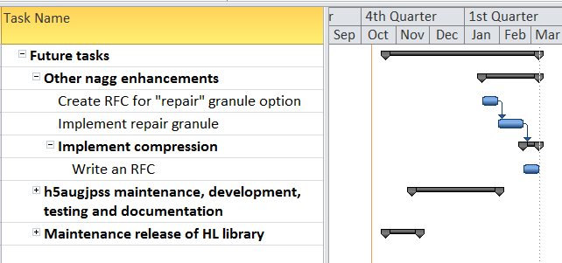

Slide 25
What about ESDIS JPSS?

Slide 26
What’s the ESDIS NPP-SDS project?
Users?
  PEATEs and their customers
  More likely comparing this data to EOS counterpart data
  Customers have likely never seen the data before
  Don’t currently do data distribution to the world, but this could happen in the future
  OMPS planning to distribute the data soon
  Other PEATEs?
  NCDC and NGDC: ESIP meetings is a good place to speak with them about their needs
Needs?
  Examples for any particular NPP products
Plans?
How can we help?

Slide 27
Thank You!

Slide 28
Acknowledgements
This work was supported by Riverside (subcontract HDF-1000, prime contract DG133E07CQ0055), and by Raytheon (subcontract 114820, prime contract NNG10HP02C).
Both contracts are funded by the National Aeronautics and Space Administration (NASA).
Any opinions, findings, conclusions, or recommendations expressed in this material are those of the authors and do not necessarily reflect the views of Riverside, Raytheon or NASA.

