Slide 1
HDF OPeNDAP support
Kent Yang, Joe Lee, Mike Folk
The HDF Group
Oct. 16, 2012

Slide 2
Outline
HDF5 OPeNDAP handler
  Review
  Current status
  Future plans
HDF4 OPeNDAP handler
  Review
  Current status
  Future plans

Slide 3
HDF5-OPeNDAP handler

Slide 4
HDF5-OPeNDAP handler – what we proposed
-- The “future plan” slide from last year’s briefing
Significant development to make general HDF-EOS5 files to be CF-compliant
  Multiple swaths/grids
  Better way to handle name clashing
  Better support for handling CF attributes
    scale_factor and add_offset
    valid_min and valid_max
Support general NASA HDF5 files
  Other MEaSUREs products
  Decadal mission products

Slide 5
HDF5-OPeNDAP handler – what we accomplished
Re-engineered the HDF5-OPeNDAP handler to accomplish all the tasks we proposed
Additionally
  Enhanced the configuration process
  Implemented a comprehensive test suite
  Added support for new products
    Aquarius Grid, ICESat-2, GOSAT/acos

Slide 6
HDF5-OPeNDAP handler – Usage
The handler was released on June 18th, 2012
GES DISC uses this handler
Hope other data centers will test the handler and give us feedback
Other data centers that distribute HDF5 data
  LaRC: TES
  P.O DAAC: Aquarius Grid
  NSIDC: Future SMAP and ICESat-2

Slide 7
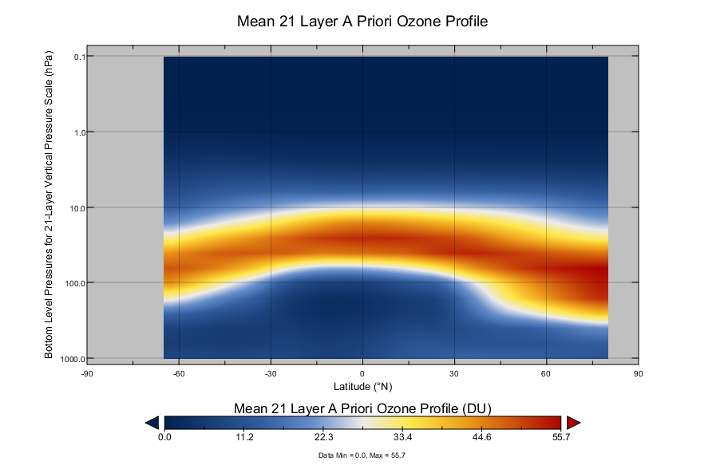
Ozone Profile (BUV)

Slide 8
HDF5 OPeNDAP Handler – Recent Update
Performance improvement when handling many objects in a file
Minor release soon

Slide 9
HDF5 handler Future Plans
Continue supporting new NASA HDF5/HDF-EOS5 products
Release on March 15th every year
Provide customized versions to data centers if necessary

Slide 10
HDF5 handler future work discussion
Question: Do we want to support this feature?
Under the CF option
  Make the HDF5 handler also support the netCDF-4 enhanced model

Slide 11
HDF5 handler future work discussion
Question: How should we support the default option?
Background
  In 2007, the original HDF5 OPeNDAP handler was developed to support:
    The access of general HDF5 files via OPeNDAP
    The visualization of NASA HDF-EOS5 files via OPeNDAP clients by following CF
  NASA data centers are only interested in the CF support
  In 2011, work was funded to re-engineer the HDF5 OPeNDAP handler to enhance the CF support for the current and new products. This is the CF option part of the handler.
  However, most codes that support the access of general HDF5 files have not been updated since 2007. This is the default option part of the handler.

Slide 12
HDF5 handler future work discussion
The current status of the default option
  Supports the default mapping from HDF5 to DAP2
    Preserves the HDF5 group hierarchy
    Maps HDF5 compound datatype to DAP structure
    Maps HDF5 reference to DAP URL
  Need to improve the code quality and tests
  The default option is disabled in the handler release; users can turn on the option by themselves.
Proposal:
  Can we gradually improve the support of the default option?

Slide 13
HDF4-OPeNDAP handler

Slide 14
HDF4-OPeNDAP handler – what we proposed
MISR “swath” support
Some TRMM support
Added support for vdata in hybrid HDF-EOS2 files
Better way to handle name clashing
Support for more CF attributes
  scale_factor and add_offset
  valid_min and valid_max

Slide 15
HDF4-OPeNDAP handler – what we accomplished
CF support for MISR “swath”, MODIS level 1B, MODIS LAMAZ, TRMM, OBPG, HDF4 in P.O. DAAC
Enhanced general vdata handling
Generally to follow the naming conventions of HDF5 handler
Better way to handle name clashing
Support for more CF attributes
  scale_factor and add_offset
  valid_min and valid_max
Addition of a comprehensive test suite
Improvements to the configuration process
……

Slide 16
HDF4-OPeNDAP handler
Major release sometime in October

Slide 17
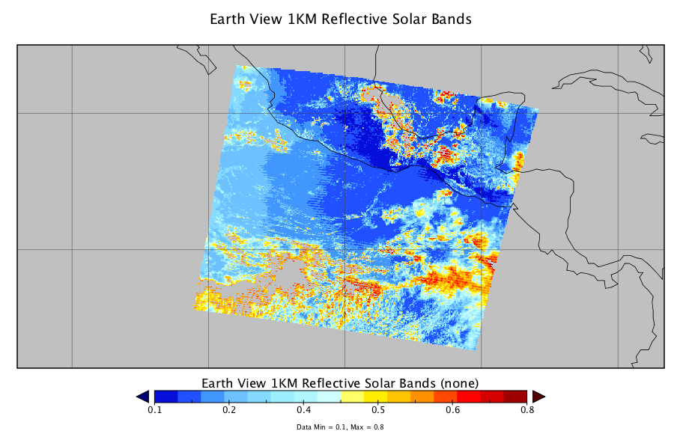
EV_1KM_RefSB in MOD021KM

Slide 18
Future plans
Release on September 15th every year
Improve code readability, error handling, etc., for easy maintenance
Improve support for MISR products
May need to revise the handlers to accommodate new versions of NASA HDF4 and HDF-EOS2 products
  For example, the file structure of the new AIRS products is different than the previous versions

Slide 19
Future plans (continued)
Other possible work:
  Investigate access to VIIRS data distributed in MODAPS via IDV/Panoply?
  Support the netCDF file dumper module?
    The netCDF file dumper converts OPeNDAP to netCDF and it was developed by OPeNDAP
    Some data centers use HDF OPeNDAP handlers and this module to generate netCDF output
    Bugs in this module that prevent the generation of netCDF output may not be fixed promptly
    Can we help OPeNDAP fix bugs related to generate netCDF output via this module?

Slide 20
Thank You!

Slide 21
Acknowledgements
This work was supported by Subcontract number 114820 under Raytheon Contract number NNG10HP02C, funded by the National Aeronautics and Space Administration (NASA). Any opinions, findings, conclusions, or recommendations expressed in this material are those of the authors and do not necessarily reflect the views of Raytheon or the National Aeronautics and Space Administration.

