Slide 1
HDF-EOS Status,
Related Tools and Issues
Abe Taaheri, Raytheon IIS
The HDF Group Visit
October 16, 2012

Slide 2
Overview
Support Overview
Downloadable Software
Software Releases
Major Development & Fixes since last meeting
Future Plans
User Support

Slide 3
TOOLKIT / HDF-EOS Support
Under NASA EOSDIS Evolution & Development (EED) contract we support:
Current support
      HDF-EOS 2 & 5
      SDP & MTD Toolkits
      HDF-EOS2 to GeoTIFF Converter (HEG)
      HDF-EOS plug-in for THG HDFView
      Other Toolkit/HDF-EOS related software
      helpdesk for Toolkit/HDF-EOS/HEG

Slide 4
ECS Support of HDF-EOS
Both HDF4 and HDF5 based flavors of HDF-EOS are part of ECS baseline.
DAACS are supported with
  TOOLKIT/HDF-EOS & HEG deliveries during yearly DAAC releases or patch deliveries
  On demand
Other users can download our software from
  our tools’ web sites
  directly from our ftp site:
      ftp://edhs1.gsfc.nasa.gov/edhs

Slide 5
Downloadable Software
SDP Toolkit (Science Data Processing Tools)
MTD Toolkit (Metadata, Time/ Date Tools)
HDF-EOS2 (HDF4 based)
HDF-EOS5 (HDF5 based)
heconvert
  Converts hybrid HDF4/HDF-EOS2 files to HDF-EOS 5
DumpMetadata (Dump HDF-EOS metadata)

Slide 6
Downloadable Applications
HEG
- GeoTIFF conversion
- Spatial subsetting, Field Subsetting
- reprojection
- stitching, sub-sampling and more ….
HDFView Plug-in, Java-based browser (HDF4, HDF5, HDF-EOS 2 and 5 access)
HE5View* (HDF5 - based browser)
EOSView* (HDF4 - based browser)
* Dropped support for OS updates on July 2006

Slide 7
Software Releases

Slide 8
Software Releases
SDP Toolkit/HDF-EOS:
Last release – January 2012
  TOOLKIT 5.2.18
  HDF-EOS 2.18, HDF- EOS5.1.14
    with HDF4.2.6, HDF5-1.8.8, Szip2.1, zlib1.2.5
Next release – (January 2013)
  TOOLKIT 5.2.19
  HDF-EOS 2.19, HDF-EOS5.1.15
    with new releases of HDF4 (2.8), 5 (1.8.9 or later)

Slide 9
Software Releases
MTD Toolkit:
Last release – Dec 2006
  Version 5.2.13
    in-sync with SDP TOOLKIT 5.2.13
    with HDF4.2r0, HDF5-1.6.3, Szip1.2
Next release – Dec 2012
  Version 5.2.18
    in-sync with SDP TOOLKIT 5.2.18
    with HDF releases of HDF4 (2.6), 5 (1.8.8)

Slide 10
Software Releases
HDF-EOS Plug-in for HDFView:
Last release – August 2011
  For HDFView Version 2.7
Next release – Dec 2012
  For HDFView Version 2.9

Slide 11
Software Releases
HECONVERT (HDF-EOS2 to HDF-EOS5 Converter):
Last releases
– Aug. 2011 Version 3.0
Next release
– Dec. 2012 Version 4.0
    Fix for some missing global attributes in the converted file
    Fix for missing some swath attributes in hybrid files
DumpMetadata (ASCII Dump of HDF-EOS metadata)
Last release
    Dec. 2008 Version 1.0
Notes:
11

Slide 12
Software Releases
HEG (HDF-EOS2 to GeoTIFF Converter):
Last Stand-alone release – Mar. 2011
  Version 2.11
Last DAAC release – April 2012
  Release 8.1
Next release
  Stand-alone Version 2.12 (Nov. 2012)
  DAAC release 8.2 (Aug. 2013)
Notes:
12

Slide 13
Major Development & Fixes
Since Last HDF Group Visit Meeting
Notes:
13

Slide 14
Major Development, Bug Fixes
  TOOLKIT (5.2.18):
  15-arc second (500 m) DEM elevation and Standard deviation of Elevation data support in Toolkit
  15-arc second (500 m) land/water mask data support in Toolkit
  15-arc second DEM elevation and Land/water data (from USGS/UMD) conversion from GeoTIFF to hdfeos format for use with DEM tools in TOOLKIT

Slide 15
Major Developments, Bug Fixes
  Support for 32 & 64-bit Mac OSX Intel with X86_64 and i386 structures
  Added capability to install Toolkit/HDF-EOS5 in threadsafe mode for Linux and MacIntel (32 and 64-bit)
  Capability for adding non-standard C and FORTRAN flags to TOOLKIT on installation command line
  Use of gfortran (instead of PGF90) for f90 DAAC TOOLKIT compilation

Slide 16
Major Developments, Bug Fixes
  HDF-EOS2 (2.18):
  HDF-EOS5 (1.14):
  Support for HDF4 version 4.2.6 and HDF5 version 1.8.8
  A few fixes for correct handling of unlimited dimensions in hdfeos5
  New Toolkit style INSTALL scripts for HDF-EOS2 and HDF-EOS5
  support of GDij2ll for State Plane Projection
  Support for new AMSE-E Browse file by adding general raster image conversion in hdf2jpeg

Slide 17
Major Developments, Bug Fixes
  HDF-EOS Plug-in for HDFView2.7:
Support of Linux and MAC OSX Intel 64-bit Platforms.
Support for Zonal Average (ZA) objects of HDF-EOS5.
Draw Map of Coastlines, international borders,
and US state lines onto GRID images for all
HDF-EOS supported projections.
heconvert 3.0 usage.

Slide 18
Major Developments, Bug Fixes
heconvert (3.0, 4.0):
Handle hybrid hdf files. Write HDF objects (created by HDF4 calls) in addition to the HDF-EOS objects (created by HDF-EOS2 calls) to the output.
Convert Dimension Scales when present.
Copy ECS's Inventory and Archive metadata into the output
Write HDF written field/group attributes to the output fields/groups.

Slide 19
Major Developments, Bug Fixes
Add global attributes to the converted file
Add swath attributes in hybrid input files

Slide 20
Major Development, Bug Fixes
  HEG:
  Enhancement :
  Performance improvement for conversion to Conical or Azimuthal projection
  Performance improvement for all supported products (EED On-Demand-Data-Access Web Services)
  Preserving input datum for output projection
  Better default values when user fails to enter some key projection parameters specifically when input grid is global and output projection LCC or LA
  Chunking/Compressing data fields for HDF-EOS outputs
Notes:
20

Slide 21
Major Development, Bug Fixes
  Better handling of UTM outputs when user fails to enter appropriate UTM zone and/or subset area for Global input grids
  Windows VISTA and 7 testing/support
  Resolving problem with some output State Plane projection conversions when user fails to enter appropriate SP zone (leading 0 in some 3-digit SP zone codes in statezones.h)
  Modifying input default lat of +/- 90 for AE Ocean products when output projection is Mercator
Notes:
21

Slide 22
Major Development, Bug Fixes
  Support for fields with dimensions 5 or larger (MISR)
  Allowing HEG to open Parameter file with Stand-alone GUI
  Support HEG in MAC Intel
  Added field image for subsetting (conversion GUI/Grid only)
  Allowing to stitch all 180 MISR blocks when memory is available
  Better conversion and interpolation schemes for swath conversion and stitching
Notes:
22

Slide 23
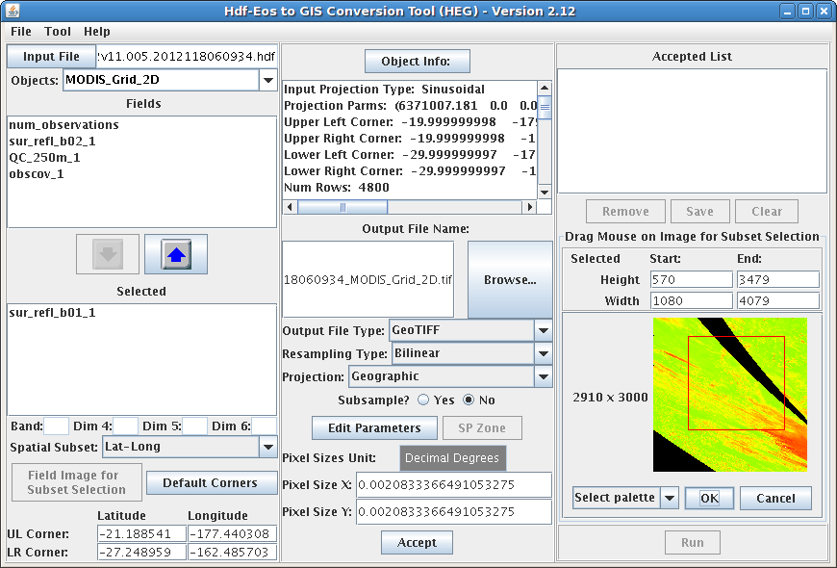
Major Development, Bug Fixes
Notes:
23

Slide 24
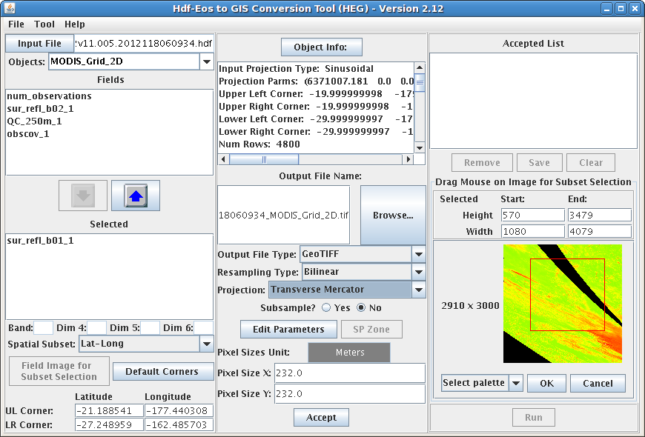
Major Development, Bug Fixes
Notes:
24

Slide 25
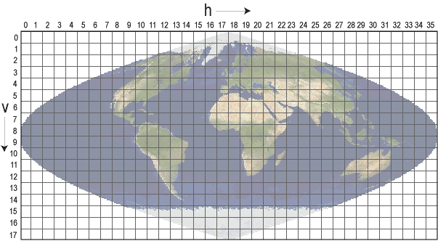
Major Development, Bug Fixes
  Bug Fixes
    Same input/output pixel numbers for EASE grid when No-Reprojection is used (AMSR_E Daily Snow)
    MOD11_L2 version 5 support
    Opening of MODIS grid files containing
    edge tiles (Sinusoidal projected grids)
    Add ellipsoid code SP projected output
    Stand-alone HEG GUI fixes for subset area selection for some products such as AMSR_E Sea-Ice products
    Correcting a problem offending input negative Earth Flattening value in AMSR_E SeaIce products
Notes:
25

Slide 26
Future Plans
Notes:
26

Slide 27
Future Plans
TOOLKIT/HDF-EOS:
Support for new versions of HDF4 - HDF5
XML Metadata reading in TOOLKIT
Add APIs for local and group attributes in HDF-EOS2
Fix for getting correct compression info for a field in HDF-EOS5, when Gdcompinfo / SWcompinfo fails to get the info from Structure metadata
New 500-M DEM Data for areas with fillvalue (Antarctica & Greenland) using 1-KM data

Slide 28
Future Plans
Store info in structural metadata somewhere else
Auto Configuration for TOOLKIT
RPMs for HDF-EOS and Toolkit
Validation tool for HDF-EOS5 files
Fix for user/DAAC reported bugs
Break SDP TOOLKIT into small pieces separating general tools from PGE used tools
New dimension scale routines for ease in setting dimscale for multi-field objects

Slide 29
Future Plans
HDF-EOS Plug-in for HDFView:
More functionalities :
  Cut/paste objects, modify/delete attributes.
  Create new grid/swath
  Adding some HEG capabilities (such as Geotif output, swath to grid conversion, projection conversion, subsetting, resampling, etc)
  Default data directory selection
  Draw Map of Coastlines, international borders, and US state lines onto swath images

Slide 30
Future Plans
HEG:
  Selected Field spatial subseting box (lat/lon) calculation using swath fielde image
  Processing of many similar files (for the same product) in a given directory using HEG stand-alone GUI (instead of batch scripts)
  Support of STP projection for swath conversion
  Better handling of MISR grids for online orders and with stand-alone HEG
    Resolve problems associated with too many fields in some MISR products (such as AEROSOL products)

Slide 31
User Support
Notes:
31

Slide 32
Availability
Access to libraries, applications, Documentation:
TOOLKIT:
http://newsroom.gsfc.nasa.gov/sdptoolkit/toolkit.html
HDFView:
http://newsroom.gsfc.nasa.gov/sdptoolkit/HDFView/
HDFView_hdfeos_plugin.html
HEG:
http://newsroom.gsfc.nasa.gov/sdptoolkit/HEG/HEGHome.html
Email
  Abe_Taaheri@raytheon.com
  PGSTLKIT@raytheon.com

Slide 33
Thank You!

