Slide 1
HDF Support for NASA Data Producers
Kent Yang, Mike Folk, Gerd Heber, Elena Pourmal
The HDF Group
Oct. 17, 2012

Slide 2
Outline
How we can help
What we’ve done in the past year
Outstanding issues
Notes:
ICESat-2
SMAP
MEaSURES
MOPITT
Others

Slide 3
How we can help
  Usage of HDF4 and HDF5 libraries
    APIs, compilers, performance tuning
  Interoperability with other technologies
    CF related
    netCDF
    OPeNDAP
    XML related
Notes:
ICESat-2
SMAP
MEaSURES
MOPITT
Others

Slide 4
What we helped with in the past year
  SMAP team
    Produce ISO 19139 via XSLT from XML representation of HDF5 metadata
    Write ISO 19139 into an HDF5 attribute in an HDF5 file
  ICE-Sat team
    Interoperability with netCDF-4, CF and OPeNDAP
  MOPITT team
    Transition from HDF-EOS2 to HDF-EOS5
      Fortran
      Interoperability with netCDF-4, CF and OPeNDAP
  Several MEaSUREs teams
    Interoperability with netCDF-4, CF and OPeNDAP
Notes:
ICESat-2
SMAP
MEaSURES
MOPITT
Others

Slide 5
Other activities
Participate in ESDSWG SPG HDF-related telecons
Provide suggestions and information to HDF and netCDF Technical working groups

Slide 6
Issues for NASA HDF4 (EOS2) products

Slide 7
Issues for NASA HDF4 (EOS2) products
We found these issues while working on other projects
We then documented them according to our best knowledge
We also documented some information (projection related etc.) that users may not be familiar with.
Covers HDF data from the following centers:
GES DISC
NSIDC
LP DAAC
GHRC
LAADS
LaRC ASDC
PO DAAC
OBPG

Slide 8
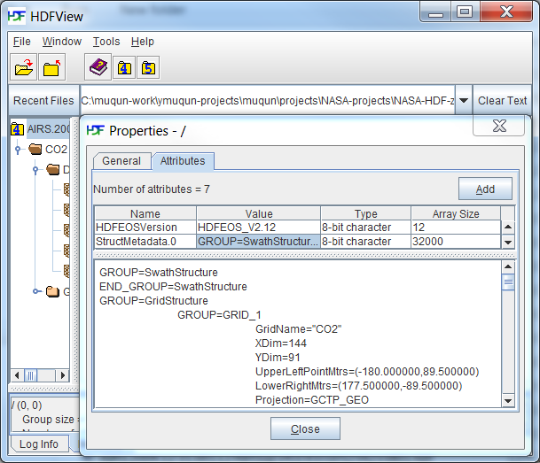
Category 1: Incorrect Metadata
Only found in a few products
Parameter 'UpperLeftPoint/LowerRight Mtrs' should be packed in degrees, minutes, seconds format (DDDMMMSSS.SS). In this file, this parameter doesn't follow the DDDMMMSSS.SS format. In DDDMMMSSS.SS format, the value of UpperLeftPoint should be
(-180000000.000000,90000000.000000). But in this file, the UpperLeftPointMtrs is (-180.000000,89.500000)', which only shows the degrees. This will generate the wrong latitude and longitude values if one uses the HDF-EOS2 library to retrieve the latitude and longitude values.

Slide 9
Category 2: Information needed outside the HDF file
Geo-location or CF attributes
  An example:
    latitude and longitude for some CERES products can only be found from on-line documents.
Notes:
Information can only be found outside the HDF file.

Slide 10
Category 3: Not following conventions
Field/attribute not following CF conventions etc.
  An example:
    Some field names in AMSR products contain non-CF characters
Notes:
The Information provided by NASA HDF4 and HDF-EOS2 files may not be presented in a standard way such as following the common usage of the HDF-EOS2 library or following some widely used conventions (CF conventions etc).
In some data fields of AMSR products, some field names contain special characters(period “.” and parentheses”()”).

Slide 11
Category 4: “Special” files
Users need to be aware of unusual data arrangements
  An example:
    For some MODIS files, HDF4 APIs are used to add information to the HDF-EOS2 file. Accordingly, such information cannot be retrieved by HDF-EOS2 APIs.
Notes:
Data and metadata are arranged in a way that users may need to be aware in order to retrieve the correct information.
For most cases, there is nothing wrong with the arrangement, but users just need to be aware of the situation.
Example: For some MODIS files, HDF4 APIs are used to add information to the HDF-EOS2 file. Accordingly, such information cannot be retrieved

Slide 12
Currently all the information stored in an excel file

Slide 13
What to do with this document?

Slide 14
Thank You!

Slide 15
Acknowledgements
This work was supported by Subcontract number 114820 under Raytheon Contract number NNG10HP02C, funded by the National Aeronautics and Space Administration (NASA). Any opinions, findings, conclusions, or recommendations expressed in this material are those of the authors and do not necessarily reflect the views of Raytheon or the National Aeronautics and Space Administration.

Slide 16
Questions/comments? help@hdfgroup.org

