Slide 1
Support EOS:
Review and Discussions
Kent Yang and Joe Lee
The HDF Group
October 16, 2012

Slide 2
Outline
HDF-EOS Website
ESDIS tools
Misc.
Notes:
Almost one-to-one mapping

Slide 3
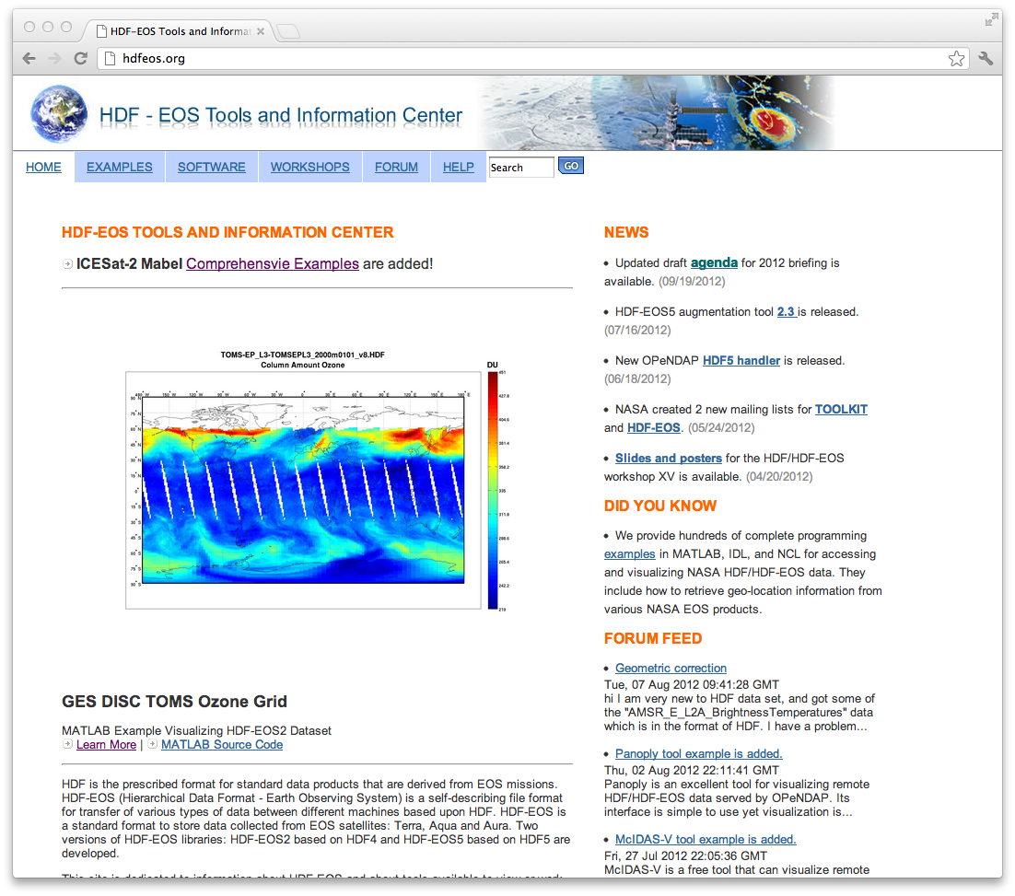
HDF-EOS Web Site http://hdfeos.org

Slide 4
2011-2012 work review
Actively maintain the website
  Review and update most pages
  Moderate the user forum
  Promptly update the workshop and briefing pages
Improve the main page
Add new tool examples
  Panoply, McIDAS-V, and Webification
  H4CF Conversion Toolkit
Actively update MATLAB/IDL/NCL comprehensive example pages

Slide 5
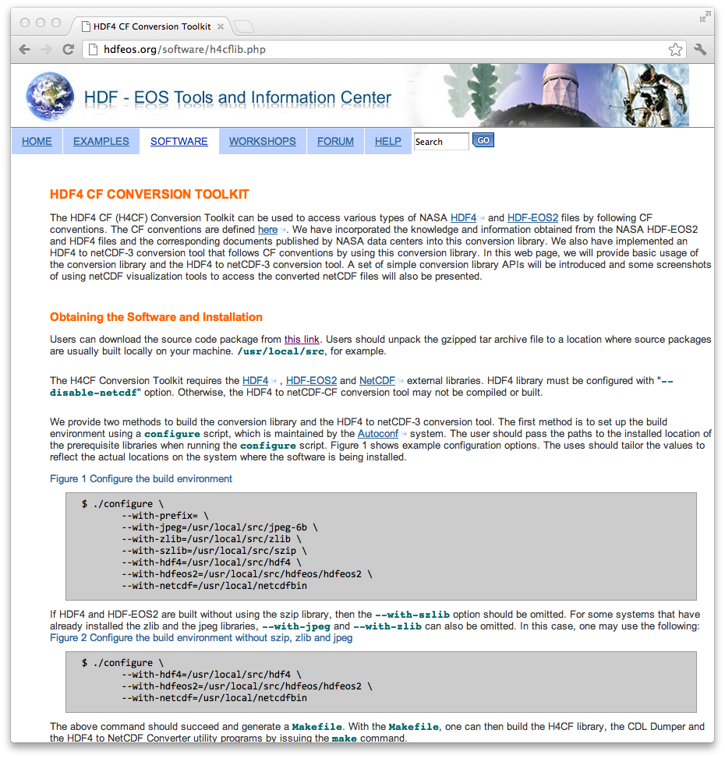
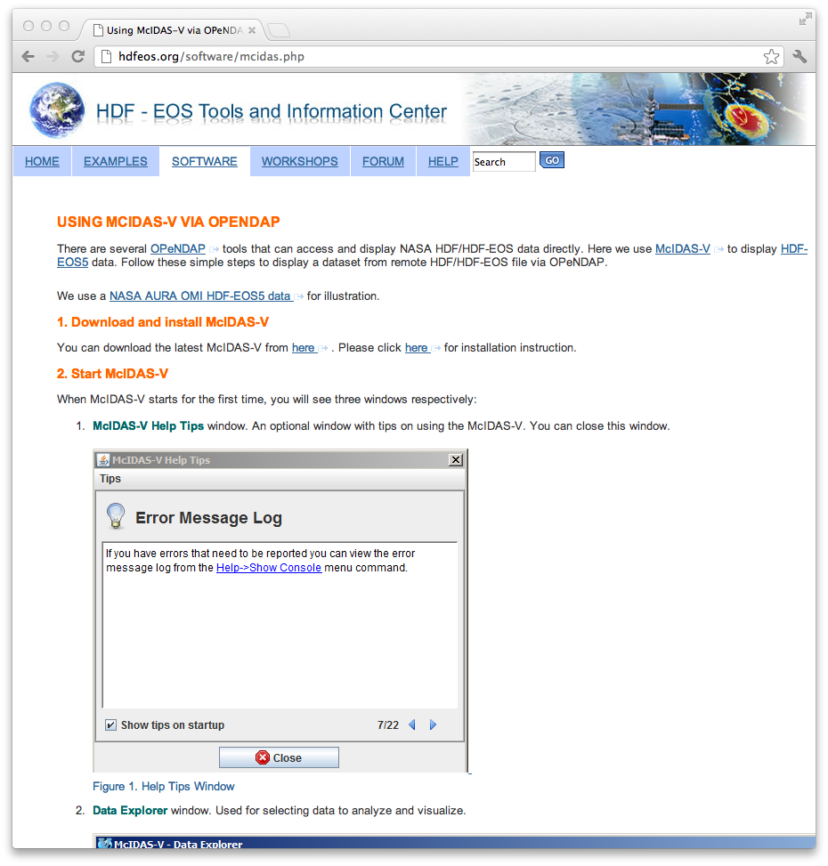
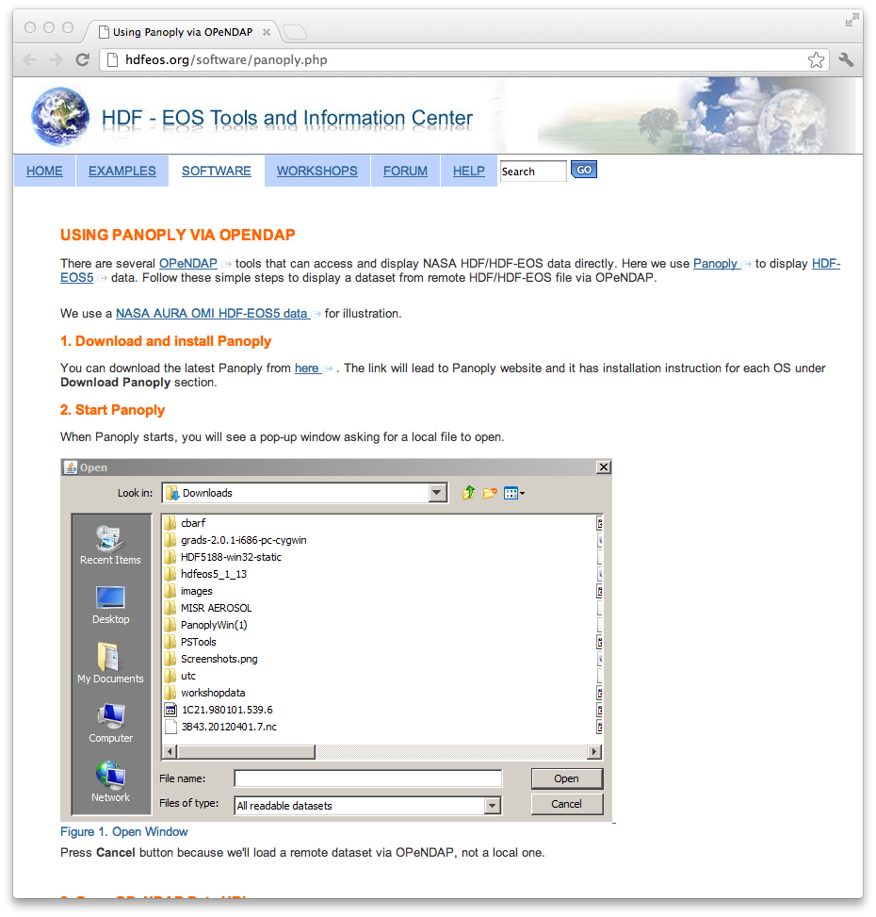
Tools Added
Panoply
McIDAS-V
H4CF Conversion Toolkit

Slide 6
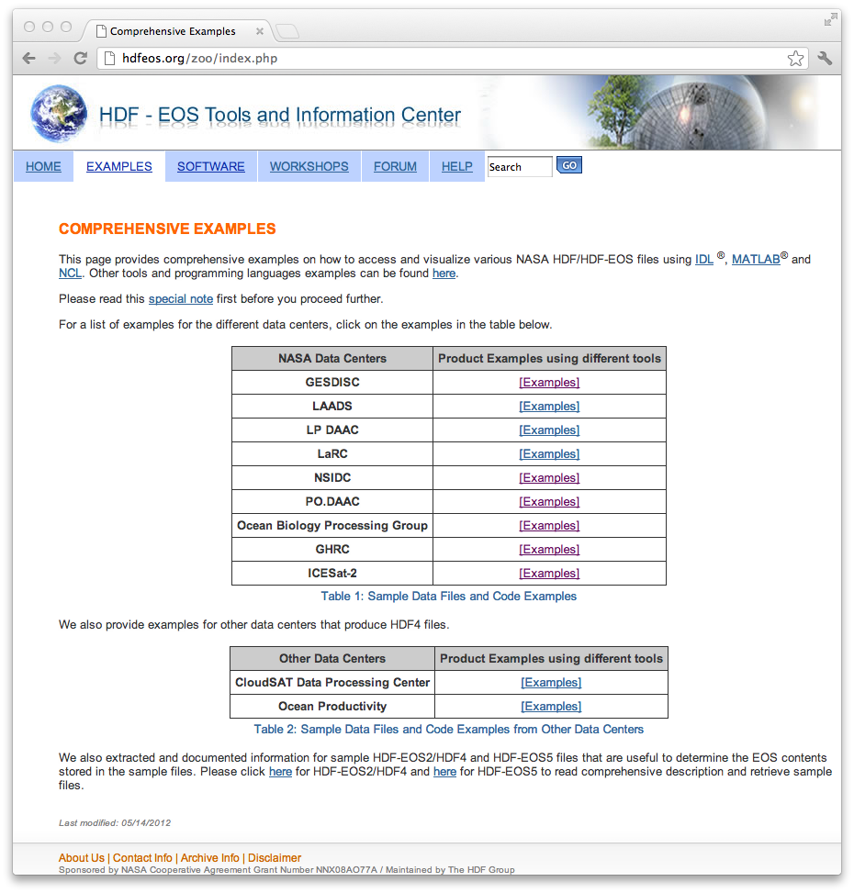
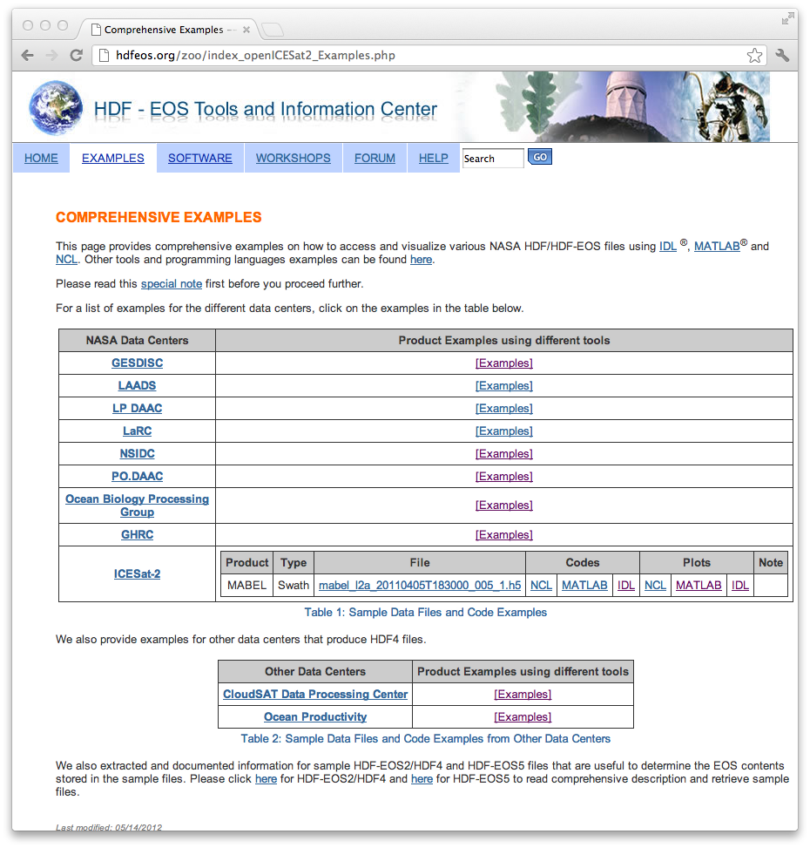

NCL/IDL/MATLAB examples
Many examples from different NASA data centers
Example codes and plots

Slide 7
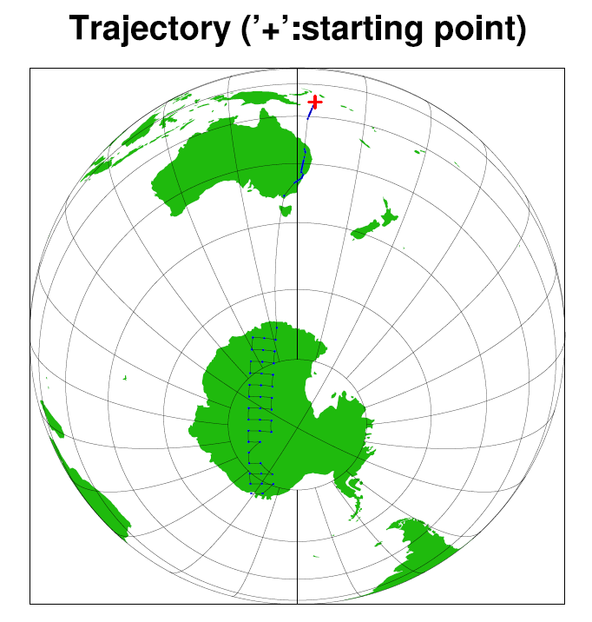

An example of accessing GOSAT/acos
; Use h5_file->sounding_latitude_geoid instead of h5_file->sounding_latitude
; according to [1].
;
; Latitude.
lat = h5_file->sounding_latitude_geoid
lat@long_name = "latitude"
lat@units = h5_file->sounding_latitude_geoid@Units
; Use h5_file->sounding_longitude_geoid instead of h5_file->sounding_longitude
; according to [1].
;
; Longitude.
lon = h5_file->sounding_longitude_geoid
lon@long_name = "longitude"
lon@units = h5_file->sounding_longitude_geoid@Units
; Altitude
lev = h5_file->sounding_altitude
lev@long_name = "altitude"
lev@units = h5_file->sounding_altitude@Units
; CO2 Data.
data = h5_file->xco2
data@long_name = "xco2"
data@units = h5_file->xco2@Units

Slide 8
A new face for the main page
hdfeos.org

Slide 9
HDF-EOS website statistics

Slide 10
Definitions
Visits – The total number of visits to the website.
Pageviews – The total number of pages viewed on the website. Repeated views of a single page are counted.
Pages/Visit – The average number of page views per visitor.
Bounce Rate – The percentage of single-page visits. (Total number of visits viewing one page) / (Total number of visits)
Avg. Visit Duration – The average visit duration.
% New visits – The percentage of visits by people who had never visited the website before.

Slide 11
Current Trends
Current Period: Mar. 25 2012 – Sep. 22 2012
Previous Period: Sep. 25 2011 - Mar. 24 2012

Slide 12
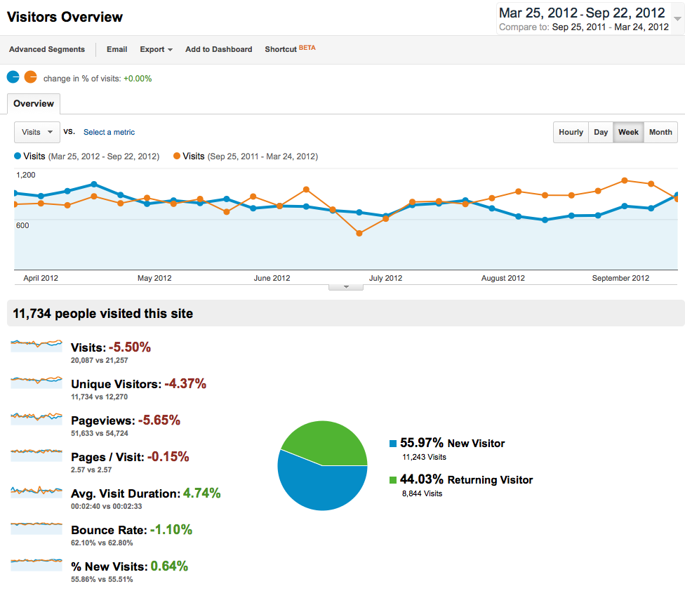
Number of Visitors are stable
3/25/12~09/22/12
9/25/11~03/24/12
Notes:
The key highlight - definitely more visits.

Slide 13
Top 10 Examples
R | Page Title | PageViews
1 | How to Read and Visualize HDF-EOS2 data Using Matlab | 1123
2 | How to Read and Visualize HDF-EOS2 data Using IDL | 587
3 | How to Read and Visualize HDF-EOS5 MLS data Using IDL | 466
4 | How to Visualize HDF-EOS data Using MATLAB via OPeNDAP | 412
5 | How to Visualize HDF-EOS data Using IDL via OPeNDAP | 366
6 | How to Retrieve Longitude and Latitude from HDF-EOS2 Grid | 282
7 | Using GrADS via OPeNDAP | 281
8 | How to Read HDF-EOS2 Grid data in C | 213
9 | How to Read HDF-EOS2 Grid data - More Examples | 172
10 | How to Read HDF-EOS5 Grid data in Fortran | 140
MATLAB and IDL examples are popular. Users look for product specific / geo-location extraction solution.
Notes:
Overall, people look for tools and examples on how to use them.

Slide 14
Top 10 Comprehensive Examples
Rank | Data Center Index Page | PageVeiws
1 | GESDISC | 1133
2 | LAADS | 650
3 | LP DAAC | 461
4 | LaRC | 325
5 | OBPG | 302
6 | NSIDC | 282
7 | PO.DAAC | 247
8 | ICESat-2 | 239
9 | Ocean Productivity | 234
10 | CloudSAT Data Processing Center | 211
Notes:
Overall, people look for tools and examples on how to use them.

Slide 15
Before and After
Current Period: May. 19 2012 – Sep. 15 2012
Period before the launch of the new website : Jul. 4 2009 – Oct. 31 2009

Slide 16
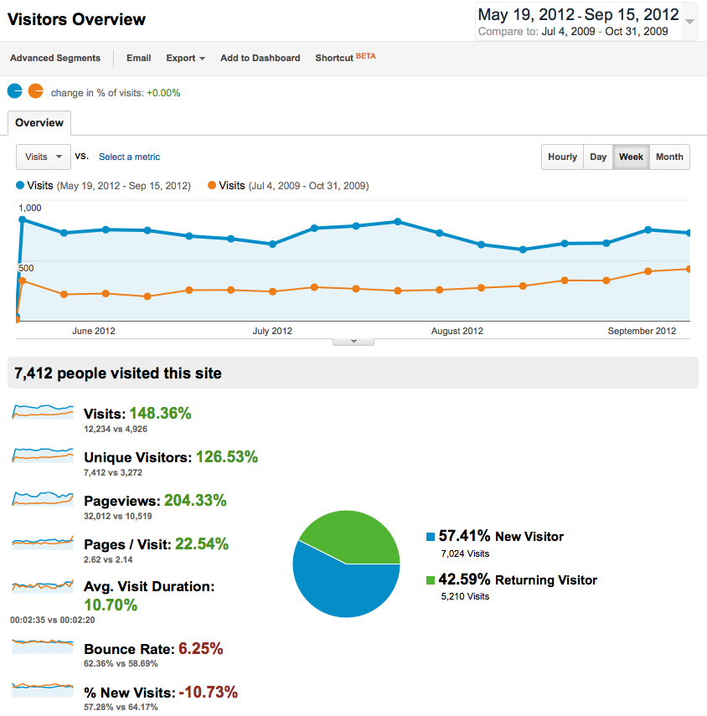
More Visits and Pageviews
5/19/12~09/15/12
7/4/09~10/31/09
Notes:
The key highlight - definitely more visits.

Slide 17
Top 10 Software
Rank | Page (URL)
1 | GrADS
2 | How to Build HDF-EOS
3 | PyHDF
4 | Global Mapper GeoTIFF Viewer
5 | NCL
6 | HDF Explorer
7 | HEG
8 | GDAL
9 | H4CF Conversion Toolkit
10 | GDL
Notes:
Help us prioritize our tasks
In this slide, GeoTIFF and GDAL become important

Slide 18
Top 10 Examples
Rank | Page Title
1 | How to Read and Visualize HDF-EOS2 data Using MATLAB
2 | How to Read and Visualize HDF-EOS2 data Using IDL
3 | How to Read and Visualize HDF-EOS5 MLS data Using IDL
4 | How to Visualize HDF-EOS data Using IDL via OPeNDAP
5 | Using GrADS via OPeNDAP
6 | How to Visualize HDF-EOS data Using MATLAB via OPeNDAP
7 | How to Retrieve Longitude and Latitude from HDF-EOS2 Grid
8 | How to Read HDF-EOS2 Grid data in C
9 | How to Read HDF-EOS2 Grid data - More Examples
10 | How to Read HDF-EOS5 Grid data in Fortran
Users look for tool examples and programming examples for reading geo-location information.
Notes:
Overall, people look for tools and examples on how to use them.

Slide 19
Direct Email Support Stats
2009: from November
2012: until September
We’ve got 300% more questions via email
after the launch of the new website.
Notes:
More traffics from smart phones and mobile devices look certain.
Are we ready?

Slide 20
An email message from a user
“Hi folks,
I am new to MODIS and I am trying to extract Land surface temperature from MOD11A1 product. It would be great if an example of how to use this product for extraction and plotting of the data can be uploaded on http://hdfeos.org/zoo.
Thank you in anticipation.”

Slide 21
A question from users
Can we redistribute the HDF-EOS plug-in together with HDFView?

Slide 22
Current Work
The website is mainly in maintenance mode:
Improve the quality of comprehensive example codes and plots.
  Add new products and visualization techniques.
Improve the visibility of the website.
  Create brochures and posters.
Improve the tools page
  Stay up to date with dependent libraries.

Slide 23
HDF OPeNDAP Work Update – A separate talk in the afternoon

Slide 24
HDF-EOS5 augmentation tool

Slide 25
Past Work Review
Upgrade the source code to HDF5 1.8 APIs
Major update for documentation
  Add the usage and the validation documents
Support more platforms
  Linux-64 bit
  Mac OS X

Slide 26
Possible Future Work
Handle swaths having 2-D coordinate variables
Augment an augmented file
  The tool provides several ways to augment a file
  Users may prefer one way to another
  An HDF-EOS5 file may be augmented in a way that users don’t prefer
  Once a file has been augmented, currently it cannot be augmented a second time.
  Users want to be able to use the tool to re-augment this augmented file in the way they like
  We had some discussions with users. But we haven’t heard from them if they want this feature
Notes:
Rewrite

Slide 27
HDF4/HDF-EOS2 CF conversion Toolkit

Slide 28
Motivation
Follow the CF conventions can improve the accessibility and usability of NASA HDF4 and HDF-EOS2 files

Slide 29

H4CF Conversion Toolkit
Panoply / IDV
NETCDF-3
h4cf
hdf4
eos2
Follow CF convention
Both Library and Tools
http://hdfeos.org/software/h4cflib
NETCDF-4
Classic

Slide 30
Current Status
An alpha release
  Basic CF support of converting HDF-EOS2 and some HDF4 files
  Implement netCDF3/netCDF-4 classic conversion tools based on the conversion library
HDF-EOS2 products include
  MODIS, MISR, AIRS
HDF4 products include
  Some TRMM, CERES, OBPG products

Slide 31
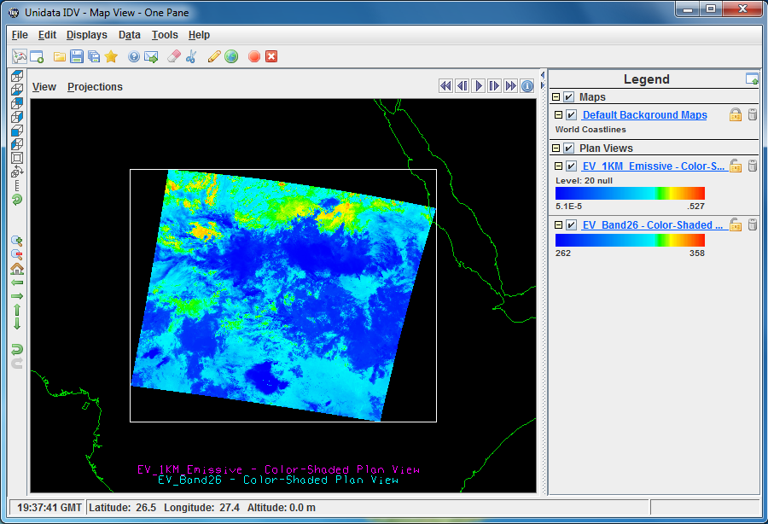
Converted from MODIS level 1B swath

Slide 32
Future Plan
Make the conversion toolkit consistent with the HDF4 OPeNDAP handler
  Update the naming conventions
  Fix critical bugs
  Improve features for popular products such as MODIS
  Implement a test suite
  Update the configuration process
Notes:
The scalability of the toolkit may not be an issue since we expect NASA will use HDF5 in the future.

Slide 33
Other tools

Slide 34
HDF-EOS2 dumper
Can be used to quickly obtain the latitude and longitude data
It is a command-line tool only supported on Linux and Mac OS
The output is in ASCII format
The dumper is used to generate some HDF-EOS2 plots via IDL,NCL and MATLAB

Slide 35
HDF-EOS2 dumper
In maintenance mode
Improve the quality of documentation
May support new projections

Slide 36
HDF-EOS5 to netCDF-4 converter
Converts HDF-EOS5 to netCDF-4
Follows netCDF enhanced data model
Hasn’t been updated in the past two years
Plan to release as needed

Slide 37
ESDIS tool release time (1)
Tools | Release dates (starting from 2013)
HDF5 OPeNDAP handler | March 15th
HDF4/HDF-EOS2 conversion toolkit* | June 15th
HDF4 OPeNDAP handler | September 15th
HDF-EOS5 augmentation tool | December 15th
*: Major release in 2013

Slide 38
ESDIS tool release time (2)
HDF-EOS2 dumper
  Maintenance release on Jan. 15th, 2014
  Then release every other year
HDF-EOS5 to netCDF-4 conversion tool
  Maintenance release on Jan. 15th, 2013
  Then release every other year

Slide 39
Misc.

Slide 40
HDF5 CF examples
Provide programming examples on how to add CF attributes to an HDF5 file via
  HDF5 C and Fortran APIs
  Python via h5py
  netCDF-4 C and Fortran APIs
  HDF-EOS5 C and Fortran APIs
Detailed documents also provided
URL: http://www.hdfgroup.org/HDF5/faq/cfattributes.html

Slide 41
Thank you!

Slide 42
Acknowledgements
This work was supported by Subcontract number 114820 under Raytheon Contract number NNG10HP02C, funded by the National Aeronautics and Space Administration (NASA). Any opinions, findings, conclusions, or recommendations expressed in this material are those of the authors and do not necessarily reflect the views of Raytheon or the National Aeronautics and Space Administration.

Slide 43
Questions/comments? help@hdfgroup.org

