Slide 1
Important ESDIS 2010 tasks review
Kent Yang, Mike Folk
The HDF Group
April 5th, 2011

Slide 2
Outline
HDF-EOS Website
HDF OPeNDAP support
HDF-EOS5 Augmentation tool
Others
Notes:
Almost one-to-one mapping

Slide 3
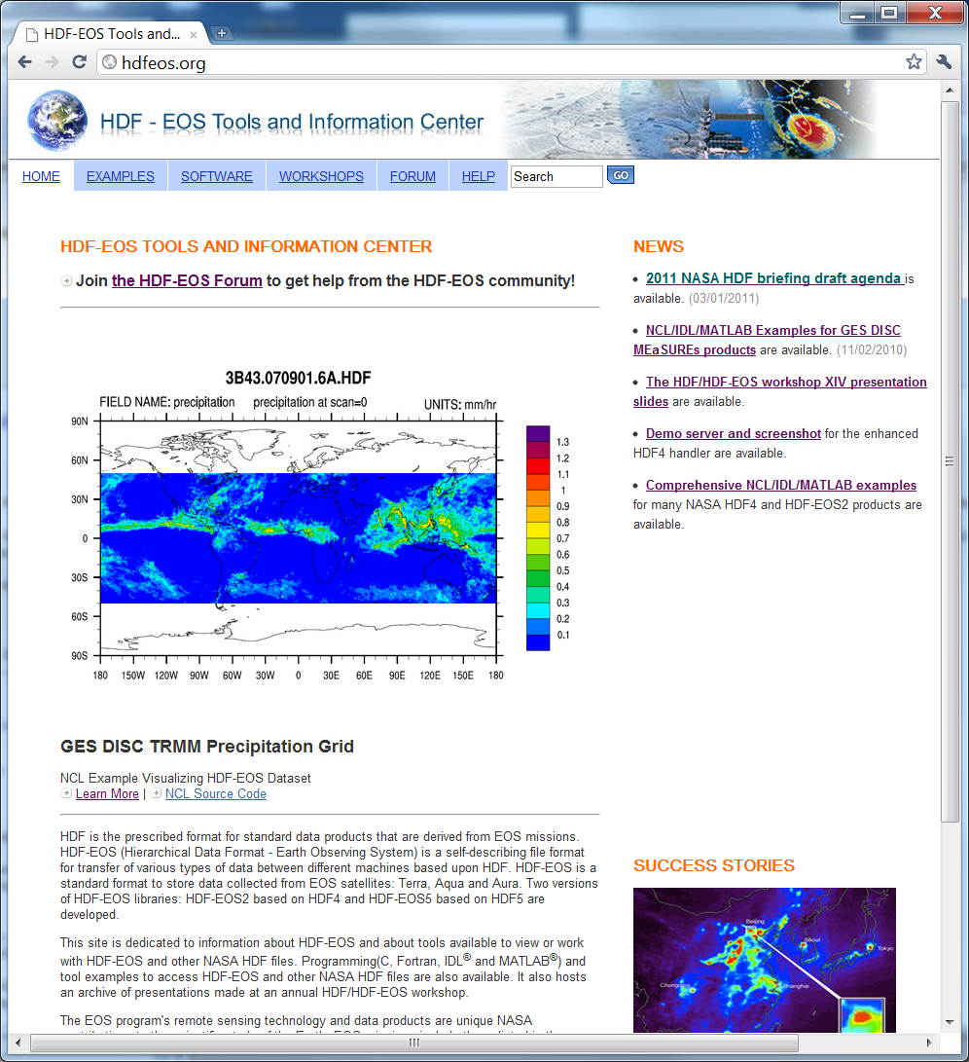
HDF-EOS Web Site http://hdfeos.org

Slide 4
2009-2010 work review
Add the “Example” section
  C/Fortran/IDL/MATLAB examples
  Tool Examples: HEG, GrADS, NCL etc.
Enhance the “Software” section
  Evaluated 35 tools and libraries
  Added 11 tools and libraries
  Added detailed descriptions
Renovate the user forum

Slide 5
2010-2011 work review
Actively maintain the website
  Review and update most pages
  Moderate the user forum
  Timely update the workshop and briefing pages
Add detailed description of five tools
Add a MATLAB/IDL/NCL comprehensive example page

Slide 6
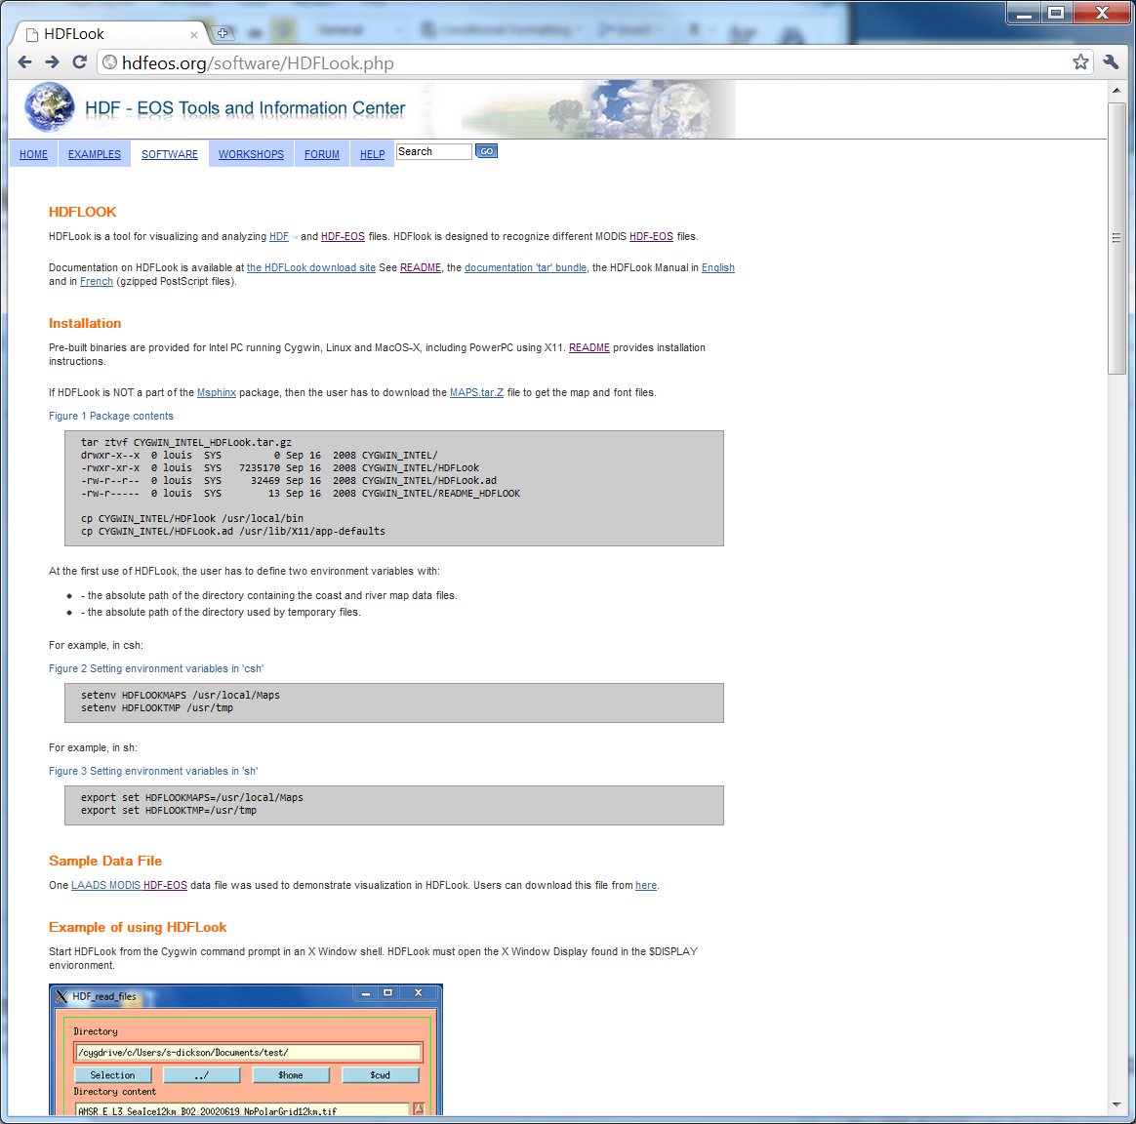
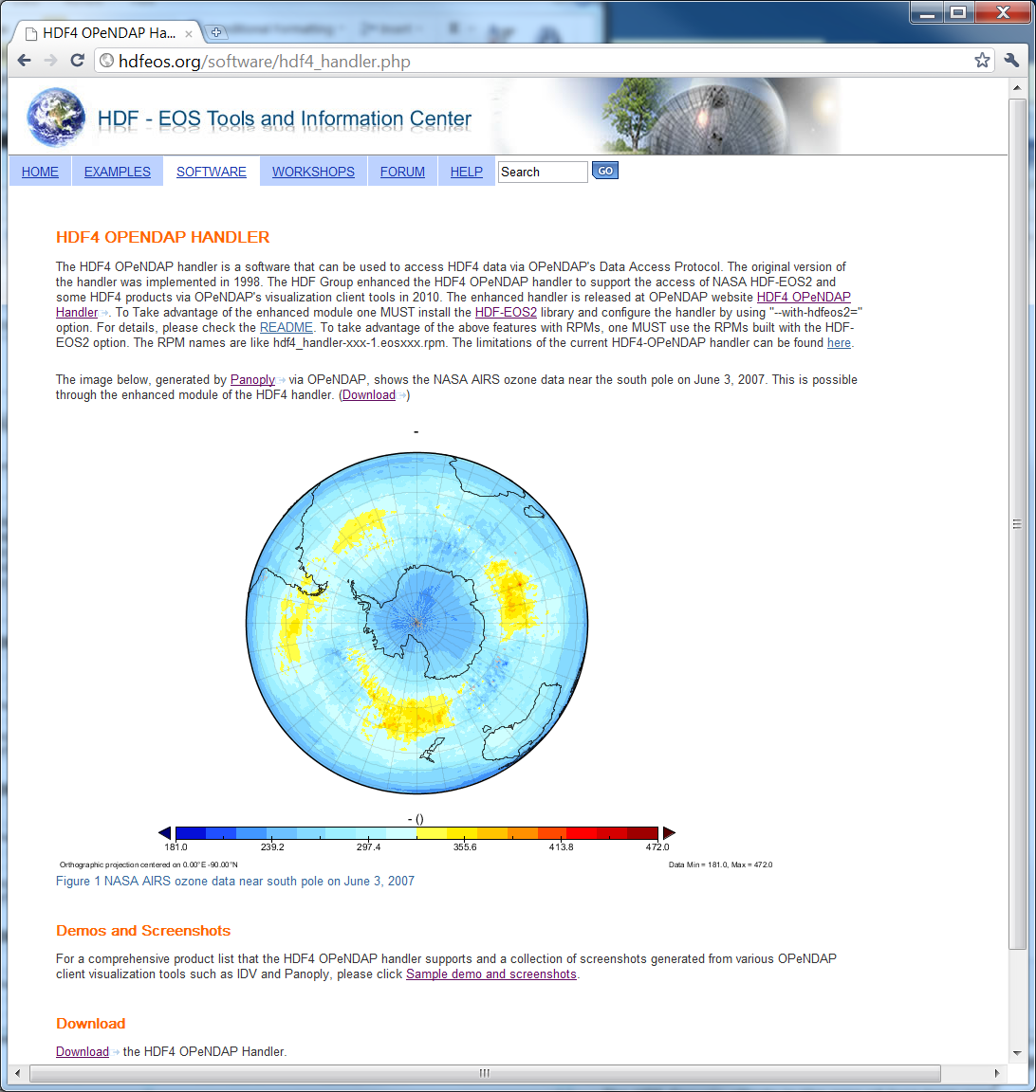
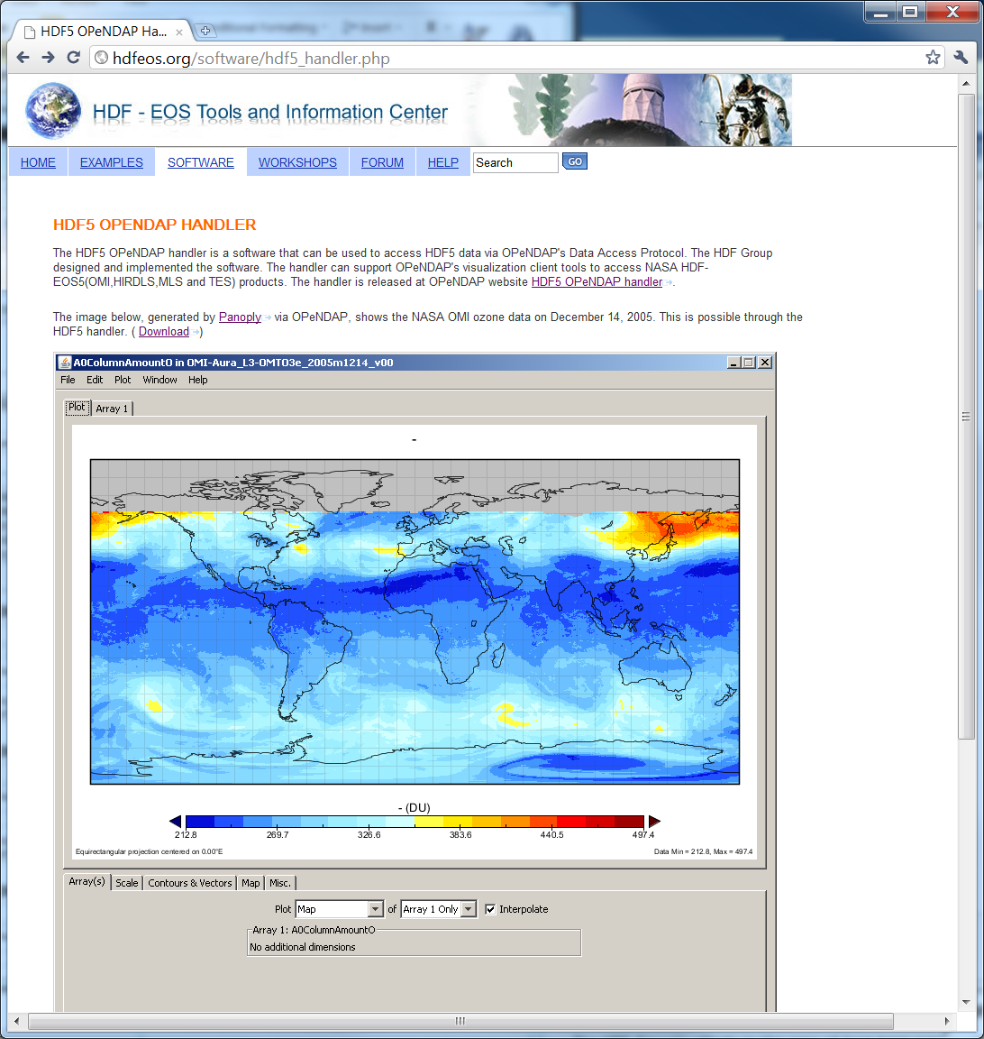
Tools Added
HDF5 OPeNDAP hander
HDF4 OPeNDAP hander
HDFLook

Slide 7
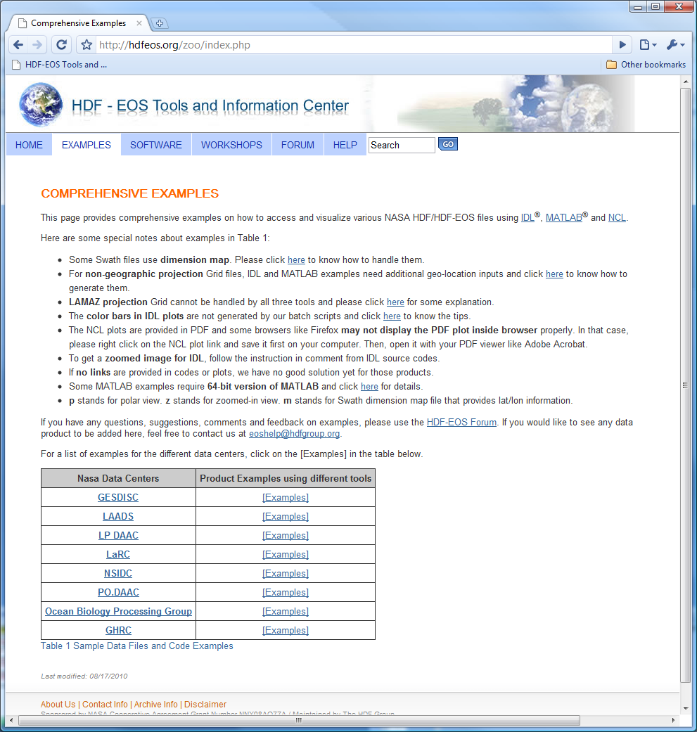
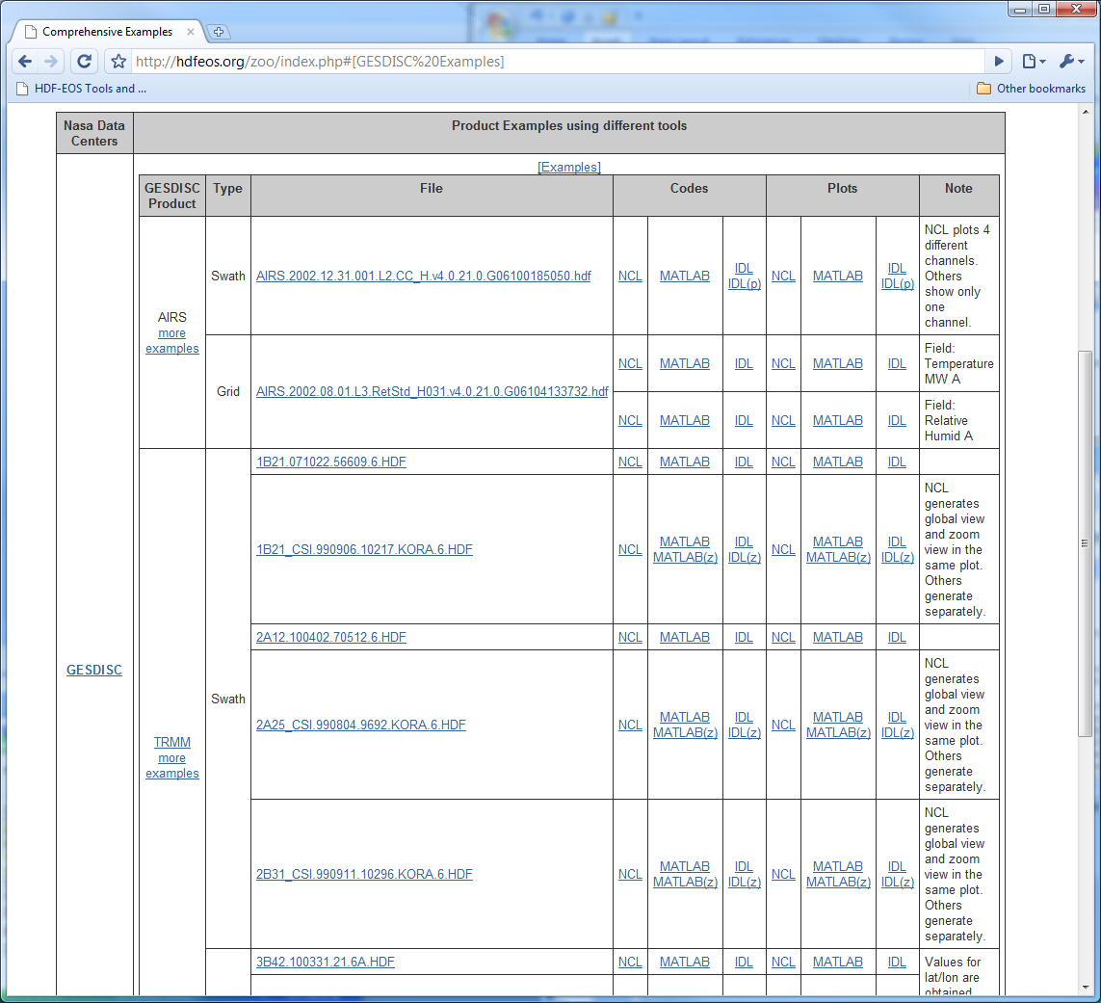
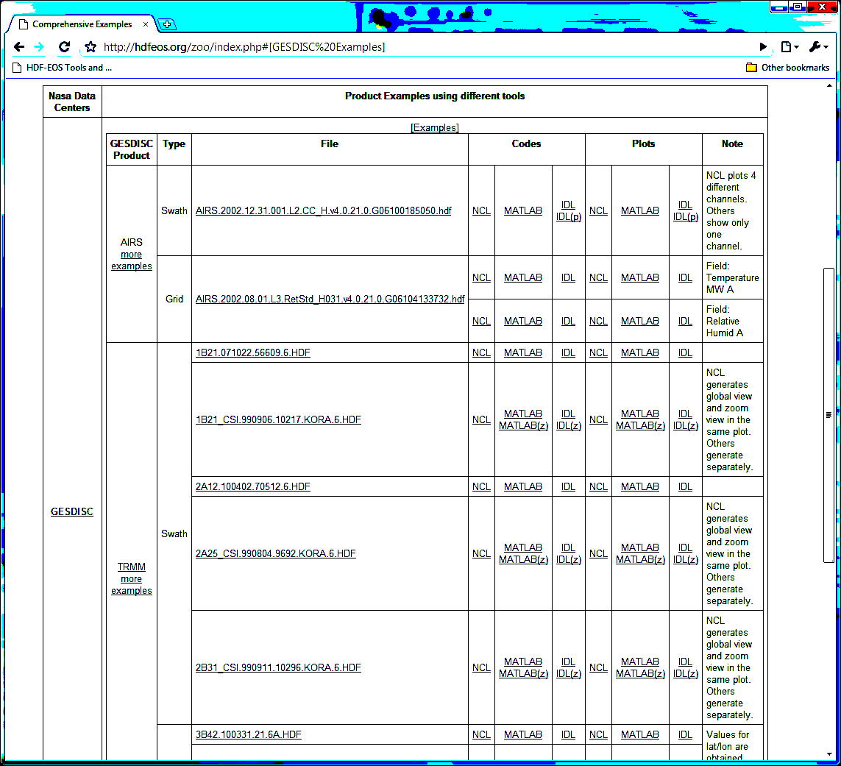
NCL/IDL/MATLAB examples
Many examples from different NASA data centers
Example codes and plots

Slide 8
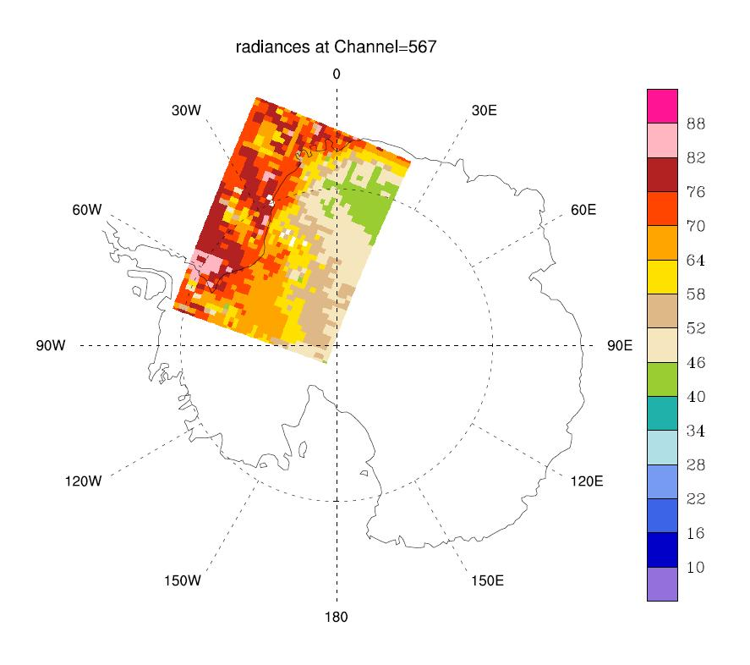
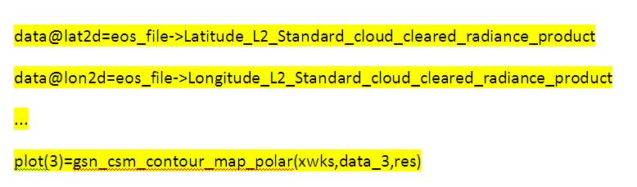
An example to access AIRS Swath
Directly read the lat/lon and use polar view
…
data=eos_file->radiances_L2_Standard_cloud_cleared_radiance_product(:,:,0) ; read specific subset of data field
; In order to read the radiances data field from the HDF-EOS2 file, the group
; under which the data field is placed must be appended to the data field in NCL. For more information,
; visit section 4.3.2 of http://hdfeos.org/software/ncl.php.
data@lat2d=eos_file->Latitude_L2_Standard_cloud_cleared_radiance_product ; associate longitude and latitude
data@lon2d=eos_file->Longitude_L2_Standard_cloud_cleared_radiance_product
data@_FillValue=-9999 ;
…
res@gsnCenterString="radiances at Channel=567"
plot(2)=gsn_csm_contour_map_polar(xwks,data_2,res)
res@gsnCenterString="radiances at Channel=1339"
plot(3)=gsn_csm_contour_map_polar(xwks,data_3,res)
delete(plot) ; cleaning up resources used
delete(data)
NCL
Notes:
In general, for all the following slides: You need to specify the tool name under the plot. The font should not be too small.
Add another code section:
Amplify
data@lat2d=eos_file->Latitude_L2_Standard_cloud_cleared_radiance_product
..
Amplify:
plot(3)=gsn_csm_contour_map_polar(xwks,data_3,res…)
Replace the plot with channel 567

Slide 9
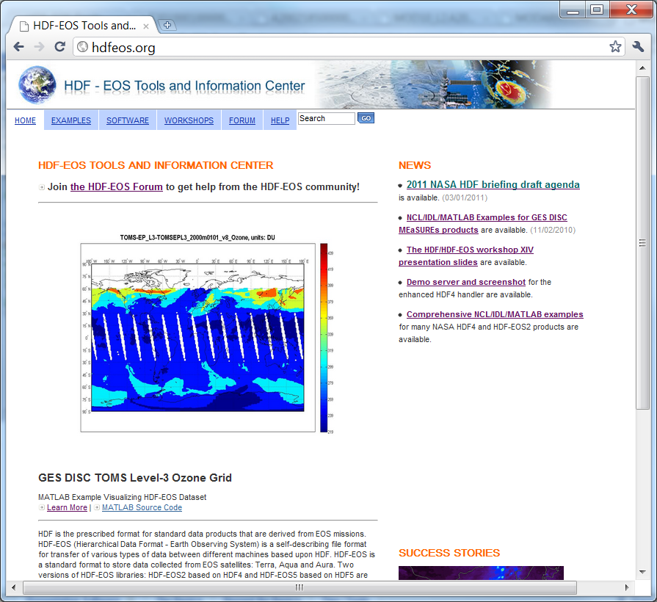
A new face for the main page
hdfeos.org

Slide 10
HDF-EOS website statistics

Slide 11
Definitions
Visits – The total number of visits to the website.
Pageviews – The total number of pages viewed on the website. Repeated views of a single page are counted.
Pages/Visit – The average number of page views per visitor.
Bounce Rate – The percentage of single-page visits. (Total number of visits viewing one page) / (Total number of visits)
Avg. Time on Site – The average visit duration.
% New visits – The percentage of visits by people who had never visited the website before.
Organic – Web traffic which comes from unpaid listing at search engines or directories.

Slide 12
Current Period: Sep. 1 2010 – Feb. 28 2011
Previous Period: Mar. 1 2010 – Aug. 31 2010

Slide 13
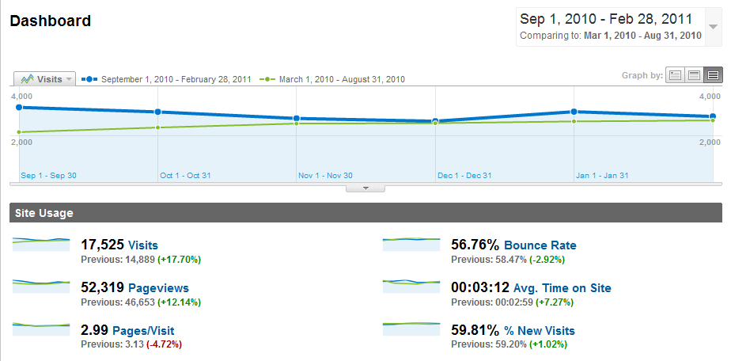
18% More Visits and 12% More Pageviews
Notes:
The key highlight - definitely more visits.

Slide 14
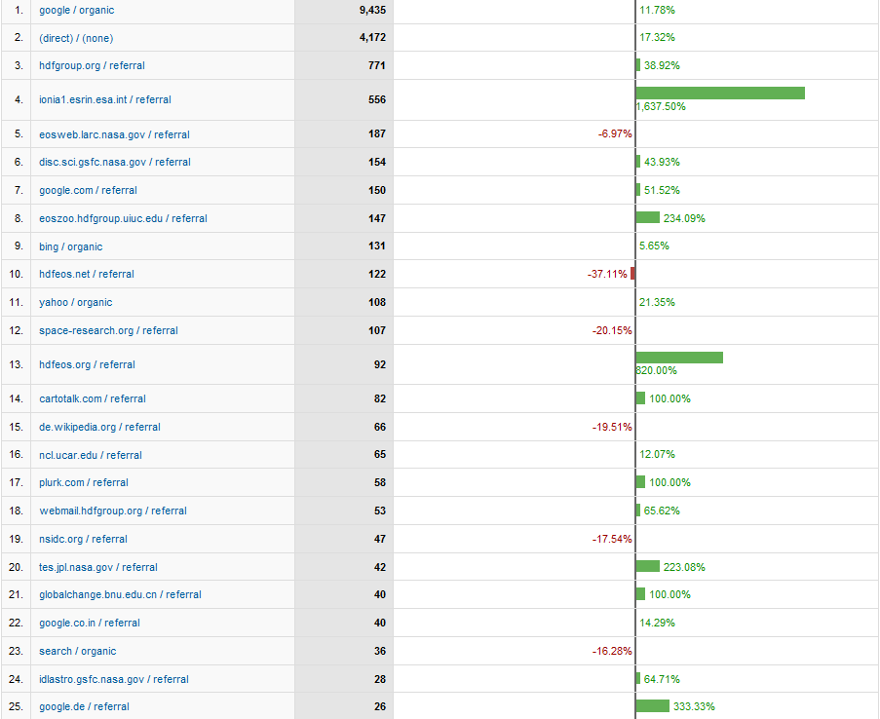
Top 25 Traffic Sources
European Space Agency
NASA LaRC
NASA GES DISC
Microsoft Bing
Self referral
NASA JPL
Notes:
Google search is the winner.
European Space Agency listed our site in their FAQ but dropped the link recently.
Other than Google and direct traffic, NASA sites are our good friends.
Note that the new search engine Bing gains some popularity.

Slide 15
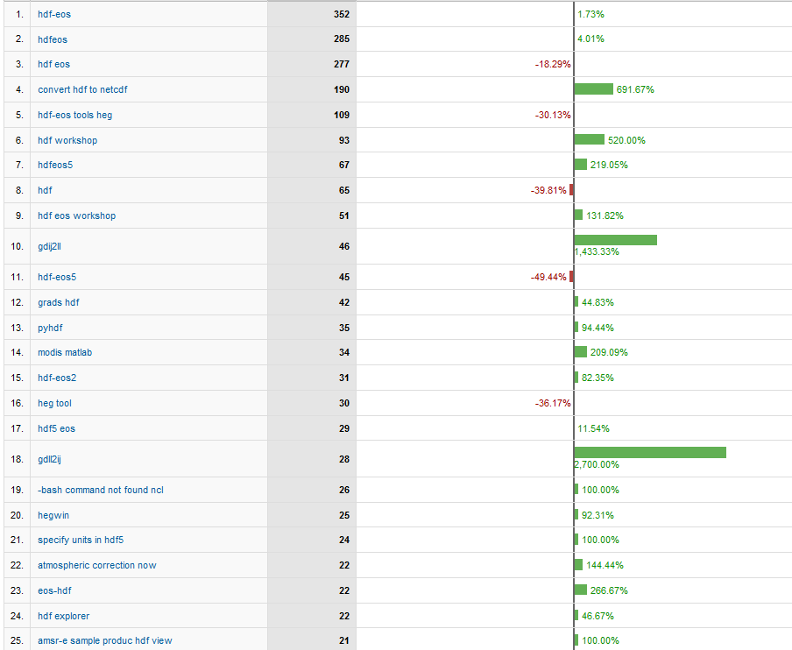
Top 25 Keywords
HDF to netCDF
hdf
hdfeos5
hdf-eos5
gdij2ll
modis matlab
gdll2ij
Notes:
The winner is hdf-eos.
It’s interesting to see that people look for hdf to netcdf converter.
HDF-EOS5 is gaining popularity.
I don’t know why gdij2ll is important.

Slide 16
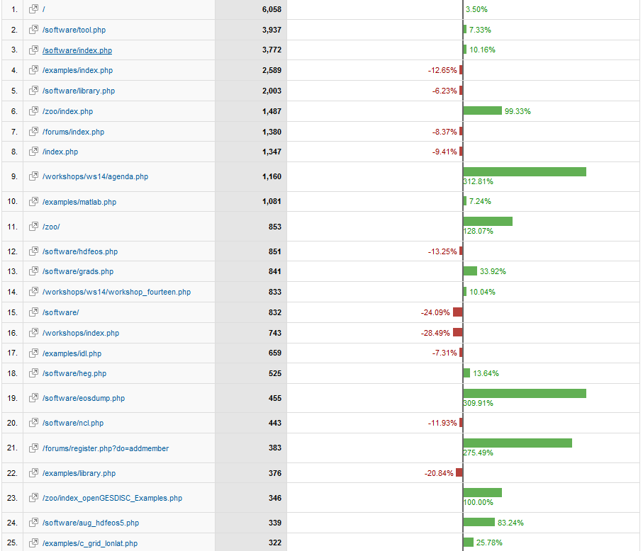
Top 25 Contents
Tool is winner
Comp. examples
WS 14
MATLAB
Comp. examples
GrADS
IDL
HEG
EOS dump
NCL
Comp. examples
Notes:
Overall, people look for tools and examples on how to use them.

Slide 17
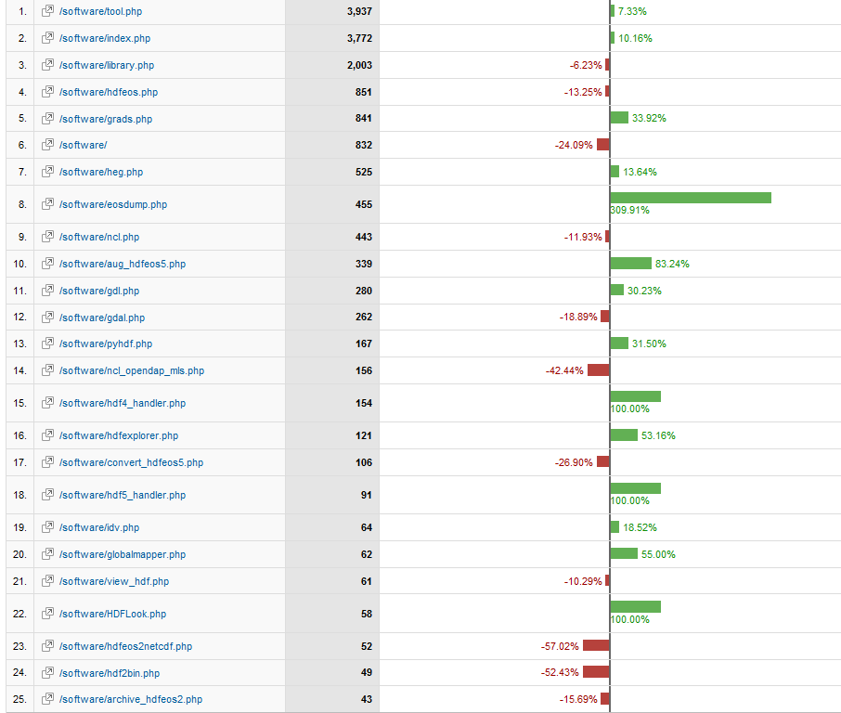
Top 40 Software (1-25)
GrADS
HEG
eosdump
Aug_hdfeos5
Notes:
Overall, people look for tools and examples on how to use them.

Slide 18
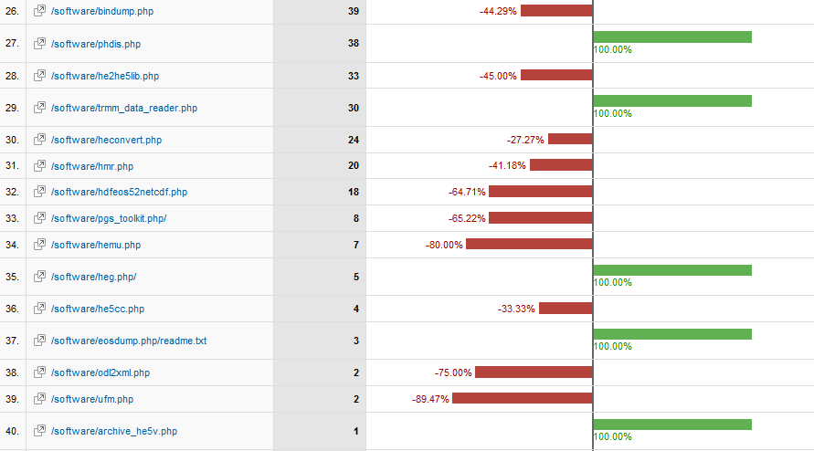
Top 40 Software (26-40)
Notes:
Overall, people look for tools and examples on how to use them.

Slide 19
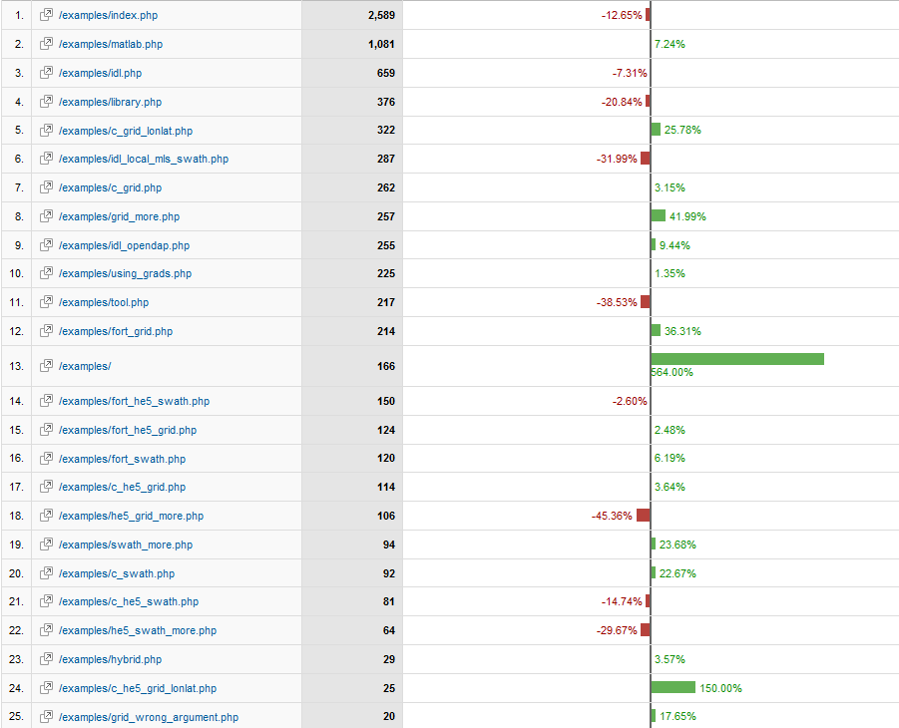
Top 25 Examples
MATLAB
IDL
C lat/lon Grid
FORTRAN Grid
Notes:
Overall, people look for tools and examples on how to use them.

Slide 20
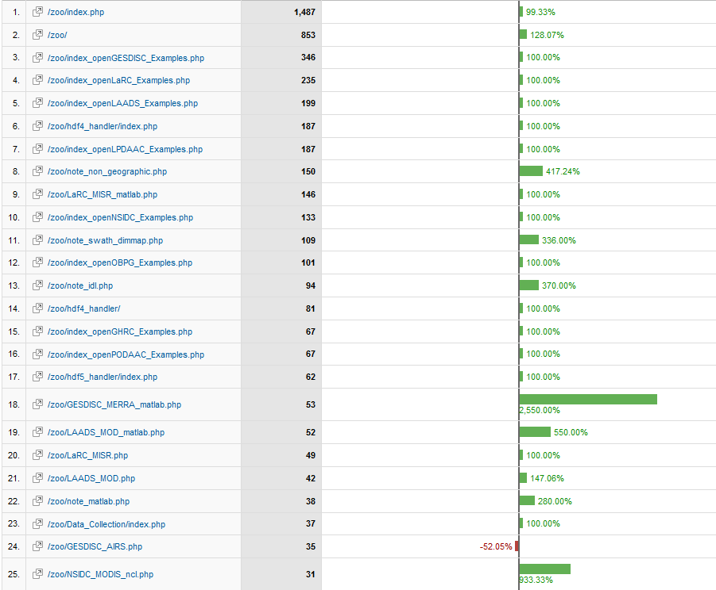
Top 25 Comprehensive Examples
Increase in traffic
Note on Non-geographic projection
Note on Swath Dim Map
MERRA MATLAB
MODIS NCL
Notes:
Overall, people look for tools and examples on how to use them.

Slide 21
Current Period: Sep. 1 2010 – Feb. 28 2011
Period before the launch of the new website : Jul. 4 2009 – Oct. 31 2009

Slide 22
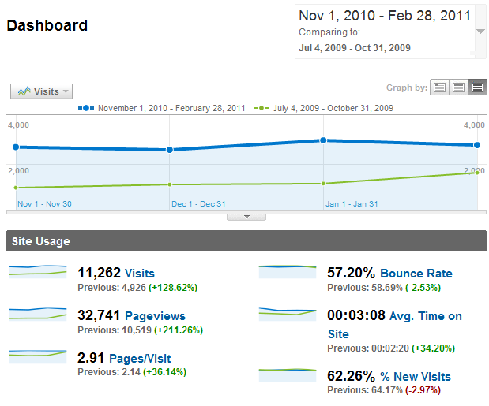
More Visits and Pageviews
Notes:
The key highlight - definitely more visits.

Slide 23
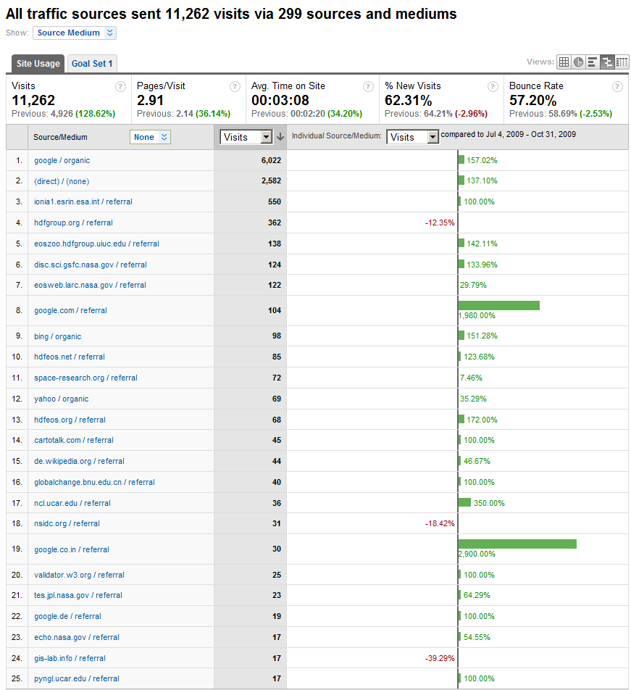
Top 25 Traffic Sources
European Space Agency
NASA GES DISC
Microsoft Bing
NCL UCAR
Notes:
Google search is the winner.
European Space Agency listed our site in their FAQ but dropped the link recently.
Other than Google and direct traffic, NASA sites are our good friends.
Note that the new search engine Bing gains some popularity.

Slide 24
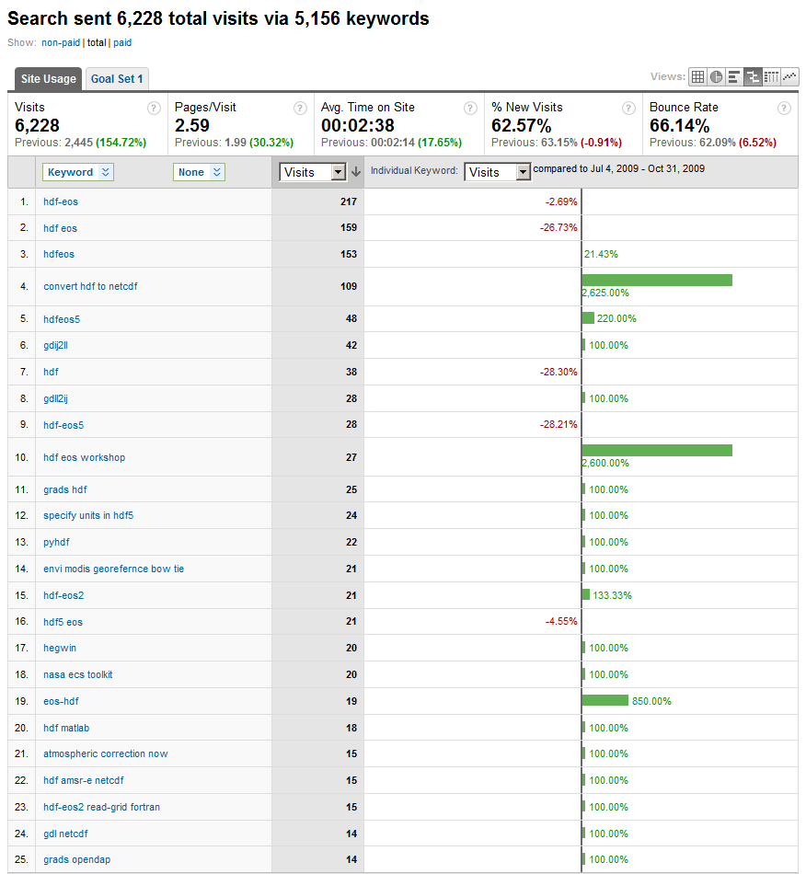
Top 25 Keywords
HDF to netCDF
HDF-EOS5
gdij2ll
Notes:
The winner is hdf-eos.
It’s interesting to see that people look for hdf to netcdf converter.
HDF-EOS5 is gaining popularity.
I don’t know why gdij2ll is important.

Slide 25
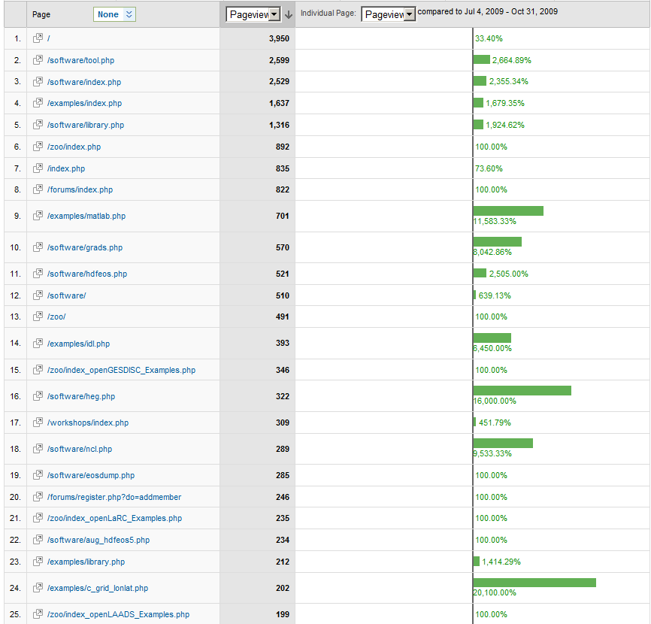
Top 25 Contents
Tool is winner
New but Top 6 already
MATLAB
GrADS
IDL
HEG
Notes:
Overall, people look for tools and examples on how to use them.

Slide 26
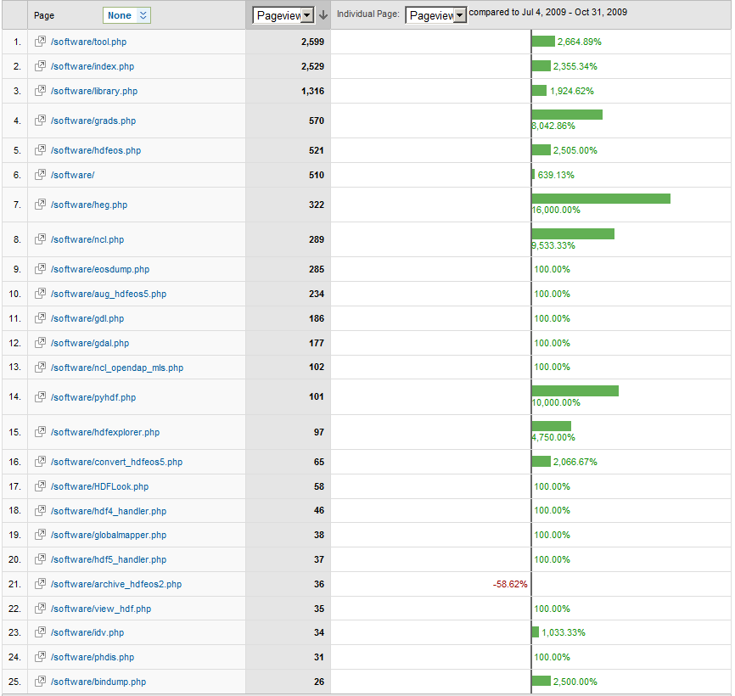
Top 40 Software (1-25)
GrADS
HEG
NCL
pyHDF
Convert HDF-EOS5
IDV
Notes:
Overall, people look for tools and examples on how to use them.

Slide 27
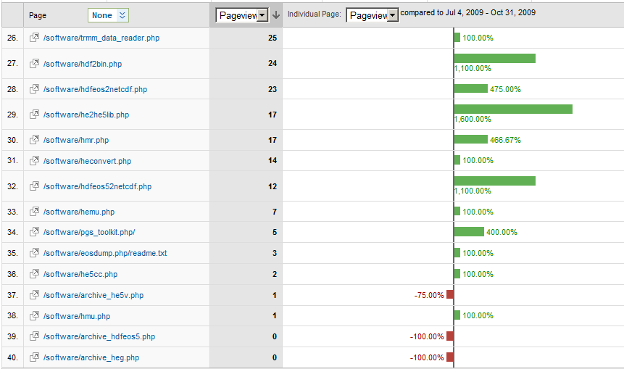
Top 40 Software (26-40)
Notes:
Overall, people look for tools and examples on how to use them.

Slide 28
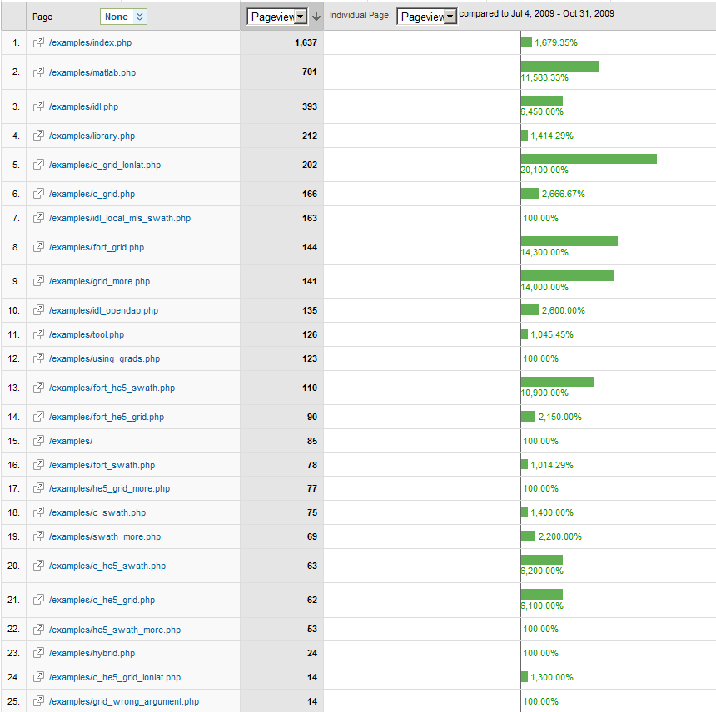
Top 25 Examples
MATLAB
IDL
C lat/lon Grid
FORTRAN HDF-EOS5 Swath
Notes:
Overall, people look for tools and examples on how to use them.

Slide 29
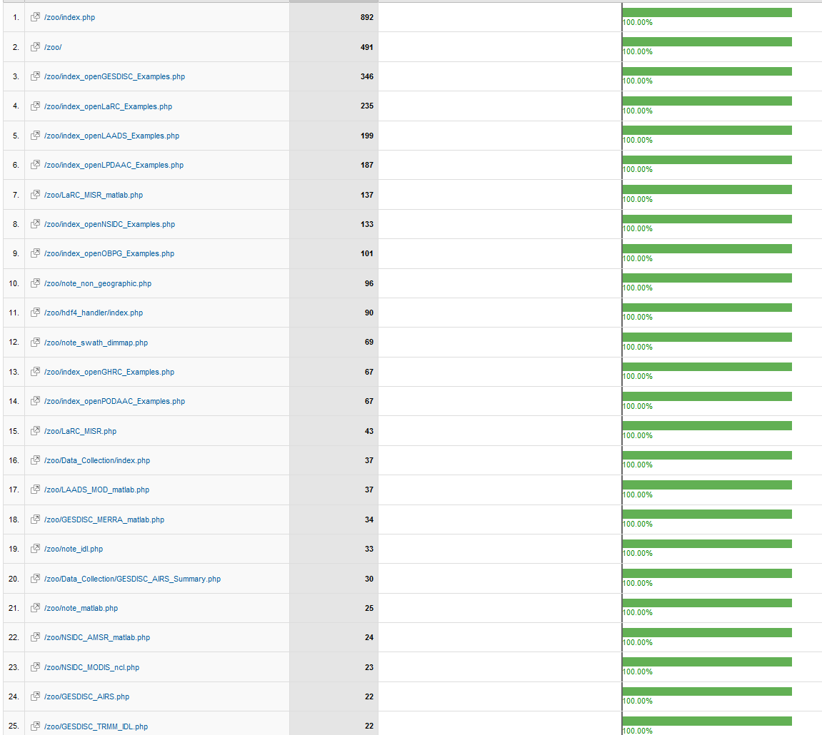
Top 25 Comprehensive Examples
GES DISC
MISR MATLAB
Note on Non-geographic projection
Notes:
Overall, people look for tools and examples on how to use them.

Slide 30
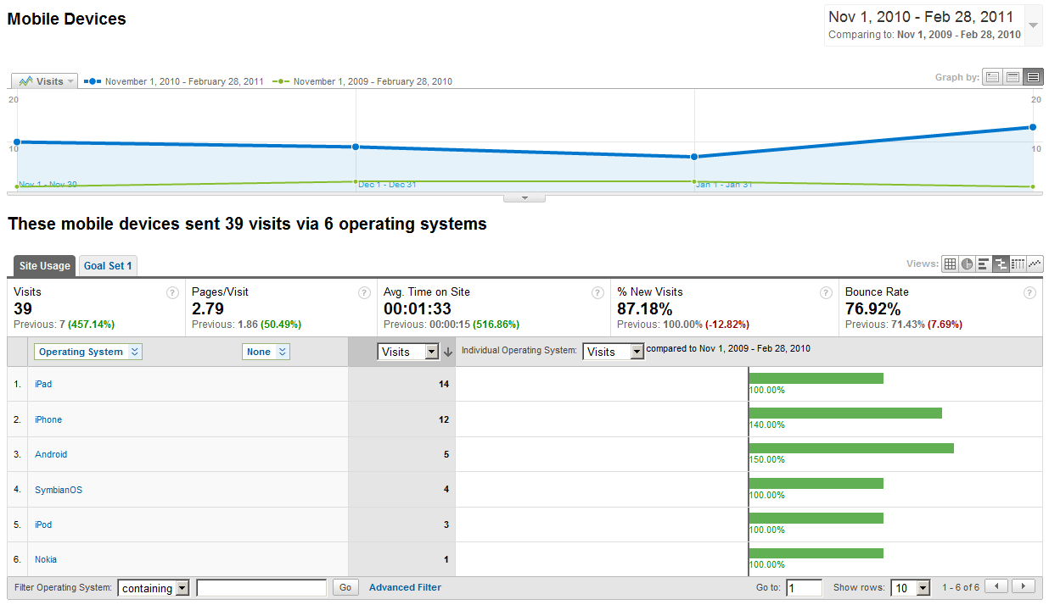
Future of Website – Are We Ready?
Notes:
More traffics from smart phones and mobile devices look certain.
Are we ready?

Slide 31
Current work

Slide 32
Current Work
Improve the quality of comprehensive example codes and plots
Improve the visibility of the website

Slide 33
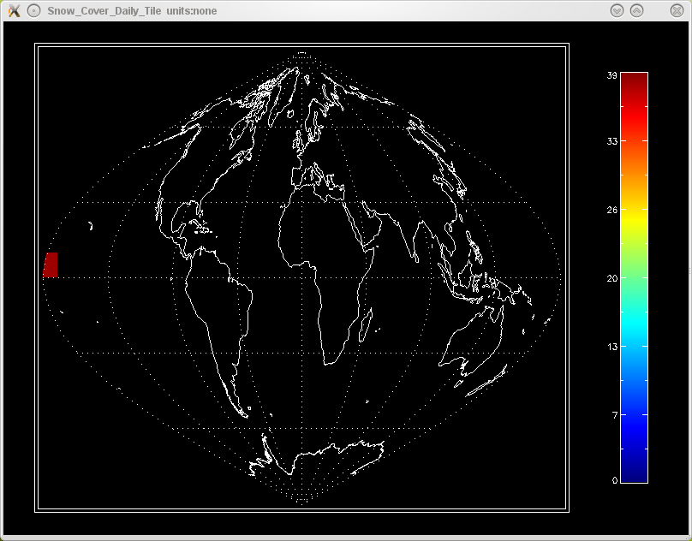
What to improve
An IDL example of a NSIDC MODIS file

Slide 34
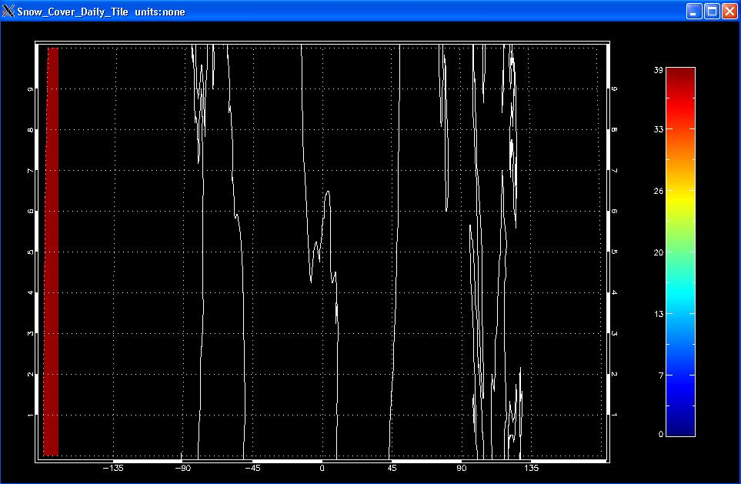
What to improve
The current zoom plot

Slide 35
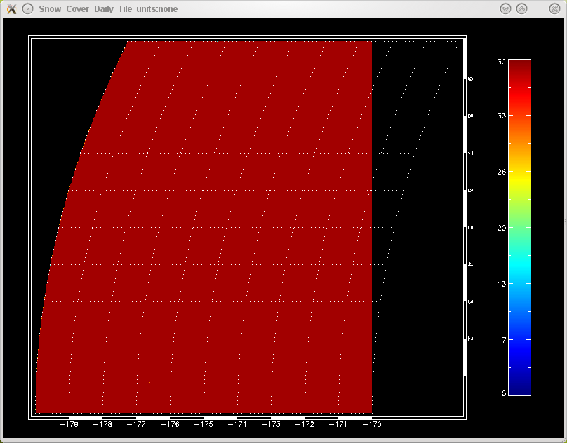
What to improve
The “high quality” zoom plot

Slide 36
HDF OPeNDAP Work Update

Slide 37
Outline
Overview of HDF4 and HDF5 OPeNDAP handlers
Demos
Future plan

Slide 38
Overview of the past year’s work

Slide 39
HDF4–OPeNDAP Handler
Three official releases from OPeNDAP website since the last briefing
Support the access of many NASA HDF4 and HDF-EOS2 product by visualization tools
We also provide several customized RPMs for
GESDISC
URL: http://opendap.org/download/hdf4_server.html

Slide 40
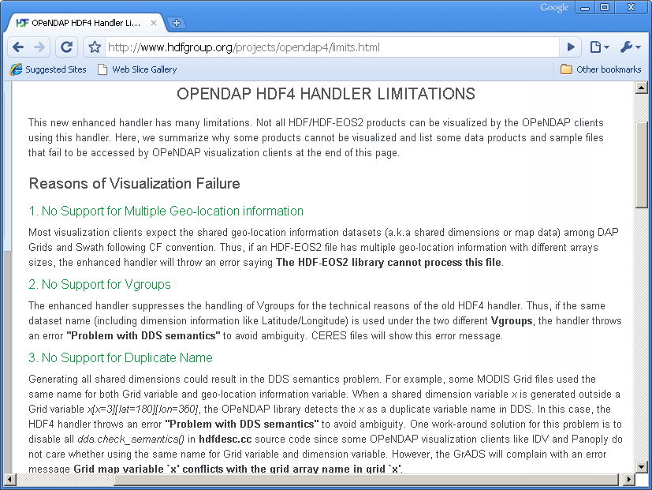
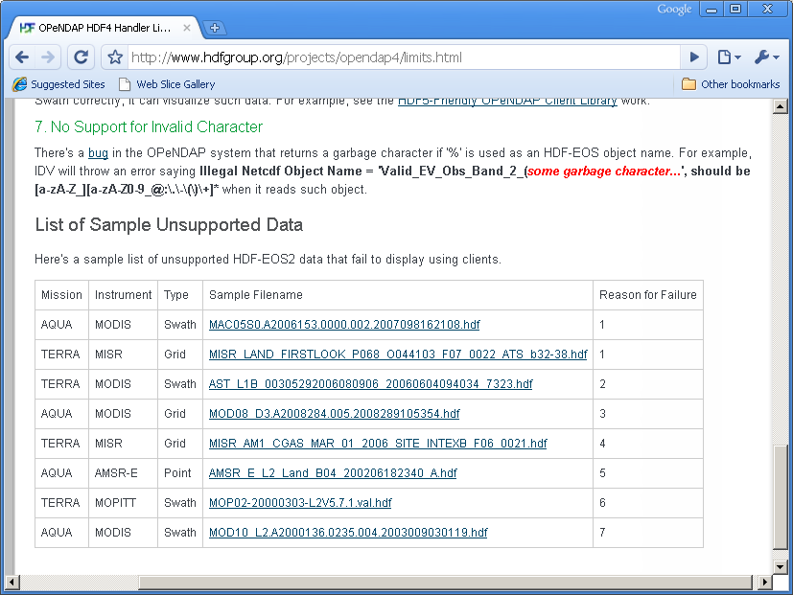
HDF-EOS2 Products Supported
GES DISC
  AIRS / MERRA / TOMS
LAADS / LP DAAC / NSIDC
  Many MODIS products
NSIDC
  AMSR_E / NISE
LaRC
  MISR / MOPITT / some CERES(TRMM)

Slide 41
Pure HDF4 Products Supported
GES DISC
  TRMM L1B, L2B Swath
  TRMM L3B Grid 42 & 43 products
P.O DAAC
  AVHRR
OBPG (Ocean Color)
  SeaWiFS / MODIST / MODISA
  CZCS / OCTS
Notes:
We have summarized the top 7 reasons why some HDF-EOS will fail.
We also listed some sample files that will not work with HDF4 handler.
Here are screenshots of website.
Make animation – screen shots in between texts.

Slide 42
Pure HDF4 Products Supported
CERES
  CER_AVG
  CER_ES4
  CER_ISCCP-D2like-Day
  CER_ISCCP-D2like-GEO
  CER_SRBAVG
  CER_SYN
  CER_ZAVG
Notes:
We have summarized the top 7 reasons why some HDF-EOS will fail.
We also listed some sample files that will not work with HDF4 handler.
Here are screenshots of website.
Make animation – screen shots in between texts.

Slide 43
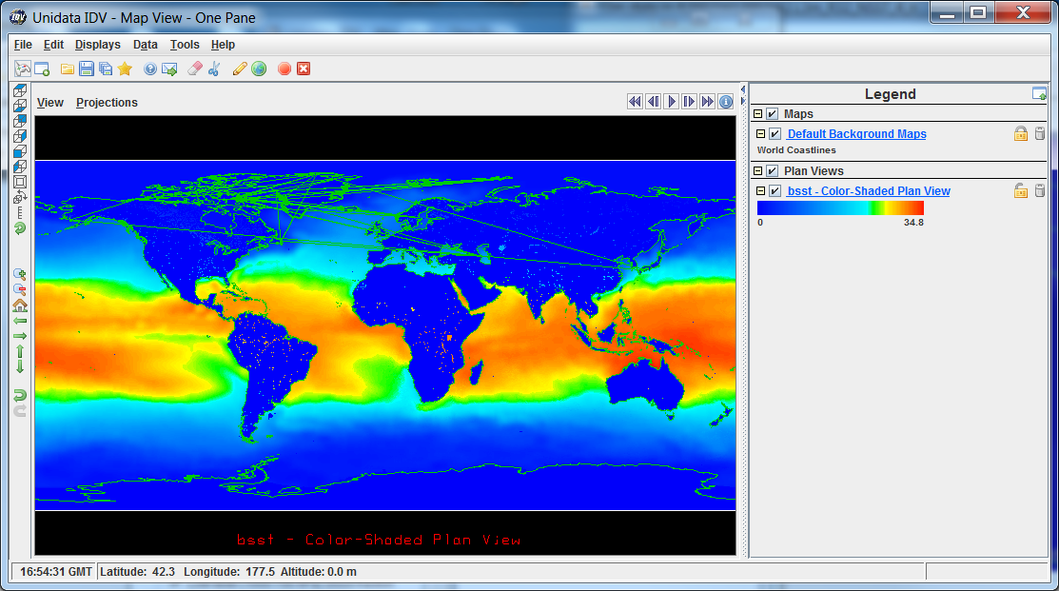
Demo
IDV shows the access of AVHRR data
Real-time demo to show the access of MERRA data

Slide 44
HDF5–OPeNDAP Handler
Two official releases from the OPeNDAP website
since the last briefing
Add the limited support for handling HDF-EOS5 multiple grid and swath files
Aura MLS, OMI, HIRDLS, TES and MEaSUREs GSSTF files can be served via OPeNDAP
URL: http://opendap.org/download/hdf5_handler.html

Slide 45
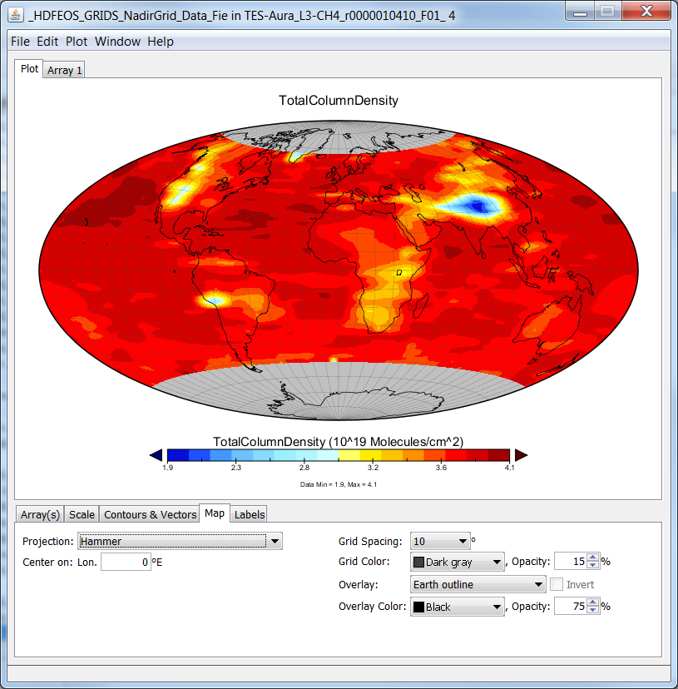
Demo
IDV shows the access of TES data
Real-time demo to show the access of MEaSUREs GSSTF data

Slide 46
Future Plan

Slide 47
HDF5-OPeNDAP handler
Significant development to make general HDF-EOS5 files to be CF-compliant
  Multiple swaths/grids
  Better way to handle name clashing
  Better support for more CF attributes
    scale_factor and add_offset
    valid_min and valid_max
Support general NASA HDF5 files
  Other MEaSUREs products
  Decadal mission products

Slide 48
HDF4-OPeNDAP handler
Development includes
  MISR “swath” support
  Some TRMM support
  Add the support of vdata in hybrid HDF-EOS2 files
  Better way to handle name clashing
  Better support for more CF attributes
    scale_factor and add_offset
    valid_min and valid_max

Slide 49
HDF-EOS5 augmentation tool

Slide 50
HDF-EOS5 and NetCDF-4
Enabling NetCDF4 to access HDF-EOS5 data
  Conversion
  Augmentation
    One file can be used for both EOS5 and NetCDF-4.
    Note that EOS5 users are not affected at all.
Augmentation
HDF-EOS5
HDF-EOS5
file
Augmented
HDF-EOS5
file
NetCDF-4
file
NetCDF4
HDF5
HDF5

Slide 51
Past Work Review
Handle multiple Swath/grid files
Provide more options for users to provide dimension scale data
Add the support of zonal average(ZA) HDF-EOS5 data
Test more Aura HDF-EOS5 files

Slide 52
Future Work
Handle the swath having 2-D coordinate variables
Improve the quality of the documentation
Add more testing
Consistency checker
  If one modifies dim info in an augmented file, file becomes inconsistent.
Notes:
Rewrite

Slide 53
HDF4/HDF-EOS2-CF conversion library

Slide 54
Motivation
Improve the accessibility and usability of NASA HDF4 and HDF-EOS2 files

Slide 55
Approach
Make a CF-compliant conversion library
The library can be used to implement a conversion utility to convert the HDF4/HDF-EOS2 files to other data formats such as netCDF
“Desktop” version of the HDF4-OPeNDAP handler

Slide 56
Current Status
Basic CF support of converting HDF-EOS2 and some HDF4
Implement a netCDF3/netCDF-4 classic conversion tool based on the conversion library
HDF-EOS2 products include
  MODIS, MISR, AIRS
HDF4 products include
  Some TRMM, CERES, OBPG products
Investigate the conversion to GeoTIFF
Still in progress – 80% work done

Slide 57
Others

Slide 58
HDF-EOS2 dumper
Can be used to quickly obtain the latitude and longitude data
It is a command-line tool only supported on Linux
The output is ASCII format
The dumper is used to generate some HDF-EOS2 plots via IDL,NCL and MATLAB

Slide 59
HDF-EOS2 dumper
In maintenance mode
Improve the quality of documentation

Slide 60
HDF5 CF examples
Provide programming examples on how to add CF attributes to an HDF5 file via
  HDF5 C and Fortran APIs
  Python via h5py
  netCDF-4 C and Fortran APIs
  HDF-EOS5 C and Fortran APIs
Now writing a document and cleaning up codes
Many investigate on how to use HDF5 tools such as h5edit and HDFView to add CF attributes

Slide 61
Thank You!

Slide 62
Acknowledgements
This work was supported by the Cooperative Agreement with the National Aeronautics and Space Administration (NASA) under NASA grant NNX08A077A.
Any opinions, findings, conclusions or recommendations expressed in this material are those of the author(s) and do not necessarily reflect the views of NASA.

Slide 63
Questions/comments?

Slide 64
Backup slides

Slide 65
Role of HDF4-OPeNDAP handler
OPeNDAP Clients
OPeNDAP
HDF-EOS2
HDF4-OPeNDAP handler

